Slide 1
Park&Fly
Year-long AUV deployment w/ periodic or event-driven monitoring.
Active program: feasibility study of benthic monitoring (Ken Smith)
New Opportunity: 2019 mud-volcano monitoring in Arctic (Charlie Paull).
Far-reaching concept, cross-field applicability:
  Military: DARPA Upward Falling Payload, ONR Forward Deployed Energy and Communication Outpost, DARPA Hydra.
  Oil&Gas: leak detection, field-resident reservoir monitoring.
  Science: on-demand monitoring, field-residence.
Goal of this meeting
  make mgmt aware of a critical bottleneck – (schedule)
  solicit program acceleration

Slide 2
Near-term opportunities
Benthic AUV (Ken)
4 deep transects in 12 months.
Sample w/down-looking camera one way, MBES the other way.
Highly desirable: Event-triggered response.
Arctic AUV (mud volcanoes, Charlie)
6 under-ice surveys in 12 months
MBES & SSS
Highly desirable: Event-triggered response.
Ship date: April 2019
Notes
Camera: low-altitude / low-speed
Trigger: a-comms from sediment event sensor.
Notes
300m<D< 750m depending on volcano
Trigger: sound-pressure level from eruption.

Slide 3
Risk elements
Schedule (arctic AUV 2019 launch window).
Long-term environmental exposure.
Long-duration.
Robust docking/undocking.
Unattended boot reliability.
Guaranteeing data quality & integrity.
Extended duration S/W error-handling.
Testing long mission in a short time.
Cannot monitor AUV progress while under-ice.

Slide 4
Proposed Approach
Risk | Approach
Schedule | ramp-up funding July 2016 resource continuity go/nogo gates
Long-term environmental exposure | all Ti/plastic larger oil reserve / testing
Long-duration | hibernation battery chemistry: trade study
Robust docking | simpler line capture/tine
Unattended boot | testing/fix
Data quality/integrity | testing/fix
S/W error-handling | testing/fix
Testing long-duration in short time | see Test Sequence
No progress monitoring under-ice | fail-safe mission aborts

Slide 5
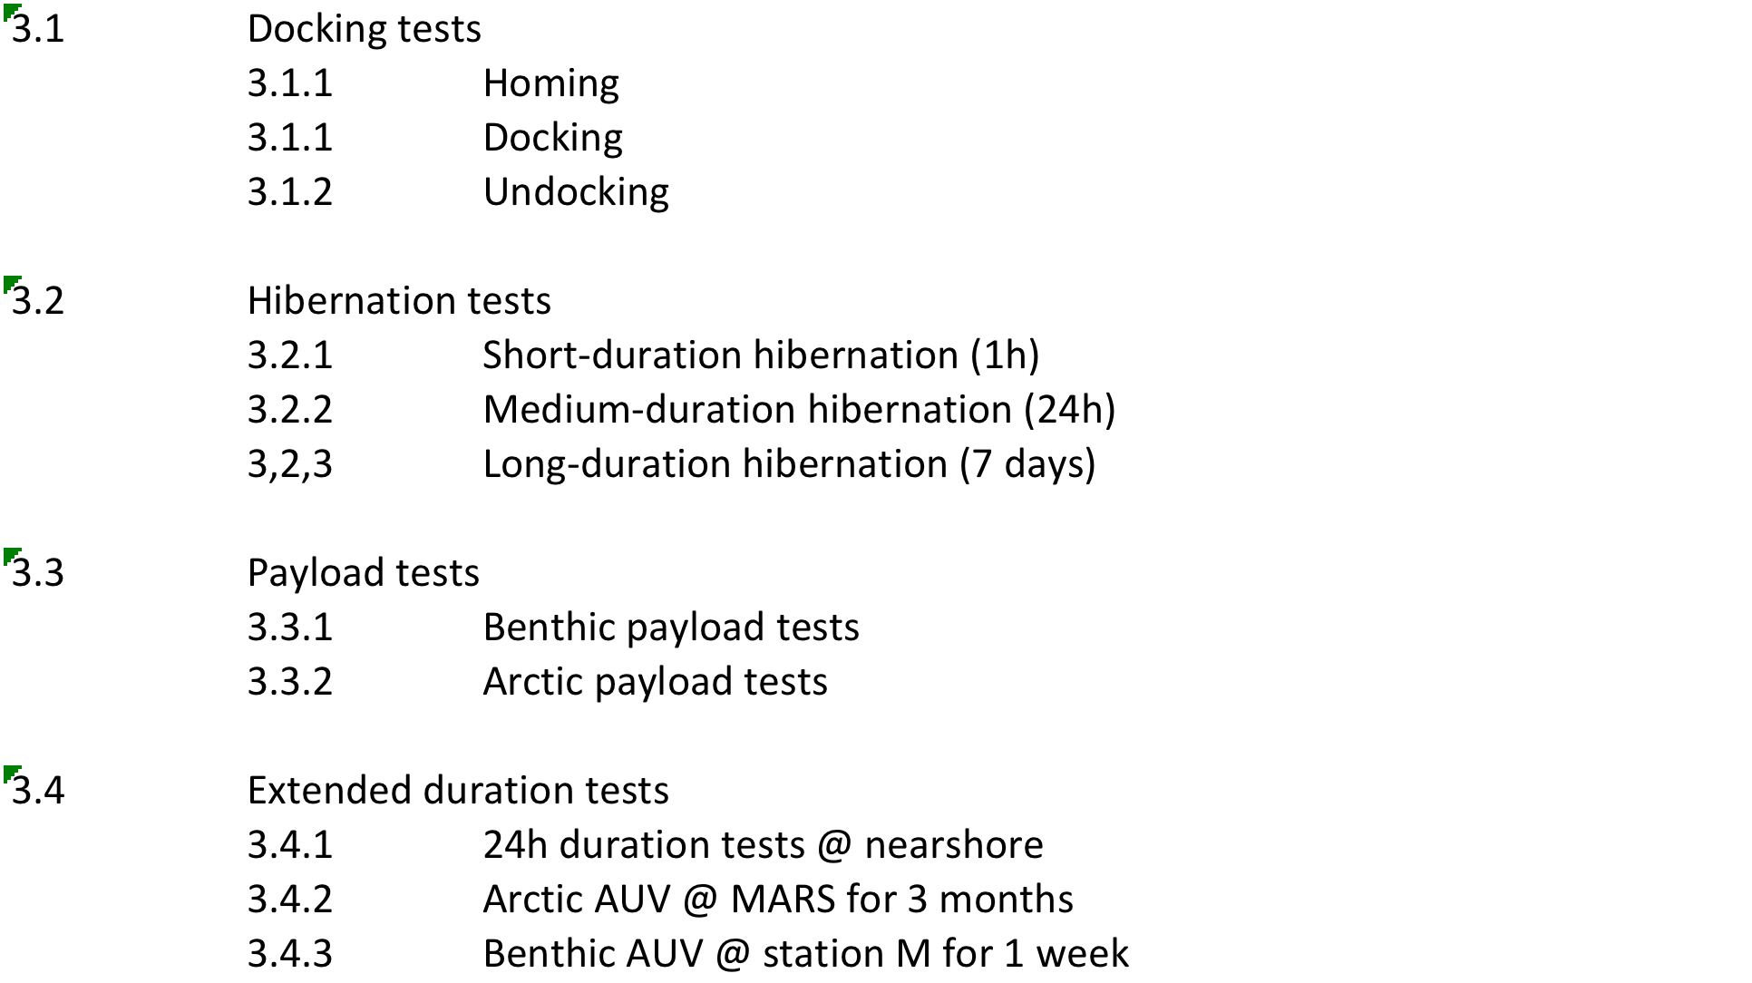
Proposed Test Sequence

Slide 6
Notional Vehicle
float
corrosion-free exterior
USBL transponder
Avtrak
(track&comms)
iUSBL
tines
nose
battery
science payload
control
emergency scuttle
INS/DVL
hibernation controller
acoustic release
LBL (x4)
trigger:
a-modem (benthic)
eruption detector (arctic)
anchor

Slide 7
New Design elements
Must have
  Benthic payload.
  Docking system.
  Hibernation controller.
  Corrosion-free exterior.
  Extended duration s/w.
  Fail-safe aborts:
    when docked: stay docked.
    when undocked: park on seafloor.
Highly desirable
  Event-triggered response

Slide 8
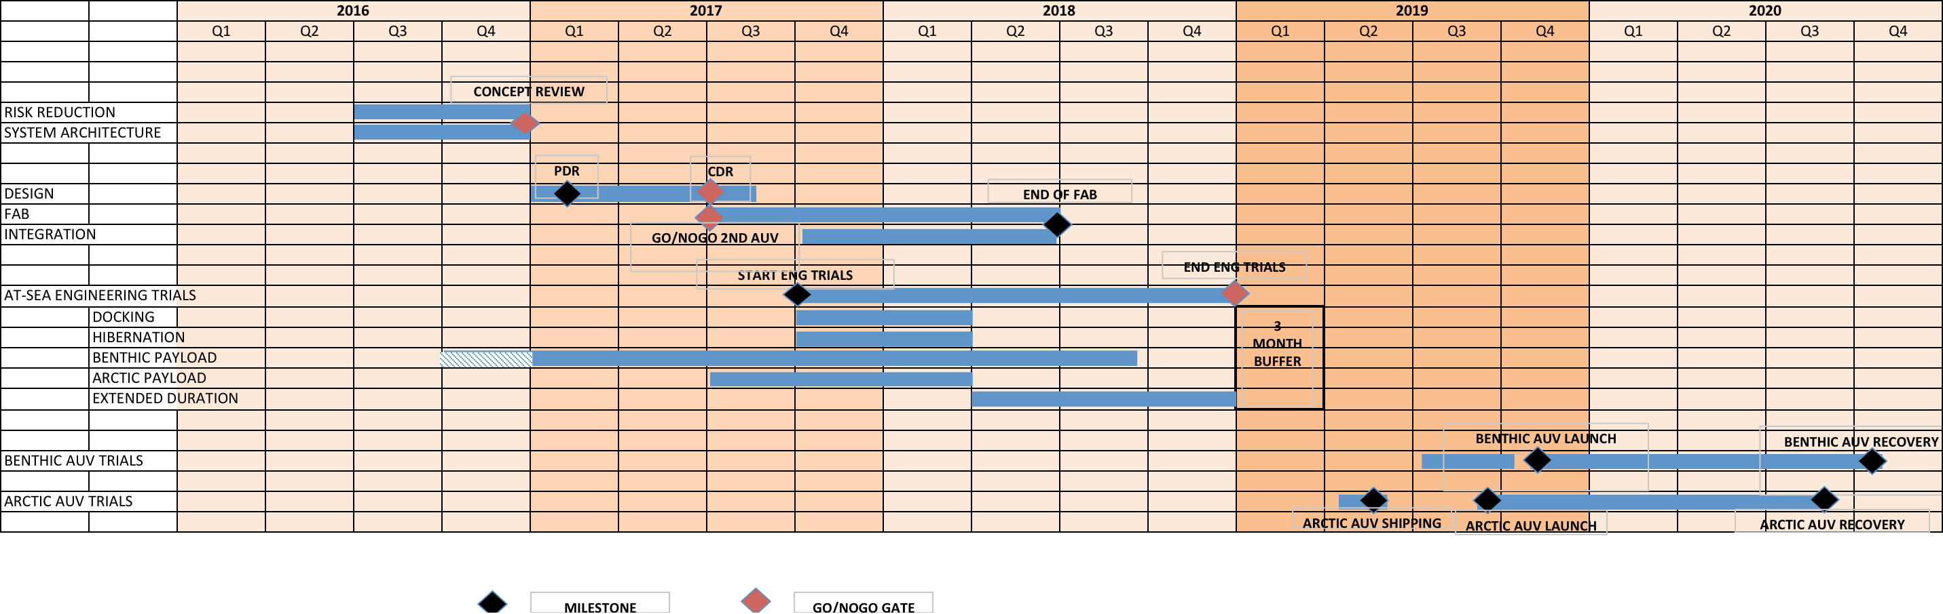
Timelines

Slide 9
WBS: see spreadsheet

Slide 10
Resources
year | labor | ship time
2016 (acceleration) | Brett: +1month Rob: +2 weeks Hans: + 1 month (MK: 1 day/week) | 3 days
2017 | 5 FTEs: design/fab/testing | 10 days
2018 | 5 FTEs: fab/assembly/at-sea testing | 10 days
2019 | 2 deployments | 5 days (contingency)
2020 | 2 recoveries | n/a

Slide 11
2 VEHICLES OR 1?
2 is preferred:
  doubles the amount of testing hours
  allows the two missions to be run in parallel
July 2017 go/nogo gate

Slide 12
Backups

Slide 13
Park&Fly: Notional CONOPS
Arrive at site
Deploy the dock and LBL
Prep the AUV
Launch the AUV
Run first transect
Park
Parking verification
Depart site
AUV periodically parks and flies
Return to site
Recover AUV
Recover dock and LBL (minus anchor)

