Slide 1
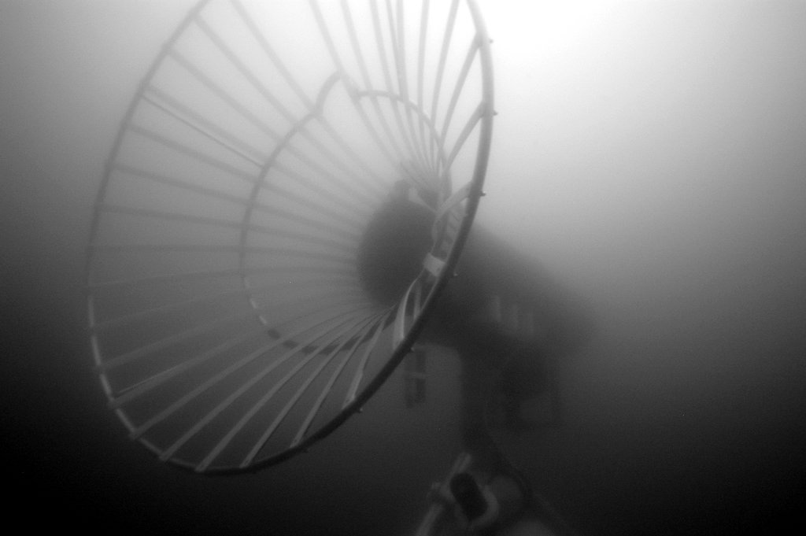
Park –n- Fly AUV
PI: Ken Smith
Scientists: Ken Smith and Charlie Paull
Project Manager: Brett Hobson
AUV Engineer: Hans Thomas
Controls Engineer: Rob McEwen
EE: Mark Chaffey, Paul McGill, Alana Sherman
SE: Kent Headley, Rich Henthorn, Brian Kieft
ME: Francois Cazenave, Jon Erickson, Brett Hobson

Slide 2
Park & Fly AUV – Abstract
Develop the capability for a persistent presence in the deep ocean
Conduct seasonal, seafloor imaging and bioacoustics surveys at Station-M. Without a ship.
Conduct seasonal, seafloor mapping with sidescan and multi-beam sonars to investigate the geologic evolution of mud volcanoes in the Arctic. Under the ice, without a ship, for one year.

Slide 3
Near-term opportunities
Benthic AUV (Ken)
4 deep transects in 12 months.
Sample w/down-looking camera one way, MBES the other way.
Highly desirable: Event-triggered response.
Arctic AUV (mud volcanoes, Charlie)
6 under-ice surveys in 12 months
MBES & SSS
Highly desirable: Event-triggered response.
Ship date: April 2019
Notes
Camera: low-altitude / low-speed
Trigger: a-comms from sediment event sensor.
Notes
300m<D< 750m depending on volcano
Trigger: sound-pressure level from eruption.

Slide 4
Approach -1
Stretch AUV operation from a continuous run over 17 hours to ~four 3-hours missions spaced over one year
Park the AUV inside of a docking station between missions and put it to sleep
Use an independent hibernation controller to wake the AUV up, run the checks, start the mission and watch for problems. If the AUV cannot get back to the dock, sink the AUV to the seafloor and wait for help
Optionally trigger the deployments remotely or locally for event response

Slide 5
Why we think this is Do-able
Strong fleet of Dorado vehicles, spares and operational know-how
Dorado docking success in 2007, and efforts at Bluefin, WHOI/Hydroid and SPAWAR
Long-term deployment of the Benthic Rover
Industrial partnerships (motivated to ensure our success) with Sonardyne (homing), Bluefin, General Atomics (power/data transfer, batteries, homing)

Slide 6
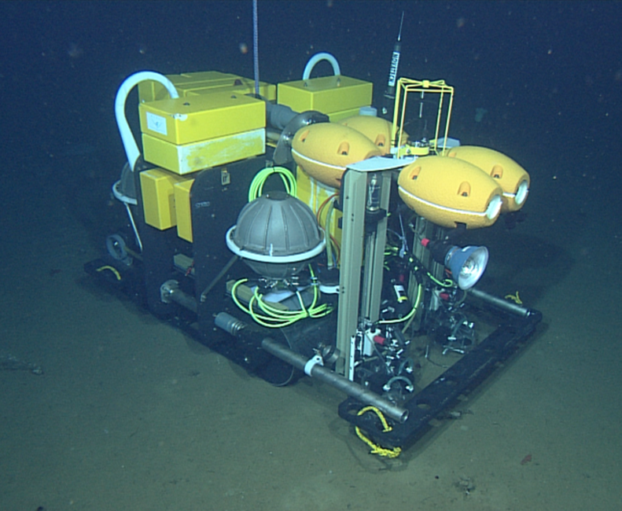
Benthic Rover
5+ years at 4km
Demonstrated success:
  Materials corrosion
  Oil compensation dynamic shaft seals
  Connectors
  Foam floatation
  Free-vehicle descent/moorings
  Simple autonomy
  Waveglider acoustic gateway

Slide 7
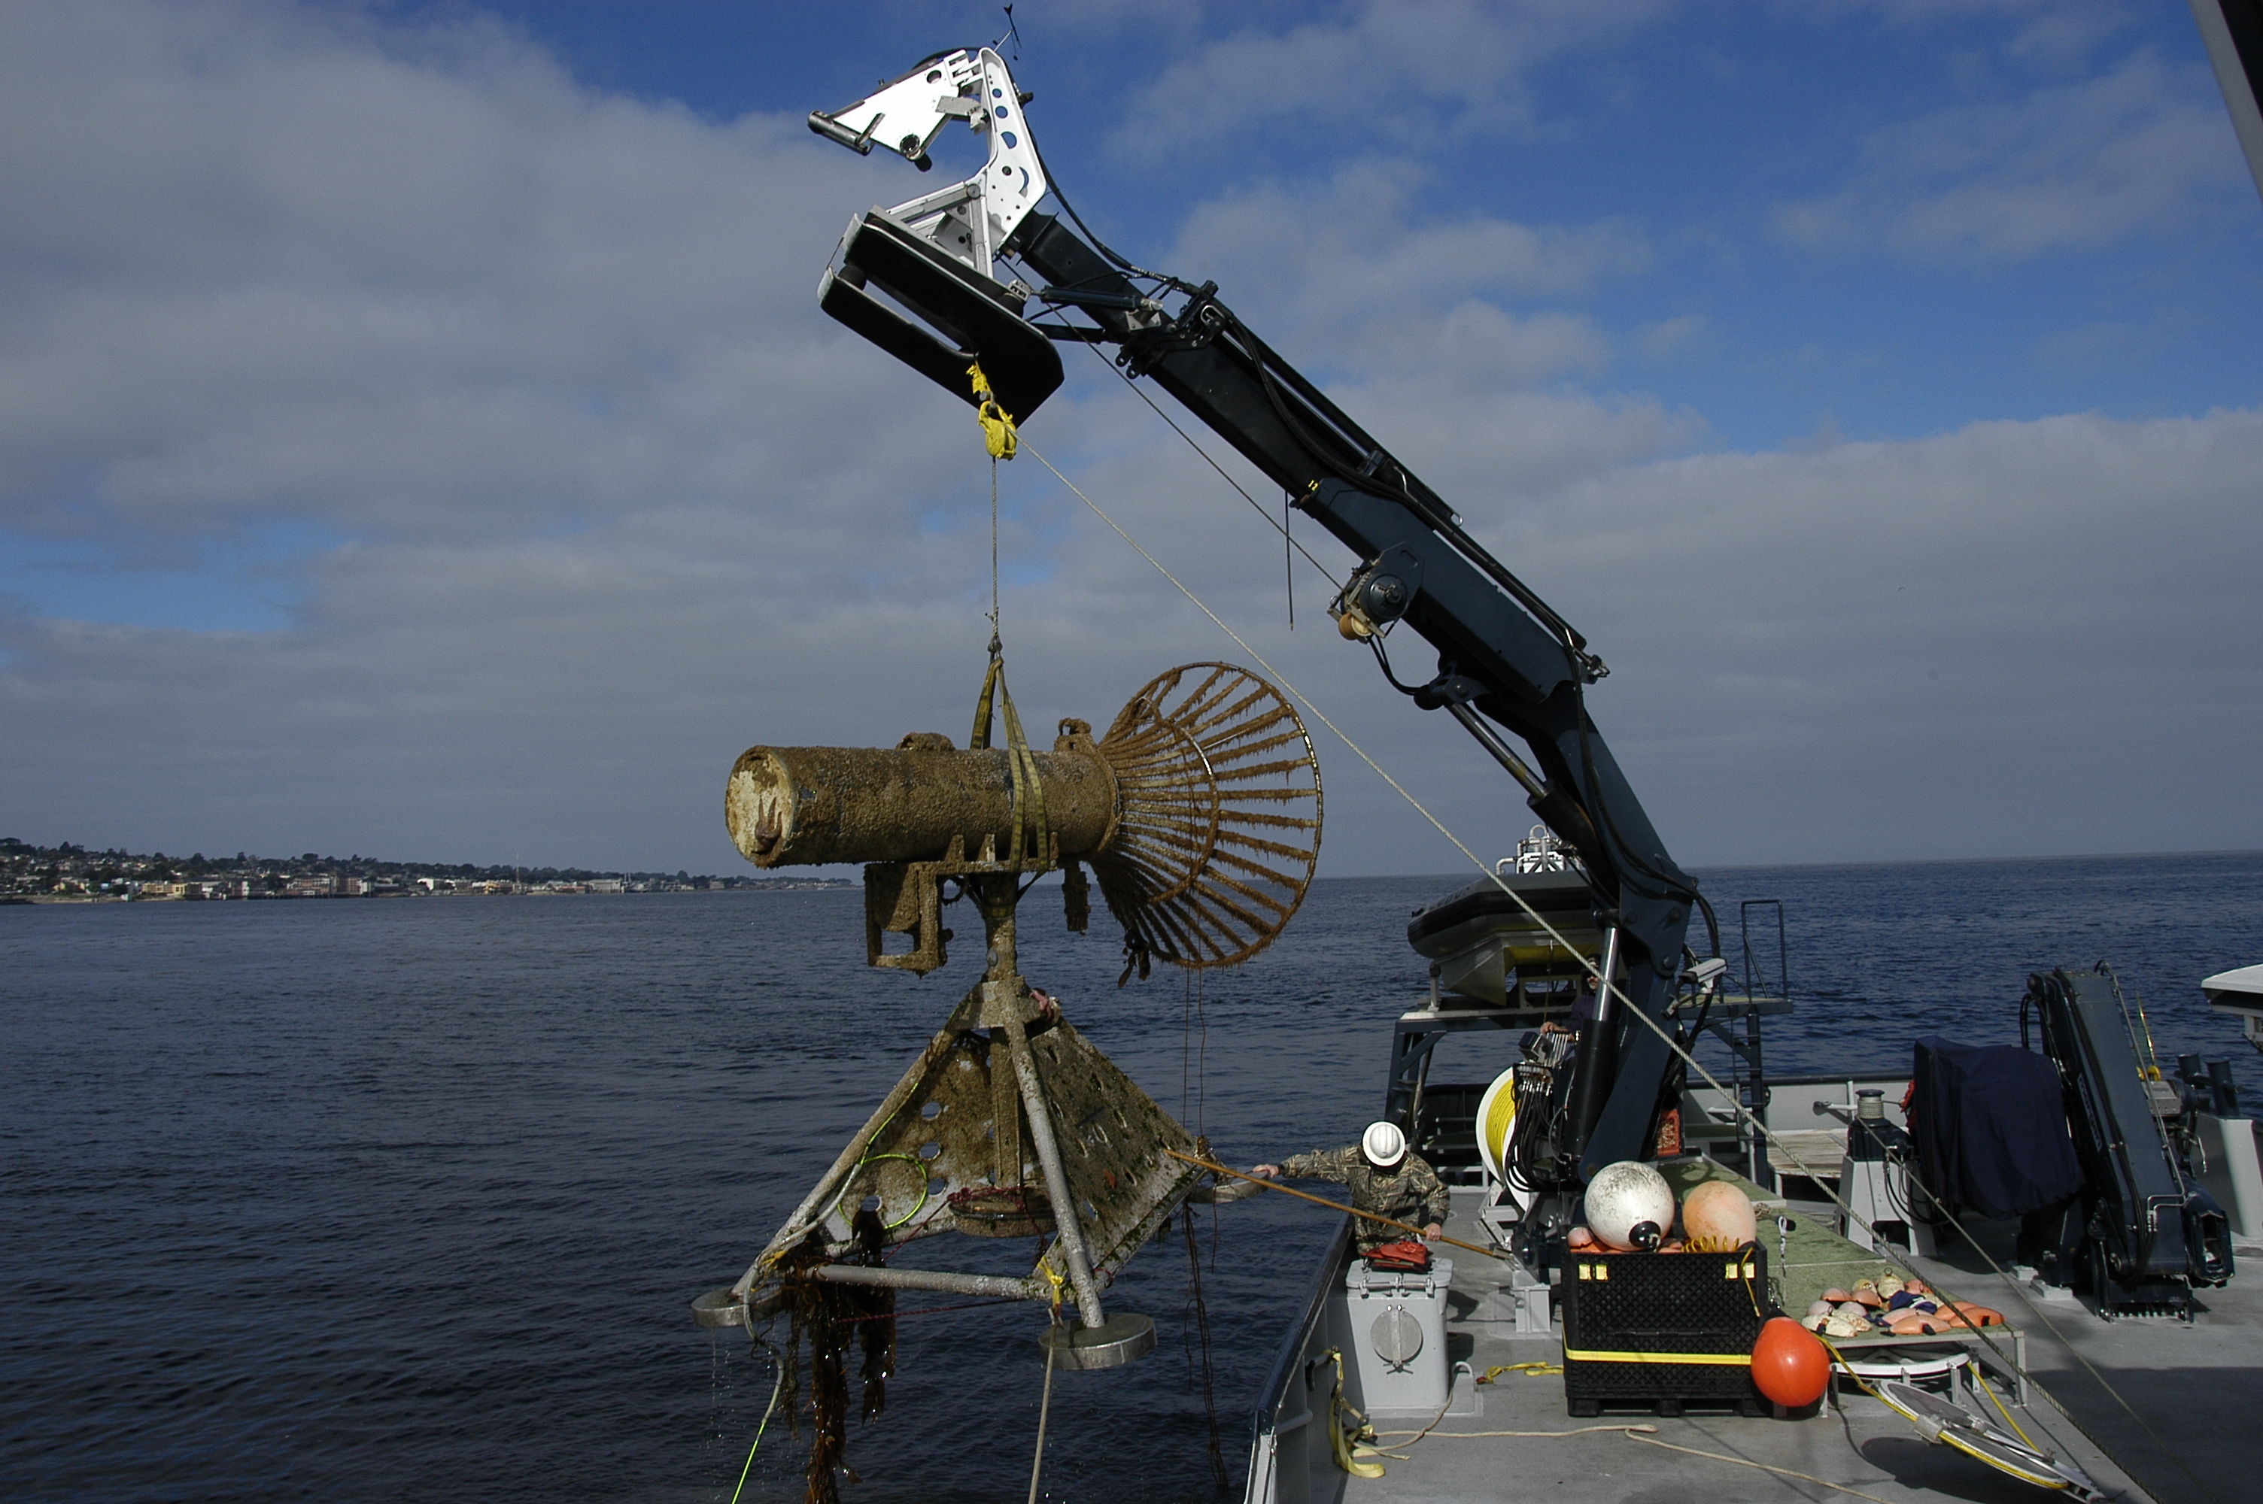
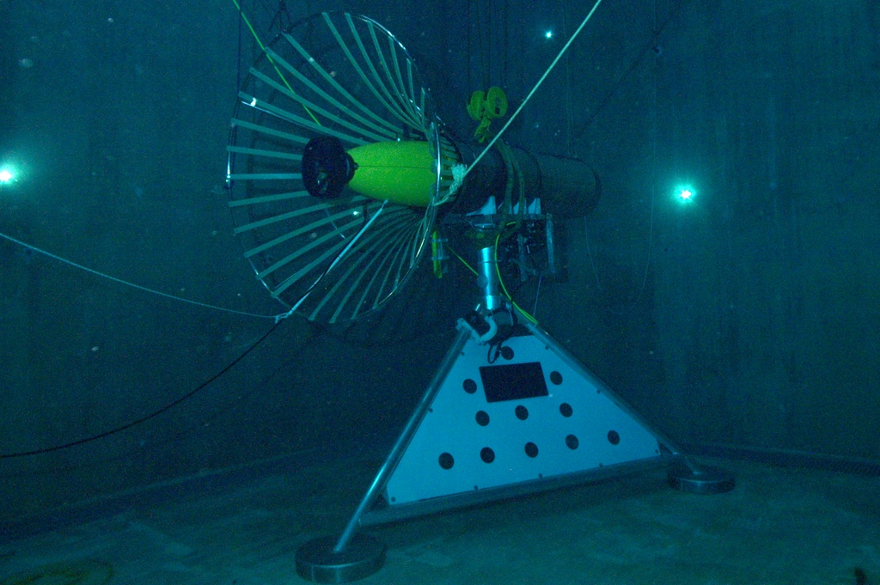
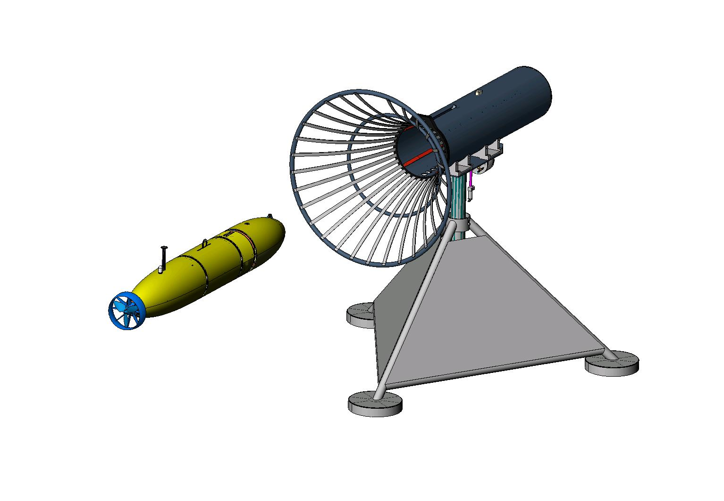
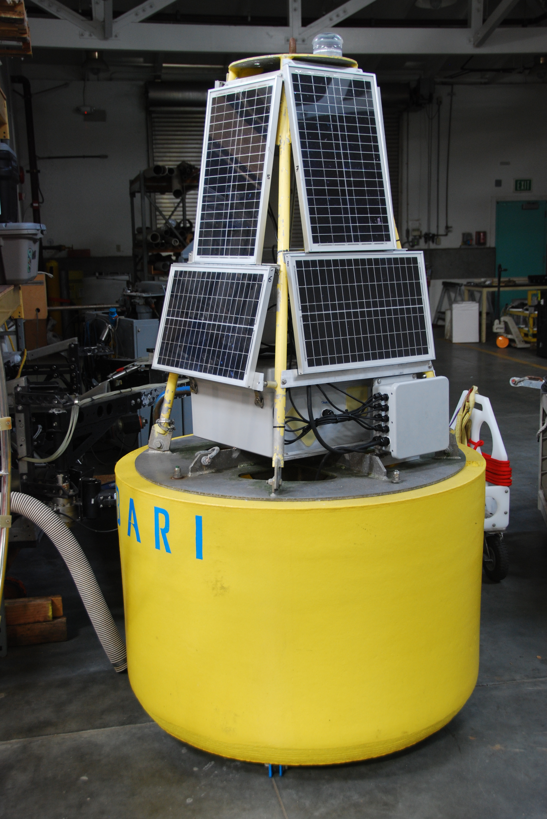
2007 MBARI Dock

Slide 8
What are the Risk elements?
Schedule
Long-term environmental exposure
Long-duration
Robust docking/undocking
Unattended boot reliability
Guaranteeing data quality & integrity
Extended duration S/W error-handling
Testing long mission in a short time
Cannot monitor AUV status
Cost and # of operational assets

Slide 9
Risk Reduction
Risk | Approach
Schedule | ramp-up funding 2018 resource continuity go/nogo gates
Long-term environmental exposure | all Ti/plastic/FRP larger oil reserve / testing
Long-duration | hibernation battery chemistry: trade study
Robust docking | Lots of testing
Unattended boot | testing/fix
Data quality/integrity | testing/fix
S/W error-handling | testing/fix
Testing long-duration in short time | see Test Sequence
No AUV status | WG for St. M, fail-safe mission abort

Slide 10
Notional Vehicle
corrosion-free exterior
Data & Opt.
Power
Transfer
USBL transponder
iUSBL
Docking Pin
AUV Dock
battery
science payload
control
nose
emergency scuttle
INS/DVL
hibernation controller
trigger:
a-modem (benthic)
eruption detector (arctic)
acoustic release
anchor
End of TL seafloor beacon (s)

Slide 11
2016 Highlights
Down selected many concepts and had planned to conduct the Concept Design Review – coming soon
Started long-term testing
  Worried about syntactic foam loosing buoyancy over the year
  28 samples were deployed at St.M (4km) for one year
    Weight gain ranged from 0.14 – 3.2 %
    Buoyancy loss ranged from 0.1 to 5.2%
Benthic payload
  Deployed T-20 on ROV to investigate ability of multibeam to detect pelagic fish
  Camera/LED flash testing – ROV test dive showed LED flash panels should be doubled up

Slide 12
2017 MT Feedback
The ultimate goal of achieving a long-term, in situ AUV presence to conduct repeat surveys or respond to ephemeral events without constant human oversight is well aligned with institutional goals and strategies.
Limited appetite for an expensive new AUV, but we are encouraged to invest engineering resources and existing vehicles to explore this topic.

Slide 13
2017 Objectives
Demonstrate reliable acoustic homing
  Brett, Rob, Francois,
Hibernation Controller
  Mark, Paul, Alana
Continue long-term testing
  Syntactic Foam - Brett
  battery self-discharge - Paul
Dorado automation and reliability
  Kent, Rich, Ben/Mathieu

Slide 14
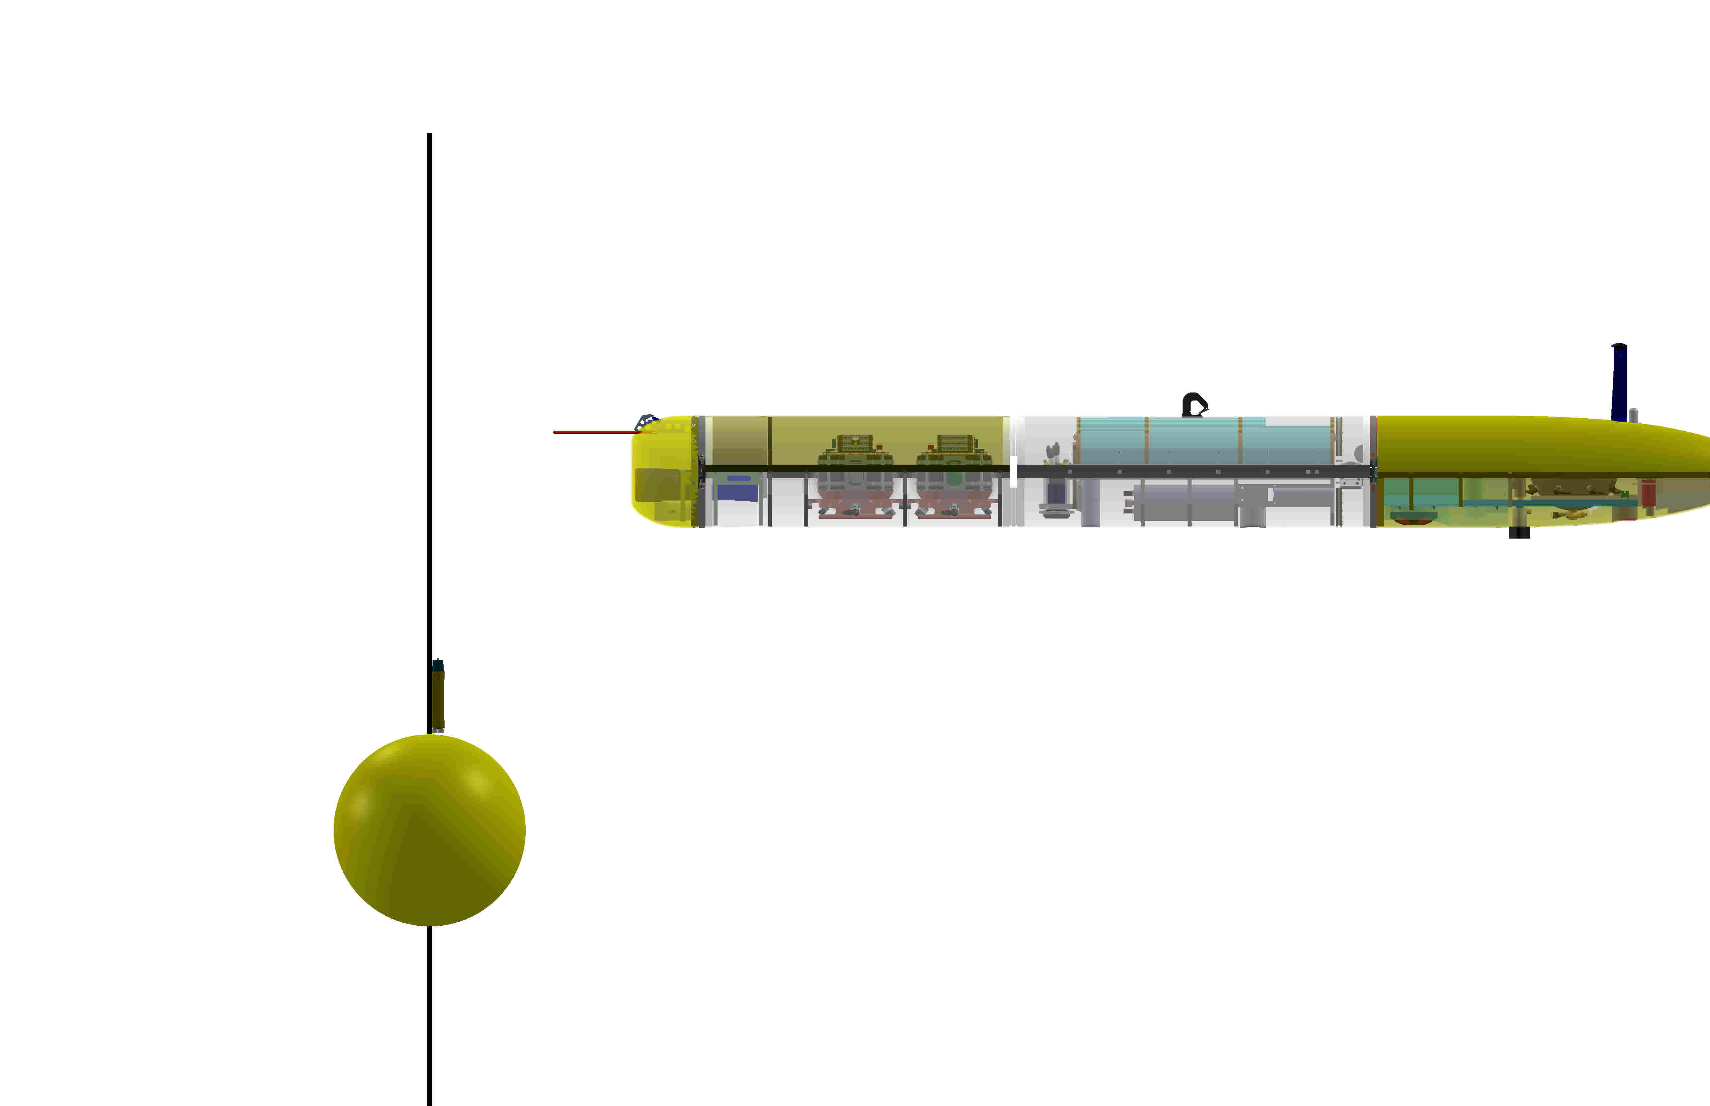
Demonstrate reliable acoustic homing
Perform 100+ homing attempts
Use Iceberg AUV (after it returns from arctic)
Borrow iUSBL, Use existing nose foam from BIAUV
10 Paragon days –
Omni-directional
  Concept uses directional cone dock, but omni is a contingency
Use SeaStar camera and iUSBL to validate

Slide 15
Hibernation Controller
Independent system to the AUV up
Run the checks
Start the mission
Watch for problems.
If the AUV cannot get back to the dock, sink the AUV to the seafloor and wait for help

Slide 16
Other
Long-term battery self discharge tests
  Battery packs are here
  Paul working on test plan and coordinating with DMO to borrow an 8 stick backplane
Dorado check-list automation
Dorado startup
  MVC, Kearfott, Edgetech, Reson (BIT check), Camera and Sensors
2nd set of syntactic foam samples were deployed in Nov
Long-term testing of Glue-joint

Slide 18
Park&Fly: Notional CONOPS
Arrive at site
Deploy the dock and outer beacon
Prep the AUV
Launch the AUV
Run first transect
Park
Parking verification
Depart site
AUV periodically parks and flies
  - At Station-M, could control from shore via wave-glider comm relay
Return to site
Recover AUV
Recover dock and LBL (minus anchor)

Slide 19
Docking Sequence
1
Current
Dock
2
Heading
3
x_{B}
y Cross-Track Error
N
Bearing
−ΔΨ
Pure Pursuit Homing & Navigation Fix
Cross-track control (Waypoint)
Cross-track USBL control (Docking)
Outer Marker
Waypoint
y_{B}
Vehicle
4 states; ΔΨ, r, y, v
ΔΨ is heading deviation
y is cross-track error
E
Inertially Fixed
Coordinates

Slide 20
Docking State Transition Diagram
Flight
(Waypoints,
Setpoints)
Docking
Homing
Undocking
Stopped
Missed
Approach
Pin
Inserted
Electrical
Dock
Contact

Slide 21
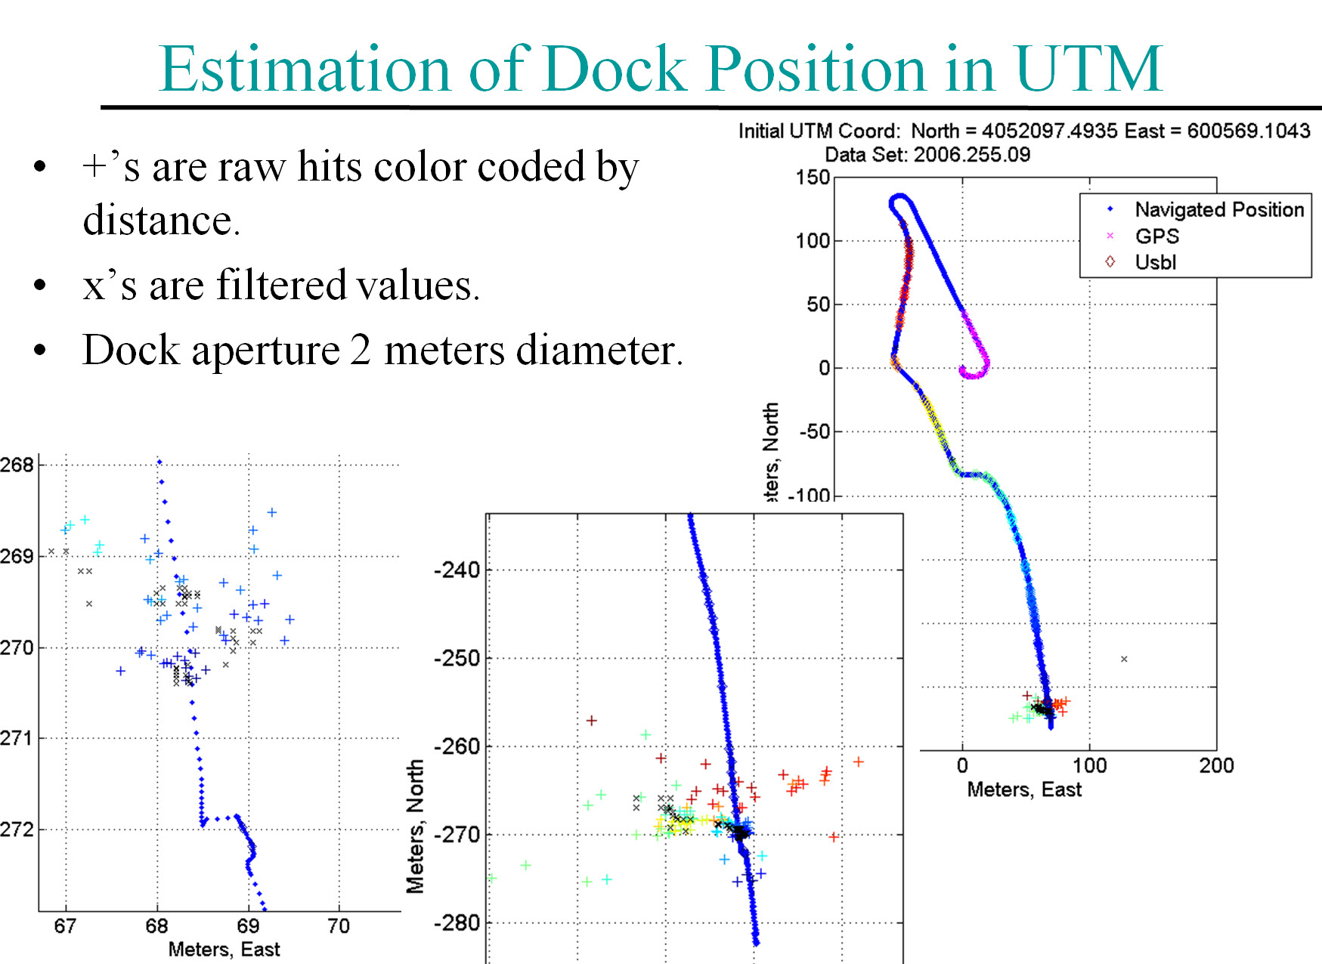

Slide 22
New Design elements
Must have
  Benthic payload.
  Docking system.
  Hibernation controller.
  Corrosion-free exterior.
  Extended duration s/w.
  Fail-safe aborts:
    when docked: stay docked.
    when undocked: park on seafloor.
Highly desirable
  Event-triggered response

Slide 23
Timelines

Slide 24
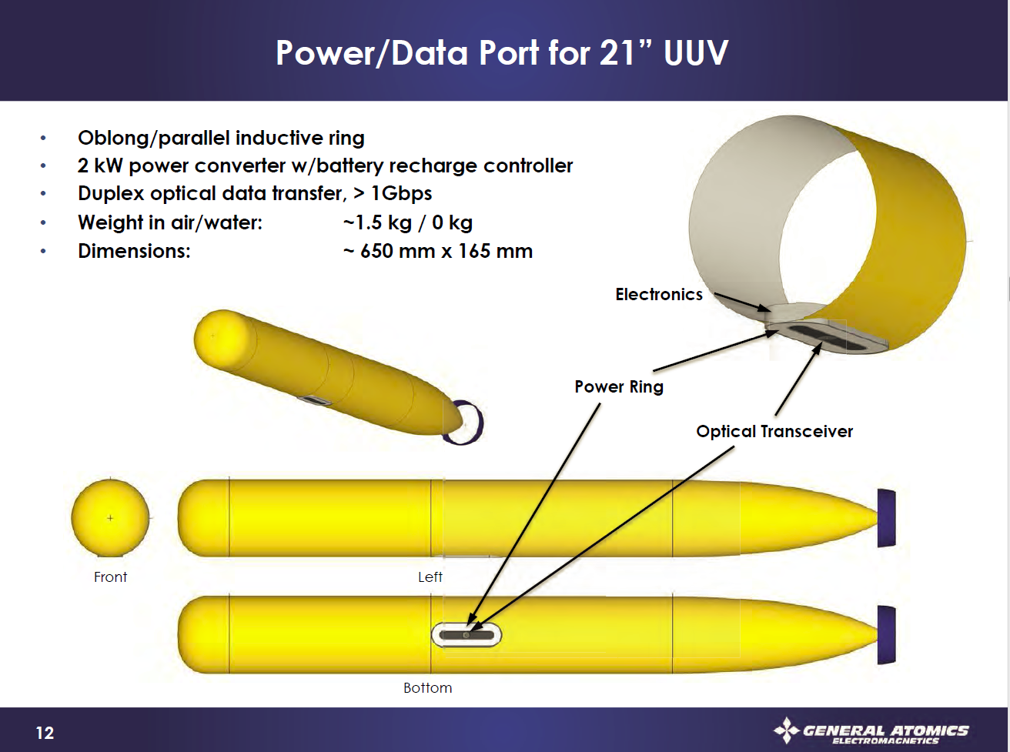
General Atomics - Notional

