Slide 1
LRAUV homing test
How to confirm that the AUV has hit the target?
Engineer: François Cazenave
April 13, 2017

Slide 2
Solution 1: Target with ArUco markers
Downward facing camera and light on vehicle.
Horizontal target with ArUco markers.
Post processing of video using open CV to determine position of AUV relative to target.
Advantages:
  gives accurate position of AUV relative to target.
  Can run a large number of tests without risk of damage.
Drawbacks:
  requires fast shutter and high resolution to get sharp image of the target. New camera system must be developed or purchased. Powerful light required.
  Complicated software and long data post processing

Slide 3
Solution 2: Simple video target
Downward facing camera and light on vehicle.
Horizontal target with checkered or other simple pattern.
Visual analysis of video to determine approximate position of AUV relative to target.
Advantages:
  Easy to implement, no software development.
  Simple imaging system (QX1 camera or gopro would probably work)
  Can run a large number of tests without risk of damage.
Drawbacks:
  Long processing time of video by human eye
  Approximate position of AUV.

Slide 4
Solution 3: Vertical pole, mechanical and video detection
6 to 8 ft long, ¼” diameter fiberglass pole mounted on top of elevator. Pole can be mounted on antenna spring or some other compliant attachment.
V or other shape bars (see examples) mounted to nose of AUV.
Pole triggers a switch on the bars to confirm hit.
Test can start with wide bars (i.e. 4ft) and end with narrow bars (i.e 2ft)
In addition, a forward facing camera system could be mounted to the exterior of the AUV (camera on top of the nose, light on bottom) to show accurate location of hit on graduated bars and pole.

Slide 5
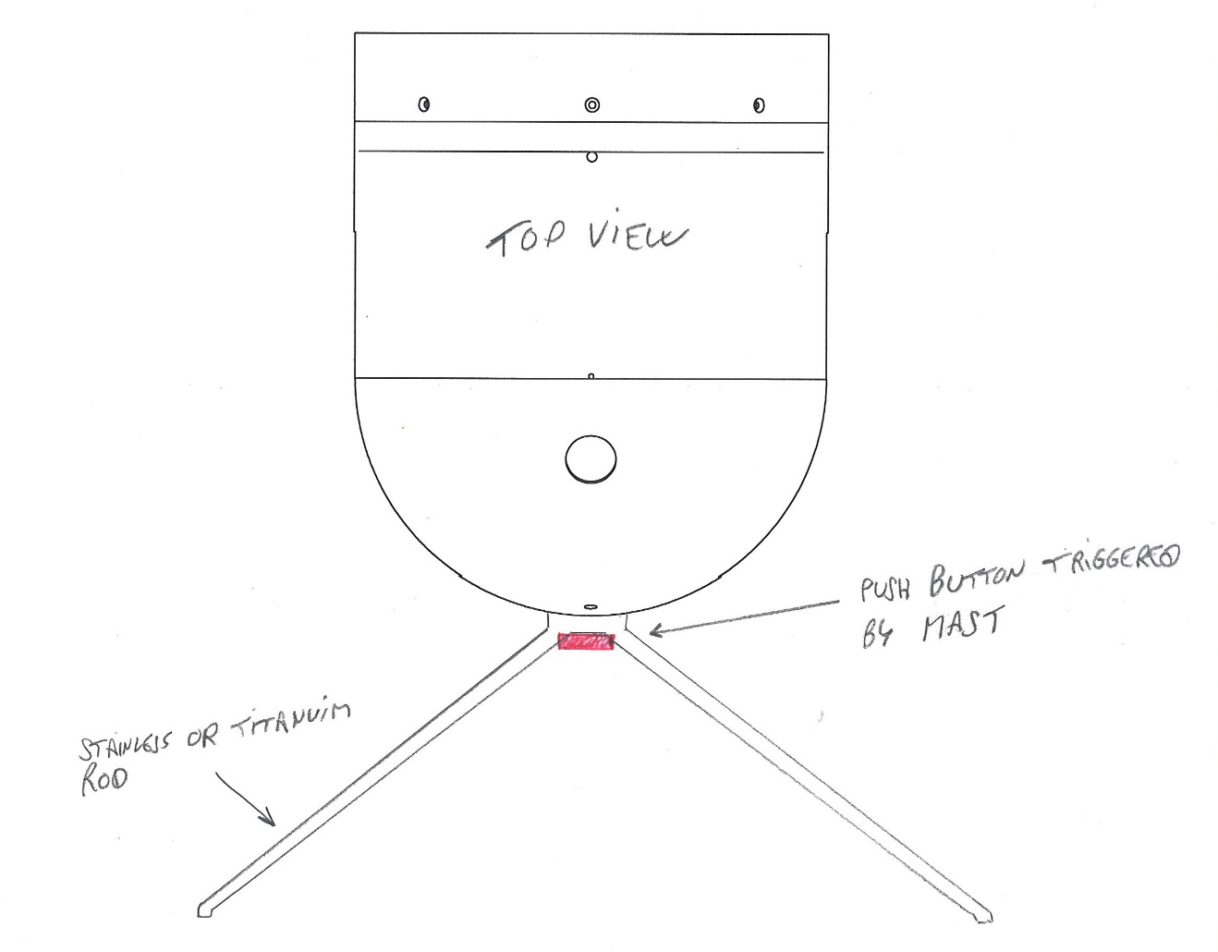
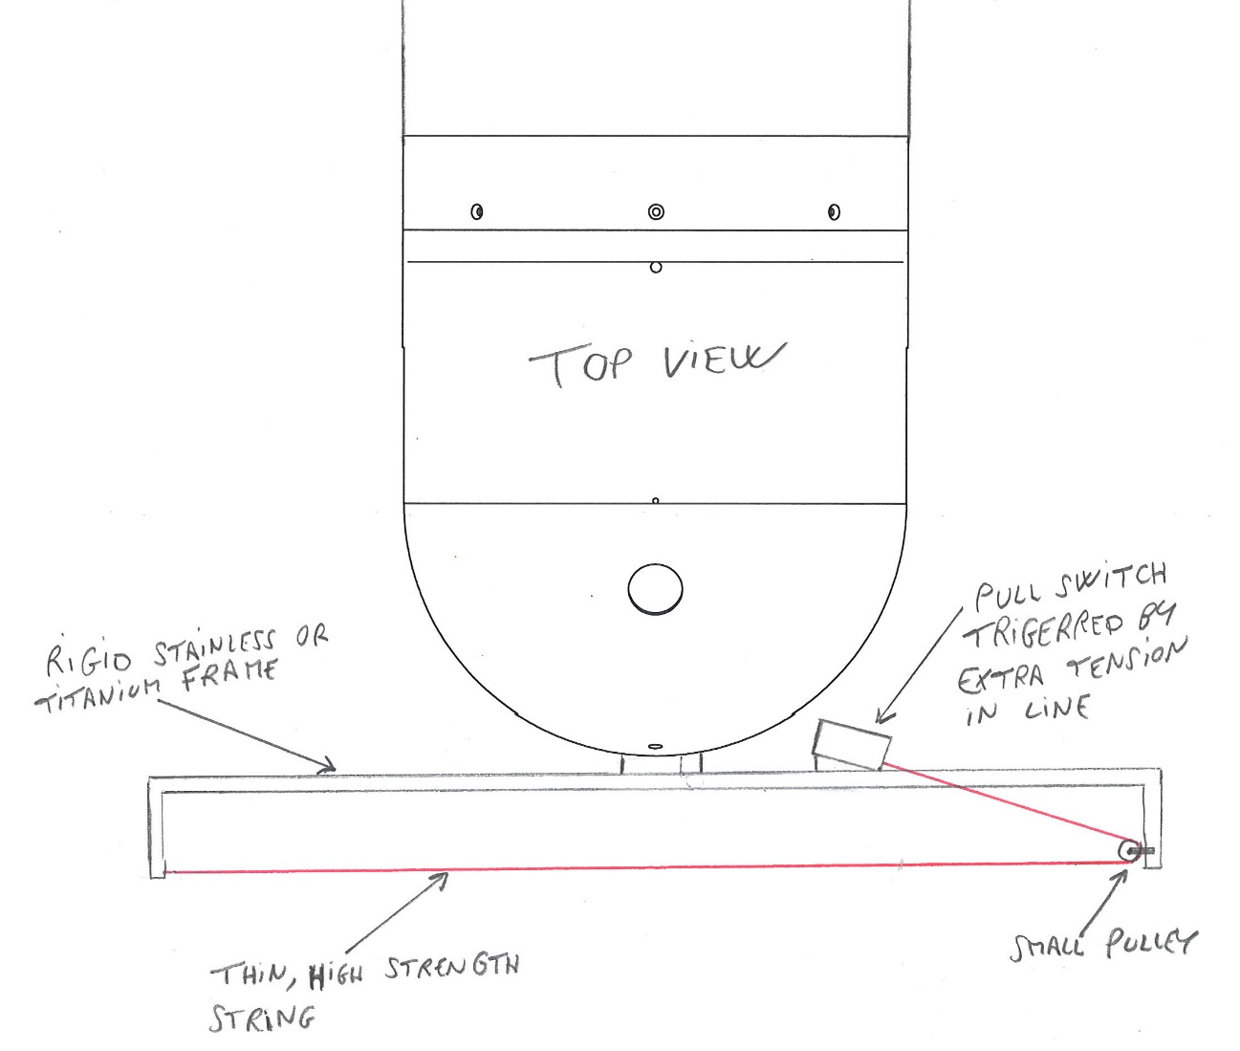
Solution 3: continued. Examples of mechanical triggers.

Slide 6
Solution 3: continued
Advantages:
  Binary result: no post-processing of data or questioning of success
  Relativity easy to implement
  Results can be immediately transmitted to the boat once AUV surfaces, no need to open housings etc.
  Exact time of trigger known by AUV
Drawbacks
  Binary result: no detail on accuracy of hit, unless video is also used.
  Deployment of elevator and AUV are more complicated
  Possible unreliability and wear of trigger mechanism

