Slide 1
Park-n-Fly AUV proposal
PI | Project Manager | Lead Scientist | Lead Engineer
Ken Smith | Brett Hobson | Ken Smith | Brett Hobson

Slide 2
Outline
Autonomy from ship-based measurements – key to success of long time-series studies
  Critical goal of integrated time-series at MBARI
  Two internally funded projects to develop 2 AUVs - sampling/imaging upper 1500 m water column I2MAP, LRAUV
Existing benthic surveys likely missing fish on and near the bottom
  Bioacoustics are the best technology to count these fish
  Wide-swath multi-beam sonars are ideal instruments
Seasonal and event driven benthic surveys are needed to address important questions about patchiness
A resident AUV that can perform scheduled and event driven benthic surveys at 4km depth with yearly servicings is needed.

Slide 3
Table 1. Comparison of existing and proposed AUVs
Vehicle | LRAUV | I2MAP | Deep AUV
Depth rating | 300m | 1500m | 4000m
Power Duration | Weeks | Days | Year
Range | 1000km | 100km | 100km
Sensors | CTD, O₂, Fluorometer | CTD, O₂, Fluorometer | CTD, O₂, Transmissometer
Camera system | Under development | Video w/lights | Still w/strobes
Acoustic backscatter | Under development | EK15 | Multibeam (200kHz)
Total onboard energy | 6kwhr(rech)/ 11kwhr(primary) | 10kwhr | 20kwhr

Slide 4
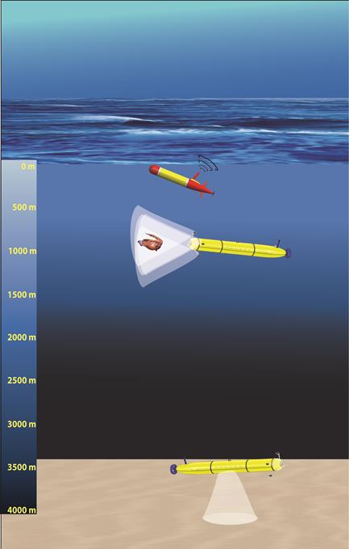
Figure 1. Existing and proposed AUVs

Slide 5
Proposed capabilities of Park-n-Fly AUV
Working depth to 4000 m, deployment duration 12 months
Onboard battery capacity to perform 48 hours of operation
Surveys can either be seasonal or event-driven
  events detected by Sedimentation Event Sensor (SES)
Bottom photo-transect with sufficient resolution to perform animal identification and measure detrital aggregation
Benthopelagic acoustic backscatter with a multibeam echosounder over a 120 degree swath, with sufficient resolution to perform animal counts
Record CTD/O₂ data on each transect
Park on sea floor in sleep-mode between 8-hr surveys
Communicate with shore via Wave Glider Acoustic gateway
Emergency scuttling (float drop to park on seafloor)

Slide 6
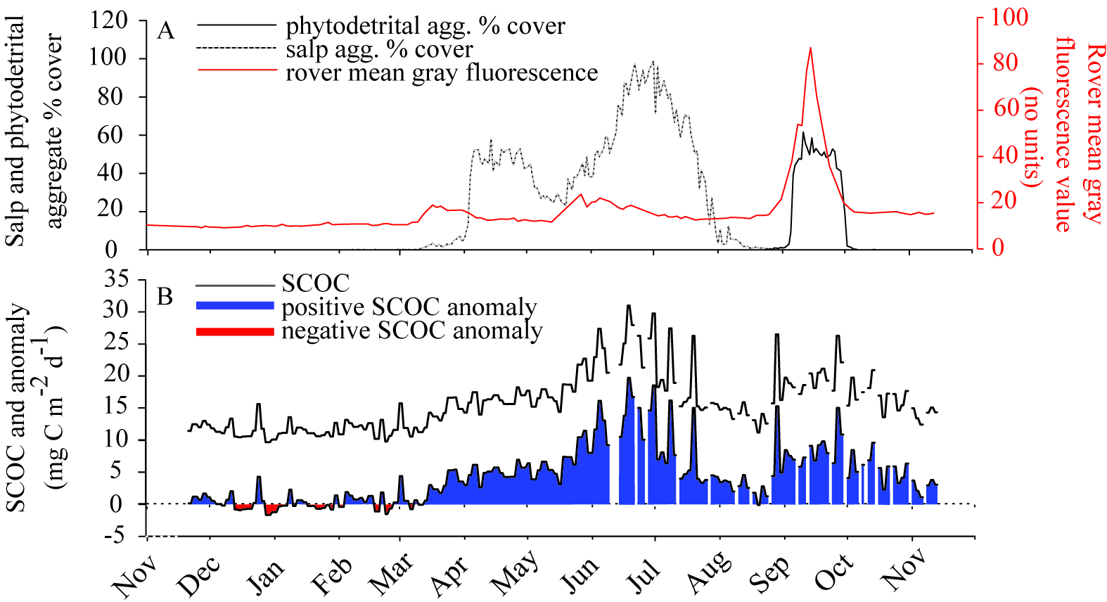
Scientific Justification
26-year time series at Sta. M reveal significant daily to weekly changes in benthic community and environment.

Slide 7
Why is a Mobile Platform Needed?
Seasonal or event triggered surveys not feasible using ship-based facilities
Ecological patchiness at scale of 10 m -1 km requires survey coverage not feasible with stationary assets
Allows flexible tradeoff between survey frequency spatial coverage

Slide 8
Proposed development
Modified Dorado AUV
Add shutdown firmware to rechargeable battery packs
Existing Downward-looking still camera/strobe system
  (Existing VARS analyses, processing)
Utilize Reson T20 downward-looking multi-beam sonar with Echoview analyses )
Inertial navigation or acoustic long baseline (running same trajectory for each transect)
Existing Wave Glider acoustic gateway for comms to (status reports, triggering)
Event triggering of surveys from Sedimentation Event Sensor
Mechanical docking to anchored riser
Acoustic homing to riser (existing USBL and controllers from AUV docking)
Emergency anchoring watchdog system with float release (any faults when not docked result in vehicle parked on seafloor that requires ROV recovery)

Slide 9
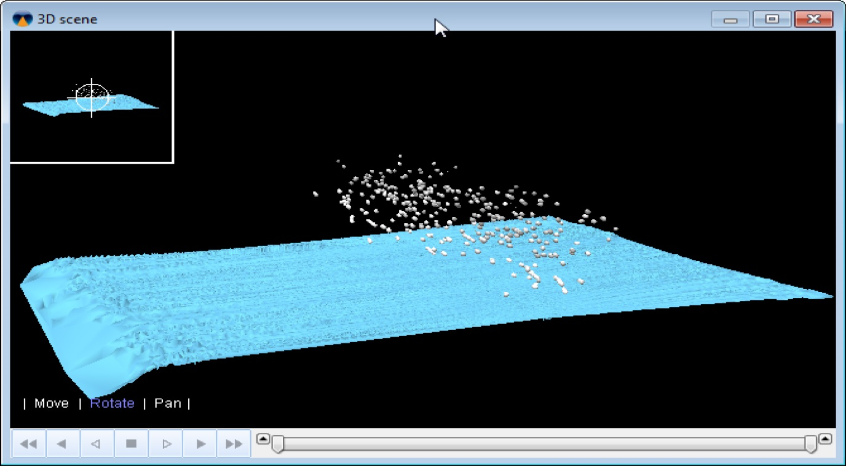
Data products and analysis:
Backscatter
Echoview plot of backscatter data from Reson Multi-beam data in Monterey Canyon- ~900m, near MARS. Resolution capable of detecting targets in 10-100 cm size range. This image shows targets 20-50 m above bottom.

Slide 10
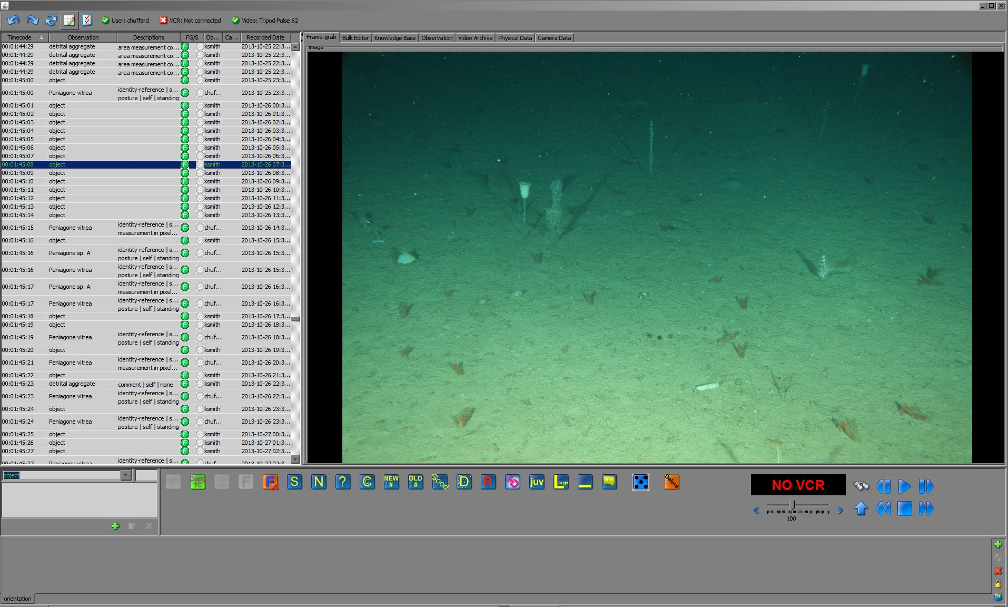
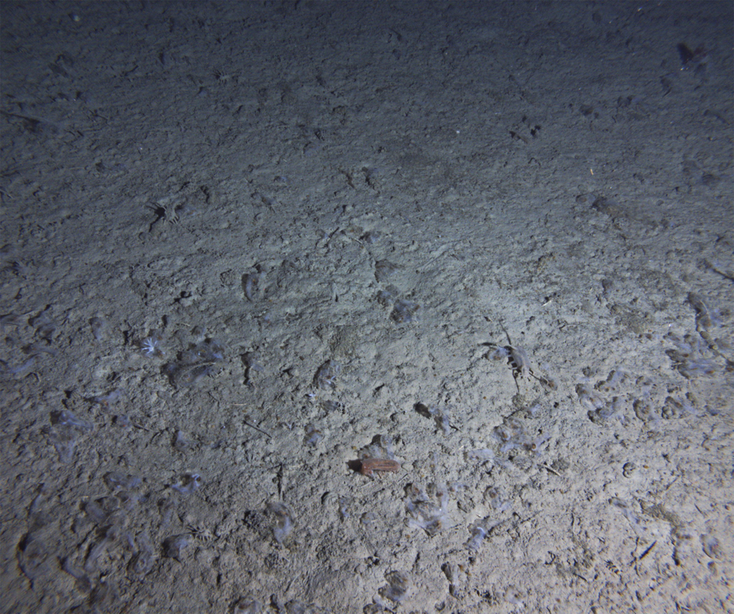
Data products and analysis:
Transect images
Use VARS to measure:
Detrital aggregate area
Animal identification
Animal size
Animal density
Annotation:
Work toward automation
Subsample for now
Create library for machine
Learning (Video TAG)
VARS screenshot

Slide 11
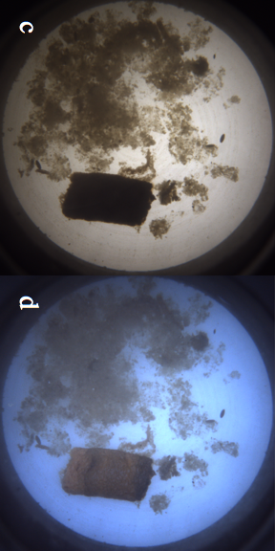
Event triggering by SES
A
B

Slide 12
Proposed Schedule
2016:
Calibrate Reson T-20 system, then collect and analyze bio-acoustic data
Demonstrate AUV hibernation features in lab
Identify modifications needed to use Iceberg AUV to demonstration
2017:
Detailed design of AUV
Either modify Iceberg AUV or integrate new platform from in-house and new components
Develop and demonstrate docking capability
Deploy Iceberg AUV at Sta. M during a Pelagic-Benthic cruise to collect a test dataset (optical and acoustic)
2018:
MARS test deployment
Station M deployment Oct/November

Slide 13
Relevance to MBARI
Strategic Plan: Ecosystem dynamics – We are the only research group making long time-series measurements of carbon flux to the abyssal sea floor and its utilization by the benthic community, and by subtraction estimating carbon sequestration. A specific example is the salp bloom study we published in 2014 (L&O 59:745-757).
Technology Roadmap: Problem statement #6 relating water column conditions and variability to the abundance, distribution and activity of organisms. Our time-series research also addresses Problem statement #8, providing insights into the future ocean. Additionally, our collaboration with the integrated time series (ITS) project forms an essential role addressing Problem statement #3 in advancing a detailed quantitative view of the biological pump.

