Slide 1
Park&Fly
Year-long AUV deployment w/ periodic or event-driven monitoring.
Build 2 AUVs
  Program 1: feasibility study of benthic monitoring (Ken Smith)
  Program 2 : 2019 mud-volcano monitoring in Arctic (Charlie Paull).
Far-reaching concept, cross-field applicability:
  on-demand monitoring, field-residence
  Event response
  Station-keeping power generator

Slide 2
Near-term opportunities
Benthic AUV (Ken)
4 deep transects in 12 months.
Sample w/down-looking camera one way, MBES the other way.
Highly desirable: Event-triggered response.
Arctic AUV (mud volcanoes, Charlie)
6 under-ice surveys in 12 months
MBES & SSS
Highly desirable: Event-triggered response.
Ship date: April 2019
Notes
Camera: low-altitude / low-speed
Trigger: a-comms from sediment event sensor.
Notes
300m<D< 750m depending on volcano
Trigger: sound-pressure level from eruption.

Slide 3
Risk elements
Schedule (arctic AUV 2019 launch window).
Long-term environmental exposure.
Long-duration.
Robust docking/undocking.
Unattended boot reliability.
Guaranteeing data quality & integrity.
Extended duration S/W error-handling.
Testing long mission in a short time.
Cannot monitor AUV progress while under-ice.

Slide 4
Proposed Approach
Risk | Approach
Schedule | ramp-up funding July 2016 resource continuity go/nogo gates
Long-term environmental exposure | all Ti/plastic larger oil reserve / testing
Long-duration | hibernation battery chemistry: trade study
Robust docking | Lots of testing
Unattended boot | testing/fix
Data quality/integrity | testing/fix
S/W error-handling | testing/fix
Testing long-duration in short time | see Test Sequence
No progress monitoring under-ice | fail-safe mission aborts

Slide 5
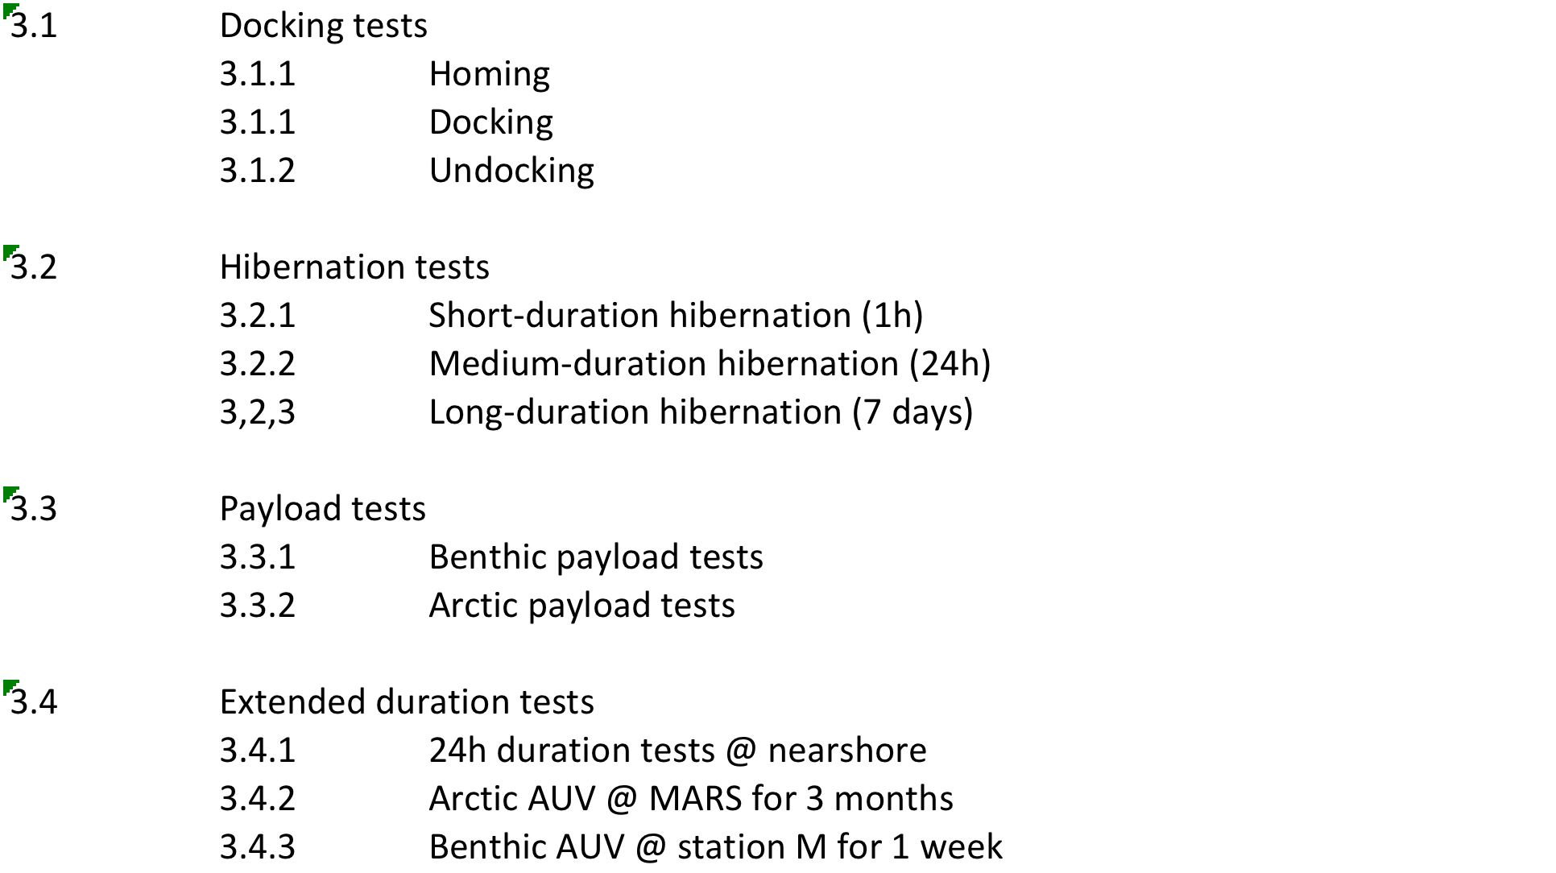
Proposed Test Sequence

Slide 6
Notional Vehicle
float
corrosion-free exterior
USBL transponder
Avtrak
(track&comms)
iUSBL
AUV Dock
nose
battery
science payload
control
emergency scuttle
INS/DVL
hibernation controller
Opt.
Data
Power
Transfer
LBL (x4)
trigger:
a-modem (benthic)
eruption detector (arctic)
acoustic release
anchor

Slide 7
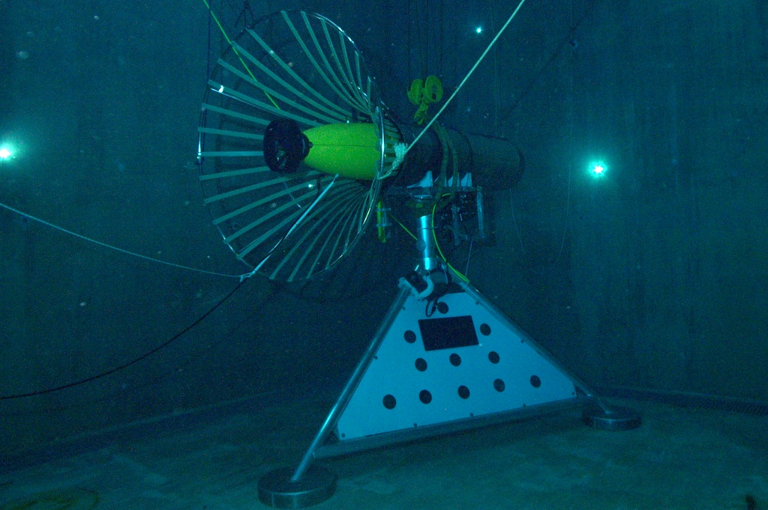
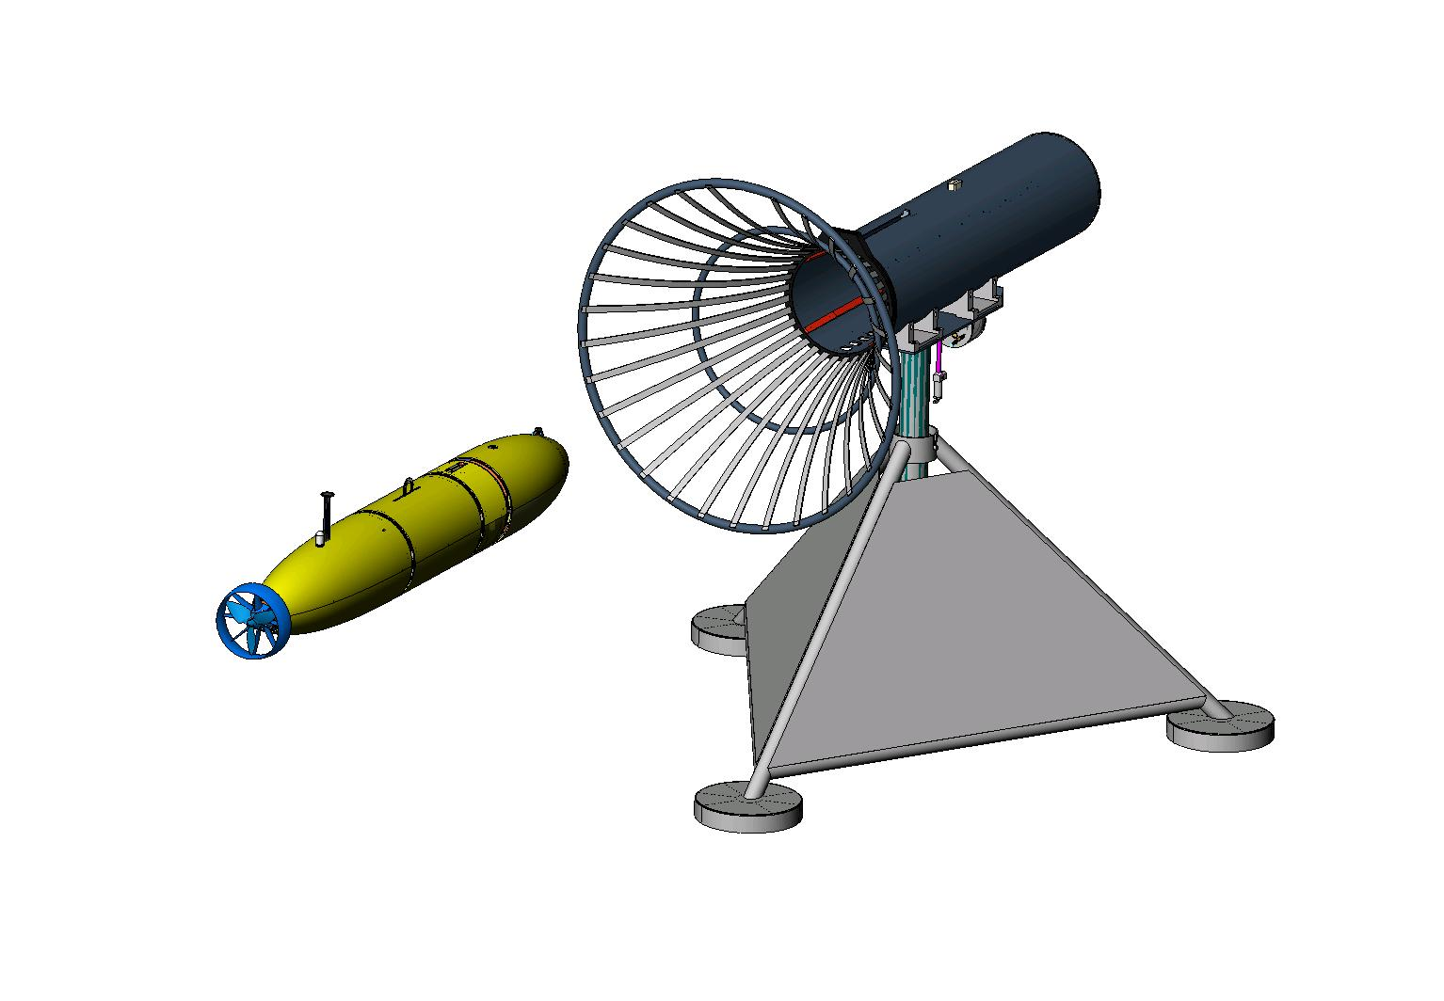
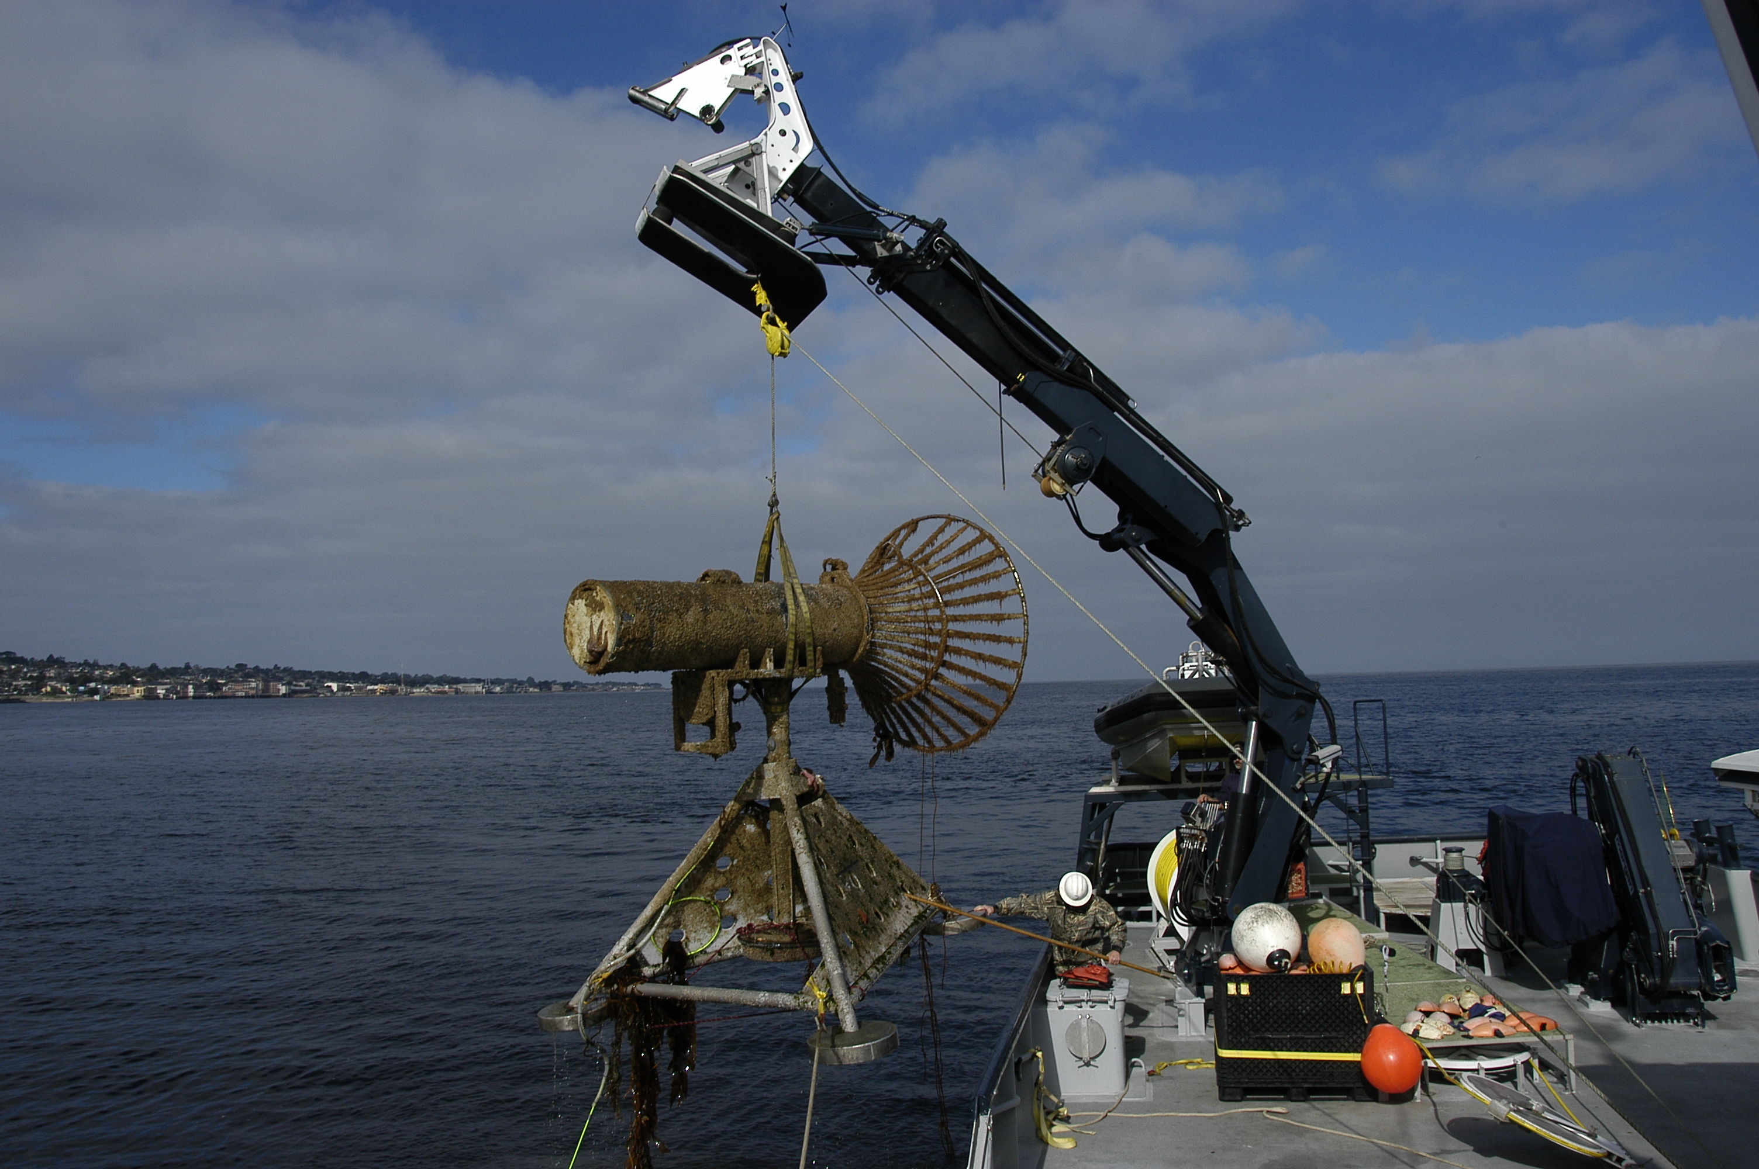
MBARI Dock

Slide 8
Docking Sequence
1
Current
Dock
2
Heading
3
x_{B}
y Cross-Track Error
N
Bearing
−ΔΨ
Pure Pursuit Homing & Navigation Fix
Cross-track control (Waypoint)
Cross-track USBL control (Docking)
Outer Marker
Waypoint
y_{B}
Vehicle
4 states; ΔΨ, r, y, v
ΔΨ is heading deviation
y is cross-track error
E
Inertially Fixed
Coordinates

Slide 9
Docking State Transition Diagram
Flight
(Waypoints,
Setpoints)
Docking
Homing
Undocking
Stopped
Missed
Approach
Pin
Inserted
Electrical
Dock
Contact

Slide 10
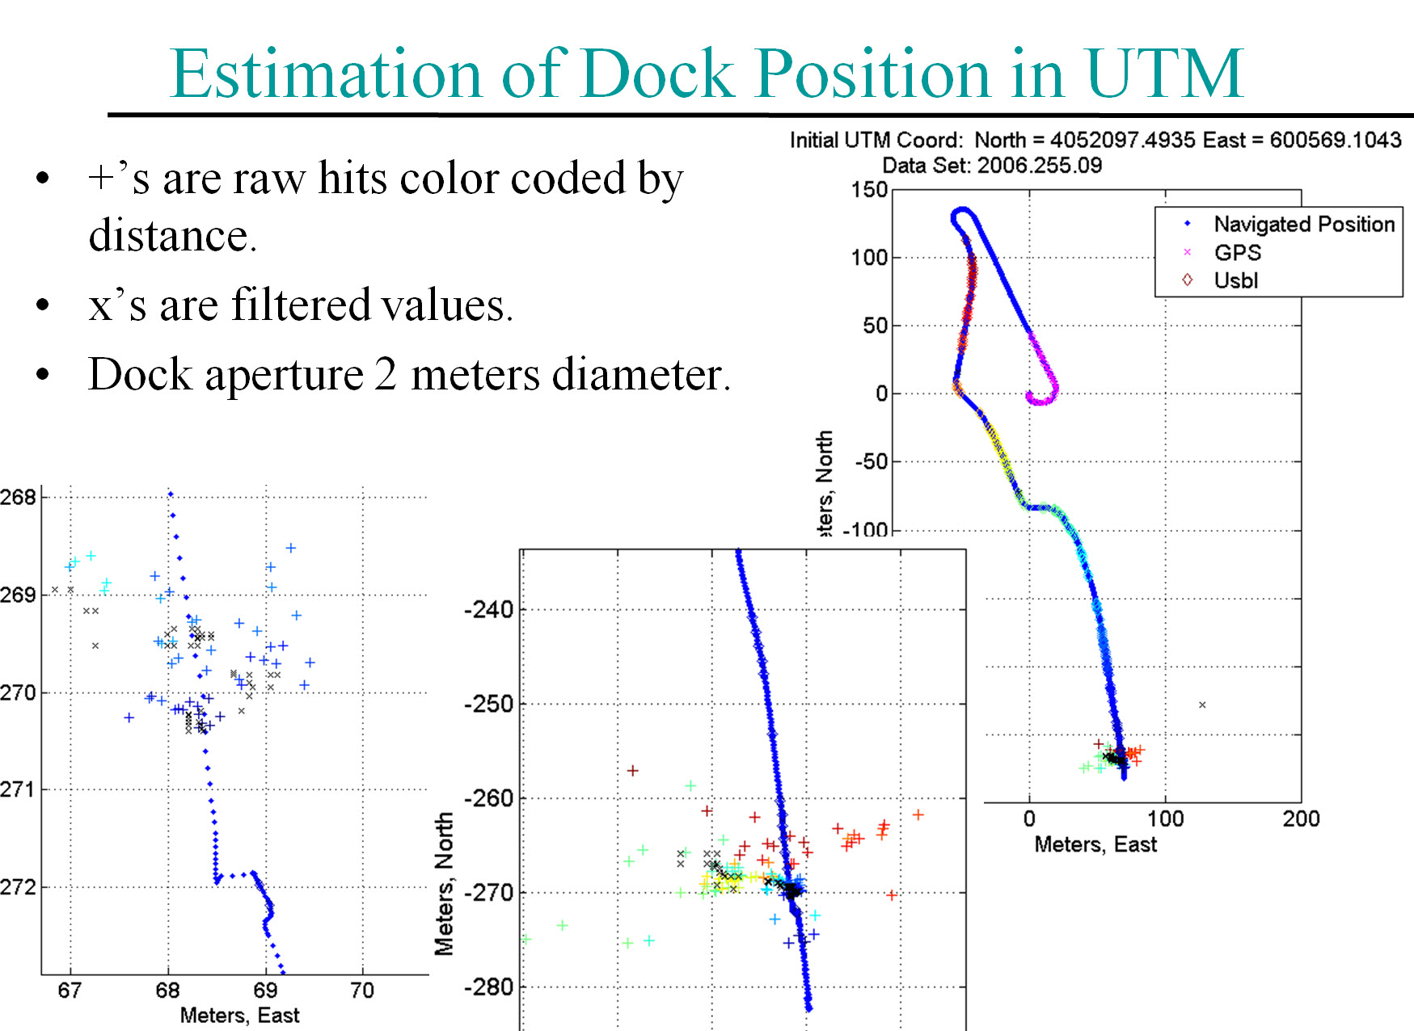

Slide 11
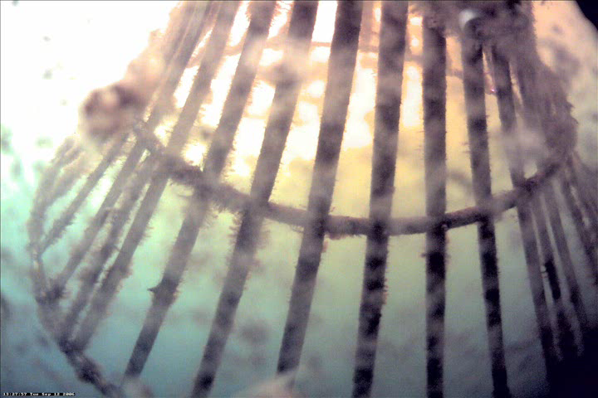
Docking Video
Will show other three docks last

Slide 12
New Design elements
Must have
  Benthic payload.
  Docking system.
  Hibernation controller.
  Corrosion-free exterior.
  Extended duration s/w.
  Fail-safe aborts:
    when docked: stay docked.
    when undocked: park on seafloor.
Highly desirable
  Event-triggered response

Slide 13
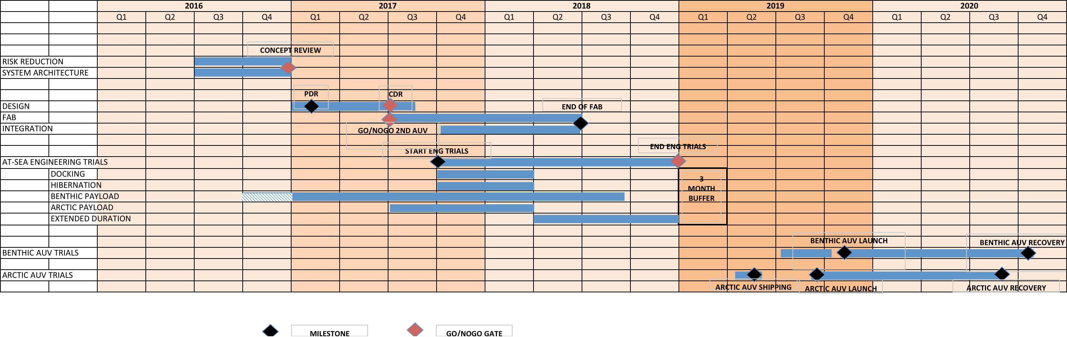
Timelines

Slide 14
WBS: see spreadsheet

Slide 15
Resources
year | labor | ship time
2016 (acceleration) | Brett: +1month Rob: +2 weeks Hans: + 1 month (MK: 1 day/week) | 3 days
2017 | 5 FTEs: design/fab/testing | 10 days
2018 | 5 FTEs: fab/assembly/at-sea testing | 10 days
2019 | 2 deployments | 5 days (contingency)
2020 | 2 recoveries | n/a

Slide 16
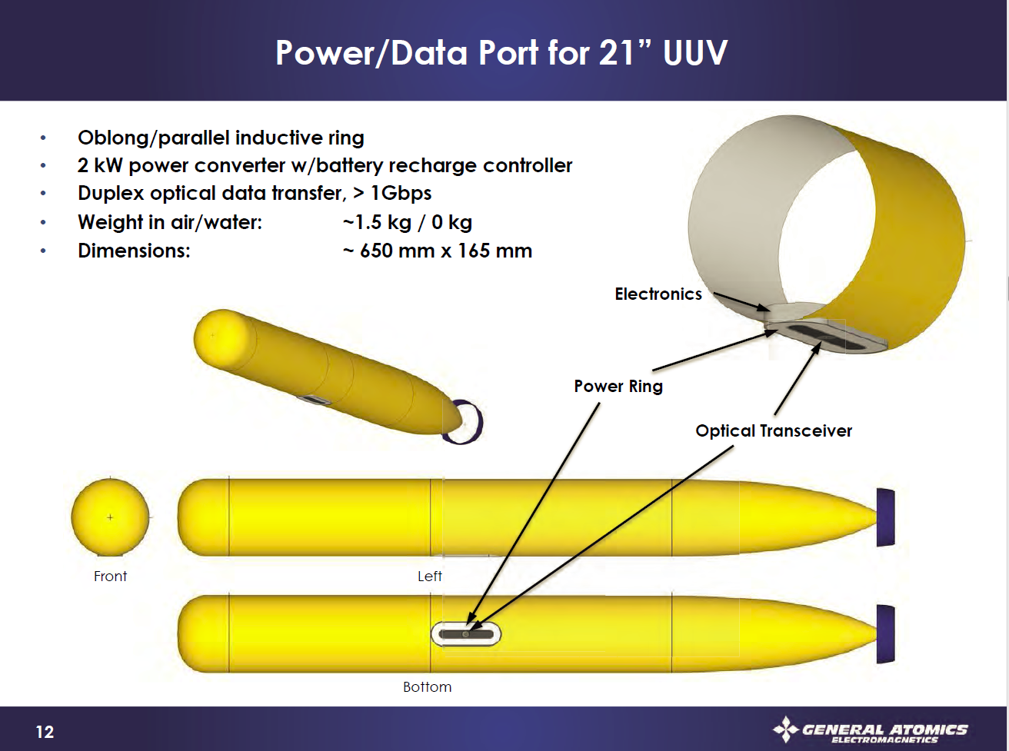
General Atomics - Notional

Slide 17
WPDX Medium Power Data Sheet
MBARI/Maughan
Power:
  150 Watt continuous, 240 Watt peak (1 hr), resonant transfer using PowerByProxi technology
  Voltage: 24v DC input and output
  Current: 6 Amp output
  Efficiency: ~75%
Data:
  100 Mbps ethernet
  Option RF: 2.4 GHz point to point Ubiquity Radio, 10mW nominal, adjustable to 600mW
  Option Optical: ‘work in progress’
0 to 5 mm separation (derated from 1cm to allow for potting thickness)

Slide 18
Block Diagram of What we want to build for MARS Toast goes in the Toaster
Input:
375v @ 2 amps
or
24v @ 30 amps
150W continuous
240W peak
Inrush Lim / 375 to 24v
Ethernet Switch / Status Mon
802.11 PtP Radio
Load Control / Mon
Resonant Power
Load Light

Slide 19
Backups

Slide 20
Park&Fly: Notional CONOPS
Arrive at site
Deploy the dock and LBL
Prep the AUV
Launch the AUV
Run first transect
Park
Parking verification
Depart site
AUV periodically parks and flies
Return to site
Recover AUV
Recover dock and LBL (minus anchor)

