Slide 1
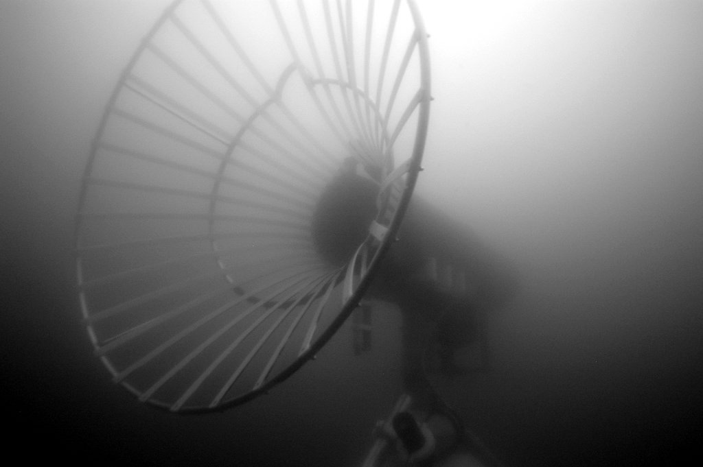
Park –n- Fly AUV
PI: Ken Smith
Scientists: Ken Smith and Charlie Paull
Project Manager: Brett Hobson
Systems Engineer: Mathieu Kemp
AUV Engineer: Hans Thomas
Controls Engineer: Rob McEwen
EE: Scott Jensen, Paul McGill
SE: Kent Headley, Rich Henthorn
ME: Jon Erickson, Brett Hobson

Slide 2
Park & Fly AUV – Abstract
Develop the capability for a persistent presence in the deep ocean
Conduct seasonal, seafloor imaging and bioacoustics surveys at Station-M. Without a ship.
Conduct seasonal, seafloor mapping with sidescan and multi-beam sonars to investigate the geologic evolution of mud volcanoes in the Arctic. Under the ice, without a ship, for one year.

Slide 3
Near-term opportunities
Benthic AUV (Ken)
4 deep transects in 12 months.
Sample w/down-looking camera one way, MBES the other way.
Highly desirable: Event-triggered response.
Arctic AUV (mud volcanoes, Charlie)
6 under-ice surveys in 12 months
MBES & SSS
Highly desirable: Event-triggered response.
Ship date: April 2019
Notes
Camera: low-altitude / low-speed
Trigger: a-comms from sediment event sensor.
Notes
300m<D< 750m depending on volcano
Trigger: sound-pressure level from eruption.

Slide 4
Approach -1
Stretch AUV operation from a continuous run over 17 hours to ~four 3-hours missions spaced over one year
Park the AUV inside of a docking station between missions and put it to sleep
Use an independent hibernation controller to wake the AUV up, run the checks, start the mission and watch for problems. If the AUV cannot get back to the dock, sink the AUV to the seafloor and wait for help
Optionally trigger the deployments remotely or locally for event response

Slide 5
Why we think this is Do-able
Strong fleet of Dorado vehicles, spares and operational know-how
Dorado docking success in 2007, and efforts at Bluefin, WHOI/Hydroid and SPAWAR
Long-term deployment of the Benthic Rover
Industrial partnerships (motivated to ensure our success) with Sonardyne (homing), Bluefin, General Atomics (power/data transfer, batteries, homing)

Slide 6
What are the Risk elements?
Schedule (arctic AUV 2019 launch window)
Long-term environmental exposure
Long-duration
Robust docking/undocking
Unattended boot reliability
Guaranteeing data quality & integrity
Extended duration S/W error-handling
Testing long mission in a short time
Cannot monitor AUV status
Cost and # of operational assets

Slide 7
Risk Reduction
Risk | Approach
Schedule | ramp-up funding July 2016 resource continuity go/nogo gates
Long-term environmental exposure | all Ti/plastic/FRP larger oil reserve / testing
Long-duration | hibernation battery chemistry: trade study
Robust docking | Lots of testing
Unattended boot | testing/fix
Data quality/integrity | testing/fix
S/W error-handling | testing/fix
Testing long-duration in short time | see Test Sequence
No AUV status | WG for St. M, fail-safe mission abort

Slide 8
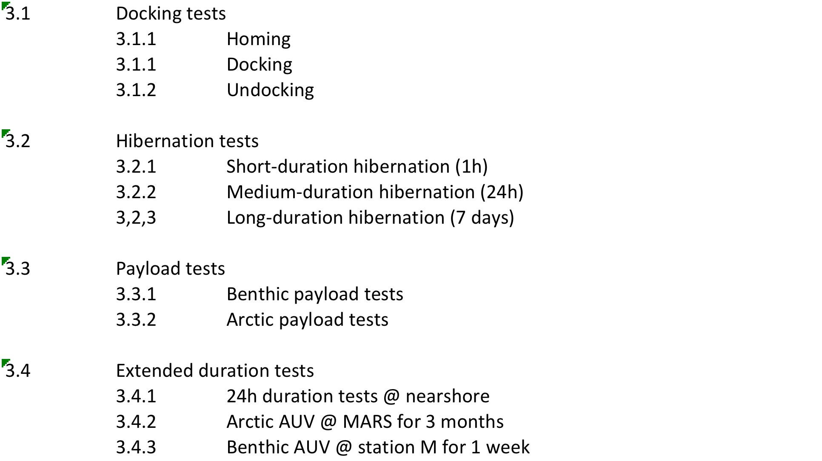
Proposed Test Sequence

Slide 9
Estimated Resources
year | labor | expense | ship time
2016 (acceleration) | Brett: +1month Rob: +2 weeks Hans: + 1 month (MK: 1 day/week) | $2k | 3 days
2017 | 5 FTEs: design/fab/testing | $100k | 10 days
2018 | 5 FTEs: fab/assembly/at-sea testing | $ 700k | 10 days
2019 | 2 deployments |  | 5 days (contingency)
2020 | 2 recoveries |  | n/a

Slide 10
Notional Vehicle
float
corrosion-free exterior
USBL transponder
Avtrak
(track&comms)
iUSBL
AUV Dock
nose
battery
science payload
control
emergency scuttle
INS/DVL
hibernation controller
Data & Opt.
Power
Transfer
acoustic release
trigger:
a-modem (benthic)
eruption detector (arctic)
Opt. LBL (x4)
anchor

Slide 11
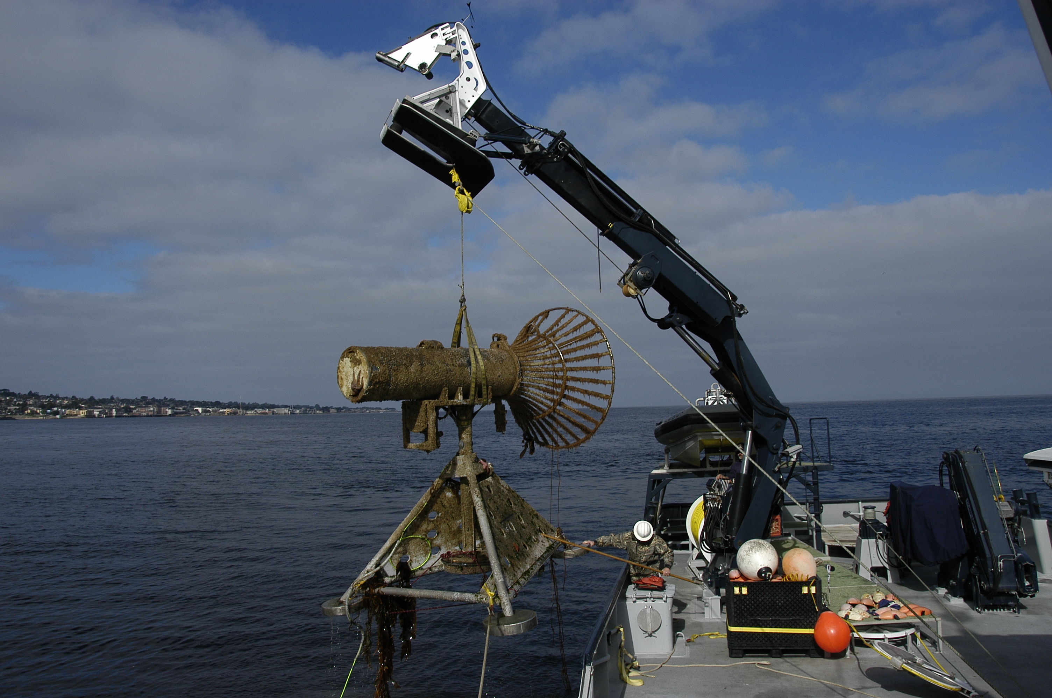
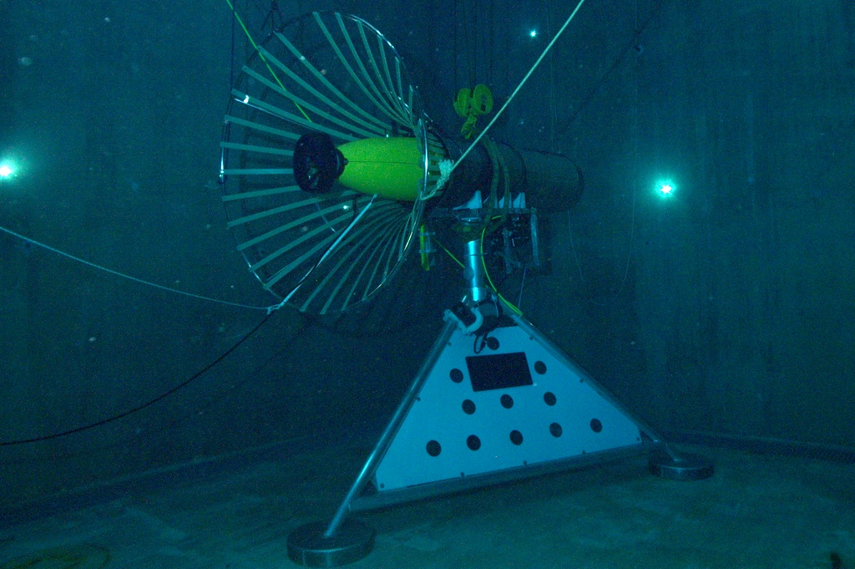
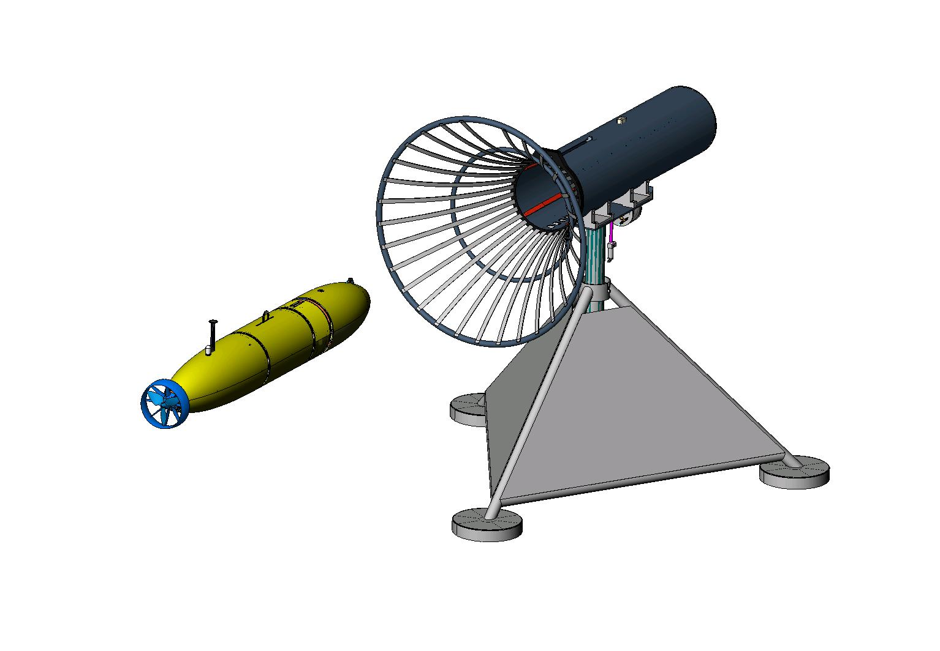
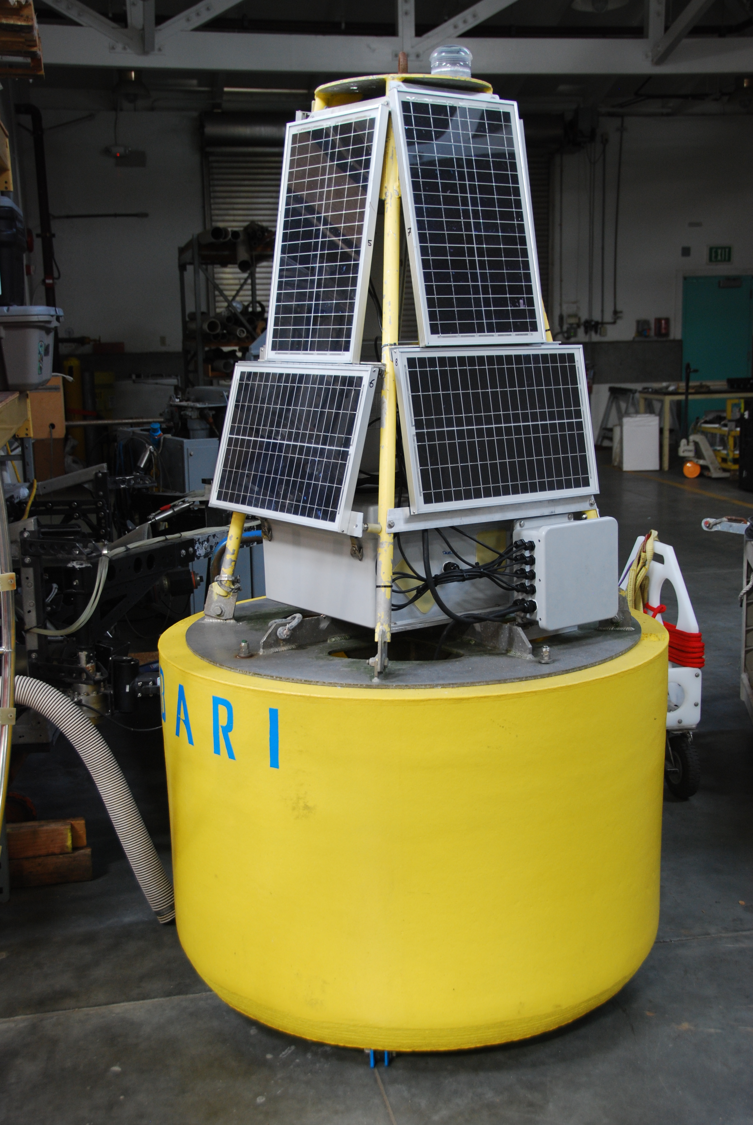
2007 MBARI Dock

Slide 12
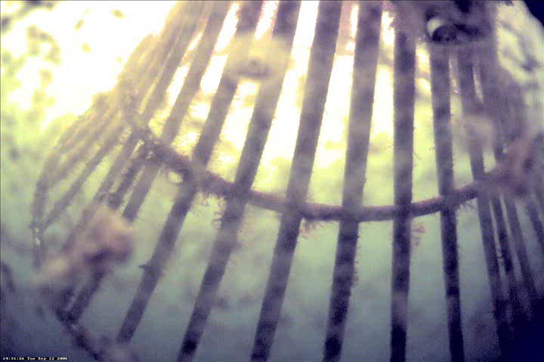
‘07 Docking Video
- plays during question period

Slide 13
End

Slide 14
Approach -2
Leverage previous work by MBARI and others
  MBARI’s AUV docking (2007), Bluefin, WHOI/Hydroid, General Atomics, SPAWAR
  Benthic Rover – 5 years of continuous (almost) operations at St.M
Build 2 AUVs
  Program 1: Pelagic Benthic Coupling and Carbon Cycling (Smith)
  Program 2 : 2019 mud-volcano monitoring in Arctic (Paull)

Slide 15
Docking State Transition Diagram
Flight
(Waypoints,
Setpoints)
Docking
Homing
Undocking
Stopped
Missed
Approach
Pin
Inserted
Electrical
Dock
Contact

Slide 16
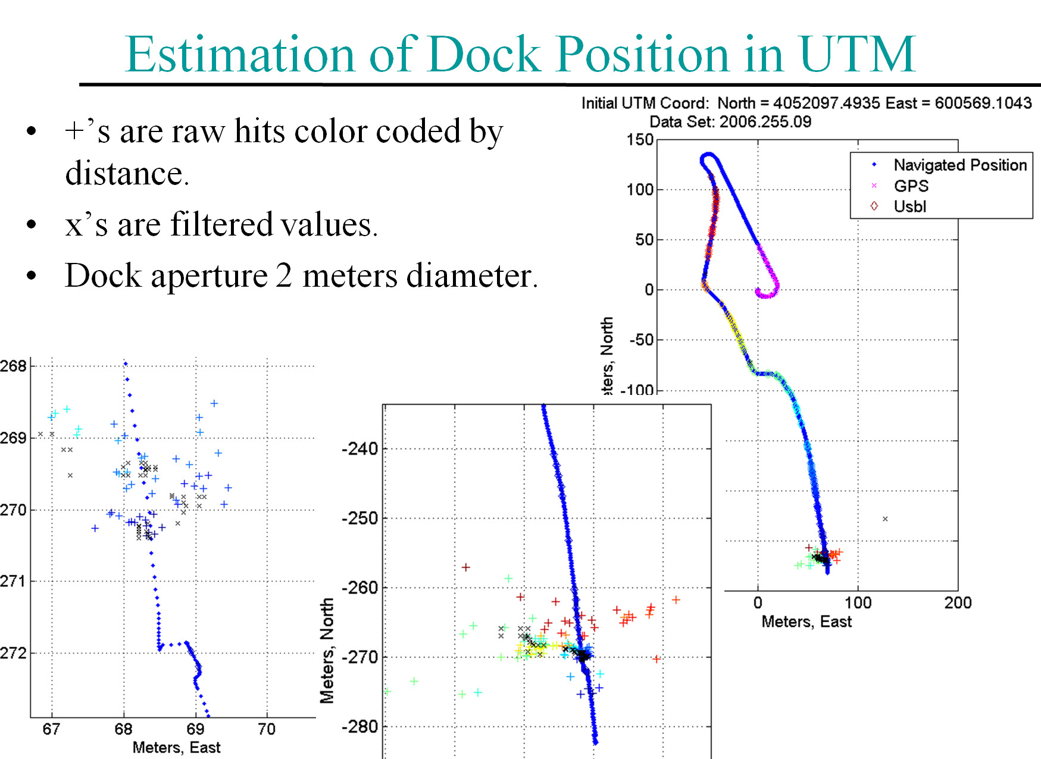

Slide 17
New Design elements
Must have
  Benthic payload.
  Docking system.
  Hibernation controller.
  Corrosion-free exterior.
  Extended duration s/w.
  Fail-safe aborts:
    when docked: stay docked.
    when undocked: park on seafloor.
Highly desirable
  Event-triggered response

Slide 18
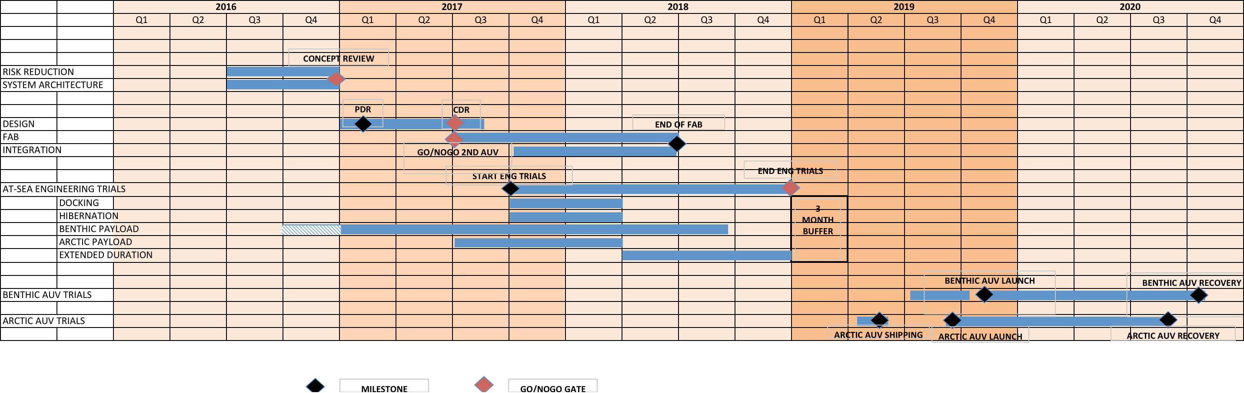
Timelines

Slide 19
WBS: see spreadsheet

Slide 20
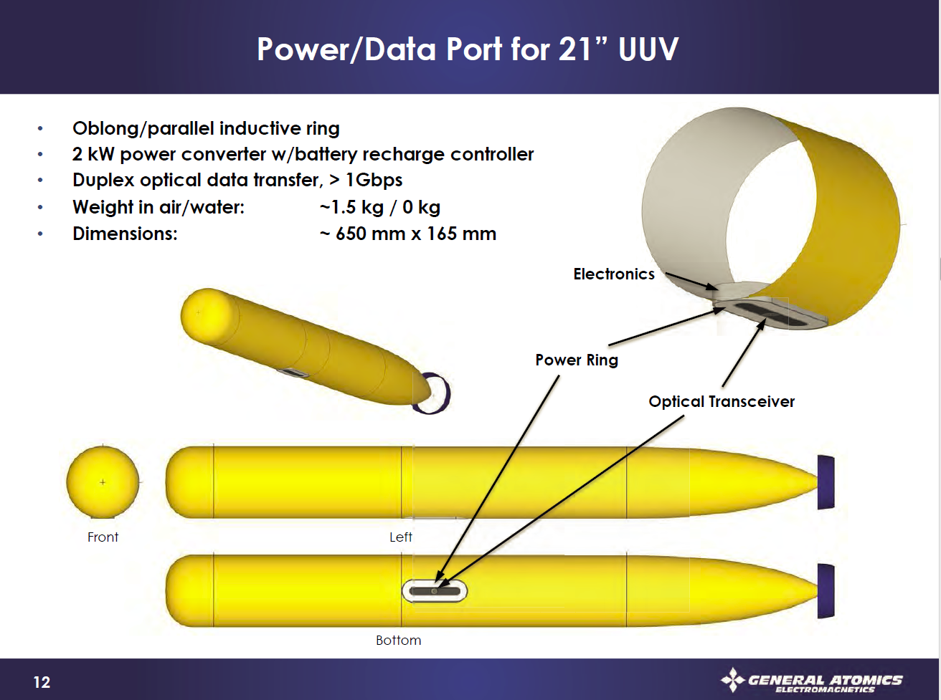
General Atomics - Notional

Slide 21
WPDX Medium Power Data Sheet
MBARI/Maughan
Power:
  150 Watt continuous, 240 Watt peak (1 hr), resonant transfer using PowerByProxi technology
  Voltage: 24v DC input and output
  Current: 6 Amp output
  Efficiency: ~75%
Data:
  100 Mbps ethernet
  Option RF: 2.4 GHz point to point Ubiquity Radio, 10mW nominal, adjustable to 600mW
  Option Optical: ‘work in progress’
0 to 5 mm separation (derated from 1cm to allow for potting thickness)

Slide 22
Block Diagram of What we want to build for MARS Toast goes in the Toaster
Input:
375v @ 2 amps
or
24v @ 30 amps
150W continuous
240W peak
Inrush Lim / 375 to 24v
Ethernet Switch / Status Mon
802.11 PtP Radio
Load Control / Mon
Resonant Power
Load Light

Slide 23
Backups

Slide 24
Park&Fly: Notional CONOPS
Arrive at site
Deploy the dock and LBL
Prep the AUV
Launch the AUV
Run first transect
Park
Parking verification
Depart site
AUV periodically parks and flies
  - At Station-M, could control from shore via wave-glider comm relay
Return to site
Recover AUV
Recover dock and LBL (minus anchor)

