Slide 1
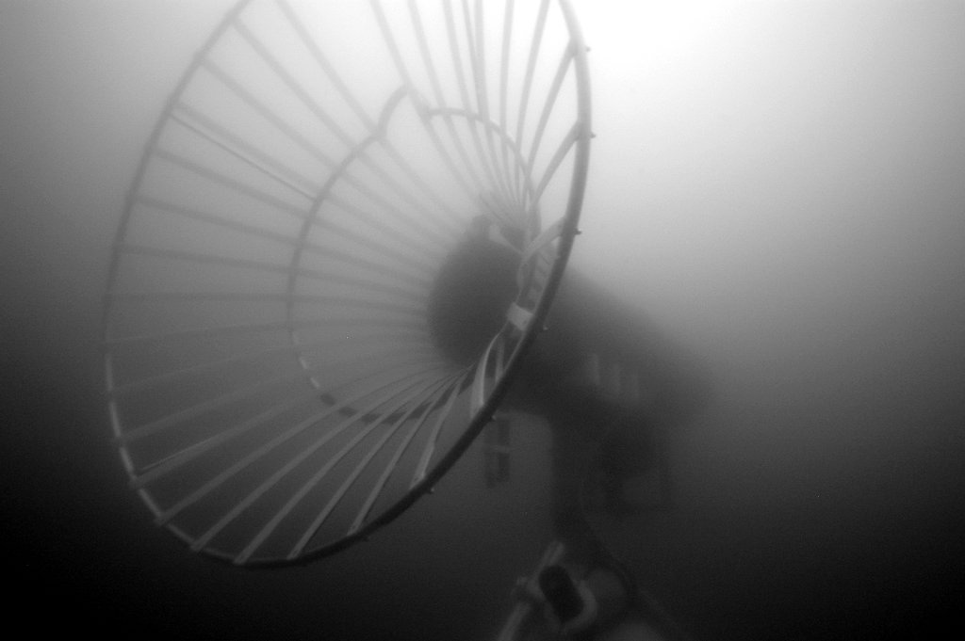
Park –n- Fly AUV
Project Team
PI: Ken Smith
Scientists: Ken Smith and Charlie Paull
Project Manager: Brett Hobson
Systems Engineer: Mathieu Kemp
AUV Engineer: Hans Thomas
Controls Engineer: Rob McEwen
EE: Scott Jensen, Paul McGill
SE: Kent Headley, Rich Henthorn
and Brian Kieft
ME: Jon Erickson, Brett Hobson

Slide 2
Abstract Feedback
Rating: Some possibility of support
MT contact: Doug
The concept of having a system that could provide long-term presence, repeat survey, and
event response is well aligned with MBARI’s future research and development
objectives. This system could enable many new and unique scientific investigations.
For your phase 1 proposal, consider the following comments:
The team should step back from a schedule that is being driven by science-deployment
deadlines. Develop a project plan that is well thought out and engineering-based. The
project plan should focus on the high-risk elements first and include go/no-go gates as
these elements are investigated. Much can be gained by making MBARI’s existing
Dorado class AUVs’ hardware and software more robust as a first step. Sufficient testing
should be scoped into this plan and timeline as well. This should include a long-duration
test equivalent to the planned deployment duration. We feel it is premature to plan on
building two vehicles in 2017.
Finally, we note that the project team members are part of several large proposals for
2017 and beyond. The group should consider the timing and scope of each of these
efforts and provide a realistic high-level plan that includes priorities and timing of these
efforts to yield a more integrated and staged development prospectus.

Slide 3
Feedback Conclusions
Drop the 2019 deployments as milestones
  Unless ready
Technology development drives the schedule
Focus on high-risk elements
Improve Dorado reliability
Lots of testing
  Including 1 year test before science deployment
Don’t pitch to build two vehicles in 2017 (no plans)
Coordinate with other projects
  Slow burn verses priority project: 5 year project

Slide 4
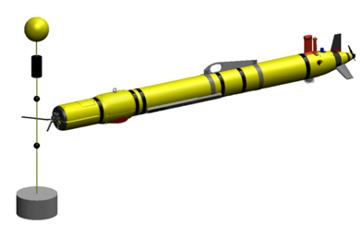
Hydroid Line Capture System
COTS (?)
Can we just buy the components, or even a complete nose section?
Can the existing system be used on a Dorado (~2x mass of Remus 600)?
Hydroid showed a path to full docking with power and data Tx
  Complicated
Bluecom or A-comms for data

Slide 5
Notional Vehicle
float
corrosion-free exterior
Data Transfer
USBL transponder
Data Transfer
Avtrak
(track&comms)
Cable Latch
nose
battery
science payload
control
Whiskers
emergency scuttle
INS/DVL
hibernation controller
iUSBL Homing Sensor
acoustic release
trigger:
a-modem (benthic)
eruption detector (arctic)
anchor

Slide 6
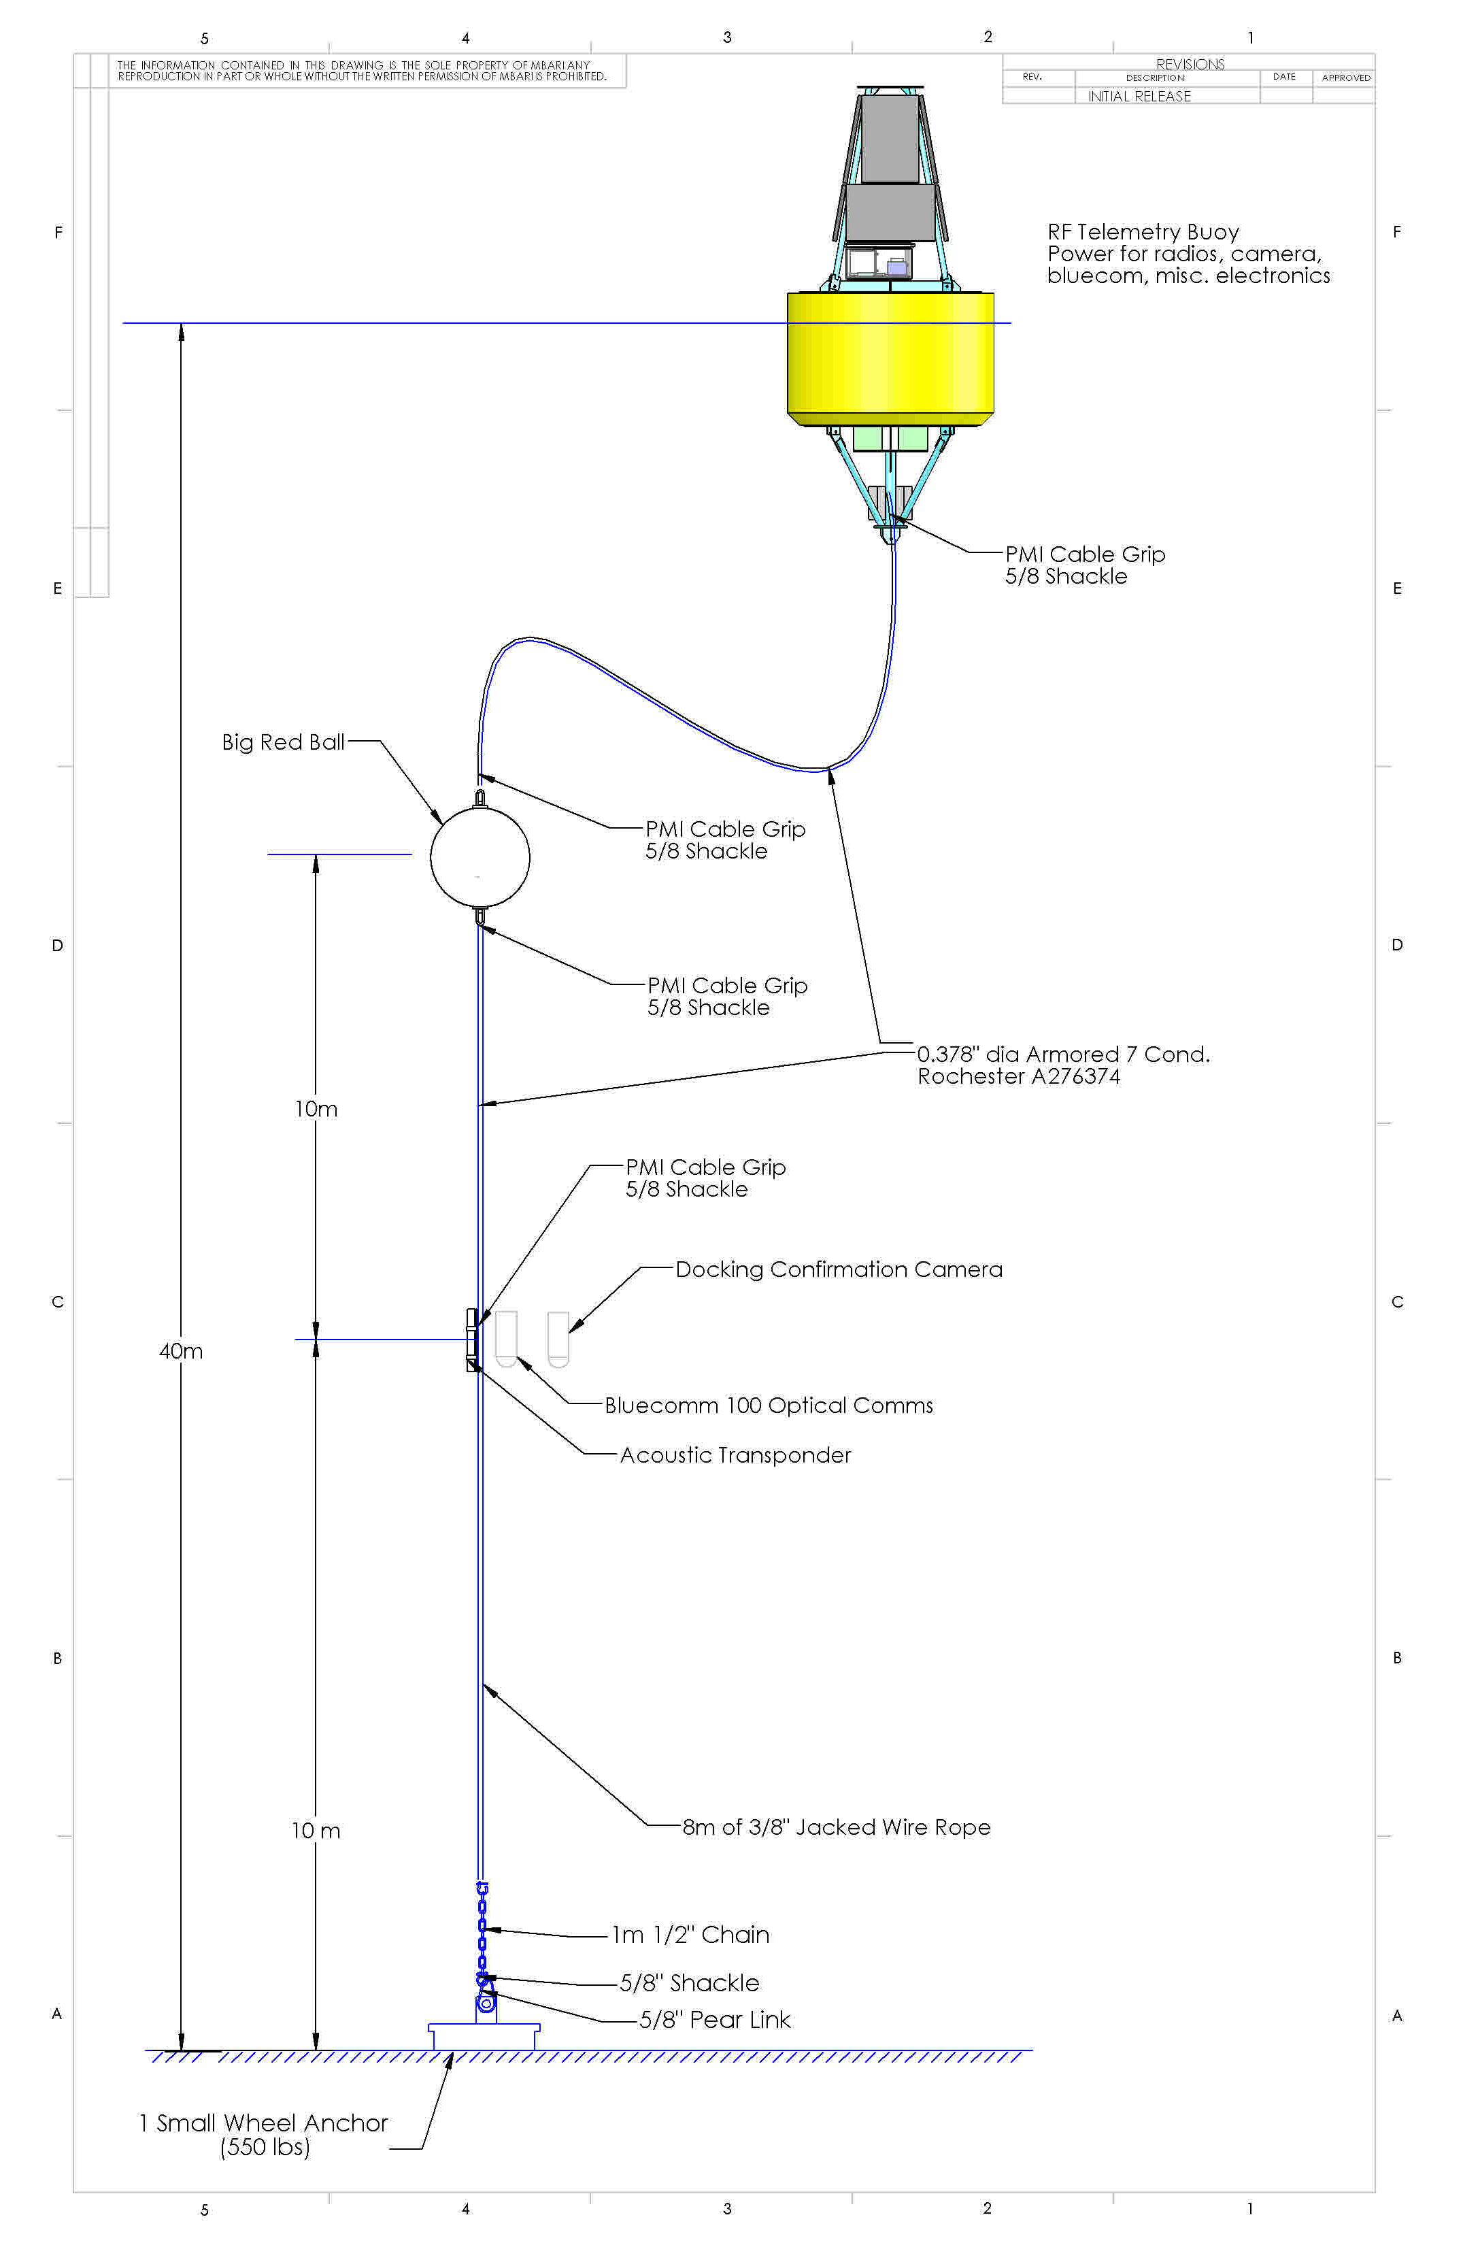
Test Dock for offshore MBARI
Line-capture docking
High bandwidth comms to MBARI
  <4 nmi
Homing beacon
Live camera feed to validate
Data transfer device

Slide 8
Park & Fly AUV – Abstract
Develop the capability for a persistent presence in the deep ocean
Conduct seasonal, seafloor imaging and bioacoustics surveys at Station-M. Without a ship.
Conduct seasonal, seafloor mapping with sidescan and multi-beam sonars to investigate the geologic evolution of mud volcanoes in the Arctic. Without a ship. For one year. Under the ice.

Slide 9
Near-term opportunities
Benthic AUV (Ken)
4 deep transects in 12 months.
Sample w/down-looking camera one way, Bioacoustics on return.
Highly desirable: Event-triggered response.
Arctic AUV (mud volcanoes, Charlie)
6 under-ice surveys in 12 months
MBES & SSS
Highly desirable: Event-triggered response.
Ship date: April 2019
Notes
Camera: low-altitude / low-speed
Trigger: a-comms from sediment event sensor.
Notes
300m<D< 750m depending on volcano
Trigger: sound-pressure level from eruption.

Slide 10
Approach
Stretch our routine AUV operation from a continuous run over 17 hours to ~four 3-hours missions spaced over one year
Park the AUV between missions and put it to sleep
An independent controller wakes the AUV up, runs the checklist, starts the mission and monitors for problems. If the AUV cannot get back to the dock, just sink to the seafloor and wait for help
Optionally enable event response by allowing a remote or local trigger the deployments remotely or locally for event response

Slide 11
Abstract Feedback
Rating: Some possibility of support
MT contact: Doug
The concept of having a system that could provide long-term presence, repeat survey, and
event response is well aligned with MBARI’s future research and development
objectives. This system could enable many new and unique scientific investigations.
For your phase 1 proposal, consider the following comments:
The team should step back from a schedule that is being driven by science-deployment
deadlines. Develop a project plan that is well thought out and engineering-based. The
project plan should focus on the high-risk elements first and include go/no-go gates as
these elements are investigated. Much can be gained by making MBARI’s existing
Dorado class AUVs’ hardware and software more robust as a first step. Sufficient testing
should be scoped into this plan and timeline as well. This should include a long-duration
test equivalent to the planned deployment duration. We feel it is premature to plan on
building two vehicles in 2017.
Finally, we note that the project team members are part of several large proposals for
2017 and beyond. The group should consider the timing and scope of each of these
efforts and provide a realistic high-level plan that includes priorities and timing of these
efforts to yield a more integrated and staged development prospectus.

Slide 12
Feedback Conclusions
Drop the 2019 deployments as milestones
  Unless ready
Technology development drives the schedule
Focus on high-risk elements
Improve Dorado reliability
Lots of testing
  Including 1 year test before science deployment
Don’t pitch to build two vehicles in 2017 (no plans)
Coordinate with other projects
  Slow burn verses priority project: 5 year project

Slide 13
Hydroid Line Capture System
COTS (?)
Can we just buy the components, or even a complete nose section?
Can the existing system be used on a Dorado (~2x mass of Remus 600)?
Hydroid showed a path to full docking with power and data Tx
  Complicated
Bluecom or A-comms for data

Slide 14
Notional Vehicle
float
corrosion-free exterior
USBL transponder
Avtrak
(track&comms)
iUSBL Homing Sensor
AUV Dock
nose
battery
science payload
control
emergency scuttle
INS/DVL
hibernation controller
Data & Opt.
Power
Transfer
acoustic release
trigger:
a-modem (benthic)
eruption detector (arctic)
Opt. LBL (x4)
anchor

Slide 15
Notional Vehicle
float
corrosion-free exterior
Data Transfer
USBL transponder
Data Transfer
Avtrak
(track&comms)
Cable Latch
nose
battery
science payload
control
Whiskers
emergency scuttle
INS/DVL
hibernation controller
iUSBL Homing Sensor
acoustic release
trigger:
a-modem (benthic)
eruption detector (arctic)
anchor

Slide 16
Test Dock for offshore MBARI
Line-capture docking
High bandwidth comms to MBARI
  <4 nmi
Homing beacon
Live camera feed to validate
Data transfer device

Slide 17
What are the Risk elements?
Schedule (arctic AUV 2019 launch window)
Environmental exposure
Long-duration
Robust docking/undocking
Software reliability & error-handling
Testing long mission in a short time
Cannot monitor AUV status
Cost and # of operational assets

Slide 18
Risk Reduction
Risk | Approach
Schedule | Address high risk ASAP Go/NoGo gates Postpone deployment
Long-term environmental exposure | all Ti/plastic/FRP larger oil reserve / testing
Long-duration | Independent hibernation controller battery chemistry: trade study
Robust docking | Lots of testing
S/W reliability and error-handling | Test and fix - early
Testing long-duration in short time | see Test Sequence
No AUV status | WG for St. M, fail-safe mission abort

Slide 19
Why we think this is Do-able
Strong fleet of Dorado vehicles, spares and operational know-how
Dorado docking success in 2007, and efforts at Bluefin, WHOI/Hydroid and SPAWAR
Long-term deployment of the Benthic Rover
Industrial partnerships (motivated to ensure our success) with Sonardyne (homing), Bluefin, General Atomics (power/data transfer, batteries, homing)

Slide 20
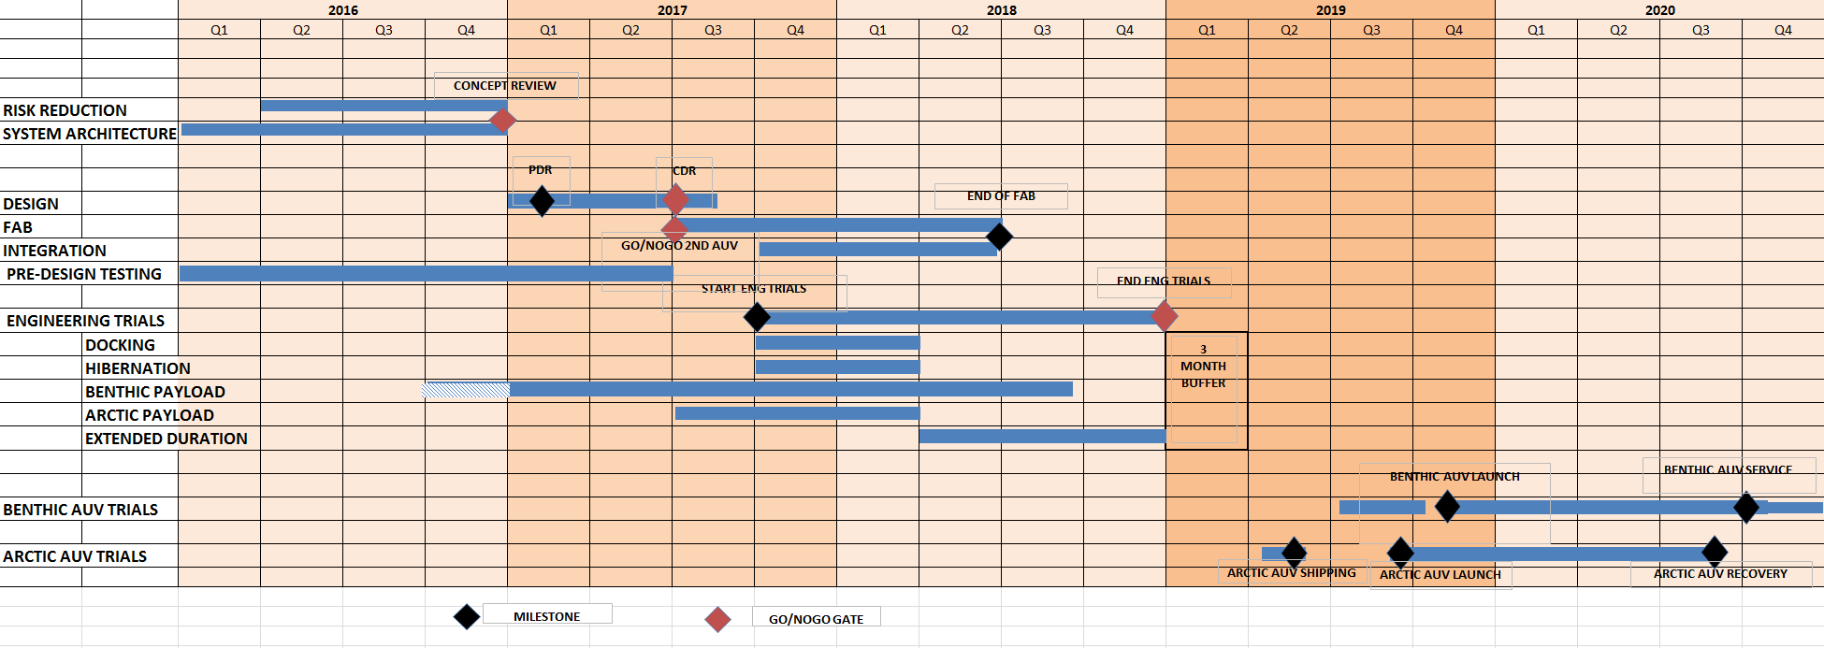
schedule
NOW:
  SYSTEM DESIGN, SYNTACTIC FOAM & BATTERY TESTING
SOON:
  COMPUTER S/W & H/W EVAL, BENTHIC PAYLOAD DEVELOPMENT, CONCEPT DESIGN REVIEW
NEXT YEAR:
  DETAILED DESIGN, TEST VEHICLE BUILD, DOCK BUILD, NEARSHORE DOCK TESTING
2018:
  PRODUCTION VEHICLE BUILD, MORE NEARSHORE TESTING FOLLOWED BY MARS TESTING AND 3-MONTH TEST DEPLOYMENT

Slide 21
Estimated Resources
year | labor | expense | ship time
2016 | Brett: +3 weeks, Andy: 2 week Rob: +2 weeks Hans: + 2 weeks MK: 1 day/week | $1.1k
2017 | 3-4 FTEs: design/fab/testing | $100k | 10 days
2018 | 3-4 FTEs: fab/assembly/at-sea testing | $ 800k 2 AUVs | 10 days
2019 | 2 deployments |  | 5 days (contingency)
2020 | 2 recoveries |  | n/a

Slide 22
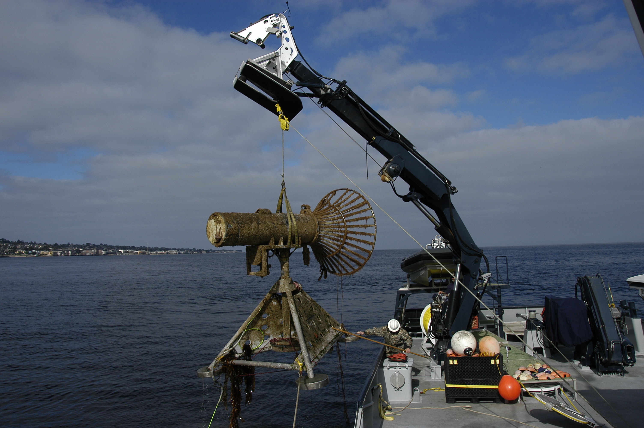
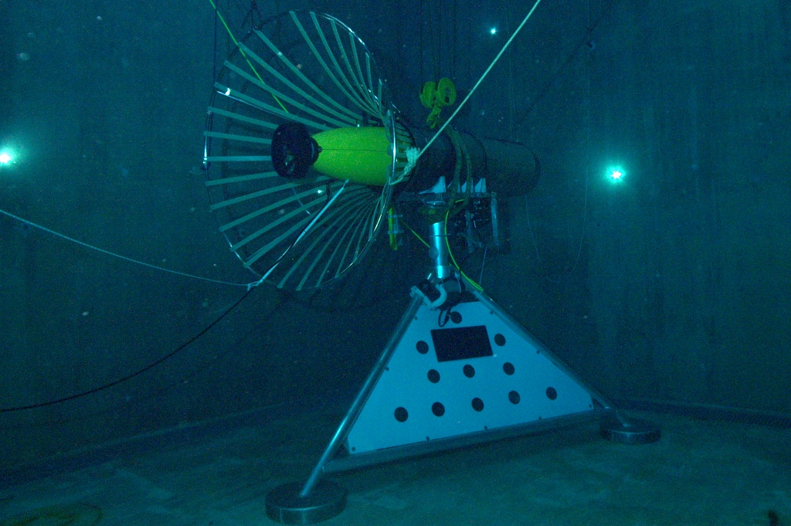
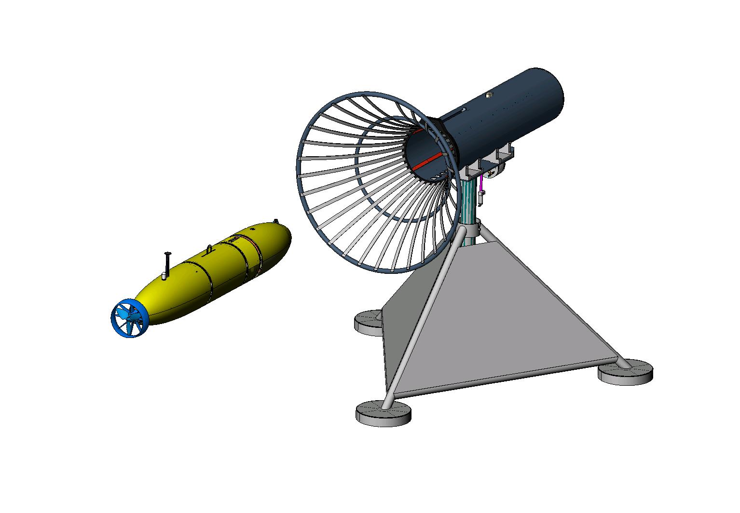
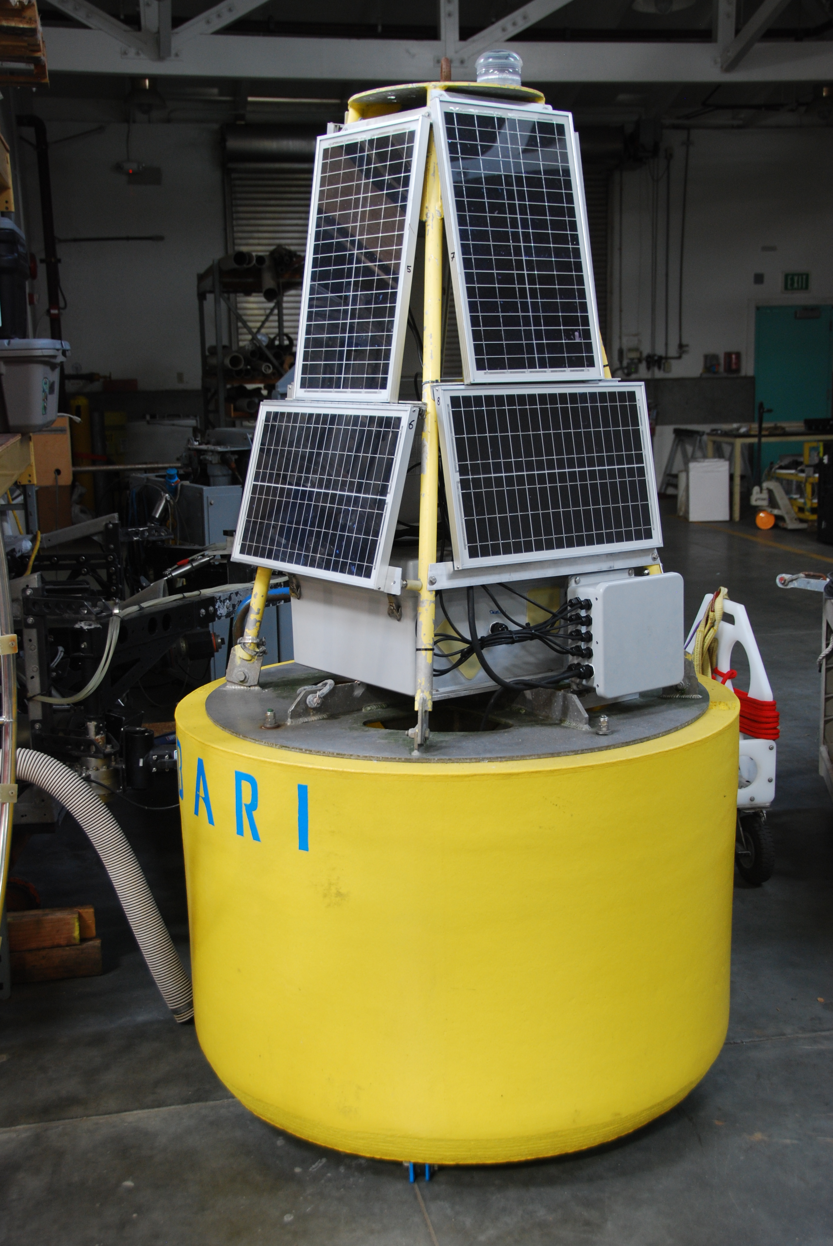
Existing MBARI Dock

Slide 23
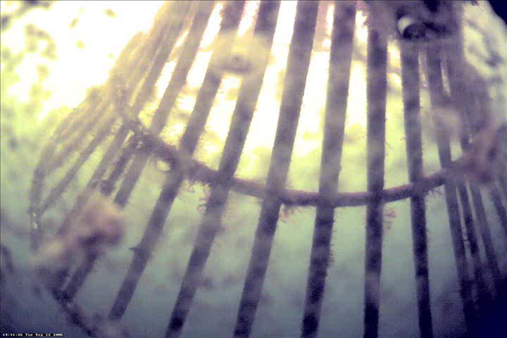
‘07 Docking Video
- plays during question period

Slide 24
End

Slide 25
Backups

Slide 26
Park&Fly: Notional CONOPS
Arrive at site
Deploy the dock and LBL
Prep the AUV
Launch the AUV
Run first transect
Park
Parking verification
Depart site
AUV periodically parks and flies
  - At Station-M, could control from shore via wave-glider comm relay
Return to site
Recover AUV
Recover dock and LBL (minus anchor)

Slide 27
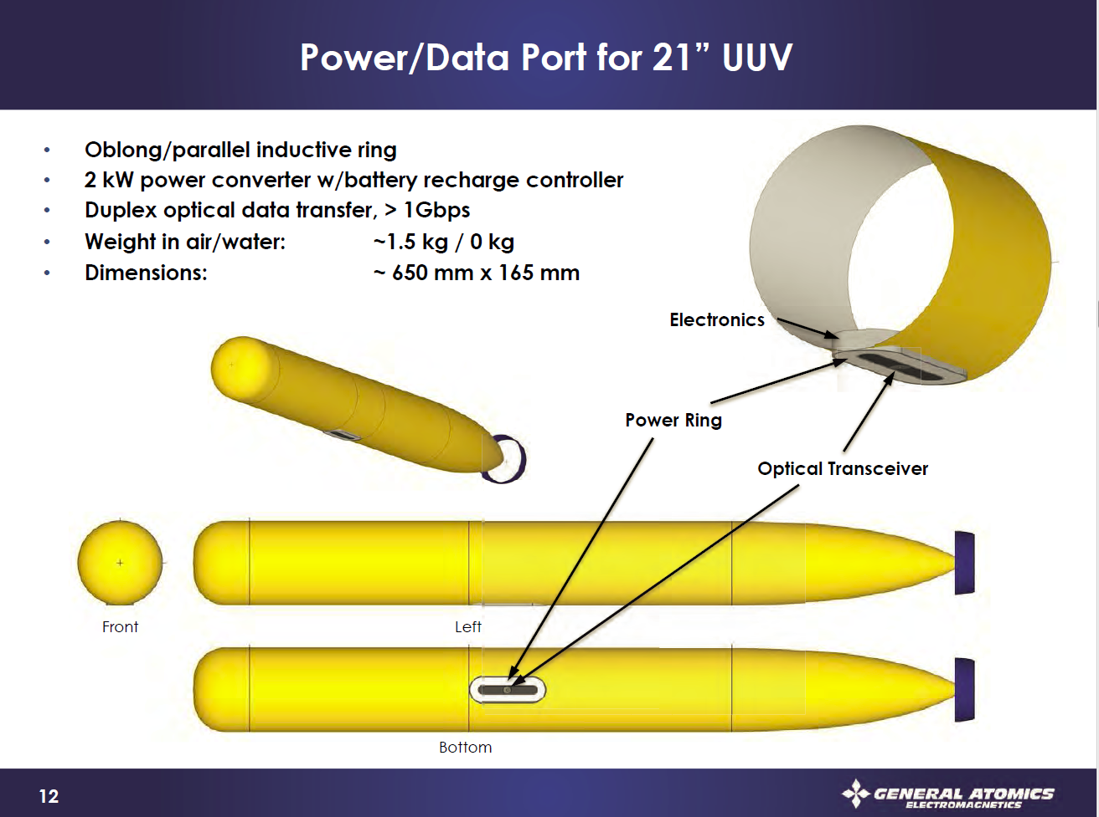
General Atomics - Notional

Slide 28
WPDX Medium Power Data Sheet
MBARI/Maughan
Power:
  150 Watt continuous, 240 Watt peak (1 hr), resonant transfer using PowerByProxi technology
  Voltage: 24v DC input and output
  Current: 6 Amp output
  Efficiency: ~75%
Data:
  100 Mbps ethernet
  Option RF: 2.4 GHz point to point Ubiquity Radio, 10mW nominal, adjustable to 600mW
  Option Optical: ‘work in progress’
0 to 5 mm separation (derated from 1cm to allow for potting thickness)

Slide 29
Block Diagram of What we want to build for MARS Toast goes in the Toaster
Input:
375v @ 2 amps
or
24v @ 30 amps
150W continuous
240W peak
Inrush Lim / 375 to 24v
Ethernet Switch / Status Mon
802.11 PtP Radio
Load Control / Mon
Resonant Power
Load Light

