Slide 1
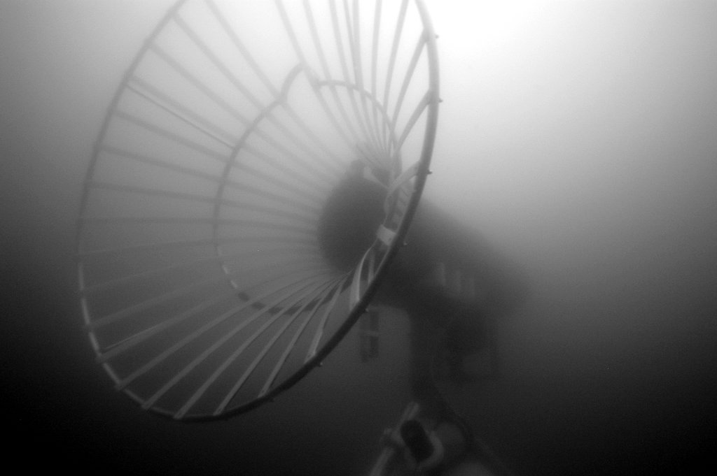
Park –n- Fly AUV
Project Team
PI: Ken Smith
Scientists: Ken Smith and Charlie Paull
Project Manager: Brett Hobson
Systems Engineer: Mathieu Kemp
AUV Engineer: Hans Thomas
Controls Engineer: Rob McEwen
EE: Scott Jensen, Paul McGill
SE: Kent Headley, Rich Henthorn
and Brian Kieft
ME: Jon Erickson, Brett Hobson

Slide 2
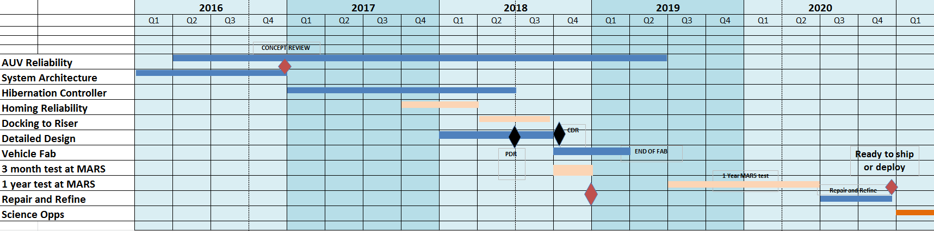

Slide 3
Notional Vehicle
float
corrosion-free exterior
Data Transfer
USBL transponder
Data Transfer
Avtrak
(track&comms)
Cable Latch
nose
battery
science payload
control
Whiskers
emergency scuttle
INS/DVL
hibernation controller
iUSBL Homing Sensor
acoustic release
trigger:
a-modem (benthic)
eruption detector (arctic)
anchor

Slide 4
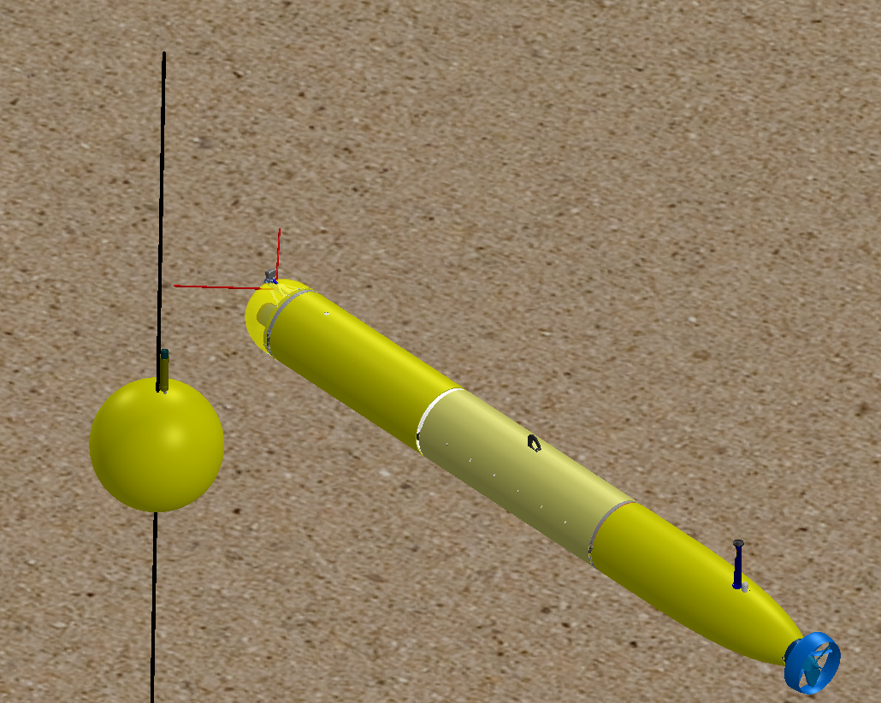

Slide 5
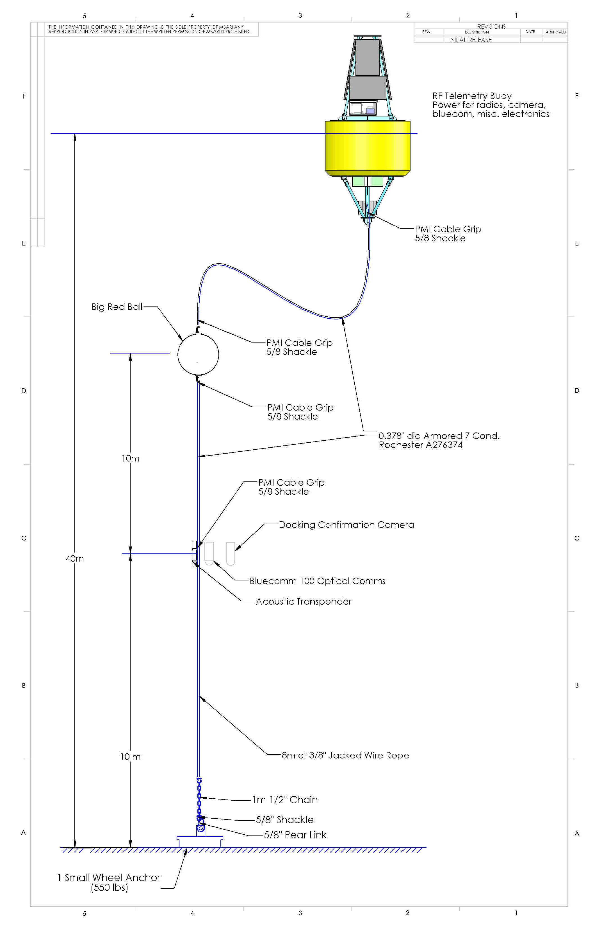
Test Dock for offshore MBARI
Line-capture docking
High bandwidth comms to MBARI
  <4 nmi
Homing beacon
Live camera feed to validate
Data transfer device

Slide 6
Park & Fly AUV – Abstract
Develop the capability for a persistent presence in the deep ocean
Conduct seasonal, seafloor imaging and bioacoustics surveys at Station-M. Without a ship.
Conduct seasonal, seafloor mapping with sidescan and multi-beam sonars to investigate the geologic evolution of mud volcanoes in the Arctic. Without a ship. For one year. Under the ice.

Slide 7
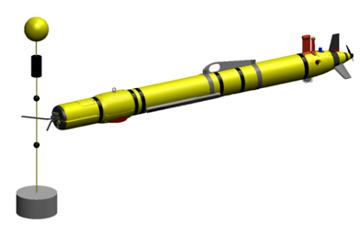
Hydroid Line Capture System
COTS (?)
Can we just buy the components, or even a complete nose section?
Can the existing system be used on a Dorado (~2x mass of Remus 600)?
Hydroid showed a path to full docking with power and data Tx
  Complicated
Bluecom or A-comms for data

Slide 8
Notional Vehicle
float
corrosion-free exterior
Data Transfer
USBL transponder
Data Transfer
Avtrak
(track&comms)
Cable Latch
nose
battery
science payload
control
Whiskers
emergency scuttle
INS/DVL
hibernation controller
iUSBL Homing Sensor
acoustic release
trigger:
a-modem (benthic)
eruption detector (arctic)
anchor

Slide 9
Test Dock for offshore MBARI
Line-capture docking
High bandwidth comms to MBARI
  <4 nmi
Homing beacon
Live camera feed to validate
Data transfer device

Slide 10
Estimated Resources
year | labor | expense | ship time
2016 | Brett: +3 weeks, Andy: 2 week Rob: +2 weeks Hans: + 2 weeks MK: 1 day/week | $1.1k
2017 | 3-4 FTEs: design/fab/testing | $100k | 10 days
2018 | 3-4 FTEs: fab/assembly/at-sea testing | $ 800k 2 AUVs | 10 days
2019 | 2 deployments |  | 5 days (contingency)
2020 | 2 recoveries |  | n/a

Slide 11
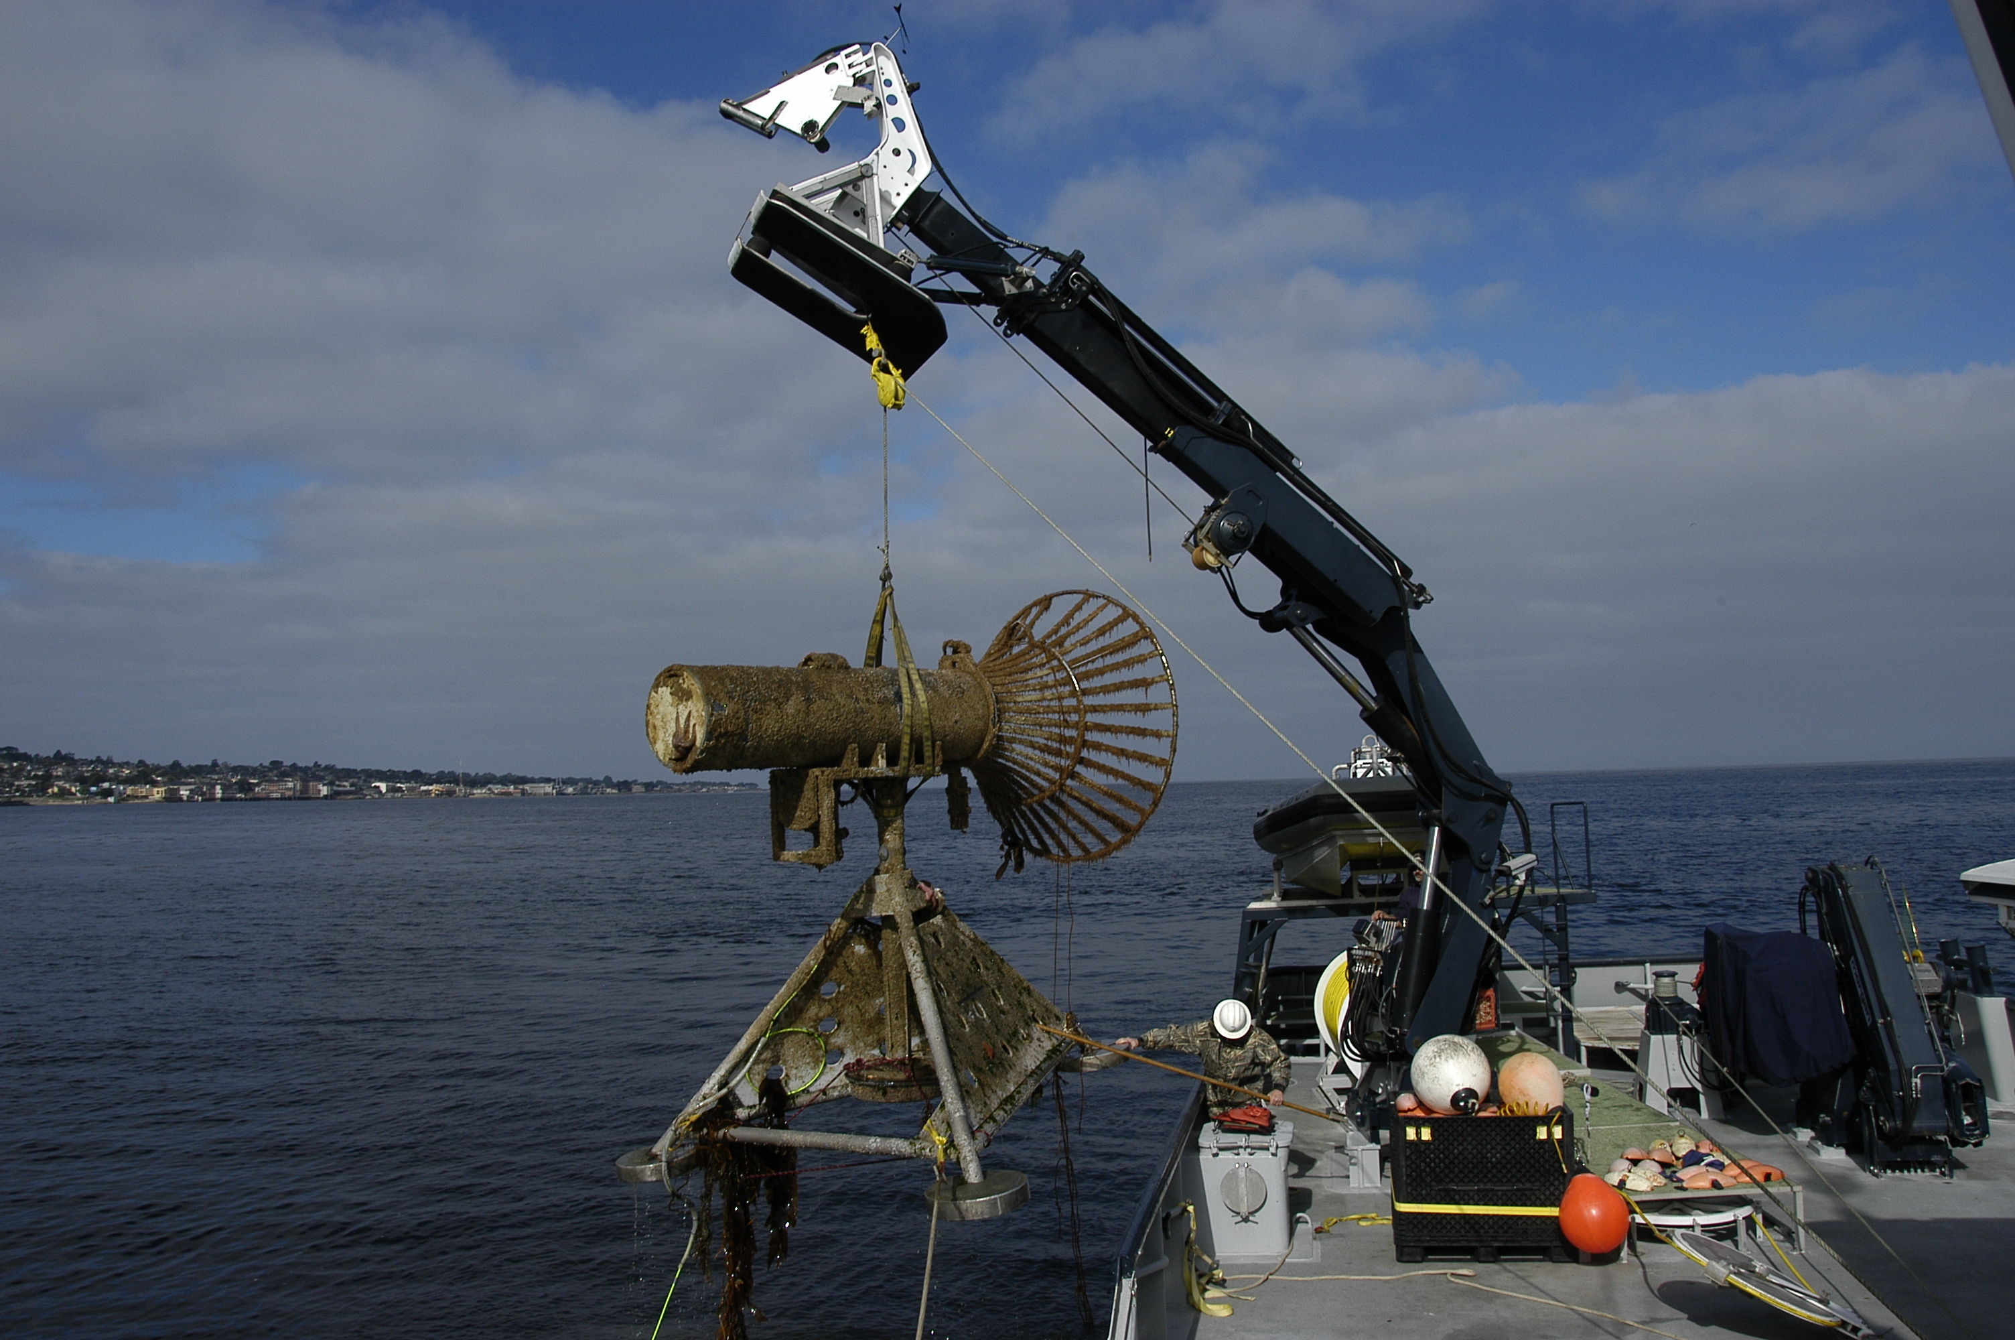
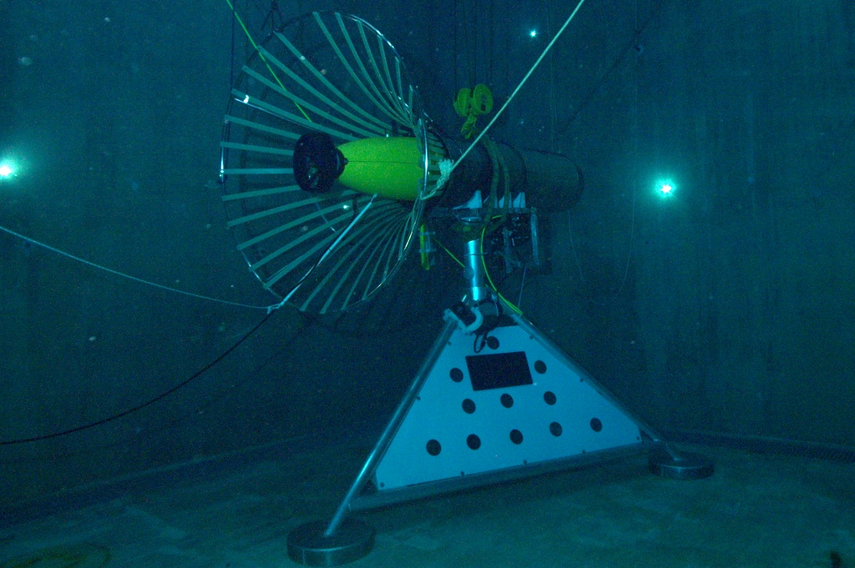
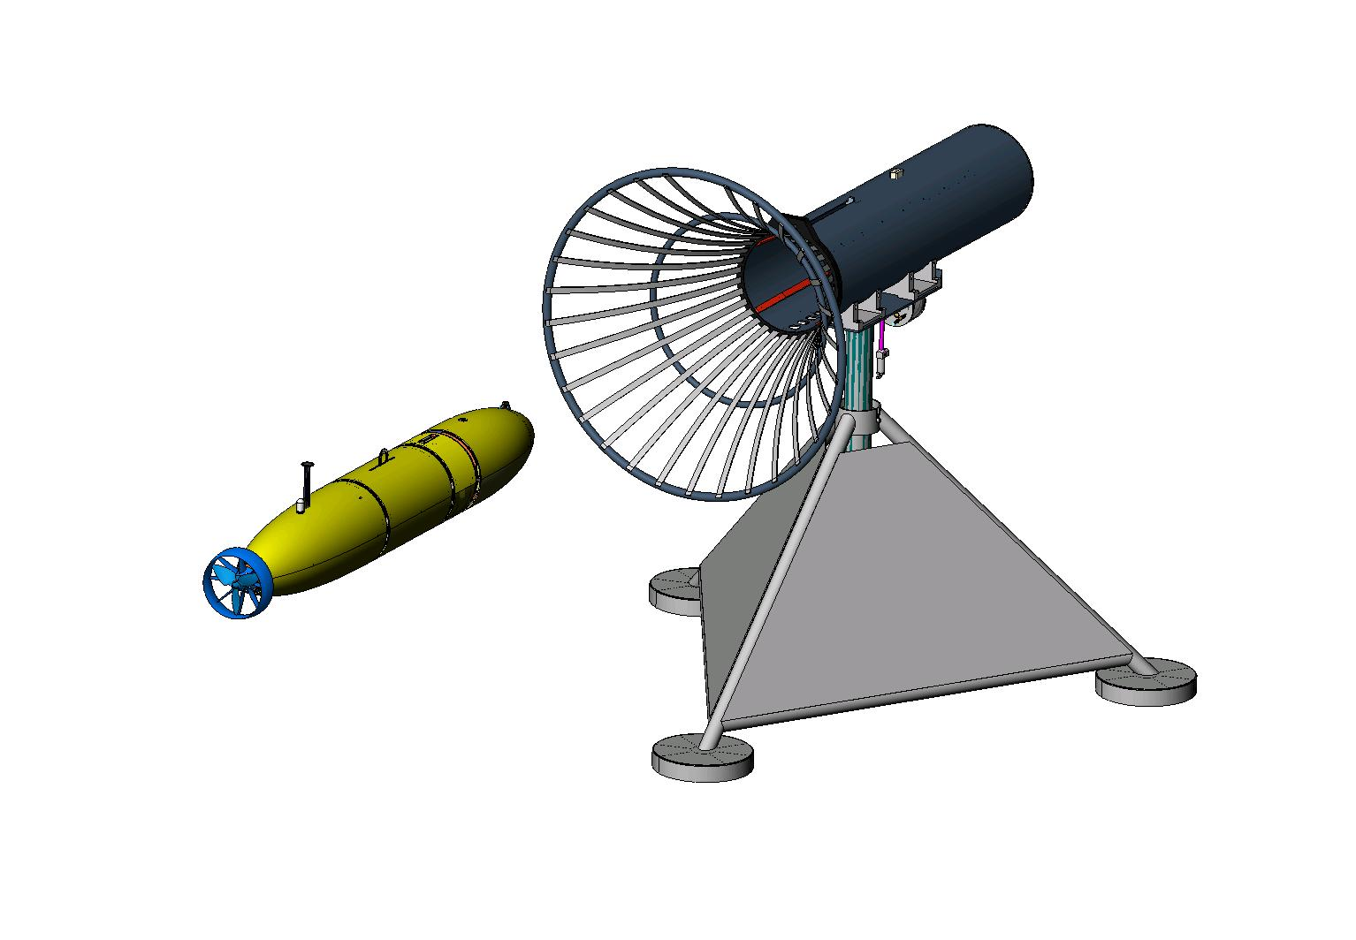
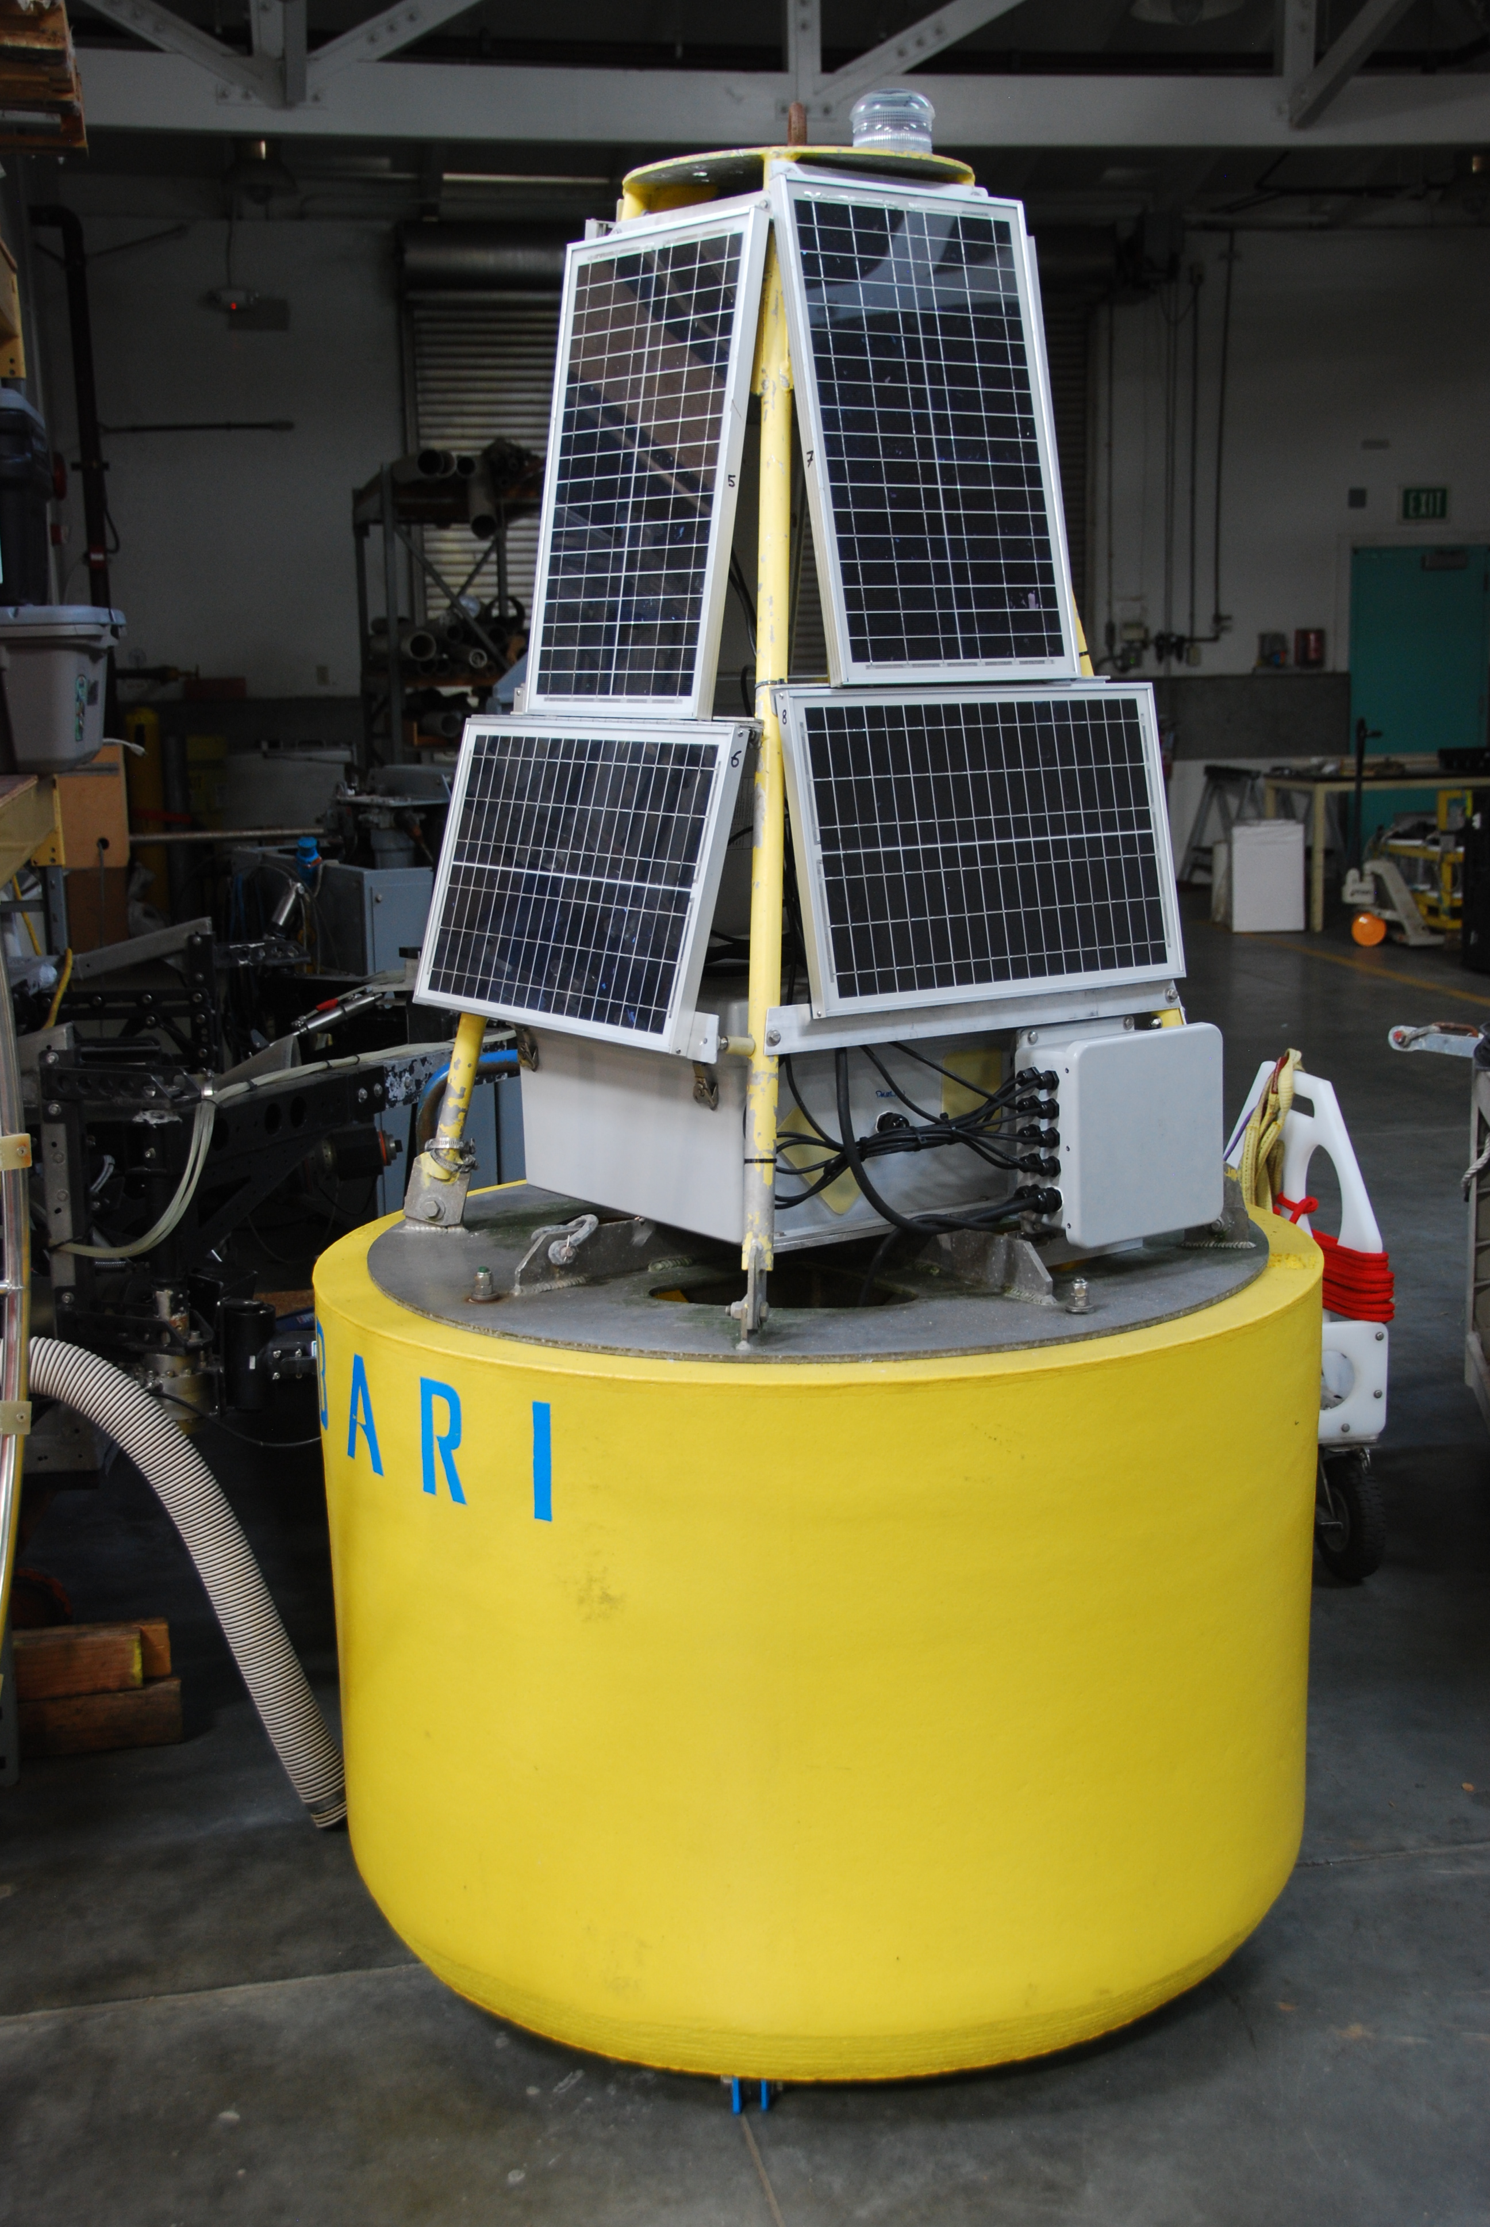
Existing MBARI Dock

Slide 12
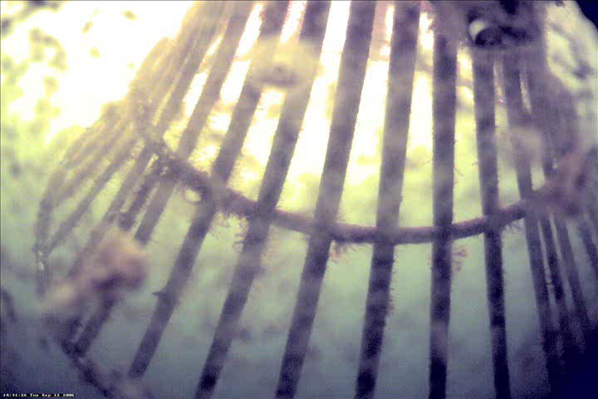
‘07 Docking Video
- plays during question period

Slide 13
End

Slide 14
Backups

Slide 15
Park&Fly: Notional CONOPS
Arrive at site
Deploy the dock and LBL
Prep the AUV
Launch the AUV
Run first transect
Park
Parking verification
Depart site
AUV periodically parks and flies
  - At Station-M, could control from shore via wave-glider comm relay
Return to site
Recover AUV
Recover dock and LBL (minus anchor)

Slide 16
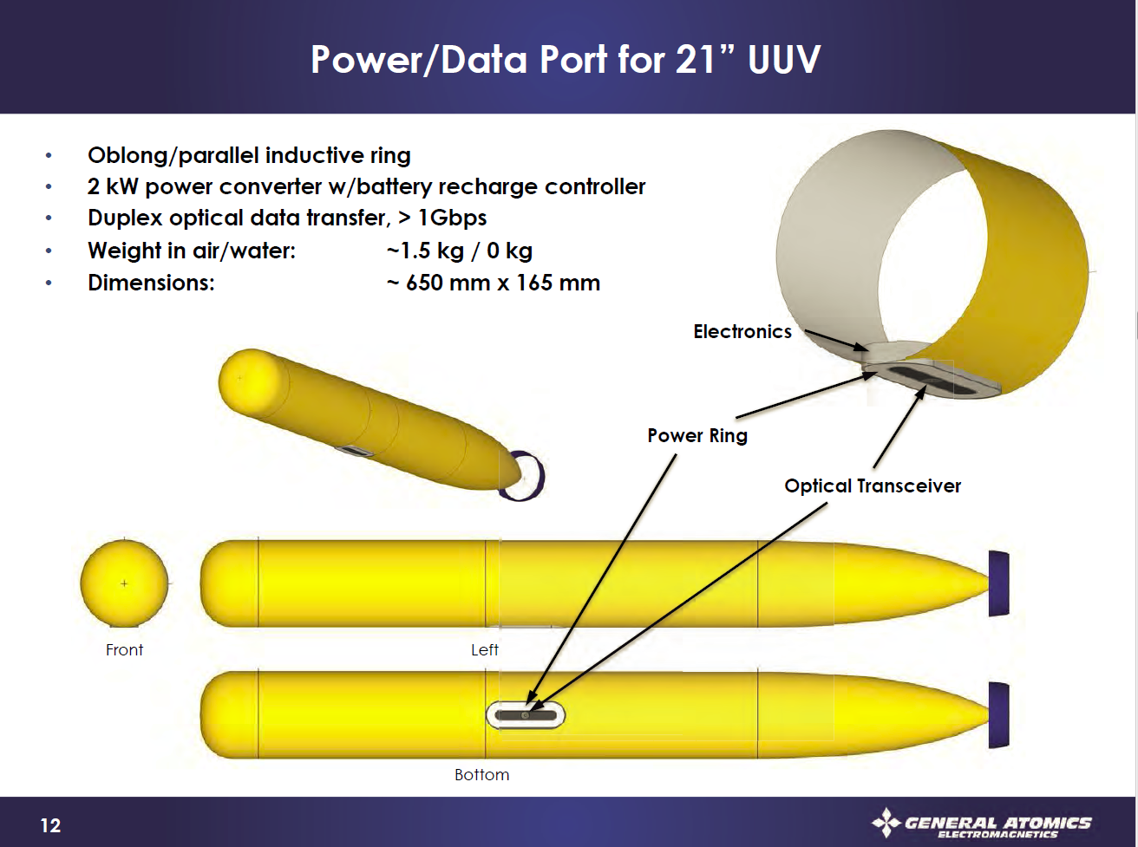
General Atomics - Notional

Slide 17
WPDX Medium Power Data Sheet
MBARI/Maughan
Power:
  150 Watt continuous, 240 Watt peak (1 hr), resonant transfer using PowerByProxi technology
  Voltage: 24v DC input and output
  Current: 6 Amp output
  Efficiency: ~75%
Data:
  100 Mbps ethernet
  Option RF: 2.4 GHz point to point Ubiquity Radio, 10mW nominal, adjustable to 600mW
  Option Optical: ‘work in progress’
0 to 5 mm separation (derated from 1cm to allow for potting thickness)

Slide 18
Block Diagram of What we want to build for MARS Toast goes in the Toaster
Input:
375v @ 2 amps
or
24v @ 30 amps
150W continuous
240W peak
Inrush Lim / 375 to 24v
Ethernet Switch / Status Mon
802.11 PtP Radio
Load Control / Mon
Resonant Power
Load Light

