Slide 1
Transducer Set One
(currently being worked on)
Near Transducer Connectors
(Subconn Micro Circular 10pin?)
Souriau Connectors About 60ft from Transducer
Souriau Connectors 20ft from Transducer
Original Amphenol Connector
38
18ft (20ft Ducer to Connector
About 40ft
1ft ?
2ft ?
Possible Future Work
Completed
Completed
Completed
To Be Done
70
Same as above
Transducer Head and Frequency
120
Same as above
200
Same as above
333
Same as above
Bulgin Mini 2 Pin
About 20ft
Ground Cable
Bare Wire

Slide 2
Transducer Set Two
Near Transducer Connectors
(Subconn Micro Circular 10pin?)
Souriau Connectors 20ft from Transducer
38
18ft (20ft Ducer to Connector
2ft ?
Possible Future Work
To Be Done
70
Same as above
Transducer Head and Frequency
120
Same as above
200
Same as above
Bare Wire
Bulgin Mini 2 Pin
60 to 65 ft
Ground Cable

Slide 3
Deep Rated Transducers
Near Transducer Connectors
(Burton connector removed and Subconn Micro Circular 8pin 2ft pigtail spliced on as a replacement)
70
Completed
7ft
120
Completed
7ft
Subconn Micro Circular 8pin 2ft pigtail spliced to standard transducer cable
Souriau Connectors 20ft from Transducer
333
To Be Done
To Be Done
7ft
13ft

Slide 4
Extra Ducers and Cable Adapters
Souriau connector to plug into transceiver box
70
Intended to use for test calibrations in tank
Subconn MCIL8F
(pigtail)
Souriau connector to plug into transceiver box
Intended to use for test calibrations in tank
(will we need this one or are there other options?)
About 40ft
(left over cable from transducer set 2 cuts?)
Near Transducer Connector
(Subconn Micro Circular 10pin?)
Near topside transceiver connection
(Souriau Connector)
40 to 60ft ???
Possible Future Work

Slide 5
Transducer Cable Work Phases
Partial work on transducer set #1 (completed)
  New 20ft from transducer connectors (Souriau connectors)
  New 40ft extension cables with new Souriau connectors
  Ground cable
Partial work on transducer set #2
  New 20ft from transducer connectors (Souriau connectors – Male 10pin)
    4 transducers total
  New longer ground cable with Bulgin Mini connector (40 to 60ft?)
Deep rated 333kHz
  Remove Burton connector and splice on 8 pin Male Subconn connector (MCIL8M)
  Make Subconn to Souriau connector extention – 8 pin Female Subconn to 10 pin male Souriau
Make Souriau to Amphenol adapters
  5 total
Add Souriau connector (male 10 pin) to end of extra 70kHz transducer
Make Subconn MCIL8F to Souriau extension cable
  For in tank calibration tests
  Utilize left over cable from transducer set #2 cuts
    Can be full length of remaining cable from on of the transducers which should end up being about 40+ ft
Priority work for middle of June Rachel Carson cruises

Slide 6
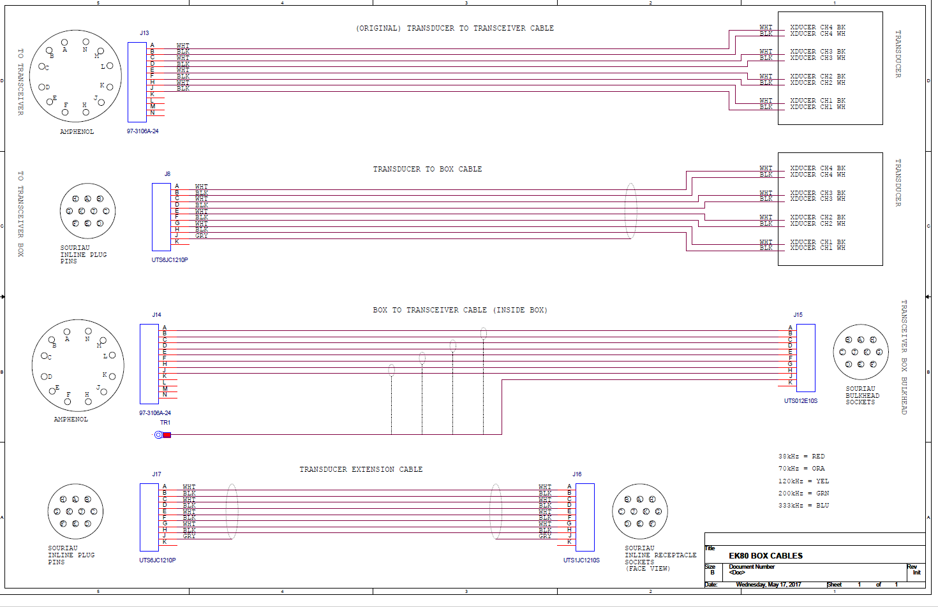

Slide 7
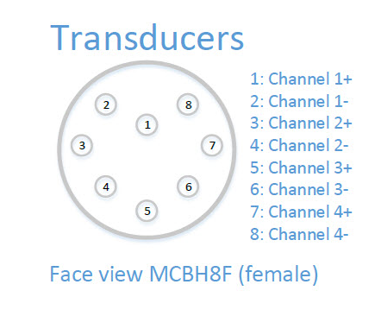
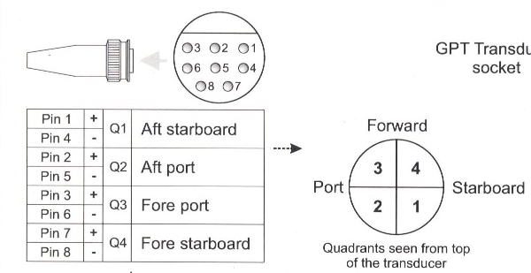
Deep Rated Transducers
Burton Connector Removal and 8 Pin Subconn Replacement
See deep rated transducer 70 and 120kHz if example work is helpful
1
1
Burton Connector
(to be removed)
4
2
2
3
333
5
4
Subconn MCIL8M
3
5
5ft
6
6
2ft
7
7
8
8

Slide 8
Subconn MCIL8 to Souriau Connectors
Extension for Deep Rated 333kHz Transducer
Updated 2017-05-31
CHECK THIS
K
J
1
G
Souriaus are wired ‘backward’ relative to quadrant numbers just like the original Amphenol connectors
2
H
Subconn MCIL8F
(pigtail)
3
E
4
F
Souriau 10 Pin
Male
5
C
6
D
7
A
8
B
About 13ft
Includes portion of Subconn pigtail and extra standard Simrad transducer cable

Slide 9
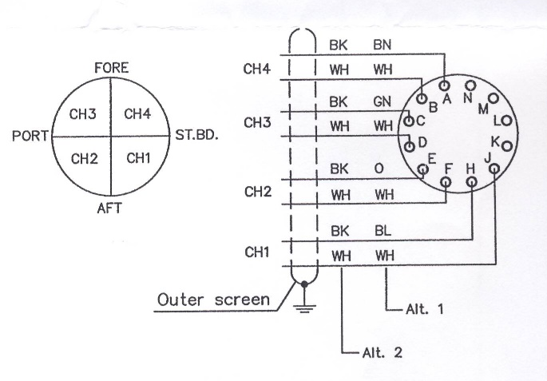
Souriau to Amphenol Connectors
Short Adapter Cables
Updated 2017-05-31
CHECK THIS
A
A
B
B
C
C
D
D
Souriau 10 Pin
Female
Original Amphenol Connector
E
E
F
F
G
H
H
J
J
Shield
K
About 1ft

