Slide 1
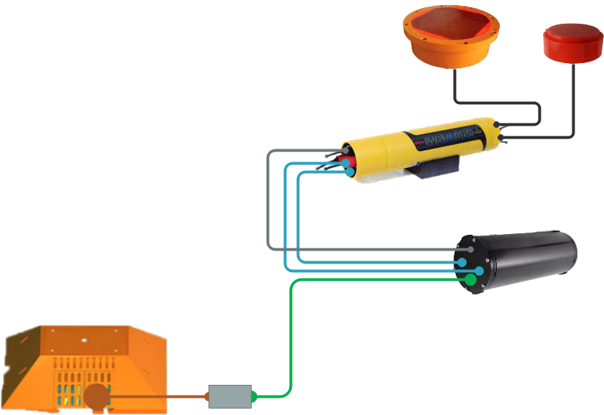
MARS Echosounder System v2
Simrad ES38-DD Transducer
Main Instruments
Simrad ES70-7CD Transducer
Simrad WBT Tube Transceiver Board Sets Can
?
MARS Node
Power and Data Interface Can
This enclosure either needs to be obtained or created
Power conversion and/or conditioning might happen in here
  (currently uncertain what the power manipulation needs might be)
Data from two Ethernet cables is combined into one line in here via Ethernet switch

Slide 2
MARS Echosounder System v2
Cables
SubConn
MCIL8M Cables
2 Meter Long
Potted Into Transducers
SubConn
MCIL5M to MCIL5F Cable
4 feet Long
2 pigtails spliced together at MBARI
For 20 to 50 volt power transfer to WBT Tube
SubConn
Ethernet Series
DIL8M to DIL8M
2 m Long
2 pigtails spliced together at MBARI
For data transfer to and from transceiver boards
?
Falmat Xtreme-Net Power and Ethernet Cable
DIL13M to DIL13F
Expected Length = 70m
(Previous length was about 30m)
ODI Connector Cable
Includes ‘possibly’ oil filled cable portion and connector conversion can
Inherited from spare MARS parts
Length = ?

Slide 3
MARS Echosounder System v2
Bulkhead Connectors
SubConn
MCBH8F Bulkheads
Transducer Connections
SubConn
MCBH5M Bulkhead
20 to 50 volt input
SubConn
MCBH5F Bulkhead
Titanium
20 to 50 volt output
SubConn
Ethernet Series
DBH8F Bulkheads
Titanium
For data transfer to and from transceiver boards
?
SubConn
Ethernet Series
DBH13F Bulkhead
Titanium
SubConn
Ethernet Series
DBH13M Bulkhead
Titanium
ODI Connector
(with oil filled cable and converter can)

Slide 4
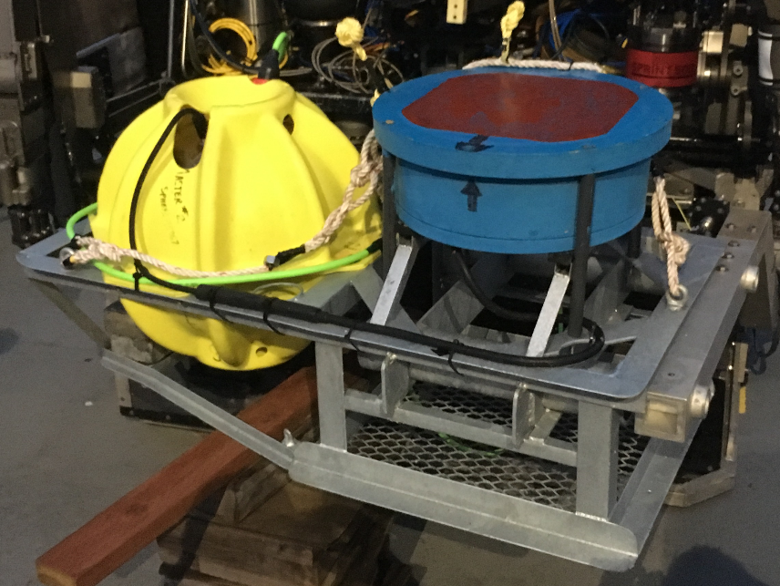
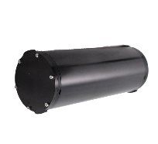

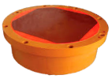

MARS Echosounder System v2
Mounting Structure with Instruments
This is currently deployed
This galvanized steel mounting structure will need to be replaced with something appropriate for the newer parts/instruments. It will need to maintain its ability to be properly carried and deployed by Ventana. This will include a lifting line that can be utilized by Ventana to move the mooring and then be secured so that the line doesn’t interfere with the data. (ROV Pilots and Marine Ops Techs will need to be consulted.)
These 2 components replace the 1 electronics sphere above
These 2 transducers replace the 1 transducer above
The front faces of these transducers should be level with each other when installed
?
The Simrad ES70-7CD Transducer has 3 evenly spaced screw inserts located at the back/bottom face. These are stainless steel size M8. These are its only mounting points. The transducer cable is potted into the transducer head and comes straight out of the center of the back/bottom of the head.
The specifications of the Power and Data Interface Can is still To Be Determined. There have been discussions that it would be better for parts like this down at MARS to be made of titanium when possible. This will need to be considered.
The Simrad ES38-DD Transducer
has 8 evenly spaced pass through holes located at the outer edge of the front/forward face. The smallest diameter of the holes is 11 mm and they can utilize the bolt material of ones choice. The transducer cable is potted into the transducer head and comes out of the side of the back/bottom of the head at an angle.
The Simrad WBT Tube is mostly covered with a ‘rubber’ coating. Its metal structure is anodized aluminum with sacrificial anodes screwed into the end caps.

Slide 5

MARS Echosounder System v2
What Needs To Be Obtained or Created
(As of Apr 2021)
Mounting structure and associated hardware
Power and Data Interface Can and all of its internal parts
(some parts may already be available in house)
?
4 bulkhead connectors to power and data interface can
Incline connector to ODI conversion can
Cable to/from Power/Data Interface Can and Node
(sounds like we have this in house)

