Slide 1
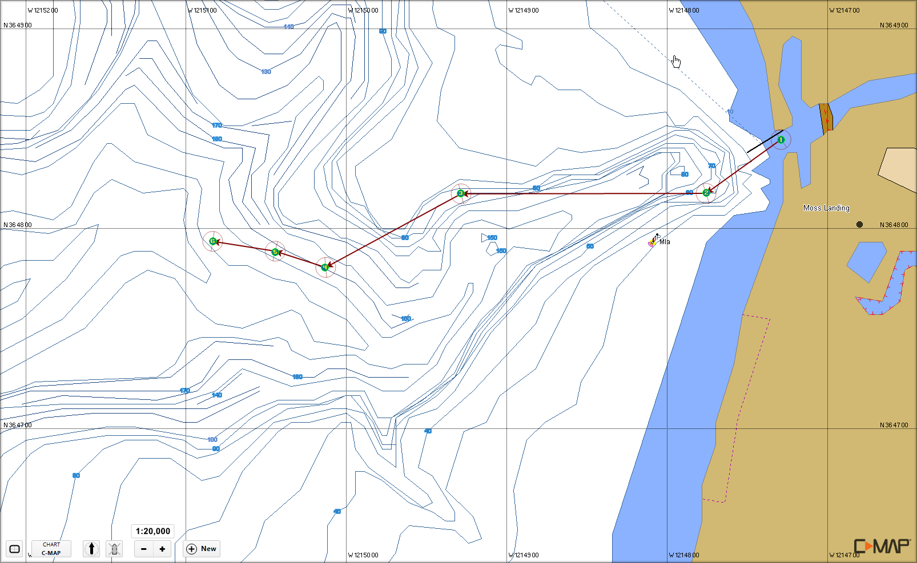
Acoustic Survey 2013-06-13 A Harbor to AUV Deploy

Slide 2
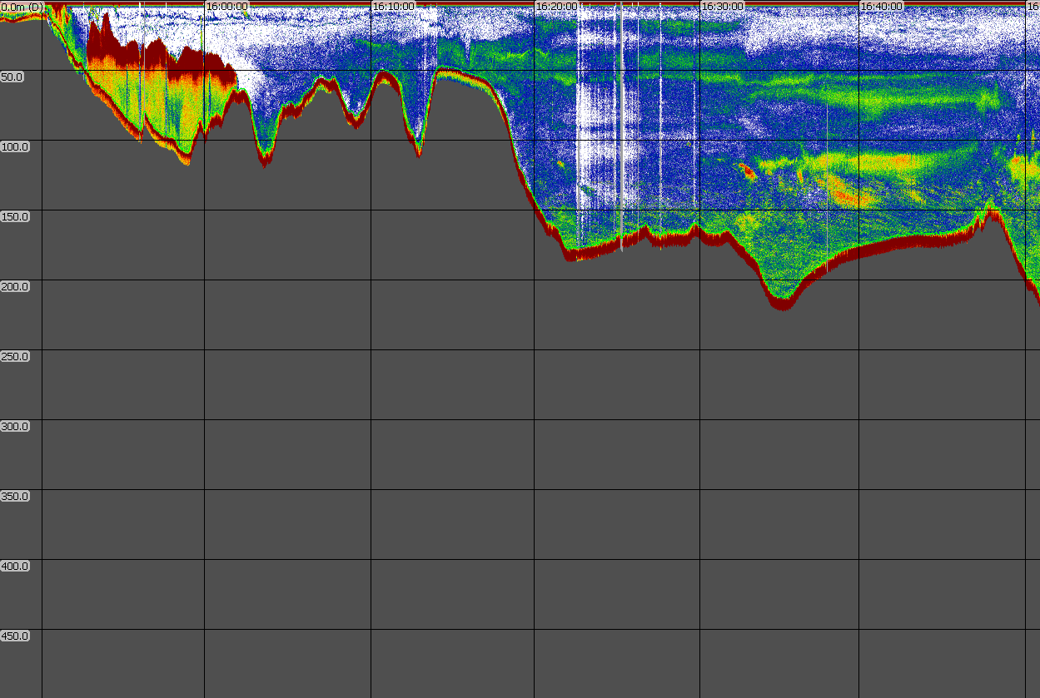
Acoustic Survey 2013-06-13 A Harbor to AUV Deploy Cleaned Raw Data
1
2
3
4
5
6

Slide 3
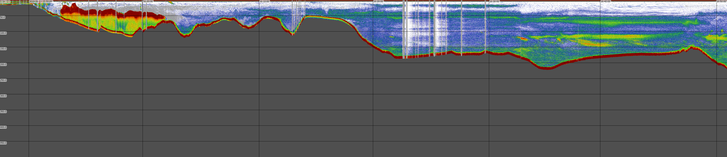
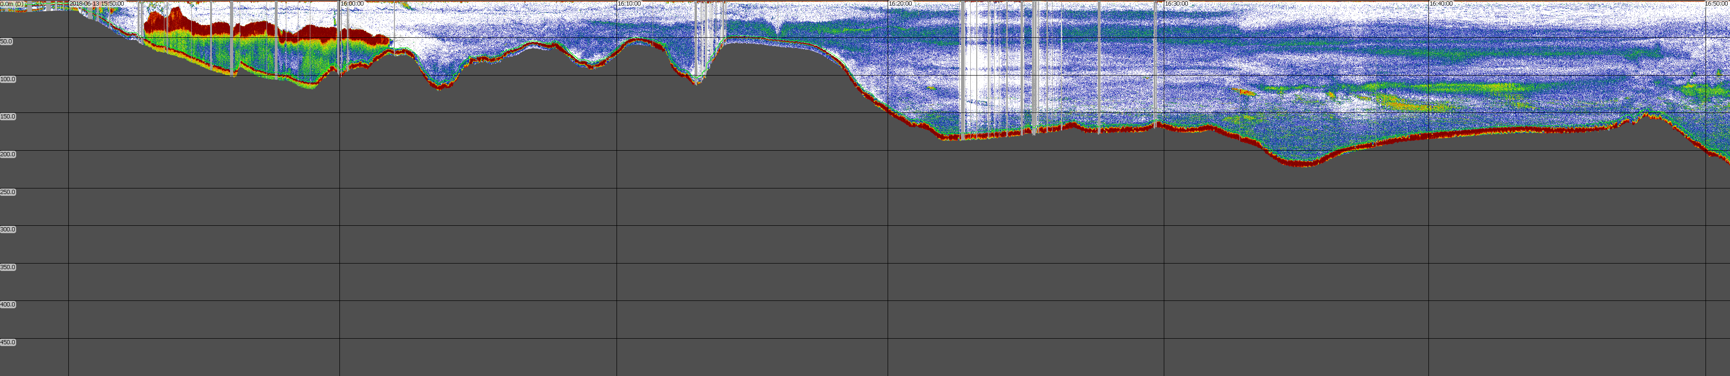
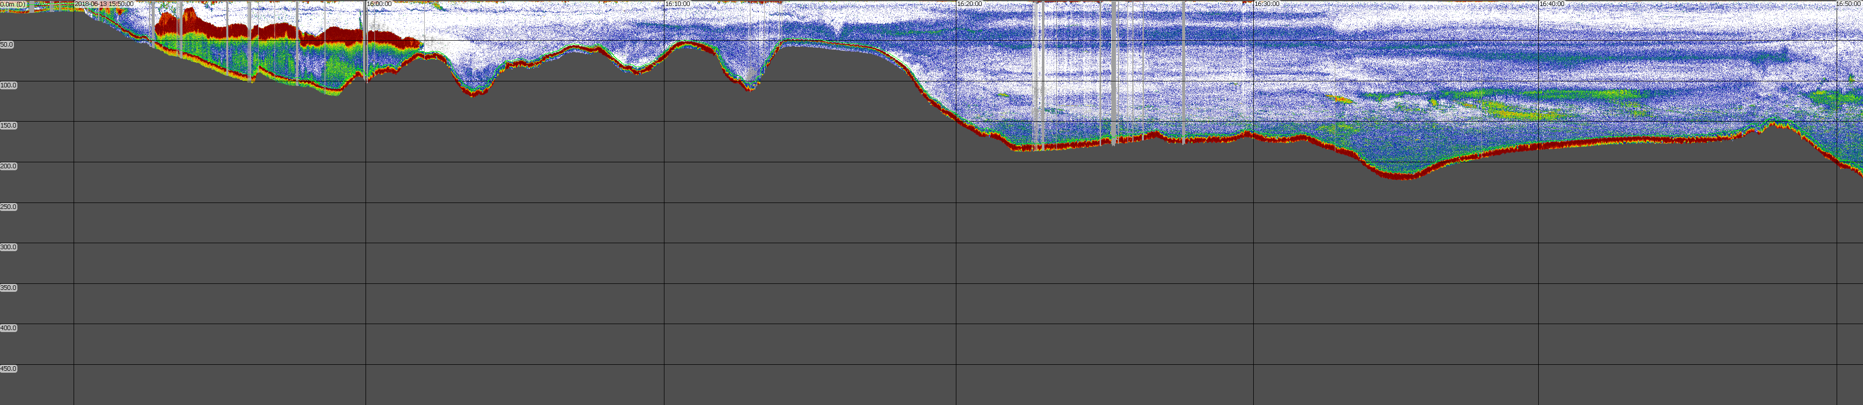
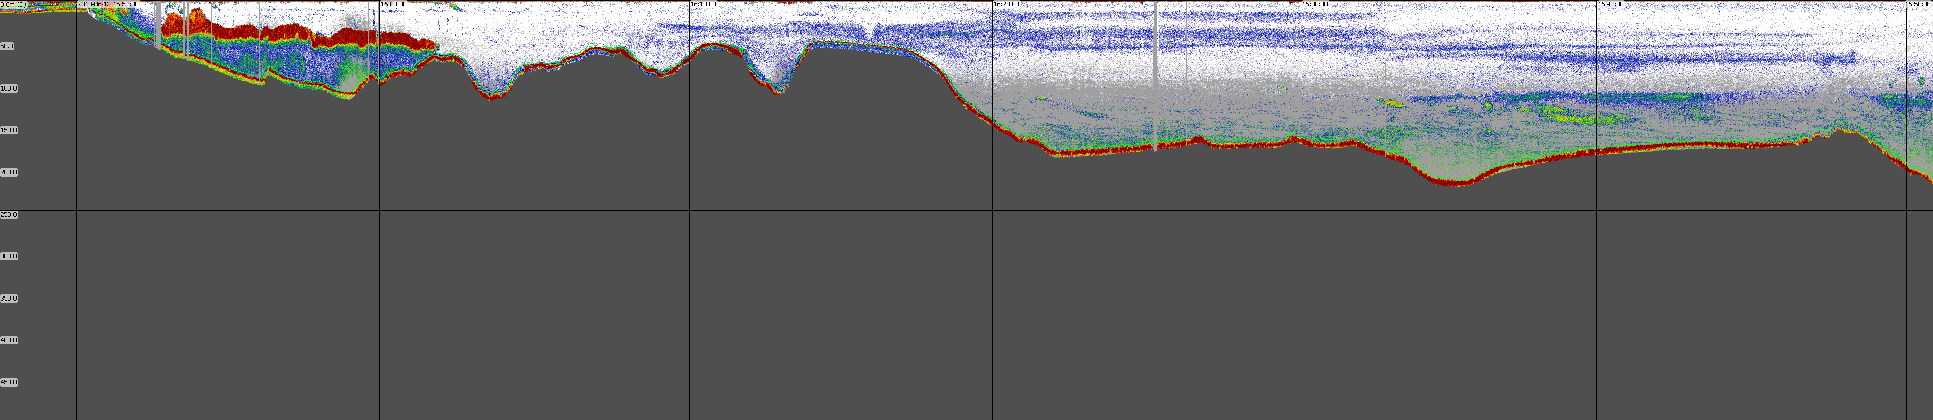
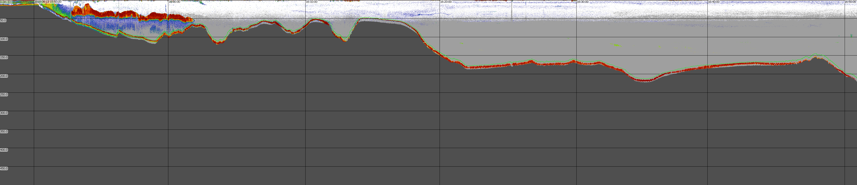
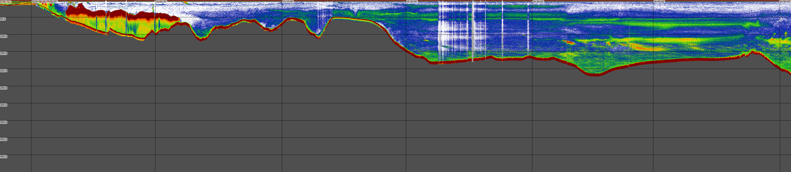
Acoustic Survey 2013-06-13 A Harbor to AUV Deploy Cleaned Raw Data
1
2
3
4
5
6

Slide 4
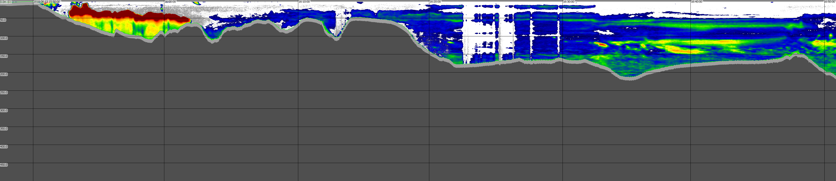
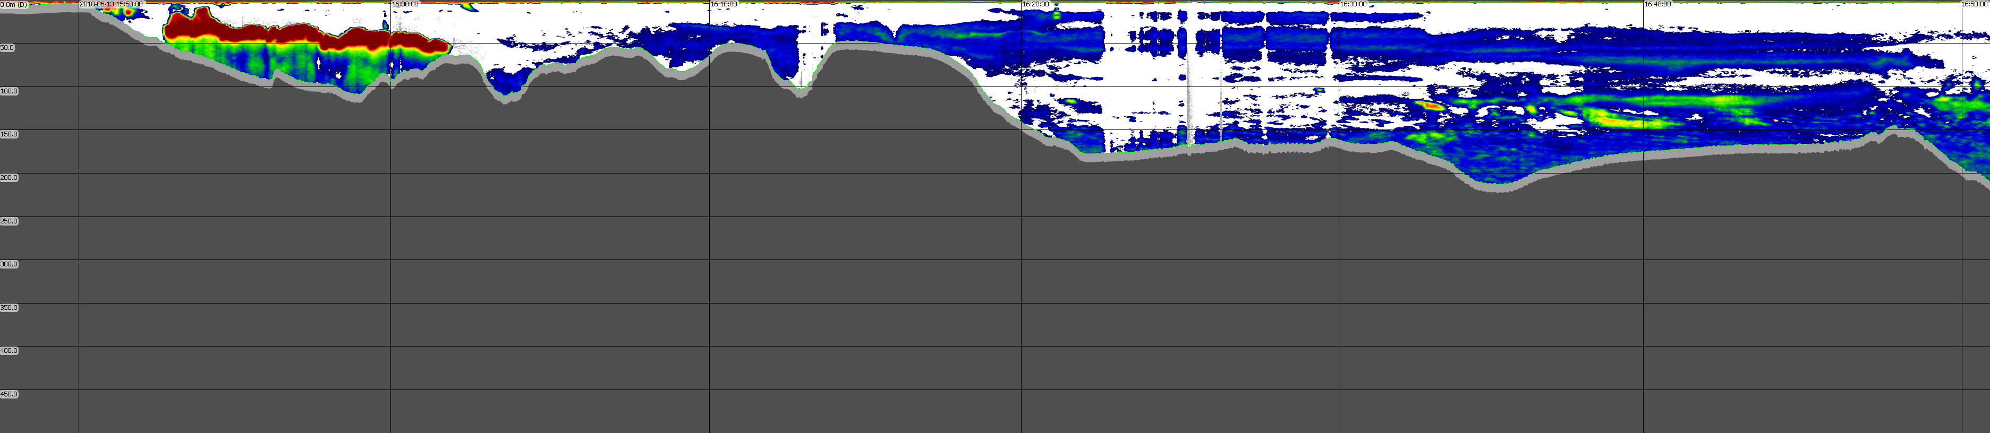
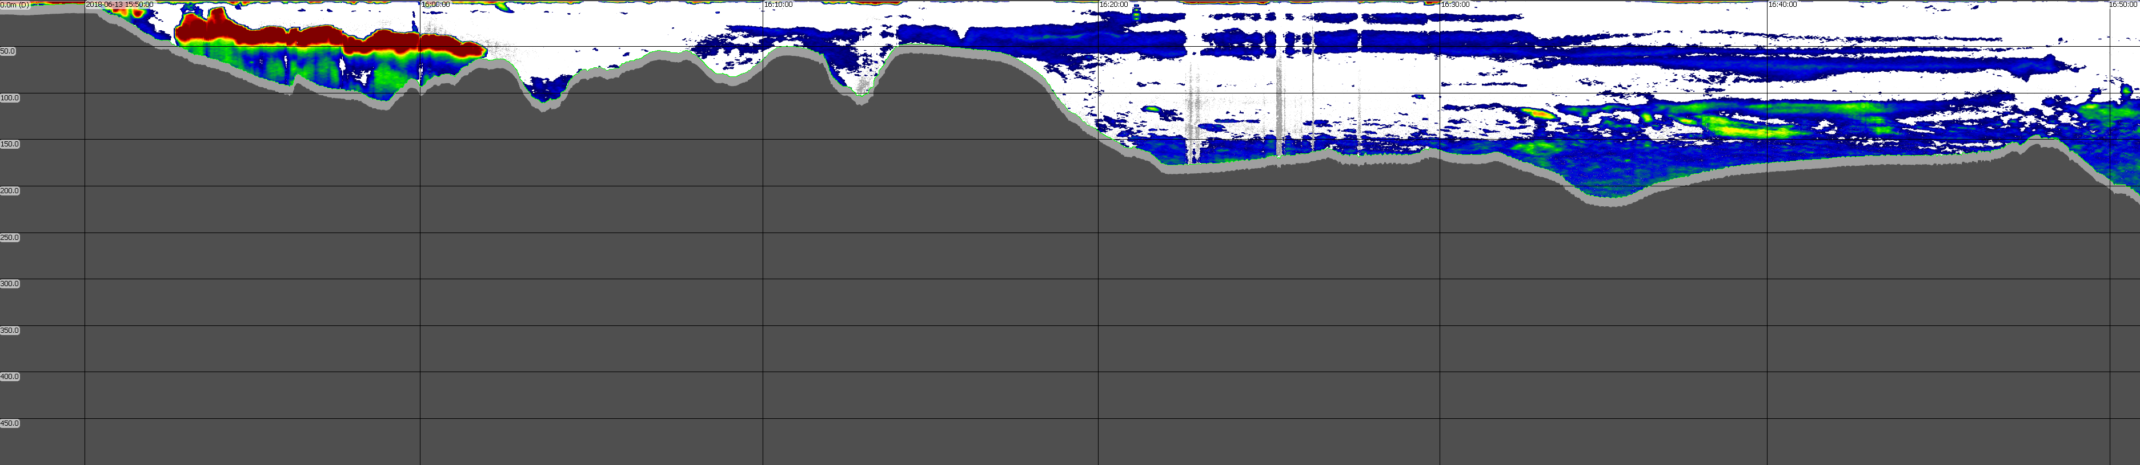
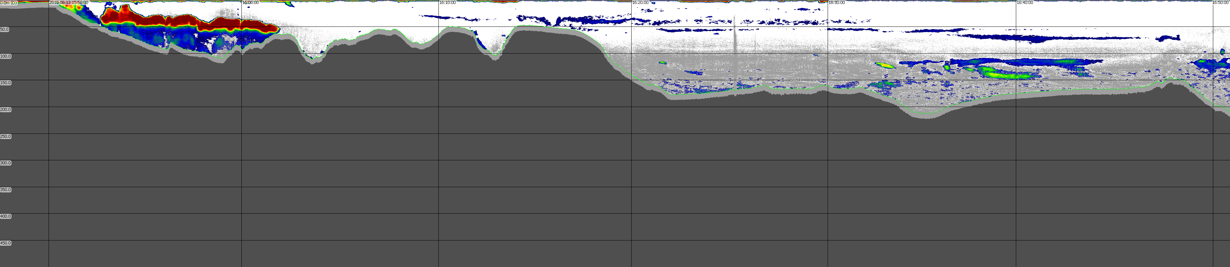
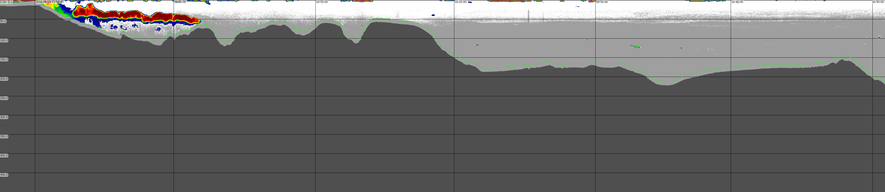
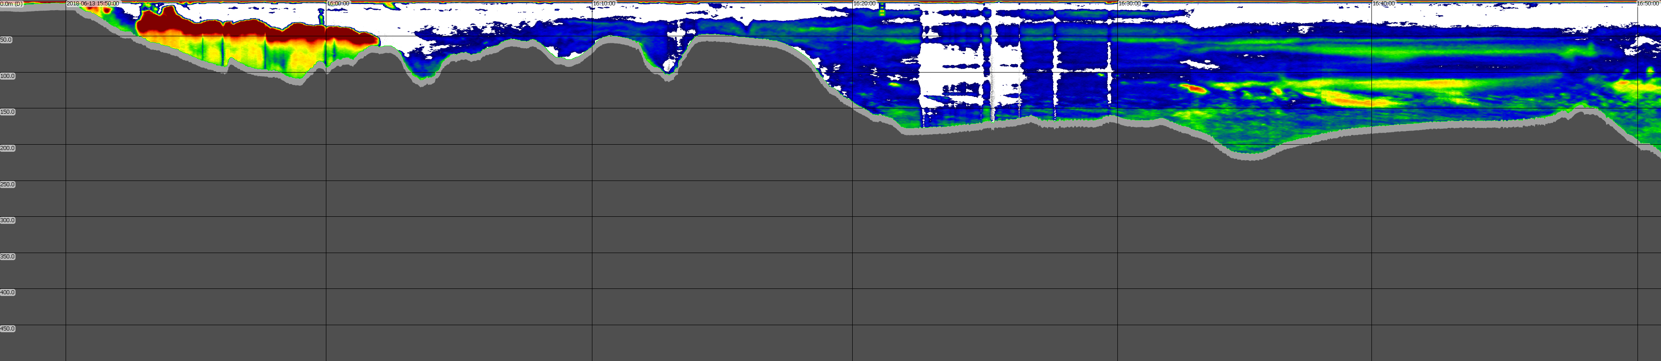
Acoustic Survey 2013-06-13 A Harbor to AUV Deploy Cleaned Smoothed Data
1
2
3
4
5
6

Slide 5
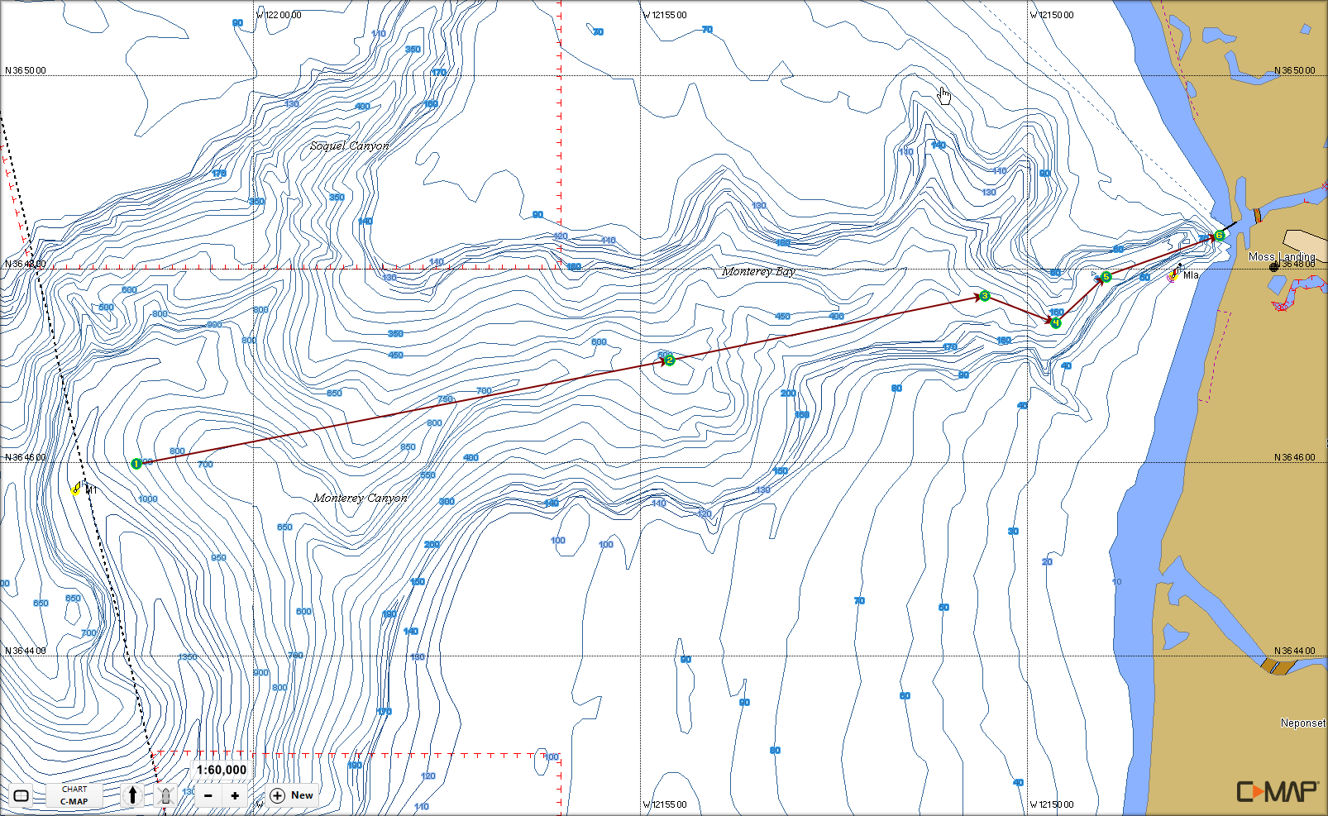
Acoustic Survey 2013-06-13 B M1 to Harbor

Slide 6
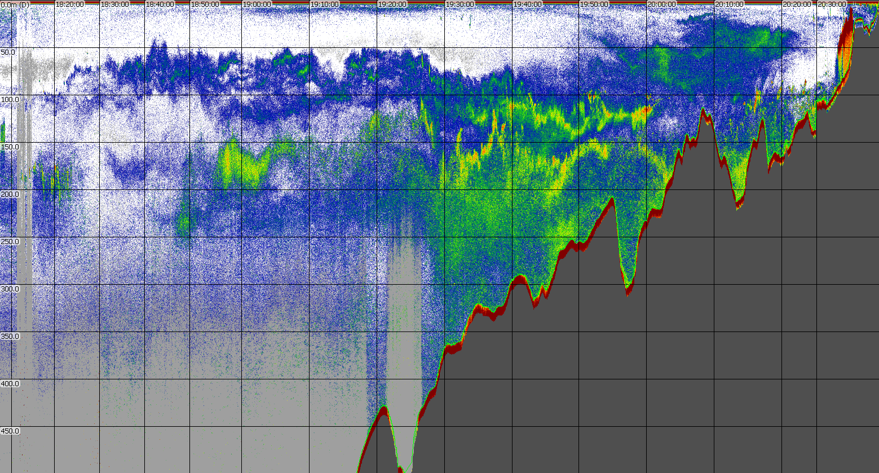
Acoustic Survey 2013-06-13 B M1 to Harbor Cleaned Raw Data
1
2
3
4
5
6

Slide 7
Acoustic Survey 2013-06-13 B M1 to Harbor Cleaned Raw Data
1
2
3
4
5
6

Slide 8
Acoustic Survey 2013-06-13 B M1 to Harbor Smoothed Raw Data
1
2
3
4
5
6

Slide 9
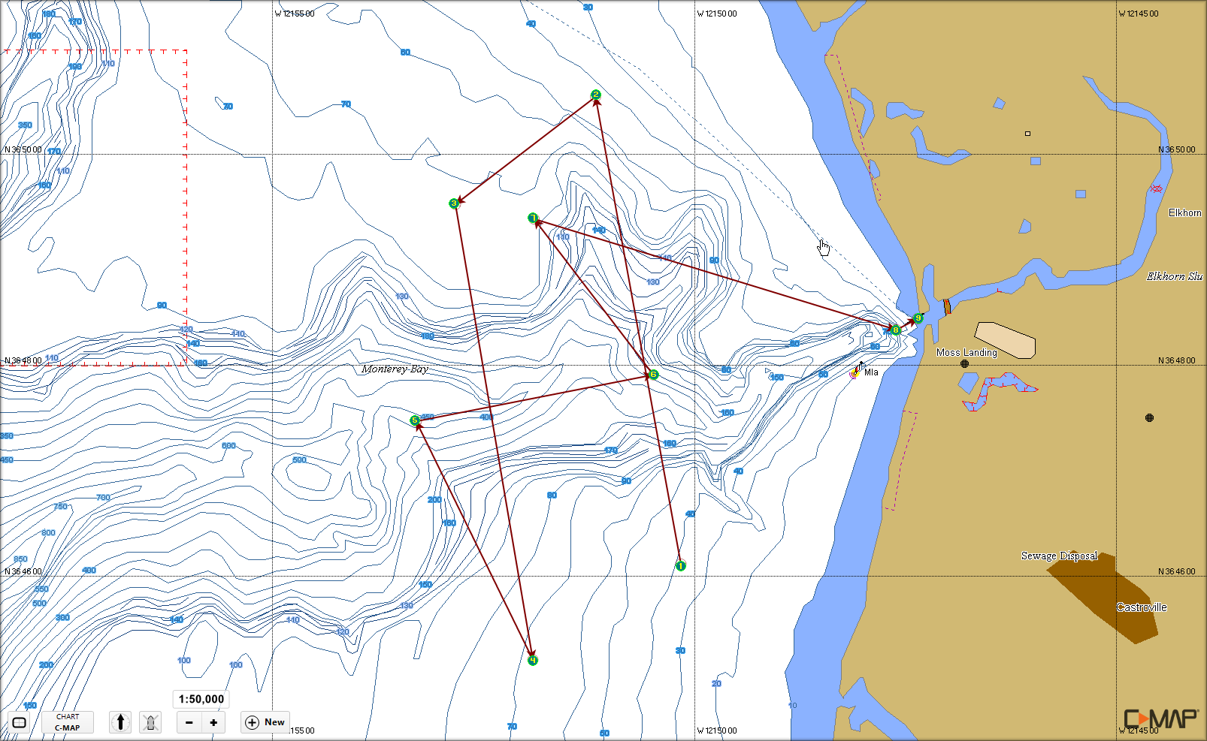
Acoustic Survey 2013-06-14 Cross Canyon and AUV Recovery

Slide 10
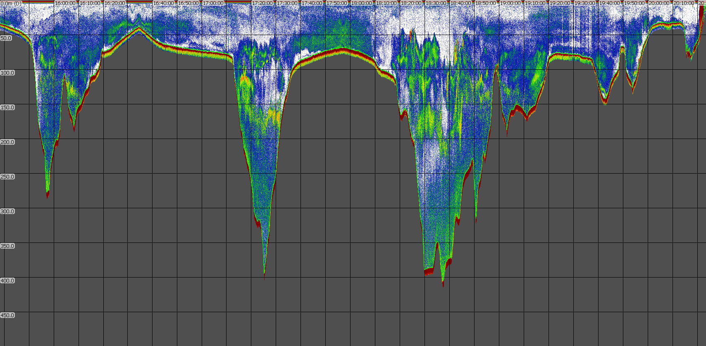
Acoustic Survey 2013-06-14 Cross Canyon and AUV Recovery Cleaned Raw Data
1
2
3
4
5
6
7
8
9

Slide 11
Acoustic Survey 2013-06-14 Cross Canyon and AUV Recovery Cleaned Raw Data
1
2
3
4
5
6
7
8
9

Slide 12
Acoustic Survey 2013-06-14 Cross Canyon and AUV Recovery Smoothed Raw Data
1
2
3
4
5
6
7
8
9

Slide 13
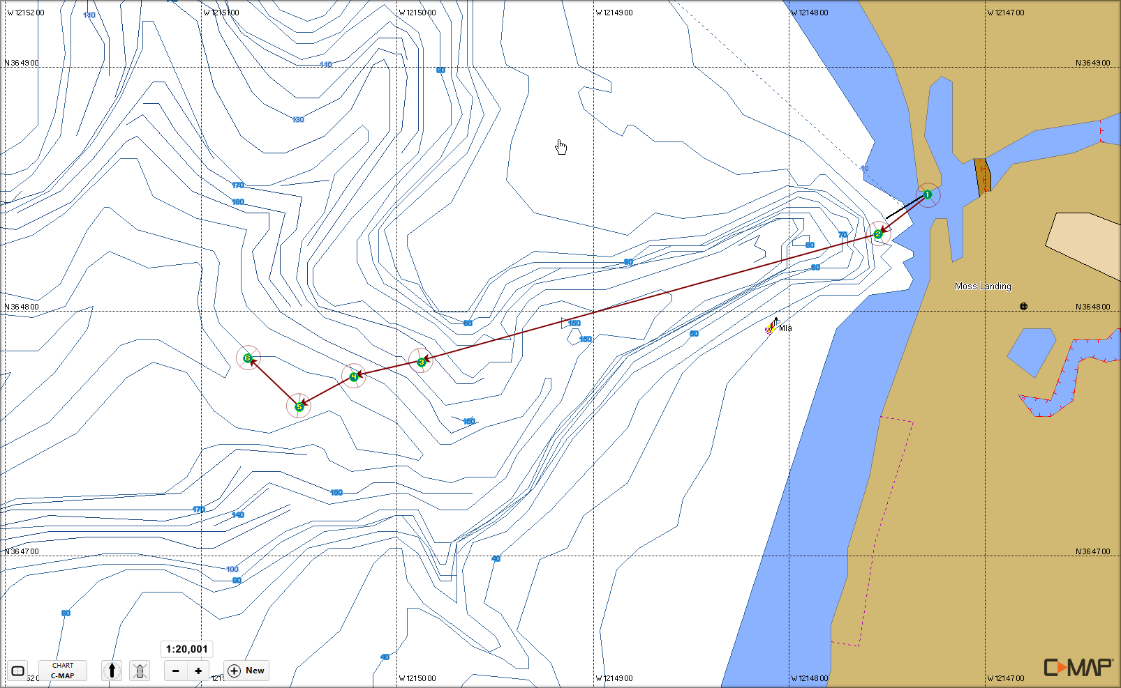
Acoustic Survey 2013-06-19 A Harbor to AUV Deploy

Slide 14
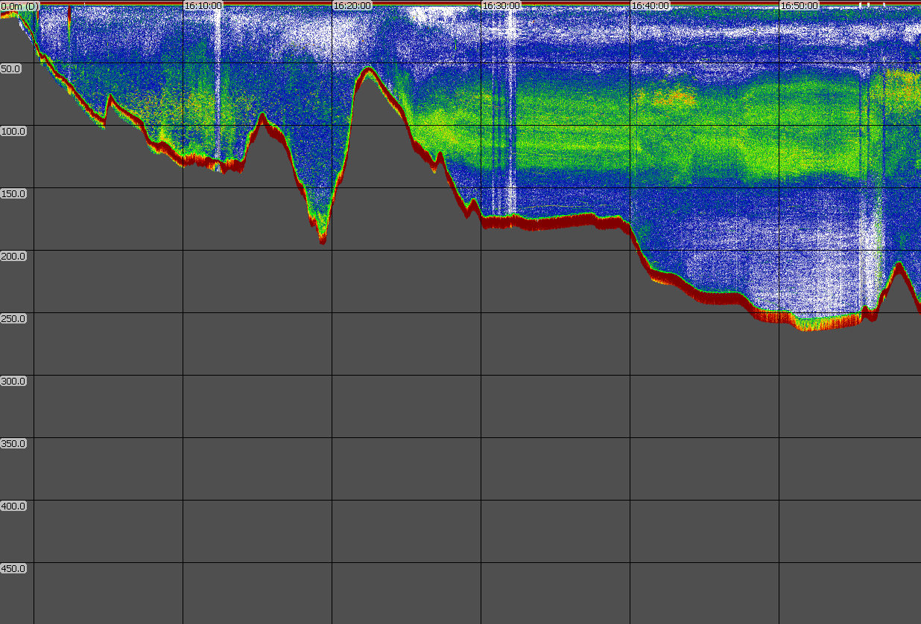
Acoustic Survey 2013-06-19 A Harbor to AUV Deploy Cleaned Raw Data
1
2
3
4
5
6

Slide 15
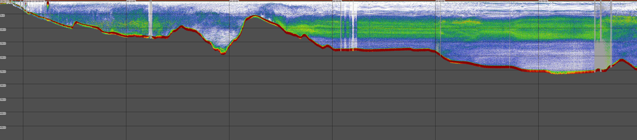
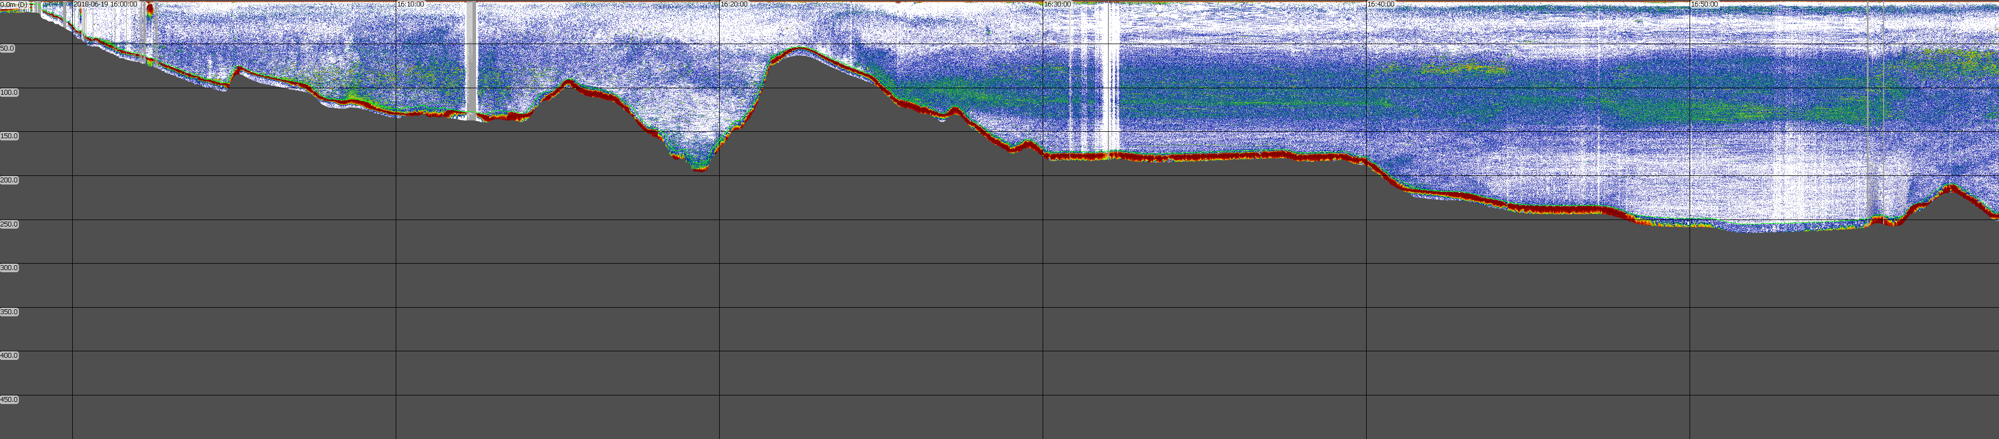
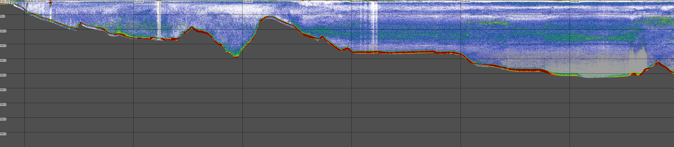
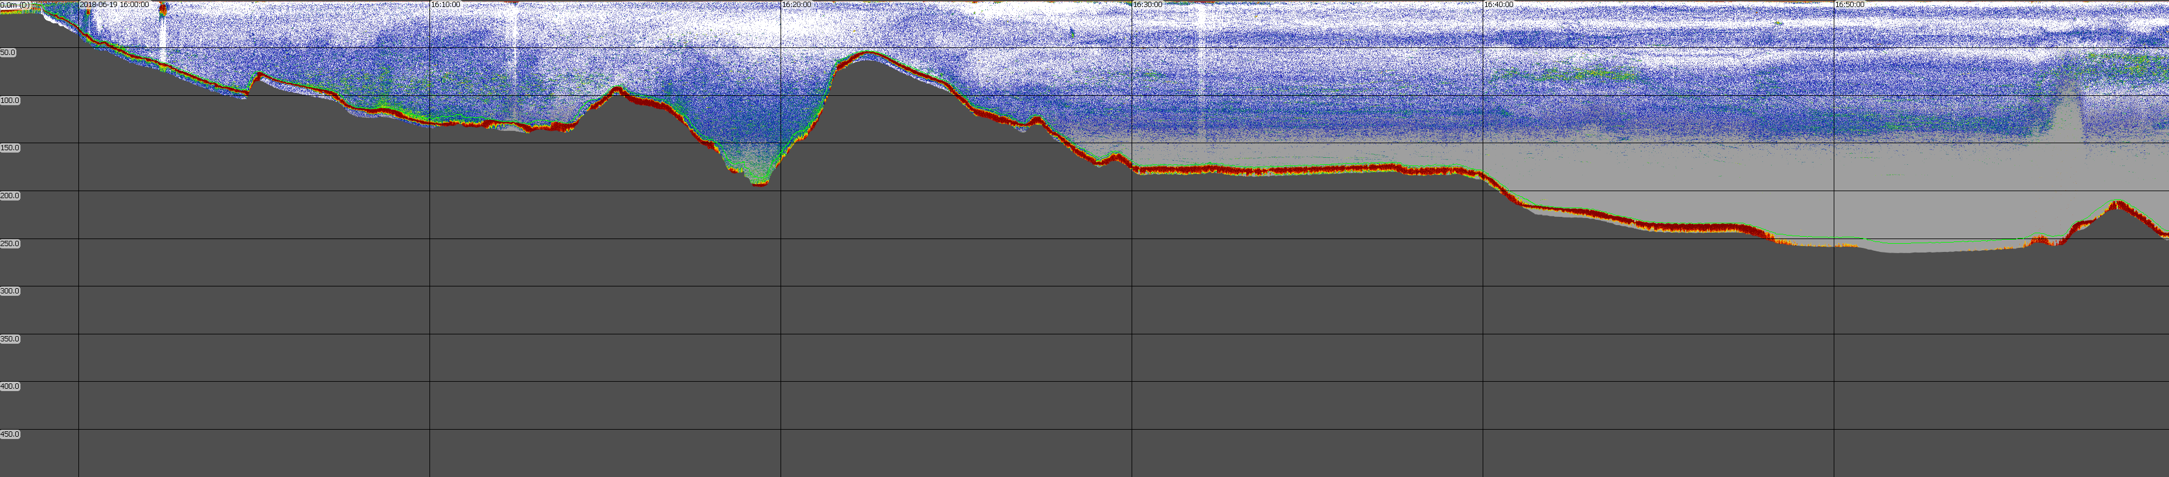
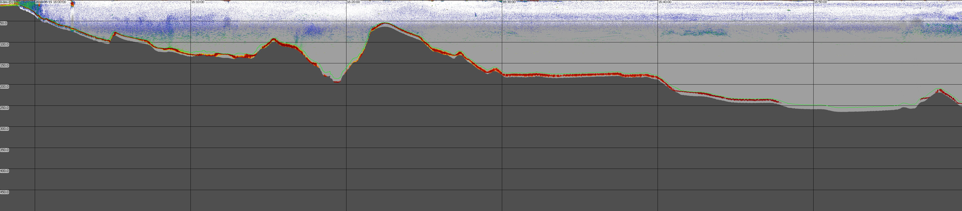
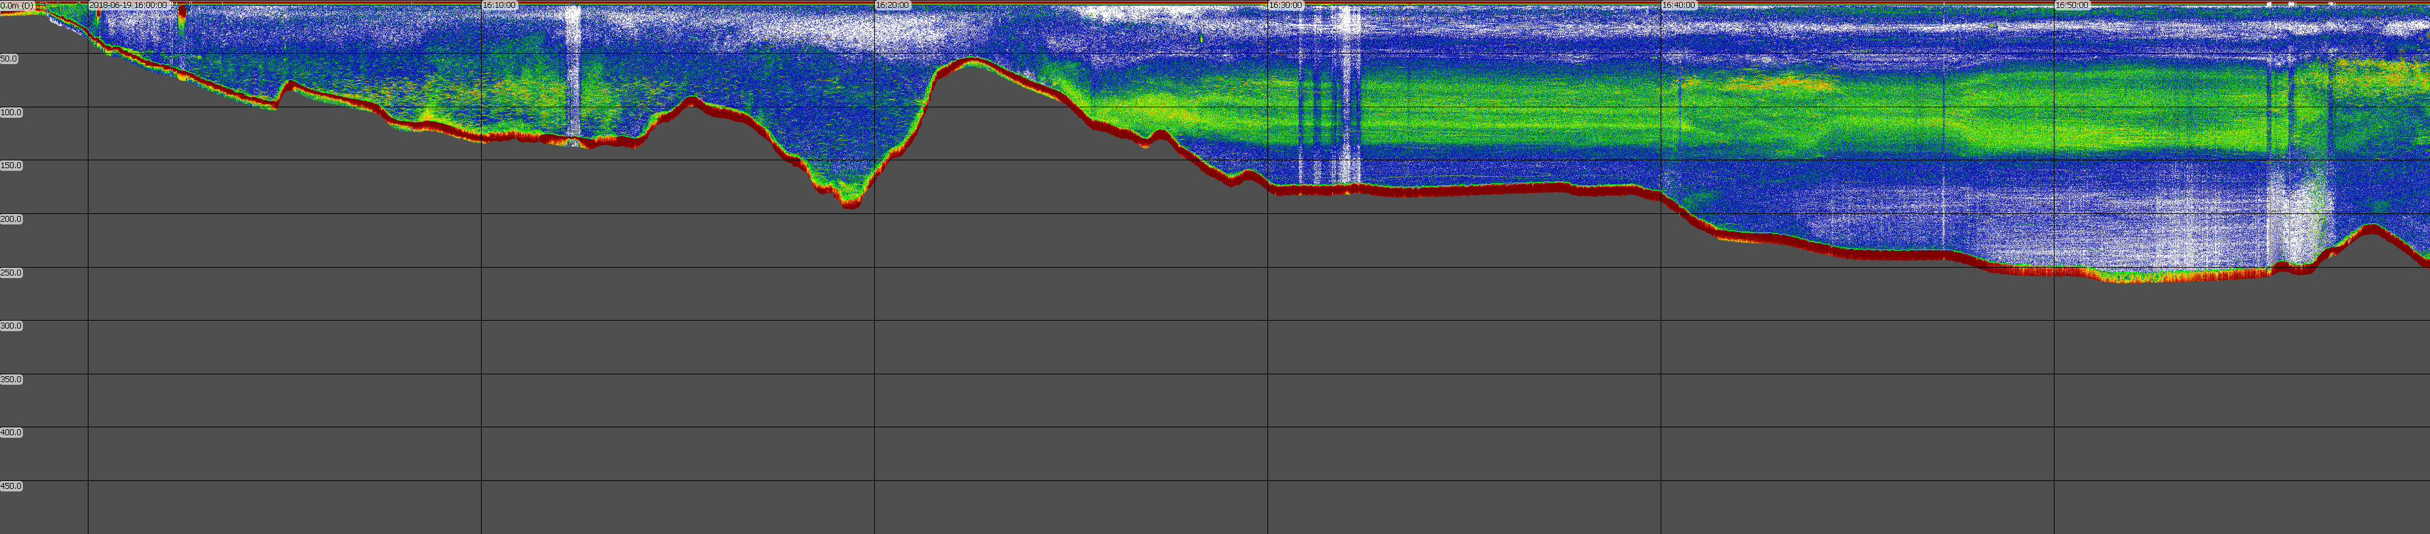
Acoustic Survey 2013-06-19 A Harbor to AUV Deploy Cleaned Raw Data

Slide 16
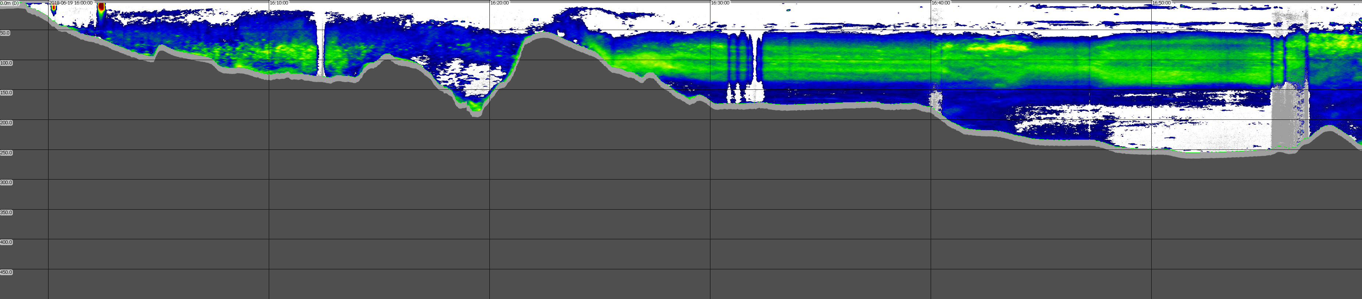
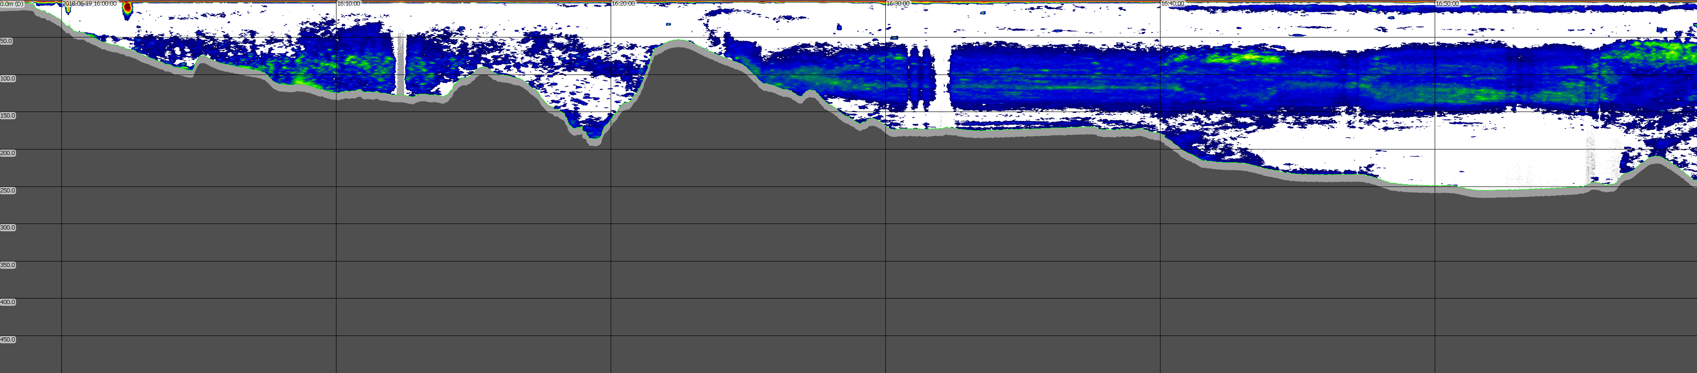
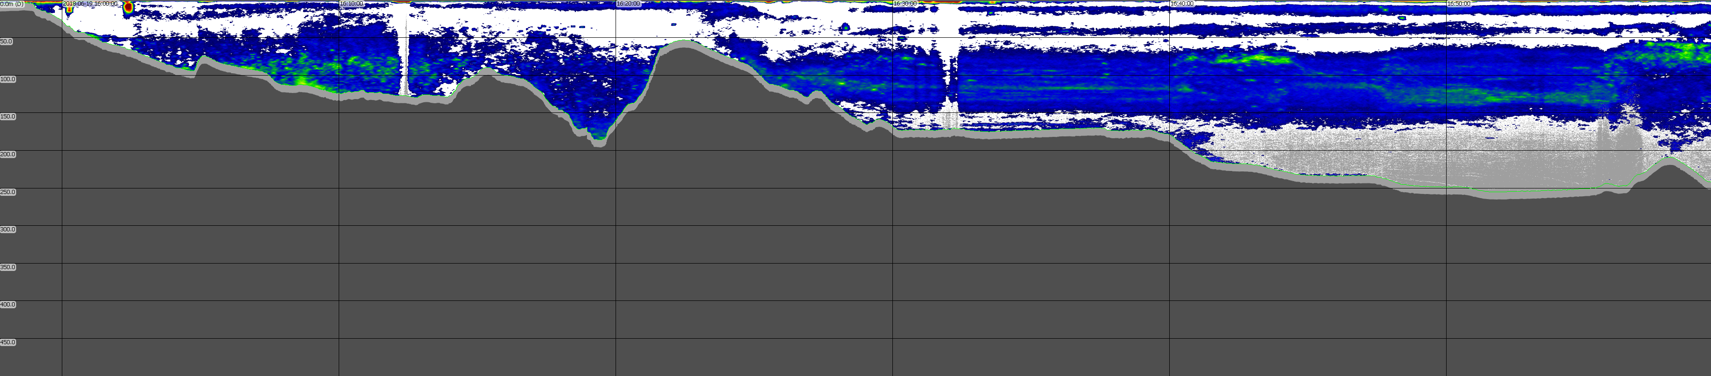
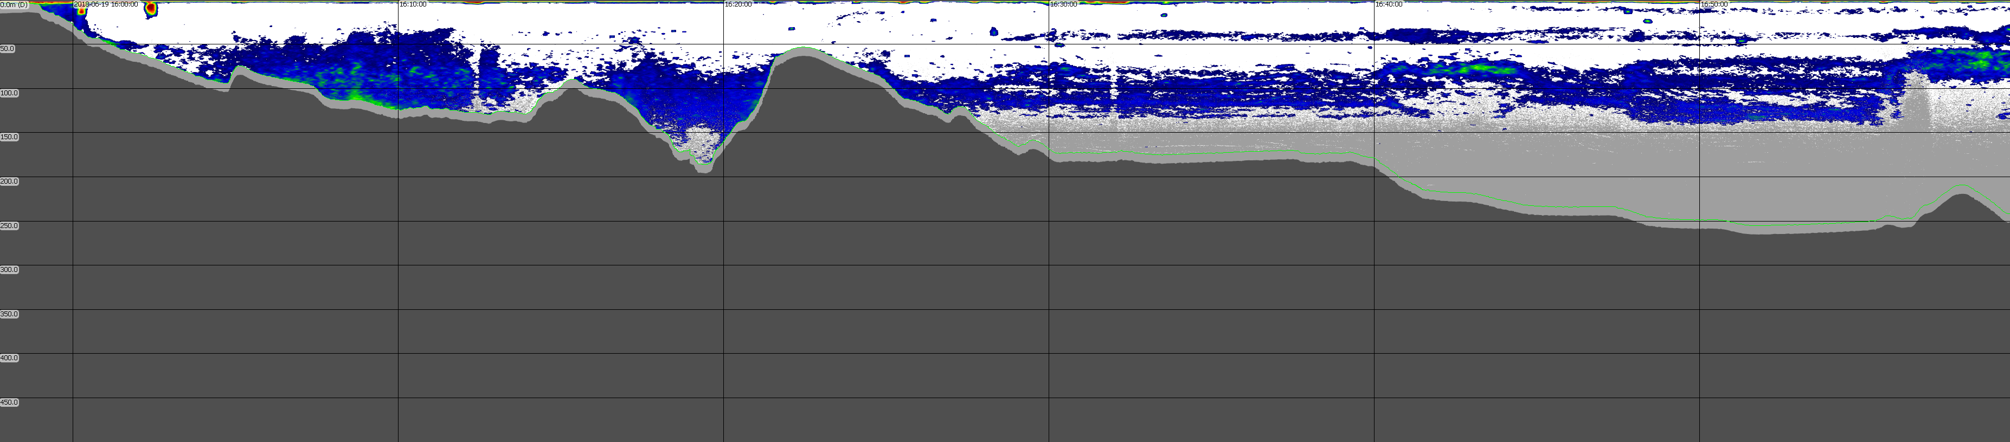
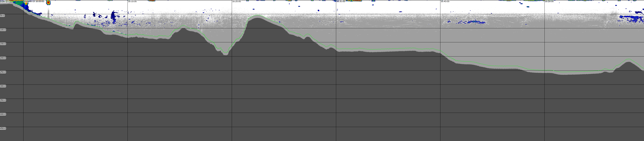
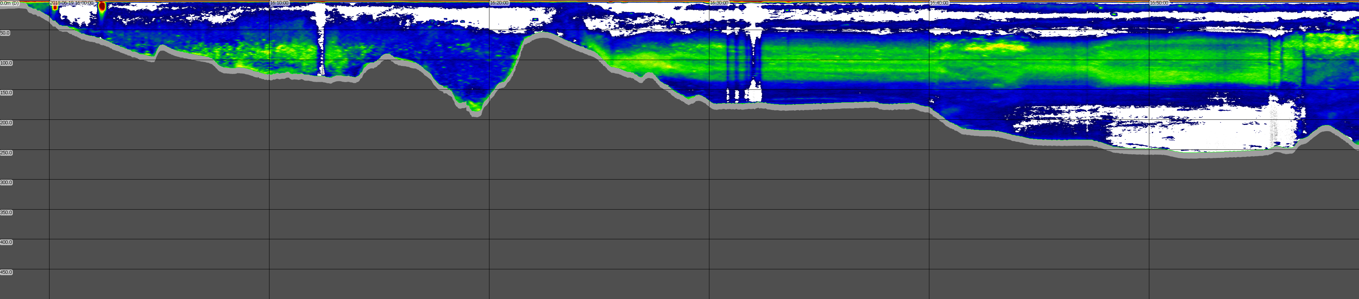
Acoustic Survey 2013-06-19 A Harbor to AUV Deploy Cleaned Smoothed Data

Slide 17
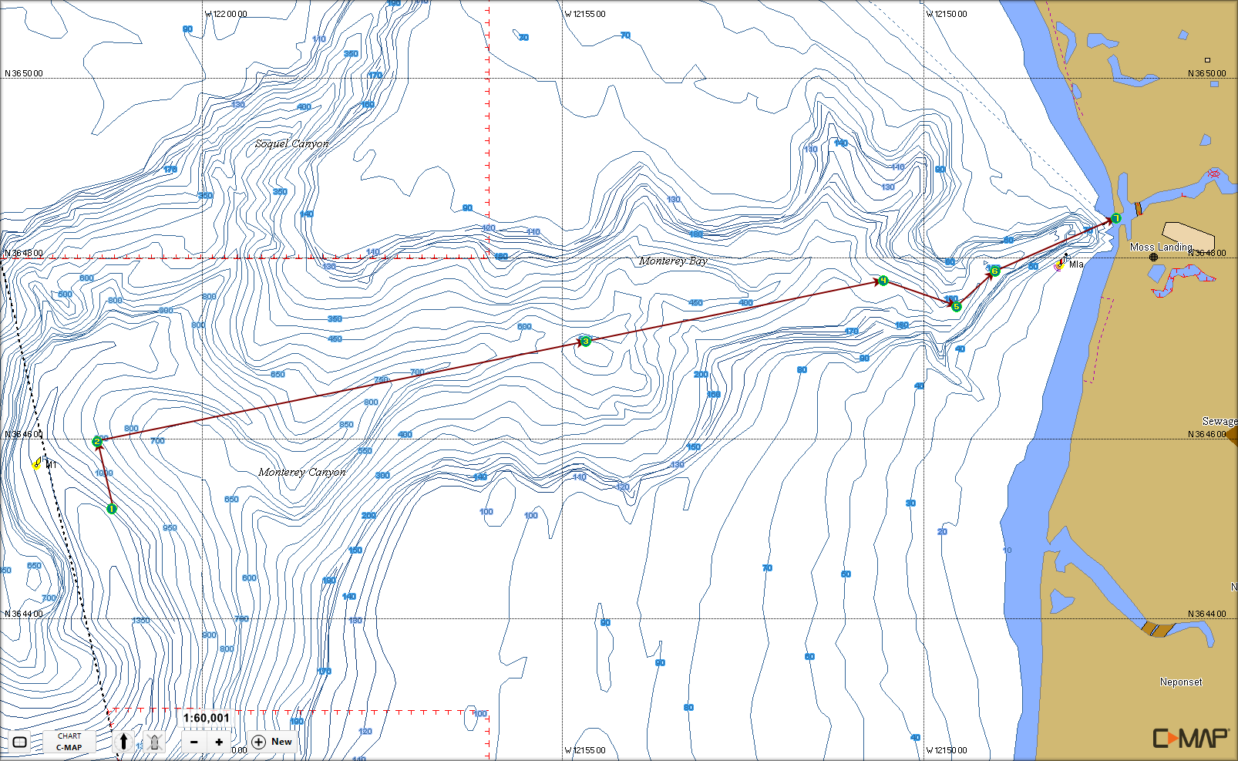
Acoustic Survey 2013-06-19 B M1 to Harbor

Slide 18
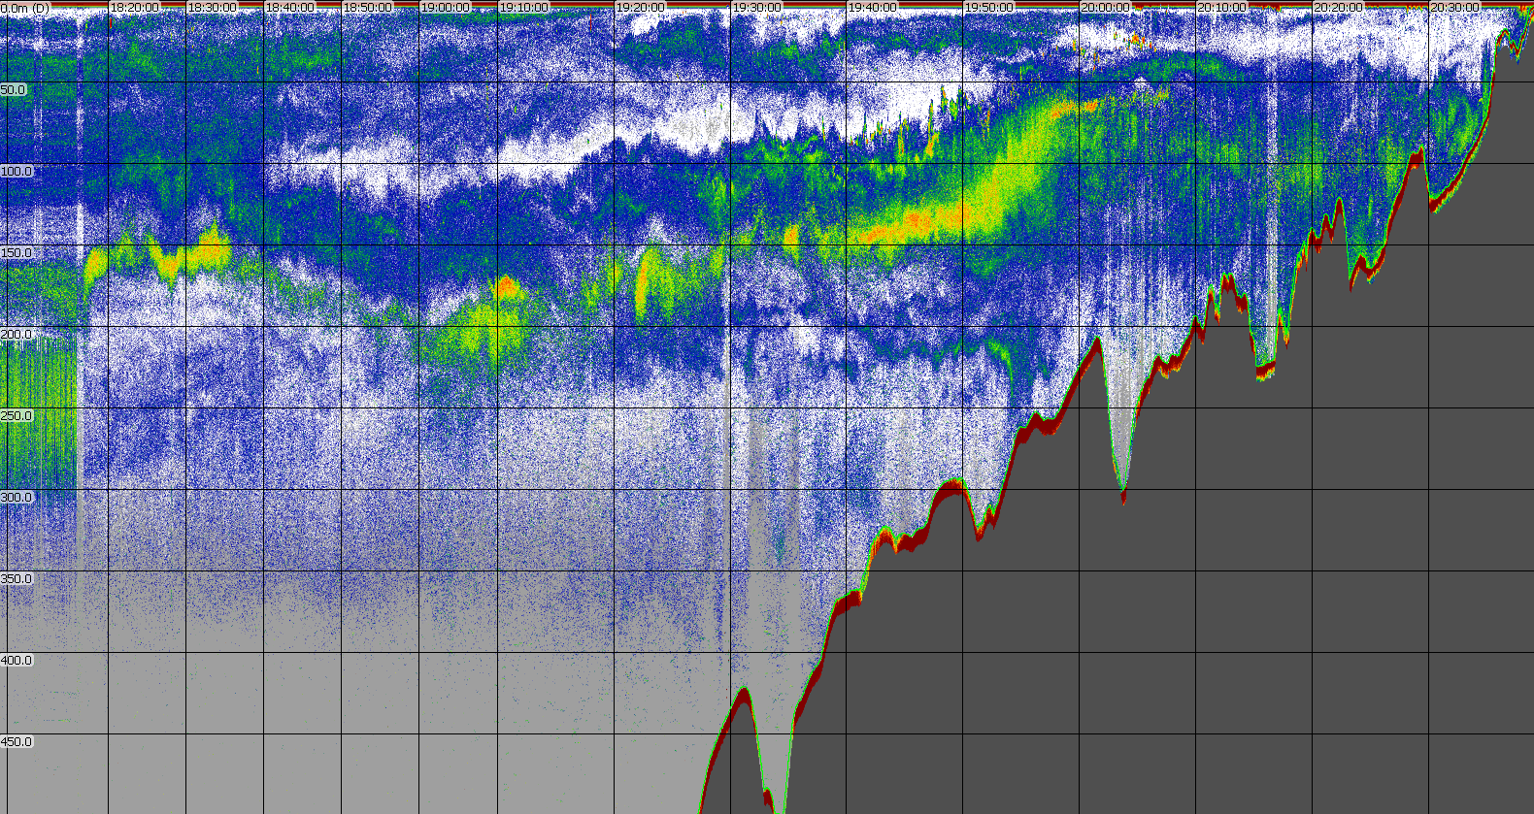
Acoustic Survey 2013-06-19 B M1 to Harbor Cleaned Raw Data
1
2
3
4
5
6

Slide 19
Acoustic Survey 2013-06-19 B M1 to Harbor Cleaned Raw Data
1
2
3
4
5
6

Slide 20
Acoustic Survey 2013-06-19 B M1 to Harbor Smoothed Raw Data
1
2
3
4
5
6

Slide 21
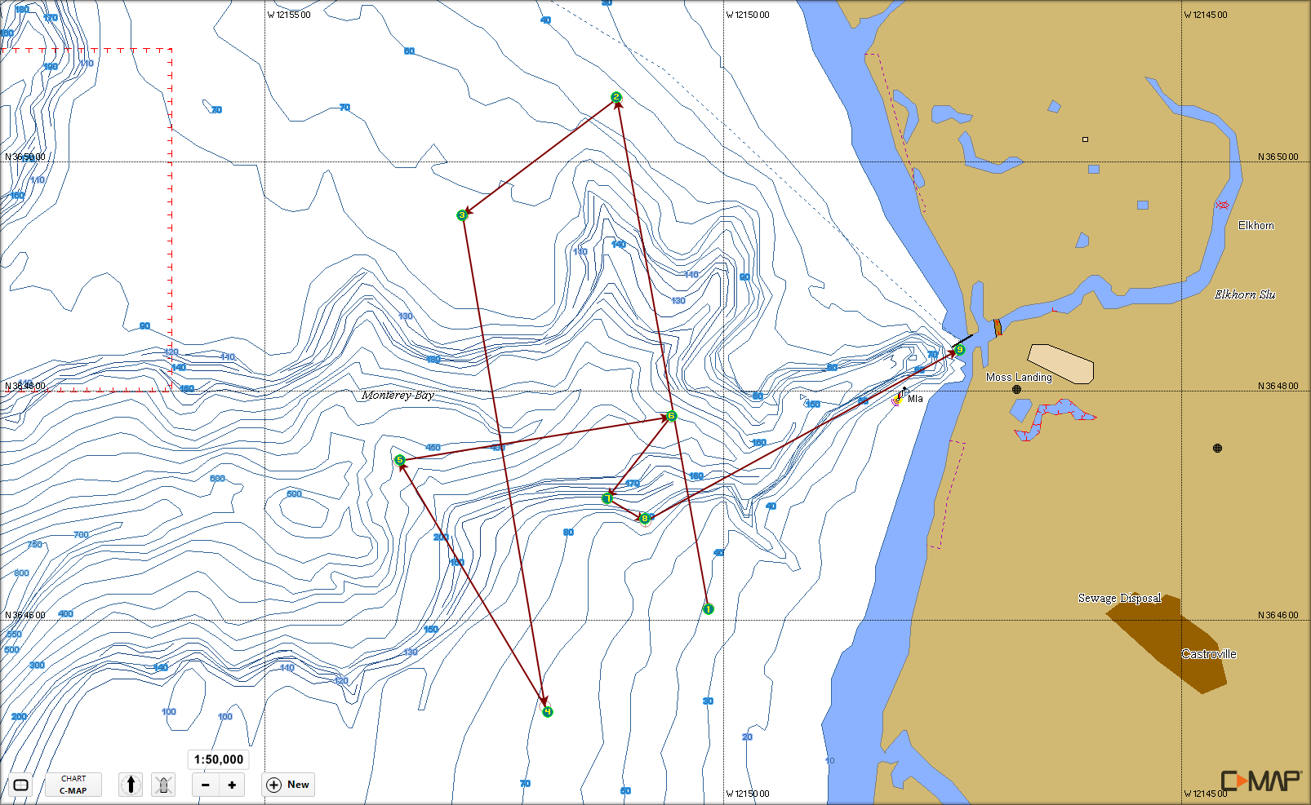
Acoustic Survey 2013-06-20 Cross Canyon and AUV Recovery

Slide 22
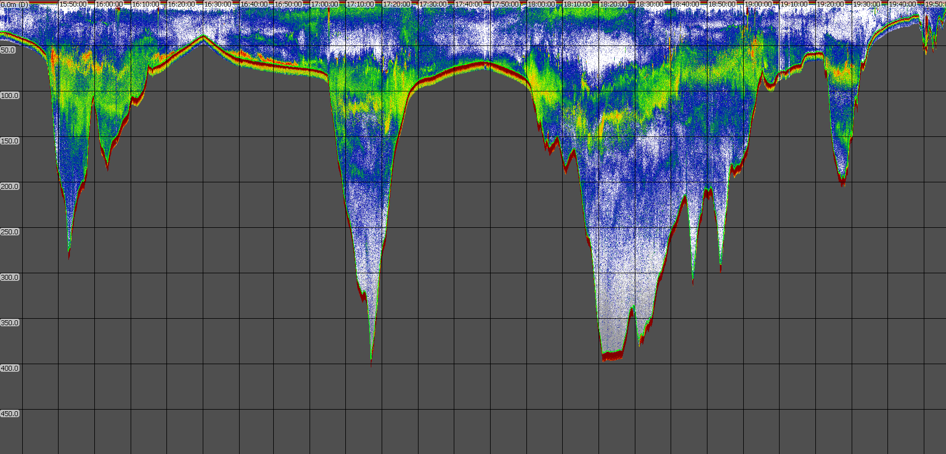
Acoustic Survey 2013-06-20 Cross Canyon and AUV Recovery Cleaned Raw Data
1
2
3
4
5
6
7
8
9

Slide 23
Acoustic Survey 2013-06-20 Cross Canyon and AUV Recovery Cleaned Raw Data
1
2
3
4
5
6
7
8
9

Slide 24
Acoustic Survey 2013-06-20 Cross Canyon and AUV Recovery Smoothed Raw Data
1
2
3
4
5
6
7
8
9

