Slide 1
BOS Operational Design Review
MBARI Project 901704
Eric Martin

Slide 2
Overview
Operational Requirements
BOS Gen 1 Design Overview
Test Platforms
Operational Scenarios
Required Components
Cost Estimates
Future Considerations
Notes:
Mention tomorrow is François' review, and to save some questions about fundamental design for then.

Slide 3
Operational Requirements
(FROM MARCH 2017 PDR)
Must operate tethered
Must be depth rated to 300 meters
Must operate in a benthic environment
Must be able to land on or hover above rocky outcroppings
Must capture stereo video
Must have near 360 degrees of stereo video coverage
Must be able to collect data from up to 30 sites within a normal operational ship day
Must be able to be deployed from various vessels of opportunity
Must provide real time telemetry data for positioning including video, depth, and heading
Notes:
LEAD: after the PDR...

Slide 4
Operational Requirements
(FOR 2017 FROM the RV John Martin and RV SHearwater)
Must operate tethered
Must be depth rated to 300 meters
Must operate in a benthic environment
Must be able to land on or hover above rocky outcroppings
Must capture stereo video
Must have near 360 degrees of stereo video coverage
Must be able to collect data from up to 30 sites within a normal operational ship day
Must be able to be deployed from R/V John Martin and R/V Shearwater
Must provide real time telemetry data for positioning including video, depth, and heading
Notes:
Still collecting requirements from Ships of Opportunity.

Slide 5
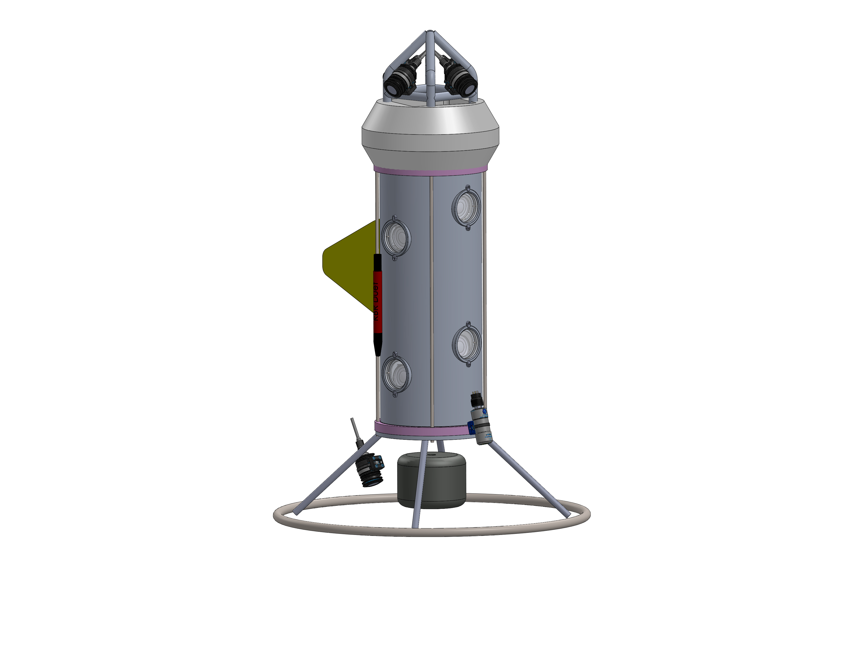
BOS Current Design
Height: ~60” , Weight: 250lbs (air)*
Components:
  Stereo Camera Pair
  Lights (5)
  Downward Video Camera
  T.D. Sensor
  Compass
  Coaxial PU Tether w/o strength member.
  Tow & Current Vane
*pending review on 6/2/2017
Notes:
add handle

Slide 6
Considerations for Seagoing Installations
(UPDATED FROM PDR MARCH 2017)
Max system weight (including clump): 500 lbs
Allowing for dynamic loading a tether must have an SWL of 875lbf, and via CFR189 the NBL of the tether must be greater than 2,665 lbf.
The tether must be the weakest link.
The winch must have a brake rated above 2,665 lbf.

Slide 7
Test Platforms
R/V John Martin and R/V Shearwater

Slide 8
R/V John Martin
Initial Testing
A-Frame: H: 116" W: 102"
Winch: 1,500m 1/4"SC
SWL: 1,000 lbs
Deck Space: > 10'x10'
Powered Capstan: Yes
Winch
Aft Deck

Slide 9
R/V Shearwater impact study
A-Frame: H: ~14’ W: 10’
Winch: 1,800m of 0.322”Ø CTD MC
SWL: 800 lbs
Deck Space:
  F/A 7’
  P/S 10’

Slide 10
Operational Scenarios
For evaluation on R/V John Martin testing days

Slide 11
Direct Winch CTD Wire
Using the winch wire, directly shackle it to the BOS and secure it to the coax using cable straps until the clump and then the line hooks to marry the two after that. Football Float in the middle of section b/t clump and BOS. Clump wrapped on with Yale Grip.
Pros:
  Payout monitored.
  Familiar operation for equipment handlers.
Cons:
  Requires over the side marrying operations.
  Heaviest cable for floated section.

Slide 12
Synthetic Rope
Deploy using only a synthetic strength member such as Spectra, using a hydraulic capstan to lift and drop the lander. The clump is attached using a shackle, and the coax is married over the side. It's possible to premarry the cable to the spectra, but the capstans can be too small for this in some uses
Pros:
  Float may be unnecessary, but is still reccommended.
  No Yale Grip for clump attachment. Likely put a bite in the line.
Cons:
  Slightly more dangerous operation, since the line must be handled by hand.
  Requires over the side marrying.
  Manual payout counting.

Slide 13
Required Components

Slide 14
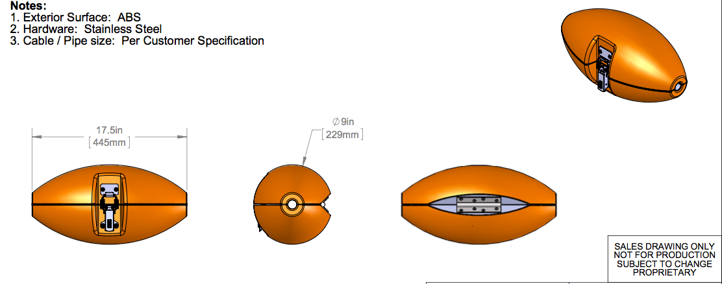
Cable Float
Deepwater Buoyancy 9” Cable Float
Wraps w/ latch around tether
Widely used in ROVs
Offers least fouling opportunities
Seawater Buoyancy 11.7 lb (5.3 kg)

Slide 15
Float Requirement For Section length
Floated Section w/ 0.322” Ø MC Wire
Estimate for Worst Case Weight + 10%
R/V Shearwater CTD Wire
  0.322”ø
  149 lbs/kft
Falmat FM030115-2
  0.304”ø
  63 lbs/kft
Each float 11.7 ± 0.8 lbs

Slide 16
Strength Members
Description | Location | Wet Weight / Length | Diameter | Breaking Strength
SC Steel | R/V John Martin | ?? | 0.257” Ø | 6,300 lbf
MC Steel | R/V Shearwater | 143 lb/kft | 0.322” Ø | 10,000 lbf
Spectra | Lander | < 0 lb/kft | 0.250” Ø | 6,050 lbf

Slide 17
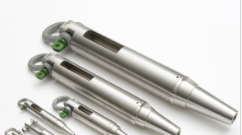
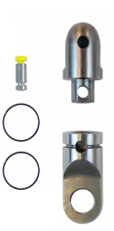
BOS Attachment
OR
A breakaway component will be added at the top and base of the Lander, so that a line break can be avoided.
As pictured this style maxes at 4,000 lbs NBL, a larger version is 6,000 lbs. All proposed strength members exceed 6,050 lbf NBL.
If final weight is below 500 lbs, the lower unit is acceptable.
There is some hazard to monitor from the gear locally falling back onto the frame.
Notes:
get break rating for martin

Slide 18
Tether Marrying
Surface to Clump
  Continue to use long line clips
Floated Section
  Use Hook and Loop Cable Ties
  Will help prevent fouling, as float will engulf the pair.
  Lighter Weight

Slide 19
Clump Application
Clump weight is mandatory for keeping the tether safe during stern operations on both platforms.
The clump is also mandated >50lbs on the R/V John Martin for safe drum storage.
CTD Wire Deployment:
  Use Yale Grip to attach.
Spectra Line Deployment:
  Put a bite in the line that passes through the block

Slide 20
Safety Equipment
Tether will be energized at 480VAC, appropriate safety gloves for all handling the cable is appropriate.
Class 00 Electrical Glove Kits Recommended
Other standard ship rules apply, hardhats, steel-toes etc.

Slide 21
Component | Part Ref | Part Link | Unit Cost | Quantity | Total Cost
Tether | Shallow RG6 19 AWG 0.304" ø | Falmat | $2.50 | 500 | $1,250.00
Floats | 9" Cable Float, Hinge and Latch, 750m | DeepWater | $425.00 | 3 | $1,275.00
Long Line Clips | TBD |  | $- | 0 | $-
Clump Weight | Borrow |  | $- | 0 | $-
Yale Grip | YALE GRIP: 7/16" x 04.5' w/ 6"Eye Color RED Cable Diameter of Cable- (3/16"-1/2") WLL - 1,200 Breaking Strength-6,000 lbs | YaleGrips | $112.00 | 2 | $224.00
Spectra Line | HTS 75 3/16" Red, 6,050lb. Breaking Strength | Port Supply | $0.58 | 820 | $475.60
Buckets | TBD |  | $- |  | $-
Velcro Cable Ties | Velcro ties, orange pack of 10 | McMaster | $6.15 | 10 | $61.50
Tether Block | TBD |  | $- | 0 | $-
Shackles | TBD |  | $- | 0 | $-
Weak Link | DCD Breakaway Series 00560 or 00530 | DCD Design | $288.84 | 1 | $288.84
Safety Gloves | Salisbury Class 00 Saftey Gloves | Grainger | $151.00 | 2 | $302.00
 |  |  |  | Total: | $3,876.94
ESTIMATED COSTS

Slide 22
Next Steps
Orders wait until after mechanical review completed and tether ordered.
Order float (4 weeks ARO)
Finalize other components selections

Slide 23
Questions?

