Slide 1
Camera selection

Slide 2
Requirements
Small size
Cost >$1500 (8x)
Stills and HD video capable
Good low light performance
Mainstream, reliable brand
Easy to interface
‘Manual’ controls

Slide 3
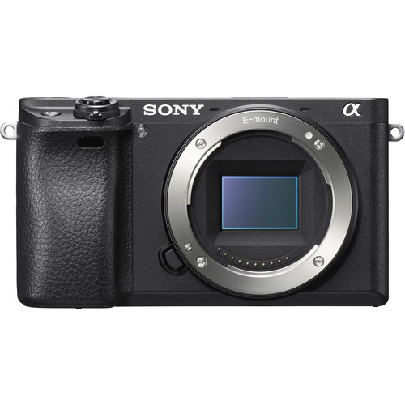
Sony Alpha 6300
$1000
Images are recorded on SD card: up to x hours of HD video. Download via USB
24.2MP APS-C Exmor CMOS Sensor
Can be controlled using proprietary SONY connector
Excellent image quality
Sony E-mount: many lens options

Slide 4
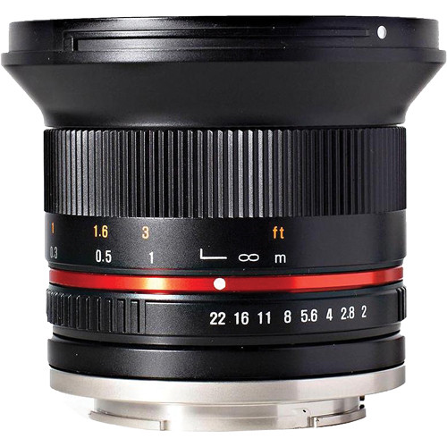
Lens selection
Requirements:
Wide angle (60 deg horizontal FOV)
Cost <$500
Small, light
Autofocus no required
Rokinon 12mm is excellent solution.

Slide 5
Cameras and lights positioning
Must have 360 degree coverage in stereo (gaps acceptable): at least 4 cameras pairs are needed.
Flat port will be used (domes are too expensive)
Minimum distance between cameras is 40 cm (16”) (tested by R. Starr)
Camera pairs must be toed in a few degrees
One camera will face down to help with lander placement
Lighting will be provided by 5 DSPL light. Backscatter is a concern.
Camera must be 40cm from seafloor
Drag, size and weight must be reduced
Number of connectors must be kept to a minimum

Slide 6
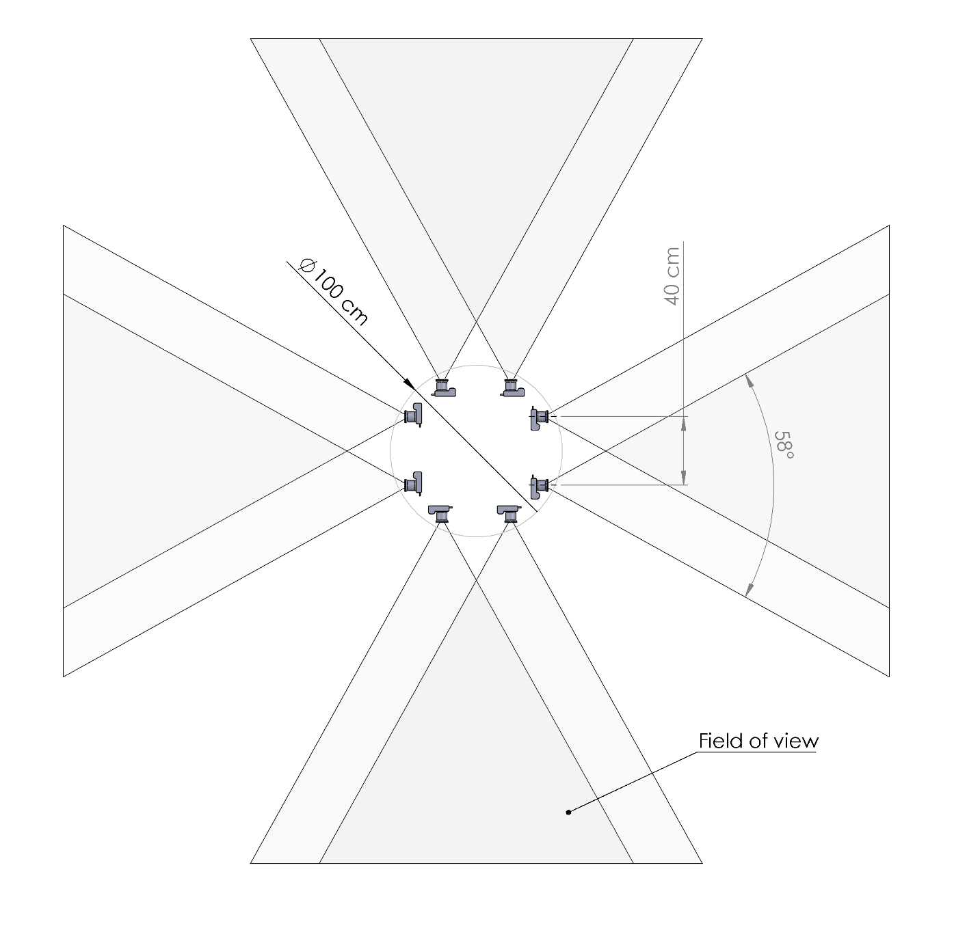
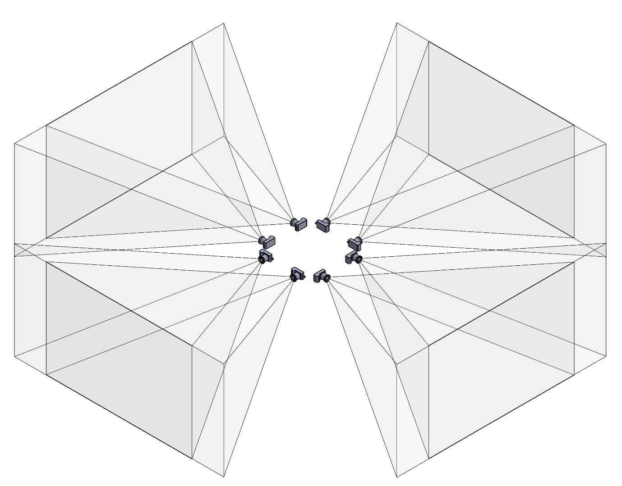
Cameras paired horizontally take too much space
Top view
Isometric view

Slide 7
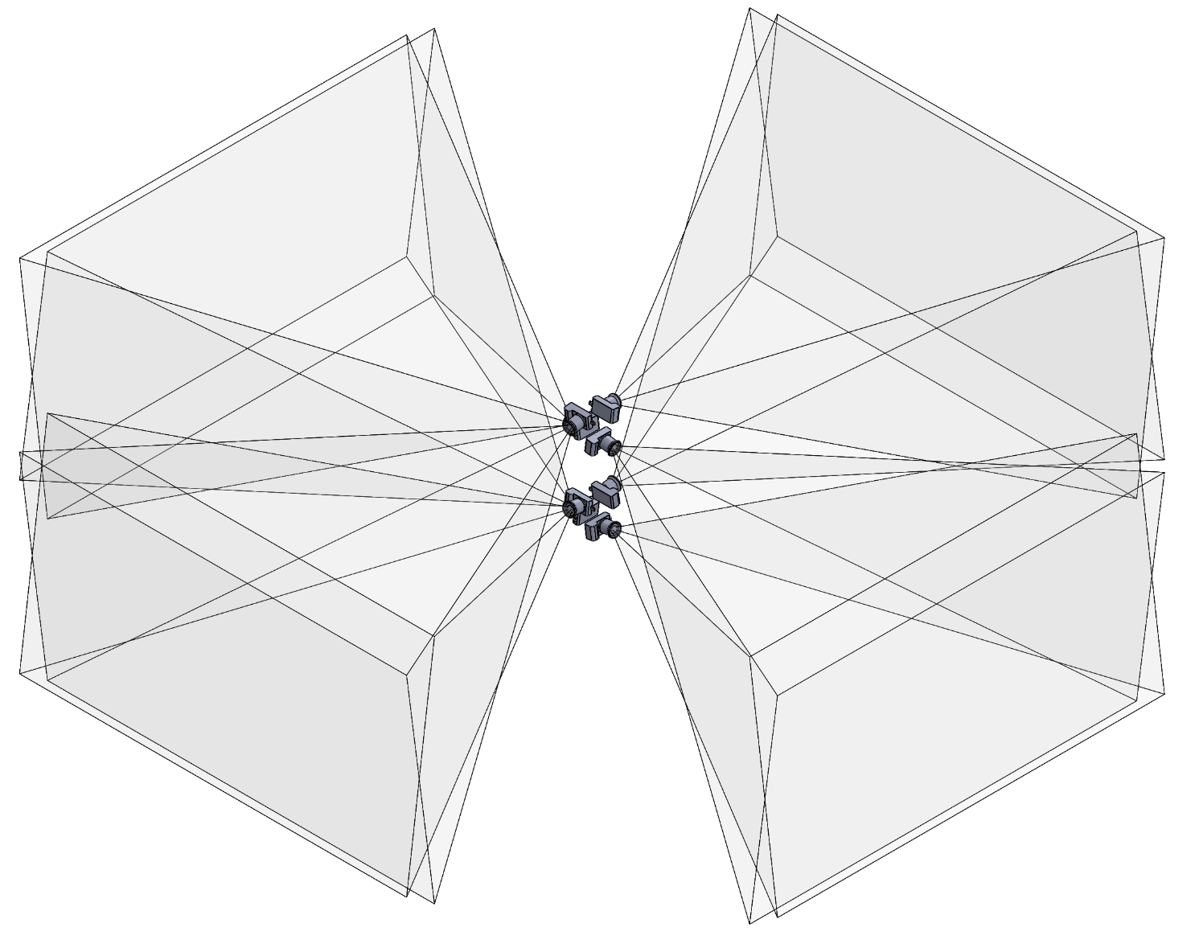
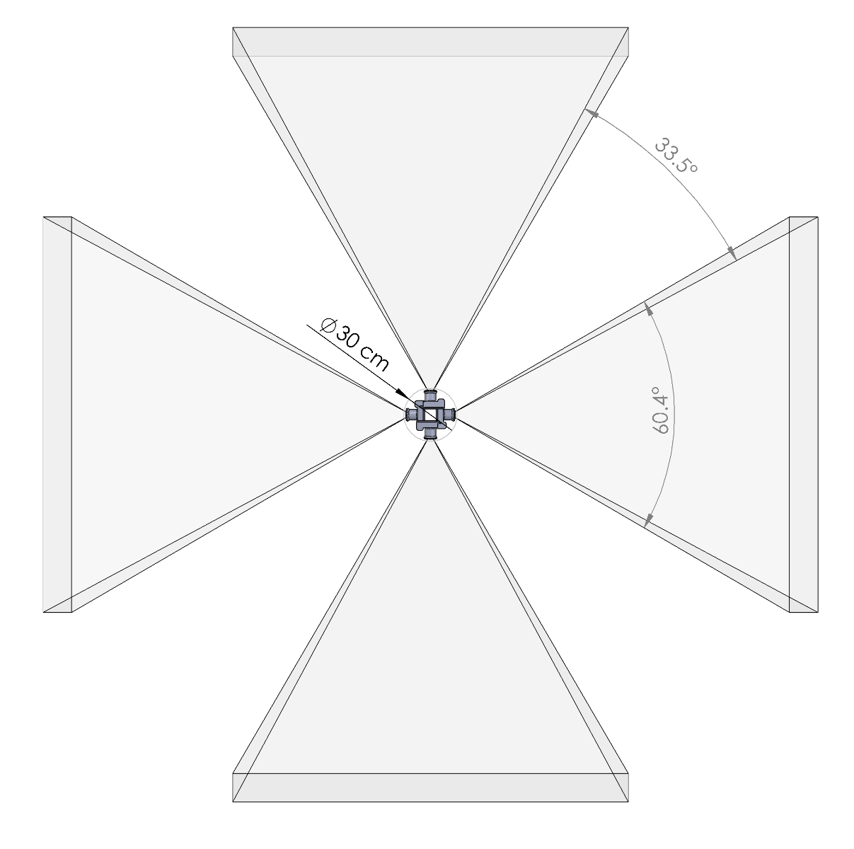
Cameras paired vertically, with offset have much smaller footprint
Top view
Isometric view

Slide 8
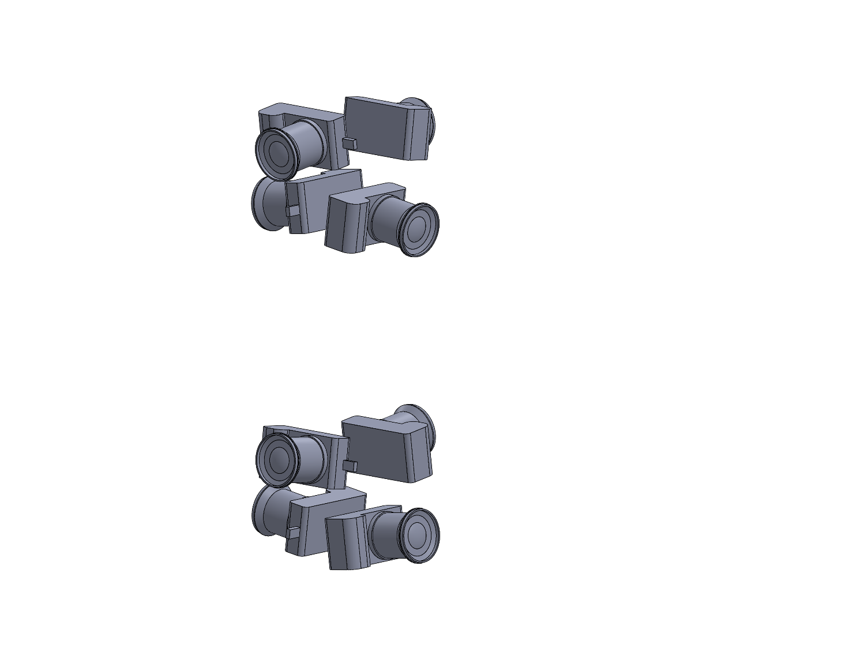
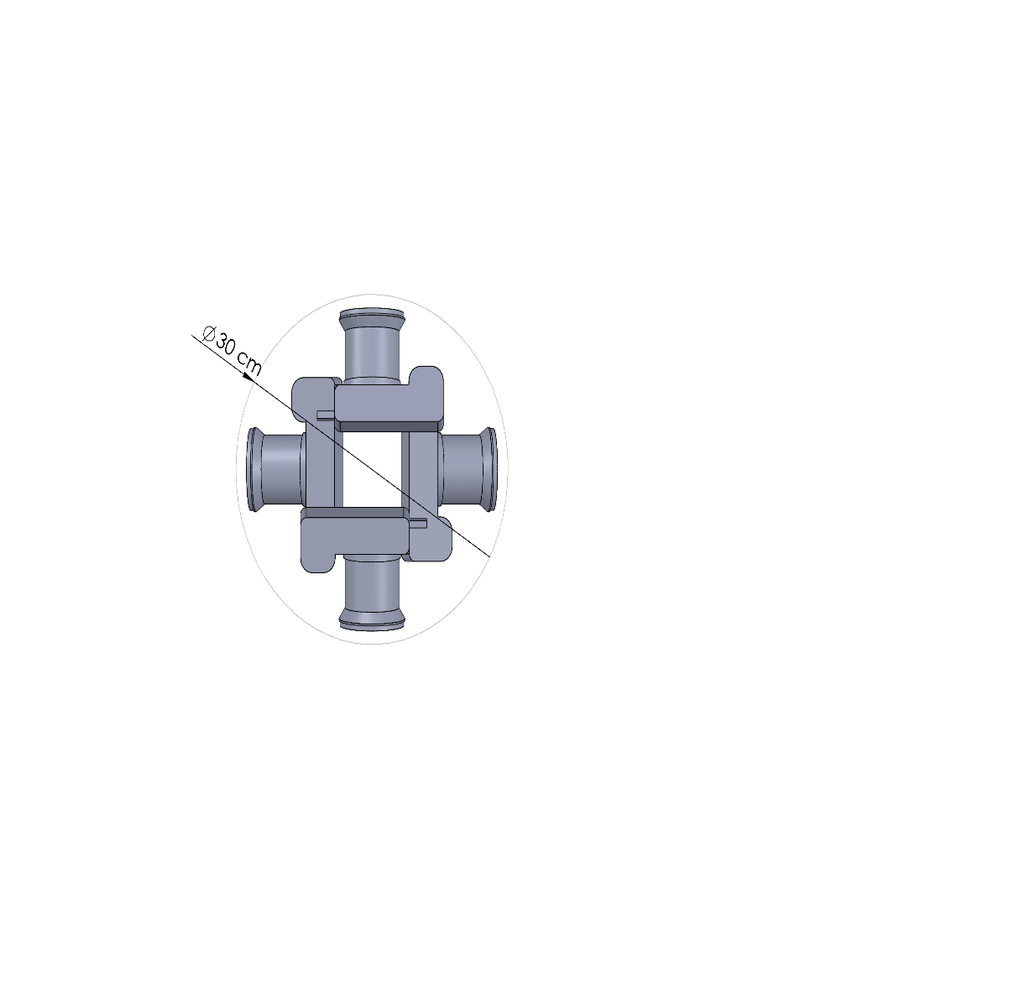
Cameras paired vertically, with offset have much smaller footprint
Can fit in a tall cylindrical housing.
Top view
Isometric view

Slide 9
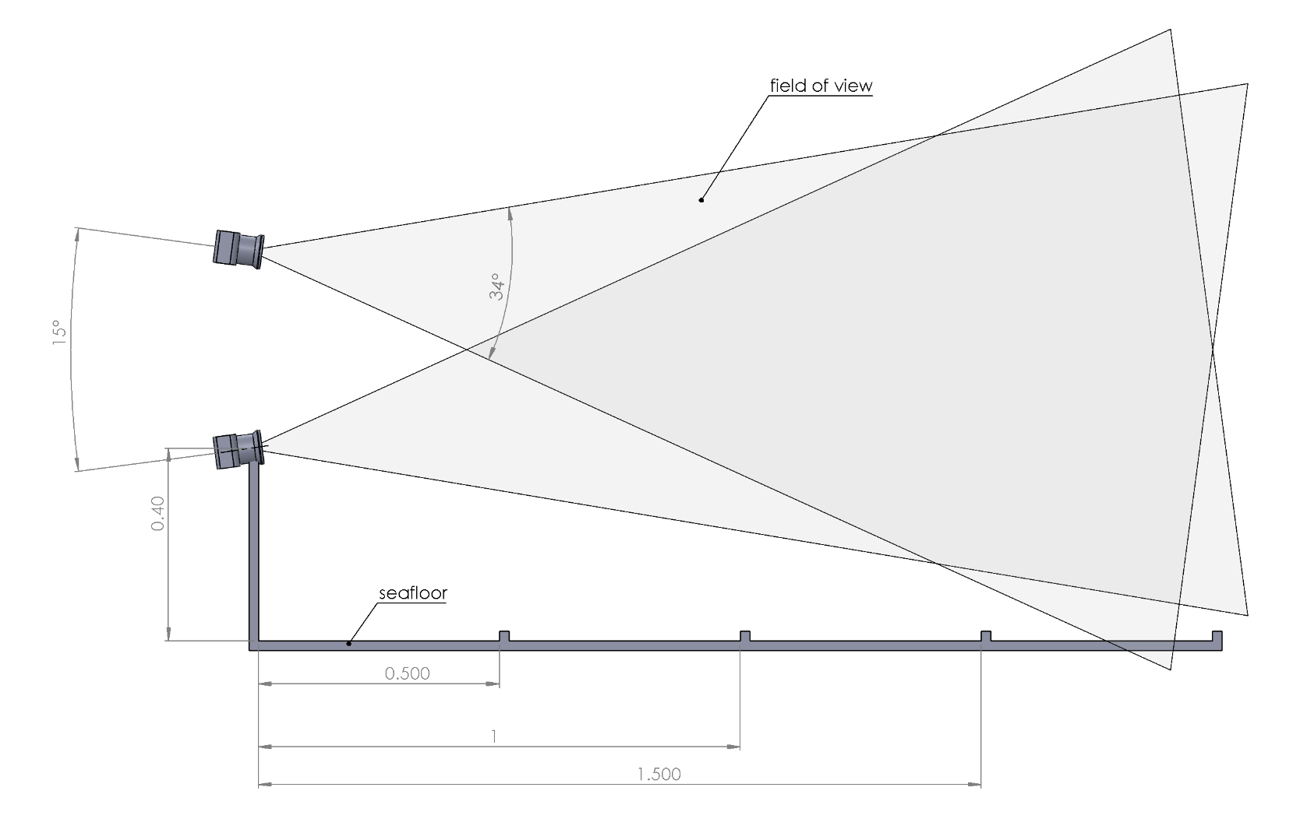
Camera angle and position relative to seafloor
Side view of fields of view of 2
Sony Alpha 6300 cameras in
video mode, with Rokinon
12mm lens, viewing through a
flat port in water.
The lower camera is 0.40m from
the seafloor. The distance
between cameras is 0.40m.
In still camera mode, the field
of view will be 15% wider and
30% taller.

Slide 10
Camera testing
Testing of single camera in the lab (in air)
  How is general camera and lens performance?
Testing of camera pair in a seawater test tank:
  How is image quality when viewing through a flat port?
  Is vertical pairing of camera suitable for photogrammetry?
  Does camera angle relative to viewing port affect photogrammetric capability?
  Does movement of camera relative to view port affect photogrammetry performance?

Slide 11
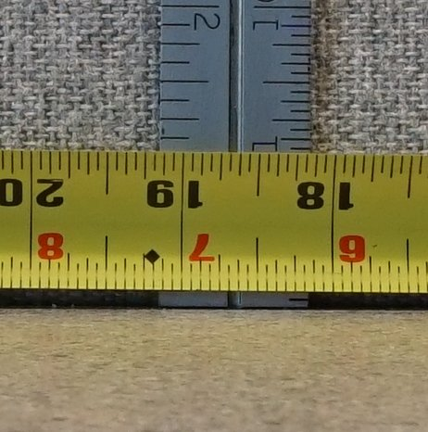
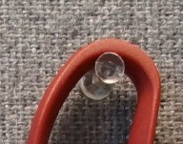
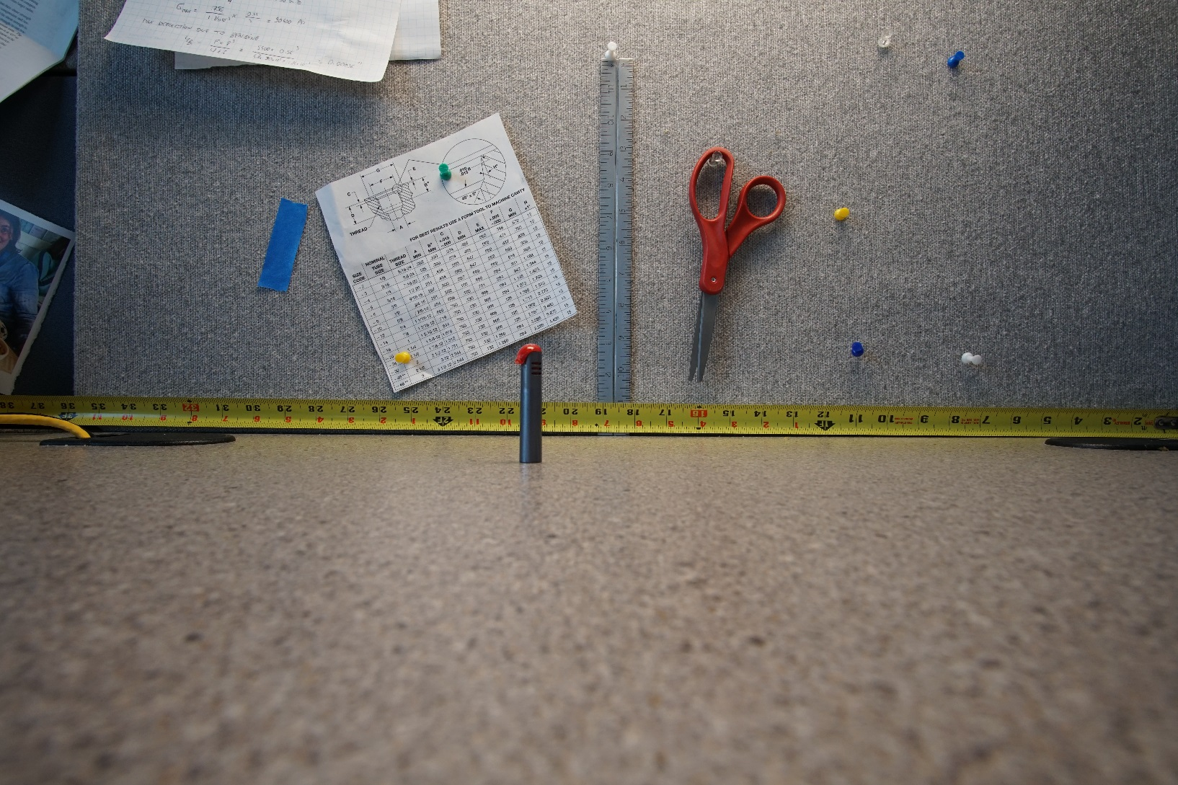
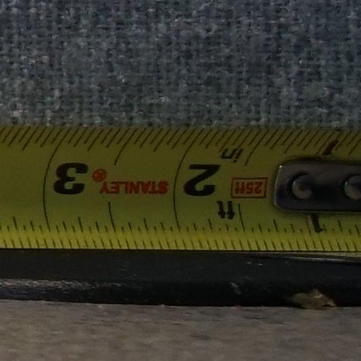
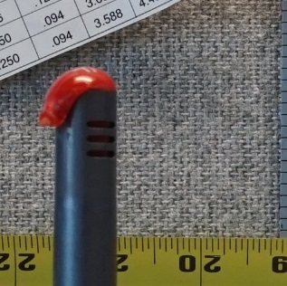
Camera test in air
Center of image
ISO 500
F8
1/125s
Natural lighting
Side of image
Depth of field
(red object at ½ distance)

Slide 12
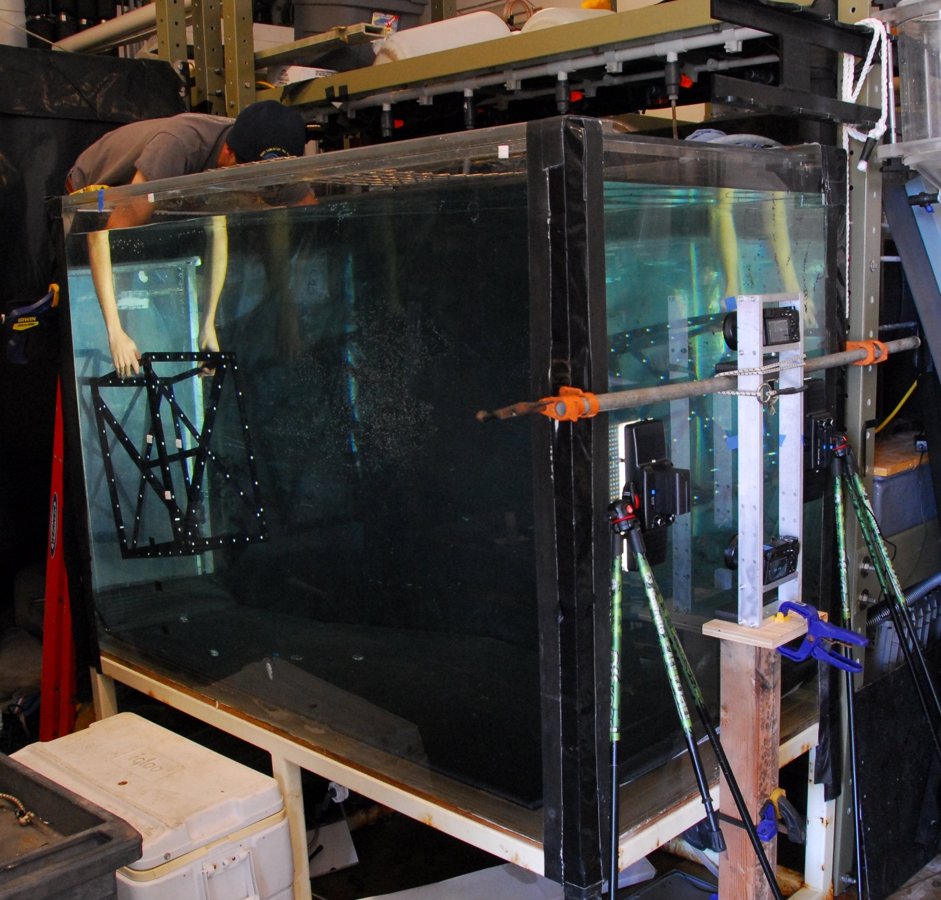
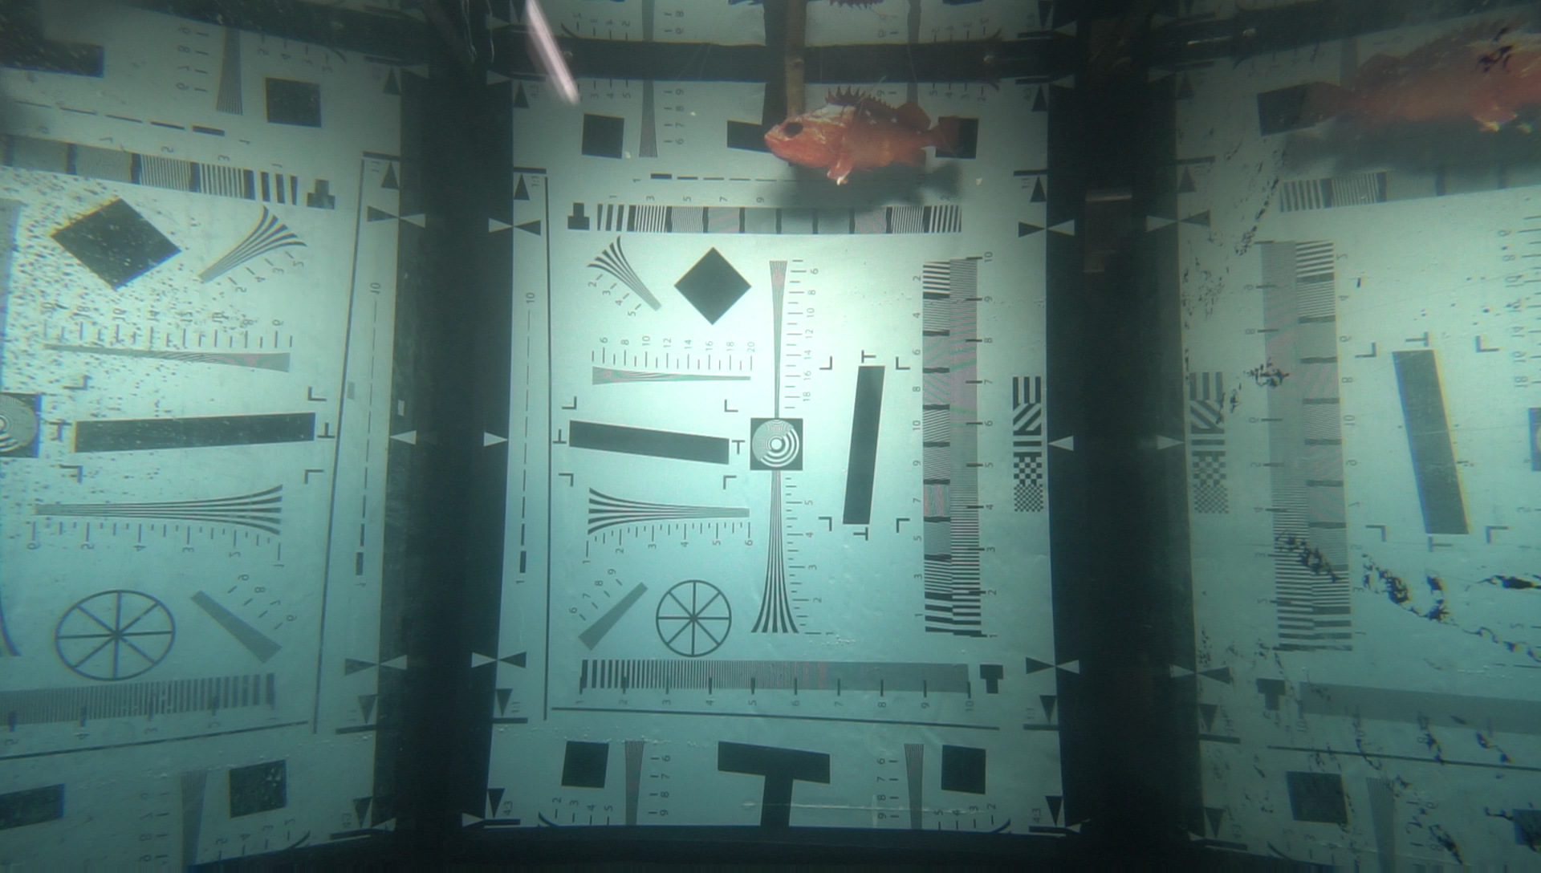
Camera pair test in sea water tank

Slide 13
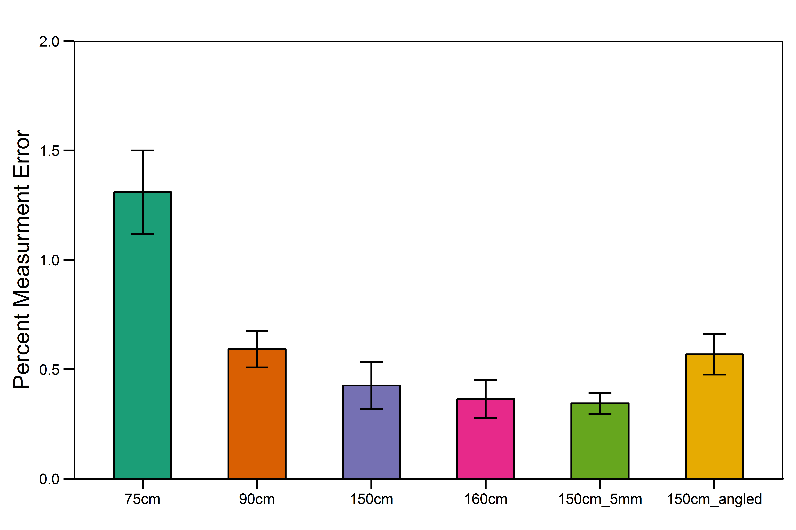
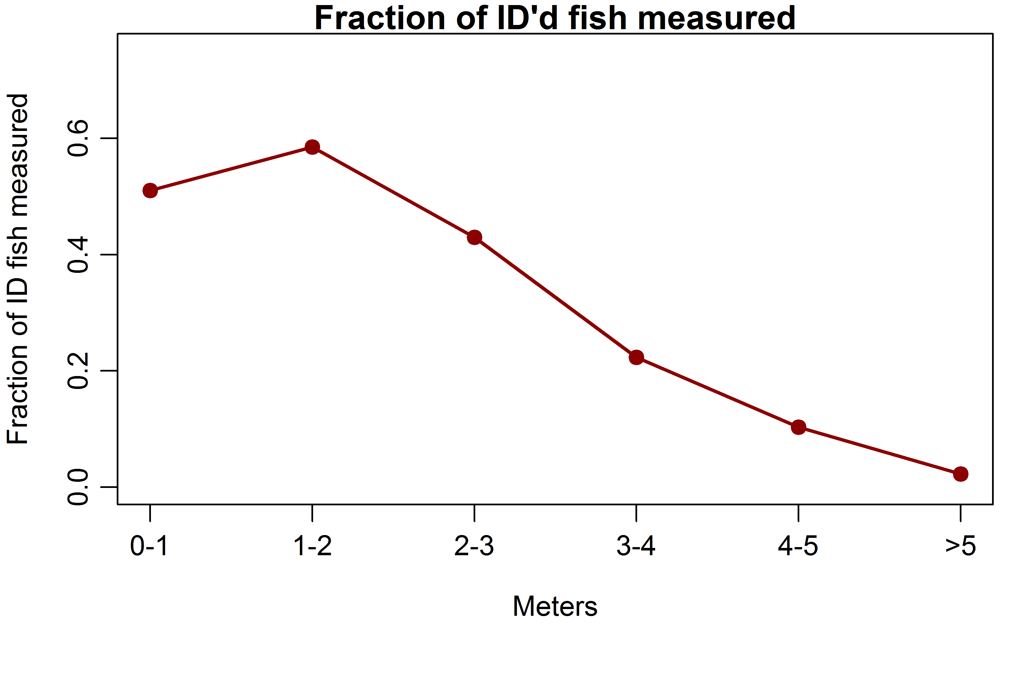
Description of results from tank test
Statistical analysis from Ryan

Slide 14
Description of camera housing concept (2 slides ?)
Camera ports
Materials, fabrication
Weight size
Rack for electronics and cameras

Slide 15
Description of lander concept (2-3 slides)
Swapable bases
Heavy at the bottom, light at the top (float) for righting moment
Low drag
Light positioning
Fin
Tether attachment

Slide 16
Description of mockup and test results 2 slides

Slide 18
Mockup 2

