Slide 1
Benthic Observation System
Main housing structural analysis
François Cazenave
06/02/2017

Slide 2
Main housing tube
OD: 11 7/8”, wall thickness: 3/8” wall. Based on available size.
Material (12” OD, ½” wall) has been ordered and dimensions checked.
Analysis for housing without ports was performed using Under Pressure.
Analysis for housing with ports was performed using Solidworks simulation.

Slide 3
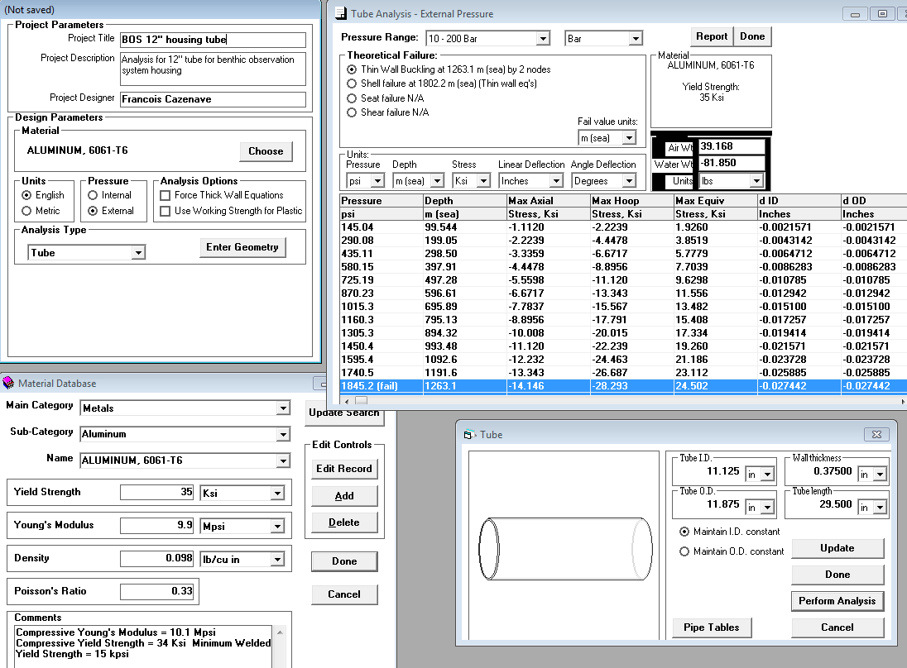

Slide 4
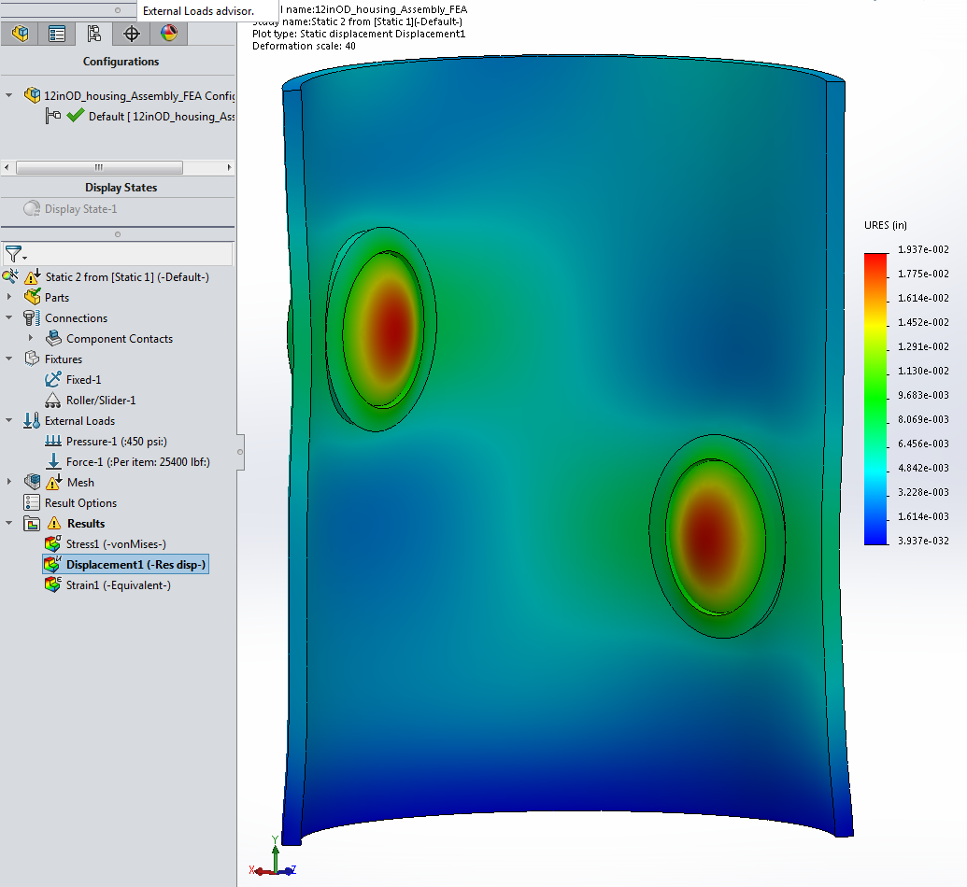
Displacement, inside.

Slide 5
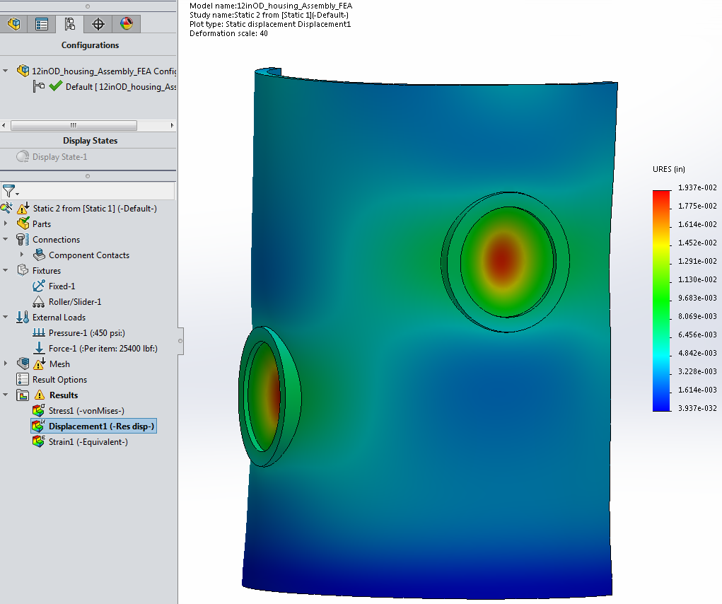
Displacement, outside.

Slide 6
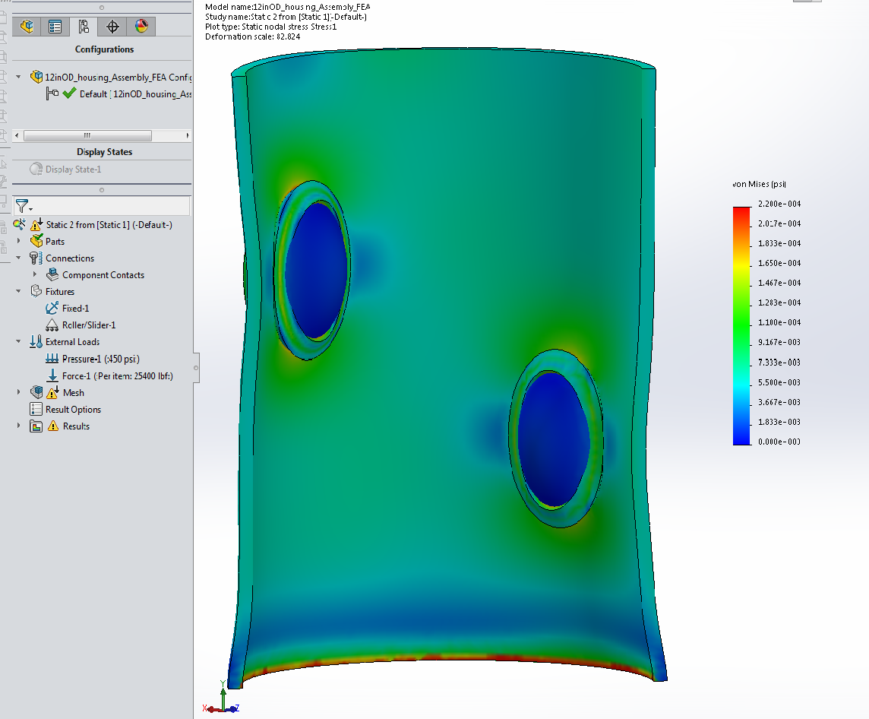
Stress, inside.

Slide 7
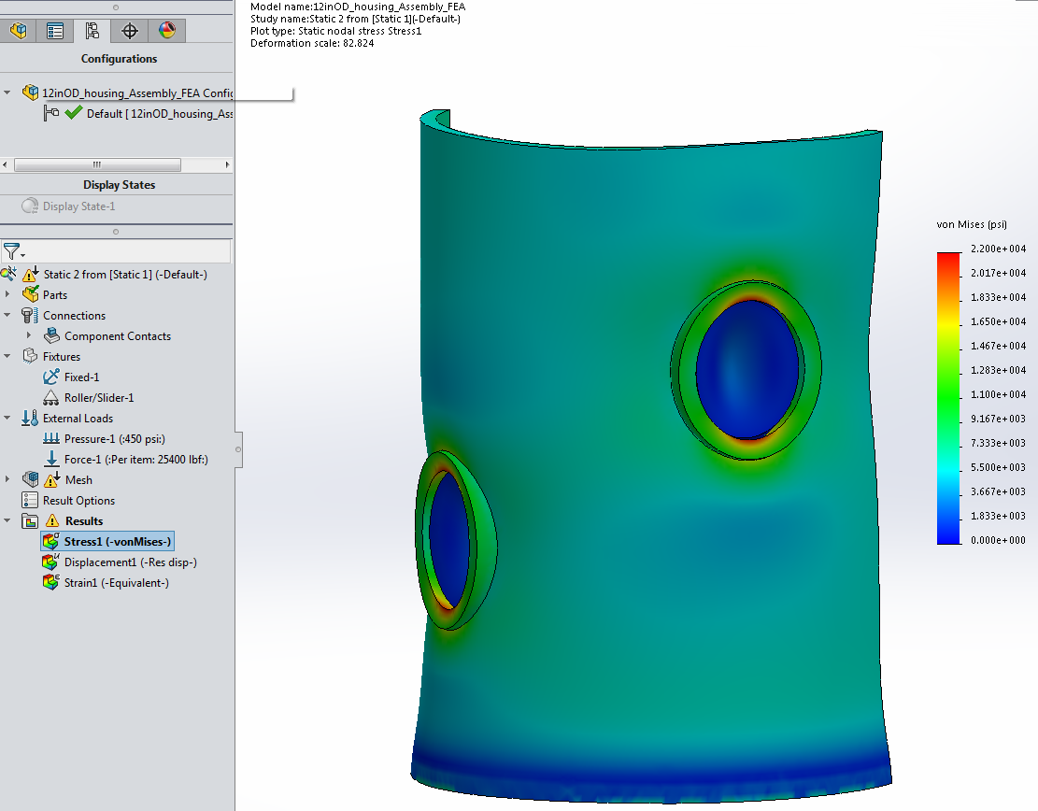
Stress, outside.

Slide 8
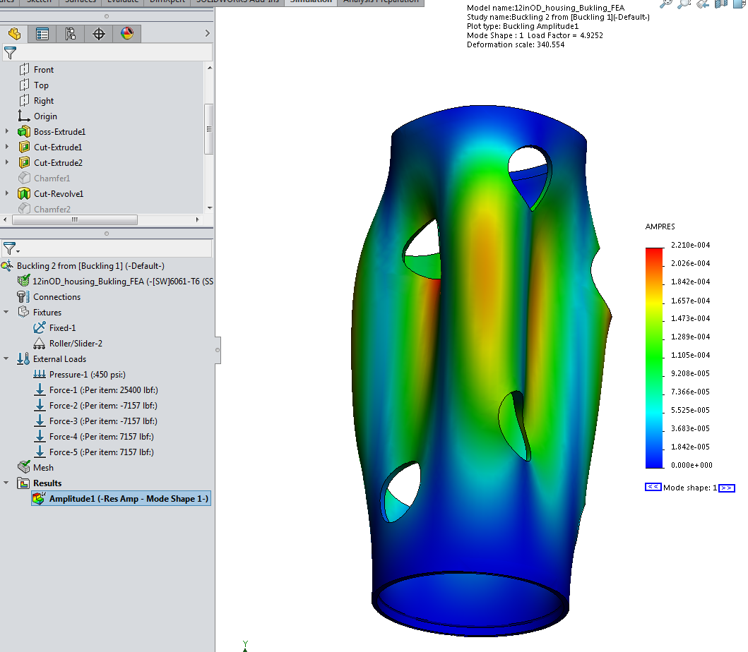
Buckling:
Load factor at 450 PSI: 4.95
(buckling at 4.92x450= 2214psi)
The analysis was also performed for a tube without holes. The load factor was 5.96 (buckling at 5.96x450psi = 2682psi). Compare with 1950PSI from Under Pressure analysis.

Slide 9
Endcaps
11.875” diameter, 0.875” thickness.
Analysis was performed using Under Pressure and Solidworks simulation.

Slide 10
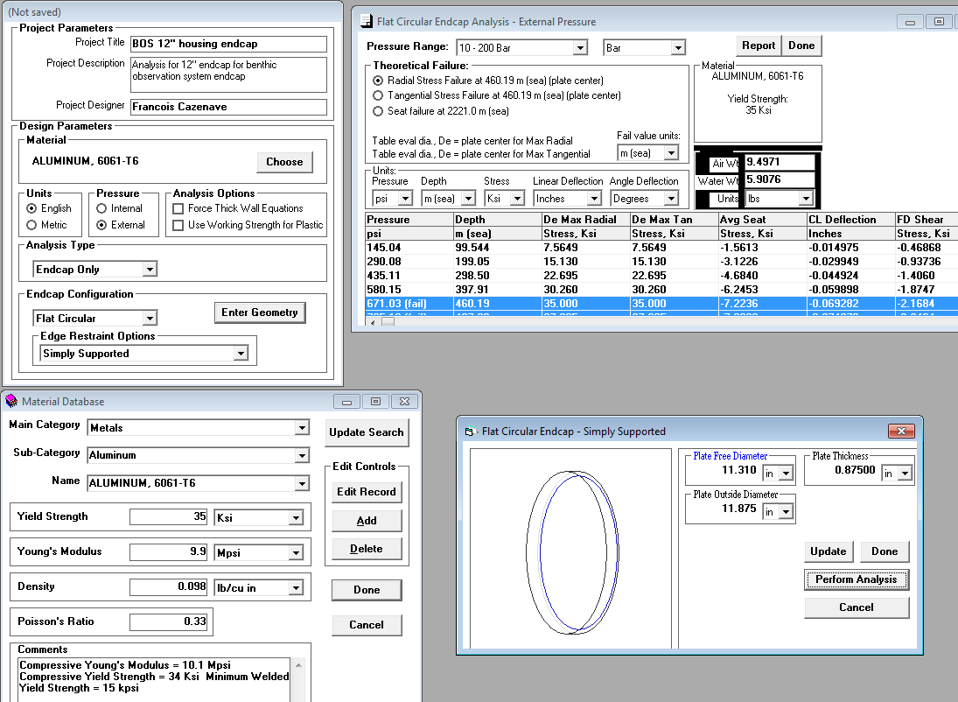

Slide 11
Acrylic port
3” diameter, 5/8” nominal thickness.
Analysis was performed using Under Pressure and Solidworks simulation.
A thick window is used to minimize deformation. Deformation of the port could result in stereo measurement error.

Slide 12
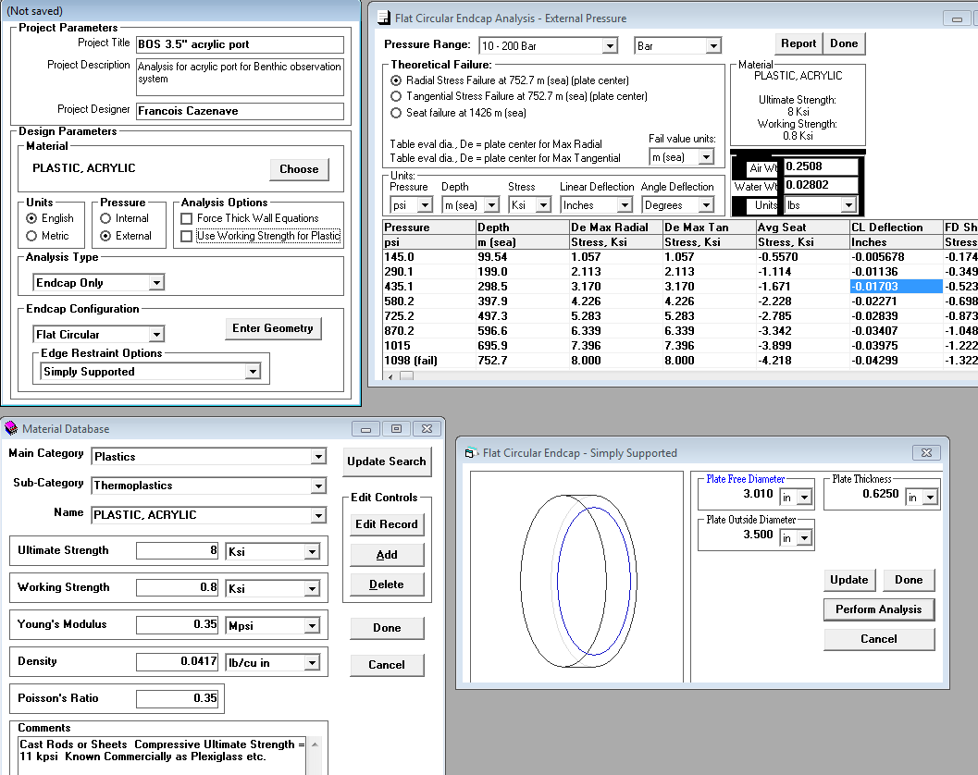

Slide 13
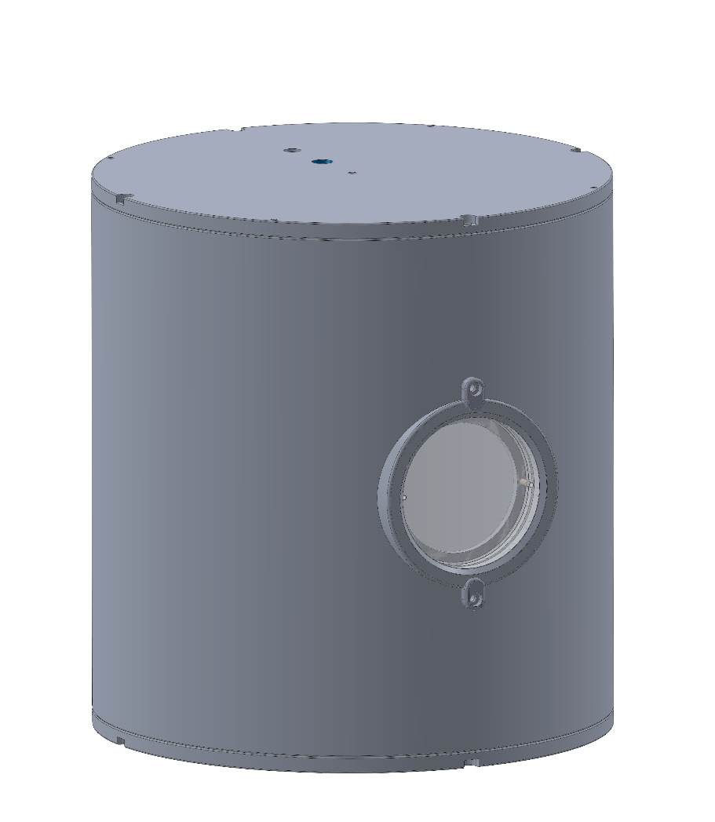
Pressure test of prototype
A 12” long housing with 1 port is being built by the machine shop and will be tested to a depth of 400m. Endcaps will be reused in the final version.
The test will be performed from R/V Paragon because the housing will not fit in MBARI’s pressure chamber.

