Slide 1
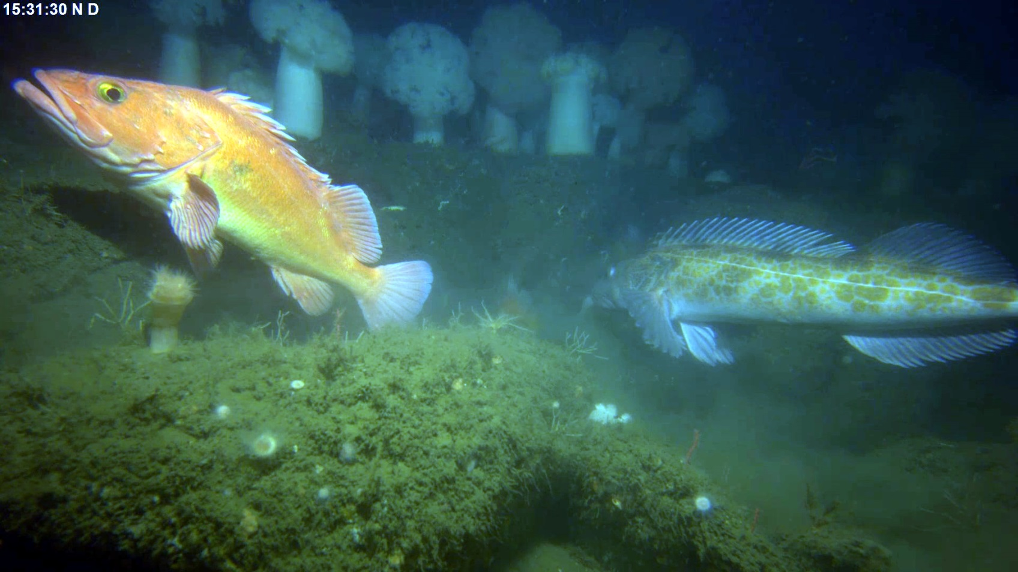
Benthic Observation Survey System (BOSS)

Slide 2
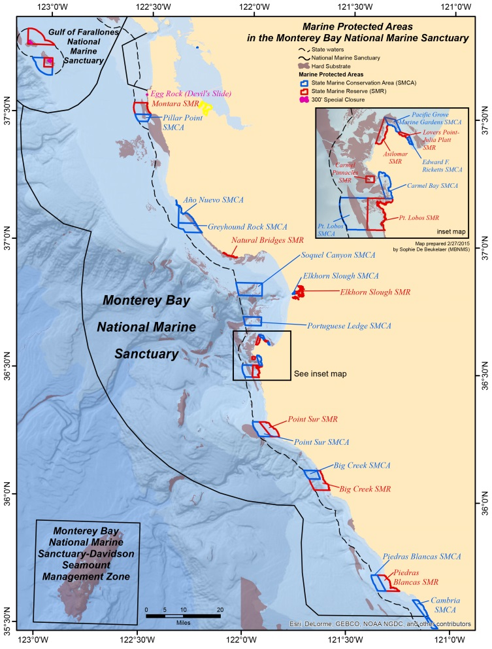
Science Background
Monterey Bay National Marine Sanctuary created in 1992
Administered by NOAA
National monuments and exclusion zones with the MBNMS
Multiple agencies taking part in coastal wide stock assessment studies

Slide 3
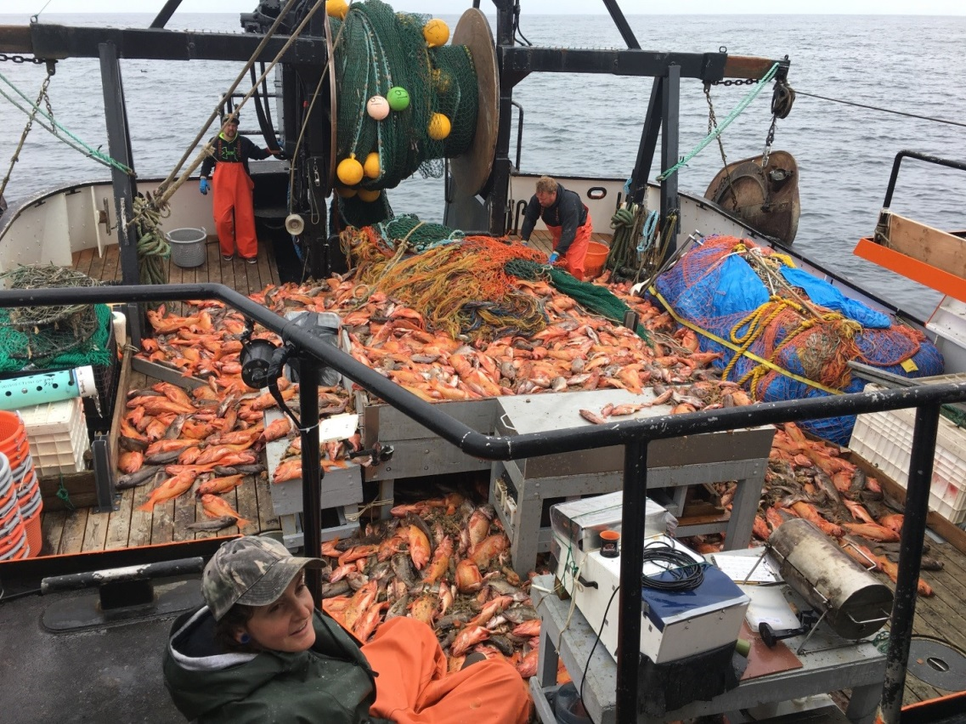
Science Background
West Coast Groundfish Bottom Trawl Survey
  Held twice annually
  Exclusively in low-relief soft-bottom habitats
  Assumption: trawlable estimation of non-trawlable areas?
Fishery Resource Analysis and Monitoring (FRAM) Division
  Frequency of occurrence
  Density
  Length-Frequency Distributions
  Calculated Biomass

Slide 4
Science Background
TNC/MLML got involved in a collaborative project to provide information on Demersal fishes in untrawlable areas:
  Distribution
  Density
  Size Structure
Hypothesis: Video surveys performed in a statistically sound manner can provide information to improve stock assessments of species that primarily inhabit untrawlable rocky areas.

Slide 5
TNC/MLML Scientific Goals
Improve fishery-independent data collection in habitats that are not adequately covered in the annual West Coast Groundfish Bottom Trawl Survey.
Develop methods to use video surveys in stock assessments with the ultimate goal of improving our knowledge of the status of rebuilding stocks.

Slide 6

Gen1 Video Lander
Built by Marine Applied Research & Exploration (MARE) in 2011-2012
  Input from Tim and Tyler Maricich
Pair of stereo cameras & lights mounted on a mechanically rotated swivel
Crab pot base
  Idea to cushion landing on rocky structure
Tethered system (power & comms)
Video recorded on lander
Rated to 300 meters

Slide 7
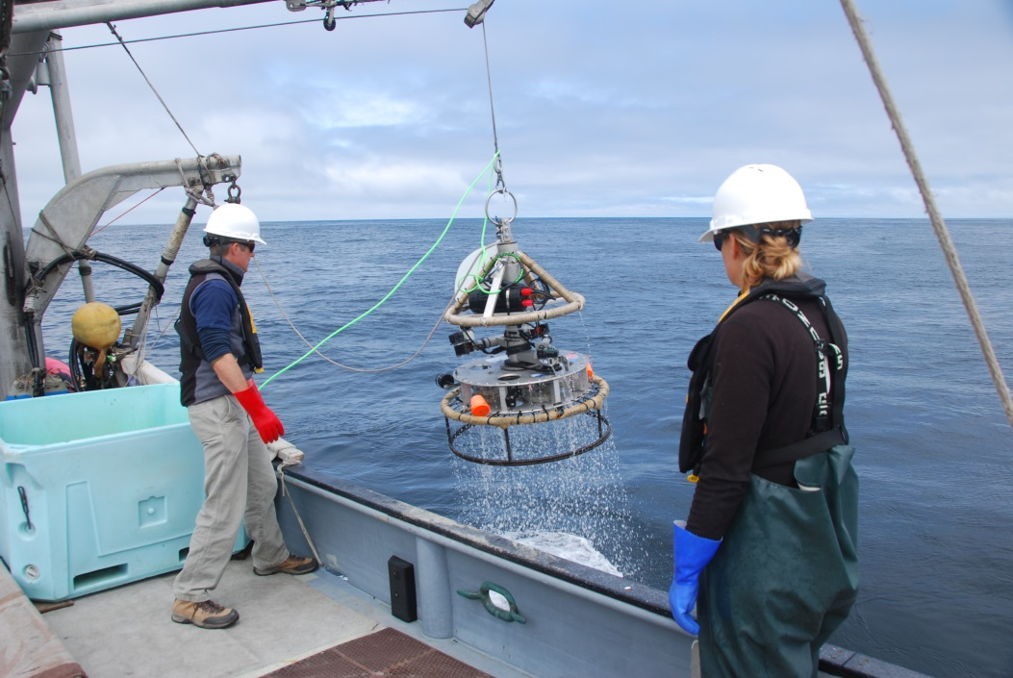
Gen1 Video Lander Limitations
Technical Issues:
  Crab pot base would not allow for easy placement on or near rocks
  Dual cameras were on a motorized swivel mount
    slow rotation resulted in occasional double counting of fish
    mechanical noise may have scared fish away
  Bulky build caused slow descent/ascent
  Difficult to launch and recover
  Limited system control from ship
TNC wanted a system that was more functional and easier to deploy
  Goal is to survey more sites per ship-day

Slide 8
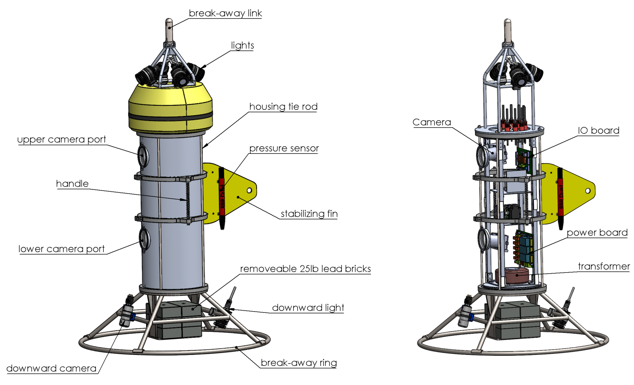
BOSS Prototype

Slide 9
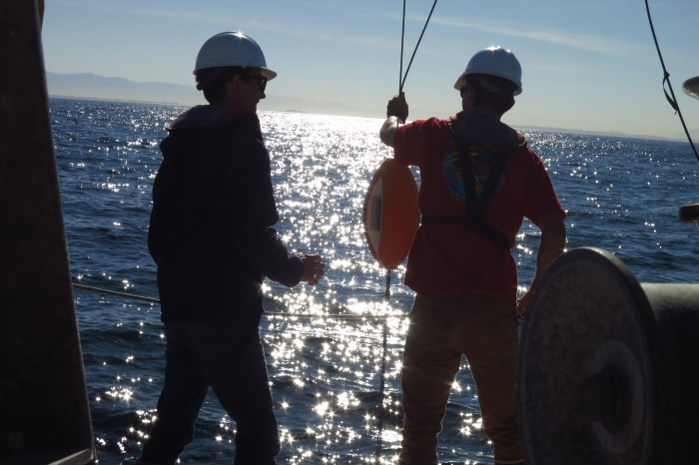
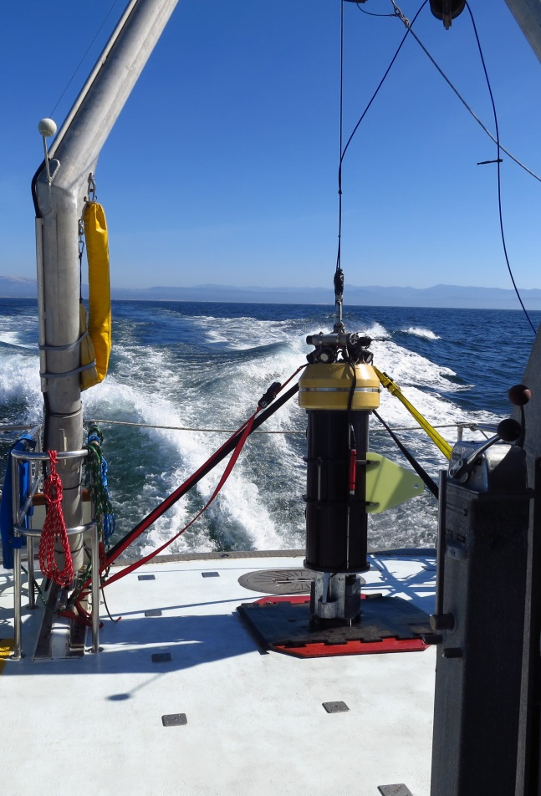
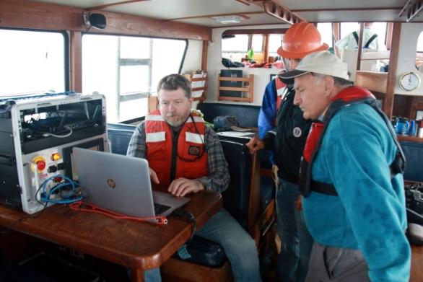
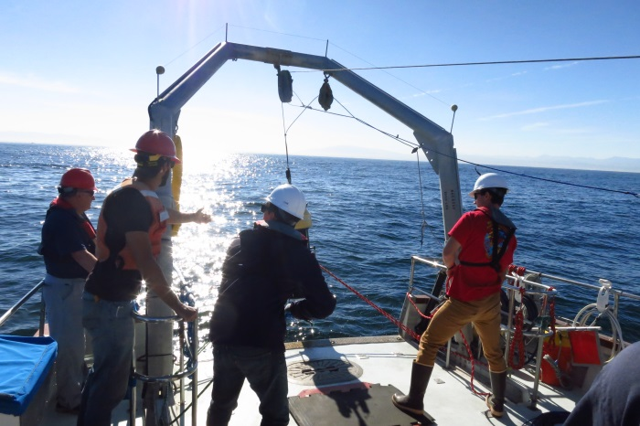
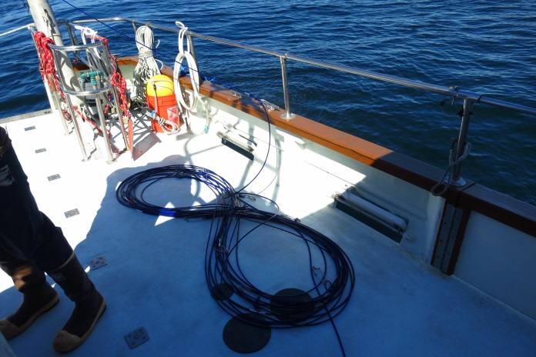
First At-Sea Trials (R/V John Martin)

Slide 10
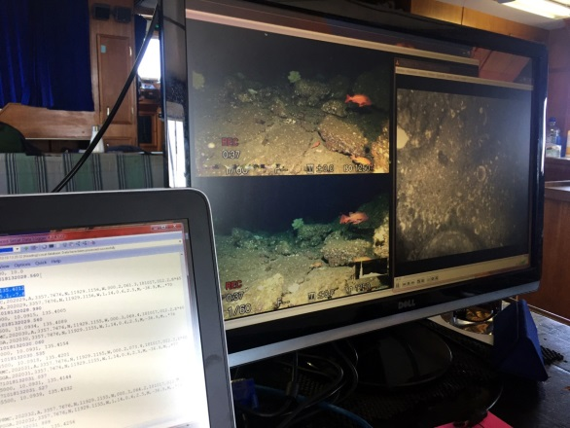
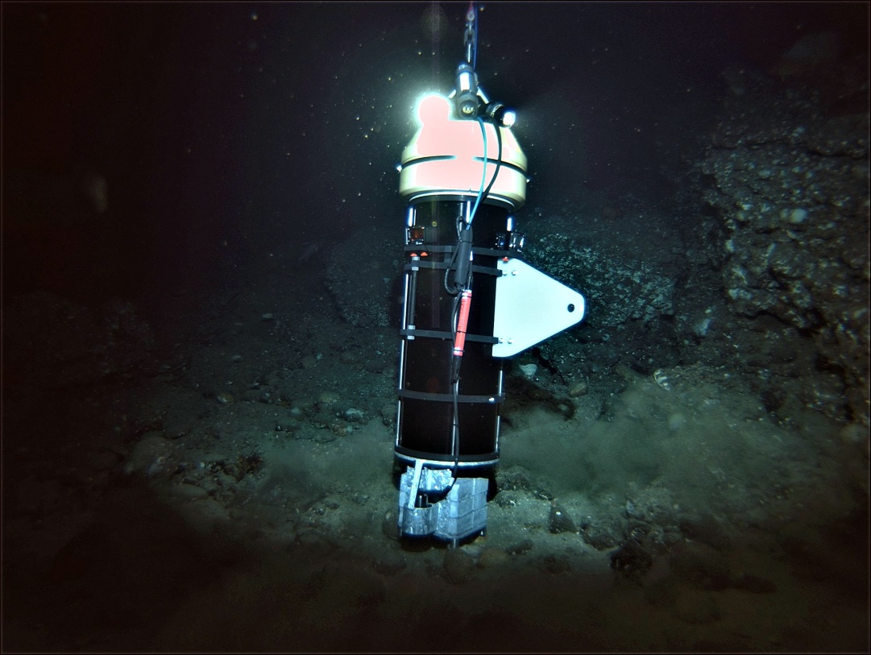
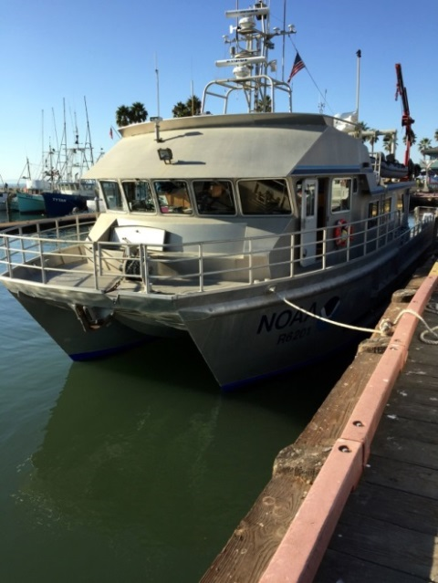
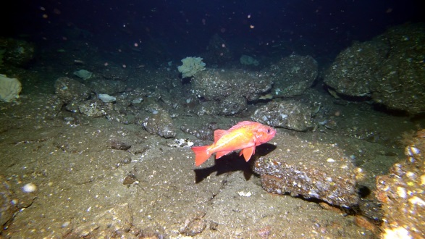
Fall 2017 Deployment (R/V Shearwater)

Slide 11
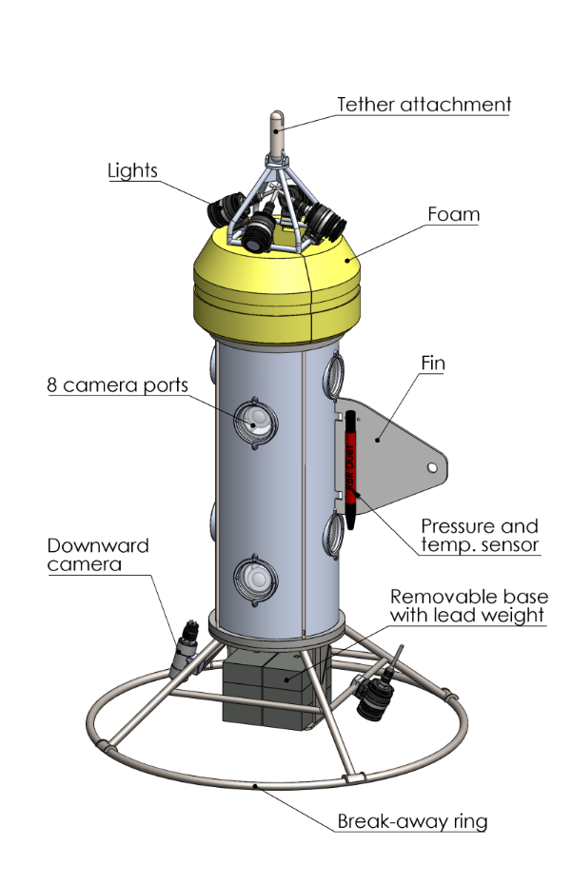
BOSS Upgrades (2018)
8 Stereo cameras
  More camera evaluation tests
Top side recording
  Ability to record 9 HD channels simultaneously
Fiber based tether
  Smallest diameter while meeting all reqs
Dedicated winch
  Multiple ships accommodation requirements

Slide 12
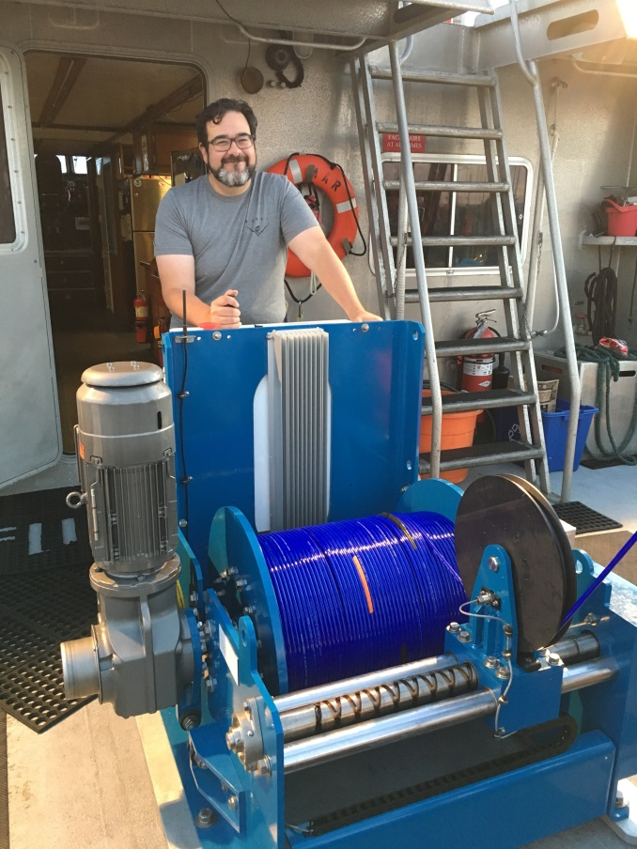
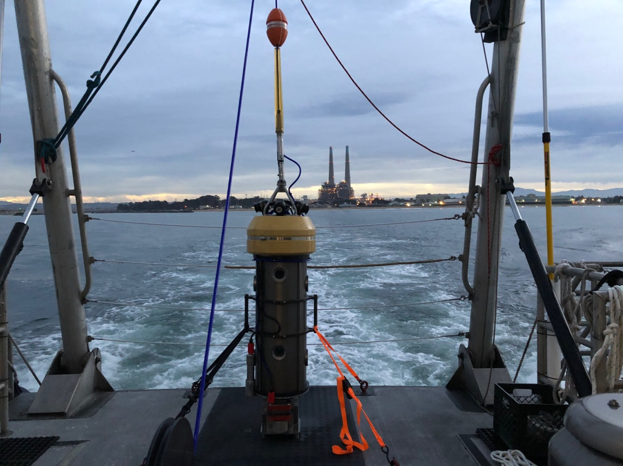
Launch & Recovery Components

Slide 13
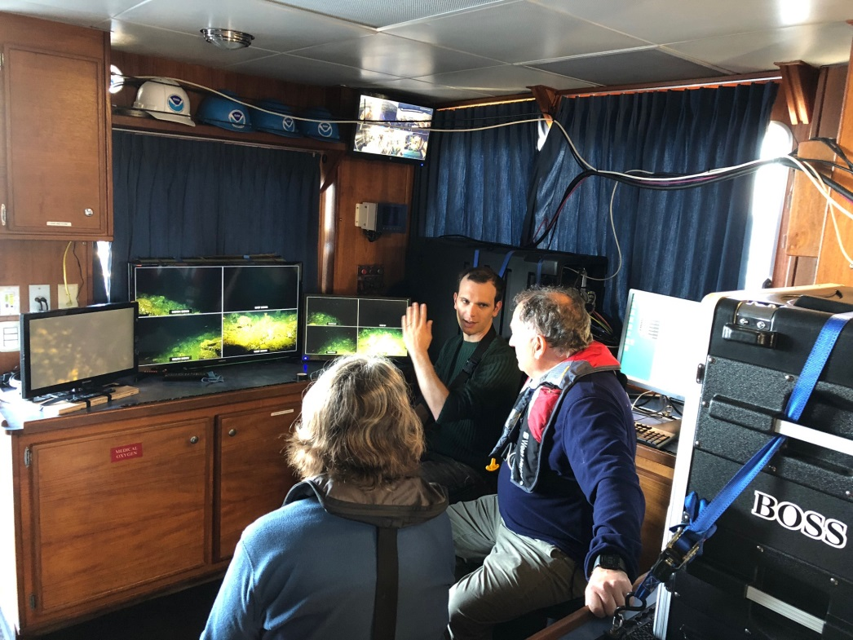
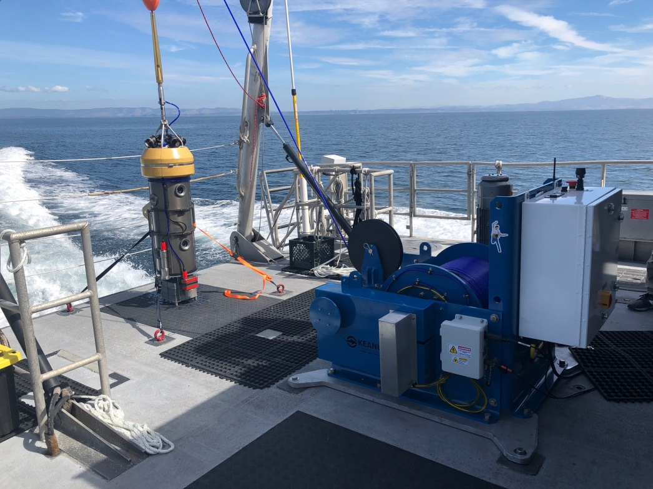
Fall 2018 Deployment (R/V Fulmar)

Slide 14
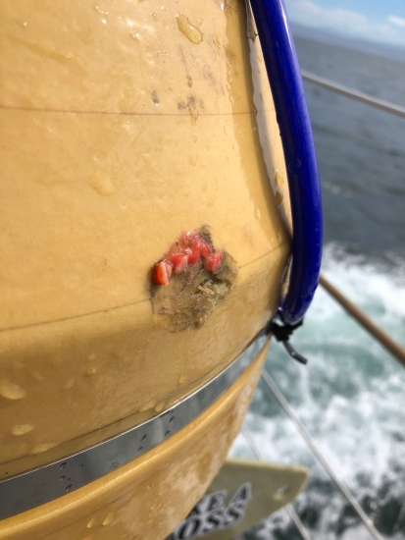
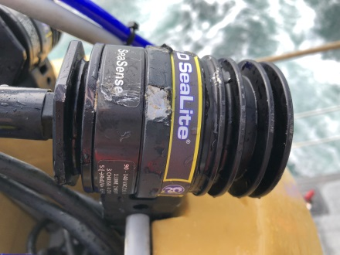
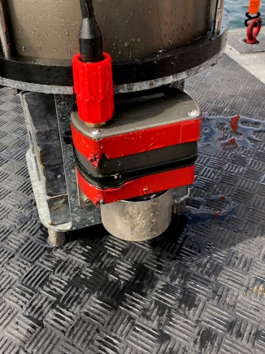
Fall 2018 Deployment Results
24 Operational Days (over 35 days)
400+ Drops made
3600+ Video files (~5 min in duration each)
1.3 TB of video
Video being analyzed by the Fisheries and Conservation Biology Lab at MLML
  Rick Starr, Ryan Fields, Jimmy Williamson, Katie Cieri
  EventMeasure Software (Jim Seager, SeaGIS)
BOSS took a few hits and dings but survived intact!

Slide 15


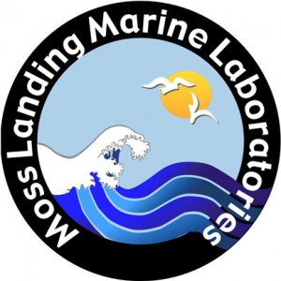
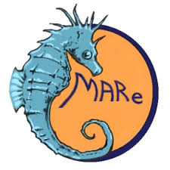
BOSS Project Team
Monterey Bay Aquarium Research Institute
The Nature Conservancy
(MBARI)
  Chad Kecy (PM, EE)
  Franҫois Cazenave (ME)
  Craig Okuda (EE)
  Eric Martin (EE)
  Kent Headley (SE)
(TNC)
  Mary Gleason (PI)
Moss Landing Marine Labs
Marine Applied Research & Exploration
(MLML)
  Rick Starr (PI)
  Ryan Fields
  Jimmy Williamson
  Katie Cieri
(MARE)
  Dirk Rosen
  Andy Lauerman
  Rick Botman

