Slide 1
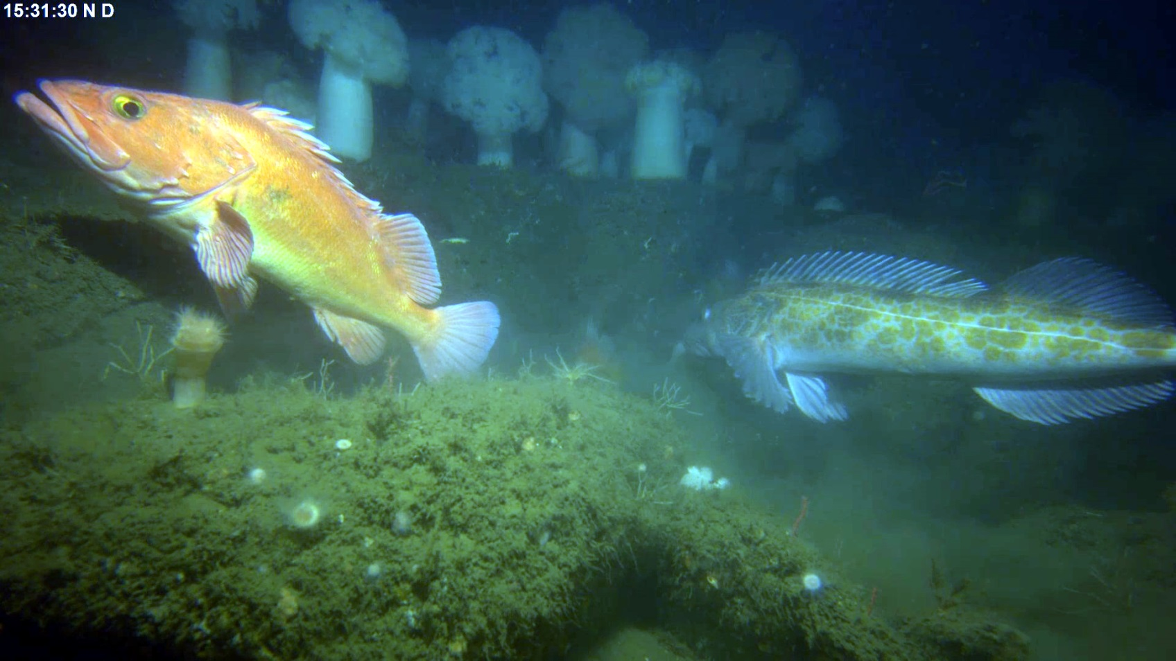
Benthic Observation Survey System (BOSS)

Slide 2

BOSS: Why do we need it?
Existing tools and methods for fish counting & sizing too slow and intrusive
First generation lander:
  Crab pot base would not allow for easy placement on or near rocks
  Dual cameras were on a motorized swivel mount
    slow rotation resulted in occasional double counting of fish
    mechanical noise may have scared fish away
  Bulky build caused slow descent/ascent
  Difficult to launch and recover
  Limited system control from ship
TNC (The Nature Conservancy) wanted a system that was more functional and easier to deploy
  Goal is to survey more sites per ship-day

Slide 3
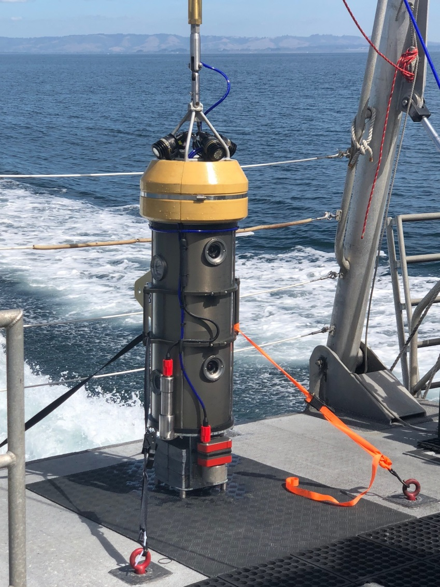
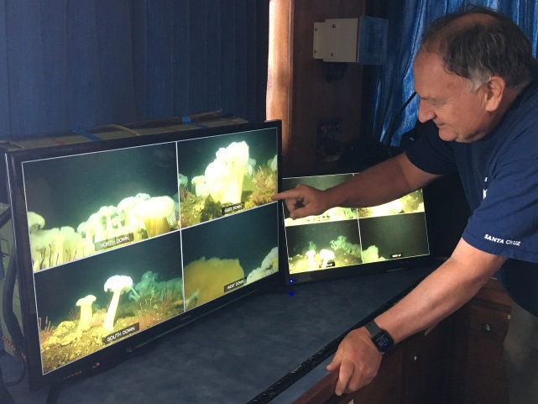
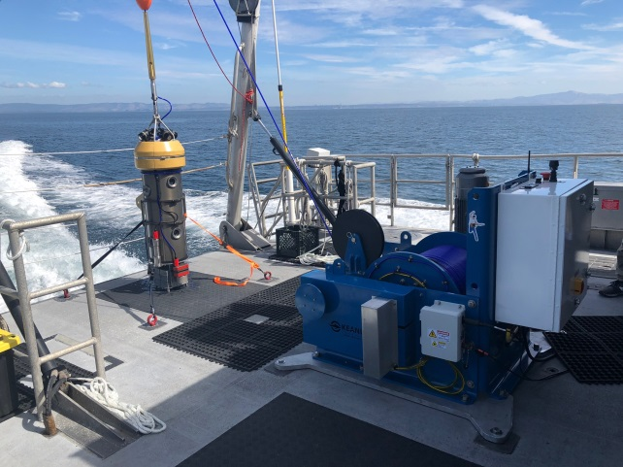
BOSS: Features & Capabilities
8 High-Definition Cameras (4 camera pairs)
  Will give 360-degree coverage
  Real-time video streamed to and recorded on ship
  Less time required at each survey site (~3-5 min per site)
Downward approach camera assists with drop location
Fiber tether with strength member and dedicated electric winch
  Minimizes launch/recovery time and complexity
  Large optical bandwidth allows 9 channels of HD video streaming topside
Narrow base allows BOSS to land in and around rocky habitats
Fin allows BOSS to be easily maneuvered to multiple sites in one dive
Full system control from ship
System is easily transported and can be deployed from multiple ship classes

Slide 4





BOSS: Plans for 2019
Third and final year of project
Technology transfer to MARE (Marine Applied Research & Exploration)
  MARE will produce multiple BOSS units for TNC/MLML
Will provide MARE a complete documentation package
TNC/MLML will continue to deploy BOSS throughout 2019

