Slide 1
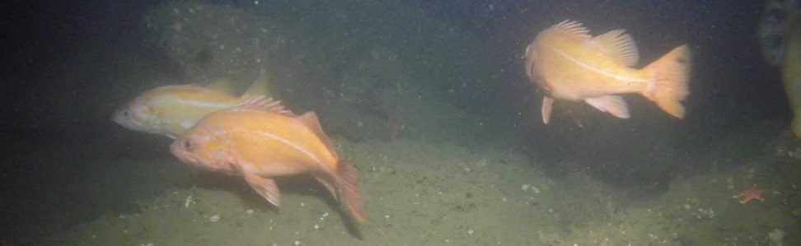
Multi-Purpose Benthic Observation System

Slide 2
Motivation for BOS
Abilities of the BOS
Need for a modular platform which combines stereo video imagery with contextual sensors
A modifiable system can reduce the number of expensive one-off systems for specific missions
Driven by an immediate need from The Nature Conservancy
  Rockfish monitoring in MPAs
Users
  The Nature Conservancy (TNC)
  Jim Barry
  Francisco Chavez
  Kelly Benoit-Bird
High-def stereo camera pair
  Live view available, if tethered
  3 additional camera pairs may be added to give 360 degrees of stereoscopic video
Up to four external instruments may be attached
May be tethered or autonomous
Rated to 300 meters
  1500 meter version in future
Can land on or near rocky outcroppings
Can be deployed from vessels of opportunity

Slide 3
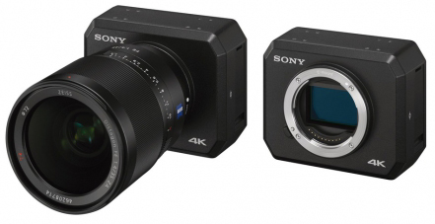
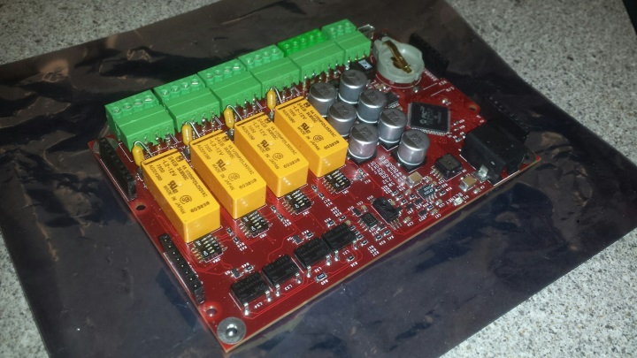
Design of Benthic Obs System
Shares existing technology with:
  SeeStar project (901107)
  Oasis5 boards (901507)
  MiniROV (901123)
Adaptable functions by mission
  3G-ESP
  360 degrees of stereoscopic imaging
  Side scanning sonars
  ADCPs, CTDs, O2, pH sensors
20+ Instrument software drivers already written for Oasis boards.

Slide 4
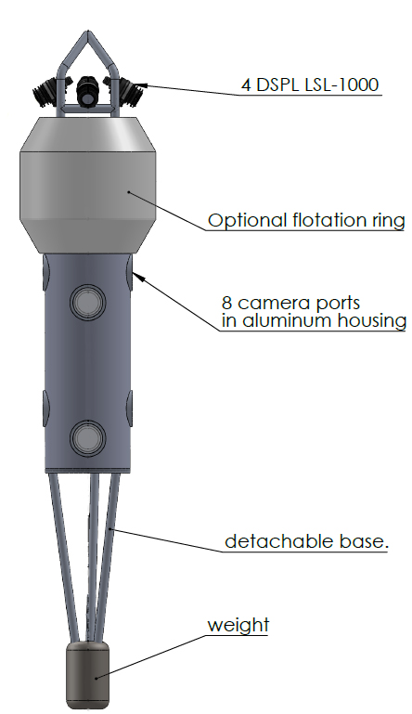
Initial TNC Concept
Will be lowered via a load bearing tether, which provides real time video and data feedback
4 camera pairs give nearly 360 degrees of stereoscopic video
Each camera pair has dedicated light
Customizable base allows for landing on rocky outcroppings or other difficult terrain
Hydrodynamic design allows it to be easily pulled from local site to site while remaining submerged

