Slide 1
Benthic Observation System (BOS)

Slide 2

BOS: Why do we need it?
Existing tools and methods for fish counting & sizing too slow and intrusive
First generation lander:
  Crab pot base would not allow for easy placement on or near rocks
  Dual cameras were on a motorized swivel mount
    slow rotation resulted in occasional double counting of fish
    mechanical noise may have scared fish away
  Bulky build caused slow descent/ascent
  Difficult to launch and recover
  Limited system control from ship
TNC wanted a system that was more functional and easier to deploy
  Goal is to survey more sites per ship-day

Slide 3
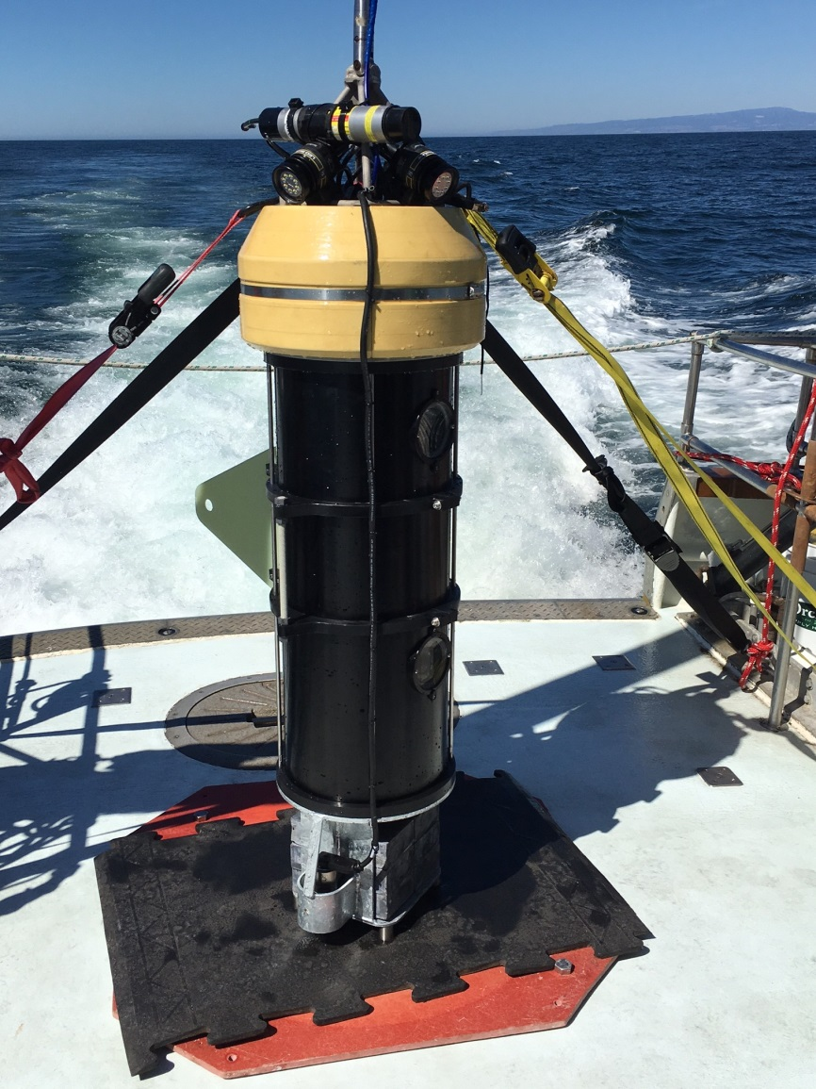
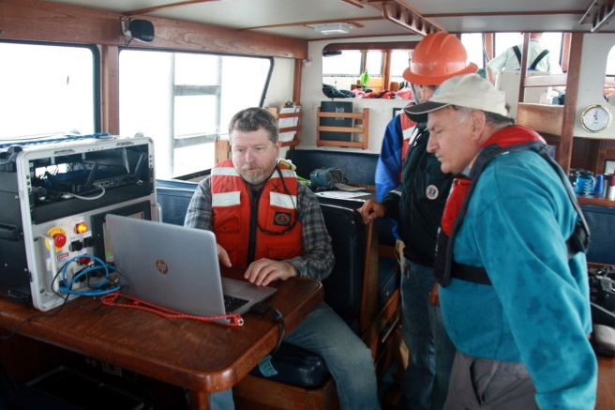
BOS: Prototype features & capabilities
Records stereoscopic HD video
  Real-time HD video also streamed to ship
Narrow base allows BOS to land in and around rocky habitats
  Swappable bases depending on seafloor type
Downward approach camera assists with drop location
Attached fin allows BOS to be easily maneuvered underwater to multiple sites in one dive
Full system control from ship
System is easily transported and can be deployed from multiple ship classes

Slide 4
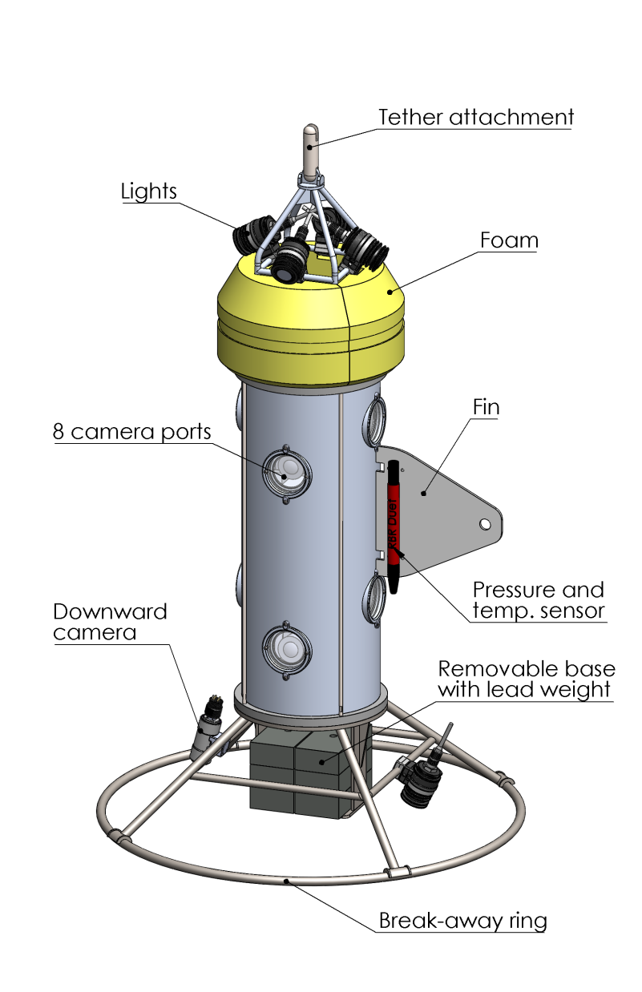
BOS: Where do we go in 2018?
8-Camera version (4 camera pairs)
  Will give 360-degree coverage
  Less time required at each survey site
Fiber tether with strength member
  Will cut down on launch/recovery time and complexity
  Large bandwidth allows 8 channels of HD video streaming topside
Topside recording
  Eliminates need for slow post-recovery video transfer via USB
  Simpler subsea camera control
Coastal wide survey planned in Fall of 2018

