Slide 1
BOS R2018A Concept Discussion
901704 Next Generation Observation Platform
MBARI 2017 – C. Kecy, F. Cazenave, K. HeadLEY, E. Martin, C. Okuda

Slide 2
Summary
Discuss Functional Requirements
Finalize Derived Requirements
  System Performance
  Telecommunication
  Power
  Operational
Updated Trade Study

Slide 3
Functional Requirements
Must be able to be deployed from ships of opportunity
Must be a tethered system
Must have a load bearing tether
Must be able to launch and recovery quickly
Must be able to operate in sea state two
Must be able to land on rocky habitats with as little impact as possible
Must be able to stay on bottom for five minutes
Must be able to hopscotch (be towed) between sites during each dive
Must have swappable bases for multiple sea floor types

Slide 4
Functional Requirements
Must be able to record stereoscopic video in (near) 360 degrees
Must have the ability to remotely control iris/ISO of the cameras
Must provide adequate lighting for all cameras
Must have the ability to add in contextual sensors
Must be able to attach transponder onto lander
Must have a downward looking camera to assist with positioning
Must provide downward video and lander depth to bridge and winch operator
Must be able to provide live video topside
Must be able to record topside
Must provide synchronization between the multiple cameras
Must combine meta-data (telemetry) into one file for each recording session
Altimeter sensor for safe approach operations

Slide 5
Telemetry Requirements
Integral sensors: lander depth and lander directional orientation
  Lander pitch and roll are nice to haves
Connections for up to 4 additional sensors
  Power: 12Vdc
  Comms: Serial
Sensor data viewable in real time topside
Live video from all 9 cameras available in real time topside
  Recording performed topside
  Downward looking camera available to bridge and winch operator
  Primary reason for move to fiber, as 8 HD streams are ~11.6Gbps
Notes:
On video delay, minimize (MARE)
Pitch and roll more important for operational understanding (MARE)
desire for current sensor
rick - add turns counter

Slide 6
Power Requirements
Using 480VAC for power transmission down tether
  1:4 topside transformer from shipboard 110VAC
Maximum power draw for lander no more than 1300 watts
  1300 watts -> 11 amps topside 110VAC
  Worst case lights: 215 watts each (x5)
  Nominal draw probably around 900 watts
Subsea AC:DC converters
Define acceptable power/voltage loss in tether
  4:1 subsea transformer; <10 volt loss on 110VAC subsea line
Cross sectional area of Copper vs power loss vs overall tether diameter
  Minimum Cu: 16AWG: 1 pair, 18/20AWG: 2 pair, 22AWG: 3 pair

Slide 7
Tether Electrical Requirements
Copper Losses
Wire Gauge | Pairs | Total Area (in^2) | Max Loss (W) (@ 1300W) | 480V V Drop (Volts) | 120V V Drop (Volts)
22 | 1 | 0.001006 | 323 | 119 | 29.75
22 | 2 | 0.002012 | 162 | 60 | 15
22 | 3 | 0.003018 | 108 | 40 | 10
22 | 4 | 0.004024 | 81 | 30 | 7.5
20 | 1 | 0.001608 | 202 | 75 | 18.75
20 | 2 | 0.003216 | 101 | 37 | 9.25
20 | 3 | 0.004824 | 67 | 25 | 6.25
20 | 4 | 0.006432 | 51 | 19 | 4.75
18 | 1 | 0.002560 | 127 | 47 | 11.75
18 | 2 | 0.005120 | 64 | 23 | 5.75
18 | 3 | 0.007680 | 42 | 16 | 4
18 | 4 | 0.010240 | 31 | 12 | 3
16 | 1 | 0.004060 | 80 | 29 | 7.25
16 | 2 | 0.008120 | 40 | 15 | 3.75
16 | 3 | 0.012180 | 27 | 10 | 2.5
16 | 4 | 0.016240 | 20 | 7 | 1.75
16AWG Cu minimum requirement for single pair.
* Calculated using a length of 400 meters

Slide 8
Operational Requirements
  Operate in 6-8 Foot Seas (SS2), 15 knots wind.
  Conduct Surveys with 10-15 drops per site without bringing the BOS onboard.
  A 12 hour day should achieve 5-10 sites
  No more than 5-minutes per drop.
  This leads to a requirement for how fast we can tow and how fast we can haul.
  Haul Speed directly affects the specification of any winch/lifting system power rating.

Slide 10
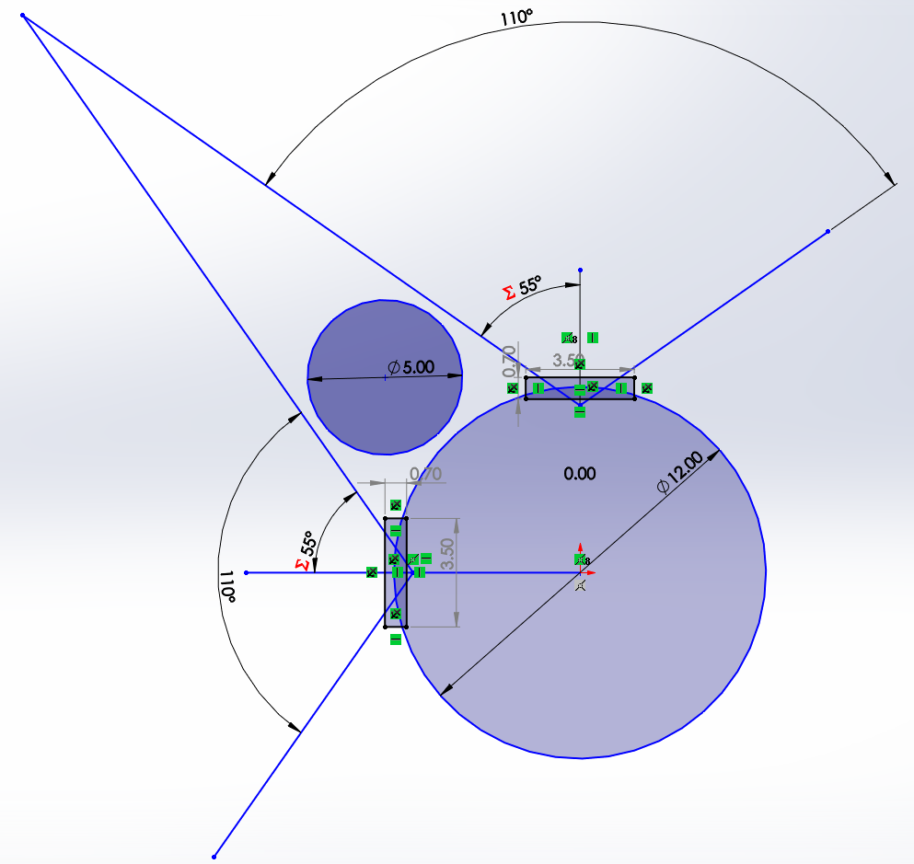
Payload
Room for some as shown
Will still need handles in 2 of the 4 sectors
Displacement of 2 filled sectors ~40 lbs
Best to remove lead for weight added.
Top Down View BOS Main Housing

Slide 11
Tether Strength Selection
  Max Design weight is 350-lbs
  Working from existing design and adding a ~40-lbs payload margin, the tether will have a minimum working load of 530-lbf (SF 1.5) and a minimum breaking load of 2,700-lbf (SF 5xSWL).
  Towing of the system should not exceed 5-knots.
  At speeds greater than 2.5-knots, tow forces may begin to exceed the static lifting requirements of the system.

Slide 12
Potential Tether
FM021814-2
Doubled NBL (2,800-lbs) brings diameter to 0.394-in
Min Bend Radius 6-in
$4,880.00 for 400-m
Meets All Requirements

Slide 14
Lift Specs
Derived Requirements:
  Must lift with force greater than SWL 600-lbf
  Must lift with minimum speed 30-m/min
  Must brake higher than tether NBL 3,000-lbf
  Storage of 400-m cable (includes working length & 2 re-terminations)
Power Demand:
  < 2HP required
  < 10A likely for a electric winch on 220VAC1Ø.
220V1Ø AC current assuming a 75% electromechanical efficiency

Slide 15
Winch Minimum Ratings
Specification | Minimum Rating
Mechanical Power | 2-HP
Dead-Lift Capacity | 530-lbs
Haul Rate | 30-m/min
Winch Brake Rating | 2,700-lbs
Primary input | 1Ø 220-V or 110-V AC 60-Hz
Payout Counter | Desired
Drum Capacity | 1300-ft of 0.394-in OD PUR hybrid fiber/copper tether
Drum & Sheave Diameter | ??13-in¿¿
Slip Ring | 2-pass 16-AWG Electrical 1-pass SM Optical

Slide 16
Winch Solution Trades
Line Hauler
Traditional Winch
Pros:
  Removes slip-ring need
  Essentially a Capstain solution
  Low-cost ($3,000)
Cons:
  Bucket storage
  Significant Weight reduction demanded.
  Limited to 1/2” Cable
  Manual Payout Counter
Pros:
  Self contained
  Safe
  Bolt-down installation
Cons:
  Higher Cost
  Higher Maintenance Requirement
  Requires Slip-ring
Notes:
deck hands reduction

Slide 17
The End

Slide 18
Supplementary Slides

Slide 19
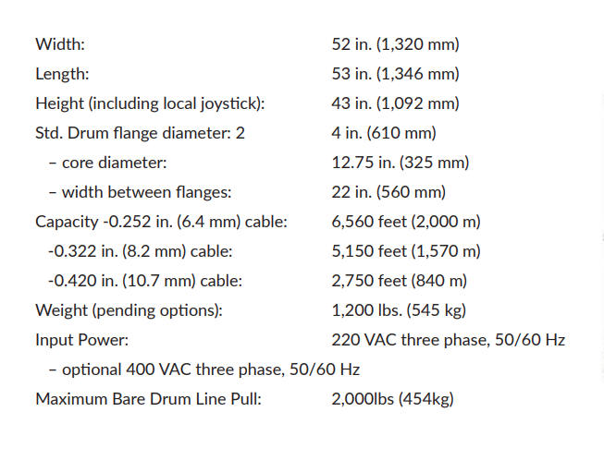
Okeanus (frm. SOS)
ECO-2000
5HP
Meets all other specs

