Slide 1
BOS R2018A Handling System
Critical Review
901704 Next Generation Observation Platform
MBARI 2018 – C. Kecy, F. Cazenave, K. HeadLEY, E. Martin, C. Okuda

Slide 2
Summary
Functional Requirements Review
Relevant Derived Requirements (2017 Concept Discussion)
System Components Review
  Tether
  Winch
  Sheave

Slide 3
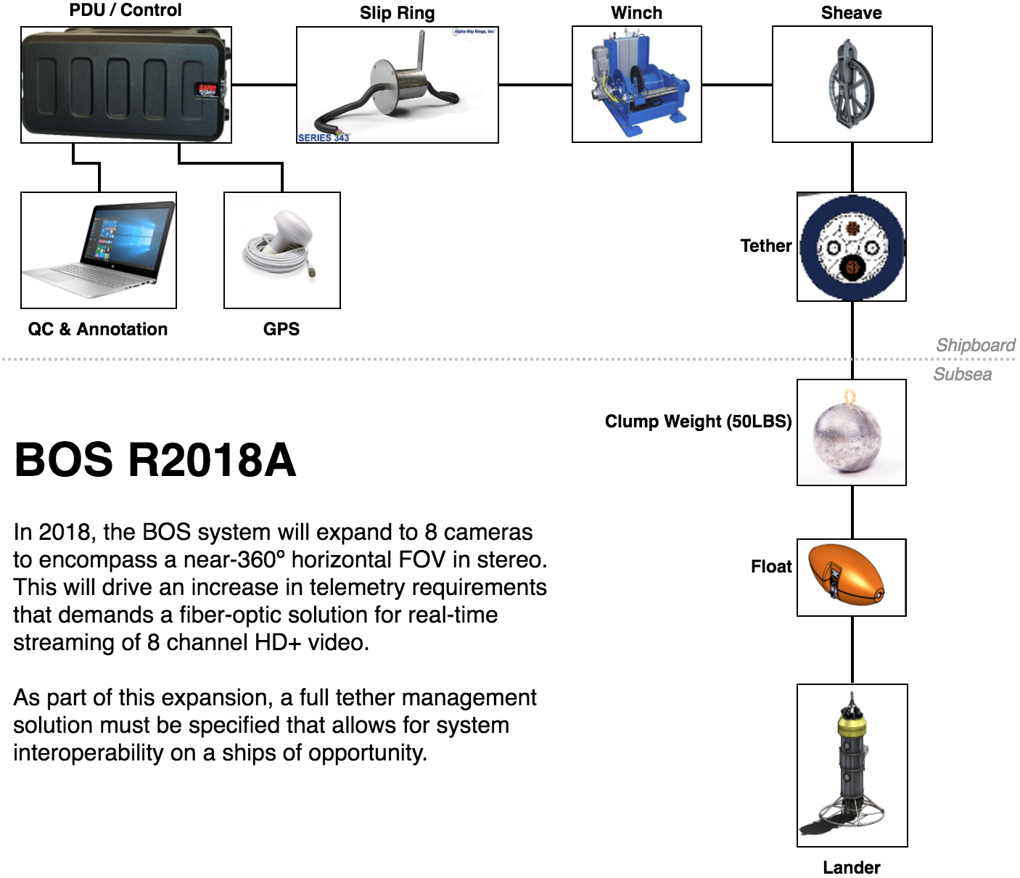

Slide 4
BOS At A Glance

Slide 5
Functional Requirements
Must be able to be deployed from ships of opportunity
Must be a tethered system
Must have a load bearing tether
Must be able to launch and recovery quickly
Must be able to operate in sea state two
Must be able to land on rocky habitats with as little impact as possible
Must be able to stay on bottom for five minutes
Must be able to hopscotch (be towed) between sites during each dive
Must have swappable bases for multiple sea floor types

Slide 6
Functional Requirements (non-handling)
Must be able to record stereoscopic video in (near) 360 degrees
Must have the ability to remotely control iris/ISO of the cameras
Must provide adequate lighting for all cameras
Must have the ability to add in contextual sensors
Must be able to attach transponder onto lander
Must have a downward looking camera to assist with positioning
Must provide downward video and lander depth to bridge and winch operator
Must be able to provide live video topside
Must be able to record topside
Must provide synchronization between the multiple cameras
Must combine meta-data (telemetry) into one file for each recording session
Altimeter sensor for safe approach operations

Slide 7
Derived Requirements (Telemetry)
Integral sensors: lander depth and lander directional orientation
  Lander pitch and roll are nice to haves
Connections for up to 4 additional sensors
  Power: 12Vdc
  Comms: Serial
Sensor data viewable in real time topside
Live video from all 9 cameras available in real time topside
  Recording performed topside
  Downward looking camera available to bridge and winch operator
  Primary reason for move to fiber, as 8 HD streams are ~11.6Gbps
Notes:
On video delay, minimize (MARE)
Pitch and roll more important for operational understanding (MARE)
desire for current sensor
rick - add turns counter

Slide 8
Derived Requirements (Power)
Using 480VAC for power transmission down tether
  1:4 topside transformer from shipboard 110VAC
Maximum power draw for lander no more than 1300 watts
  1300 watts -> 11 amps topside 110VAC
  Worst case lights: 215 watts each (x5)
  Nominal draw probably around 900 watts
Subsea AC:DC converters
Define acceptable power/voltage loss in tether
  4:1 subsea transformer; <10 volt loss on 110VAC subsea line
Cross sectional area of Copper vs power loss vs overall tether diameter
  Minimum Cu: 16AWG: 1 pair, 18/20AWG: 2 pair, 22AWG: 3 pair

Slide 9
Derived Tether Strength Requirements
  Max Design weight is 350-lbs
  Working from existing design and adding a ~40-lbs payload margin, the tether will have a minimum working load of 530-lbf (SF 1.5) and a minimum breaking load of 2,700-lbf (UNOLS SF 5xSWL).
  Towing of the system should not exceed 2-knots.
  At speeds greater than 2.5-knots, tow forces may begin to exceed the static lifting requirements of the system.

Slide 10
Selected Tether
FM021814-2
Doubled NBL (2,800-lbs) brings diameter to 0.394-in
Min Bend Radius 6-in
$4,880.00 for 400-m
80-lbf/kft (air) | 27-lbf/kft (sw)
Meets All Requirements

Slide 11
Derived Requirements (Operational)
  Operate in 6-8 Foot Seas (SS2), 15 knots wind.
  Operations:
    Conduct Surveys with 10-15 drops per site without bringing the BOS onboard.
    A 12 hour day should achieve 5-10 sites.
    No more than 5-minutes on-bottom per drop.
  30 m/min for hauling is optimal.
  System must transport via truck/trailer.
  Must operate on ships of opportunity, i.e.

Slide 12
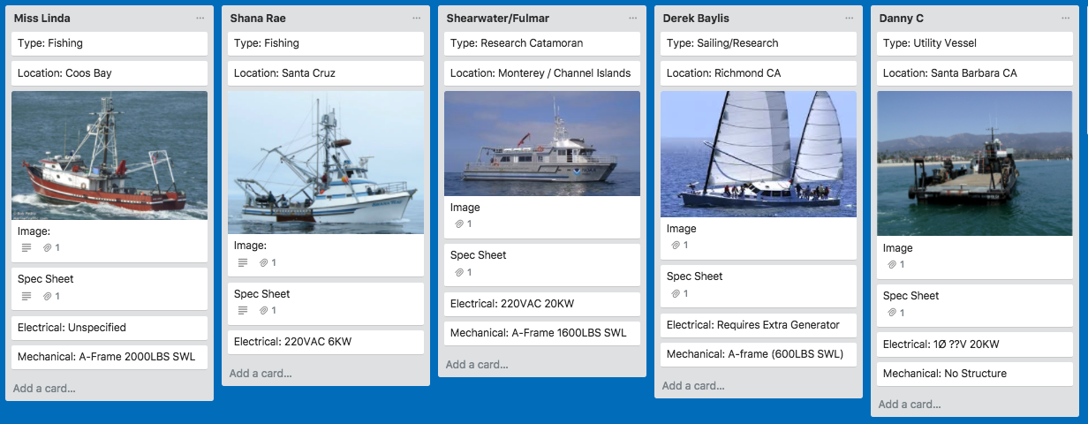
Ships of Opportunity

Slide 13
Winch Minimum Ratings
Specification | Minimum Rating
Mechanical Power | 2-HP
Dead-Lift Capacity | 530-lbs
Haul Rate | 30-m/min
Winch Brake Rating | 2,700-lbs
Primary input | 1Ø 220-V or 110-V AC 60-Hz
Payout Counter | Desired
Drum Capacity | 1300-ft of 0.394-in OD PUR hybrid fiber/copper tether
Drum & Sheave Diameter | 12-in
Slip Ring | 2-pass 480VAC 3A Electrical 1-pass SM Optical

Slide 14
Winch Selection
The mechanical loads of the system drives options away from common compact ROV solutions, but the larger drum requirement drives away from compact CTD and tow system systems as well.
No standard systems meet all requirements, but some can be modified.
4 Vendor solicited (MacArtney, Okeanus, Interocean, and Brock @ OI)
  Interocean has not completed full quote but full spec has been provided.
  MacArtney’s standard options are expensive and not as flexible, no single phase power options exist.
  Brock only had large reels, that while inexpensive, would results in less reliability and more external sensors and costs.
  Okeanus has been very responsive and down-scaled a larger system to accommodate the lower power requirements demanded by ships-of-opportunity.

Slide 15
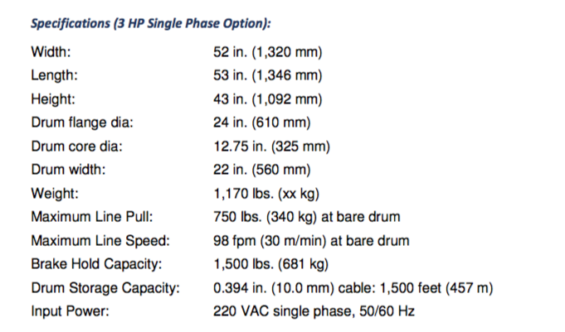
Okeanus
ECO-2000
Meets Requirements
Best Fleet Angle
Self-contained counter
UNOLS option (adaptor plate and cert doc)
1Ø220V 10A
Optional Liebus Shell
Can integrate Focal/Alpha slip ring

Slide 16
InterOcean Model 1673
Meets Requirements
Aluminum Body (700-lbs)
A little slower, 28 m/min bare drum
Machined Leibus grooves on drum
4’ Cube

Slide 17
Okeanus
DT Marine
Meets Requirements
Poor Levelwind System
No counter
22 m/min (slower)
1Ø220V 10A
Aluminum (350lbs)
Hydraulic
$14,500.00

Slide 18
Slip Ring Selection
  Slip ring is 2-pass electrical, single SM fiber pass.
  3 Vendors Solicited:
    Moog/Focal
    Alpha
    Moflon
  Alpha and Moog seem interchangeable in size and capability, with Moog being the highest build quality. Both would terminate easily via pipe fittings into junction boxes.
  Moflon is the least expensive ($900) but may not mount as easily.
    With more time a test purchase would be advisable.

Slide 19
Alpha Model 343

Slide 20
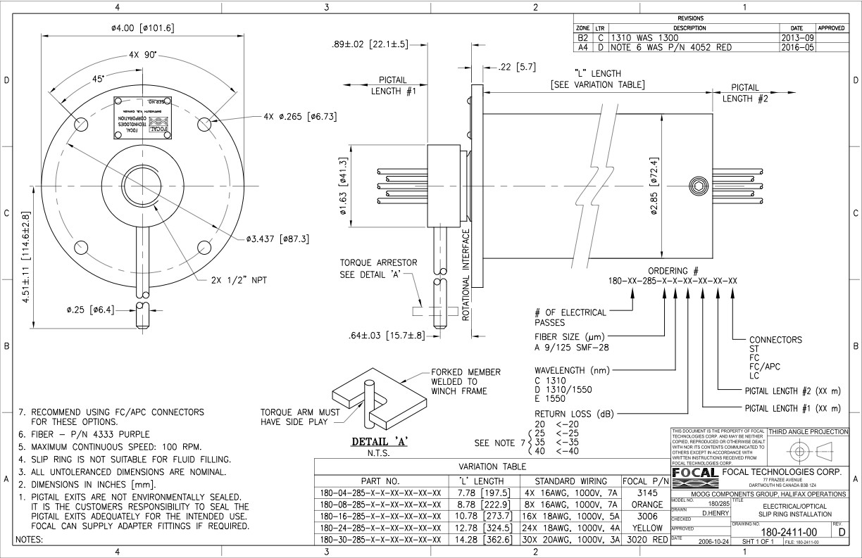
Focal Model 180

Slide 21
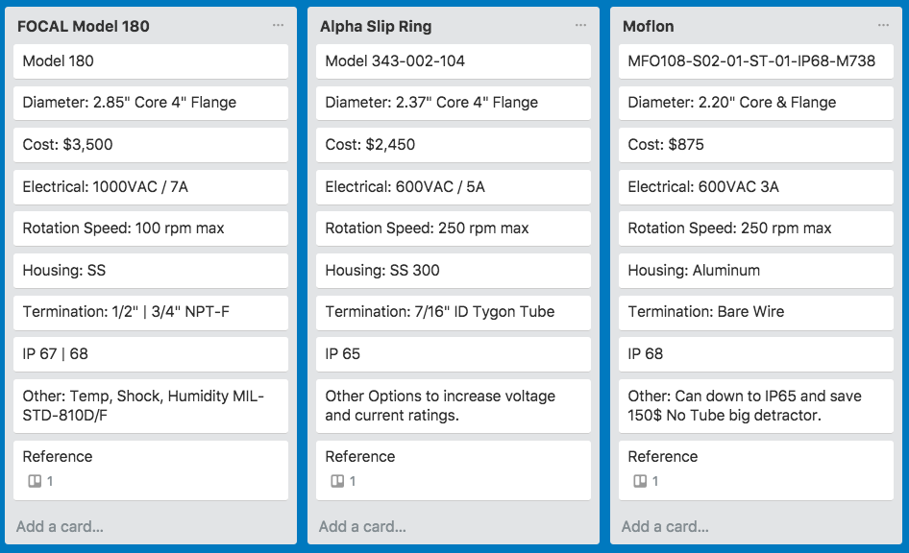
Slip Ring Comparison

Slide 22
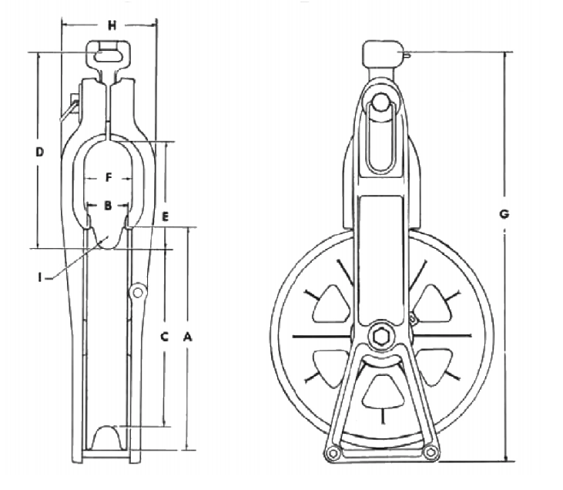
Sheave Options
Sherman & Reilly 74 Series
  12” Diameter
  Aluminum
  6,500-lbf SWL
  0.6” Groove radius (tether 0.39)
  Can go larger, but groove radius opens
  $589.00
Okeanus Eco-Sheave
  12”
  Steel/Delrin
  2,000-lbf SWL
  Specified Groove Width
  Cable-keeper option
  $2,295.00
Interocean
  12” Instrumented
  Steel/Delrin
  Cost Included with winch estimate
Question: What is the best tolerance for groove radii specifications?

Slide 23
Handling System Budget

Slide 24
System Transport
A brief survey of car trailers apply the following limits on total towable system weights:
  2-Wheel Trailers support ~3,000-LBS
  4-Wheel Trailers support ~6,000-LBS
Weight Estimates for Budgeted System:
Item | Weight (lbs)
ECO 2000 Winch | 1,170
BOS System | 350
Tether (80-lbs/kft) | 104.96
Crates/Covers (estimated) | 200
Total: | 1,825

Slide 25
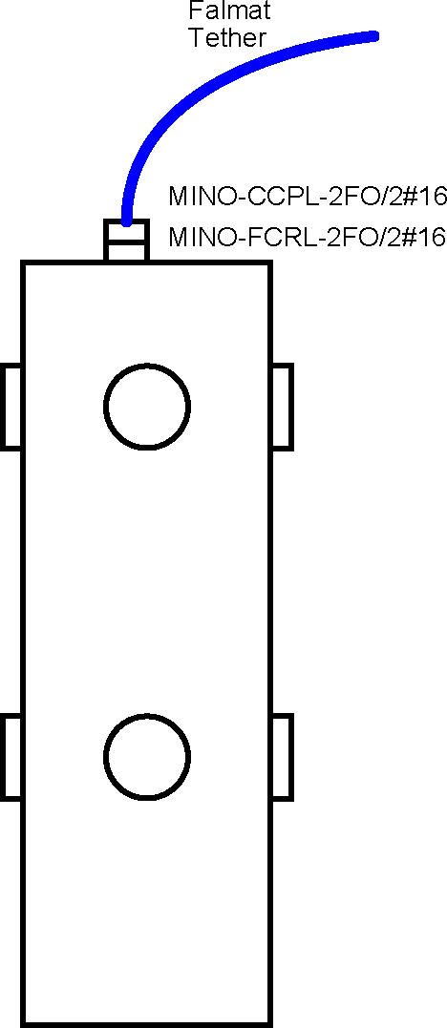
Connector Option: Seaconn
Seaconn MiniCon with Fiber Optics
  CCPL potted to tether (Manufacturer)
  FCRL on lander endcap
  Insert: 2 FO and 2#16
  Simple and space efficient
  Cannot service in the field
  Mechanical strain relief required
  ~$3500.00 (awaiting quote)

Slide 26
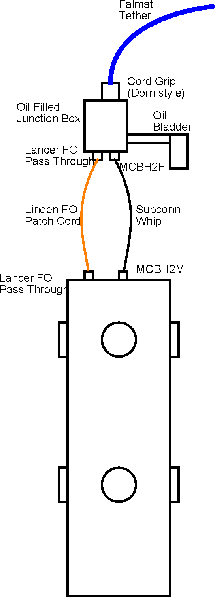
Connector Option: Patch Cord
Lancer/Linden Fiber Optic Connection
  Copper/Fiber terminated in J-Box
  Lancer pass throughs to Linden patch cord
  Power passed through Subconn connectors
  Inexpensive and serviceable
  Bulky solution, will add height to lander
  Bladder required
  Mechanical strain relief required
  ~$2350.00 (awaiting final quotes)

Slide 27
Future Decisions
  Improved Cable clump attachment:
    Current option is a yale grip.
    With a standard tether, we can design a clamping solution in house.
  Decide on subsea connector

Slide 28
The End

Slide 29
Supplementary Slides

Slide 30
Tether Electrical Requirements
Copper Losses
Wire Gauge | Pairs | Total Area (in^2) | Max Loss (W) (@ 1300W) | 480V V Drop (Volts) | 120V V Drop (Volts)
22 | 1 | 0.001006 | 323 | 119 | 29.75
22 | 2 | 0.002012 | 162 | 60 | 15
22 | 3 | 0.003018 | 108 | 40 | 10
22 | 4 | 0.004024 | 81 | 30 | 7.5
20 | 1 | 0.001608 | 202 | 75 | 18.75
20 | 2 | 0.003216 | 101 | 37 | 9.25
20 | 3 | 0.004824 | 67 | 25 | 6.25
20 | 4 | 0.006432 | 51 | 19 | 4.75
18 | 1 | 0.002560 | 127 | 47 | 11.75
18 | 2 | 0.005120 | 64 | 23 | 5.75
18 | 3 | 0.007680 | 42 | 16 | 4
18 | 4 | 0.010240 | 31 | 12 | 3
16 | 1 | 0.004060 | 80 | 29 | 7.25
16 | 2 | 0.008120 | 40 | 15 | 3.75
16 | 3 | 0.012180 | 27 | 10 | 2.5
16 | 4 | 0.016240 | 20 | 7 | 1.75
16AWG Cu minimum requirement for single pair.
* Calculated using a length of 400 meters

Slide 31
Lift Specs
Derived Requirements:
  Must lift with force greater than SWL 600-lbf
  Must lift with minimum speed 30-m/min
  Must brake higher than tether NBL 3,000-lbf
  Storage of 400-m cable (includes working length & 2 re-terminations)
Power Demand:
  < 2HP required
  < 10A likely for a electric winch on 220VAC1Ø.
220V1Ø AC current assuming a 75% electromechanical efficiency

Slide 33
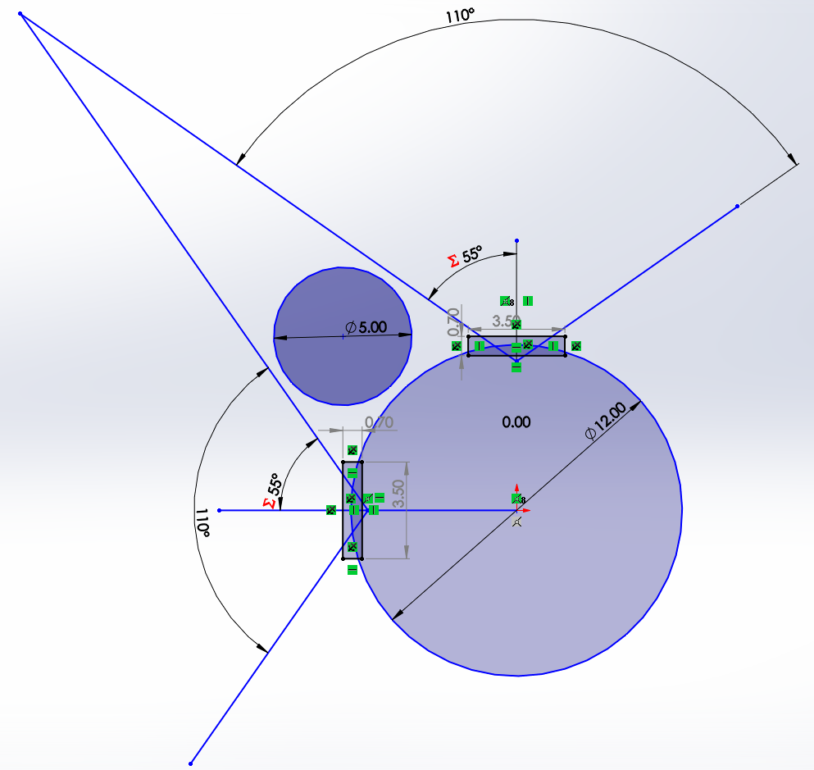
Payload
Room for some as shown
Will still need handles in 2 of the 4 sectors
Displacement of 2 filled sectors ~40 lbs
Best to remove lead for weight added.
Top Down View BOS Main Housing

Slide 34
Winch Solution Trades
Line Hauler
Traditional Winch
Pros:
  Removes slip-ring need
  Essentially a Capstain solution
  Low-cost ($3,000)
Cons:
  Bucket storage
  Significant Weight reduction demanded.
  Limited to 1/2” Cable
  Manual Payout Counter
Pros:
  Self contained
  Safe
  Bolt-down installation
Cons:
  Higher Cost
  Higher Maintenance Requirement
  Requires Slip-ring
Notes:
deck hands reduction

