Slide 1
Outline
Camera and lens selection
Camera placement for 360º stereo imaging
Main housing concept
Lander concept
Experiments to verify design concepts

Slide 2
Camera requirements
Small size
Relatively low cost (8x)
Stills and HD video
Good low light performance
Reliable brand (long life cycle)
Easy to interface for control
Onboard storage
Candidate cameras
Sony UMC-S3C
E1 Z Camera
Sony A6000 series

Slide 3
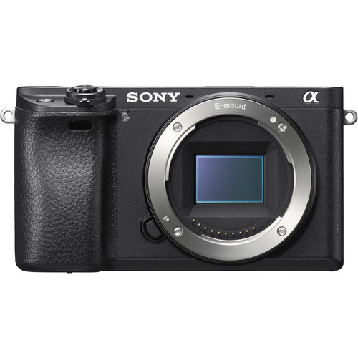
Sony Alpha 6300
$1000
Images are recorded on SD card: up to 9 hours of HD video. Download via USB
24.2MP APS-C Exmor CMOS Sensor
Can be controlled using proprietary SONY connector
Excellent image quality
Sony E-mount: many lens options

Slide 4
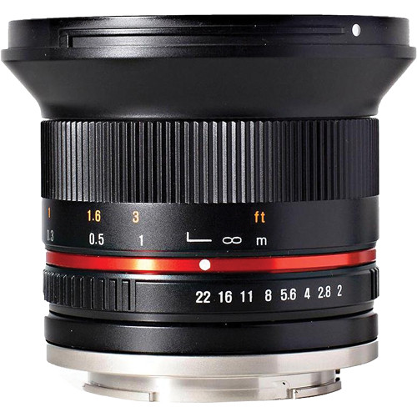
Lens selection
Requirements:
Wide angle
Low cost
Small, light
Autofocus not required
Rokinon 12mm is excellent solution.
$400, manual focus, F 2.0, 85 degree FOV.

Slide 5
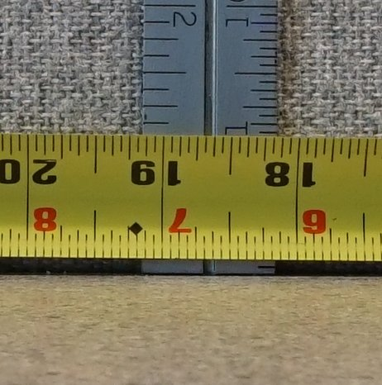
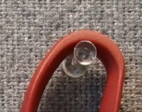
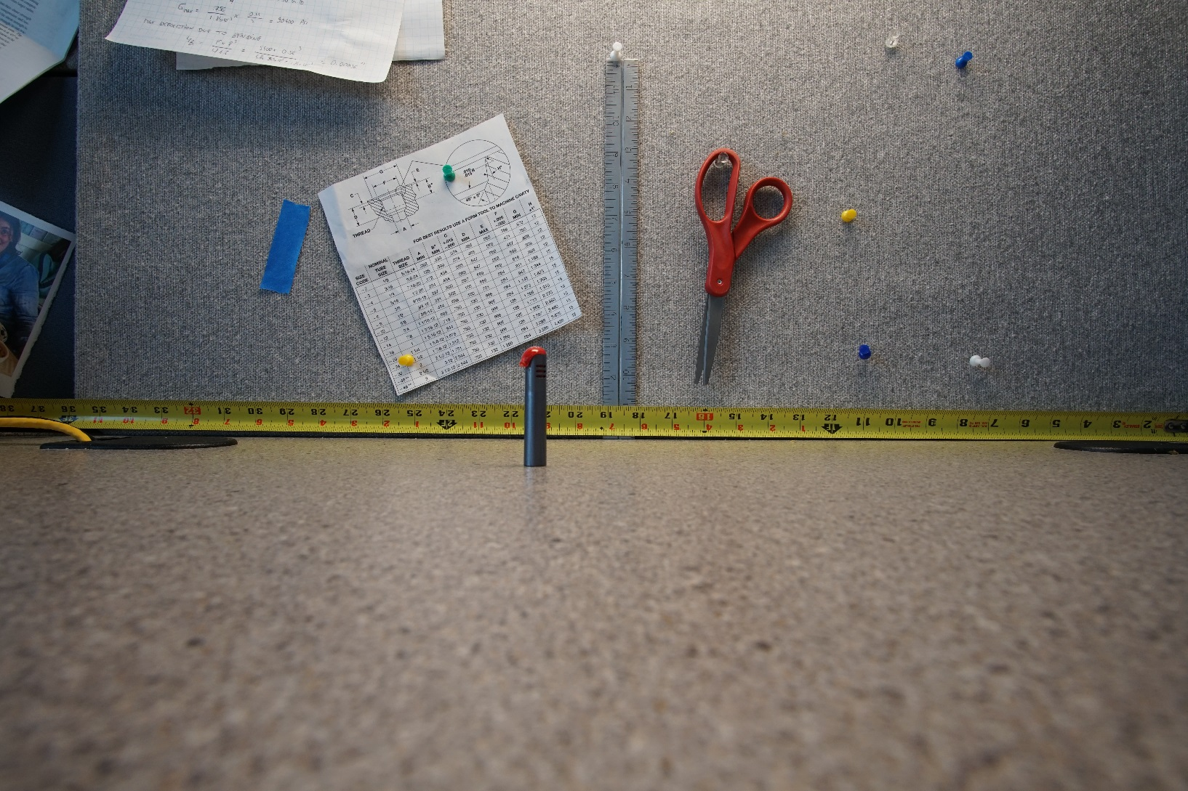
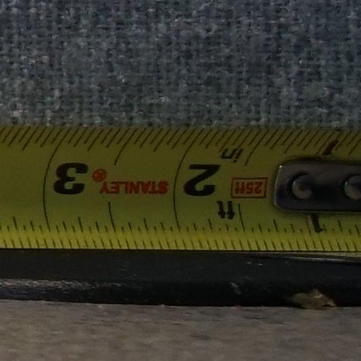
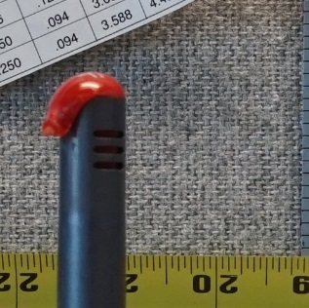
Camera test in the lab
Center of image
ISO 500
F8
1/125s
Natural lighting
Side of image
Depth of field
(red object at ½ distance)

Slide 6
Considerations for cameras and lights positioning
360º coverage in stereo (gaps acceptable): 4 cameras pairs are needed
Flat ports (domes are too expensive)
Distance between cameras is 40 cm (tested by R. Starr)
Camera pairs must be toed in a few degrees
One camera will face down to help with lander placement
Lighting will be provided by 5 DSPL lights
Camera must all be in one housing:
  reduced drag, size, weight, cost
  much fewer connectors, higher reliability
Notes:
Many factors to consider when positioning the camera:
First, we need 360 degrees coverage. In reality we can’t get 360. It would required 6 camera pairs because each pair covers about 60degree. So there will be some gaps between the FOV of each camera pair. This is ok for science.
We considered using dome ports which help get a wider FOV. But dome port are very expensive, they required corrective optics are very careful alignment of the lens and the dome. Too expesnive and complicated. So we decide to use flat ports.
Distance between the cameras is an important factor. Rick S did some testing and determined tnat 40cm is the minimum required distance for accurate fish sizing.
Camera must be toed in a few degree to have proper overlap between the FOVs. I did some modeling and some testing to determine this angle.
In addition to the 4 stereo cam pairs, we need on camera that faced down to help with lander placement. Light.
For lighting we have selected so LED light made by DSPL. There will be one light per camera pair. Because we’ll be operating on the bottom, there will be sediment in the water so backscatter in a concern and need good separation between the lights and cameras.
Early on, we decided to put all the camera in a single housing.
Having a single housing helps reduce the cost, the drag, the size and the cost.

Slide 7
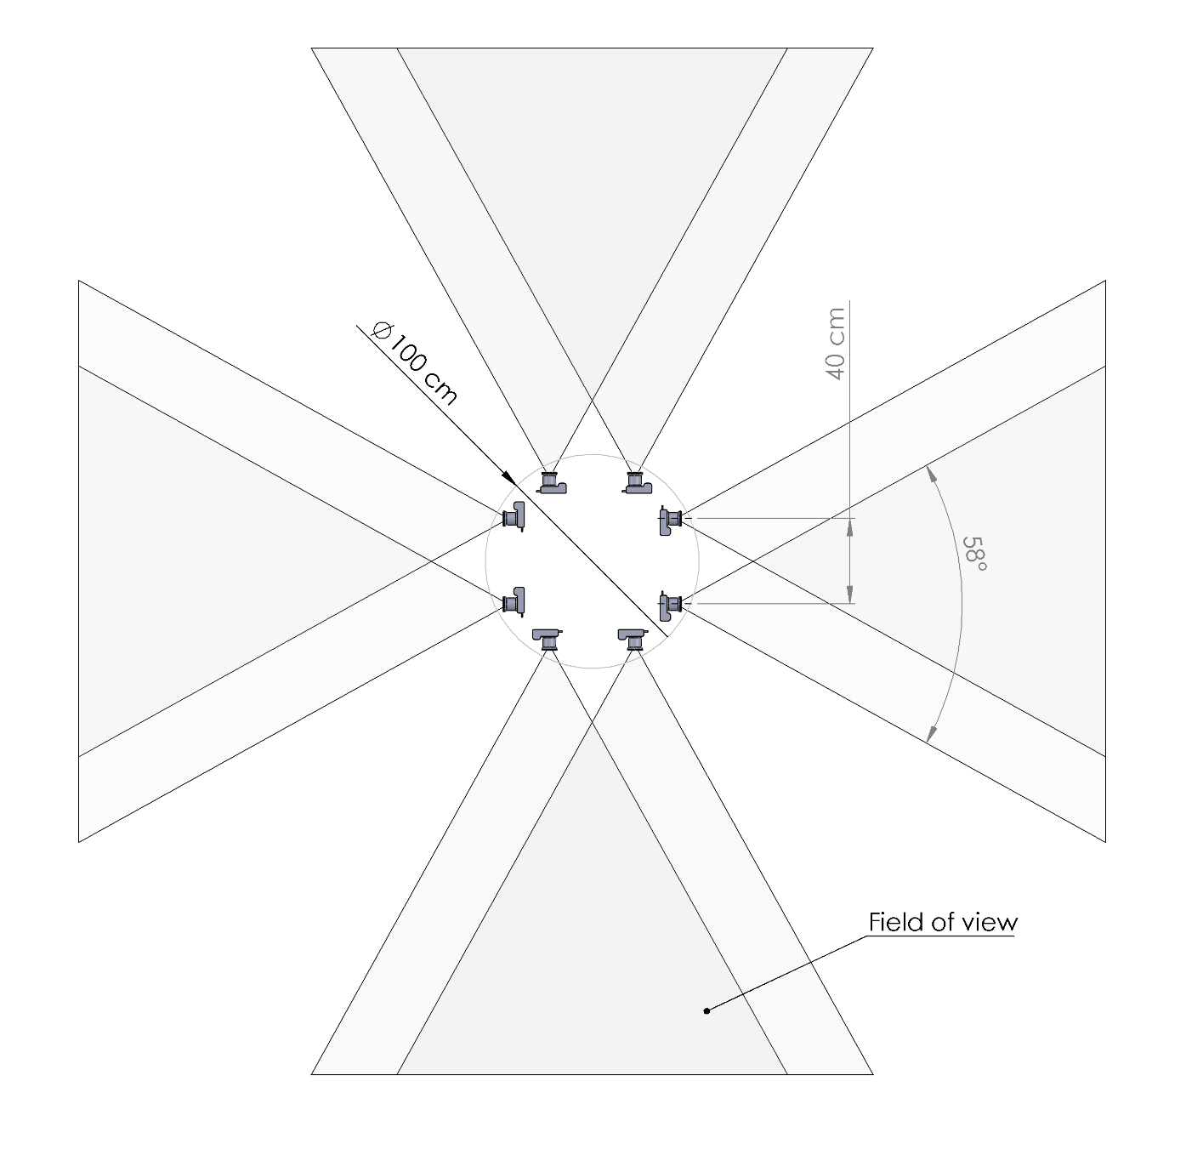
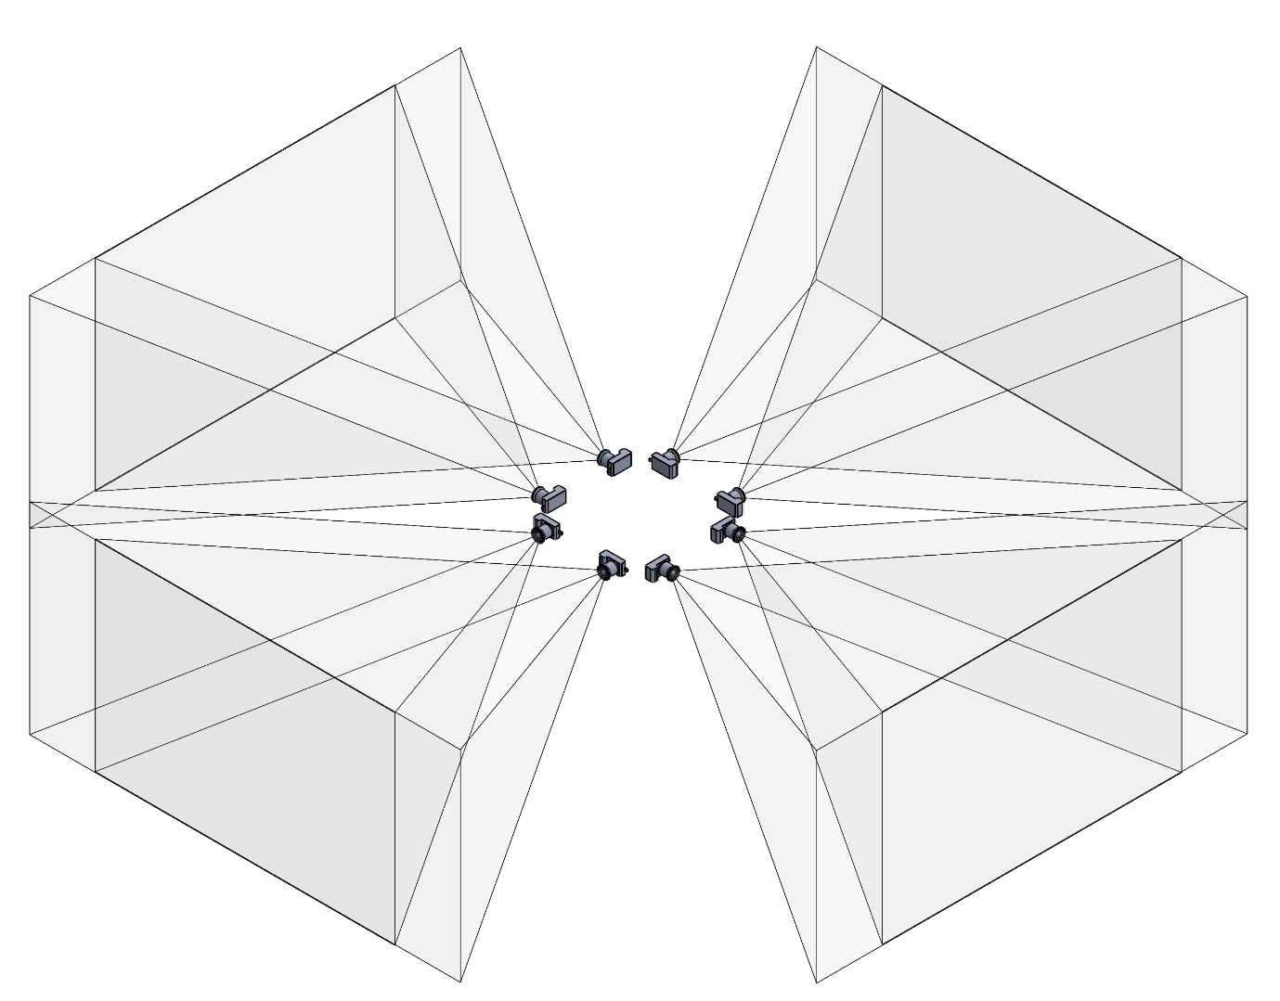
Cameras paired horizontally take too much space
Top view
Isometric view
Notes:
Typically in stereo camera system, cameras are paired horizontally (one on each side).

Slide 8
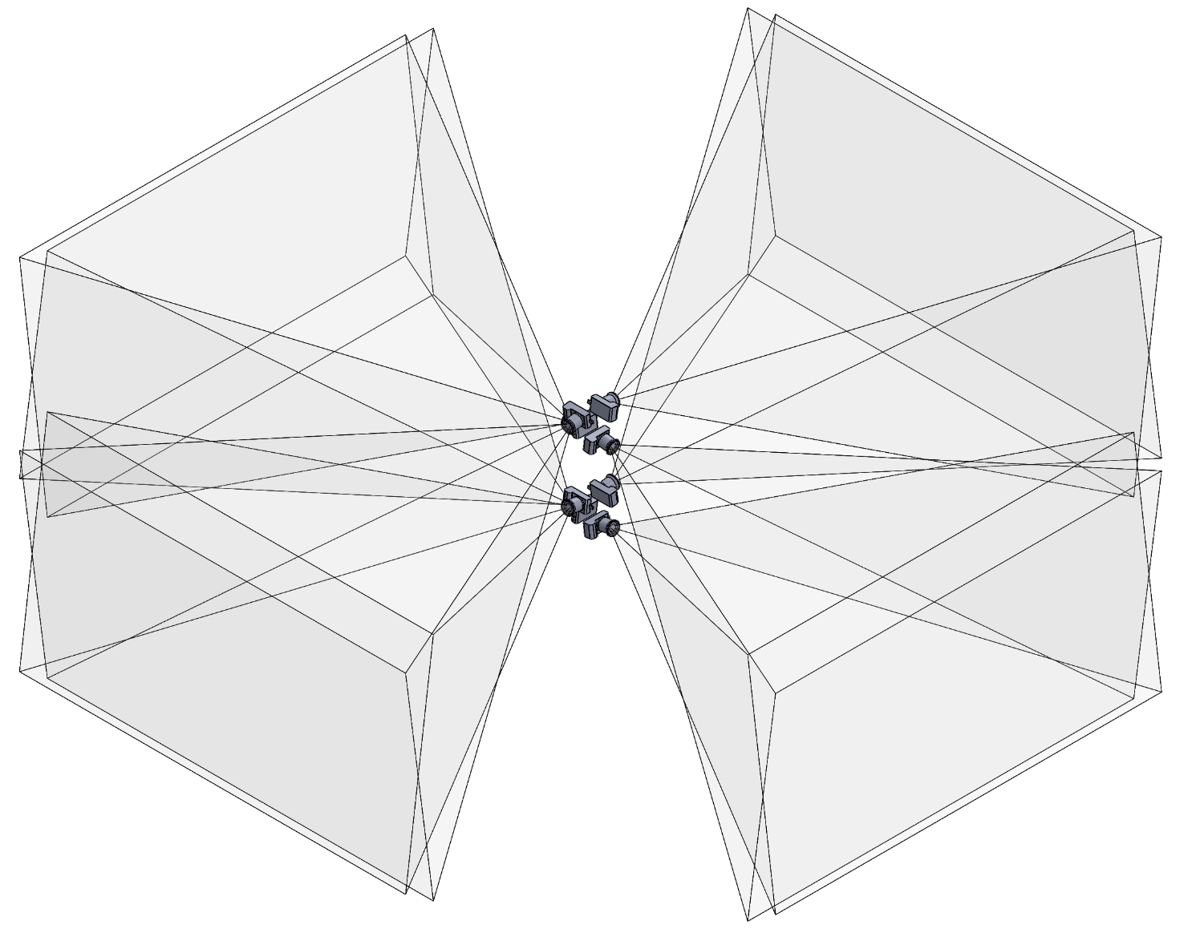
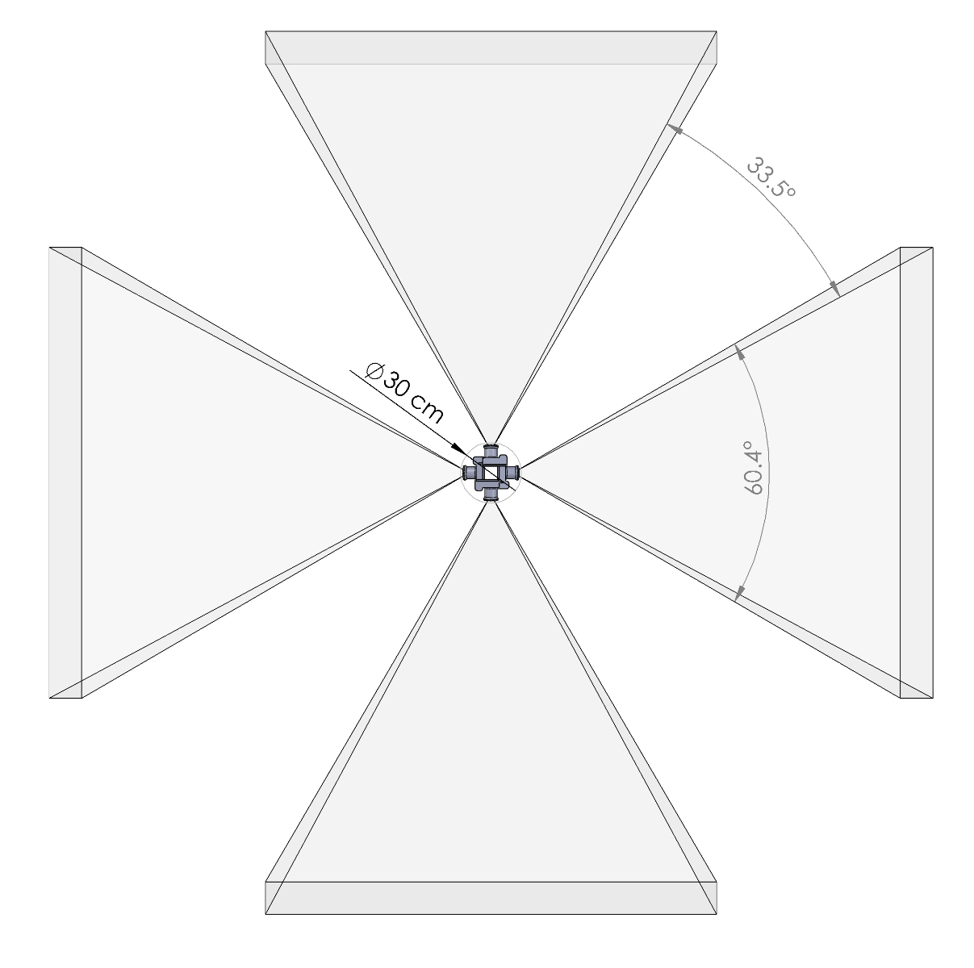
Cameras paired vertically have much smaller footprint
Top view
Isometric view

Slide 9
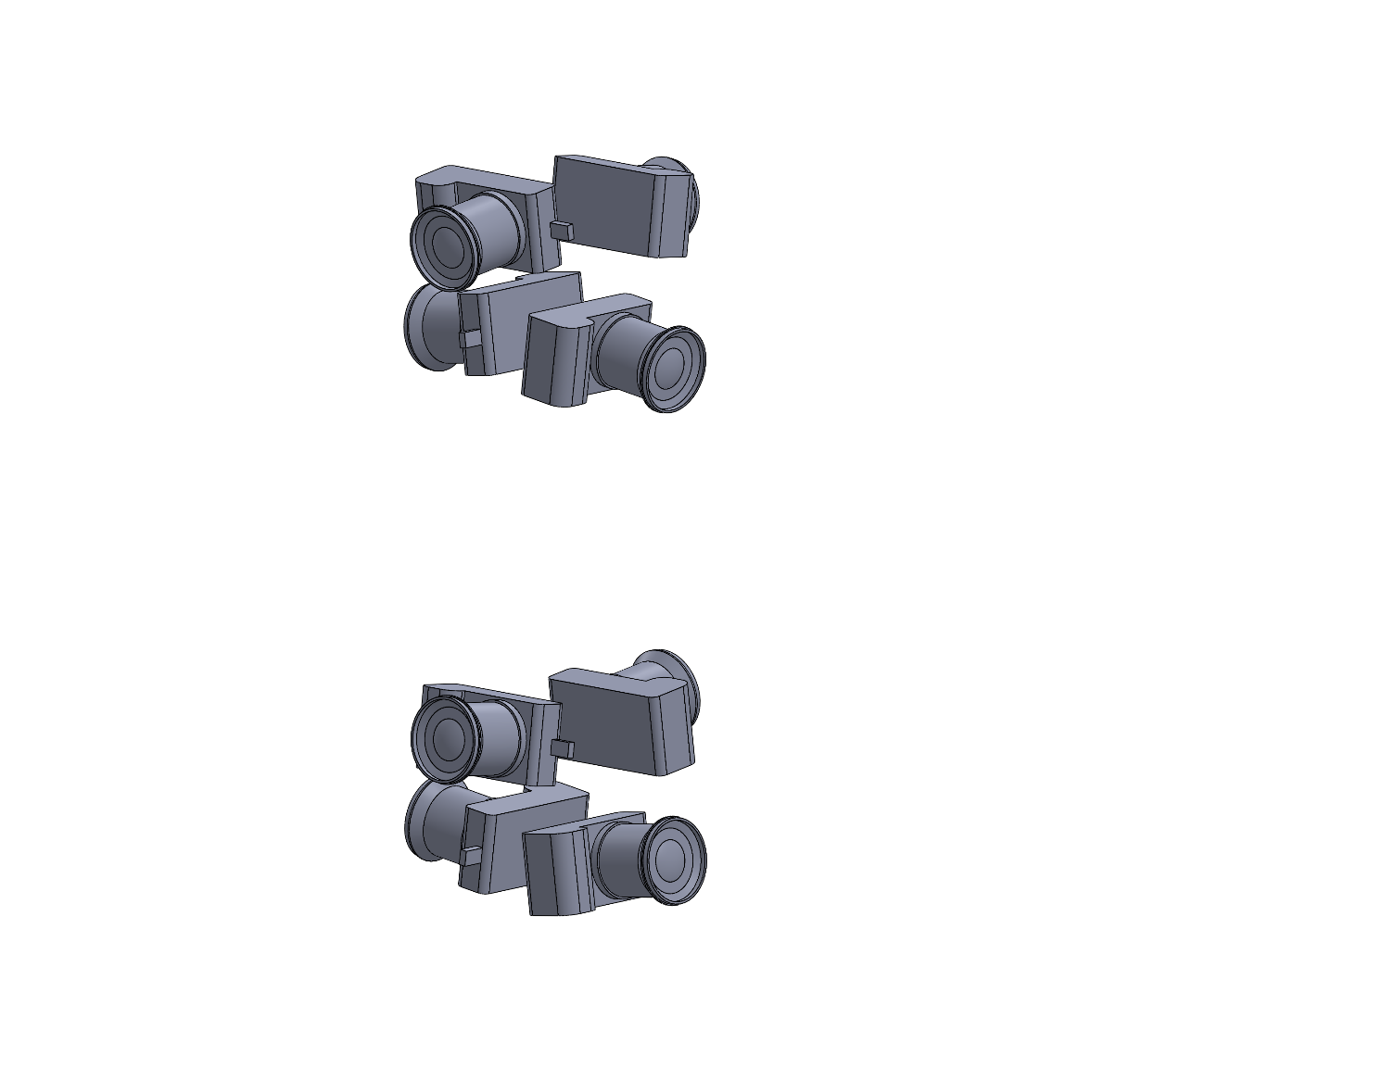
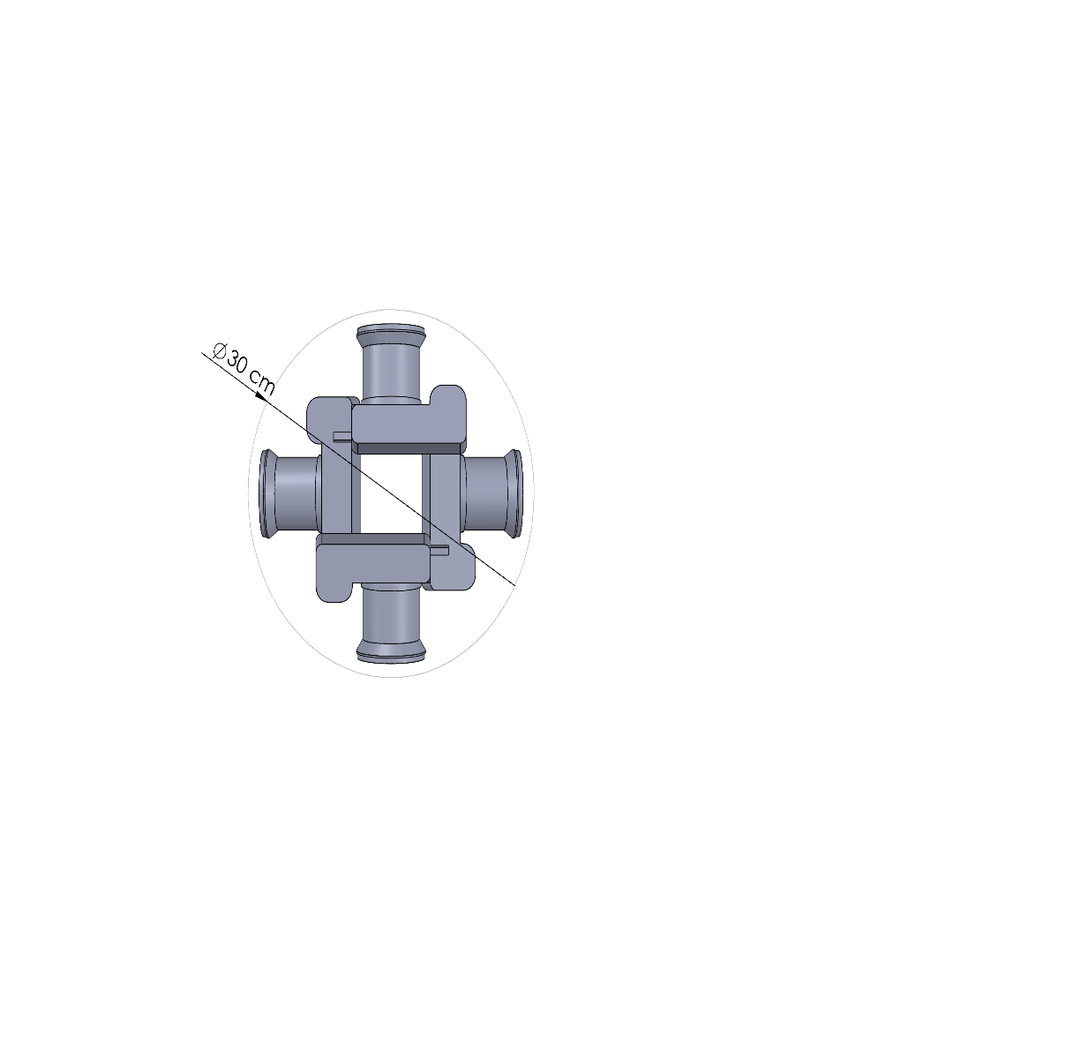
Cameras paired vertically fit in a tall cylindrical housing.
Top view
Isometric view

Slide 10
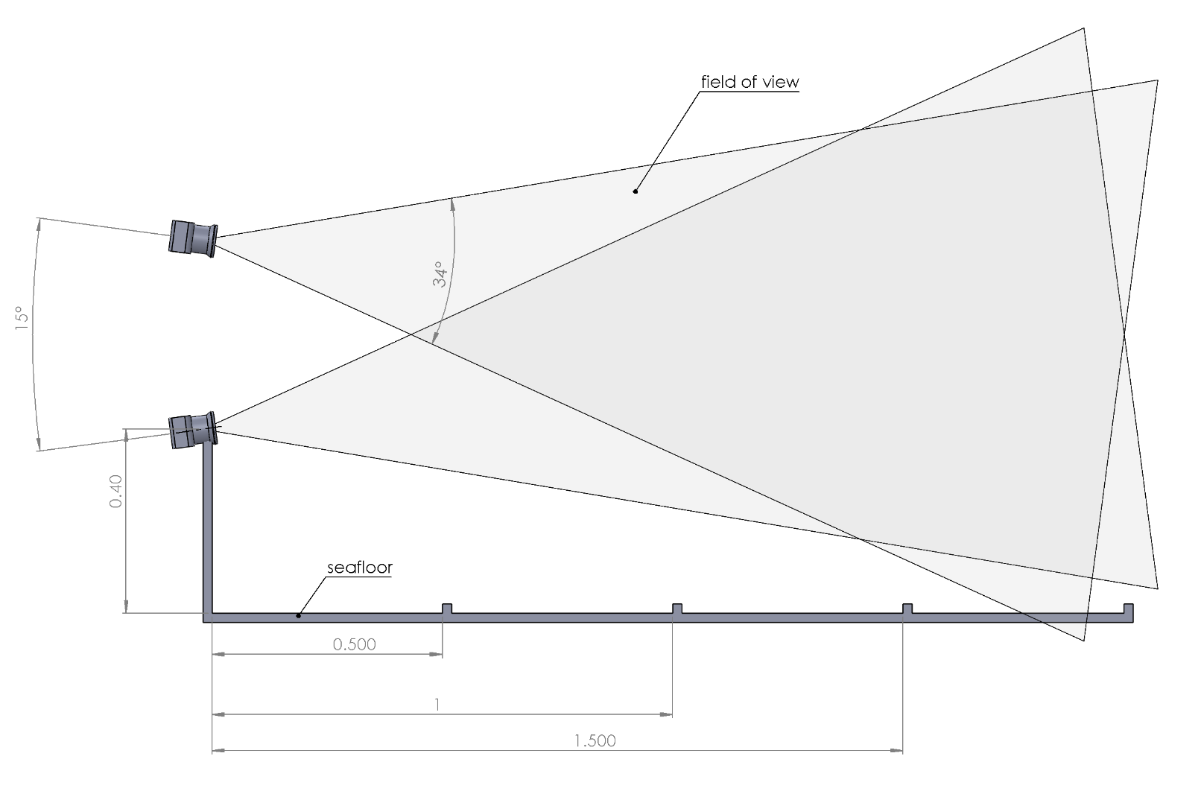
Camera angle and position relative to seafloor
Notes:
We determined that the cameras should be between 40cm and 80cm above the seafloor. Any lower and a boulder might block the view. Any higher would above whenre most of the fish hang out.

Slide 11
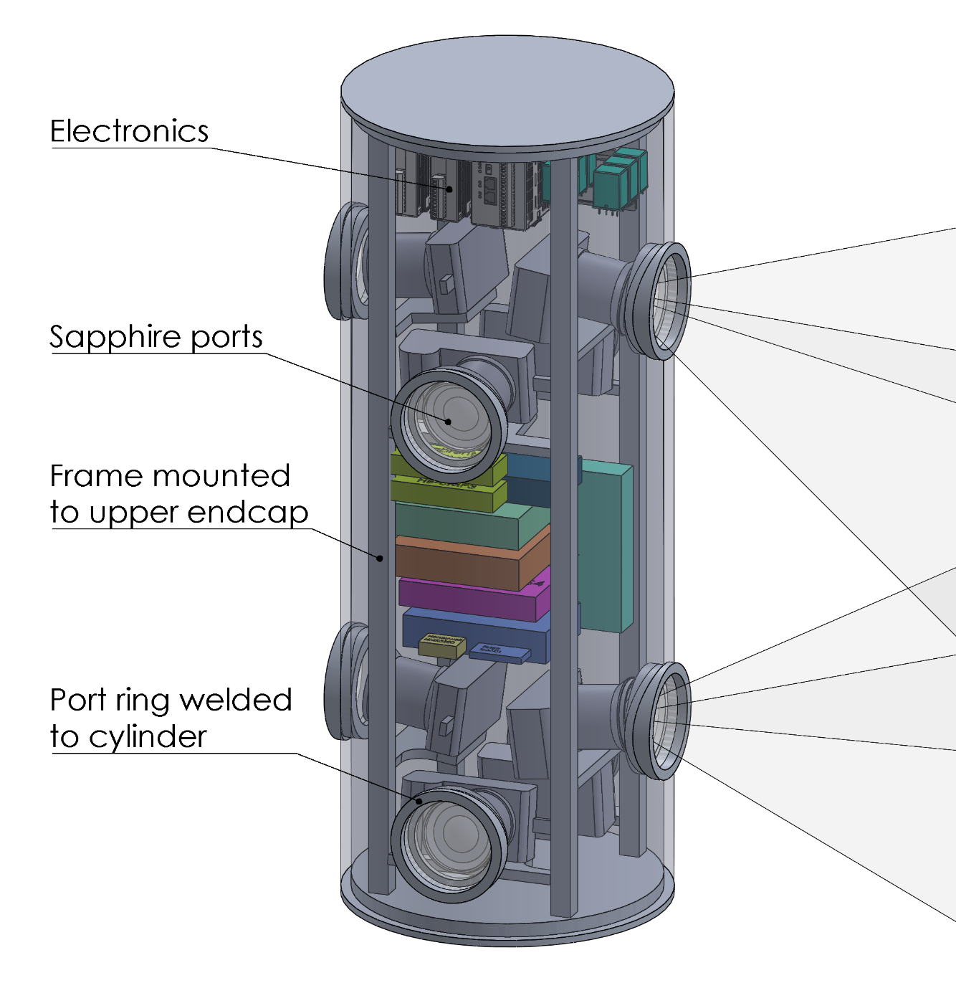
Main housing concept
Anodized 6061 Aluminum
Weight in air: 50kg
10kg buoyant
30cm diameter x 80cm tall
Rack for electronics and cameras

Slide 12
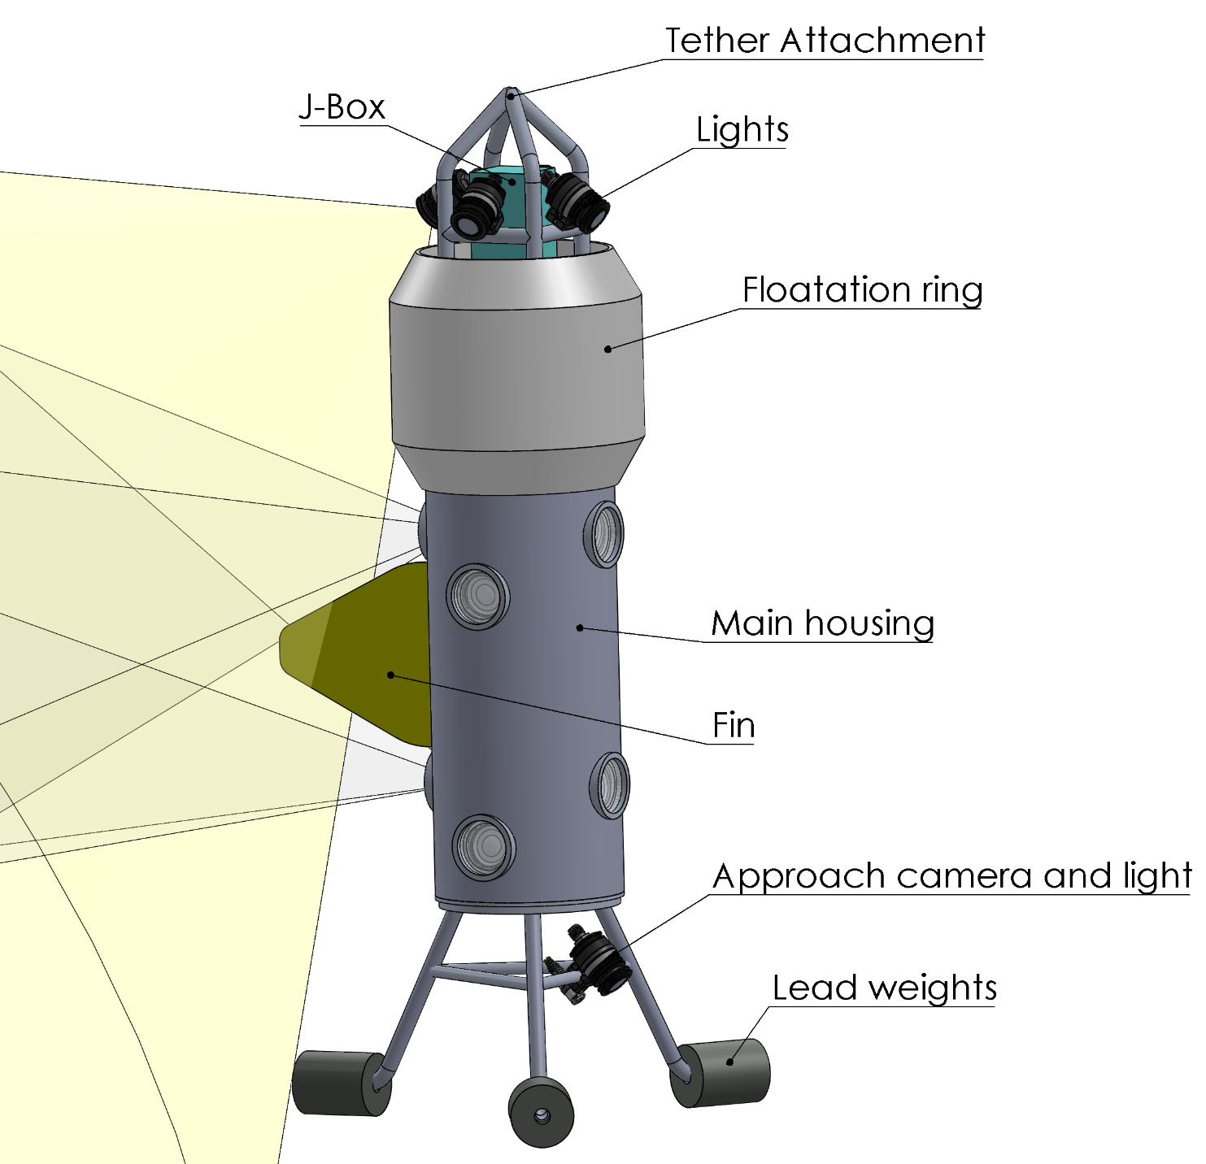
Lander concept
Height: 160cm
Weight: 75kg-200kg
Base has weak link
Heavy at the bottom, light at the top
Low drag
Different bases and float.
Configuration can evolve after testing

Slide 13
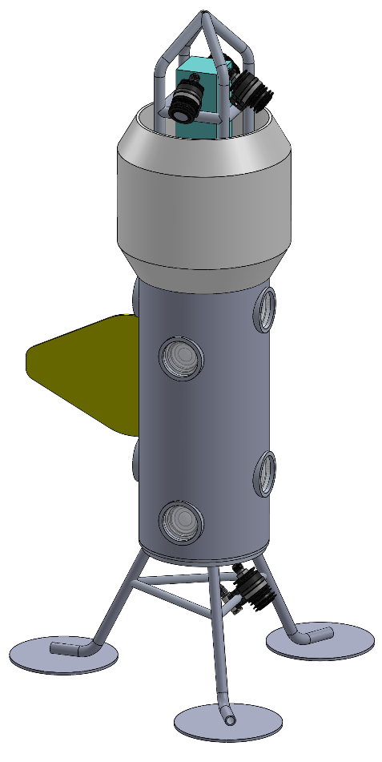
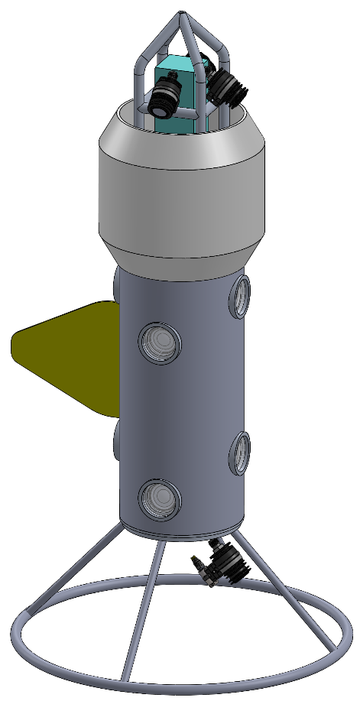
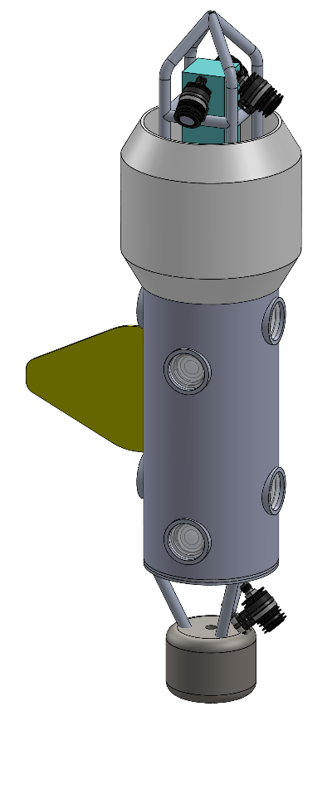
Concepts for lander base
Large feet for soft flat bottom
Large ring
Pogo stick

Slide 14
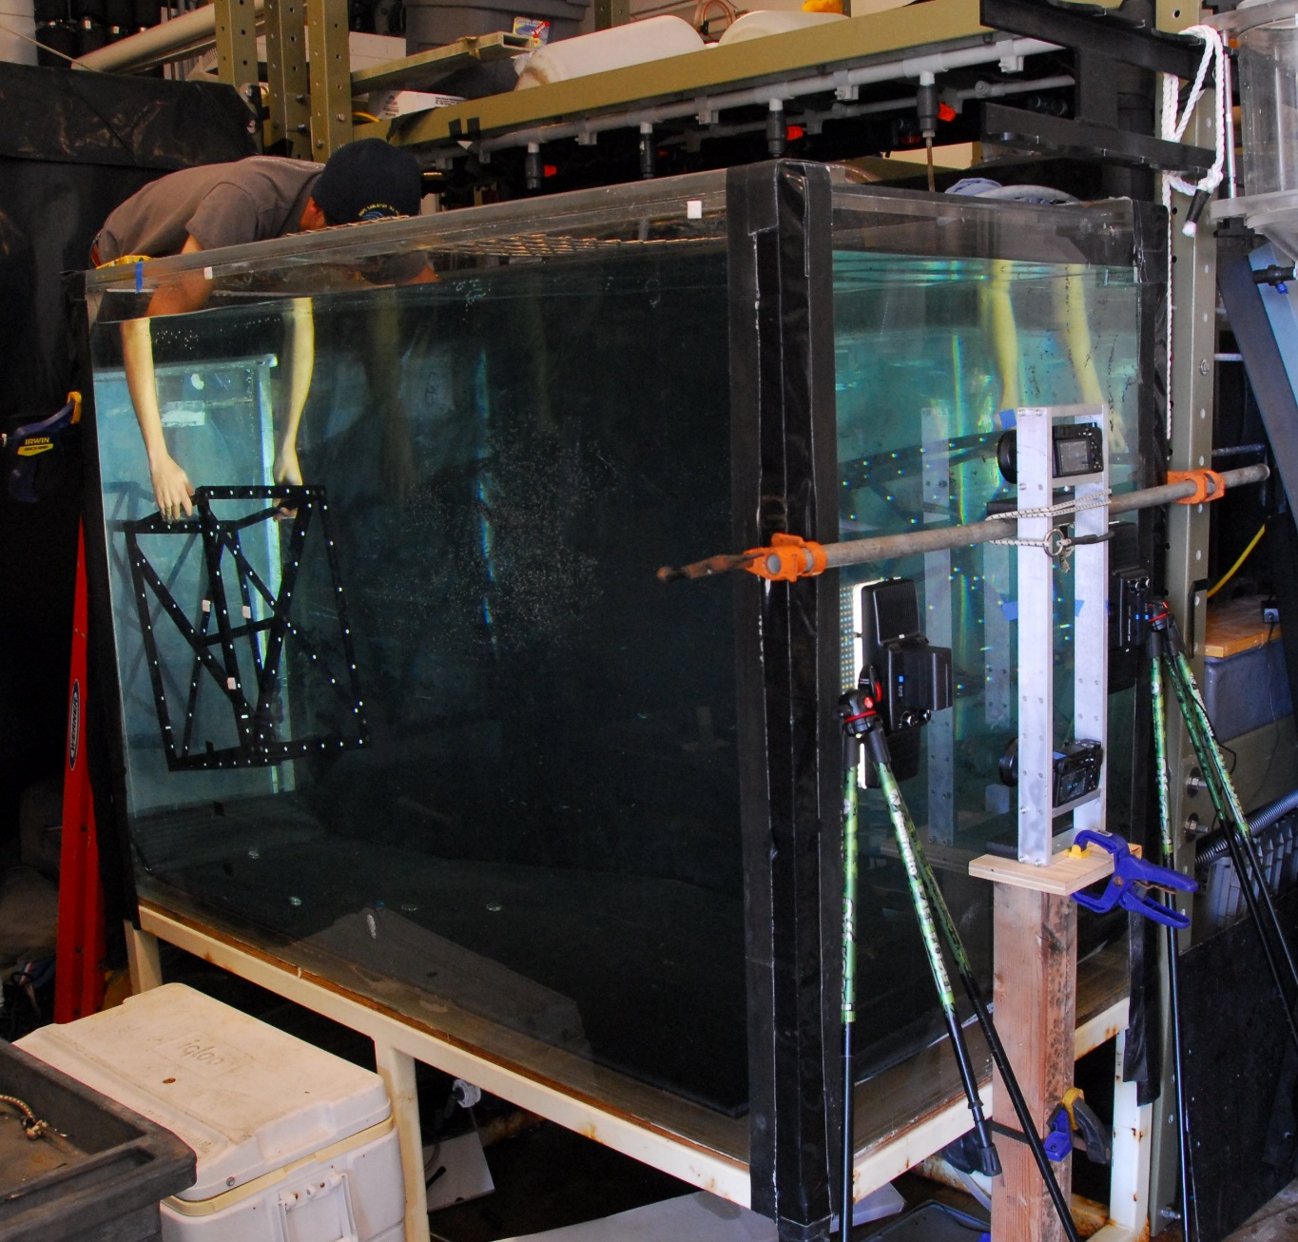
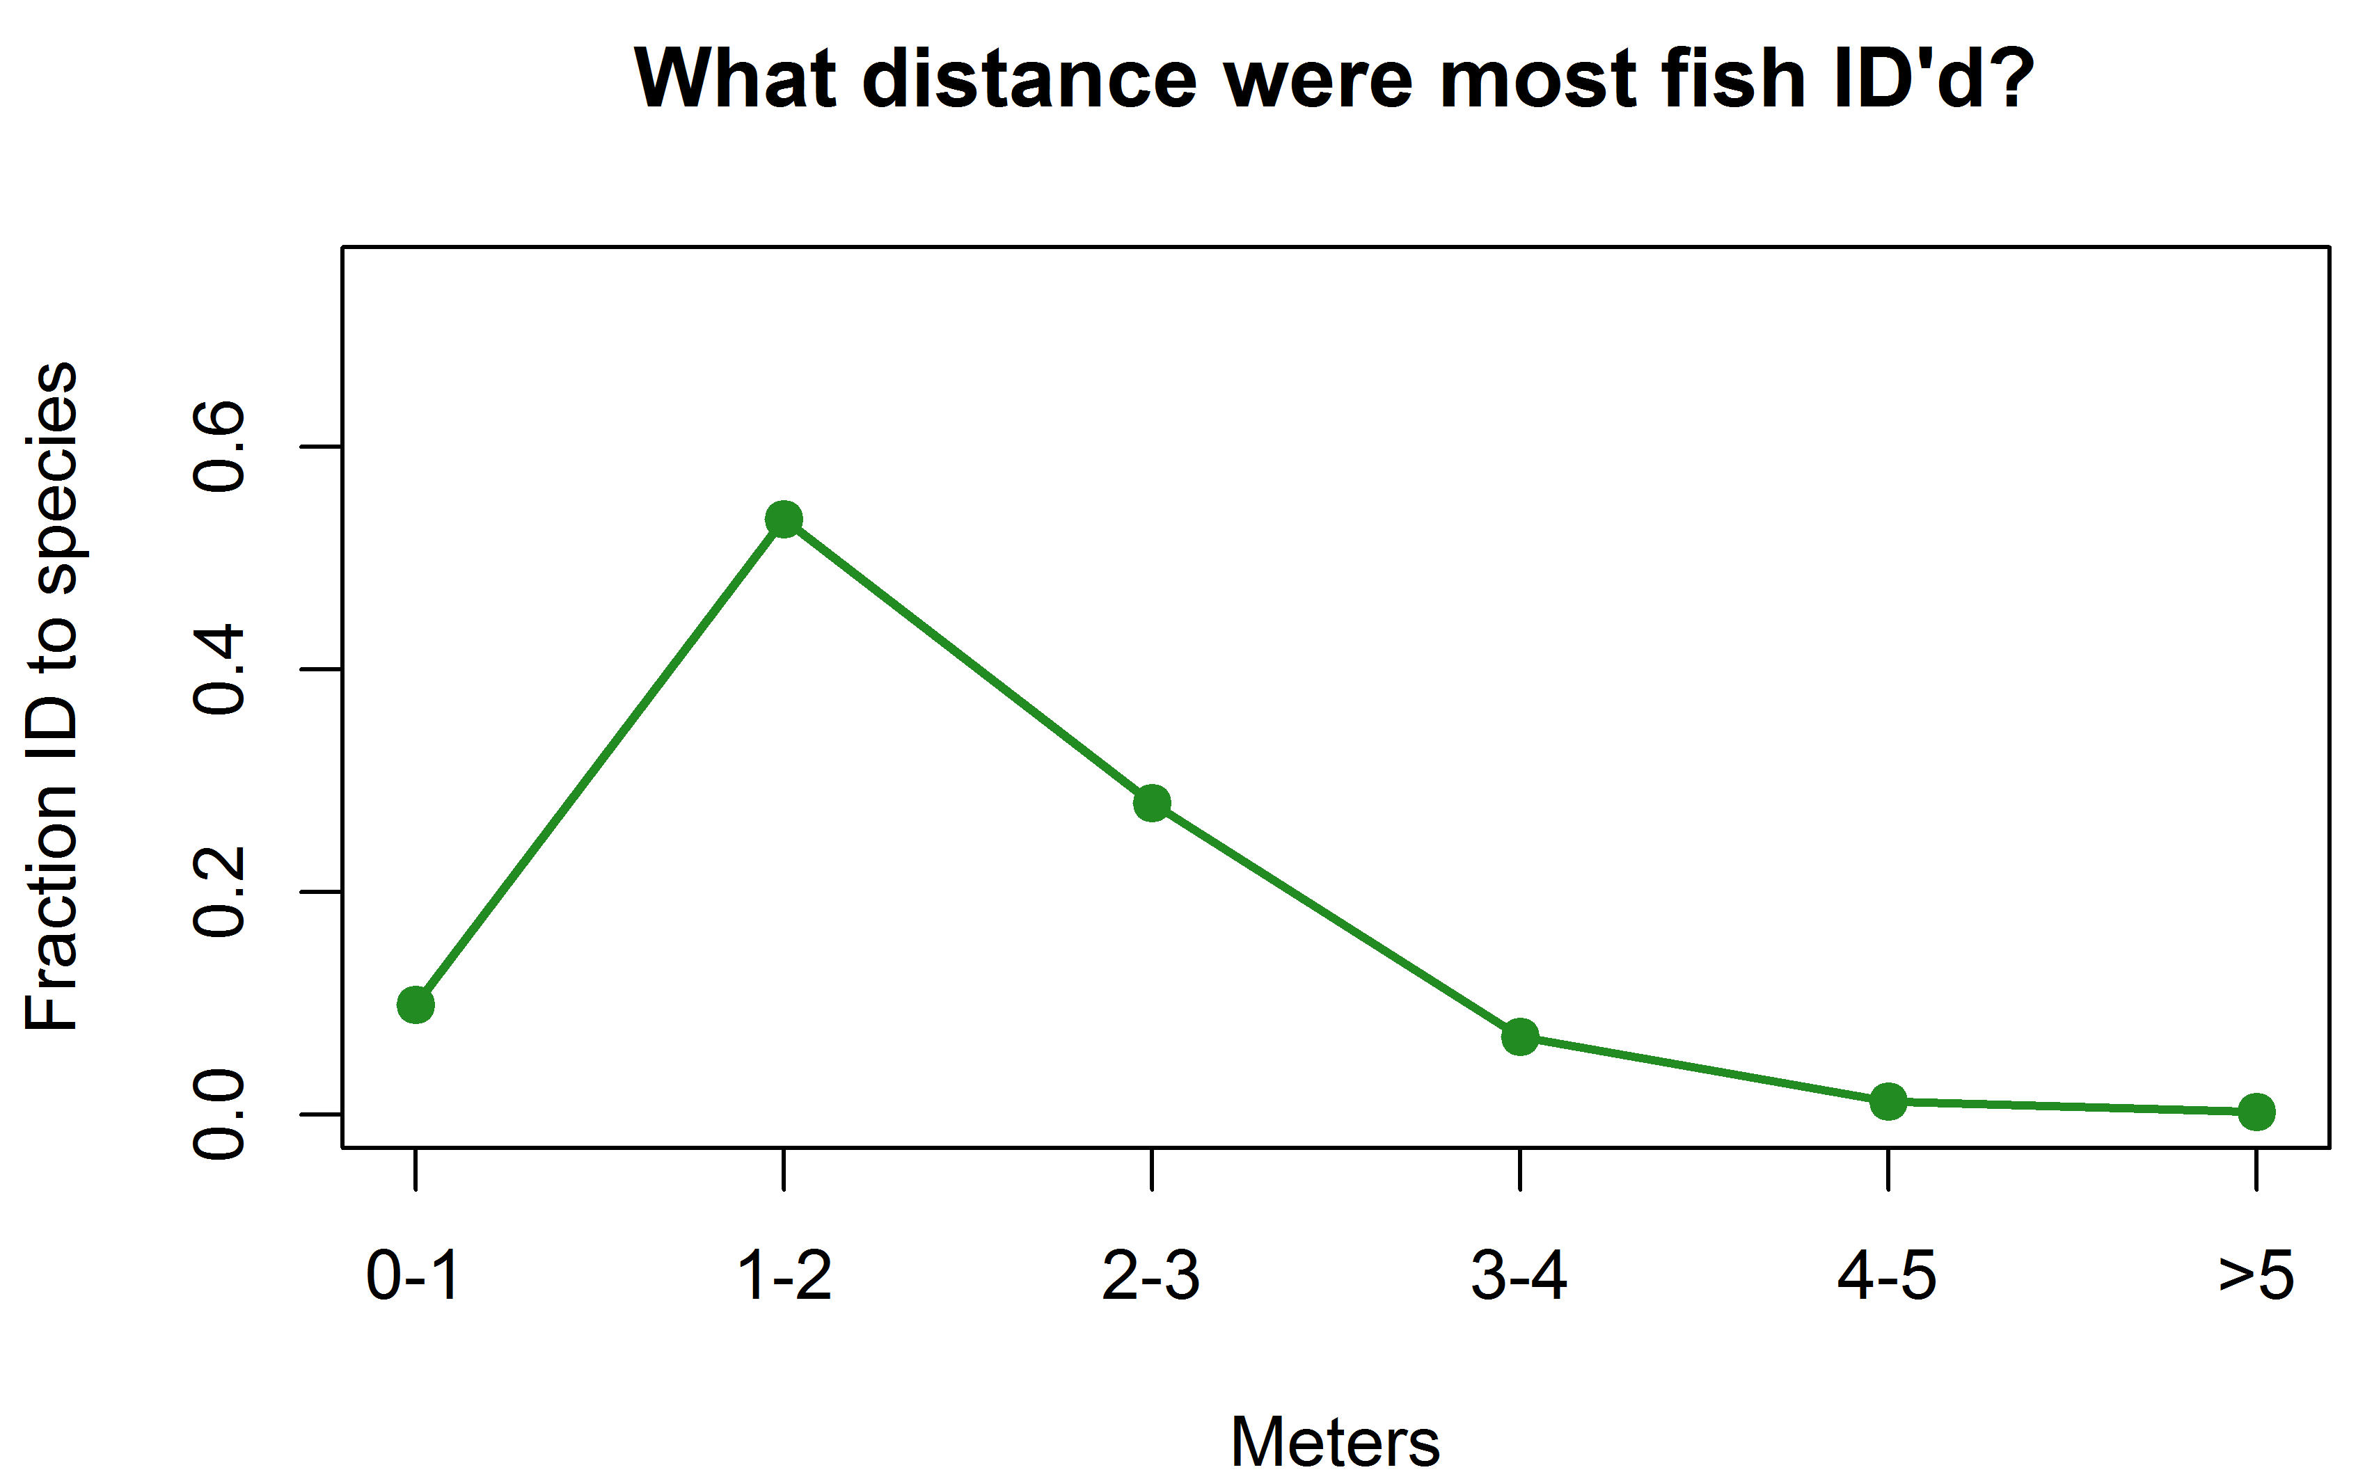
Stereo imaging performance test
  Is vertical pairing of camera suitable for stereo imaging?
  Does camera angle relative to viewing port affect performance?
  Does movement of camera relative to view port affect performance?
Plot: Ryan Fields, MLML

Slide 15
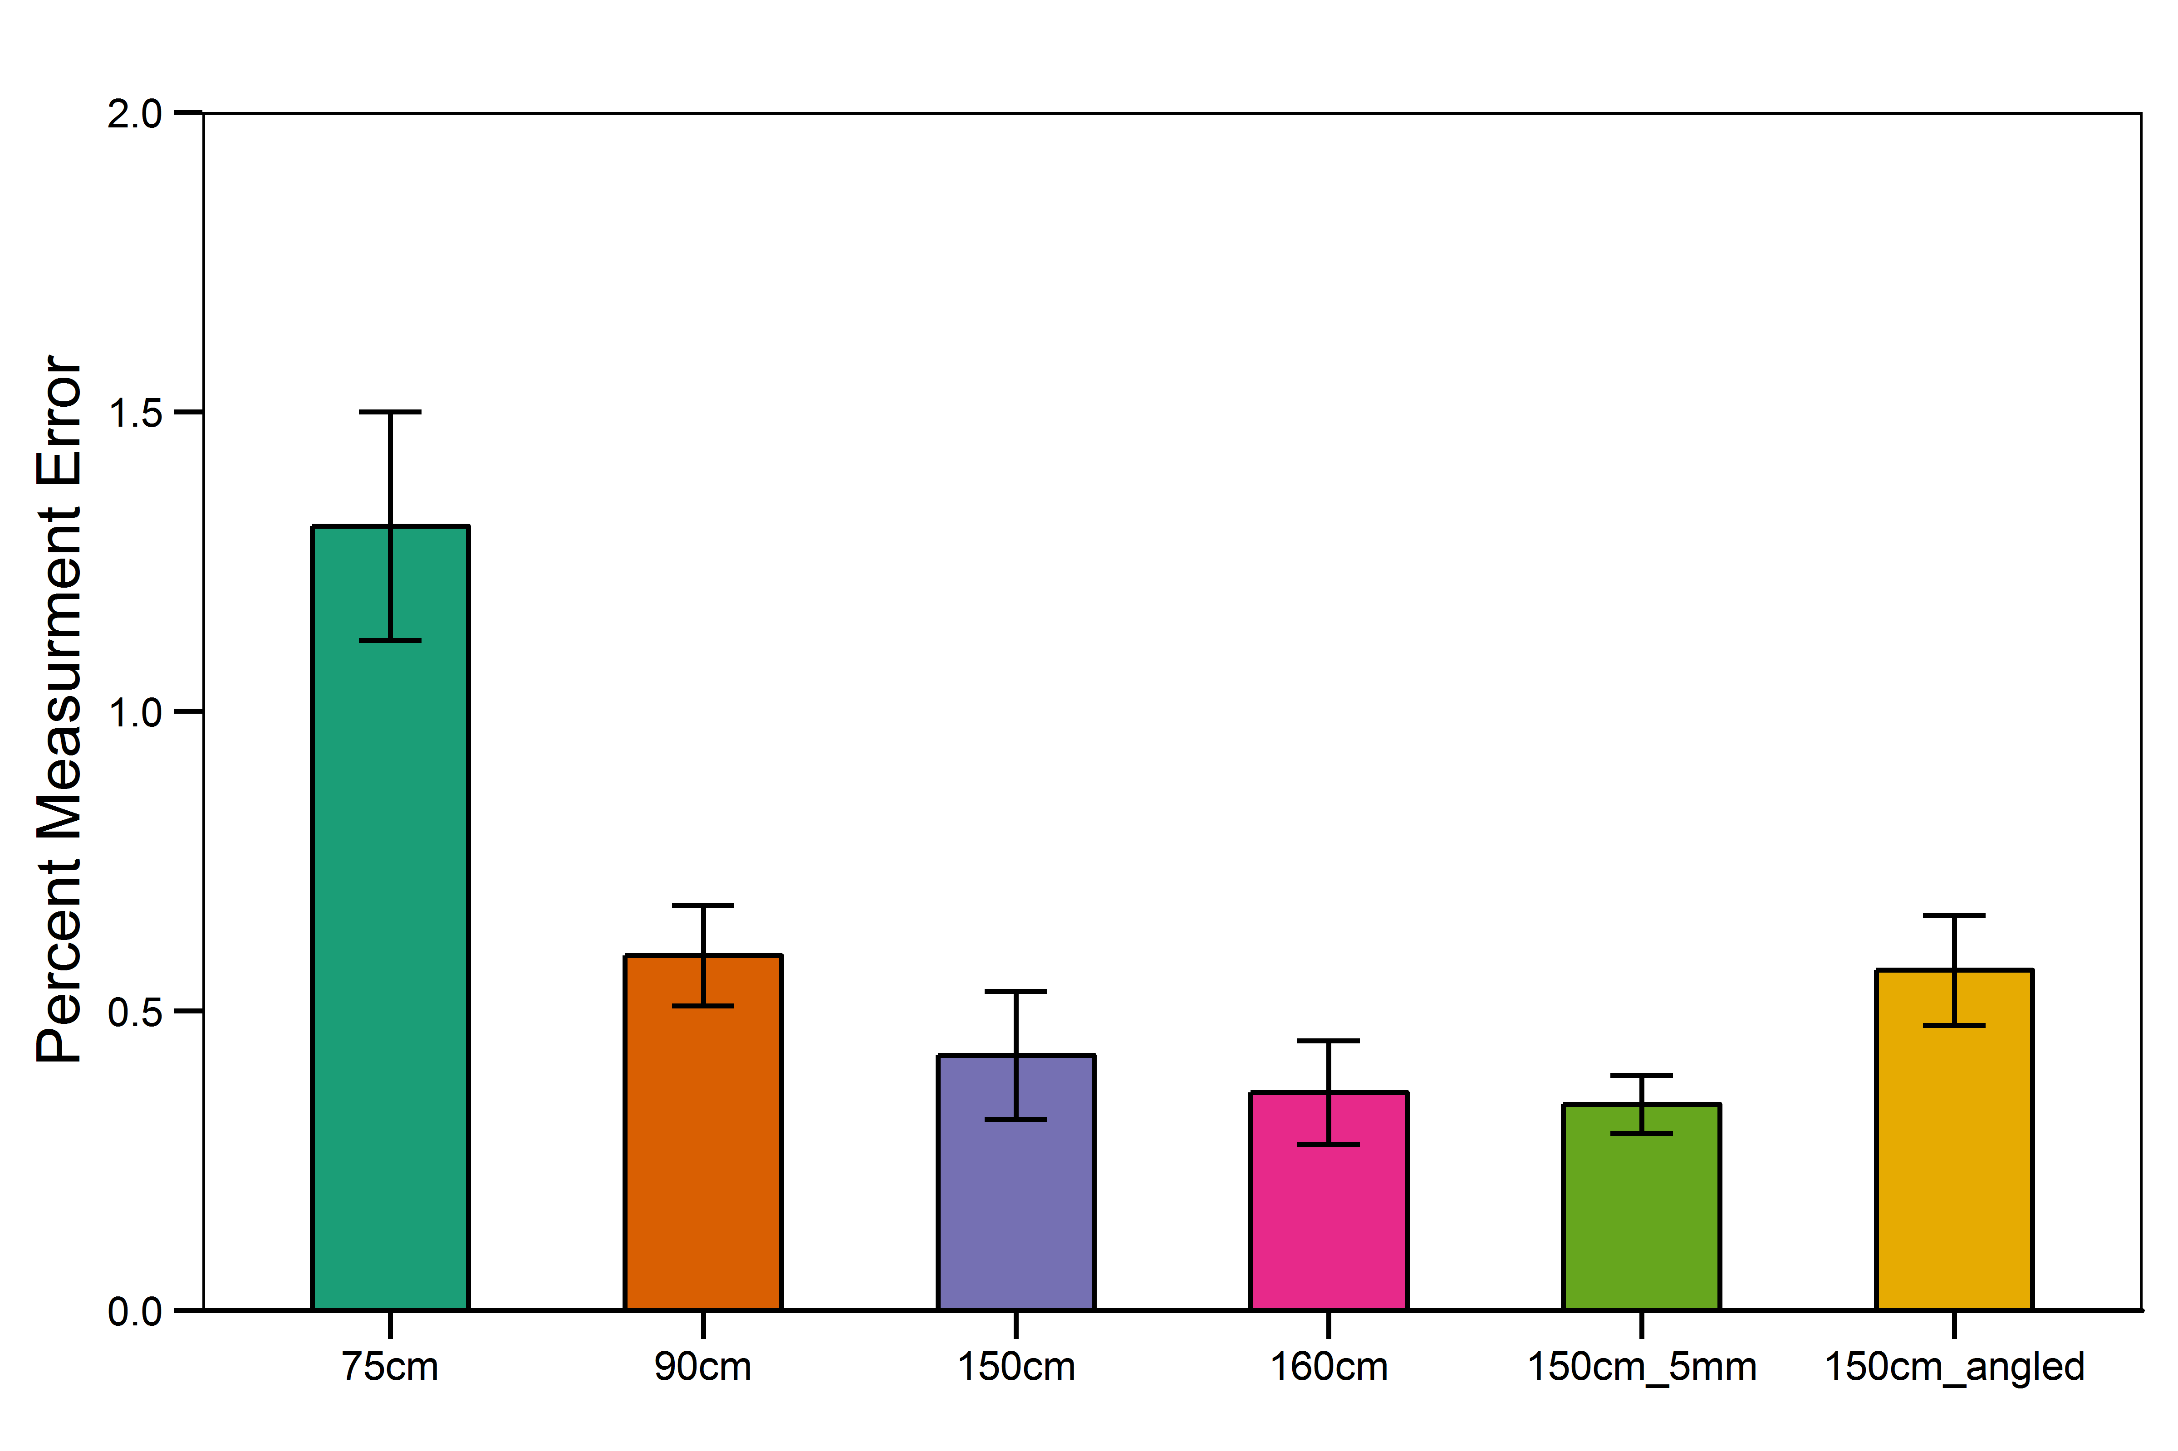
Stereo imaging performance test result
Requirement:
Less than 2% measurement at error at 1.5m.
Requirement is easily met.
Plot: Ryan Fields, MLML

Slide 16
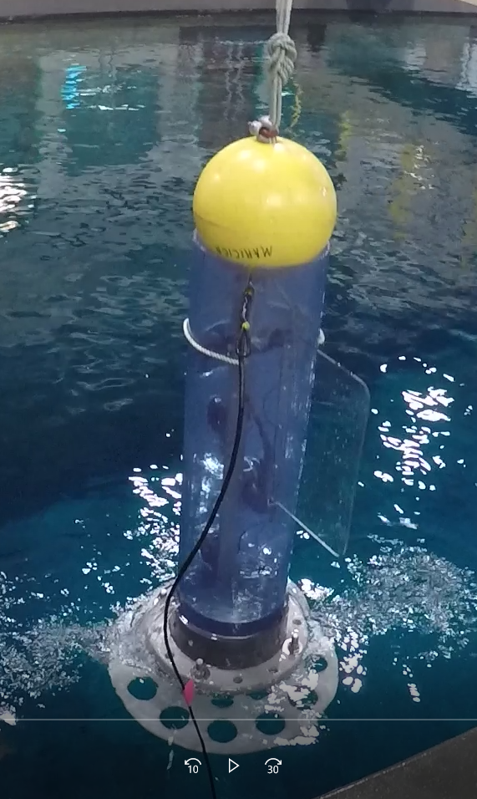
Mockup lander test in MBARI tank and Monterey Bay
Results:
Upper camera suffered from backscatter.
Sediment cleared in about 30s
Fin helped stabilize lander
Fish are scared by movement and return within 30s
Narrow base fairly stable
Compass very useful
Second mockup test
Realistic size and weight
Deeper test with clump weight

