Slide 1
Benthic Observation System
Concept Design Review
(draft)
March 27, 2017

Slide 2





Team & PIs
Principal Investigators
Design Team
Jim Barry
Francisco Chavez
Kelly Benoit-Bird
Mary Gleason (TNC)
Rick Starr (MLML)
Chad Kecy (PM)
Francois Cazenave
Kent Headley
Craig Okuda
Eric Martin
Mike Parker
Jared Figurski
Ryan Fields (MLML)
Tyler Maricich (Collaborator)

Slide 3
CDR Agenda
Motivation behind the project
Schedule
Science use cases
Functional requirements
Derived requirements
Summary

Slide 4
Motivation for Benthic Observation System
Expressed desire for a modular platform which combines stereo imagery with contextual sensors
Modifiable system can reduce the number expensive one-off specific systems
Driven by an immediate need by The Nature Conservancy

Slide 5
Science Background/Use: TNC
Collaboration with NOAA-Fisheries to add visual component to the coast wide Fishery Resource Analysis and Monitoring (FRAM) trawl survey to assess “untrawlable” (rocky) habitats and inform fisheries stock assessments and management
Will use BOS to provide density estimates (#/m²) and size structure of 6-8 demersal species
  yelloweye, cowcod, lingcod, canary, bocaccio, greenspot

Slide 6
Science Background/Use: Barry
Long term collaboration with The Monterey Bay National Marine Sanctuary (MBNMS) to study the benthic biological environment at Sur Ridge
Will use BOS to characterize environmental conditions to help understand various processes:
  Feeding in relation to water flow
  Predator-prey interactions
  Temporal variation in benthic conditions

Slide 7
Science Background/Use: Chavez
***need background info***
Will use BOS to….

Slide 8
Science Background/Use: Benoit-Bird
****need background info***
Will use BOS to utilize high resolution stereo video to:
  assist in the interpretation of the data acquired via acoustic instruments
  provide data on the behavior of the biota to the acoustic instruments themselves

Slide 9
Common Functional Requirements
The lander must provide the ability to identify, count, and size marine organisms by capturing video and/or still images.
The lander must have the ability to interface and log various contextual sensors, such as O2, pH, ADCP, acoustic, and other novel sensors such as 3G-ESP.
The lander must be a modular platform that can be reconfigured for various sensors and deployment scenarios.

Slide 10

Derived Requirements (TNC)
Must operate tethered
Must be depth rated to 300 meters
Must operate in a benthic environment
Must be able to land on or hover above rocky outcroppings
Must capture stereo video
Must have near 360 degrees of stereo video coverage
Must be able to collect data from up to 30 sites within a normal operational ship day
Must be able to be deployed from various vessels of opportunity
Must provide real time telemetry data for positioning including video, depth, and heading

Slide 11

Derived Requirements (Barry)
Must operate autonomously
Must be depth rated to 1500 meters
Must operate in a benthic environment
Must be able to sit on or near coral ridges
Must capture stereo still images
Must be able to operate from days to one year
Must be able to be deployed from MBARI ships
Must have O2, pH, ADCP, and CTD sensors

Slide 12

Derived Requirements (Chavez)
Must operate autonomously
Must be depth rated to 300 meters
Must operate in a benthic environment
Must be able to sit on seafloor
Must capture stereo video
Must be able to operate for 3-6 months
Must be able to be deployed from MBARI ships
Must have O2 and CTD sensors
Must be able to interface the 3G-ESP
Must be able to interface the EK60 Echosounder

Slide 13

Derived Requirements (Chavez)
Must operate tethered (to a cabled observatory)
Must be depth rated to 300 meters
Must operate in a benthic environment
Must be able to sit on seafloor
Must capture stereo video
Must be able to operate for one year between maintenance
Must be able to be deployed from MBARI ships
Must have O2 and CTD sensors
Must be able to interface the 3G-ESP
Must be able to interface the EK60 Echosounder
Must provide real time video/data

Slide 14

Derived Requirements (Benoit-Bird)
Must operate tethered
Must be depth rated to 300 meters
Must operate in a mid-water environment
Must be able to be suspended from a ship
Must capture stereo video
Must be able to operate 1-2 hours each at up to 5 sites per day from ships
Must be able to be deployed from MBARI ships or various smaller vessels
Must be able to interface the EK80 echosounder or similar
Must provide real time video/data

Slide 15

Derived Requirements (Benoit-Bird)
Must operate autonomous
Must be depth rated to 300 meters
Must operate in a mid-water environment
Must be able to be suspended from a mooring
Must capture stereo video
Must be able to collect 5 minutes of video/data every 30 minutes for 3 months
Must be able to be deployed from MBARI ships or various smaller vessels
Must be able to interface the EK80 echosounder or similar

Slide 16
Operational Requirements Matrix
Requirement | TNC | Barry | Chavez | Benoit-Bird
Tethered | Yes | No | Yes | Yes
Autonomous | No | Yes | Yes | Yes
Depth 300 Meters | Yes | No | Yes | Yes
Depth 1500 Meters | No | Yes | No | No
Benthic | Yes | Yes | Yes | No
Mid-water | No | No | No | Yes
Stereo video | Yes | No | Yes | Yes
Stereo imaging | No | Yes | No | No
360 degrees coverage | Yes | No | No | No
Operate from MBARI ships | No | Yes | Yes | Yes
Operate from non-MBARI ships | Yes | No | No | Yes
O2 sensor | No | Yes | Yes | No (Nice)
pH probe | No | Yes | No (Nice) | No
CTD | No | Yes | Yes | No (Nice)
ADCP | No | Yes | No (Nice) | No
EK80 echosounder (or similar) | No | No | Yes | Yes
3G-ESP | No | No | Yes | No

Slide 17
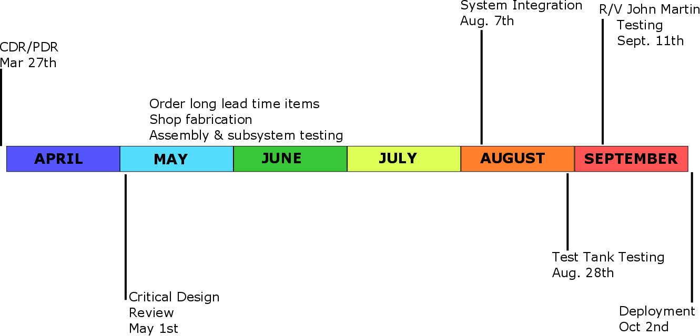
Timeline for TNC Deadline

Slide 18
Summary
TNC: Preliminary design options studied – will be presented next
MBARI Use Cases
  Widely divergent sets of requirements
  Large design gap between autonomous & tethered
    Electrical energy required & software (data management)
  Can this task be performed with existing hardware?
  Can all requirements be met by one system?
Recommendations
  TNC: Proceed with PDR + build
  MBARI: Further study needed

