Slide 1
Benthic Observation System
Preliminary Design Review for TNC Use Case
(draft)
March 27, 2017

Slide 2
Team & PIs
Jim Barry
Francisco Chavez
Kelly Benoit-Bird
Mary Gleason (TNC)
Rick Starr (MLML)
Chad Kecy (PM)
Francois Cazenave
Kent Headley
Craig Okuda
Eric Martin
Mike Parker
Jared Figurski
Ryan Fields (MLML)
Tyler Maricich (Collaborator)

Slide 3
PDR Agenda
Science Background & Motivation
1st Generation Lander
Review of Functional/Derived Requirements
  Additional Operational Requirements
  Launch and Recovery
Proposed Concept (top level block/functional diag + drawing)
Deck System
  Tether
  Winch & Accessories
Lander (Mechanical and Electrical options)
Camera Selection
Topside System
Software / Data Management

Slide 4
Science Background
Visual component to the coast wide FRAM trawl survey (mostly in rocky habitats)
Provide density estimates (#/m²) and size structure of 6-8 demersal species
  yelloweye, cowcod, lingcod, canary, bocaccio, greenspot

Slide 5

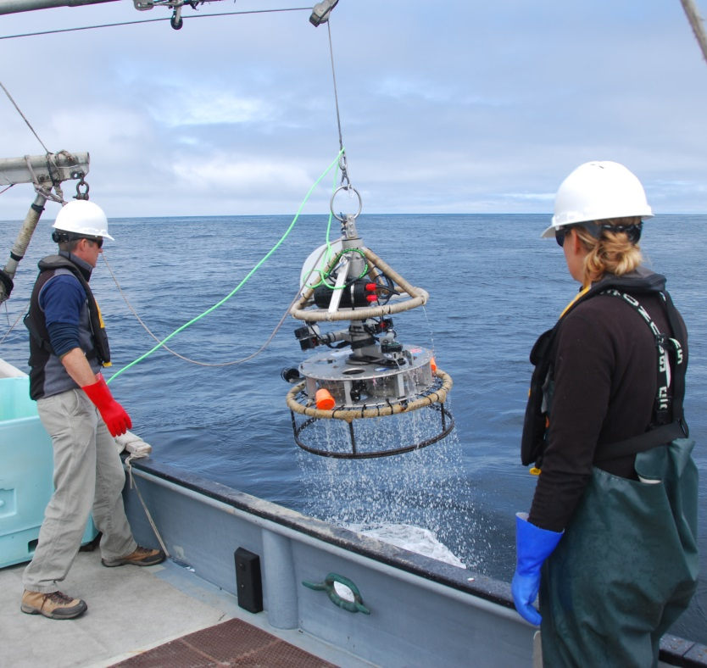
First Generation TNC Lander

Slide 6
Functional Requirements
The lander must provide the ability to identify, count, and size marine organisms by capturing video and/or still images.
The lander must have the ability to interface and log various contextual sensors, such as O2, pH, ADCP, acoustic, and other novel sensors such as 3G-ESP.
The lander must be a modular platform that can be reconfigured for various sensors and deployment scenarios.

Slide 7

Derived Requirements (TNC)
Must operate tethered
Must operate in a benthic environment
Must capture stereo video
Must have 360 degrees of stereo video coverage
Must be depth rated to 300 meters
Must be able to land on or hover above rocky outcroppings
Must be able to collect data from up to 30 sites within a normal operational ship day
Must be able to be deployed from various vessels of opportunity
Must provide real time telemetry data for positioning including video, depth, and heading

Slide 8
Other Design Criteria
Ability to transfer videos from lander during transit periods
Topside control of system
  Cameras (start/stop REC)
  Lights (on/off)
Ability to stay on station for up to 6 minutes
Ability to count fish up to 4 meters away from lander
Ability to size fish up to 2 meters away from lander
Ability to synchronize all 8 cameras
Live video feed from 1 camera in each quadrant
  Total of 5 live video feeds
Ability to record the 8 HD video feeds topside in the future
Load bearing tether (no second line)
Simplify launch and recovery processes

Slide 9
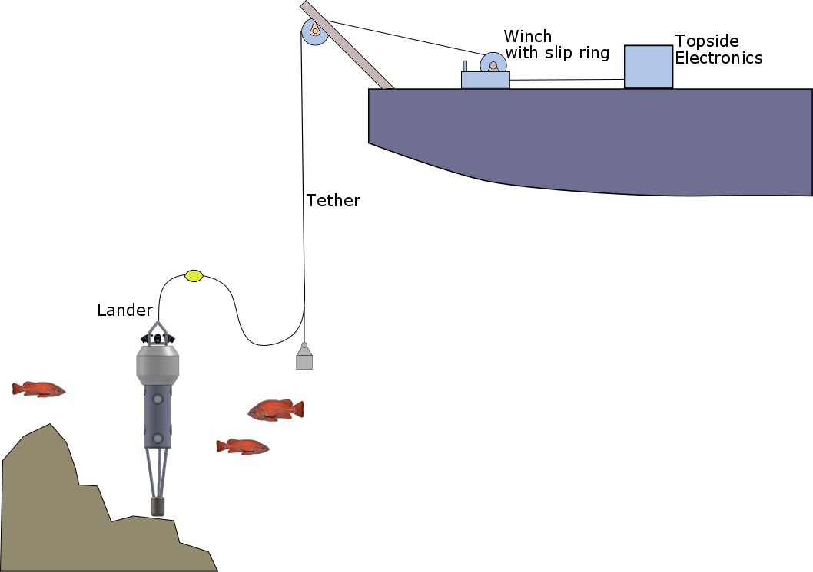
Proposed Concept Drawing

Slide 10
Deck System Options
[Eric]
Tether: fiber vs copper
Winch
Slip Ring

Slide 11
Lander: Mechanical Options
[Francois]
Horizontal vs vertical camera mounting
Multiple camera housings vs one housing
Configurable (swappable) base

Slide 12
Camera Selection
[Francois]
Criteria
  Video/image quality (sensor size, sensitivity)
  FOV large enough for covered area (swappable lenses)
  Form factor / size
  Ability to have wired interface camera (remote trigger)
  Local storage (sd card)

Slide 13
Lander: Electrical Options
[Chad]
Top level electrical decision: fiber vs. copper
Power options: AC vs DC, low or medium volts
Controller (CPU) options
Electrical block diagram
Estimated power budget

Slide 14
Topside System Options
[Chad]
Electrical power conversion (AC or DC)
Ground fault detection for source voltage
Real time video and telemetry display
Controller (CPU) for system control
Data stream management
  Logging & distribution
Topside system needs to be portable

Slide 15
Software/Data Management Options
[Kent]
Topside control of subsea components
Logging and displaying of telemetry data
Software drivers
  External temperature and pressure sensor
  Internal heading sensor

Slide 16
Summary

