Slide 1
Benthic Observation System
Preliminary Design Review for TNC Use Case
(draft)
March 27, 2017

Slide 2
Team & PIs
Principal Investigators
Design Team
Mary Gleason (TNC)
Rick Starr (MLML)
Chad Kecy (PM)
Francois Cazenave
Kent Headley
Craig Okuda
Eric Martin
Mike Parker
Jared Figurski
Ryan Fields (MLML)
Tyler Maricich (Collaborator)

Slide 3
PDR Agenda
Science Background & Motivation [Chad]
1st Generation Lander [Chad]
Schedule
Review of Functional/Derived Requirements [Chad]
  Additional Operational Requirements
  Launch and Recovery
Proposed Concept (top level block/functional diag + drawing) [Chad]
  Deck System [Eric]
    Tether
    Winch & Accessories
  Lander (Mechanical and Electrical options) [Francois & Chad]
  Camera Selection [Francois]
  Topside System [Chad]
  Software / Data Management [Kent]

Slide 4
Science Background
Collaboration with NOAA-Fisheries to add visual component to the coast wide Fishery Resource Analysis and Monitoring (FRAM) trawl survey (mostly in rocky habitats)
Provide density estimates (#/m²) and size structure of 6-8 demersal species
  size of fish

Slide 5

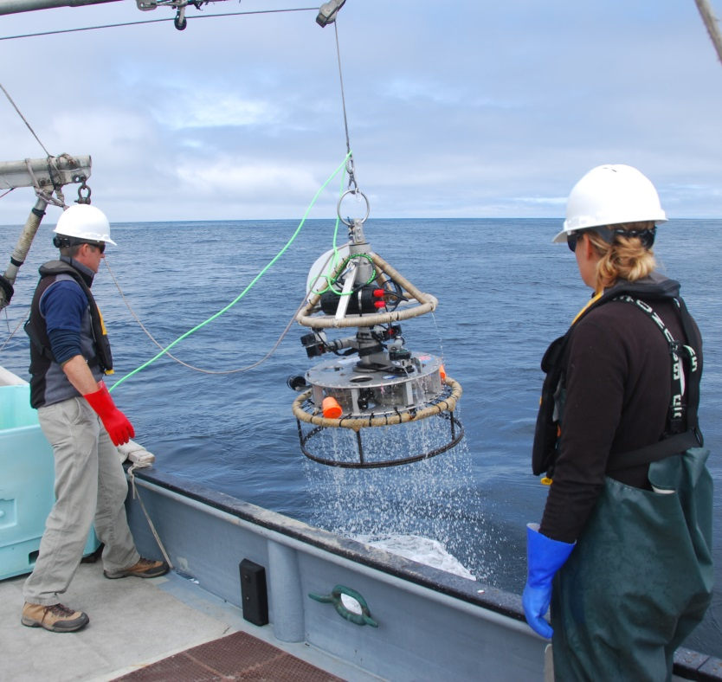
First Generation TNC Lander

Slide 6
Functional Requirements
The lander must provide the ability to identify, count, and size marine organisms by capturing video and/or still images.
The lander must have the ability to interface and log various contextual sensors, such as O2, pH, ADCP, acoustic, and other novel sensors such as 3G-ESP.
The lander must be a modular platform that can be reconfigured for various sensors and deployment scenarios.

Slide 7

Derived Requirements (TNC)
Must operate tethered
Must be depth rated to 300 meters
Must operate in a benthic environment
Must be able to land on or hover above rocky outcroppings
Must capture stereo video
Must have near 360 degrees of stereo video coverage
Must be able to collect data from up to 30 sites within a normal operational ship day
Must be able to be deployed from various vessels of opportunity
Must provide real time telemetry data for positioning including video, depth, and heading

Slide 8
Additional Requirements
Ability to transfer videos from lander during station transit periods
Topside control of system
  Cameras (start/stop REC)
  Lights (on/off)
Ability to stay on station for up to 6 minutes
Ability to count fish up to 4 meters away from lander
Ability to size fish up to 2 meters away from lander
Ability to synchronize all 8 cameras
Live video feed from 1 camera in each quadrant
  Total of 5 live video feeds
Load bearing tether (no second line)
Simplify launch and recovery processes
Ability to record the 8 HD video feeds topside in the future

Slide 9
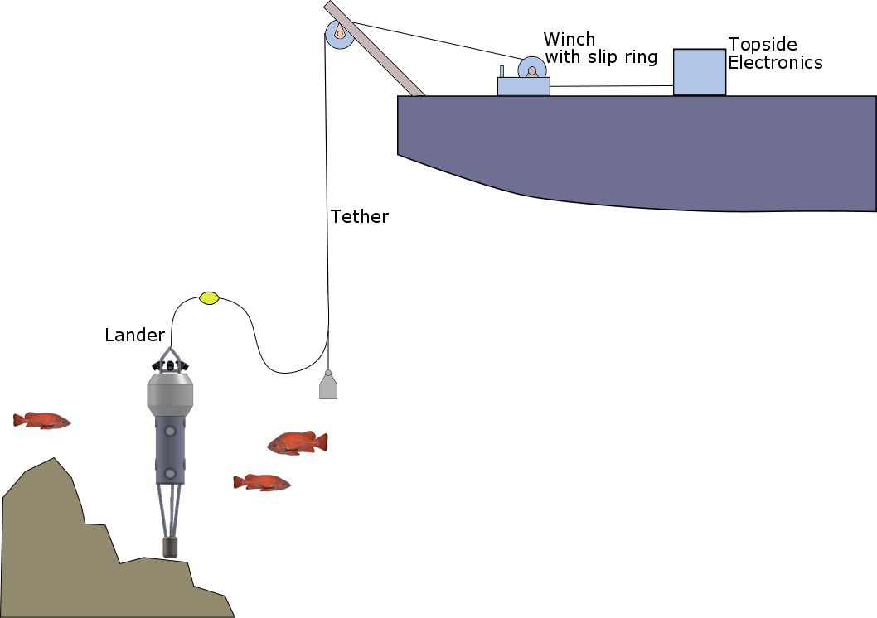
Proposed Concept Drawing for TNC

Slide 10
Deck System Options
[Eric]
Tether: fiber vs copper
Winch
Slip Ring

Slide 11
Lander: Mechanical Options
[Francois]
Horizontal vs vertical camera mounting
Preliminary testing & mock up
Multiple camera housings vs one housing
  Four quadrants with 2 cameras + 1 light each
Configurable (swappable) base

Slide 12
Camera Selection
[Francois]
Criteria
  Video/image quality (sensor size, sensitivity)
  FOV large enough for covered area (swappable lenses)
  Form factor / size
  Ability to have wired interface camera (remote trigger)
  Local storage (sd card)

Slide 13
Lander: Electrical Options
[Chad]
Top level electrical decision: fiber vs. copper
Power options: AC vs DC, low or medium volts
Controller (CPU) options
Electrical block diagram
Estimated power budget

Slide 14
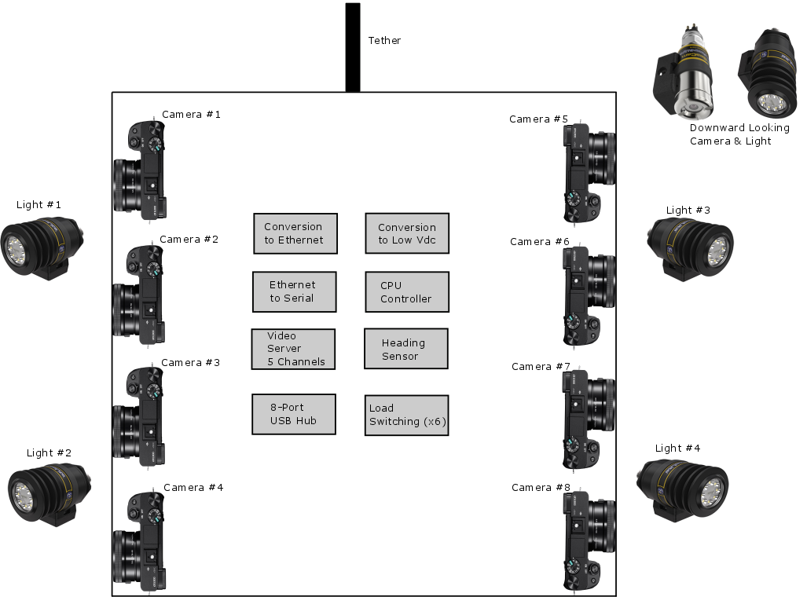
Elec: Concept Functional Diagram

Slide 15
Elec: Estimated Power Budget
Hotel Load: 100W
Lights (Switchable): 250W
Cameras (Switchable): 50W
Total: 400W

Slide 16
Elec: Tether Interface
Fiber Optic
Coax or Twisted Pairs
Single mode fibers
  BW: 10Gbps+
  Dist: >10km
Pair of OE converters
Optical path on slip ring
Future HD recording topside
14-16AWG for power
22AWG for ground fault det
GigE Ethernet
  BW: 100Mbps
  Dist: 100m
Pair of ADSL Ethernet extenders
  BW: 168Mbps
  Dist: 1km
Cheaper, smaller slip ring
Limits HD recording to subsea
14-16AWG for power
22AWG for ground fault det

Slide 17
Elec: Power Options
DC Volts
AC Volts
Must generate topside
Higher Vdc means lower i²r losses
Ground fault detection already designed & built
Conversion to low volts DC required subsea
Readily available on ships
Requires isolation transformer
Conversion to low volts DC required subsea
Less heat generated
Tethered only

Slide 18
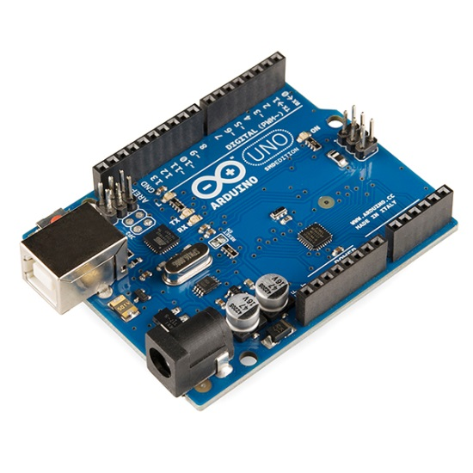
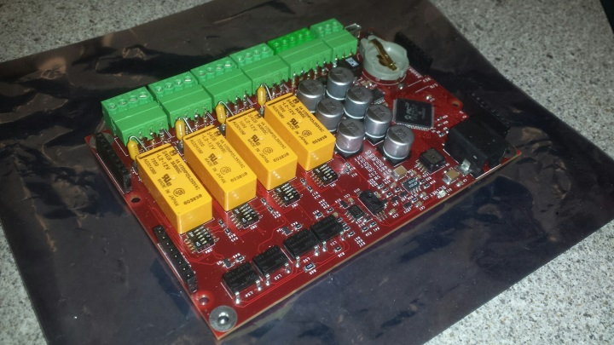
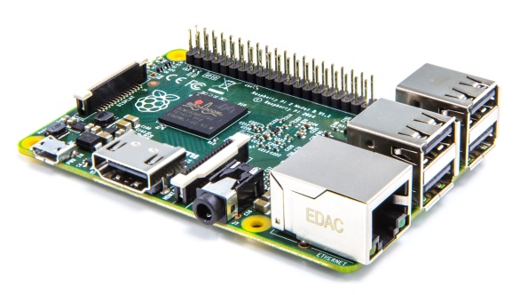
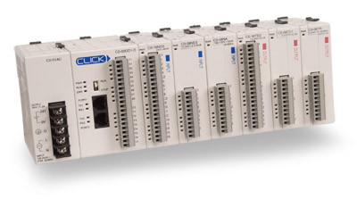
Elec: Controller (CPU) Options
Oasis5
Arduino
Raspberry Pi
Programmable
Logic Controller
(PLC) Stack

Slide 19
Oasis5
Advantages
Disadvantages
Expandable
Multiple serial ports
GPIO
Relay control
Data storage (sd card)
Some instrument drivers already written
Platform independent
Custom MBARI board (not COTS)
Firmware development required
Development system

Slide 20
Arduino/Raspberry Pi Class
Advantages
Disadvantages
Readily available (COTS)
Relatively easy to program
GPIO
Additional daughter boards (shields) necessary
  All needed functions may not exist
  May need to design custom bds
Instrument drivers need to be written
Harder to add additional ports

Slide 21
PLC
Advantages
Disadvantages
Readily available (COTS)
Extremely simple to program
Rapid deployment
Industrial robustness
Low cost
GPIO
Relay control
No serial ports
Not low power
Form factor

Slide 22
Topside System Options
[Chad]
Electrical power conversion (AC or DC)
Ground fault detection for source voltage
Real time video and telemetry display
Controller (CPU) for system control
Data stream management
  Logging & distribution
Topside system needs to be portable

Slide 23
Software/Data Management Options
[Kent]
Topside control of subsea components
Logging and displaying of telemetry data
Software drivers
  External temperature and pressure sensor
  Internal heading sensor

Slide 24
Summary
schedule (crit review)
reccomendations

