Slide 1
Benthic Observation System
Preliminary Design Review for TNC Use Case
(draft)
March 27, 2017

Slide 2
Team & PIs
Principal Investigators
Design Team
Mary Gleason (TNC)
Rick Starr (MLML)
Chad Kecy (PM)
Francois Cazenave
Kent Headley
Craig Okuda
Eric Martin
Mike Parker
Jared Figurski
Ryan Fields (MLML)
Tyler Maricich (Collaborator)

Slide 3
PDR Agenda
Science Background & Motivation
1st Generation Lander
Review of Functional & Derived Requirements
Proposed Concept
  Deck System
  Lander
  Camera Selection
  Topside System
  Software & Data Management
Proposed Design
Schedule
Next Steps

Slide 4
Science Background
Collaboration with NOAA-Fisheries to add visual component to the coast wide Fishery Resource Analysis and Monitoring (FRAM) trawl survey (mostly in rocky habitats)
Provide density estimates (#/m²) and size structure of 6-8 demersal species
  Sizes range from 4” to 16”

Slide 5

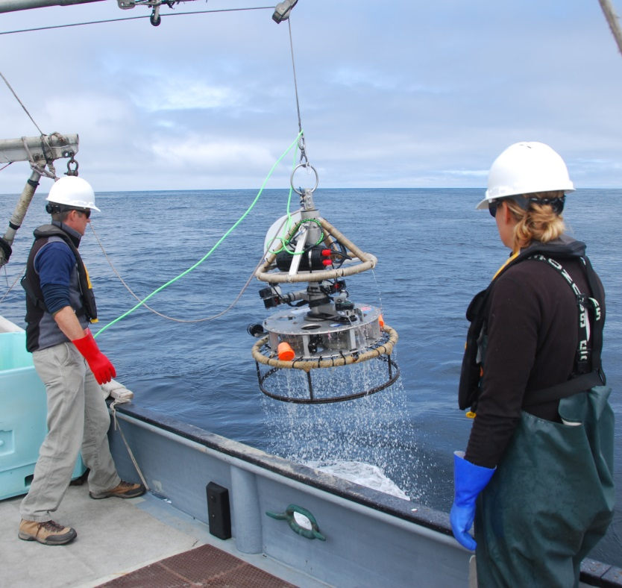
First Generation TNC Lander
Separate handling line
and electrical tether
SeeStar (not part of
TNC Lander)
Stereo camera pair on
a rotatable mount
Crab pot base

Slide 6
Functional Requirements
The lander must provide the ability to identify, count, and size marine organisms by capturing video and/or still images.
The lander must have the ability to interface and log various contextual sensors, such as O2, pH, ADCP, acoustic, and other novel sensors such as 3G-ESP.
The lander must be a modular platform that can be reconfigured for various sensors and deployment scenarios.

Slide 7

Derived Requirements (TNC)
Must operate tethered
Must be depth rated to 300 meters
Must operate in a benthic environment
Must be able to land on or hover above rocky outcroppings
Must capture stereo video
Must have near 360 degrees of stereo video coverage
Must be able to collect data from up to 30 sites within a normal operational ship day
Must be able to be deployed from various vessels of opportunity
Must provide real time telemetry data for positioning including video, depth, and heading

Slide 8
Additional Requirements
Ability to transfer videos from lander during station transit periods
Topside control of system
  Cameras (start/stop REC)
  Lights (on/off)
Ability to stay on station for up to 6 minutes
Ability to count fish up to 4 meters away from lander
Ability to size fish up to 2 meters away from lander
Ability to synchronize all 8 cameras
Live video feed from 1 camera in each quadrant
  Total of 5 live video feeds
Load bearing tether (no second line)
Simplify launch and recovery processes
Ability to record the 8 HD video feeds topside in the future

Slide 9
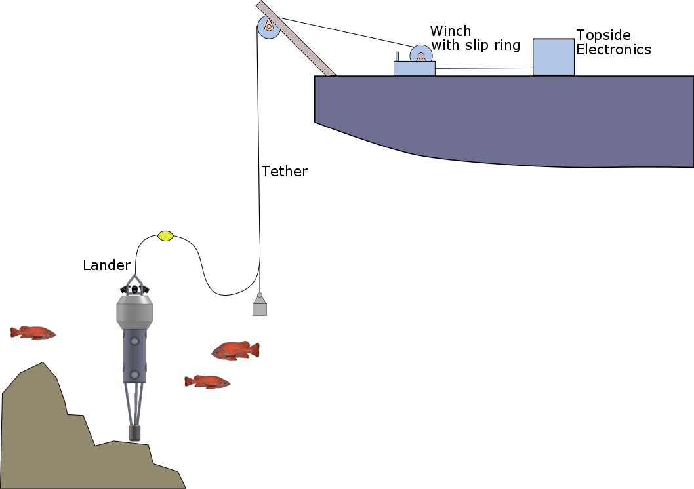
Proposed Concept Drawing for TNC

Slide 10
Deck System Options
[Eric’s slides]

Slide 11
Camera Selection
[Francois’s slides]
Criteria
  Video/image quality (sensor size, sensitivity)
  FOV large enough for covered area (swappable lenses)
  Form factor / size
  Ability to have wired interface camera (remote trigger)
  Local storage (sd card)

Slide 12
Lander: Mechanical Options
[Francois’s slides]
Horizontal vs vertical camera mounting
Preliminary testing & mock up
Multiple camera housings vs one housing
  Four quadrants with 2 cameras + 1 light each
Configurable (swappable) base

Slide 13
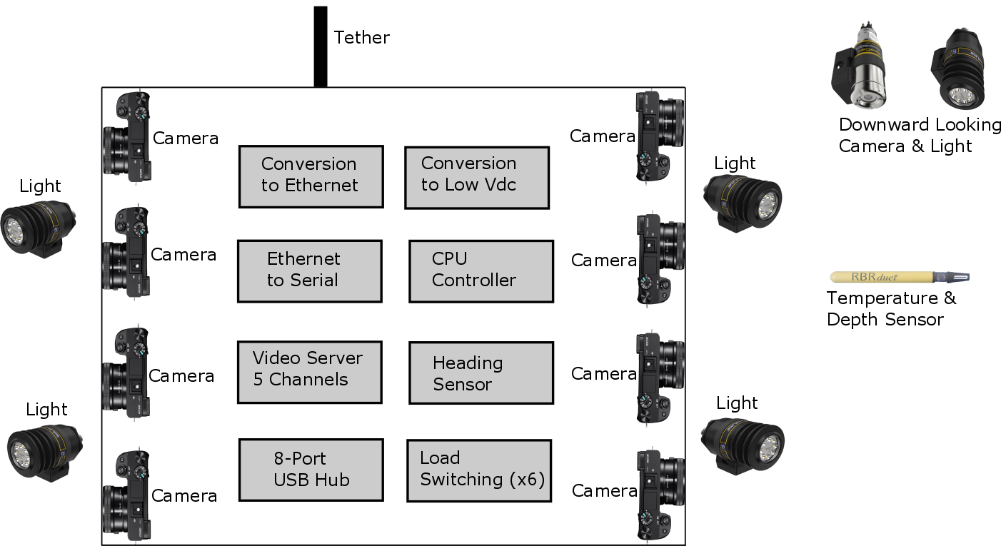
Electrical Concept Functional Diagram

Slide 14
Estimated Power Budget
Hotel Load: 100W
Lights (Switchable): 250W
Cameras (Switchable): 50W
Total: 400W

Slide 15
Tether Selection
Fiber Optic
Coax or Twisted Pairs
Single mode fibers
  BW: 10Gbps+
  Dist: >10km
Pair of OE converters
Optical path on slip ring
Future HD recording topside
14-16AWG for power
22AWG for ground fault det
GigE Ethernet
  BW: 100Mbps
  Dist: 100m
Pair of ADSL Ethernet extenders
  BW: 168Mbps
  Dist: 1km
Cheaper, smaller slip ring
Limits HD recording to subsea
14-16AWG for power
22AWG for ground fault det

Slide 16
Electrical Power Options
DC Volts
AC Volts
Must generate topside
Higher Vdc means lower i²r losses
Ground fault detection already designed & built
Conversion to low volts DC required subsea
Readily available on ships
Requires isolation transformer
Conversion to low volts DC required subsea
Less heat generated
Tethered only

Slide 17
Controller (CPU) Selection
Features
Design considerations
Data storage
Relay control
Serial ports
GPIO
Analog inputs
COTS or custom
  Tech transfer
Form factor
Ease of programming
  Firmware development
  Instrument drivers
Ease of use for end users
Daughter boards required?
Power consumption

Slide 18
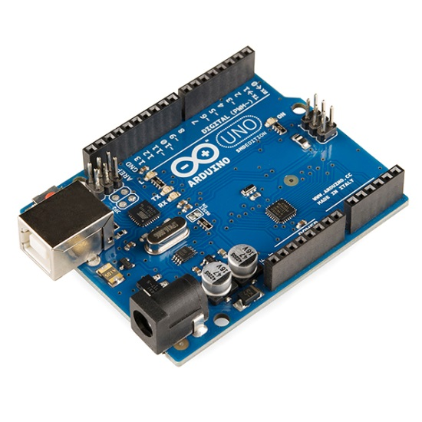
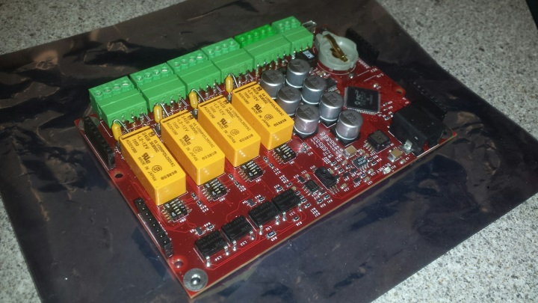
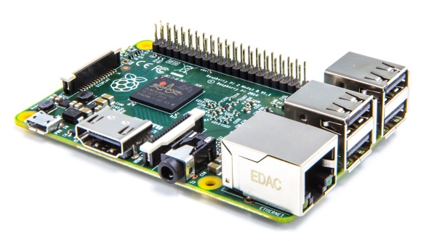
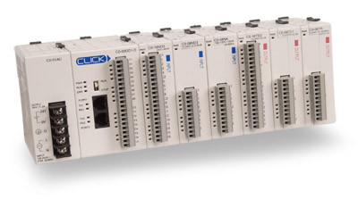
Controller (CPU) Options
Oasis5
Arduino
Raspberry Pi
Programmable
Logic Controller
(PLC) Stack

Slide 19
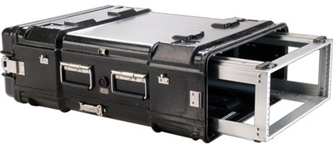
Topside Electronics Design
Functions
Design Considerations
Electrical power generation
Ground fault detection
Method for system control
Real time telemetry & video display
Method for transferring HD videos post deployment
Must be portable
Safety features
Prefer to not open housing to retrieve HD videos

Slide 20
Software/Data Management Options
[Kent’s slides]

Slide 21
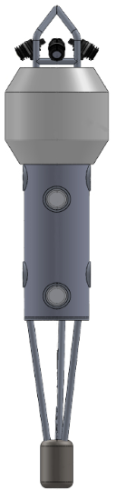
Proposed Design
Tether: Fiber
Power: DC
Housing: Single housing (with cameras)
Base: Detachable
Controller: PLC
Software: Aggsoft wedge

Slide 22
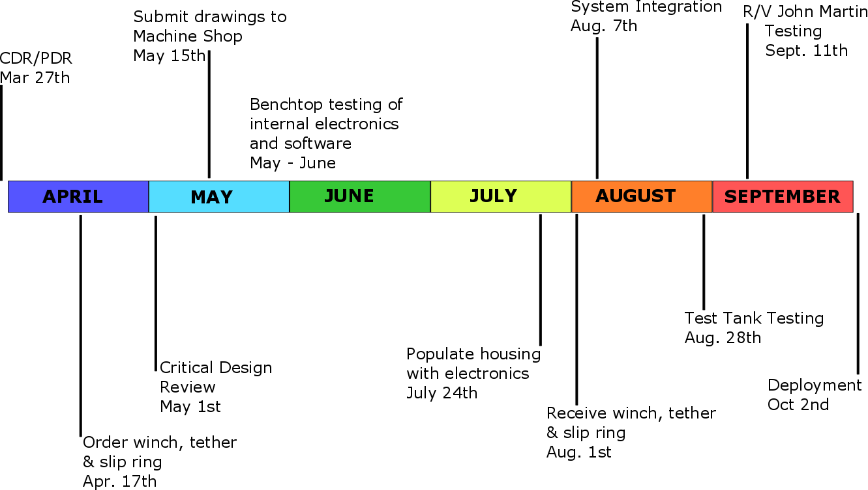
Tentative Schedule

Slide 23
Next Steps
Identify high risk & long lead time items
Evaluate feedback from this review
Schedule critical design review (or alternate)
Begin build of TNC system

