Slide 1
Benthic Observation System
Preliminary Design Review for TNC Use Case
March 27, 2017

Slide 2





Team & PIs
Principal Investigators
Design Team
Mary Gleason (TNC)
Rick Starr (MLML)
Chad Kecy (PM)
Francois Cazenave
Kent Headley
Craig Okuda
Eric Martin
Mike Parker
Jared Figurski
Ryan Fields (MLML)
Tyler Maricich (Collaborator)

Slide 3
PDR Agenda
Science Background & Motivation
1st Generation Lander
Review of Functional & Derived Requirements
Proposed Concept
  Deck System
  Lander
  Camera Selection
  Topside System
  Software & Data Management
Proposed Design
Schedule
Next Steps

Slide 4
Science Background
Collaboration with NOAA-Fisheries to add visual component to the coast wide Fishery Resource Analysis and Monitoring (FRAM) trawl survey (mostly in rocky habitats)
Provide density estimates (#/m²) and size structure of 6-8 demersal species
  Sizes range from 4” to 16”

Slide 5

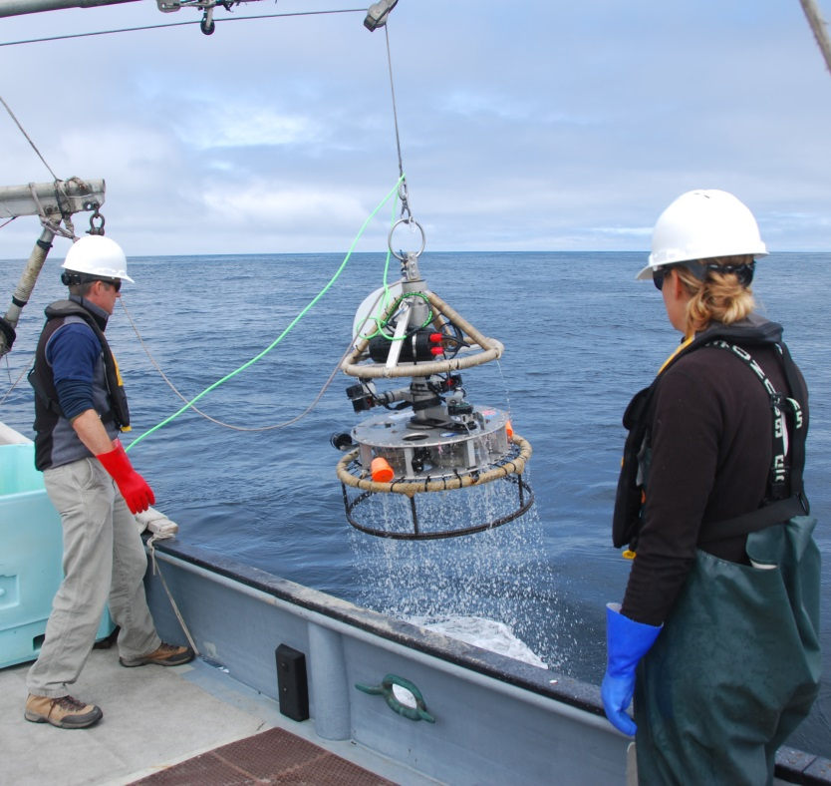
First Generation TNC Lander
Separate handling line
and electrical tether
SeeStar (not part of
TNC Lander)
Stereo camera pair on
a rotatable mount
Crab pot base

Slide 6
Functional Requirements
The lander must provide the ability to identify, count, and size marine organisms by capturing video and/or still images.
The lander must have the ability to interface and log various contextual sensors, such as O2, pH, ADCP, acoustic, and other novel sensors such as 3G-ESP.
The lander must be a modular platform that can be reconfigured for various sensors and deployment scenarios.

Slide 7

Derived Requirements
Must operate tethered
Must be depth rated to 300 meters
Must operate in a benthic environment
Must be able to land on or hover above rocky outcroppings
Must capture stereo video
Must have near 360 degrees of stereo video coverage
Must be able to collect data from up to 30 sites within a normal operational ship day
Must be able to be deployed from various vessels of opportunity
Must provide real time telemetry data for positioning including video, depth, and heading

Slide 8
Additional Requirements
Ability to transfer videos from lander during station transit periods
Topside control of system
  Cameras (start/stop REC)
  Lights (on/off)
Ability to stay on station for up to 6 minutes
Ability to count fish up to 4 meters away from lander
Ability to size fish up to 2 meters away from lander
Ability to synchronize all 8 cameras
Live video feed from 1 camera in each quadrant
  Total of 5 live video feeds
Load bearing tether (no second line)
Simplify launch and recovery processes
Ability to record the 8 HD video feeds topside in the future

Slide 9
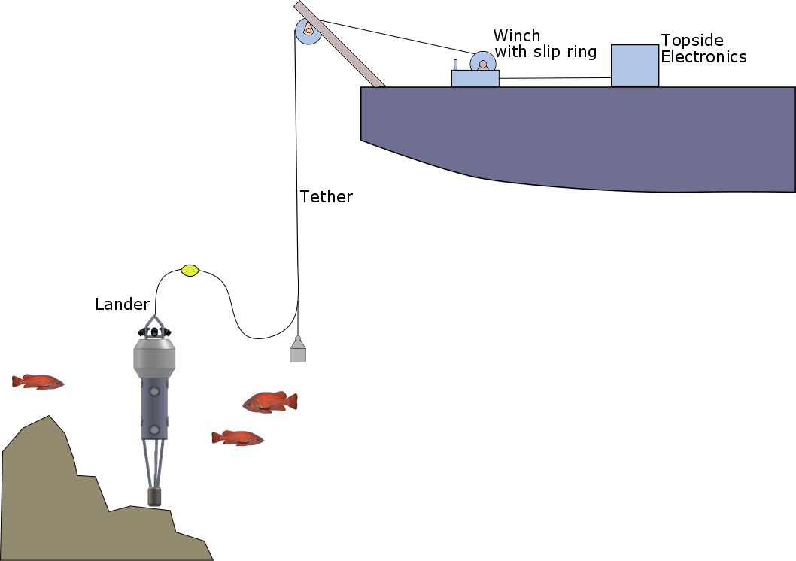
Proposed Concept Drawing for TNC

Slide 10
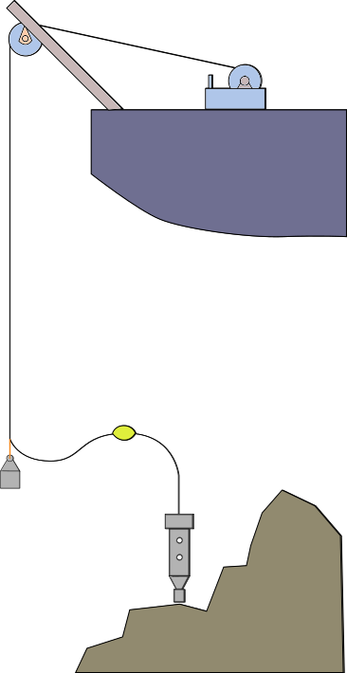
System Deployment
In order to deploy unit on bottom, the cable must keep free from propellers, not drag on bottom, and must facilitate an acceptable watch circle for a non-DP vessel.
For MBARI vessels and other identified ships this leads to a number of regulated safety factors that will inform the specification of the tether, and therefore the powered winch.

Slide 11
Considerations for Seagoing Installations
Max system weight: 500 lbs
Allowing for dynamic loading a tether must have an SWL of 1000 lbf, and via CFR189 the NBL of the tether must be 7000 lbf.
The tether must be the weakest link.
The winch must have a brake rated above 7000 lbf.
A 3 HP winch system will facilitate 30 m/min haul rates for this system, and will integrate with ships of opportunity.

Slide 12
Operational Components
BOS
Winch
Tether
Handling
Sheaves
Overboard
Frames
Slip Ring
Terminations
Subsea
Tether Management
Floats
Depressor
Weights
Payout Counter

Slide 13
Soft Jacket Fiber Tether Solution
TETHER | Custom Design will meet requirements.
ELECTRICAL | No batteries, independent GFI conductors
MECHANICAL | Can size SWL & NBL
DATA IMPACT | Topside data collection would be possible in future developments.
OPERATIONAL | Will require custom winch, larger sheaves. More care need be taken.
MAINTENANCE | Needs fiber kits and training. More downtime for damaged terms & tethers
COST | Estimated Costs 80k$, for winch, slip ring, and tether

Slide 14
Standard CTD Cable Solution
TETHER | UNOLS Standard 0.322"ø (Coax | 4C)
ELECTRICAL IMPACT | Batteries required to get to power lamps
MECHANICAL | Already supported on many ships (WF, RC, JM, SR)
DATA IMPACT | Real-Time data collection at the surface lost. Network data only.
OPERATIONAL | May Avoid depressor weight, but floats remain. More Flexible sheave options.
MAINTENANCE | Field servicable, inexpensive terminations
COST | Lower cost (~$30,000), less gear on accommodating ships

Slide 15
Solution Pathways
A trade study was conducted with regards to two potential system architectures that satisfy TNC requirements.
Option 1: Custom tether/winch to suit current needs and allow for system scalability to other applications
Option 2: Use widely available CTD wire which meets telemetry requirements and will result in lower cost system with lower maintenance impacts.
The study was not conclusive that either scenario was superior.

Slide 16
Mechanical Outline
Camera and lens selection
Camera placement for 360º stereo imaging
Main housing concept
Lander concept
Experiments to verify design concepts

Slide 17
Camera Requirements
Requirements
Candidate Cameras
Small size
Relatively low cost (8x)
Stills and HD video
Good low light performance
Reliable brand (long life cycle)
Easy to interface for control
Onboard storage
Sony UMC-S3C
E1 Z Camera
Sony A6000 Series

Slide 18
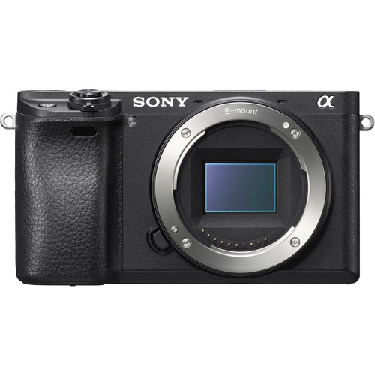
Sony Alpha 6300
$1000
Images are recorded on SD card: up to 9 hours of HD video. Download via USB
24.2MP APS-C Exmor CMOS Sensor
Can be controlled using proprietary SONY connector
Excellent image quality
Sony E-mount: many lens options

Slide 19
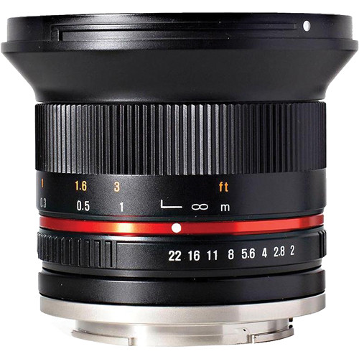
Lens Selection
Requirements:
Wide angle
Low cost
Small, light
Autofocus not required
Rokinon 12mm is excellent solution.
$400, manual focus, F 2.0, 85 degree FOV.

Slide 20
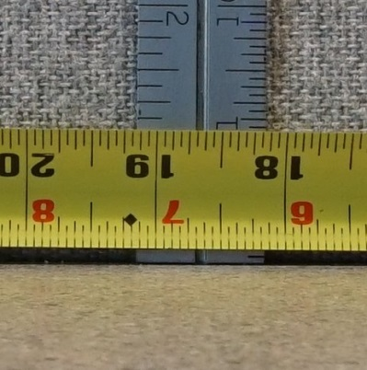
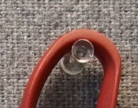
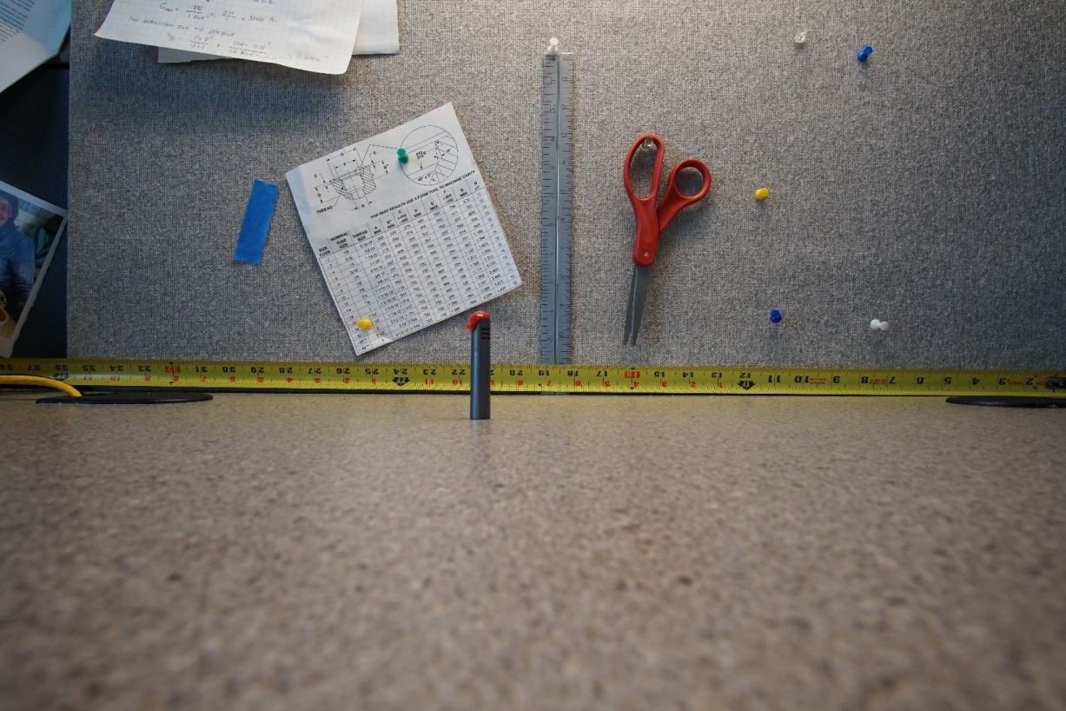
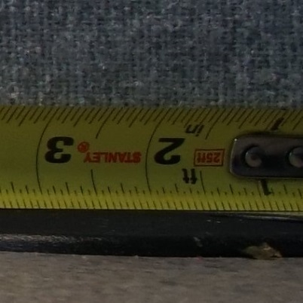
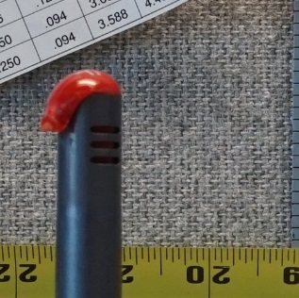
Camera Tests in the Lab
Center of image
ISO 500
F8
1/125s
Natural lighting
Side of image
Depth of field
(red object at ½ distance)

Slide 21
Considerations for Cameras and Lights Positioning
360º coverage in stereo (gaps acceptable): 4 cameras pairs are needed
Flat ports (domes are too expensive)
Distance between cameras is 40 cm (tested by R. Starr)
Camera pairs must be toed in a few degrees
One camera will face down to help with lander placement
Lighting will be provided by 5 DSPL lights
Camera must all be in one housing:
  reduced drag, size, weight, cost
  much fewer connectors, higher reliability
Notes:
Many factors to consider when positioning the camera:
First, we need 360 degrees coverage. In reality we can’t get 360. It would required 6 camera pairs because each pair covers about 60degree. So there will be some gaps between the FOV of each camera pair. This is ok for science.
We considered using dome ports which help get a wider FOV. But dome port are very expensive, they required corrective optics are very careful alignment of the lens and the dome. Too expesnive and complicated. So we decide to use flat ports.
Distance between the cameras is an important factor. Rick S did some testing and determined tnat 40cm is the minimum required distance for accurate fish sizing.
Camera must be toed in a few degree to have proper overlap between the FOVs. I did some modeling and some testing to determine this angle.
In addition to the 4 stereo cam pairs, we need on camera that faced down to help with lander placement. Light.
For lighting we have selected so LED light made by DSPL. There will be one light per camera pair. Because we’ll be operating on the bottom, there will be sediment in the water so backscatter in a concern and need good separation between the lights and cameras.
Early on, we decided to put all the camera in a single housing.
Having a single housing helps reduce the cost, the drag, the size and the cost.

Slide 22
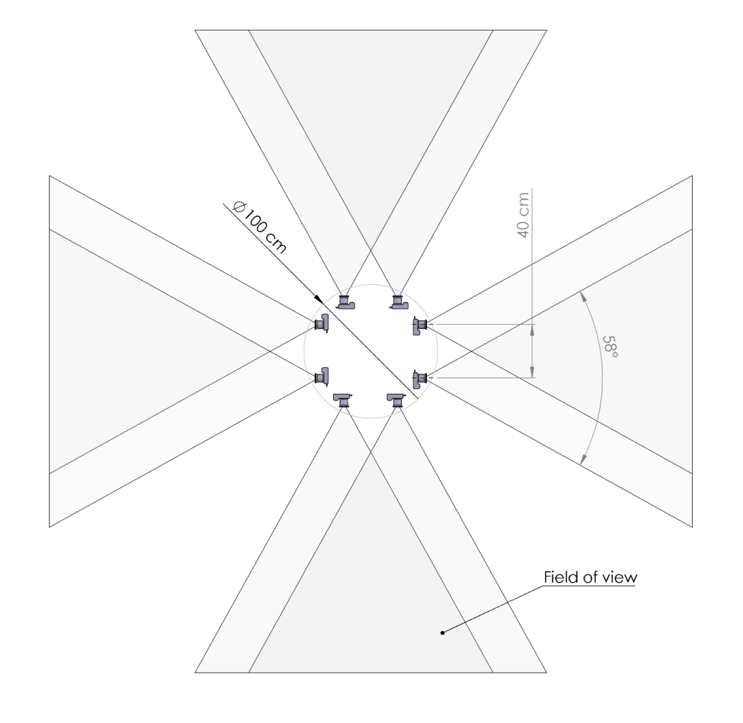
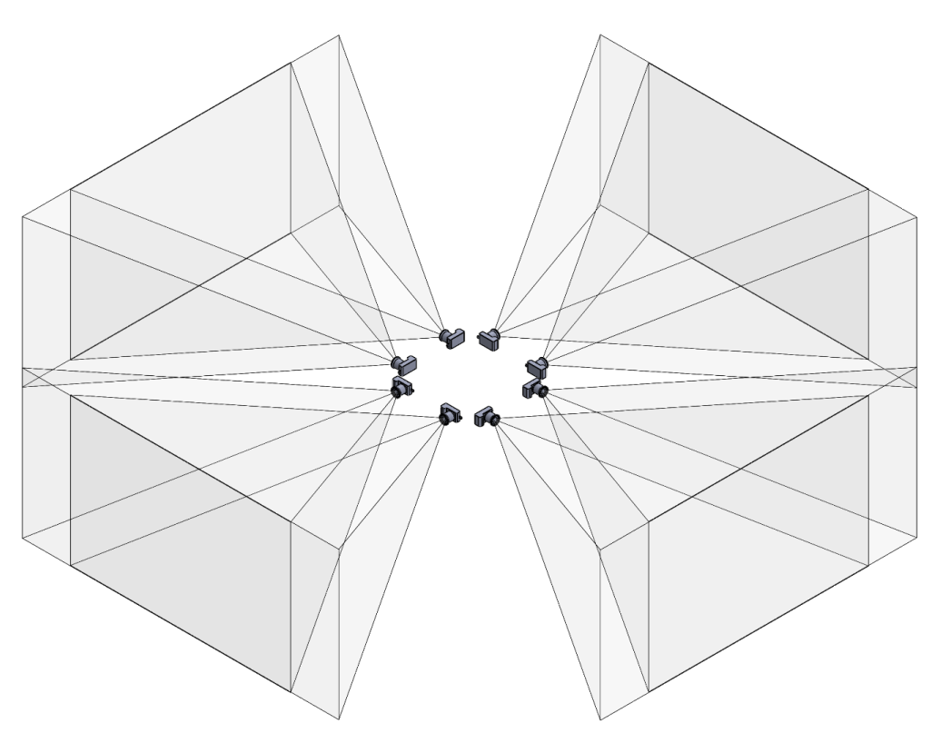
Cameras Paired Horizontally
Top View
Isometric View
Notes:
Typically in stereo camera system, cameras are paired horizontally (one on each side).

Slide 23
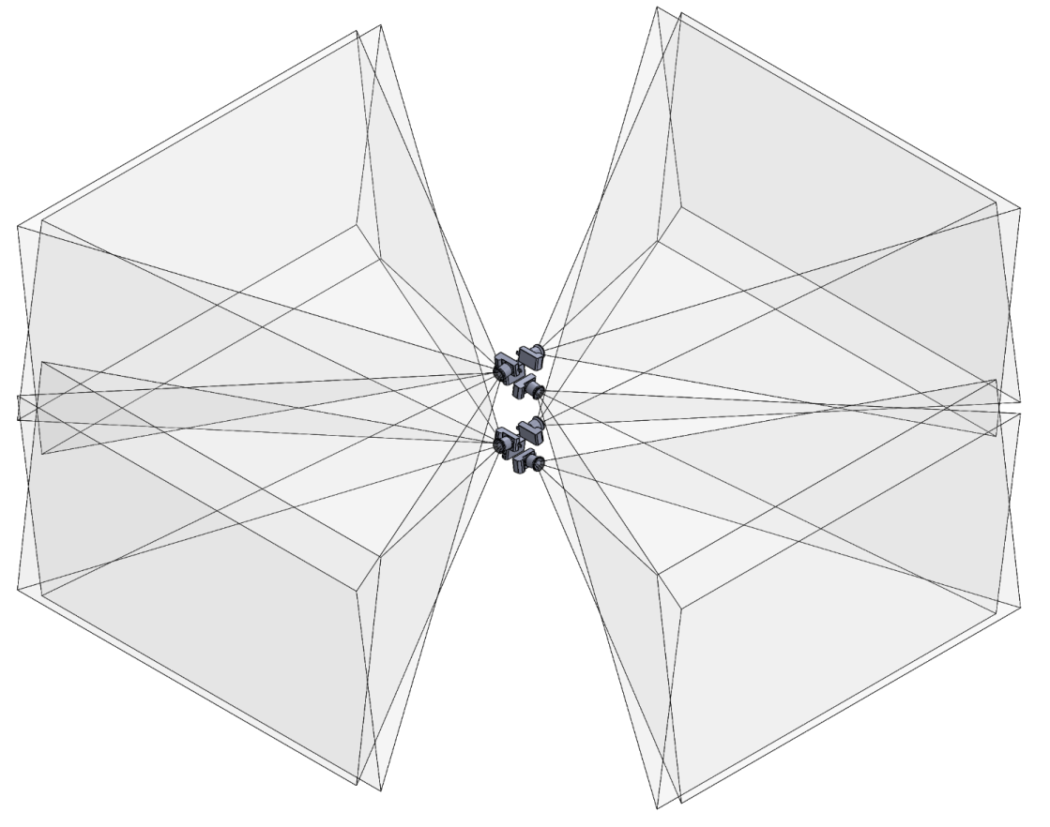
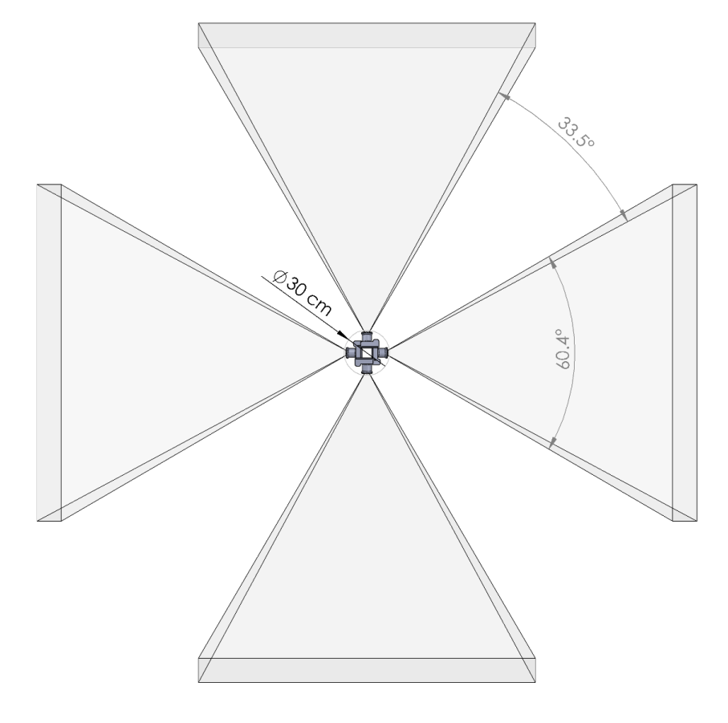
Cameras Paired Vertically
Top View
Isometric View

Slide 24
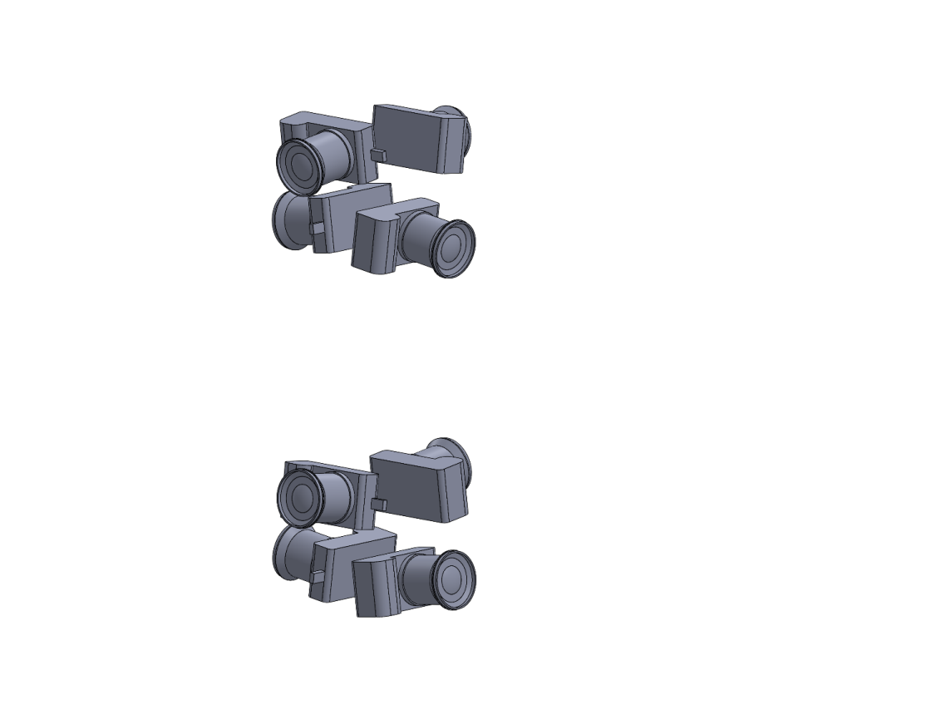
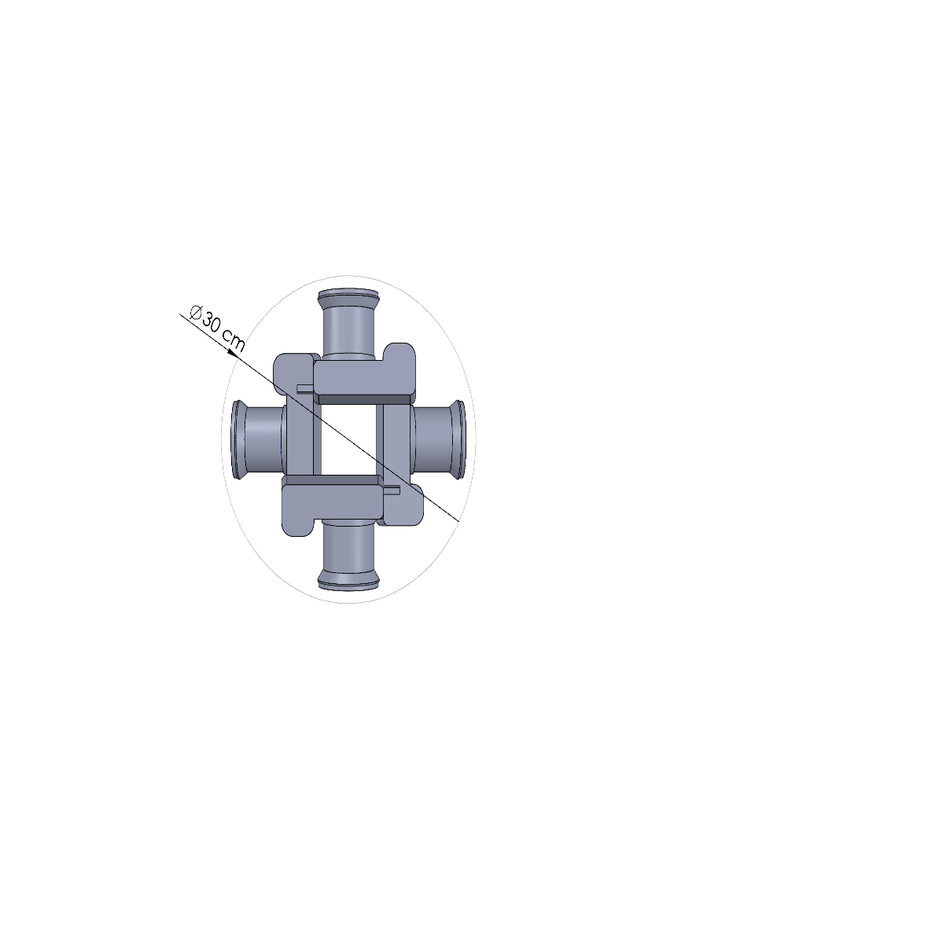
Cameras Paired Vertically
Top View
Isometric View

Slide 25
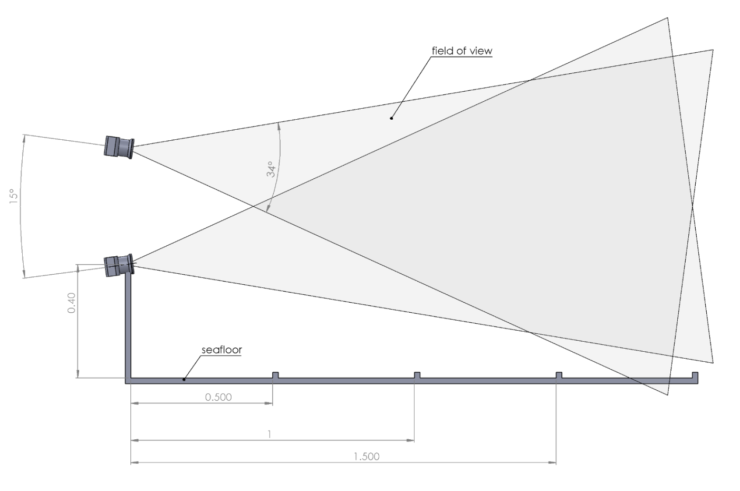
Camera Angle and Position Relative to Seafloor
Notes:
We determined that the cameras should be between 40cm and 80cm above the seafloor. Any lower and a boulder might block the view. Any higher would above whenre most of the fish hang out.

Slide 26
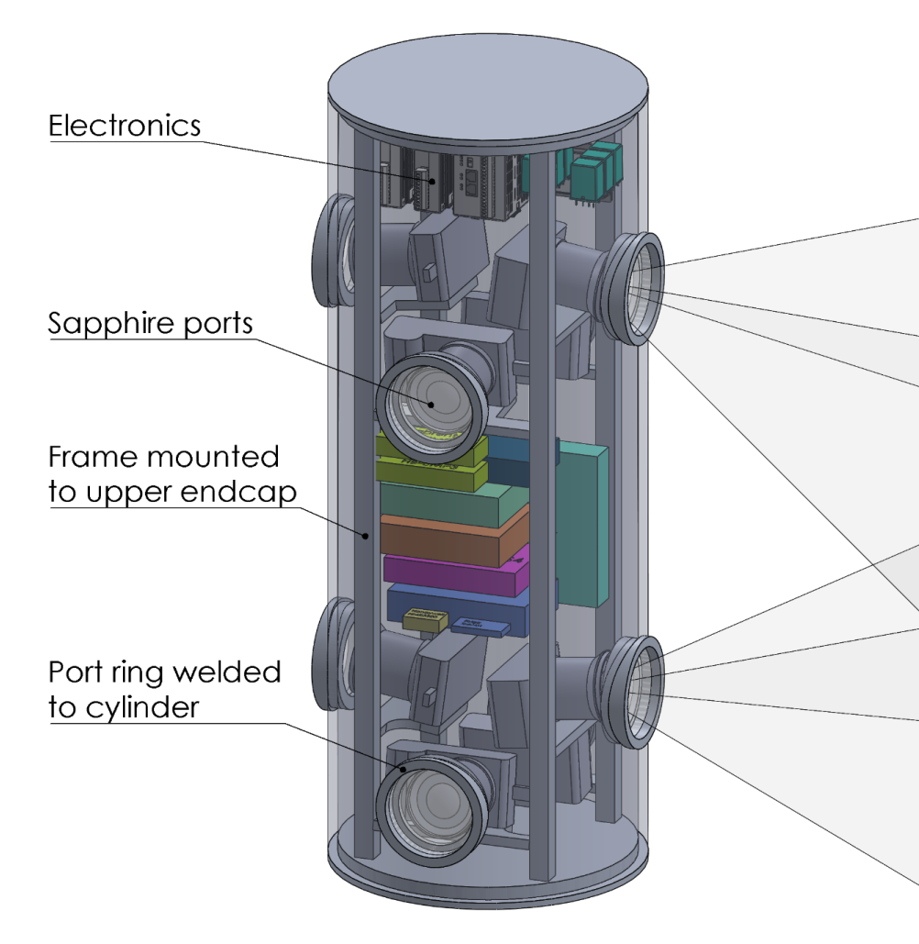
Main Housing Concept
Anodized 6061 Aluminum
Weight in air: 50kg
10kg buoyant
30cm diameter x 80cm tall
Rack for electronics and cameras

Slide 27
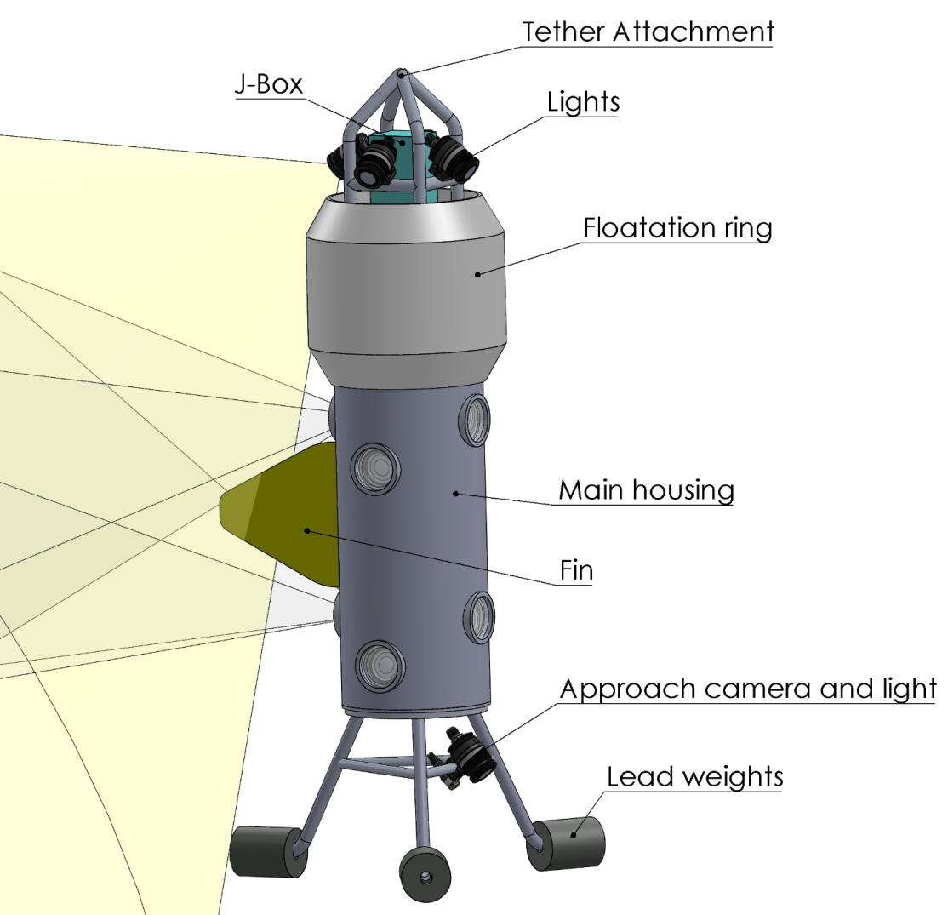
Lander Concept
Height: 160cm
Weight: 75kg-200kg
Base has weak link
Heavy at the bottom, light at the top
Low drag
Different bases and float.
Configuration can evolve after testing

Slide 28
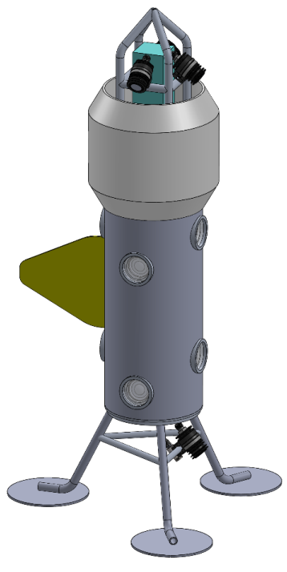
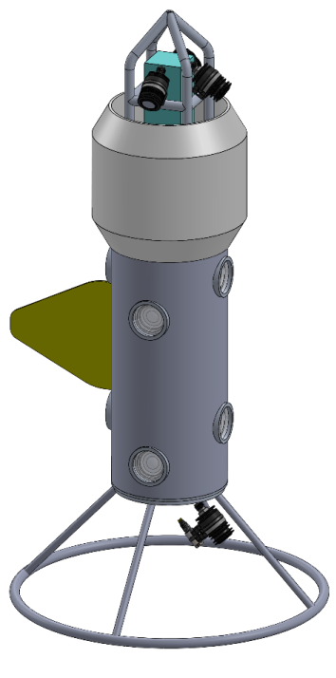
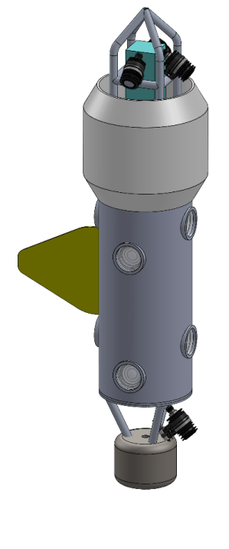
Concepts for Lander Base
Large feet for
soft flat bottom
Large ring
Pogo stick

Slide 29
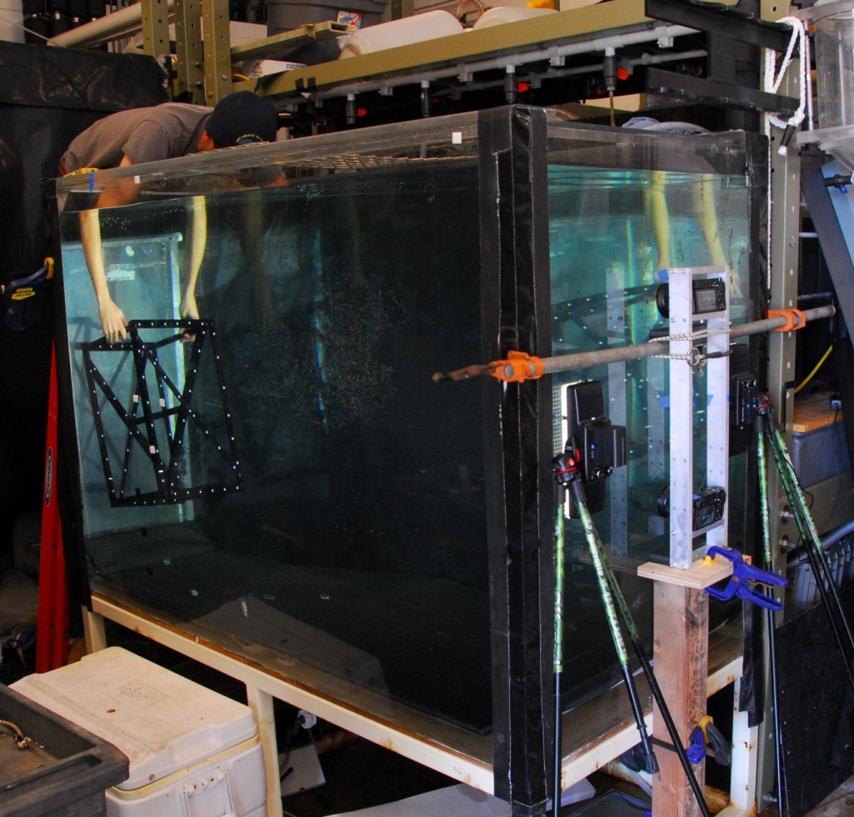
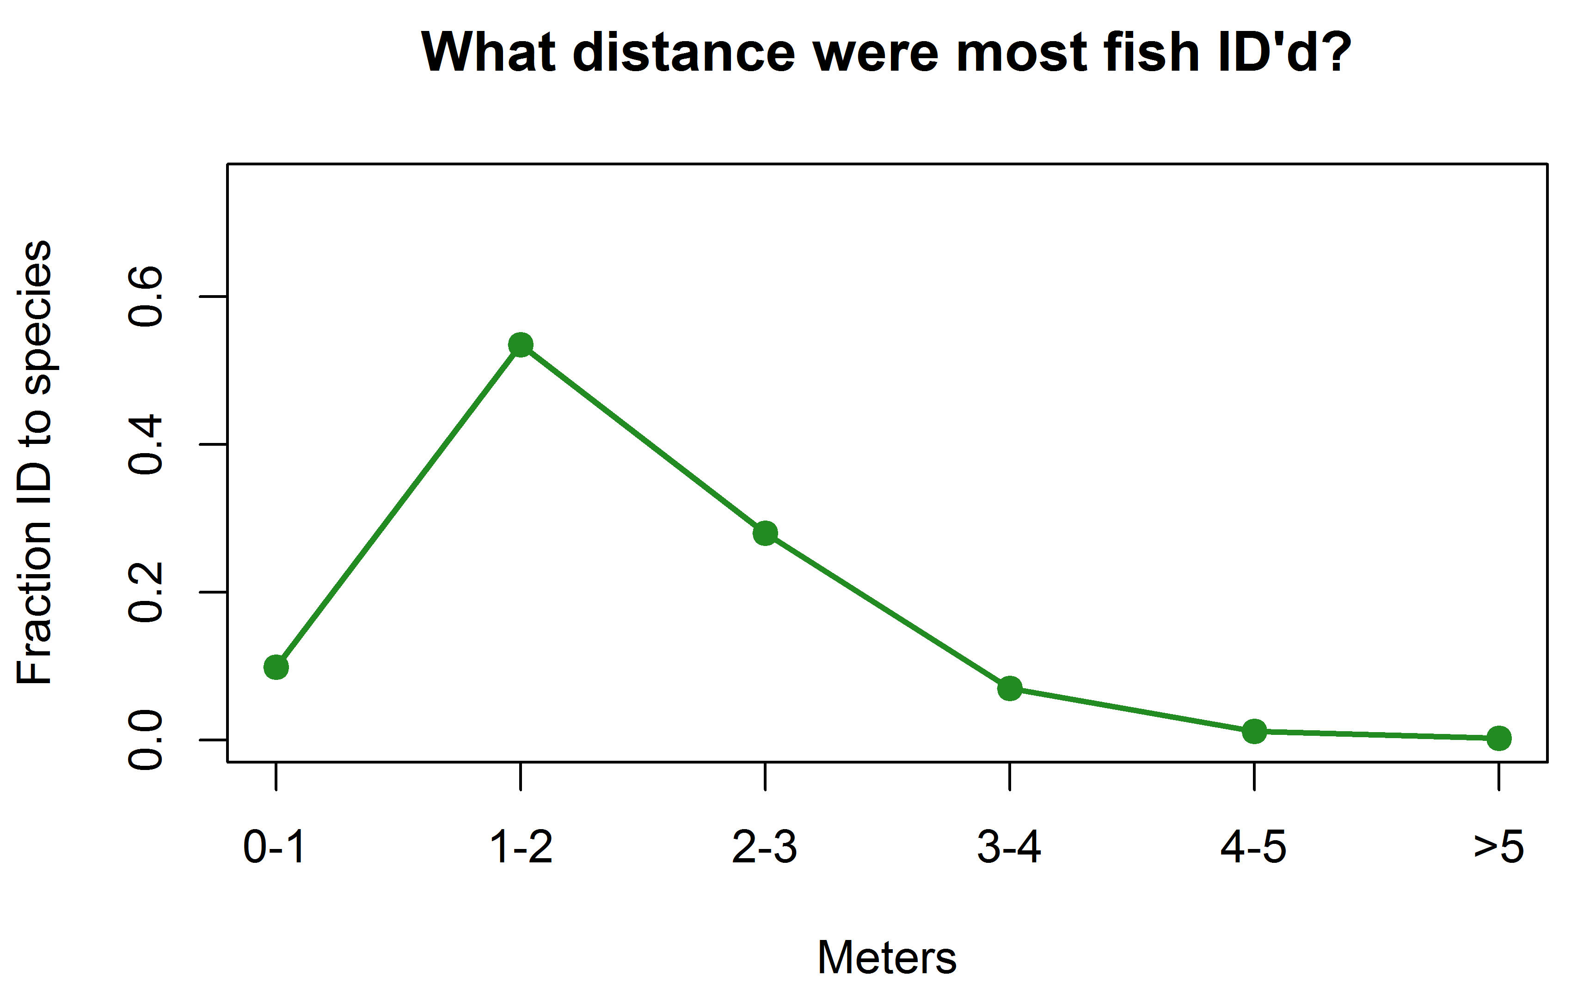
Stereo Imaging Performance Tests
  Is vertical pairing of camera suitable for stereo imaging?
  Does camera angle relative to viewing port affect performance?
  Does movement of camera relative to view port affect performance?
Plot: Ryan Fields, MLML

Slide 30
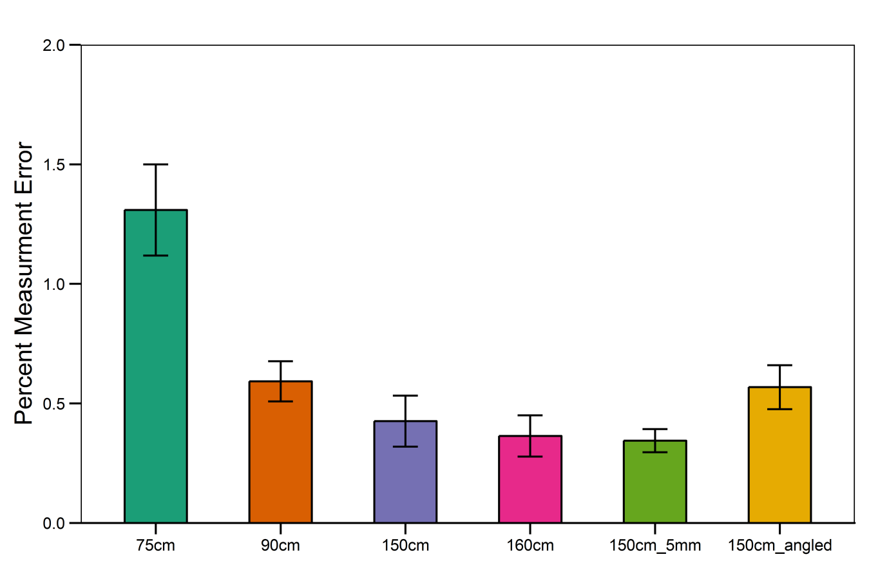
Stereo Imaging Performance Test Results
Requirement:
Less than 2% measurement at error at 1.5m.
Requirement is easily met.
Plot: Ryan Fields, MLML

Slide 31
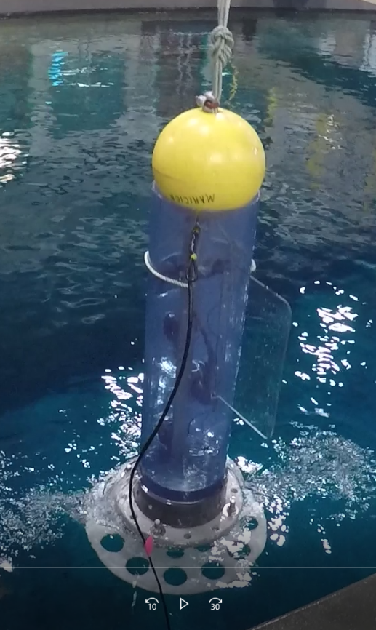
Mockup Lander Tests in MBARI Tank and Monterey Bay
Results:
Upper camera suffered from backscatter.
Sediment cleared in about 30s
Fin helped stabilize lander
Fish are scared by movement and return within 30s
Narrow base fairly stable
Compass very useful
Second mockup test
Realistic size and weight
Deeper test with clump weight

Slide 32
Electrical Outline
Functional Concept
Power Budget & Options
Tether Selection
CPU Controller Selection
Topside Electronics

Slide 33
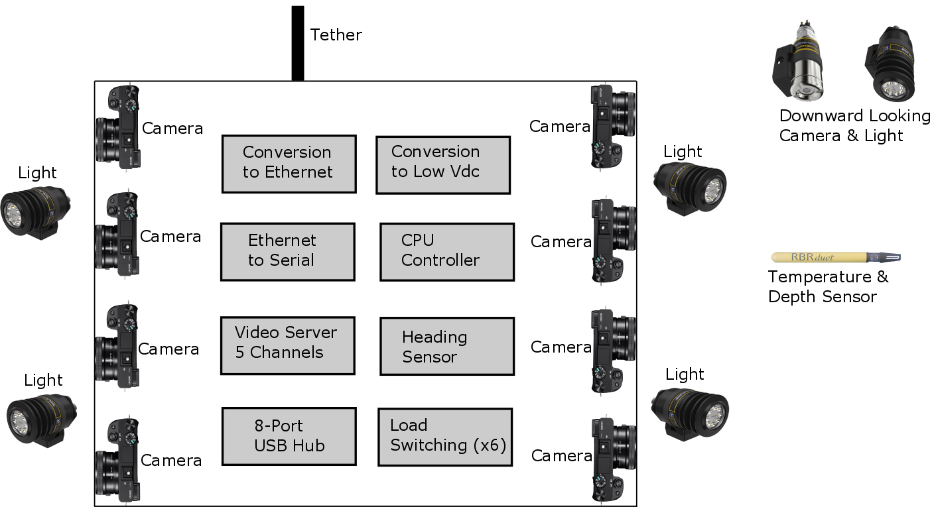
Camera Housing Concept Diagram

Slide 34
Estimated Power Budget
Hotel Load: 100W
Lights (Switchable): 250W
Cameras (Switchable): 50W
Total: 400W

Slide 35
Electrical Power Options
DC Volts
AC Volts
Must generate topside
Higher Vdc means lower i²r losses
Ground fault detection already designed & built
Conversion to low volts DC required subsea
Readily available on ships
Requires isolation transformer
Conversion to low volts DC required subsea
Less heat generated
Tethered only

Slide 36
Tether Selection
Fiber Optic
Coax or Twisted Pairs
Single mode fibers
  BW: 10Gbps+
  Dist: >10km
Pair of OE converters
Optical path on slip ring
Future HD recording topside
14-16AWG for power
22AWG for ground fault det
GigE Ethernet
  BW: 100Mbps
  Dist: 100m
Pair of ADSL Ethernet extenders
  BW: 168Mbps
  Dist: 1km
Cheaper, smaller slip ring
Limits HD recording to subsea
14-16AWG for power
22AWG for ground fault det

Slide 37
Controller (CPU) Selection
Features
Design considerations
Data storage
Relay control
Serial ports
GPIO
Analog inputs
COTS or custom
  Tech transfer
Form factor
Ease of programming
  Firmware development
  Instrument drivers
Ease of use for end users
Daughter boards required?
Power consumption

Slide 38
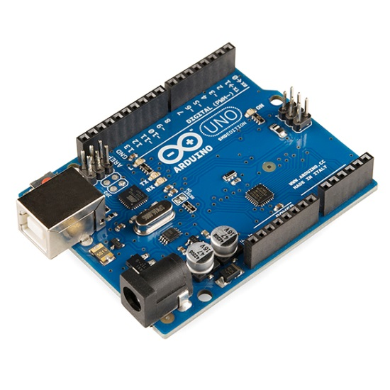
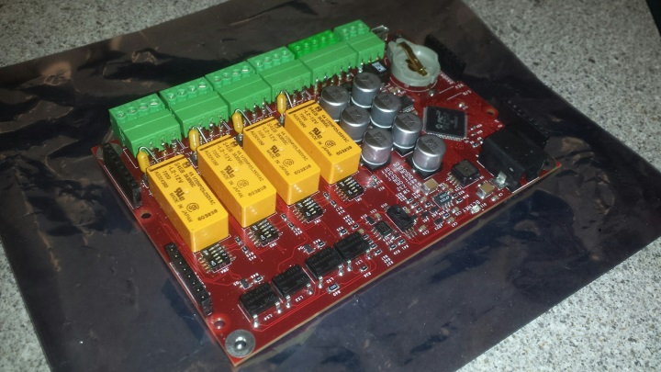
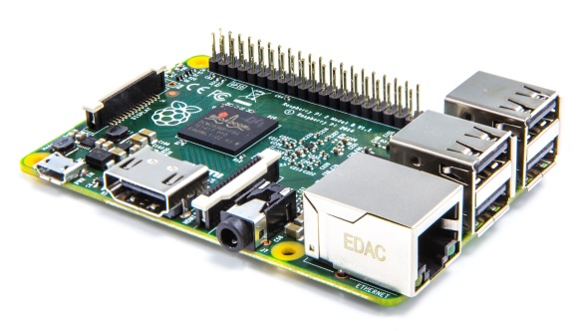
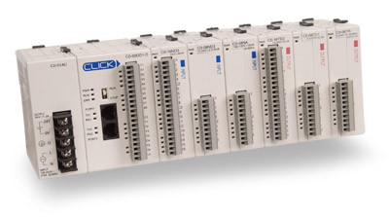
Controller (CPU) Options
Oasis5
Arduino
Raspberry Pi
Programmable
Logic Controller
(PLC) Stack

Slide 39
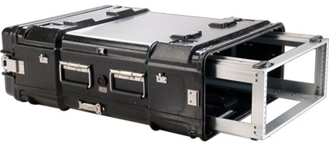
Topside Electronics Design
Functions
Design Considerations
Electrical power generation
Ground fault detection
Method for system control
Real time telemetry & video display
Method for transferring HD videos post deployment
Must be portable
Safety features
Prefer to not open housing to retrieve HD videos

Slide 40
Notes:
…
We’re in the home stretch…I have just ~10 slides on software
should be pretty quick
Will start by looking at where software may be needed in BOS system…

Slide 41
Notes:
Here: another version of BOS block diagram, this one showing required software components in dark blue.
Everything below the blue line is underwater, everything above on the surface…prob a boat
Starting at the bottom
- of course: cameras, lights, with some control system for switching power, start/stop recording,etc
Contextual sensors: TempDepth, along w/ heading sensor and steering cam to facilitate positioning
There is a control interface at the surface that reflects those control operations on the platform.
Steering video and heading data needs to be available during operations,
and sensor data along w. control events need to be archived.
And of course, we need to be able to review platform video and data in a post deployment context.

Slide 42
Notes:
Those blue boxes make up four core functional requirements for software, which I’ll shorten to CART
For control, archive, review and telemetry
I’d point out here that data time-stamping is an important archiving requirement
We need to be able to know when control events occur (lights, camera start/stop)
And align that other contextual observations and video data
Otherwise I think we’ve covered these, but I’ll refer to the CART requirements as we go along.

Slide 43
Notes:
In addition to the functional requirements, there are some nice-to-have options
That we should keep in mind – at least not design out
Computation
e.g. pull ship heading from another data stream, combine it with the platform heading to count tether turns
Configuration (…also maybe network)
There could also be configuration features that could make our lives easier
e.g. automating instrument configuration

Slide 44
Notes:
There are a few guiding principles and constraints to keep in mind as we narrow down concepts for software and system
Given that schedule and resources are tight, trying not to take on too much SW development would reduce some schedule and technical risk
As software tasks can be hard to estimate
For any software development we might choose to take on,
We should make it as easy as possible to use and extend software, with an eye toward the day-to-day operators of the system like TNC and transfer partners like MARE
We can help by reducing custom code, and if we do write software, choosing well supported languages and tools, and keeping parts count to a minimum.
We also want to be sure to leave room future expansion, and do what we can to overlap with requirements of potential MBARI users

Slide 45
Notes:
In the earlier slides, we looked at some of the hardware being considered for BOS [PLC, OASIS, COTS embedded]
I’ll cast those here as as being key parts of a platform:
by which I mean a combination of hw and sw that together satisfy our functional (ie. CART) requirements
Of course HW and SW choices are closely coupled
Here I just want to draw attention to some of the ways that hardware selection can affect
Software development, and the project as a whole
I won’t cover the whole list, but which hardware we choose has a big impact
As it locks down choices that determine
how much software we develop, how long it will take, and how much the total package going cost
And especially since this is something we intend to transfer, it‘s critical to keep an eye on what
Expertise requirements we’ll be passing on to operators and developers down the road.

Slide 46
Notes:
Lots of ways to satisfy functional requirements
Can build system with no software development – may not be best performance across the board, but could be done
The decisions focus on
what requirements to address with HW and which with SW
When it makes sense to build it ourselves (usually for performance reasons) or use COTS (to help with schedule, performance and/or mitigate risk)
In short, what platform – combo of hw, sw – is best…and what does best mean?
On the left: some of the many technologies we could use to cover CART
Short list highlighted in orange
On the right: some criteria for judging what’s best – no surprises there
The takeaway is that here are some things we considered, and the basis we used to down-select
I think most of these are familiar – OK w PLC? LabView?
COTS relays: industrial control boards functionally like PLC w/ different specs and different software interfaces
Before moving on, I’ll briefly describe OASIS and Flux
OASIS: custom mbari hw/sw,
instrument controller/data logger, isolated applications like moorings and respirometry
Covers much of control and archiving functions
Robust, low power
25+ yr history, 5th generation
Flux: a similar body of software that runs on commodity HW (desktop or embedded)
Very much like OASIS in its ability to archive data, but has some additional telemetry and review features, and is architected for connectivity
The other technology that you may not recognize is what I’m calling a software wedge…

Slide 48
Notes:
What I’ve done here is to use the short list to make 5 platforms that potentially cover CART requirements
In each platform box: HW on top, SW underneath
Here, a comparison of relative advantage (bigger in cost/time means better in that category…not higher cost, e.g.)
For me, the top pick is to combine a PC with PLCs for control,
and use Wedge software to do archiving, review, telem
PLCs are simple to configure and use, widely available and low cost
They address the control requirements with almost no software development (more configuration than coding)
A PLC touchscreen simplifies control interface, implementing distributed control interfaces w/ some configuration, but little/no code
The wedge is very inexpensive, and fills the Archive and Telemetry requirements out of the box – once again, zero coding required
There is no custom HW or SW development, and there are a number of vendors offering PLCs and wedge software, so it is somewhat modular
As you can see, that platform doesn’t rate well in the roadmap category:
mostly, this is due to power, knowing that the MBARI Pis are interested in long duration, stand-alone operations.
The take-home is that the PC/PLC/Wedge platform is best for TNC
And that OASIS and Flux (and possibly others from our list) should be looked at as options that could make sense we develop a roadmap for future MBARI applications.

Slide 49
Notes:
So, to summarize, here is a reprise of the first block diagram, with the specific software concept I’d propose using for TNC implementation of BOS
Again, the blue boxes are software
PLC and touch screen covering Control
PC and Wedge cover archiving, telemetry and (to some extent) review
Video uploads are to be done manually and stored on this or another PC
Video telemetry and review would be done using third-party applications that run on the PC
While it’s not super exciting as a software project :o),
it’s a cost-effective solution that will reduce near term risk, meet requirements and transfer well

Slide 50
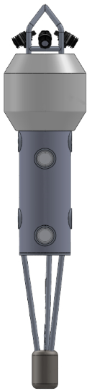
Proposed Design
Tether: Fiber
Winch: Yes, model TBD
Power: DC
Housing: Single housing
  with vertically mounted cameras
Camera: Sony A6300
Base: Detachable
Controller: PLC
Software: Aggsoft wedge

Slide 51
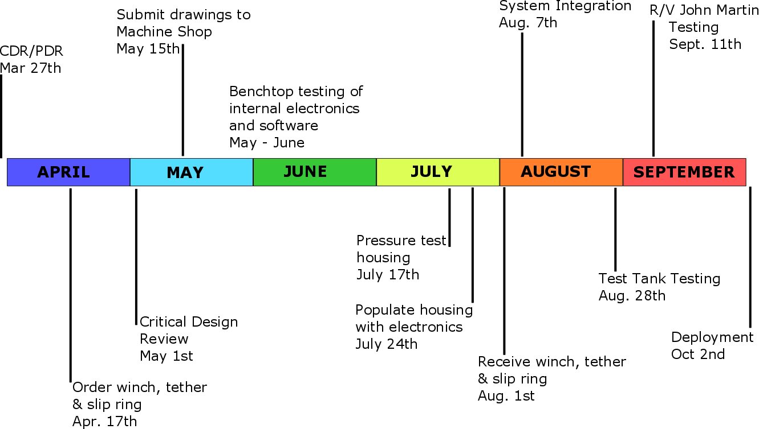
Tentative TNC Schedule

Slide 52
Next Steps
Identify high risk & long lead time items
Evaluate feedback from this review
Finalize TNC system design
Schedule critical design review (or alternate)

Slide 54
Standard CTD Cable Solution
CATEGORY | KEY SPECs | IMPACT
TETHER | UNOLS Standard 0.322"ø (Coax | 4C)
ELECTRICAL IMPACT | 19AWG Conductors 1000V rated | Batteries required to get to 600W
MECHANICAL | 10 klbf NBL, 5 klbf SWL | Already support on many ships (WF, RC, JM, SR)
DATA IMPACT | 45 Mbps limits via VDSL | Real-Time data collection at the surface lost. Network data only.
OPERATIONAL | 6” Min Bend Radius | May Avoid depressor weight, but floats remain
MAINTENANCE | Can use standard terms and splice whips | Field Servicable, inexpensive terminations
COST | ~ $30,000 (Tether/Winch/SlipRing/Xverters | Lower cost, less gear on accommodating ships

Slide 55
Soft Jacket Fiber Tether Solution
CATEGORY | KEY SPECs | IMPACT
TETHER | Custom Cable w SMF, GFI and 600W 400V Conductors | Custom Design will meet all requirements.
ELECTRICAL IMPACT | 19AWG Conductors 1000V rated | No batteries, will add GFI safety
MECHANICAL | 7 klbf NBL, 1 klbf SWL | Lower NBL will accommodate smaller ships than steel.
DATA IMPACT | Fiber facilitates 10 Gbps and CWDM for expansion | Topside data collection would be possible.
OPERATIONAL | 10” Min Bend Radius | Will require custom winch, larger sheaves. More care need be take.
MAINTENANCE |  | Needs fiber kits and training. More downtime for damaged terms & tethers
COST | ~$80,000 for winch, slip ring, and tether | Much higher cost and upkeep

