Slide 1
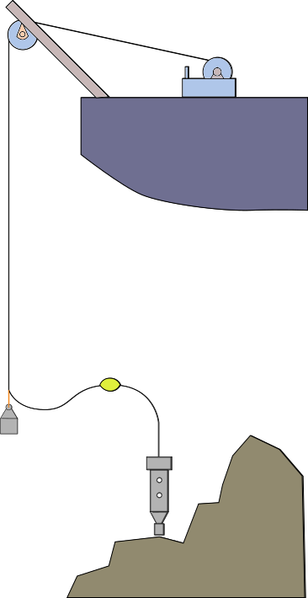
System Deployment
In order to deploy unit on bottom, the cable must keep free from propellers, not drag on bottom, and must facilitate an acceptable watch circle for a non-DP vessel.
For MBARI vessels and other identified ships this leads to a number of regulated safety factors that will inform the specification of the tether, and therefore the powered winch.

Slide 2
Considerations for Seagoing Installations
Max system weight: 500 lbs
Allowing for dynamic loading a tether must have an SWL of 1000 lbf, and via CFR189 the NBL of the tether must be 7000 lbf.
The tether must be the weakest link.
The winch must have a brake rated above 7000 lbf.
A 3 HP winch system will facilitate 30 m/min haul rates for this system, and will integrate with ships of opportunity.

Slide 3
Operational Components
BOS
Winch
Tether
Handling
Sheaves
Overboard
Frames
Slip Ring
Terminations
Subsea
Tether Management
Floats
Depressor
Weights
Payout Counter

Slide 4
Solution Pathways
A trade study was conducted with regards to two potential system architectures that satisfy TNC requirements.
Option 1: Custom tether/winch to suit current needs and allow for system scalability to other applications
Option 2: Use widely available CTD wire which meets telemetry requirements and will result in lower cost system with lower maintenance impacts.
The study was not conclusive that either scenario was superior.

Slide 5
Soft Jacket Fiber Tether Solution
TETHER | Custom Design will meet requirements.
ELECTRICAL | No batteries, independent GFI conductors
MECHANICAL | Can size SWL & NBL
DATA IMPACT | Topside data collection would be possible in future developments.
OPERATIONAL | Will require custom winch, larger sheaves. More care need be taken.
MAINTENANCE | Needs fiber kits and training. More downtime for damaged terms & tethers
COST | Estimated Costs 80k$, for winch, slip ring, and tether

Slide 6
Standard CTD Cable Solution
TETHER | UNOLS Standard 0.322"ø (Coax | 4C)
ELECTRICAL IMPACT | Batteries required to get to power lamps
MECHANICAL | Already supported on many ships (WF, RC, JM, SR)
DATA IMPACT | Real-Time data collection at the surface lost. Network data only.
OPERATIONAL | May Avoid depressor weight, but floats remain. More Flexible sheave options.
MAINTENANCE | Field servicable, inexpensive terminations
COST | Lower cost (~$30,000), less gear on accommodating ships

Slide 7
END OF PDR SLIDES

Slide 8
Standard CTD Cable Solution
CATEGORY | KEY SPECs | IMPACT
TETHER | UNOLS Standard 0.322"ø (Coax | 4C)
ELECTRICAL IMPACT | 19AWG Conductors 1000V rated | Batteries required to get to 600W
MECHANICAL | 10 klbf NBL, 5 klbf SWL | Already support on many ships (WF, RC, JM, SR)
DATA IMPACT | 45 Mbps limits via VDSL | Real-Time data collection at the surface lost. Network data only.
OPERATIONAL | 6” Min Bend Radius | May Avoid depressor weight, but floats remain
MAINTENANCE | Can use standard terms and splice whips | Field Servicable, inexpensive terminations
COST | ~ $30,000 (Tether/Winch/SlipRing/Xverters | Lower cost, less gear on accommodating ships

Slide 9
Soft Jacket Fiber Tether Solution
CATEGORY | KEY SPECs | IMPACT
TETHER | Custom Cable w SMF, GFI and 600W 400V Conductors | Custom Design will meet all requirements.
ELECTRICAL IMPACT | 19AWG Conductors 1000V rated | No batteries, will add GFI safety
MECHANICAL | 7 klbf NBL, 1 klbf SWL | Lower NBL will accommodate smaller ships than steel.
DATA IMPACT | Fiber facilitates 10 Gbps and CWDM for expansion | Topside data collection would be possible.
OPERATIONAL | 10” Min Bend Radius | Will require custom winch, larger sheaves. More care need be take.
MAINTENANCE |  | Needs fiber kits and training. More downtime for damaged terms & tethers
COST | ~$80,000 for winch, slip ring, and tether | Much higher cost and upkeep

