Slide 1
Like a BOSS:
The Unauthorized Biography of The
Benthic Observation Survey System
Project Update
Nov. 12, 2018
Chad Kecy

Slide 2




BOSS Project Team
Monterey Bay Aquarium Research Institute
The Nature Conservancy
(MBARI)
  Chad Kecy (PM, EE)
  Franҫois Cazenave (ME)
  Craig Okuda (EE)
  Eric Martin (EE)
  Kent Headley (SE)
(TNC)
  Mary Gleason (PI)
Moss Landing Marine Labs
Marine Applied Research & Exploration
(MLML)
  Rick Starr (PI)
  Ryan Fields
  Jimmy Williamson
  Katie Cieri
(MARE)
  Dirk Rosen
  Andy Lauerman
  Rick Botman

Slide 3
Outline of Talk
Need for coastal wide surveys
What was TNC/MLML doing before MBARI got involved?
MBARI lander concept and design review
Prototype built and deployed
Final version built and deployed
Future plans

Slide 4
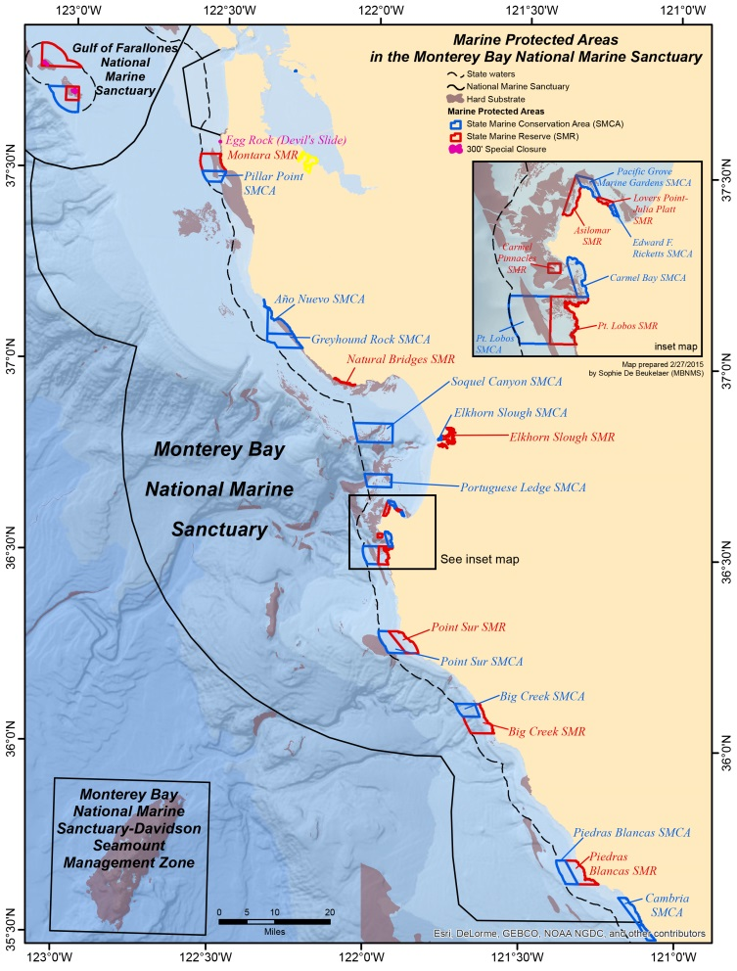
Science Background
Monterey Bay National Marine Sanctuary created in 1992
Administered by NOAA
National monuments and exclusion zones with the MBNMS
Multiple agencies taking part in coastal wide stock assessment studies

Slide 5
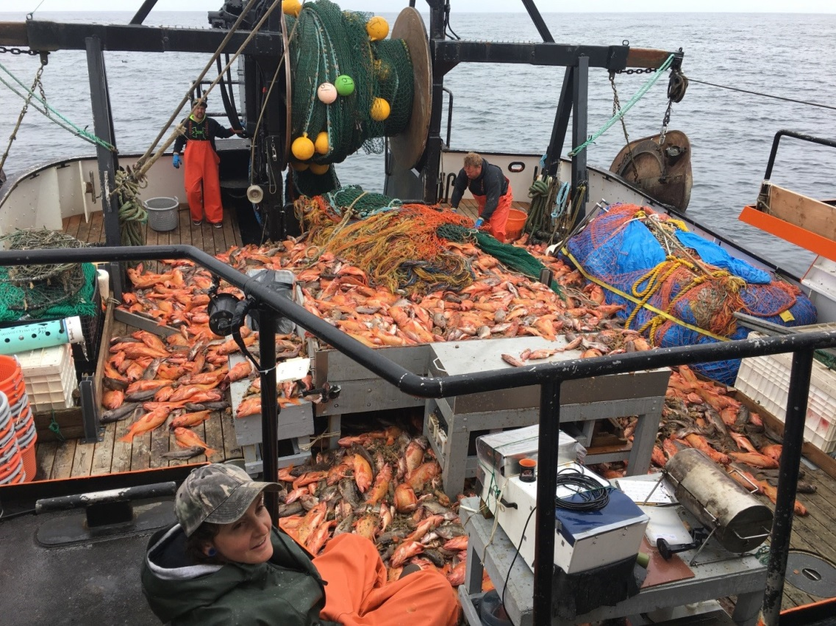
Science Background
West Coast Groundfish Bottom Trawl Survey
  Held twice annually
  Exclusively in low-relief soft-bottom habitats
  Assumption: trawlable estimation of non-trawlable areas?
Fishery Resource Analysis and Monitoring (FRAM) Division
  Frequency of occurrence
  Density
  Length-Frequency Distributions
  Calculated Biomass

Slide 6
Science Background
TNC/MLML got involved in a collaborative project to provide information on Demersal fishes in untrawlable areas:
  Distribution
  Density
  Size Structure
Hypothesis: Video surveys performed in a statistically sound manner can provide information to improve stock assessments of species that primarily inhabit untrawlable rocky areas.

Slide 7
TNC/MLML Scientific Goals
Improve fishery-independent data collection in habitats that are not adequately covered in the annual West Coast Groundfish Bottom Trawl Survey.
Develop methods to use video surveys in stock assessments with the ultimate goal of improving our knowledge of the status of rebuilding stocks.

Slide 8

Gen1 Video Lander
Built by Marine Applied Research & Exploration (MARE) in 2011-2012
  Input from Tim and Tyler Maricich
Pair of stereo cameras & lights mounted on a mechanically rotated swivel
Crab pot base
  Idea to cushion landing on rocky structure
Tethered system (power & comms)
Video recorded on lander
Rated to 300 meters

Slide 9
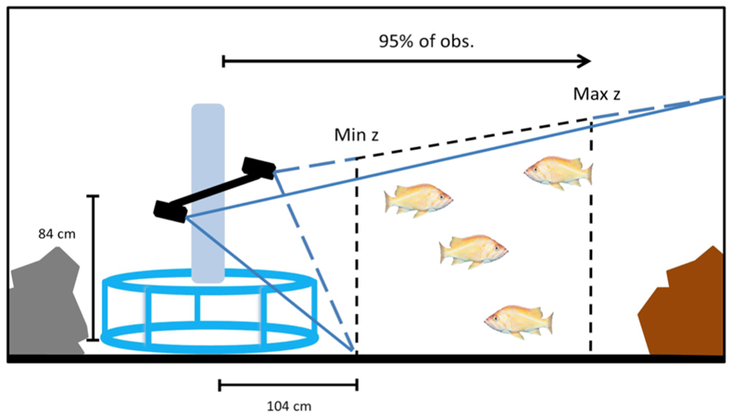
Gen1 Video Lander Measurements
Counting
  The number of fish in the area are counted over the 360 degree rotation.
Sizing
  Whole fish captured in both cameras can be measured using EventMeasure software.
Density
  EventMeasure also gives the distance at which the fish were observed.

Slide 10
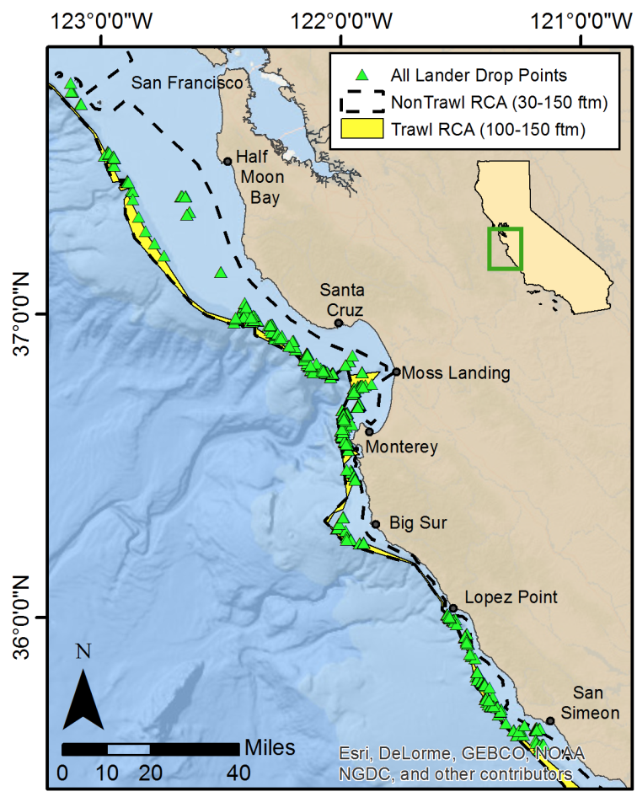
Gen1 Video Lander Locations
Operated from 2012-2015
Over 1000 drops
Rocky habitats from 100-300m

Slide 11
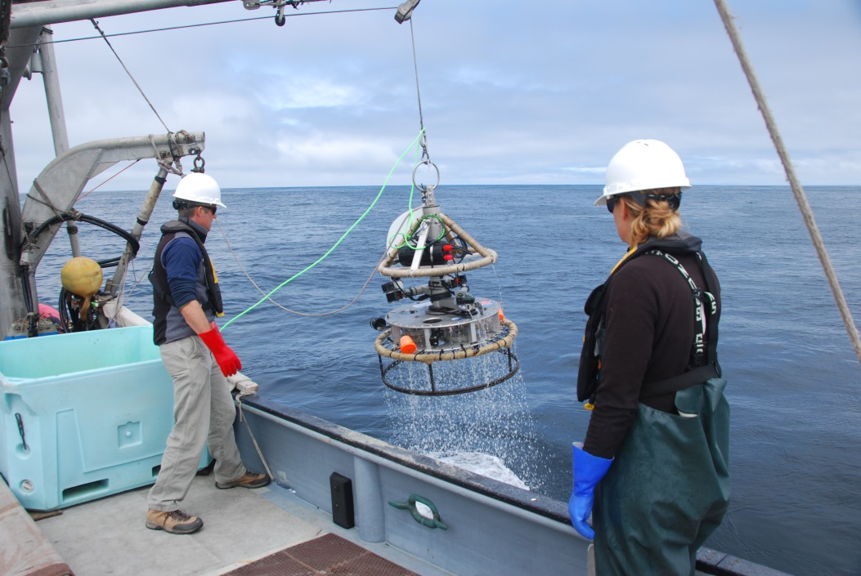
Gen1 Video Lander Limitations
Technical Issues:
  Crab pot base would not allow for easy placement on or near rocks
  Dual cameras were on a motorized swivel mount
    slow rotation resulted in occasional double counting of fish
    mechanical noise may have scared fish away
  Bulky build caused slow descent/ascent
  Difficult to launch and recover
  Limited system control from ship
TNC wanted a system that was more functional and easier to deploy
  Goal is to survey more sites per ship-day

Slide 12
MBARI Involvement (2016- )
Both using $$ from Packard Foundation
Wanted to address issues with the Gen1 lander
Plan was to develop a video lander with the ability to add in external contextual sensors
Much interest from other PI’s at MBARI
  Jim Barry
  Francisco Chavez
  Kelly Benoit-Bird
Requirements were gathered from all PI’s
Large multi-agency and multi-PI design review was held
  MBARI, TNC, MLML, MARE
  Joint CDR (Concept) and PDR (Preliminary Design)

Slide 13






Gen2 Use Cases
Tethered
(TNC)
Autonomous
(Barry)
Autonomous
(Chavez)
Tethered
(Chavez)
Tethered
(Benoit-Bird)
Autonomous
(Benoit-Bird)

Slide 14
User Requirements Matrix
Requirement | TNC | Barry | Chavez | Benoit-Bird
Tethered | Yes | No | Yes | Yes
Autonomous | No | Yes | Yes | Yes
Depth 300 Meters | Yes | No | Yes | Yes
Depth 1500 Meters | No | Yes | No | No
Benthic | Yes | Yes | Yes | No
Mid-water | No | No | No | Yes
Stereo video | Yes | No | Yes | Yes
Stereo imaging | No | Yes | No | No
360 degrees coverage | Yes | No | No | No
Operate from MBARI ships | No | Yes | Yes | Yes
Operate from non-MBARI ships | Yes | No | No | Yes
O2 sensor | No | Yes | Yes | No (Nice)
pH probe | No | Yes | No (Nice) | No
CTD | No | Yes | Yes | No (Nice)
ADCP | No | Yes | No (Nice) | No
EK80 echosounder (or similar) | No | No | Yes | Yes
3G-ESP | No | No | Yes | No

Slide 15
Design Branch Point
Derived requirements of each use case too varied to be met with one system
Recommendation: focus on TNC use case
Other PI’s work into separate (future) proposals

Slide 16
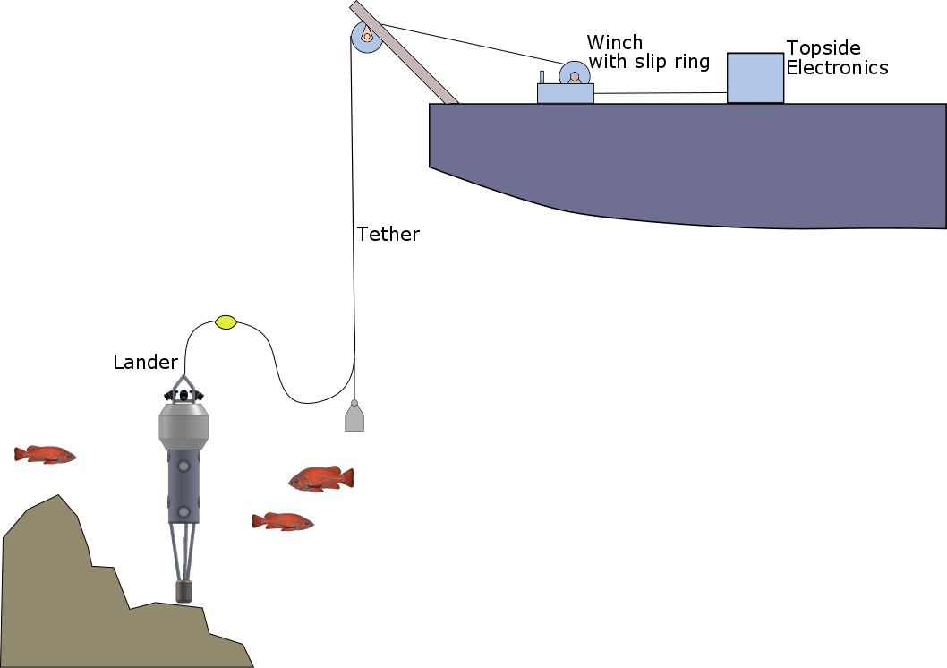
Initial Gen2 (BOS) Concept

Slide 17
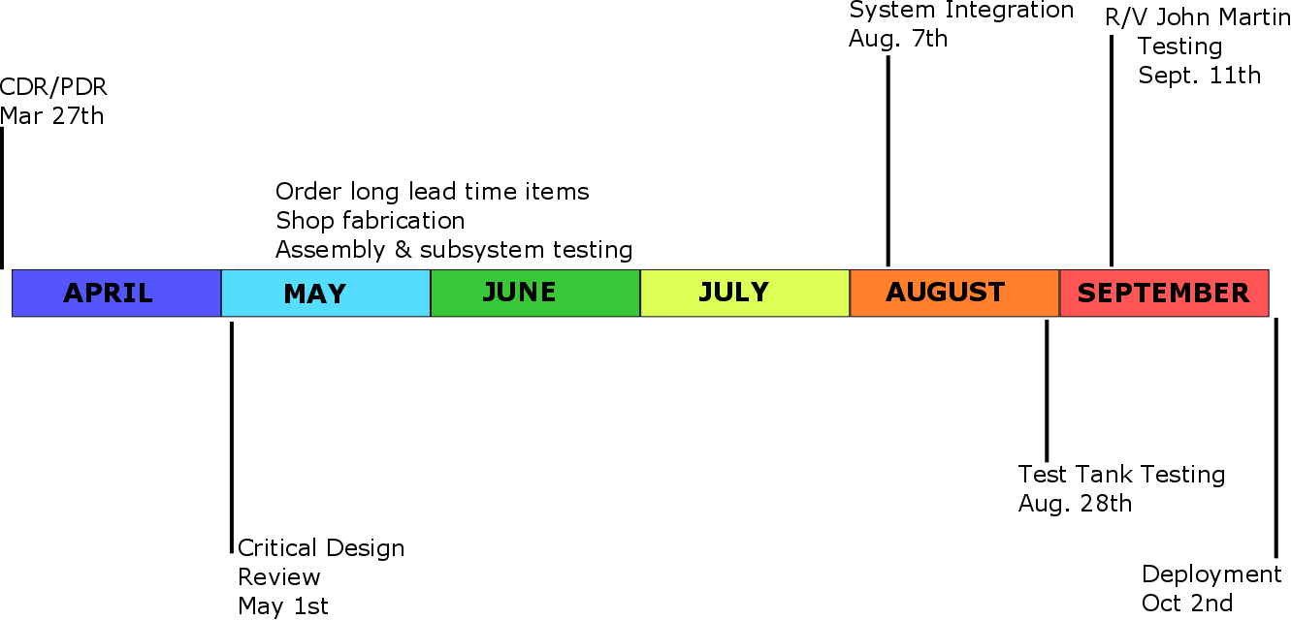
Aggressive Schedule for TNC Use Case

Slide 18
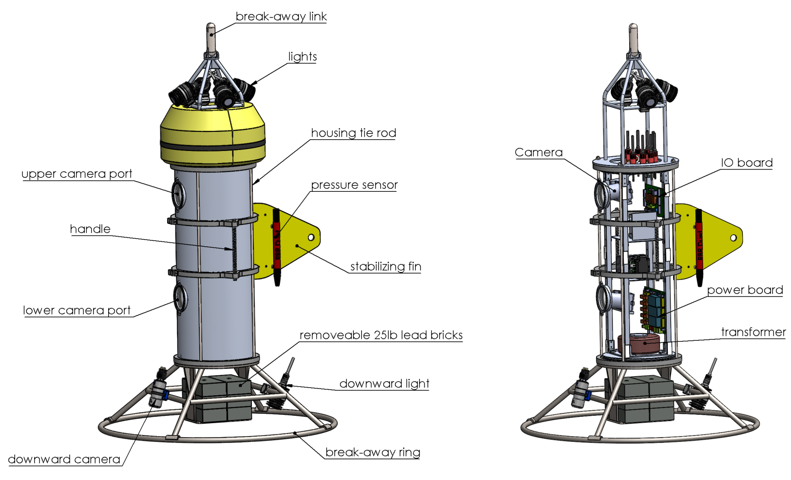
BOS Prototype

Slide 19
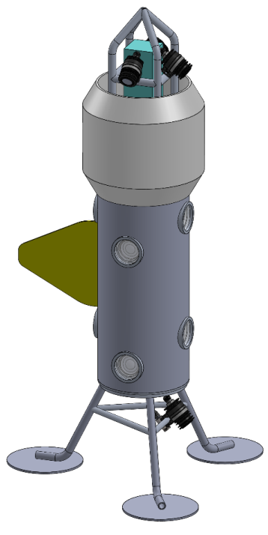
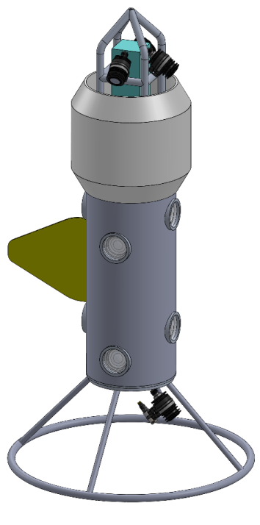
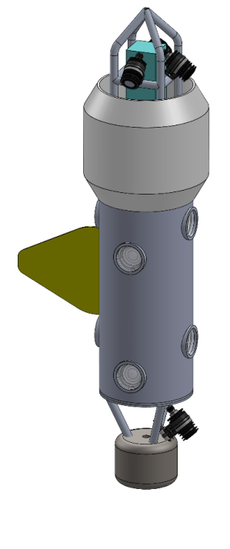
Concepts for Lander Base
Large feet for
soft flat bottom
Large ring
Pogo stick

Slide 20
BOS Prototype Technical Specifications
Power: 480 VAC
  1:4 and 4:1 Transformers
Comms: Cable Modems
Control: PLC Stack
Max Power: 600 Watts
One Stereo Camera Pair
  Sony A6300
Four 90 Watt Lights
One Downward Camera
  DSP&L Multi SeaCam
One 90 Watt Light
Video Recorded Subsea
Camera Control from Ship
Tether: Single Coax
  Non load bearing
  Married to a load bearing line
Swappable Bases
Strong Righting Moment
  150 Lbs of lead bricks in base
  200 Lbs of flotation at top
Anodized Aluminum Housing
Integrated Temp, Depth & Compass
Serial Data Logger
Overlay Generator
Tether Turns Counter
OPC Data Display

Slide 21
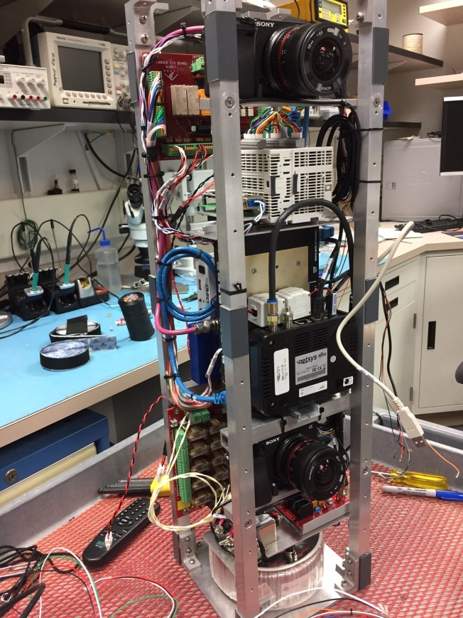
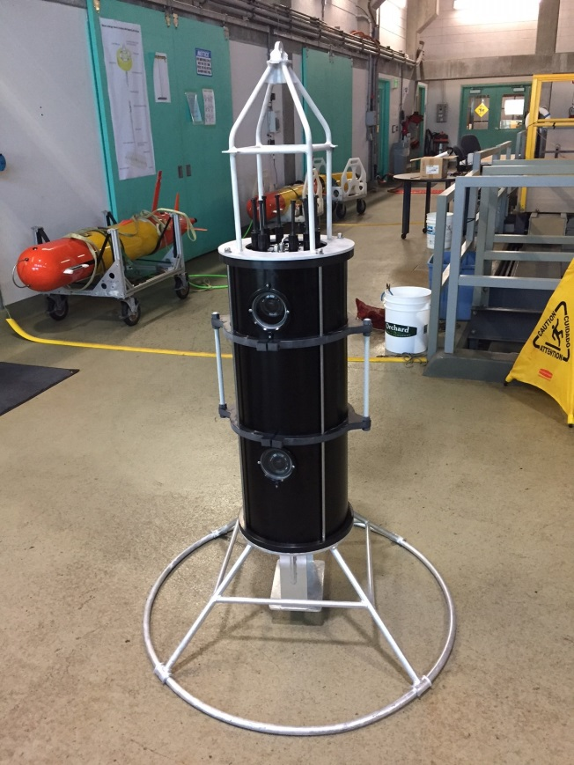
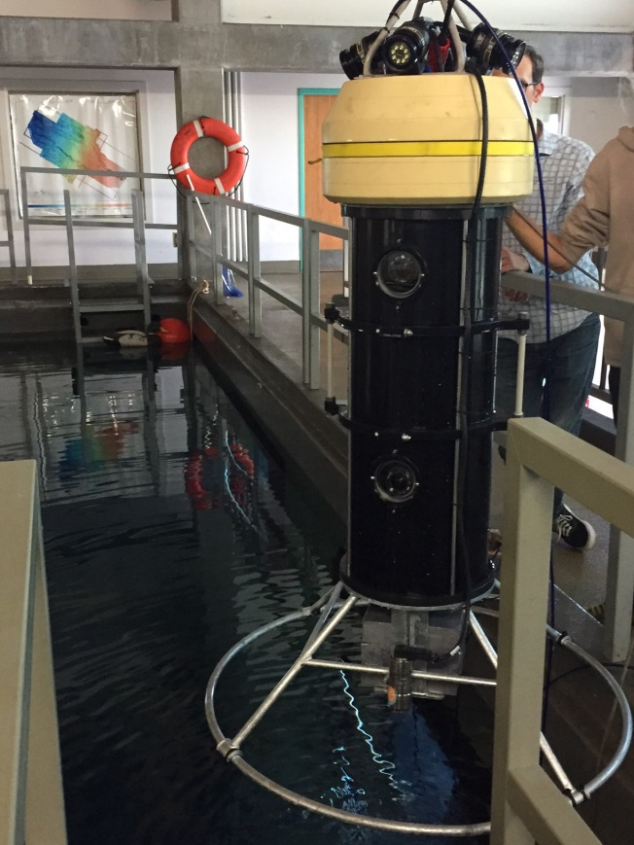
BOS Prototype Build & Testing

Slide 22
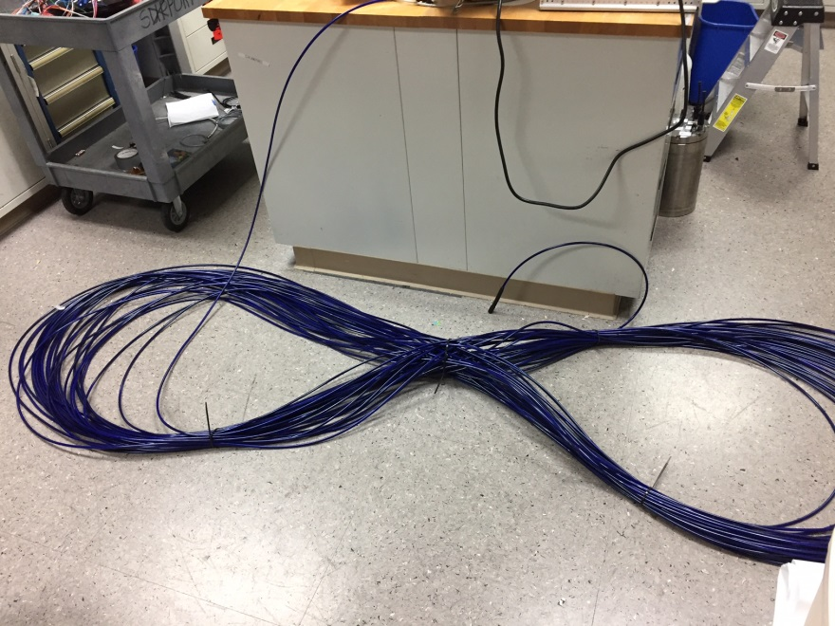
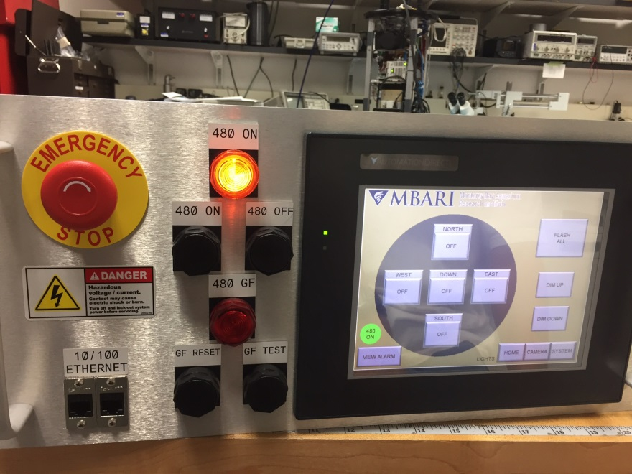
BOS Prototype Build & Testing

Slide 23
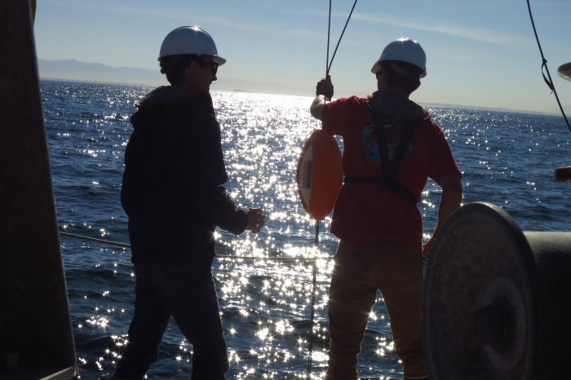
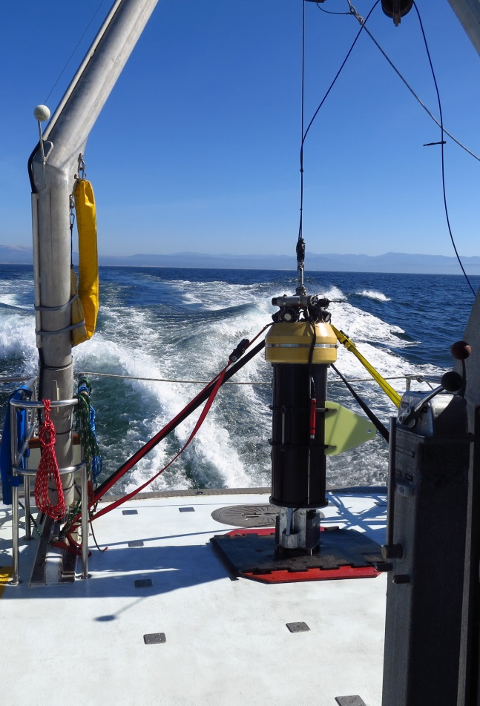
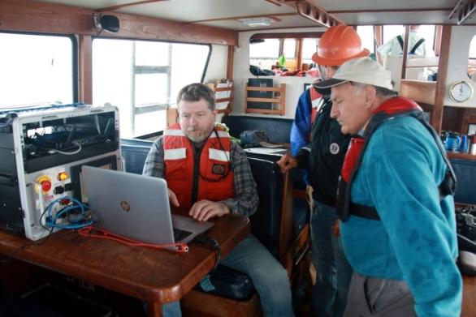
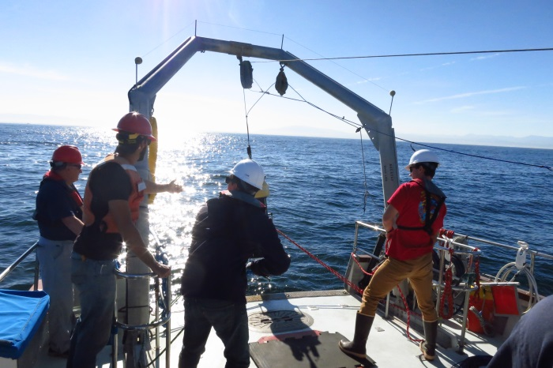
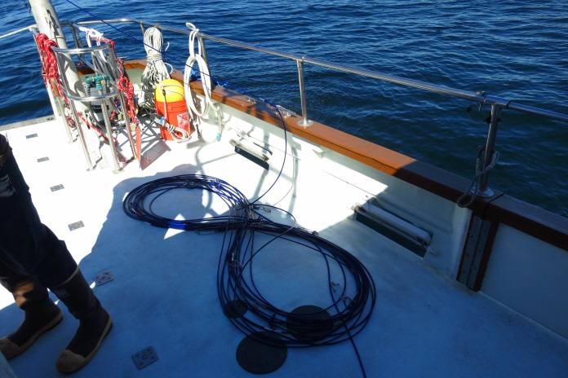
First At-Sea Trials (R/V John Martin)

Slide 24
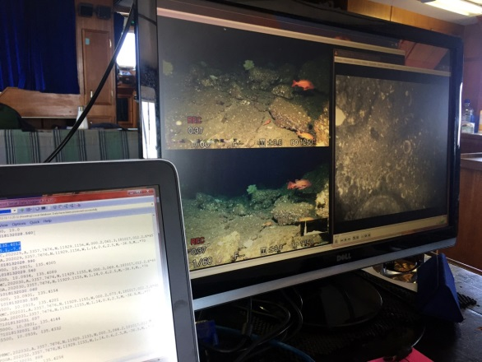
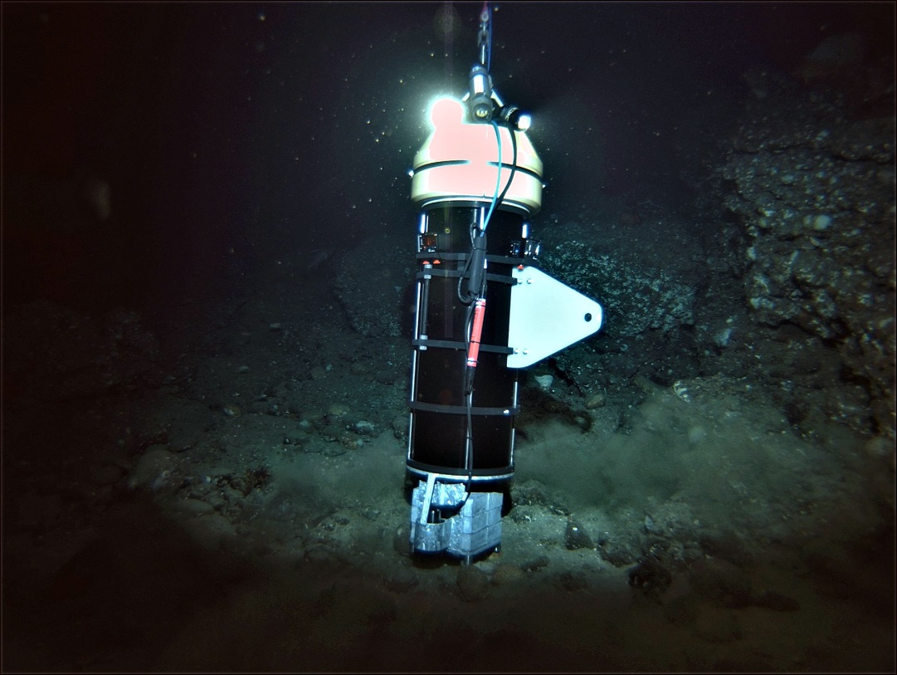
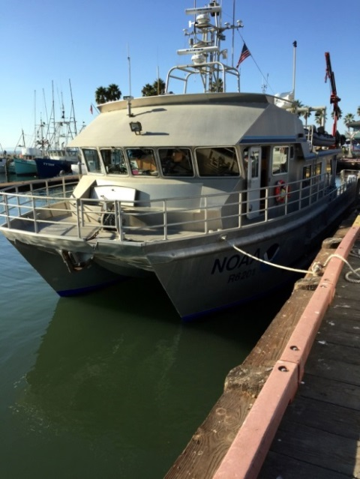
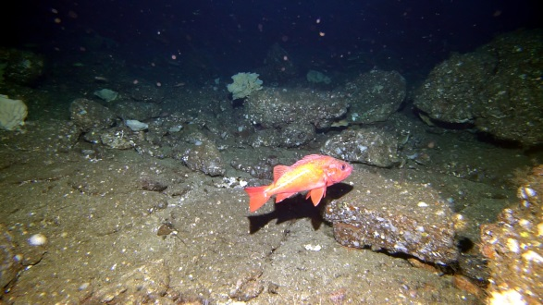
Fall 2017 Deployment (R/V Shearwater)

Slide 25
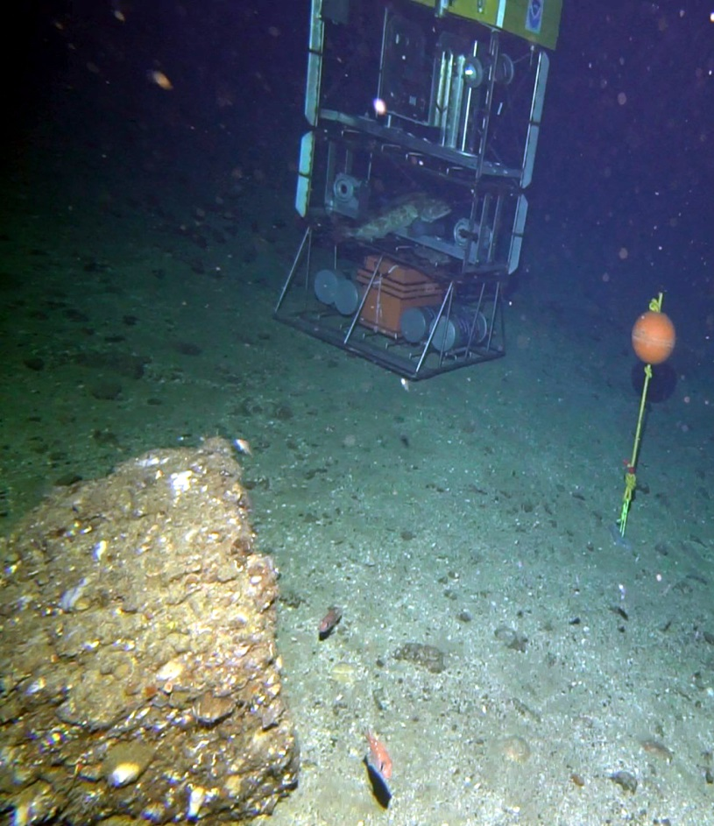
Untrawlable Habitat Strategic Initiative (UHSI)
Led by the National Marine Fisheries Service (NMFS)
Goal is to understand the effects of optical and acoustical survey tools on the behavior of rockfish in deep rocky habitats
  AUVs
  BOS
  Manned submersible
Modular Optical Underwater Survey System (MOUSS) used to monitor fish reactions to platforms
R/V Bell Shimada
R/V Velero IV
  “Deepworker” manned submersible
R/V Shearwater

Slide 26
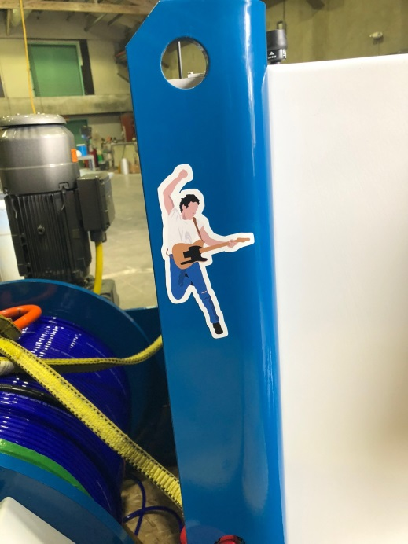
BOSS Upgrades (2018)
8 Stereo cameras
  More camera evaluation tests
Top side recording
  Ability to record 9 HD channels simultaneously
Fiber based tether
  Smallest diameter while meeting all reqs
Dedicated winch
  Multiple ships accommodation requirements

Slide 27
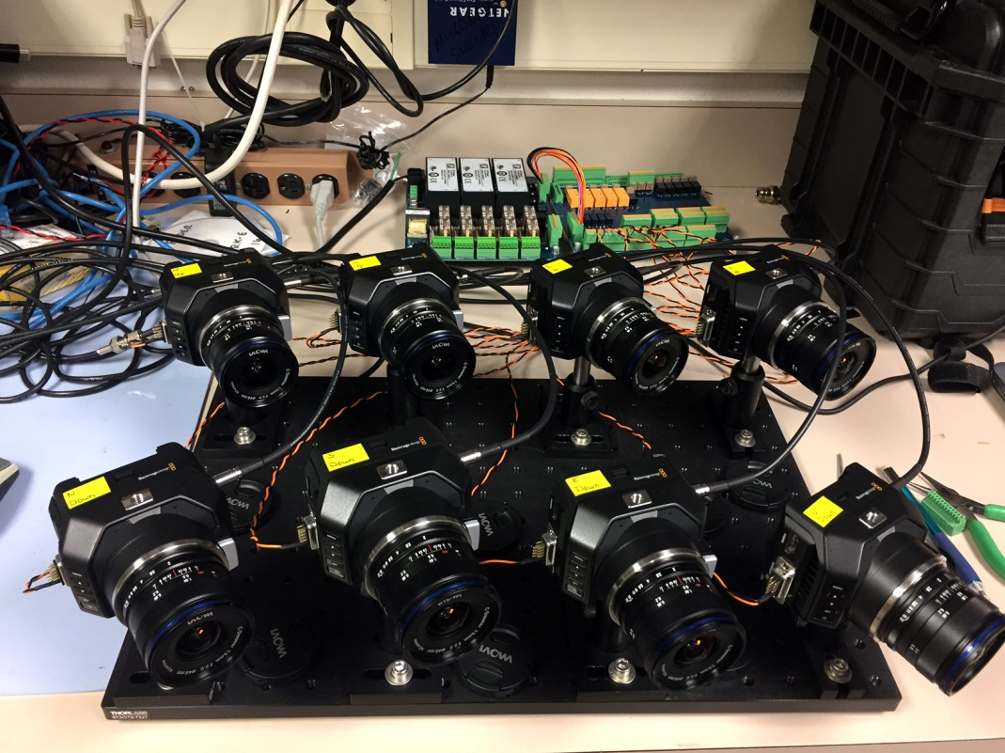
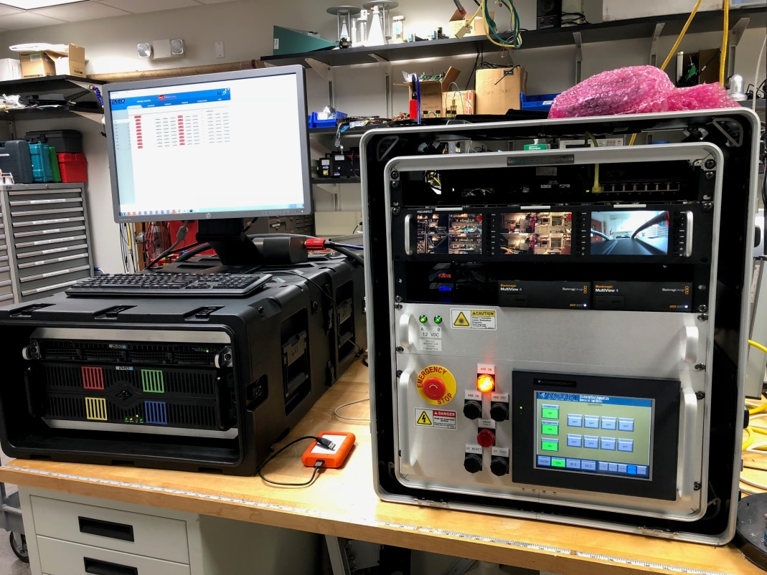
Cameras and Video Recording

Slide 28
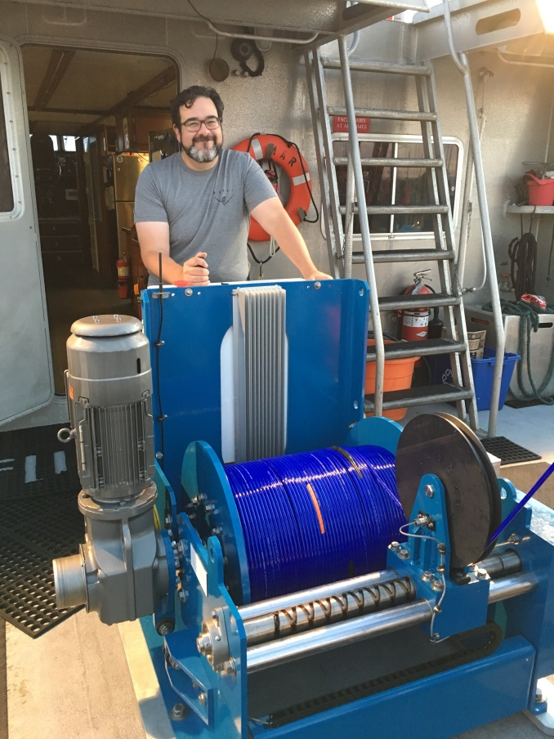
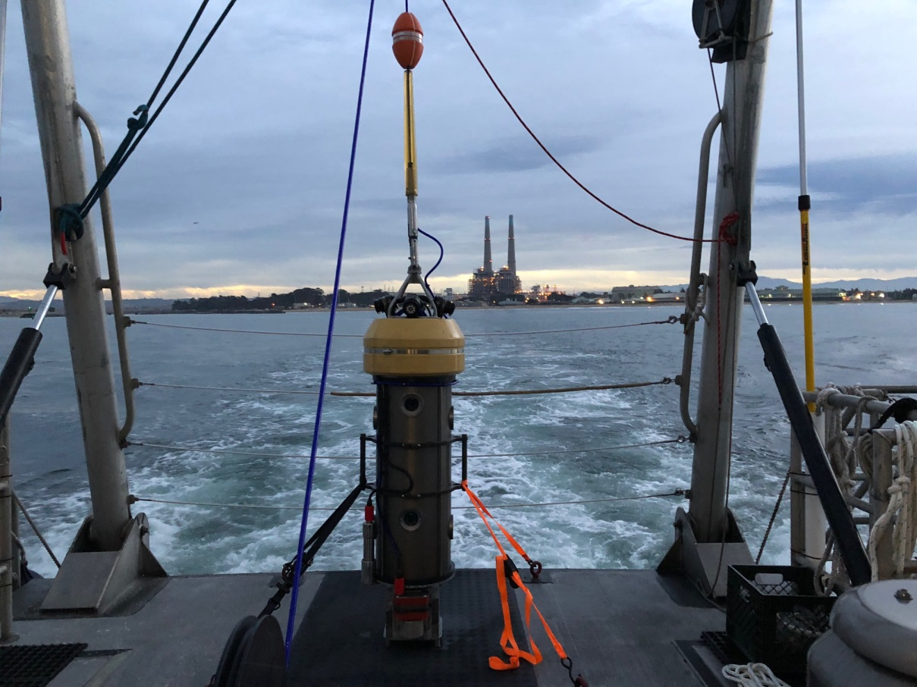
Launch & Recovery Components

Slide 29
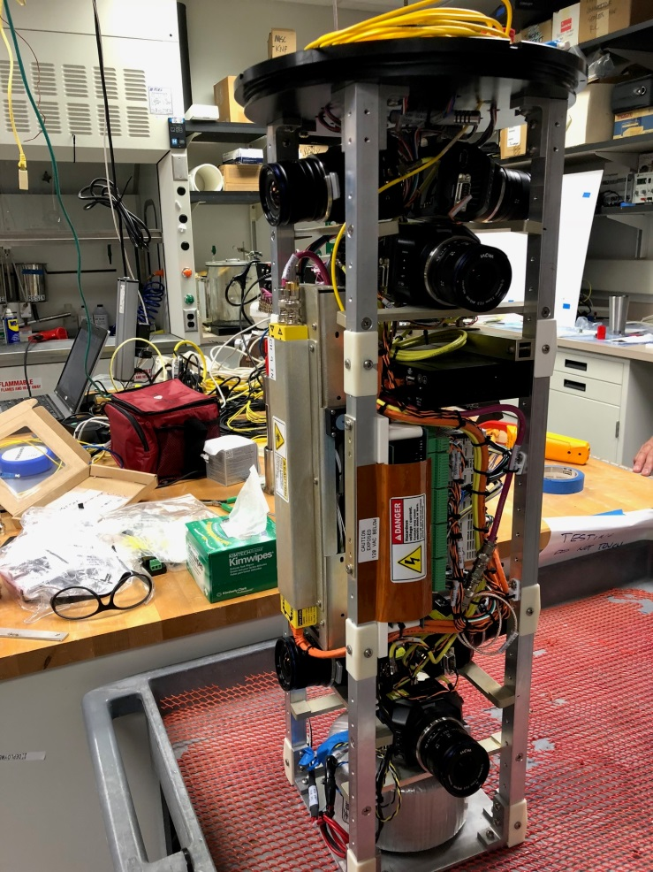
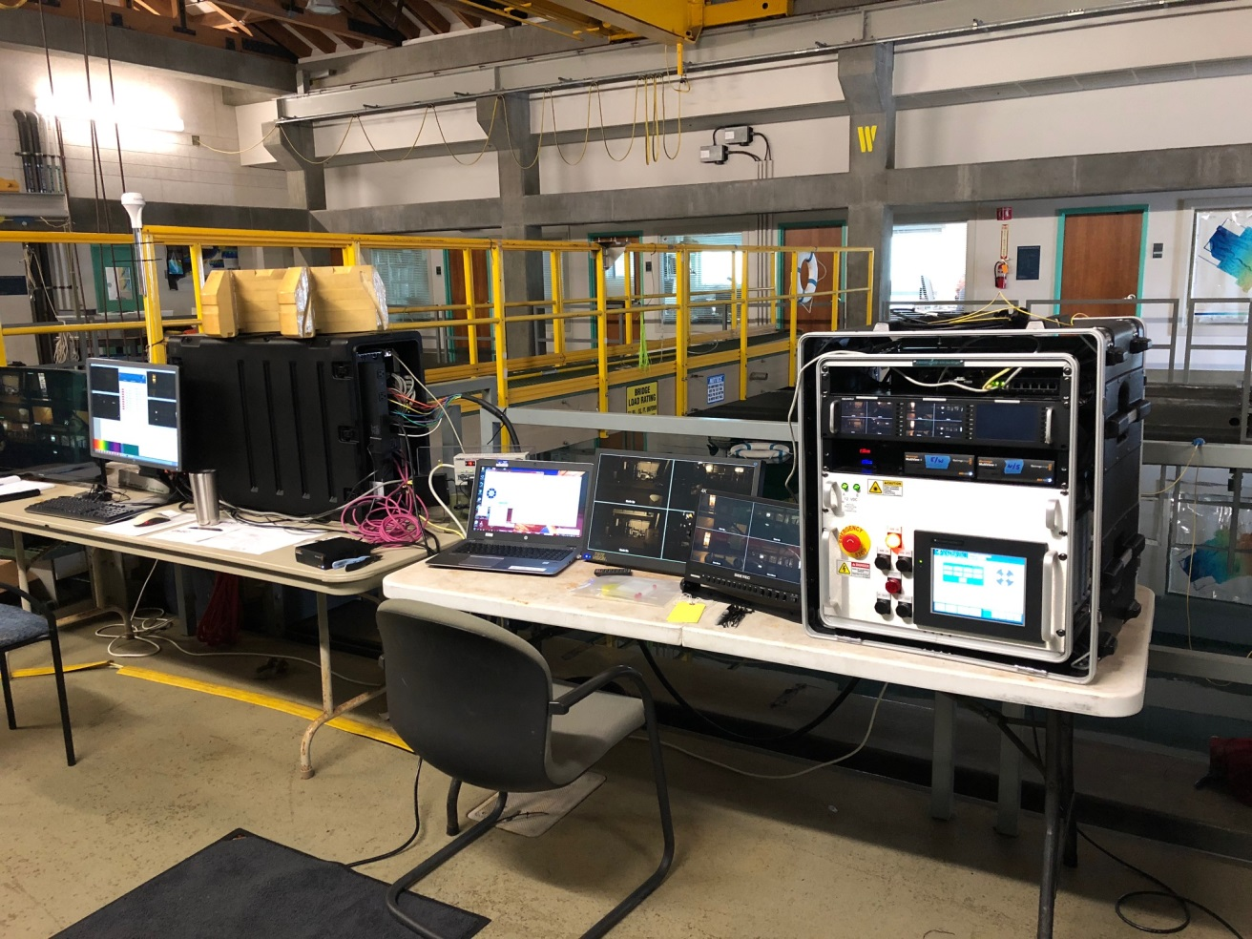
Benthic Observation Survey System

Slide 30
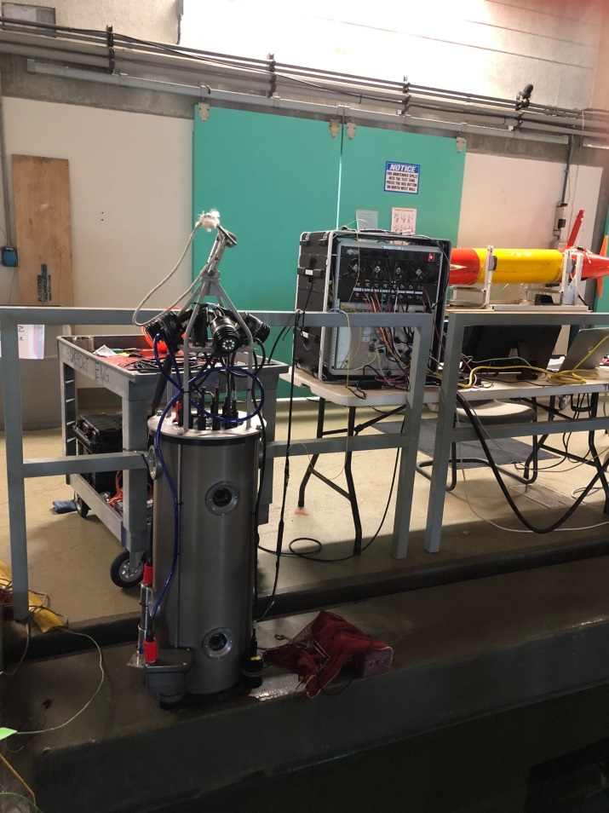
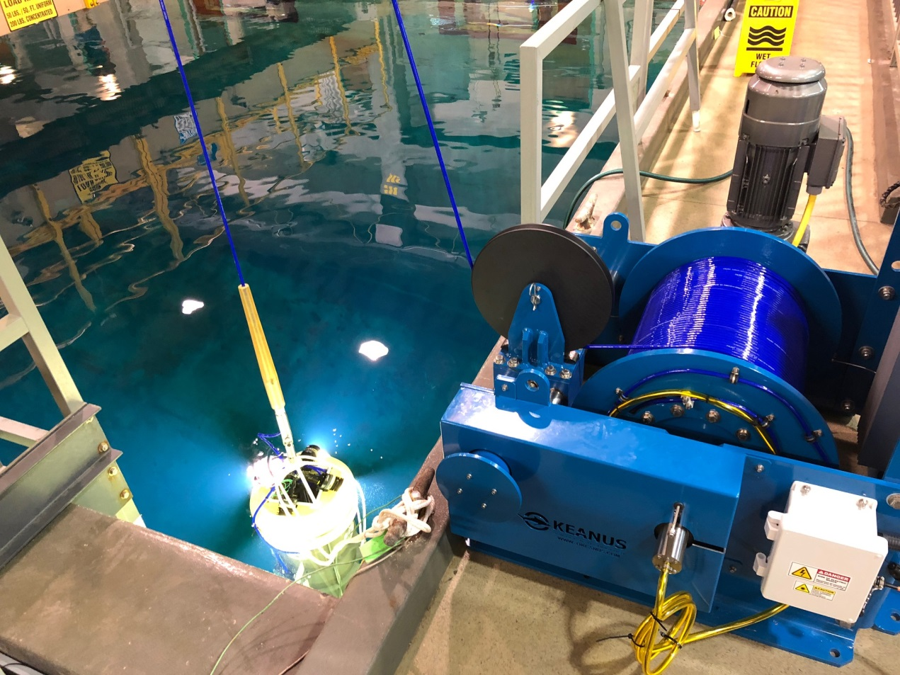
Initial Testing in Tank

Slide 31
BOSS Technical Specifications
Power: 480 VAC
  1:4 and 4:1 Transformers
Comms: Fiber Optics Transceiver Sets
  CWDM with 10 Wavelengths
Control: PLC Stack
Max Power: 1.2 Kilowatts
Four Stereo Camera Pairs
  BlackMagic Design Micro Studio 4K
Four 160 Watt Lights
One Downward Camera
  BlackMagic Design Micro Studio 4K
One 160 Watt Light
All 9 Cameras Live Stream to Ship
All 9 Cameras HD Video Recorded Topside
Tether: 2 Copper, 2 Fibers
  2700 Lbs load rating
  0.38” Diameter
Swappable Bases
Strong Righting Moment
  150 Lbs of lead bricks in base
  200 Lbs of flotation at top
Anodized Aluminum Housing
Winch: 5 HP, 33 Meters/Minute
Alpha Slip Ring (single optical pass)
Integrated Altimeter, Depth, and Compass
Serial Data Logger
Overlay Generator
Tether Turns Counter
OPC Data Display

Slide 32
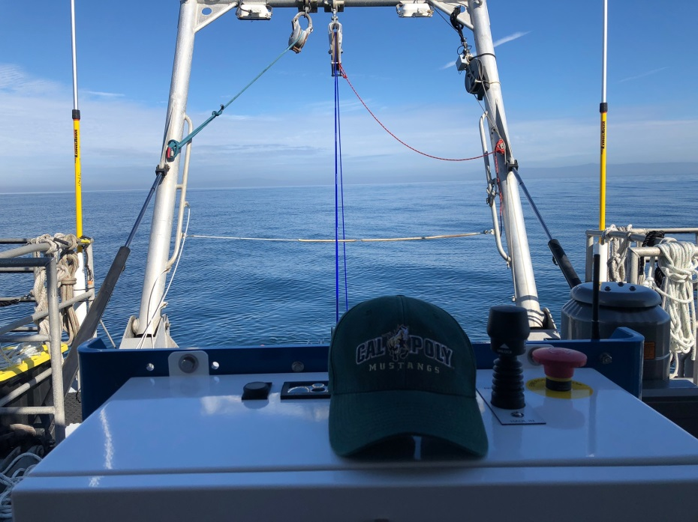
Fall 2018 Deployment (R/V Fulmar)
Mobilization: Sept. 29th
De-Mobilization: Nov. 2nd
Science crew of 4-5
30 Locations ranging from Half Moon Bay down to the Channel Islands

Slide 33
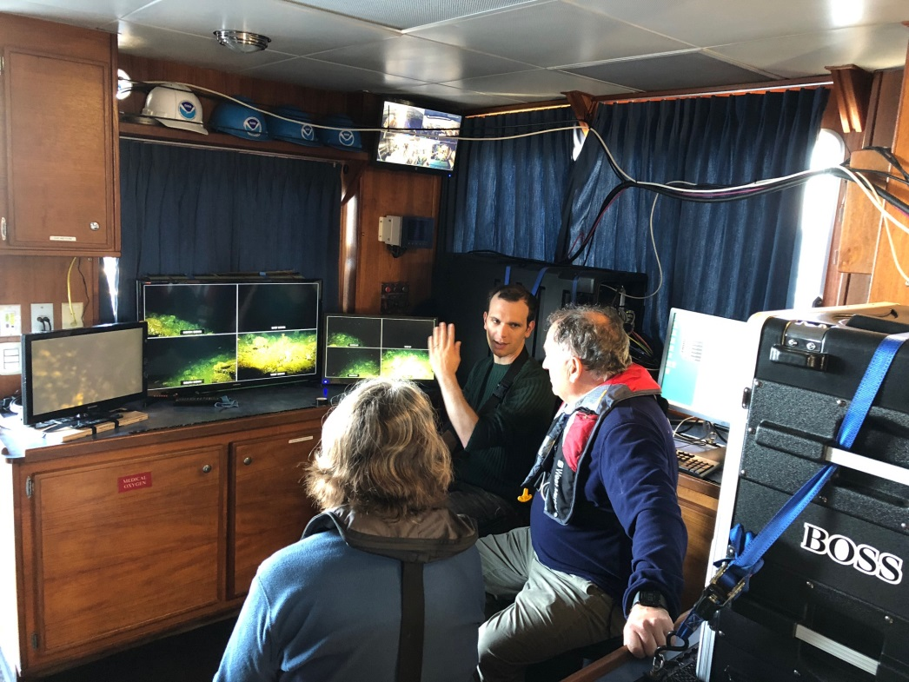
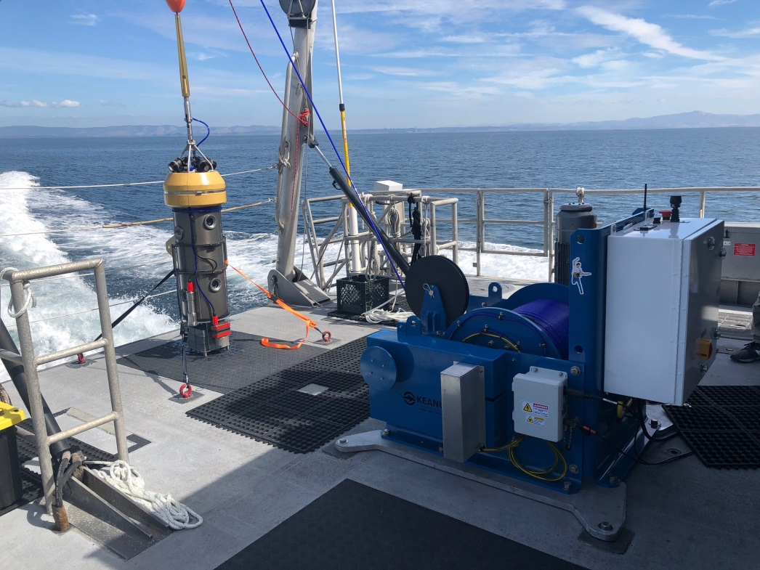
Fall 2018 Deployment (R/V Fulmar)

Slide 34
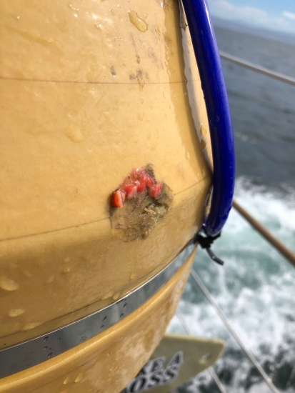
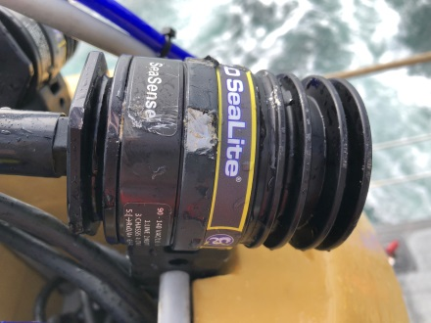
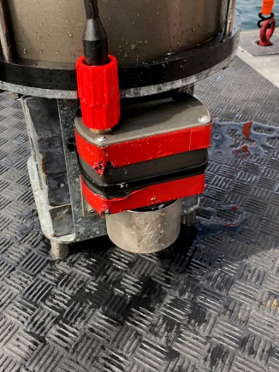
Fall 2018 Deployment Results
24 Operational Days (over 35 days)
400+ Drops made
3600+ Video files (~5 min in duration each)
1.3 TB of video
Video being analyzed by the Fisheries and Conservation Biology Lab at MLML
  Rick Starr, Ryan Fields, Jimmy Williamson, Katie Cieri
  EventMeasure Software (Jim Seager, SeaGIS)
BOSS took a few hits and dings but survived intact!

Slide 35
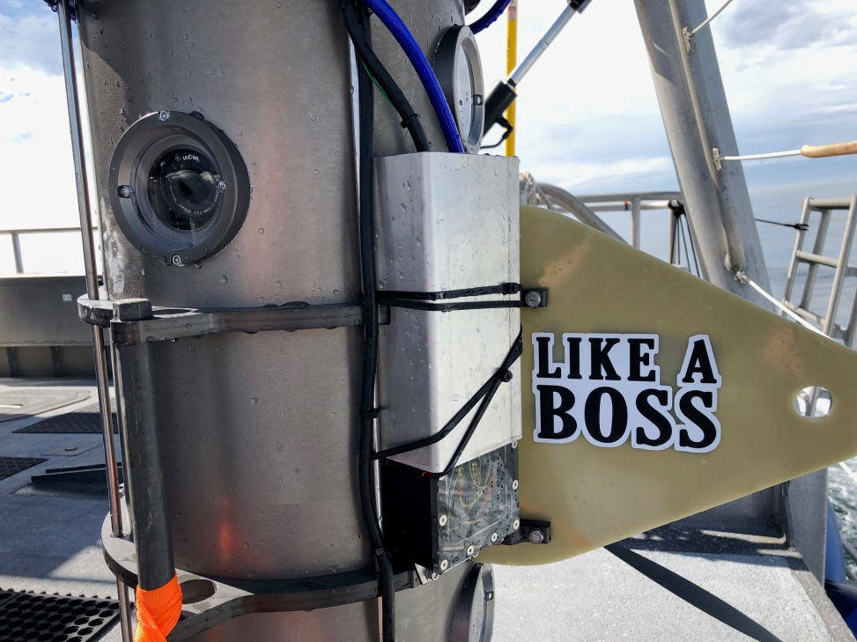
Future Plans
2018 Deployment De-brief
2019 Final Year of MBARI Project
Equipment Transfer to TNC/MLML
  BOSS continued to be used in 2019 & beyond
Complete Documentation Package
  All docs necessary to build additional systems
  Operations manual
Technology Transfer to MARE
  Plans to build 3-4 additional BOSS units

Slide 36
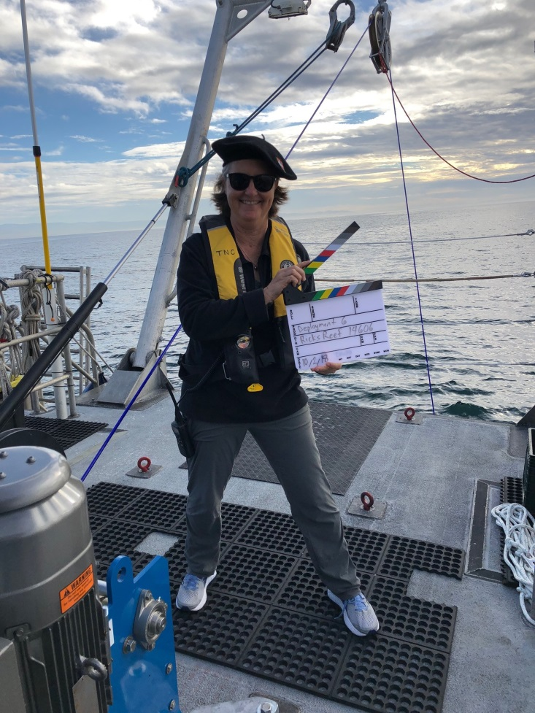
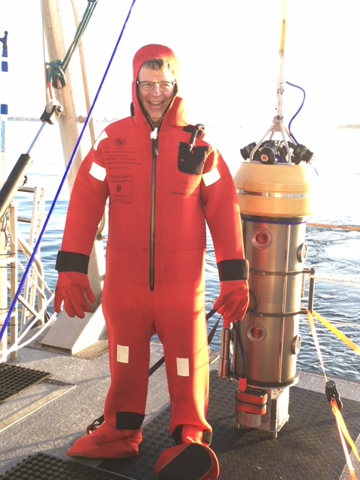
Questions?

