Slide 1




Automatic Fault Diagnosis for AUVs using Online Topic Models
Ben-Yair Raanan¹, James G. Bellingham², Yanwu Zhang¹, Mathieu Kemp¹,
Brian Kieft¹, Hanumant Singh³, Yogesh Girdhar²
¹Monterey Bay Aquarium Research Institute, Moss Landing, CA 95039
{byraanan|yzhang|mkemp|bkieft}@mbari.org
²Woods Hole Oceanographic Institution, Woods Hole, MA 02543
{jbellingham|ygirdhar}@whoi.edu
³Northeastern University, Boston, MA 02115
ha.singh@neu.edu
ONR grant N00014-14-1-0199
 |  | September 2016 / OCEANS

Slide 2
Outline
Introduction
  The reliability problem
  Approach
Topic modeling for fault diagnosis in AUVs
  Probabilistic topic models
  Modeling AUV state-sensor data
  Health monitoring
Evaluation
    Tethys Long-Range AUV
    Experiment
      Training set
      Test set
Conclusion
 |  | September 2016 / OCEANS 2

Slide 3
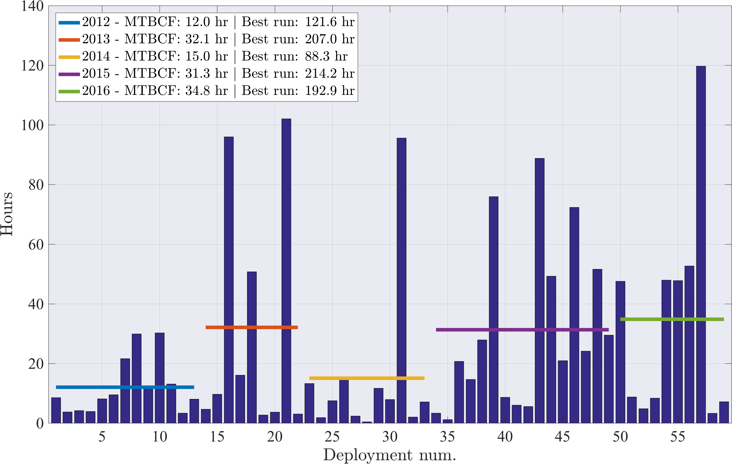
Introduction
Tethys Long-Range AUV Mean Time Between Critical Failures (MTBCF)
N=3
The reliability problem: increasing reliability of small N systems requires significant resources
 |  | September 2016 / OCEANS 3
Notes:
*~42% related to vertical plane

Slide 4
Introduction
Why is that?
Revealed reliability
  The smaller the N, the longer it will take to uncover reliability issues
System complexity
  As complexity ⬆, the number of failure modes ⬆
  As complexity ⬆, representing a system is harder
Result → failures are due to unanticipated events
 |  | September 2016 / OCEANS 4
Notes:
Can't fix a problem until it occurs

Slide 5
Introduction
GOAL: Accelerate the reliability of small-N systems
  Achieve accurate, online root-cause fault identification
  Develop a framework that anticipates and mitigates faults
APPROACH
Allow system representation to come from the data, not the developer
    Unsupervised machine learning – probabilistic topic models
    Learn performance models of "healthy" or "unhealthy” states
    Detect and classify deviations from normality
Historical mission data
Online
Unsupervised learning
Performance models
Health monitoring
 |  | September 2016 / OCEANS 5

Slide 6

Probabilistic topic models
Latent Dirichlet allocation (LDA)⁽¹⁾:
  Generative mixed-membership model for finding patterns in collections of discrete data
  Assumes that observations are generated from a mixture of latent components (topics)
  Each topic is a distribution over the collection’s vocabulary
Unsupervised: The topics emerge from the natural structure of the data
⁽¹⁾Blei et al. [2003]
Topic model
1) for entire dataset ($φ_{z}$) 2) for each observation ($θ_{t}$)
topic 1
topic 1
t₃
topic 2
Freq.
Freq.
topic 3
t₁
t₂
t₃ . . .
topic 4
. . .
1 | 2 | 3 | . | . | . |  |  |  |  |  |  |  | V
$$t∈T,w∈V$$
Words
Topics
 |  | September 2016 / OCEANS 6
Notes:
Comes from the world of NLP, terminology carries over…
The basic assumption made in LDA is that each document is generated from a random mixture of latent topics; each topic is a distribution over the collection’s vocabulary.
Example

Slide 7
Probabilistic topic models
Real-time Online Spatial-Temporal Topic-model (ROST) ⁽¹⁻²⁾
ROST⁽¹⁾ is an online Bayesian nonparametric (BNP)⁽²⁻³⁾ variant of LDA
Principal features of BNP-ROST:
  Online execution⁽¹⁾
  Automatically grows the number of topics with size and complexity of the data⁽²⁻³⁾
  Better suited for continues observations
⁽¹⁻²⁾ Girdahr et al. [2013, 2016], ⁽³⁾ Blei et al. [2010]
Topic model
1) for entire dataset ($φ_{z}$) 2) for each observation ($θ_{t}$)
topic 1
topic 1
t₃
topic 2
Freq.
Freq.
topic 3
t₁
t₂
t₃ . . .
topic 4
. . .
1 | 2 | 3 | . | . | . |  |  |  |  |  |  |  | V
$$t∈T,w∈V$$
Words
Topics
 |  | September 2016 / OCEANS 7
Notes:
Comes from the world of NLP, terminology carries over…
The basic assumption made in LDA is that each document is generated from a random mixture of latent topics; each topic is a distribution over the collection’s vocabulary.
Example

Slide 8
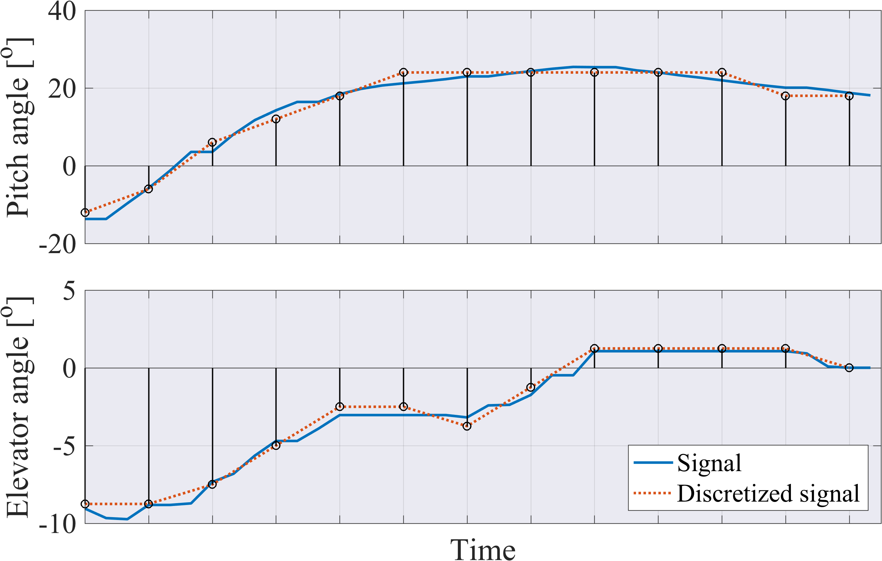


Topic modeling AUV data
Generating a vocabulary of state-sensor data (“state-words”):
Observations
Discretize each of the N signals, $S={\left\{s_{n}\right\}}_{n=1}^{N}$ into $m_{n}$ non-overlapping bins*
*We use equal-width-binning
S₁
S₂
S_{n}
. . . t₁
t₂
t₃ . . .
State-words
S₁
S₂
Concatenate discrete elements into a vocabulary of size $V=\sum_{n=1}^{N}{m_{n}}$
1 | 2 | 3 | . | . | m
1 | 2 | 3 | . | . | m
1 | . | . | m
a | b | c | . | . | .
a | b | c | . | . | .
a | . | . | .
1 | 2 | 3 | . | . | . |  |  | 9 | . | . | . |  |  |  | V
t₁
t₂
t₃
0 | 1 | 0 | 0 | 0 | 0 | 0 | 0 | 1 | 0 | 0 | 0 | 0 | 0 | 0 | 0
1 | 2 | 3 | . | . | . |  |  | 9 | . | . | . |  |  |  | V
 |  | September 2016 / OCEANS 8
Notes:
Concreate example!
This process can be viewed as a transformation of a time-series made of heterogeneous data (e.g., numeric, Boolean or text), to a common domain space.

Slide 9

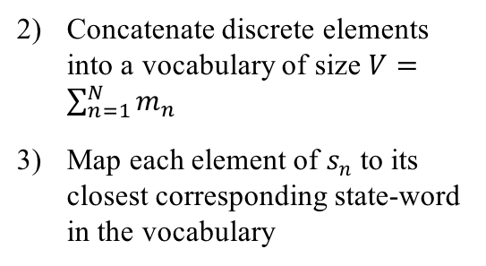
Topic modeling AUV data
Generating a vocabulary of state-sensor data (“state-words”):
Observations
Discretize each of the N signals, $S={\left\{s_{n}\right\}}_{n=1}^{N}$ into $m_{n}$ non-overlapping bins*
*We use equal-width-binning
S₁
S₂
S_{n}
. . . t₁
t₂
t₃ . . .
State-words
S₁
S₂
Concatenate discrete elements into a vocabulary of size $V=\sum_{n=1}^{N}{m_{n}}$
Map each element of $s_{n}$ to its closest corresponding state-word in the vocabulary
1 | 2 | 3 | . | . | m
1 | 2 | 3 | . | . | m
1 | . | . | m
a | b | c | . | . | .
a | b | c | . | . | .
a | . | . | .
1 | 2 | 3 | . | . | . |  |  | 9 | . | . | . |  |  |  | V
t₁
t₂
t₃
0 | 1 | 0 | 0 | 0 | 0 | 0 | 0 | 1 | 0 | 0 | 0 | 0 | 0 | 0 | 0
1 | 2 | 3 | . | . | . |  |  | 9 | . | . | . |  |  |  | V
 |  | September 2016 / OCEANS 9
Notes:
Concreate example!

Slide 10
Topic modeling AUV data
Observations
Time
 |  | September 2016 / OCEANS 10

Slide 11
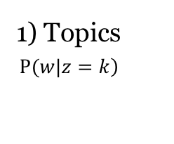
Topic modeling AUV data
Generating a performance model of the AUV from training data
Freq.
Freq.
Freq.
State-words
State-words
State-words
1) Topics
$$\left.P(w|z=k\right)$$
. . .
Observations
Time
Topics correspond to the control policies or behaviors that are executed onboard, and capture the dynamic relationship between the actuators and the AUV’s performance
 |  | September 2016 / OCEANS 11

Slide 12
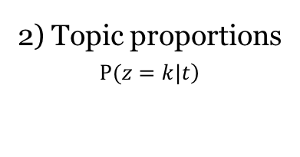
Topic modeling AUV data
Generating a performance model of the AUV from training data
Freq.
Freq.
Freq.
State-words
State-words
State-words
1) Topics
$$\left.P(w|z=k\right)$$
. . .
Observations
Time
2) Topic proportions
$$\left.P(z=k|t\right)$$
Freq.
Freq.
Freq.
Freq.
Topics correspond to the control policies or behaviors that are executed onboard, and capture the dynamic relationship between the actuators and the AUV’s performance
 |  | September 2016 / OCEANS 12

Slide 13

Topic modeling AUV data
Generating a performance model of the AUV from training data
Freq.
Freq.
Freq.
Freq.
State-words
State-words
State-words
State-words
1) Topics
$$\left.P(w|z=k\right)$$
. . .
Observations
Time
2) Topic proportions
$$\left.P(z=k|t\right)$$
Freq.
Freq.
Freq.
Freq.
Topics correspond to the control policies or behaviors that are executed onboard, and capture the dynamic relationship between the actuators and the AUV’s performance
 |  | September 2016 / OCEANS 13
Notes:
Characterize performance patterns

Slide 14
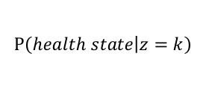
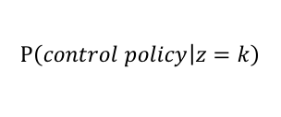
Topic modeling AUV data
Generating a performance model of the AUV from training data
$$P\left(health state | z=k\right)$$
✔
✔
✔
𝗫
Freq.
Freq.
Freq.
Freq.
State-words
State-words
State-words
State-words
1) Topics
$$\left.P(w|z=k\right)$$
. . .
$$P\left(control policy | z=k\right)$$
pitch
float
pitch
float
Observations
Time
2) Topic proportions
$$\left.P(z=k|t\right)$$
Freq.
Freq.
Freq.
Freq.
Topics correspond to the control policies or behaviors that are executed onboard, and capture the dynamic relationship between the actuators and the AUV’s performance
 |  | September 2016 / OCEANS 14
Notes:
Characterize performance patterns

Slide 15
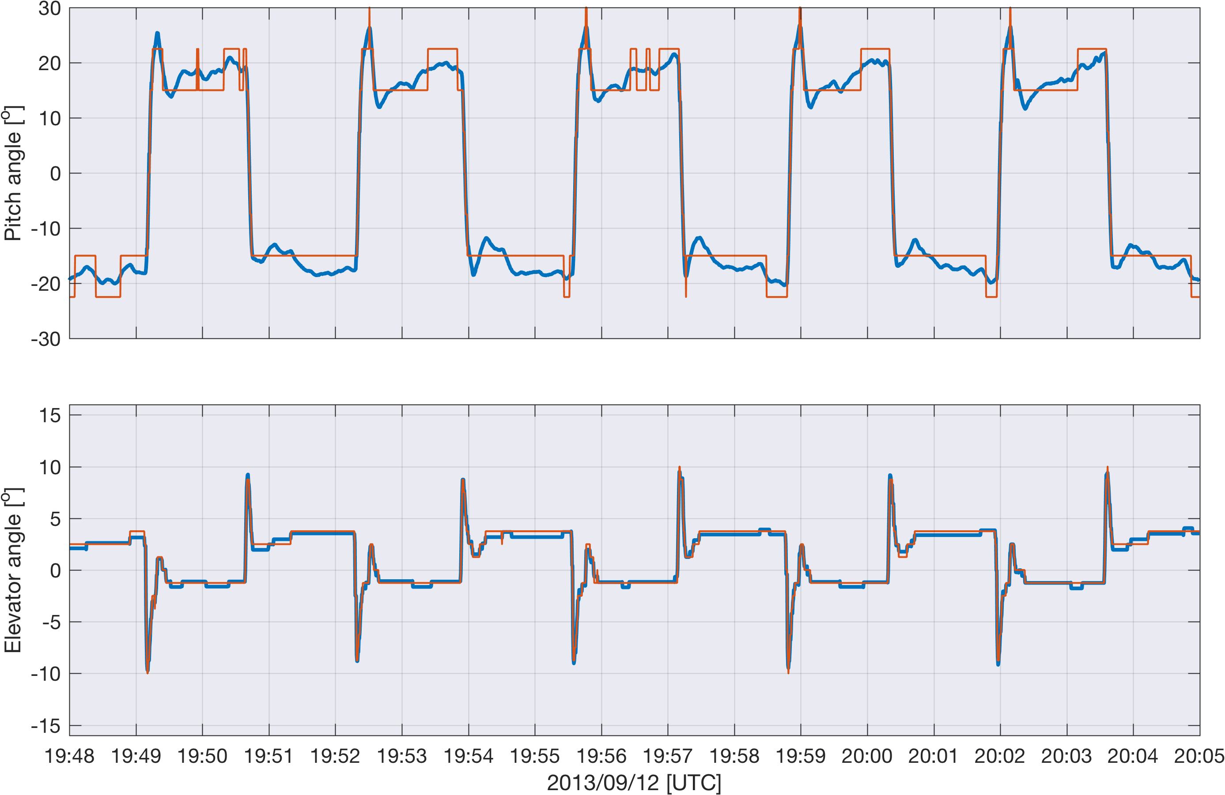
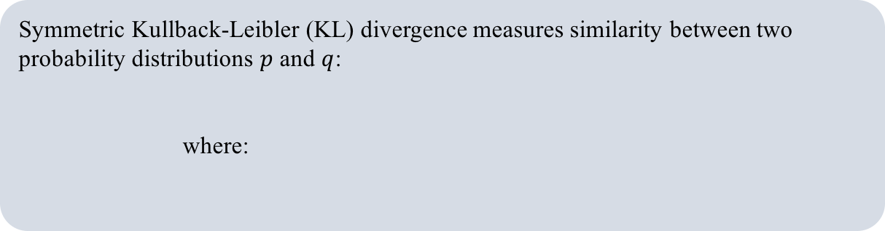


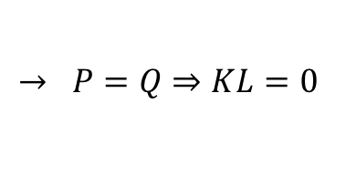
Health monitoring
Nearest-Neighbor classifier based on symmetric Kullback-Leibler divergence
Symmetric Kullback-Leibler (KL) divergence measures similarity between two probability distributions $p$ and $q$:
      where:
$$KL\left(p,q\right)=\frac{1}{2}\left[D\left(p,q\right)+D\left(q,p\right) \right]$$
$$D\left(P,Q\right)=\sum_{i=1}^{V}{P_{i}}\log_{2}\frac{P_{i}}{Q_{i}}$$
$$→ P=Q⇒KL=0$$
Observations
State-words
Labeled topics
1
2
.
.
.
V
Nearest-Neighbor
Classifier
(Kullback–Leibler)
1
0
0
0
1
0
topic 1
topic 3
S₁
Monitoring
Diagnosis
topic 2
topic 4
S_{n}
. . . t₁
t₂
t₃
t₁
t₂
t₃ . . .
topic 2
Control policy: 2
Health state:
✔
 |  | September 2016 / OCEANS 15
Notes:
Rescale state-word vec so it sums to 1

Slide 16
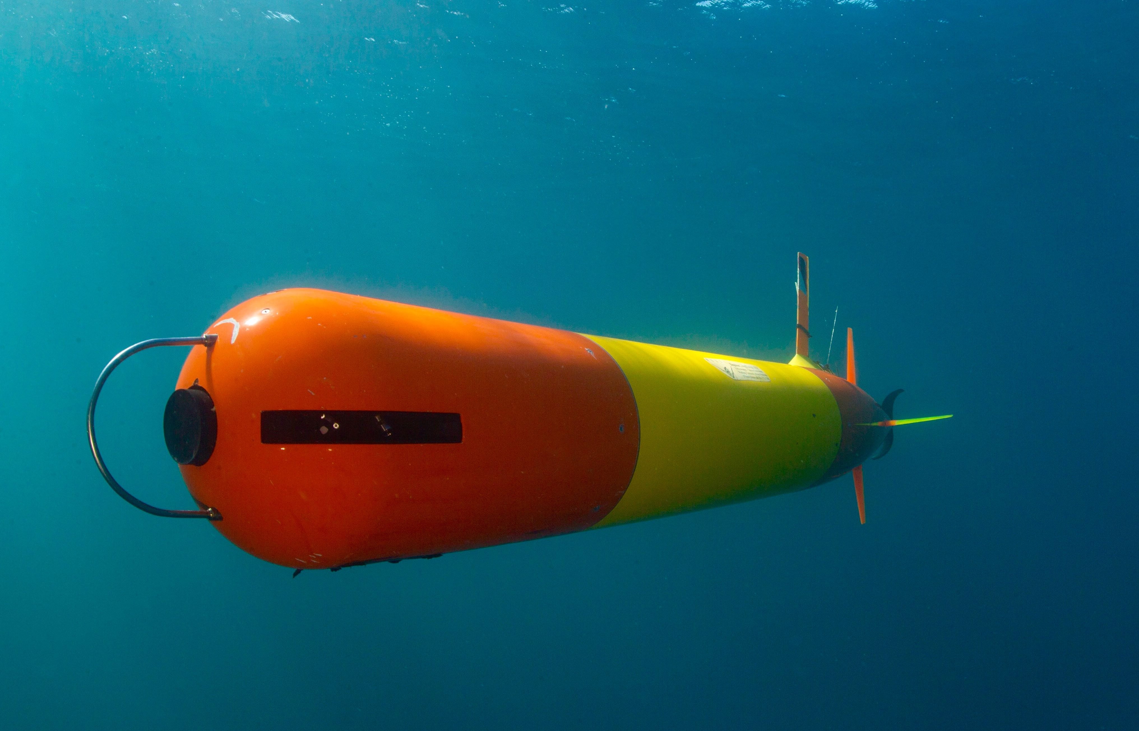
Evaluation
Tethys Long-Range AUV (LRAUV), MBARI
Photo: Kip Evens
 |  | September 2016 / OCEANS 16

Slide 17
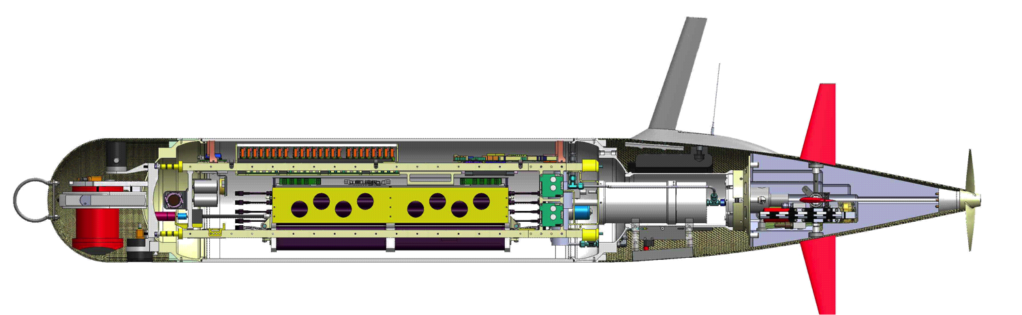
Tethys LRAUV
Redundant systems, including vertical plane control
Tethys is capable of ballasting to neutral buoyancy and adjusting its trim while at sea
2.26m
mbari.org/at-sea/vehicles/autonomous-underwater-vehicles/long-range-auv-tethys/
Bellingham et al. [2010], Kieft et al. [2011], Hobson et al. [2012]
 |  | September 2016 / OCEANS 17
Notes:
Every aspect of Tethys’ design is geared to maximize efficiency, for example Tethys can regulate vertical pitch angle by shifting its batteries forward and aft to reduce drag generated by high elevator fin angles.
And it’s the combination of these efficient sub-systems that provide a foundation for studying phytoplankton booms for bloom to bust (3 weeks).
Efficient operation of Tethys depends on running at neutral buoyancy and trimmed for zero angle of attack - Shift mass
2) Ability to trim to neutral buoyancy and drift.
3) Redundant Systems, Including Vertical Plane Control
4) Drop weight
5) Communicates with shore via Iridium sat link and now 4G
----- Meeting Notes (8/11/14 11:54) -----
ballast to
website!

Slide 18
Evaluation
Experimental setup:
2 datasets collected by LRAUV, one in 2013 and the other in 2015
Both datasets included nominal performance and faults that led to bottoming
In both datasets the fault occurred in the internal mass-shifting system
2013
Training set
Use topics trained on 2013 data
2015
Test set
 |  | September 2016 / OCEANS 18

Slide 19
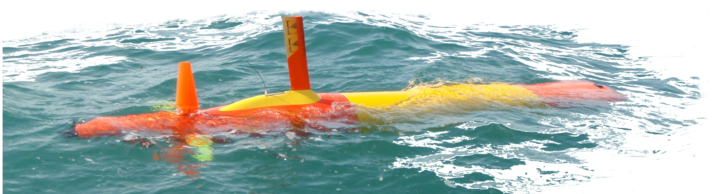
Evaluation
Training set (2013)
 |  | September 2016 / OCEANS 19

Slide 20
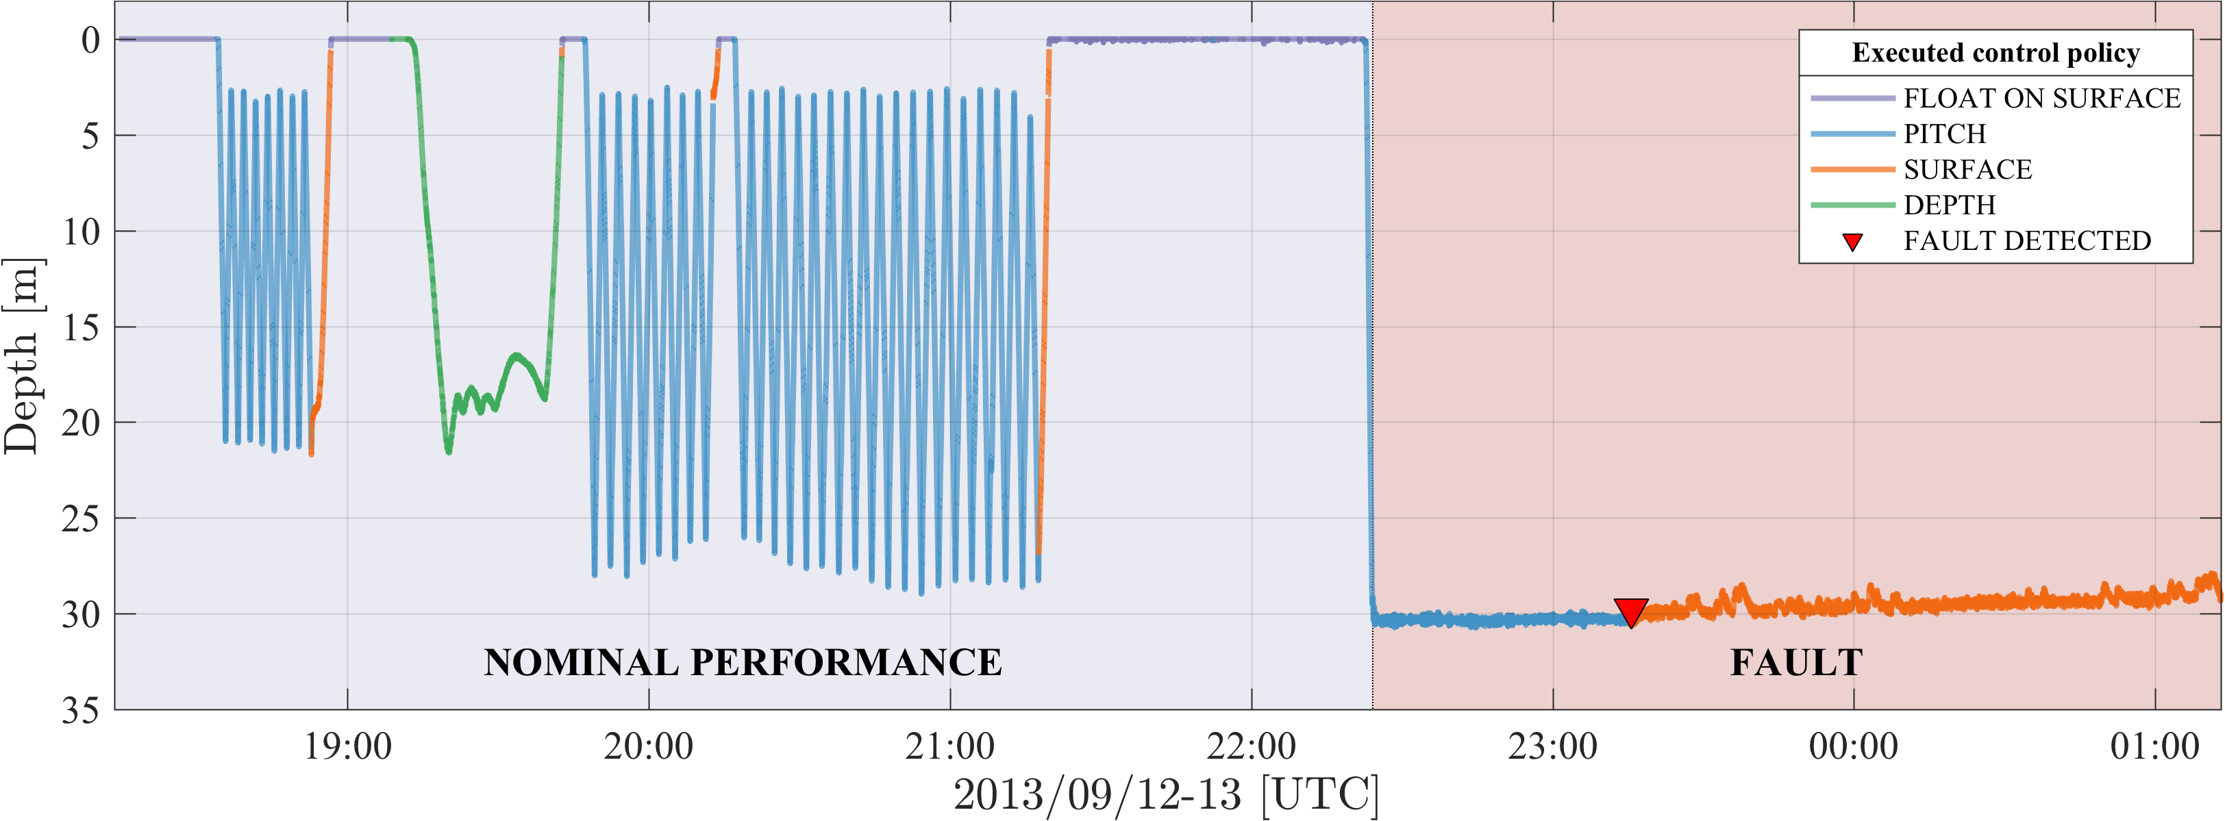
Training set (2013)
The AUV correctly executed a series of vertical profiles using 4 control policies
A rupture of the mass-shifter set-screw caused the battery-mass to shift all the way forward → the AUV collided with the bottom
The AUV identified the problem as a “failure to ascend” fault
Extract state-words from 20 signals → BNP-ROST
 |  | September 2016 / OCEANS 20
Notes:
The AUV remained on the bottom for 27 hours and was eventually located on the beach 8 km away from its last reported position
62,920 observations → 20 signals (14 numerical, 6 bool) → V=356
(a) Time series of vehicle depth (2013 dataset); line color indicates the executed control policy and the red shaded background indicates the bottoming fault. The LRAUV system identified the “failure to ascend” fault approximately 50 minutes after the vehicle had bottomed (red triangle).

Slide 21
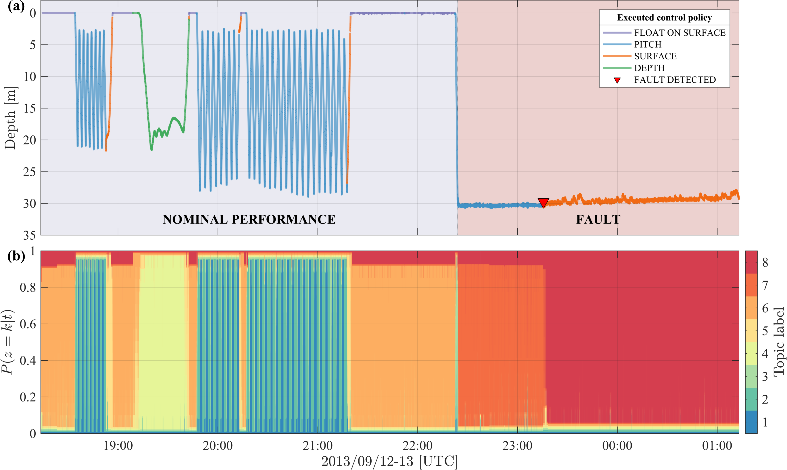
Training set (2013) - Results
 |  | September 2016 / OCEANS 21
Notes:
Fig. shows the distribution of topic labels for each time step and illustrates how topics change over time within the model; the width of bands indicate the topic proportions.
As shown, the executed control policies correspond well to the topics, and are consistently represented by a single topic. Unique topics are assigned to the deployment segments where the AUV has bottomed (topics 7 and 8).
(b) A stacked plot showing the distribution of topic labels for each time step, computed using BNP-ROST. The learned topics exactly match the various control policies and unique topics are assigned to the deployment segments where the AUV has bottomed (topics 7 and 8).

Slide 22
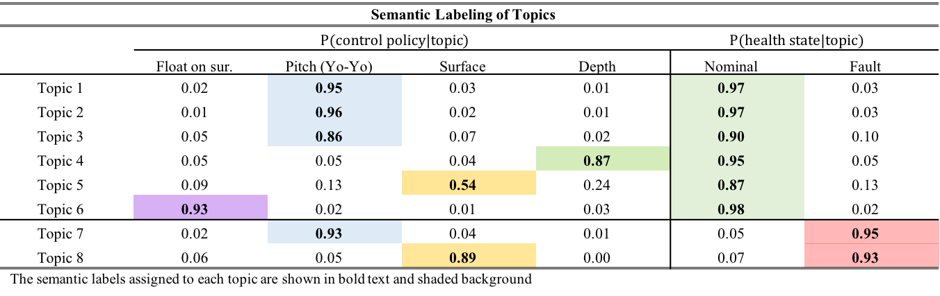
Training set (2013) - Results
Semantic Labeling of Topics
 | $$P(control policy|topic)$$ |  |  |  | $$P(health state|topic)$$
 | Float on sur. | Pitch (Yo-Yo) | Surface | Depth | Nominal | Fault
Topic 1 | 0.02 | 0.95 | 0.03 | 0.01 | 0.97 | 0.03
Topic 2 | 0.01 | 0.96 | 0.02 | 0.01 | 0.97 | 0.03
Topic 3 | 0.05 | 0.86 | 0.07 | 0.02 | 0.90 | 0.10
Topic 4 | 0.05 | 0.05 | 0.04 | 0.87 | 0.95 | 0.05
Topic 5 | 0.09 | 0.13 | 0.54 | 0.24 | 0.87 | 0.13
Topic 6 | 0.93 | 0.02 | 0.01 | 0.03 | 0.98 | 0.02
Topic 7 | 0.02 | 0.93 | 0.04 | 0.01 | 0.05 | 0.95
Topic 8 | 0.06 | 0.05 | 0.89 | 0.00 | 0.07 | 0.93
The semantic labels assigned to each topic are shown in bold text and shaded background
 |  | September 2016 / OCEANS 22
Notes:
To analyze quantitatively we project the topic model on to a 2D representation following Chuang et al. 2012.
The areas of the circles are proportional to the relative prevalence of each topic, P(𝑧 = 𝑘). The locations of the circles and the distances between them reflect how similar topics are to one another. Similarities are calculated using the KL similarity measure (Eq. 6) and reduced to 2D using PCA [42]. The PCA recomposition preserved 97% of the variance. (a) The pie-chart slices in each circle are proportional to the relative probability of the control policies, P(control policy|𝑧 = 𝑘), computed using the proposed method for topic labeling (Eq. 4-5). In (b) the pie-chart slices are proportional to the relative probability of the AUV’s health, P(health state|𝑧 = 𝑘).

Slide 23
Evaluation
Test set (2015)
 |  | September 2016 / OCEANS 23

Slide 24
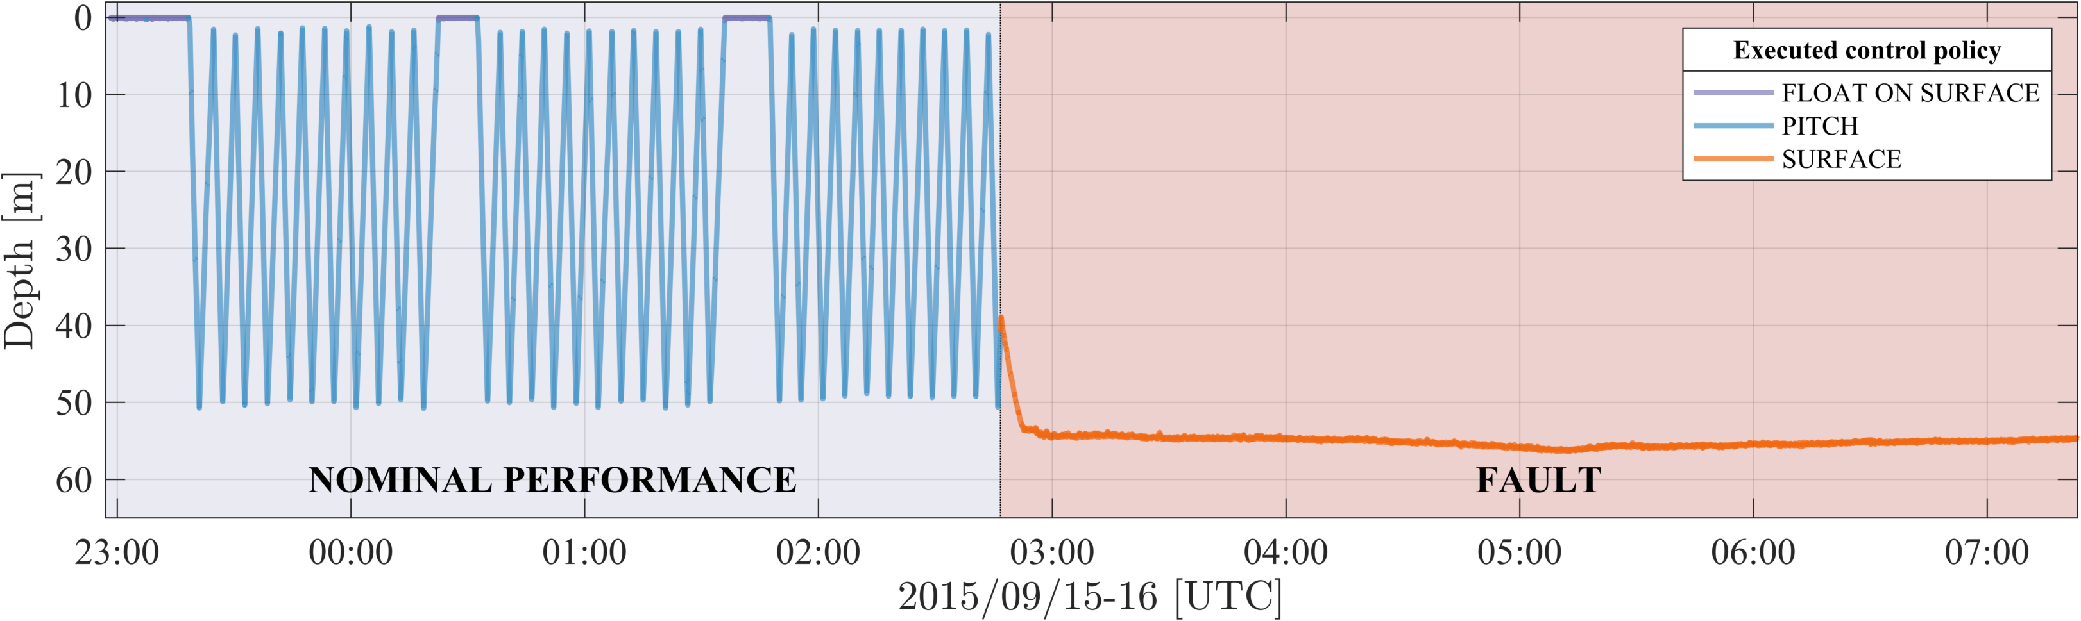
Test set (2015)
The AUV correctly executed a series of vertical profiles using 2 control policies
Erroneous software configuration caused the internal mass-shifter to repeatedly overload and eventually disabled it → the AUV collided with the bottom
Test set (2015)
Training set (2013)
Training set (2013)
 |  | September 2016 / OCEANS 24

Slide 25
Classification results
Summary of KL Nearest-Neighbor Classification Accuracies
Dataset | Class | Label | Accuracy (%) | TPR (%) | FPR (%)
Training set (2013) | Health state | Nominal | 99.96 | 100.00 | 0.10
 |  | Fault | 99.96 | 99.90 | 0.00
 | Control policy | Surface | 99.55 | 99.31 | 0.35
 |  | Depth | 99.28 | 92.57 | 0.13
 |  | Pitch | 99.40 | 98.92 | 0.31
 |  | Float on sur. | 98.94 | 99.64 | 1.28
Test set (2015) | Health state | Nominal | 99.49 | 100.00 | 0.94
 |  | Fault | 99.49 | 99.06 | 0.00
 | Control policy | Surface | 99.88 | 99.79 | 0.02
 |  | Depth | 99.87 | 0.00 | 0.13
 |  | Pitch | 99.88 | 99.79 | 0.02
 |  | Float on sur. | 99.87 | 0.00 | 0.13
TPR: True Positive Ratio, FPR: False Positive Ratio
Training set (2013)
    ~51 min before LRAUV’s fault detection system
    ~0.4 min (25 seconds) before AUV bottomed
Test set (2015)
    ~1.6 min after LRAUV’s fault detection system
    ~3.8 min before AUV bottomed
 |  | September 2016 / OCEANS 25

Slide 26
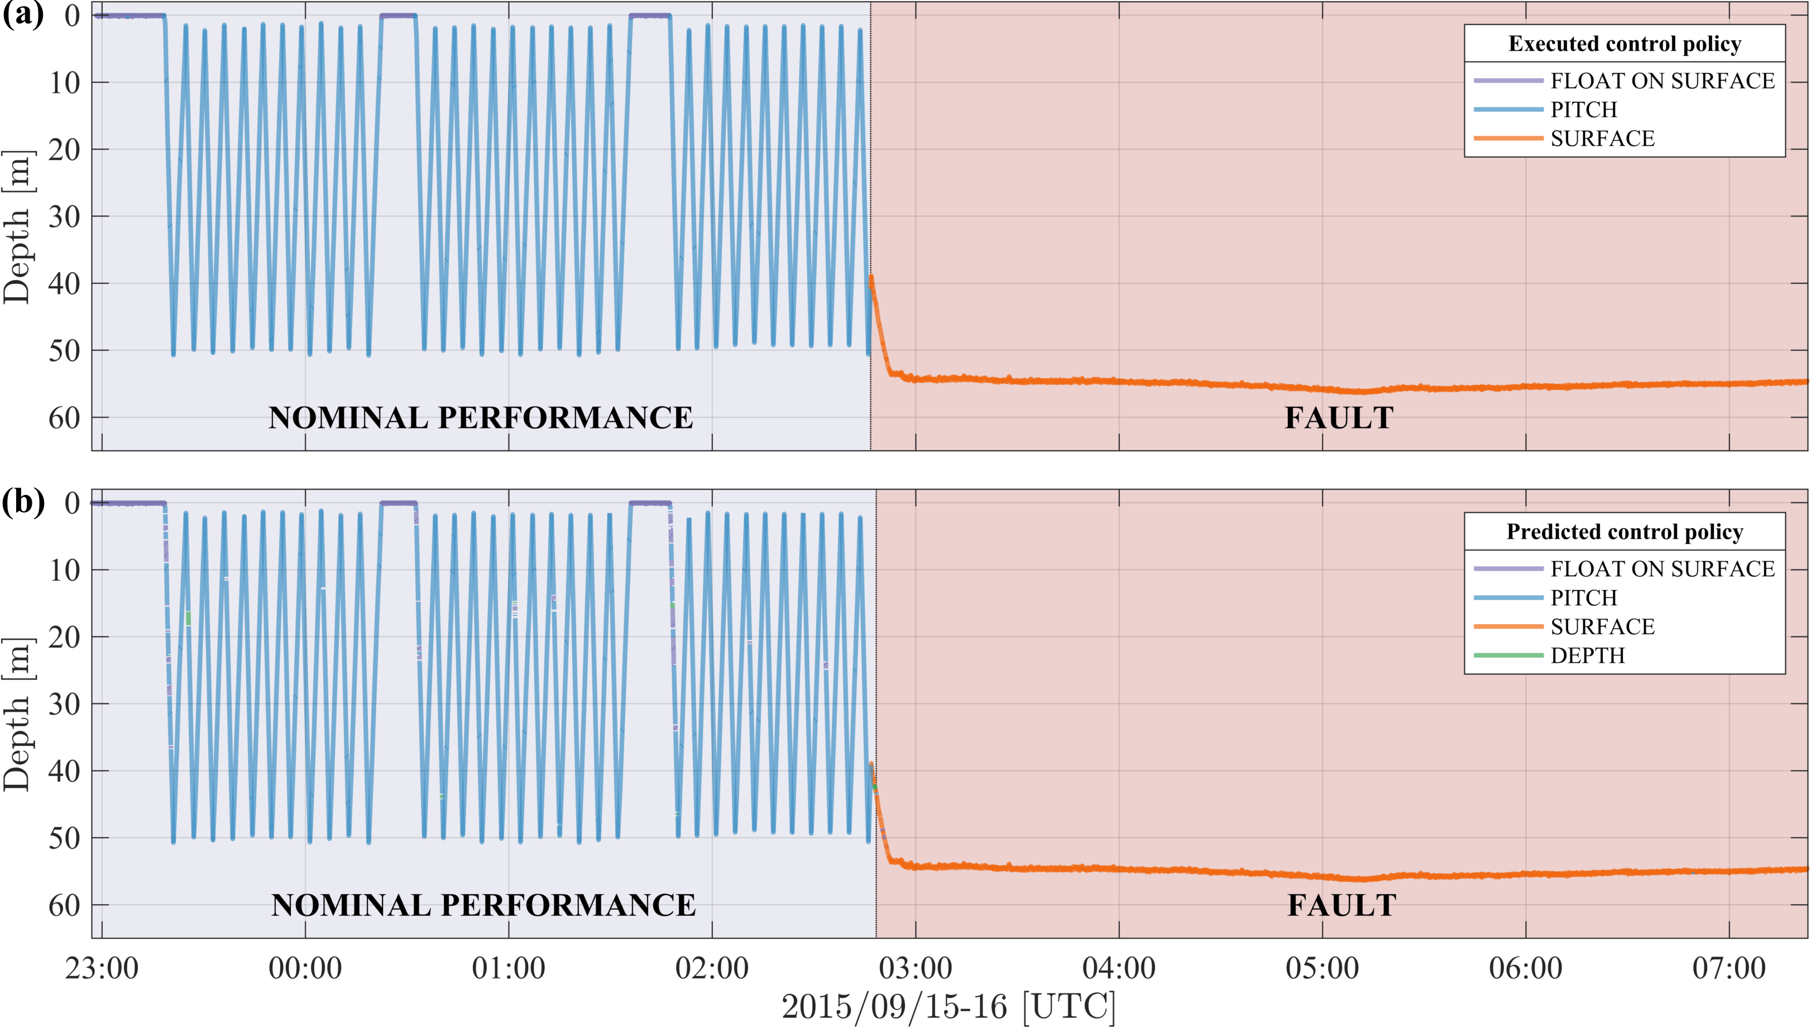
Test set (2015) - Results
 |  | September 2016 / OCEANS 26

Slide 27
Conclusion
We found:
Framework automatically characterized performance patterns (topics) for nominal and failure states directly from the training data (N=1).
The topics matched the control policies executed onboard the AUV.
KL-NN classifier classified faults with high probability of detection and no false detects.
The mixed-membership nature of the approach allows efficient modeling of state transitions.
Limitations:
Model provides diagnosis of fault states, rather than determining which specific subsystem is subject to failure.
 |  | September 2016 / OCEANS 27

Slide 28
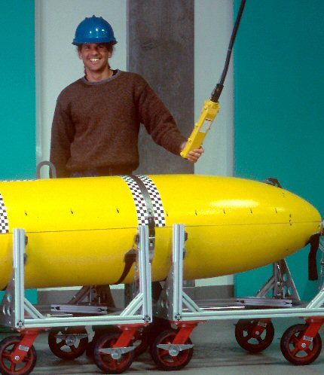
Acknowledgments
ONR grant N00014-14-1-0199
Brett Hobson
Jordan Stanway
John Erickson
Ed Mellinger
Denis Klimov
Carlos Rueda
Tom O’Reilly
Doug Au
Cynthia Hanrahan
Drew Gashler Memorial
Internship
 |  | September 2016 / OCEANS

Slide 29
Backup slides
 |  | September 2016 / OCEANS 29

Slide 30
Framework overview
Observations
State-words
Topic model
Semantic labels
1
2
.
.
.
V
0
0
1
0
0
0
1
0
0
0
1
topic 1
topic 1
Control policy: 5
S₁
1
2
.
.
.
M
z
z
Health state:
✔
S₁
z
z
z
Training
z
z
z
topic 2
topic 2
Control policy: 2
z
z
z
Health state:
✔
z
z
z
S₂
S₂
z
z
z
topic 3
topic 3
Control policy: 5
z
z
z
Health state:
𝗫
t₁
z
t₂
z
Control policy: 3
S_{n}
. . . t₁
t₂
t₃ . . .
t₃ . . .
topic 4
topic 4
Health state:
✔
t₁
t₂
t₃ . . .
Observations
State-words
Labeled topics
1
2
.
.
.
V
Nearest-Neighbor
Classifier
(Kullback–Leibler)
1
0
0
0
1
0
topic 1
topic 3
S₁
Monitoring
Diagnosis
topic 2
topic 4
S_{n}
. . . t₁
t₂
t₃ . . .
t₁
t₂
t₃ . . .
topic 2
Control policy: 2
Health state:
✔
 |  | September 2016 / OCEANS 30

Slide 31
Topic modeling AUV data
Dirichlet(α)
Freq.
Freq.
Freq.
State-words
State-words
State-words
Topics
. . .
Observations
Time
Freq.
Freq.
Freq.
Freq.
CRP(β)
 |  | September 2016 / OCEANS 31

Slide 32
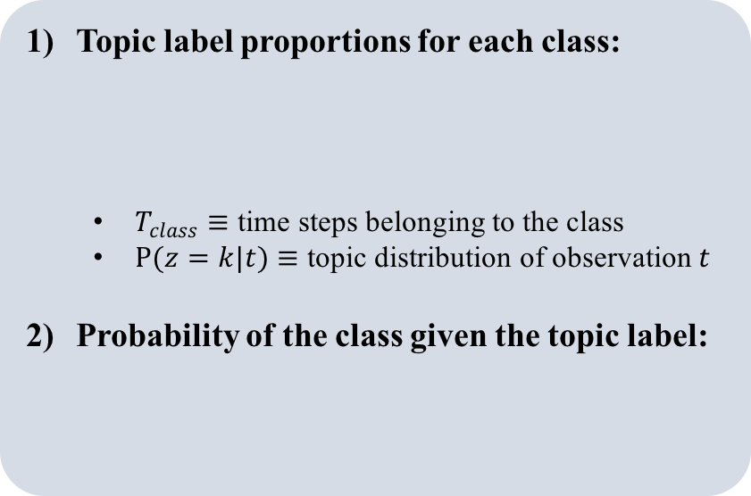
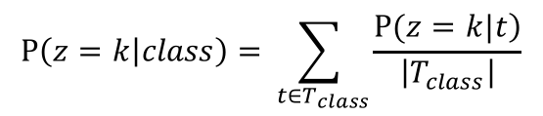
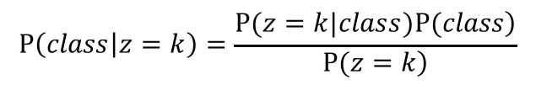
Topic modeling for robots
Using a trained topic-model for classification:
Topic label proportions for each class:
  $T_{class}$ $≡$ time steps belonging to the class
  $P(z=k|t)$ $≡$ topic distribution of observation $t$
Probability of the class given the topic label:
Semantic labels
Control policy: 5
$$P\left(z=k | class\right)=\sum_{ {t∈T}_{class}}{\frac{\left.P(z=k|t\right)}{\left|T_{class}\right|}}$$
topic 1
Health state:
✔
Control policy: 2
topic 2
Health state:
✔
topic 3
Control policy: 5
Health state:
𝗫
$$P\left(class | z=k\right)=\frac{\left.P(z=k|class)P(class\right)}{\left.P(z=k\right)}$$
topic 4
Control policy: 3
Health state:
✔
 |  | September 2016 / OCEANS 32

Slide 33
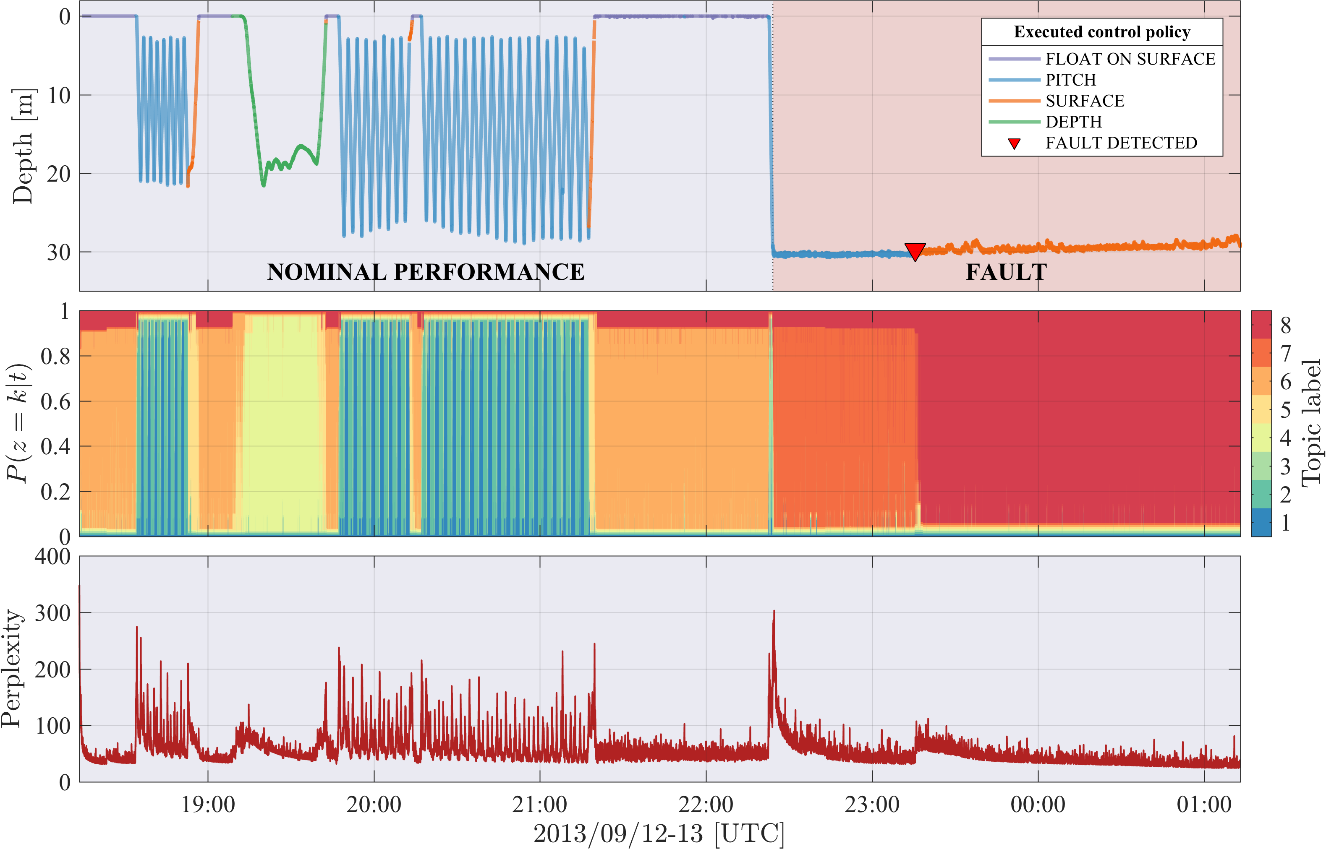
Training set (2013)
 |  | September 2016 / OCEANS 33

Slide 34
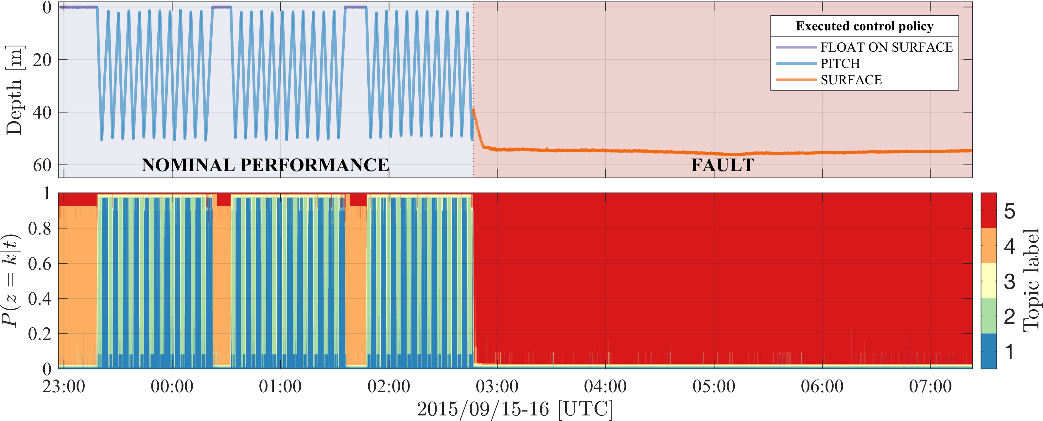
Test set (2015)
 |  | September 2016 / OCEANS 34

Slide 35

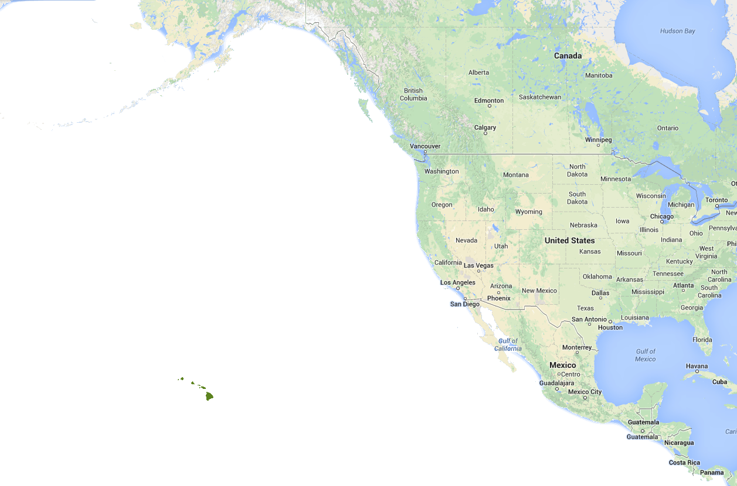
Tethys LRAUV
Tethys class long-range AUVs (LRAUVs)
Capabilities fall between existing propeller driven vehicles and buoyancy-driven vehicles (gliders)
Rechargeable | 2 week | ~1000km
Expendable | 4 weeks | ~2250 km
Goal | 7-8 weeks | ~3700 km
Hawaii
Photo: Thomas Hoover, MBARI
Hobson et al. [2012]
 |  | September 2016 / OCEANS 35
Notes:
What is long-range?

Slide 36
Evaluation
List of AUV state-sensor signals and data-products used as inputs to the topic-modeling framework:
20 features – mostly focused on vertical-plane performance
Discretized using 25 equally-spaced bins
 |  | September 2016 / OCEANS 36

Slide 37
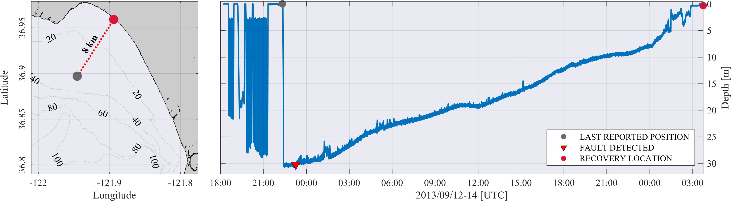
Training set (2013)
The AUV correctly executed a series of vertical profiles using 4 control policies
A rupture of the mass-shifter set-screw caused the battery-mass to shift all the way forward → the AUV collided with the bottom
The AUV identified the problem as a “failure to ascend” fault
The AUV remained on the bottom for 27 hours and was eventually located on the beach 8 km away from its last reported position
 |  | September 2016 / OCEANS 37
Notes:
The AUV remained on the bottom for 27 hours and was eventually located on the beach 8 km away from its last reported position
20 signals → 62,920 observations

Slide 38
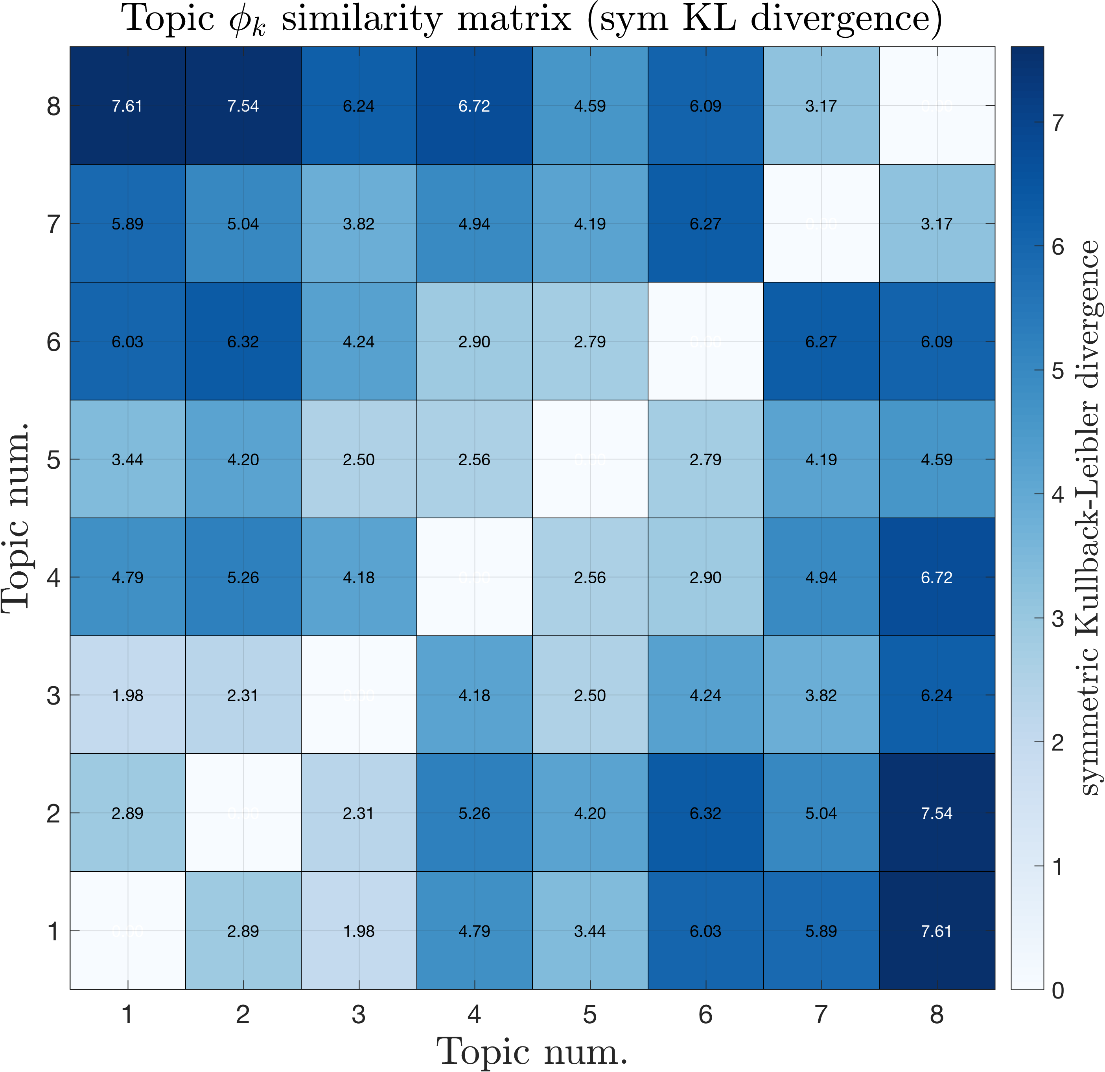
Training set (2013)
2D visualization of the topic model
Compute similarity matrix using the symmetric KL divergence
Reduced to 2D using Principal Component Analysis (PCA)
Chuang et al. [2012]
 |  | September 2016 / OCEANS 38

Slide 39
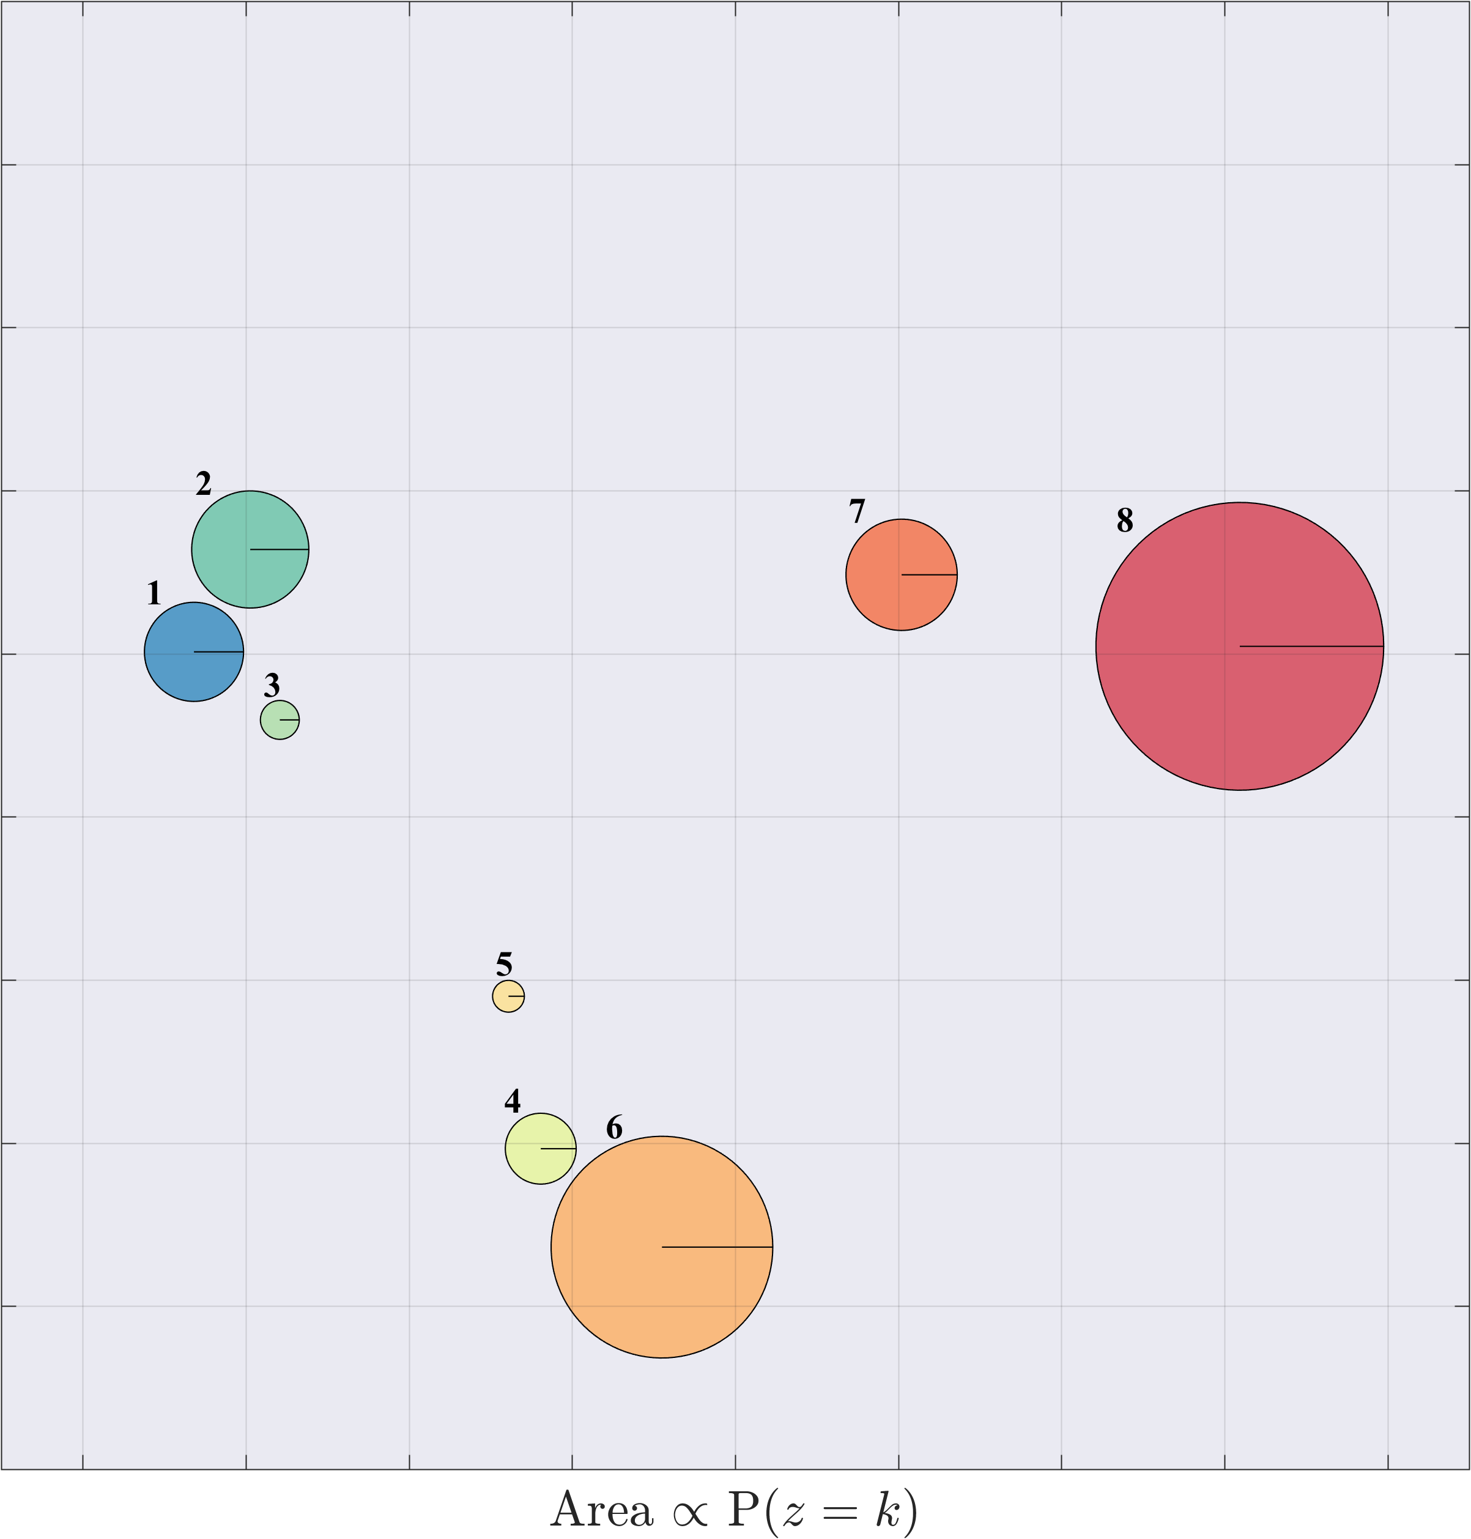
Training set (2013)
2D visualization of the topic model
Compute similarity matrix using the symmetric KL divergence
Reduced to 2D using Principal Component Analysis (PCA)
We encode the topics as circles, with areas proportional to the relative prevalence of each topic, P(𝑧 = 𝑘)
Distance encodes similarity
2D PCA recomposition preserved 97% of the variance
Chuang et al. [2012]
 |  | September 2016 / OCEANS 39
Notes:
This provides a convenient platform to analyze the resulting topics

Slide 40
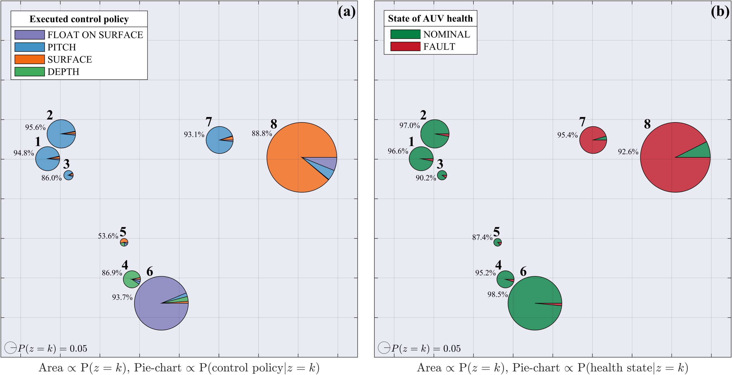
Training set (2013) - Results
Circle area encodes topic prevalence, distance encodes similarity (KL)
Pie-chart ∝ P(control policy|topic)
Pie-chart ∝ P(health state|topic)
Chuang et al. [2012]
 |  | September 2016 / OCEANS 40
Notes:
To analyze quantitatively we project the topic model on to a 2D representation following Chuang et al. 2012.
The areas of the circles are proportional to the relative prevalence of each topic, P(𝑧 = 𝑘). The locations of the circles and the distances between them reflect how similar topics are to one another. Similarities are calculated using the KL similarity measure (Eq. 6) and reduced to 2D using PCA [42]. The PCA recomposition preserved 97% of the variance. (a) The pie-chart slices in each circle are proportional to the relative probability of the control policies, P(control policy|𝑧 = 𝑘), computed using the proposed method for topic labeling (Eq. 4-5). In (b) the pie-chart slices are proportional to the relative probability of the AUV’s health, P(health state|𝑧 = 𝑘).

Slide 41
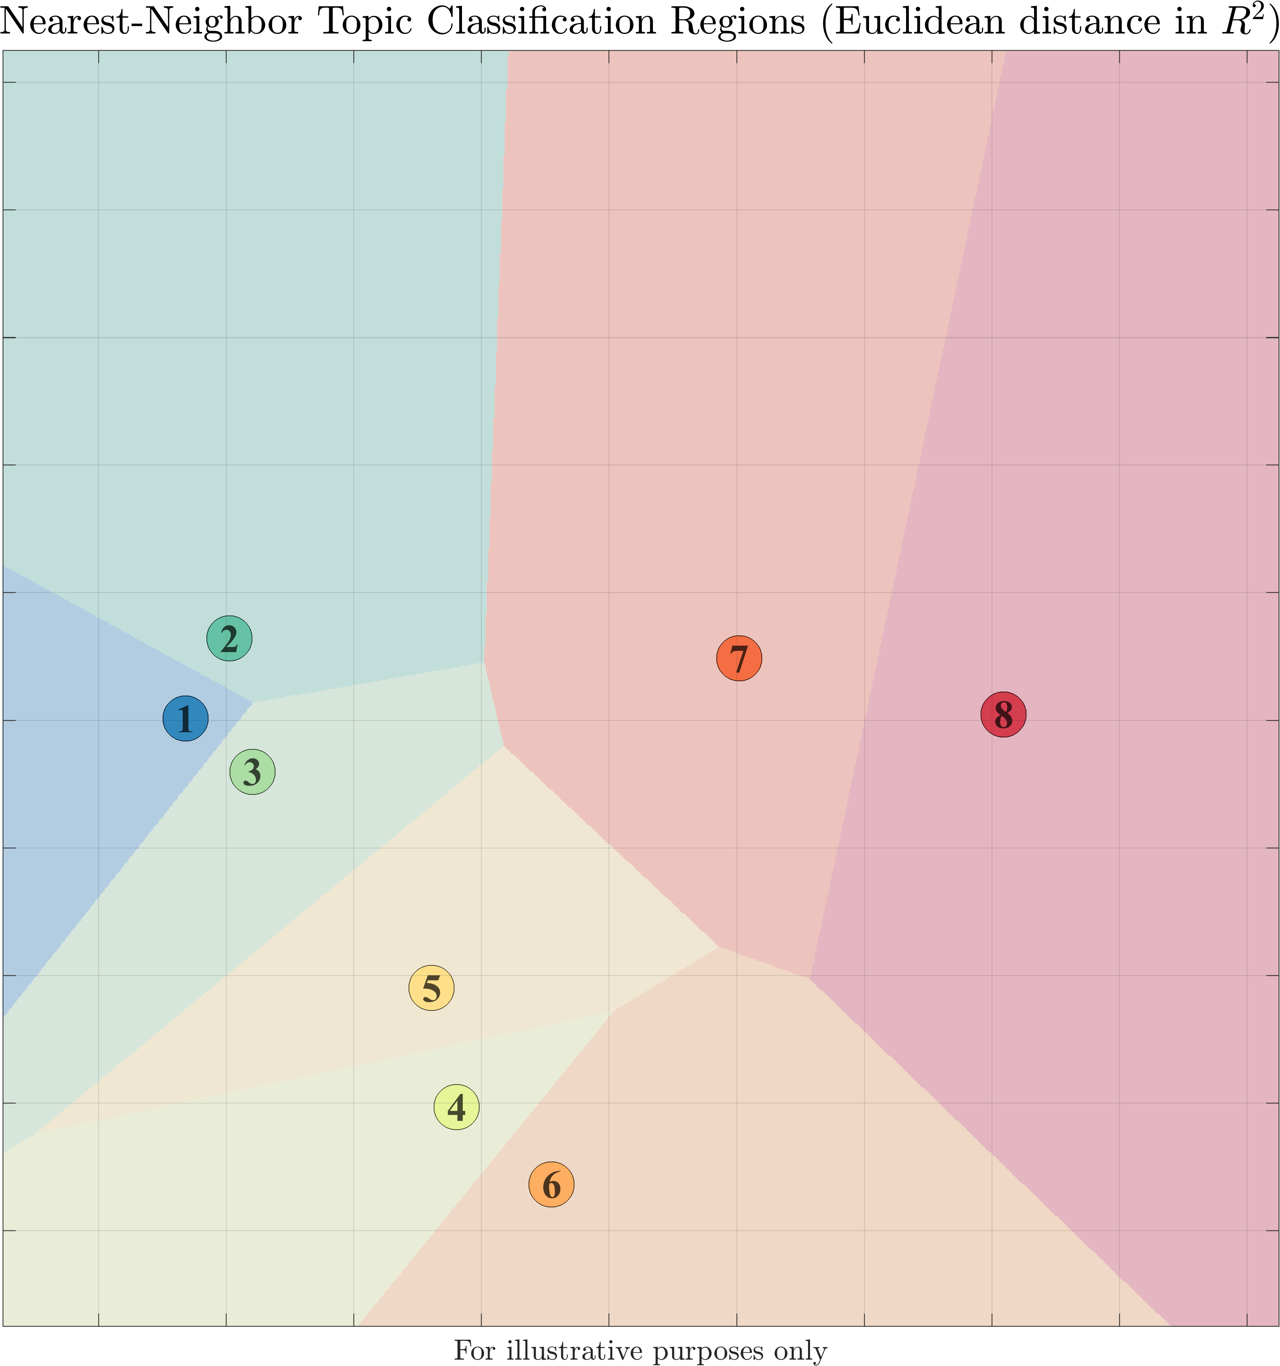
Training set (2013)
Topics are probability distributions
over state-words
Freq.
1 | 2 | 3 | . | . | . |  |  |  |  |  |  |  | V
State-words
State-words
1
2
.
.
.
V
Nearest-Neighbor
Classifier
(Kullback–Leibler)
1
0
0
0
1
0
Diagnosis
t₁
t₂
t₃
topic 2
Control policy: 2
Health state:
✔
 |  | September 2016 / OCEANS 41

Slide 42


Probabilistic topic models
Latent Dirichlet Allocation (LDA)⁽¹⁾
Generative probabilistic model for discovering patterns in collections of discrete data
Assumes that observations (documents) are generated from a mixture of latent components
Each component (topic) is a distribution over the collection’s vocabulary
⁽¹⁾ Blei et al. [2003]
Words
Topic model
1) for each observation ($θ_{d}$) 2) for entire dataset ($φ_{z}$)
w₁
w₂
.
.
.
V
topic 1
d₃
topic 1
0
0
1
0
0
0
1
0
0
0
1
z
z
z
z
z
z
z
z
topic 2
z
z
z
z
z
z
Freq.
Freq.
z
z
z
topic 3
z
z
z
d₁
z
d₂
z
d₃
topic 4
d₁
d₂
d₃
1 | 2 | 3 | . | . | . |  |  |  |  |  |  |  | V
$$d∈D$$
$$w∈V$$
Topics
Words
 |  | September 2016 / OCEANS 42
Notes:
Comes from the world of NLP, terminology carries over…
The basic assumption made in LDA is that each document is generated from a random mixture of latent topics; each topic is a distribution over the collection’s vocabulary.
Example – Hilary Clintons health…

Slide 43

Probabilistic topic models
Real-time Online Spatial-Temporal Topic-model (ROST) ⁽¹⁻²⁾
ROST⁽¹⁾ is an online Bayesian nonparametric (BNP)⁽²⁻³⁾ variant of Latent Dirichlet Allocation (LDA)⁽⁴⁾
Principal features of BNP-ROST:
  Unsupervised – patterns emerge from the data
  Online execution⁽¹⁾
  Automatically grows the number of classes with size and complexity of the data⁽²⁻³⁾
  Accounts for continuity in the data
⁽¹⁻²⁾ Girdahr et al. [2013, 2016], ⁽³⁾ Blei et al. [2003, 2010]
Words
Topic model
1) for each observation ($θ_{t}$) 2) for entire dataset ($φ_{z}$)
w₁
w₂
.
.
.
V
topic 1
t₃
topic 1
0
0
1
0
0
0
1
0
0
0
1
z
z
z
z
z
z
z
z
topic 2
z
z
z
z
z
z
Freq.
Freq.
z
z
z
topic 3
z
z
z
t₁
t₂
z
z
t₃ . . .
topic 4
t₁
t₂
t₃ . . .
1 | 2 | 3 | . | . | . |  |  |  |  |  |  |  | V
$$t∈T$$
$$w∈V$$
. . .
Topics
Words
 |  | September 2016 / OCEANS 43
Notes:
Comes from the world of NLP, terminology carries over…
The basic assumption made in LDA is that each document is generated from a random mixture of latent topics; each topic is a distribution over the collection’s vocabulary.
Example

Slide 44
Header here
Some text..
Some more text..
 |  | September 2016 / OCEANS 44

