Slide 1
Predictive Fault-Detection:
Concept Review
04 April 2018

Slide 2
Team Composition / Roles
CORE TEAM
Matt systems, algorithms
Eric firmware/software
Mark hardware
tbd* software, integration, testing
ADDITIONAL RESOURCES
Tom O’Reilly software assist
Jon, Mike Parker, Brian Kieft point help
* as soon as the new person is hired

Slide 3
Foundation

Slide 4
Vehicle | Endurance | MTBF | Source
Autosub (1996-2000) | 45h | 10h | Griffiths 2003
Autosub LR | 4,400h | 20h | Brito 2015
Webb Gliders (2010-12) | 6 months | 1 month | Brito 2014
LRAUV (2012-16) | 21 days | 35h | MBARI
Commercial aircraft | 10 h | 10,000h | Patton 1991
HOW DID THEY GET TO 10,000h?

Slide 5
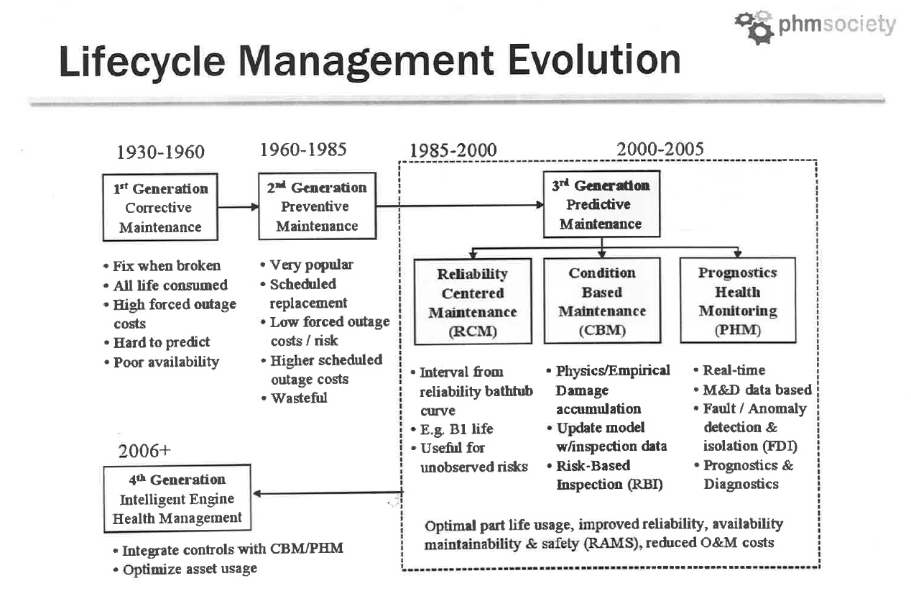
Using redundancy wherever possible
  sensor, incl. dynamic redundancy
  actuator
  processing
Using predictive health monitoring (awareness)
  FDI/PR framework
  time-to-failure prediction
  FDI/PR
  Fault = non-nominal operation
  Detect a fault “something’s weird”
  Isolate the fault “it’s a mass-shifter limit tab fault”
  Predict the time-to-failure “it will overload in 8 seconds”
  Recovery “pull the actuator back and disable it”
IS IT POSSIBLE TO ACHIEVE RELIABILITY IN A SMALL MARKET WITH LIMITED FUNDING?

Slide 6
Lessons from aerospace/automotive:
  reliable systems have redundancies
    adding sensors and actuators actually decreases the operating cost
    the weight penalty is ~ 10%
  most hardware failures are from sensors
  most in-mission failures are algorithmic
  prediction + analytic redundancy are ways of reducing cost
    prediction allows taking action before a failure happens
    analytic reduncancy allows redundancy without new h/w
  realistic failure testing is essential
POSSIBLY

Slide 7
2017 FAULT DETECTION
HOST PROCESSOR RUNNING FAULT DETECTION AND ISOLATION MATRIX ALGORITHIMS
THRUSTER VOLTAGE AND CURRENT
MASS SHIFTER POSITION, VOLTAGE AND CURRENT

Slide 8
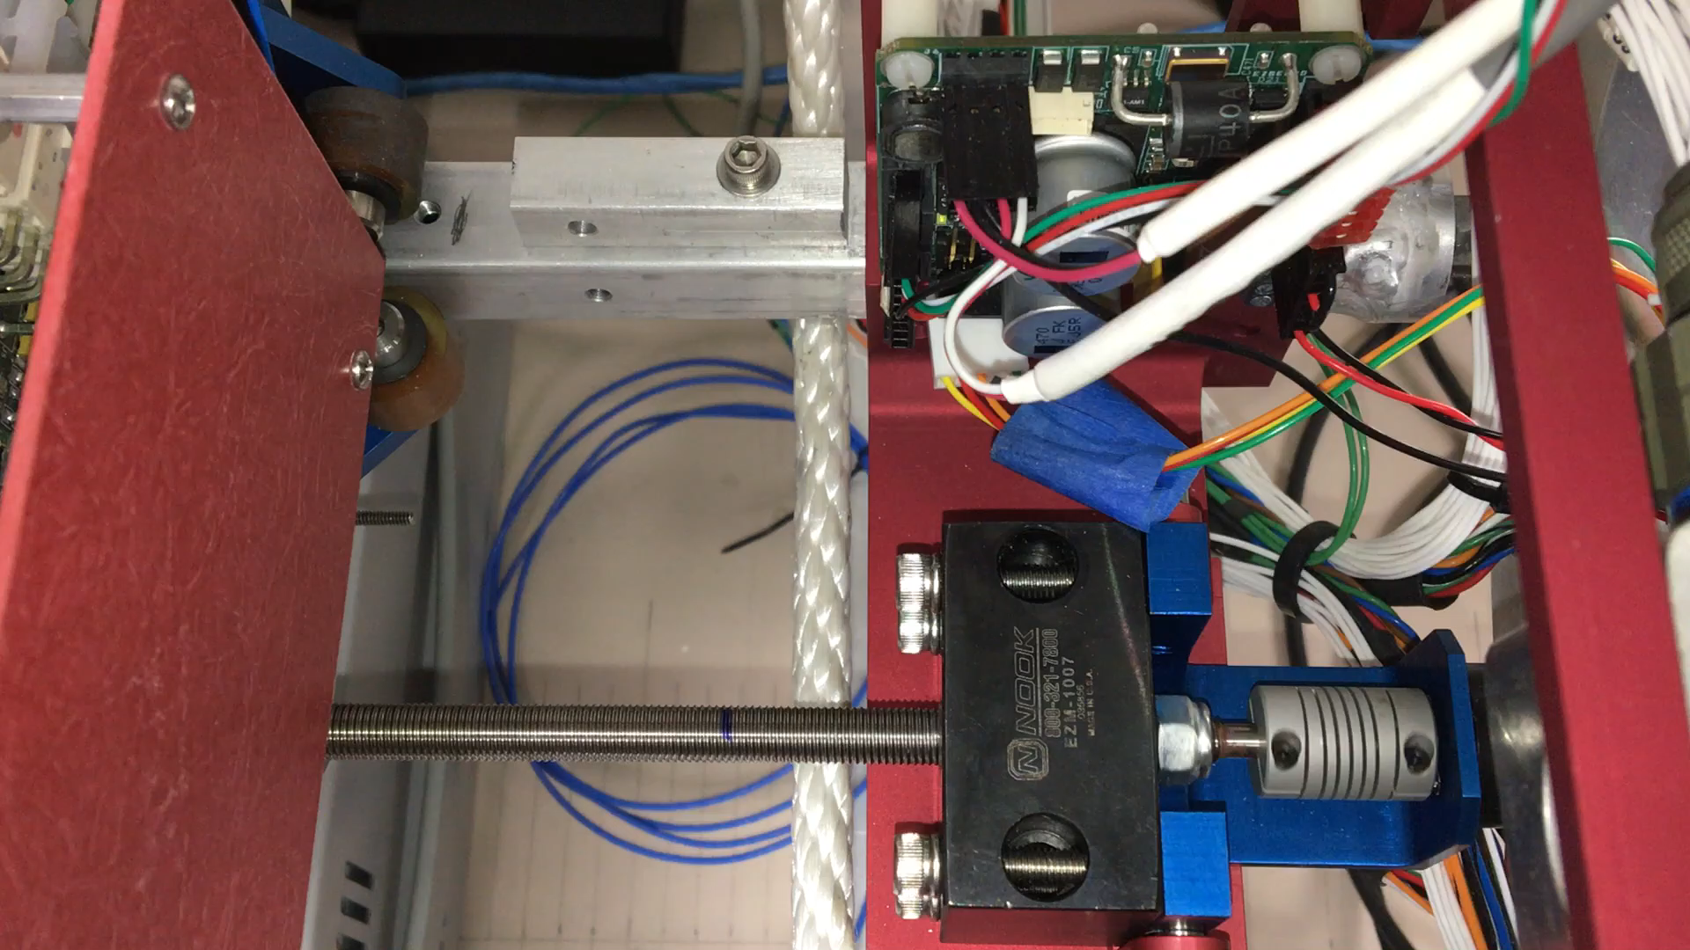
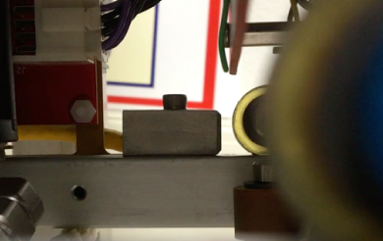
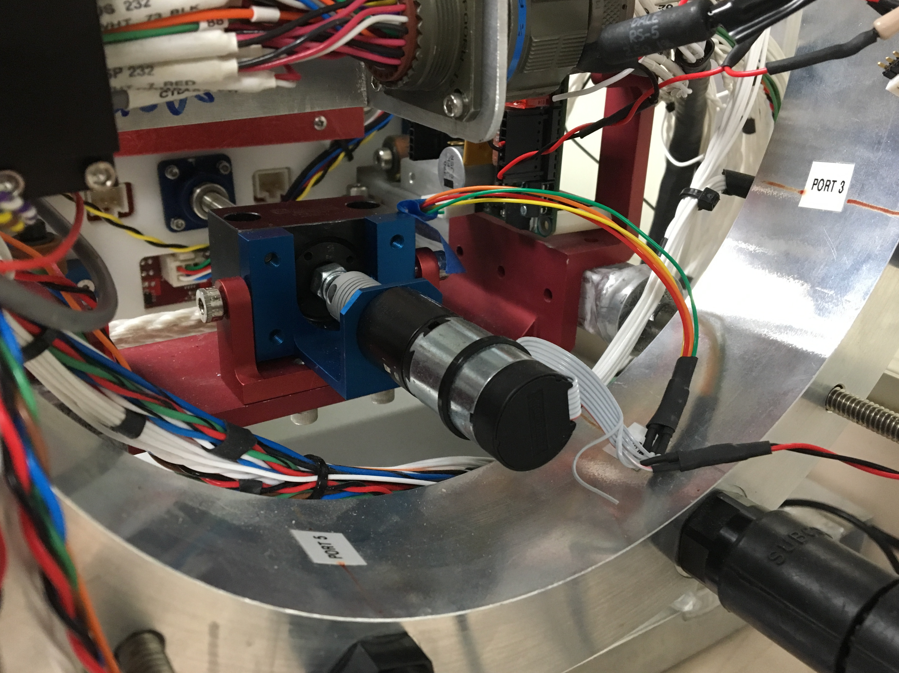
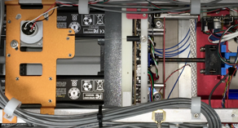
2017: Fault characterization of a critical actuator*
nominal operation
#1. overload
#2. loose lead-screw
#3. bad sensor
*LRAUV mass-shifter

Slide 9
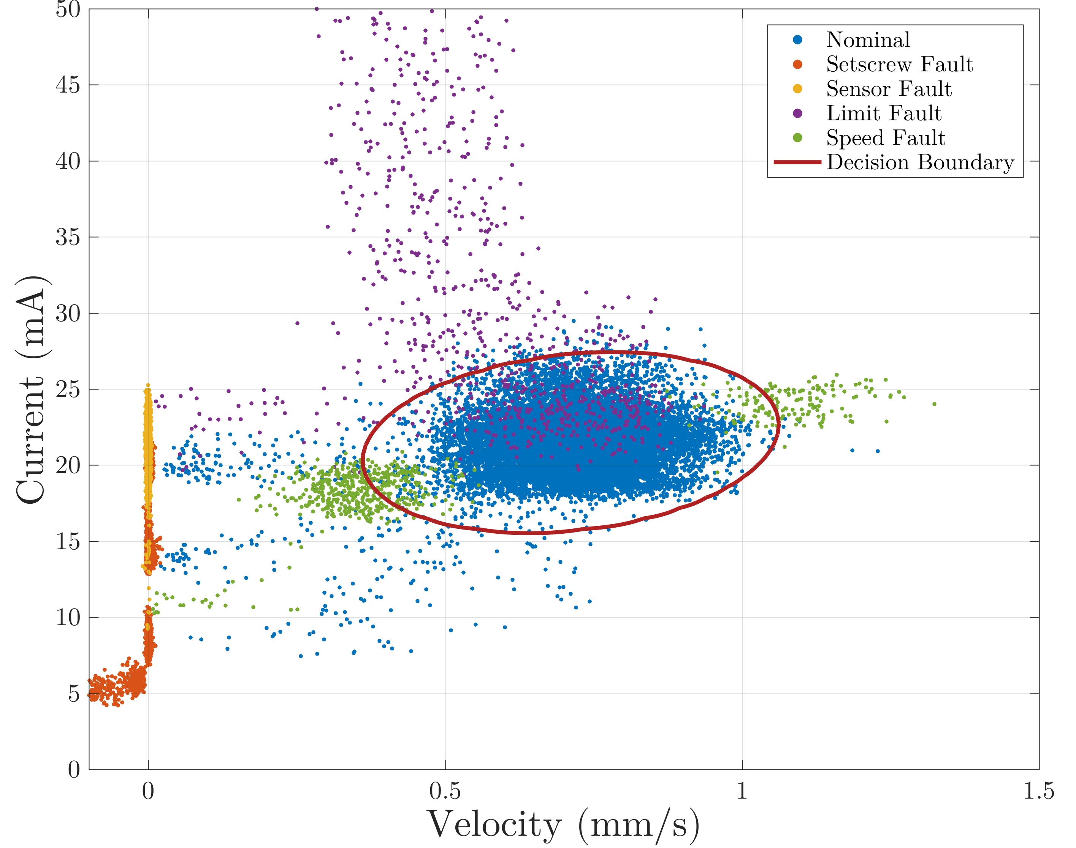
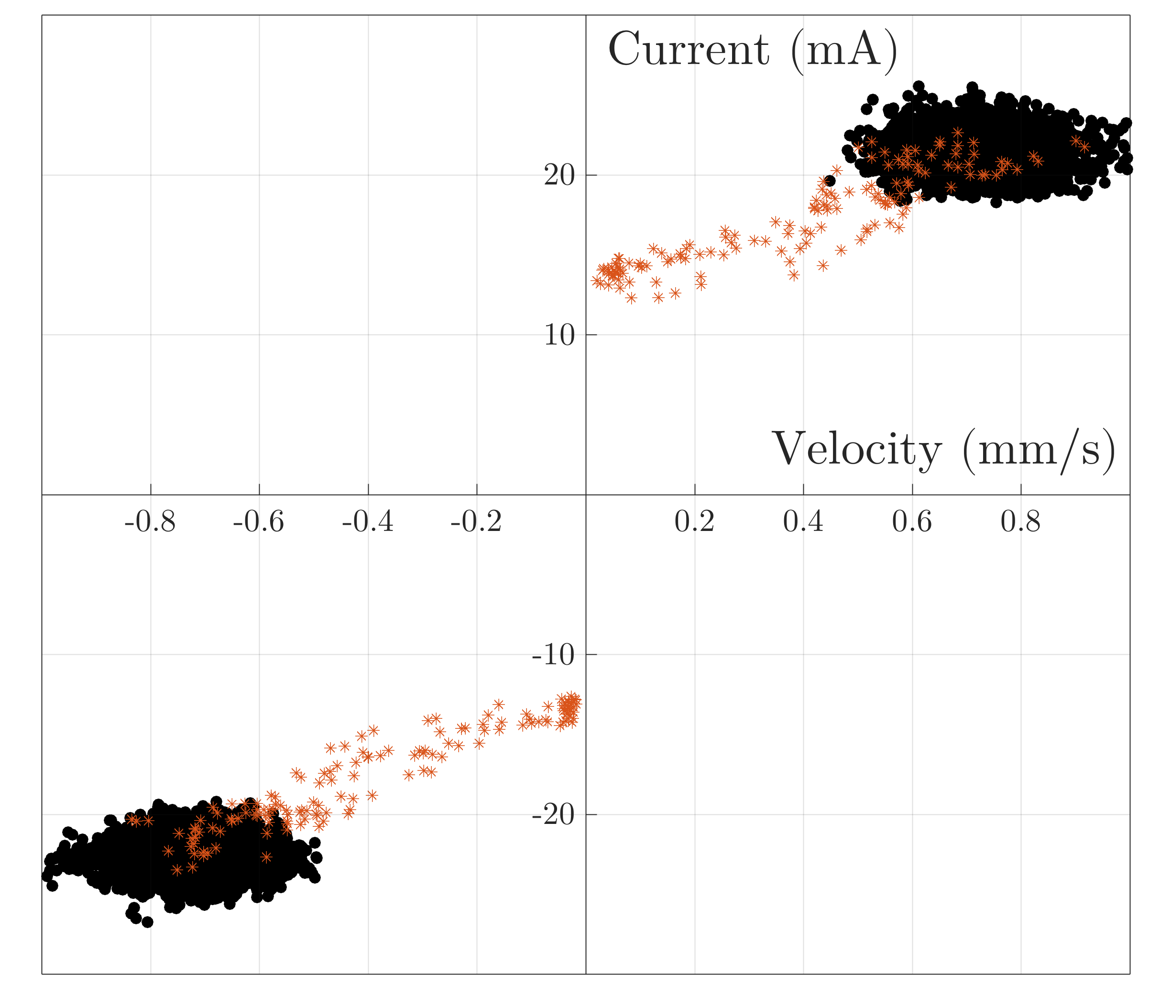
Fault Detection and Fault Isolation?
nominal +faults
nominal performance
OVERLOAD
SENSOR
NOMINAL
LEAD SCREW
YES: NOMINAL AND FAULTS ARE WELL-SEPARATED
Notes:
All the data. Nice separation, except for the tails.

Slide 10
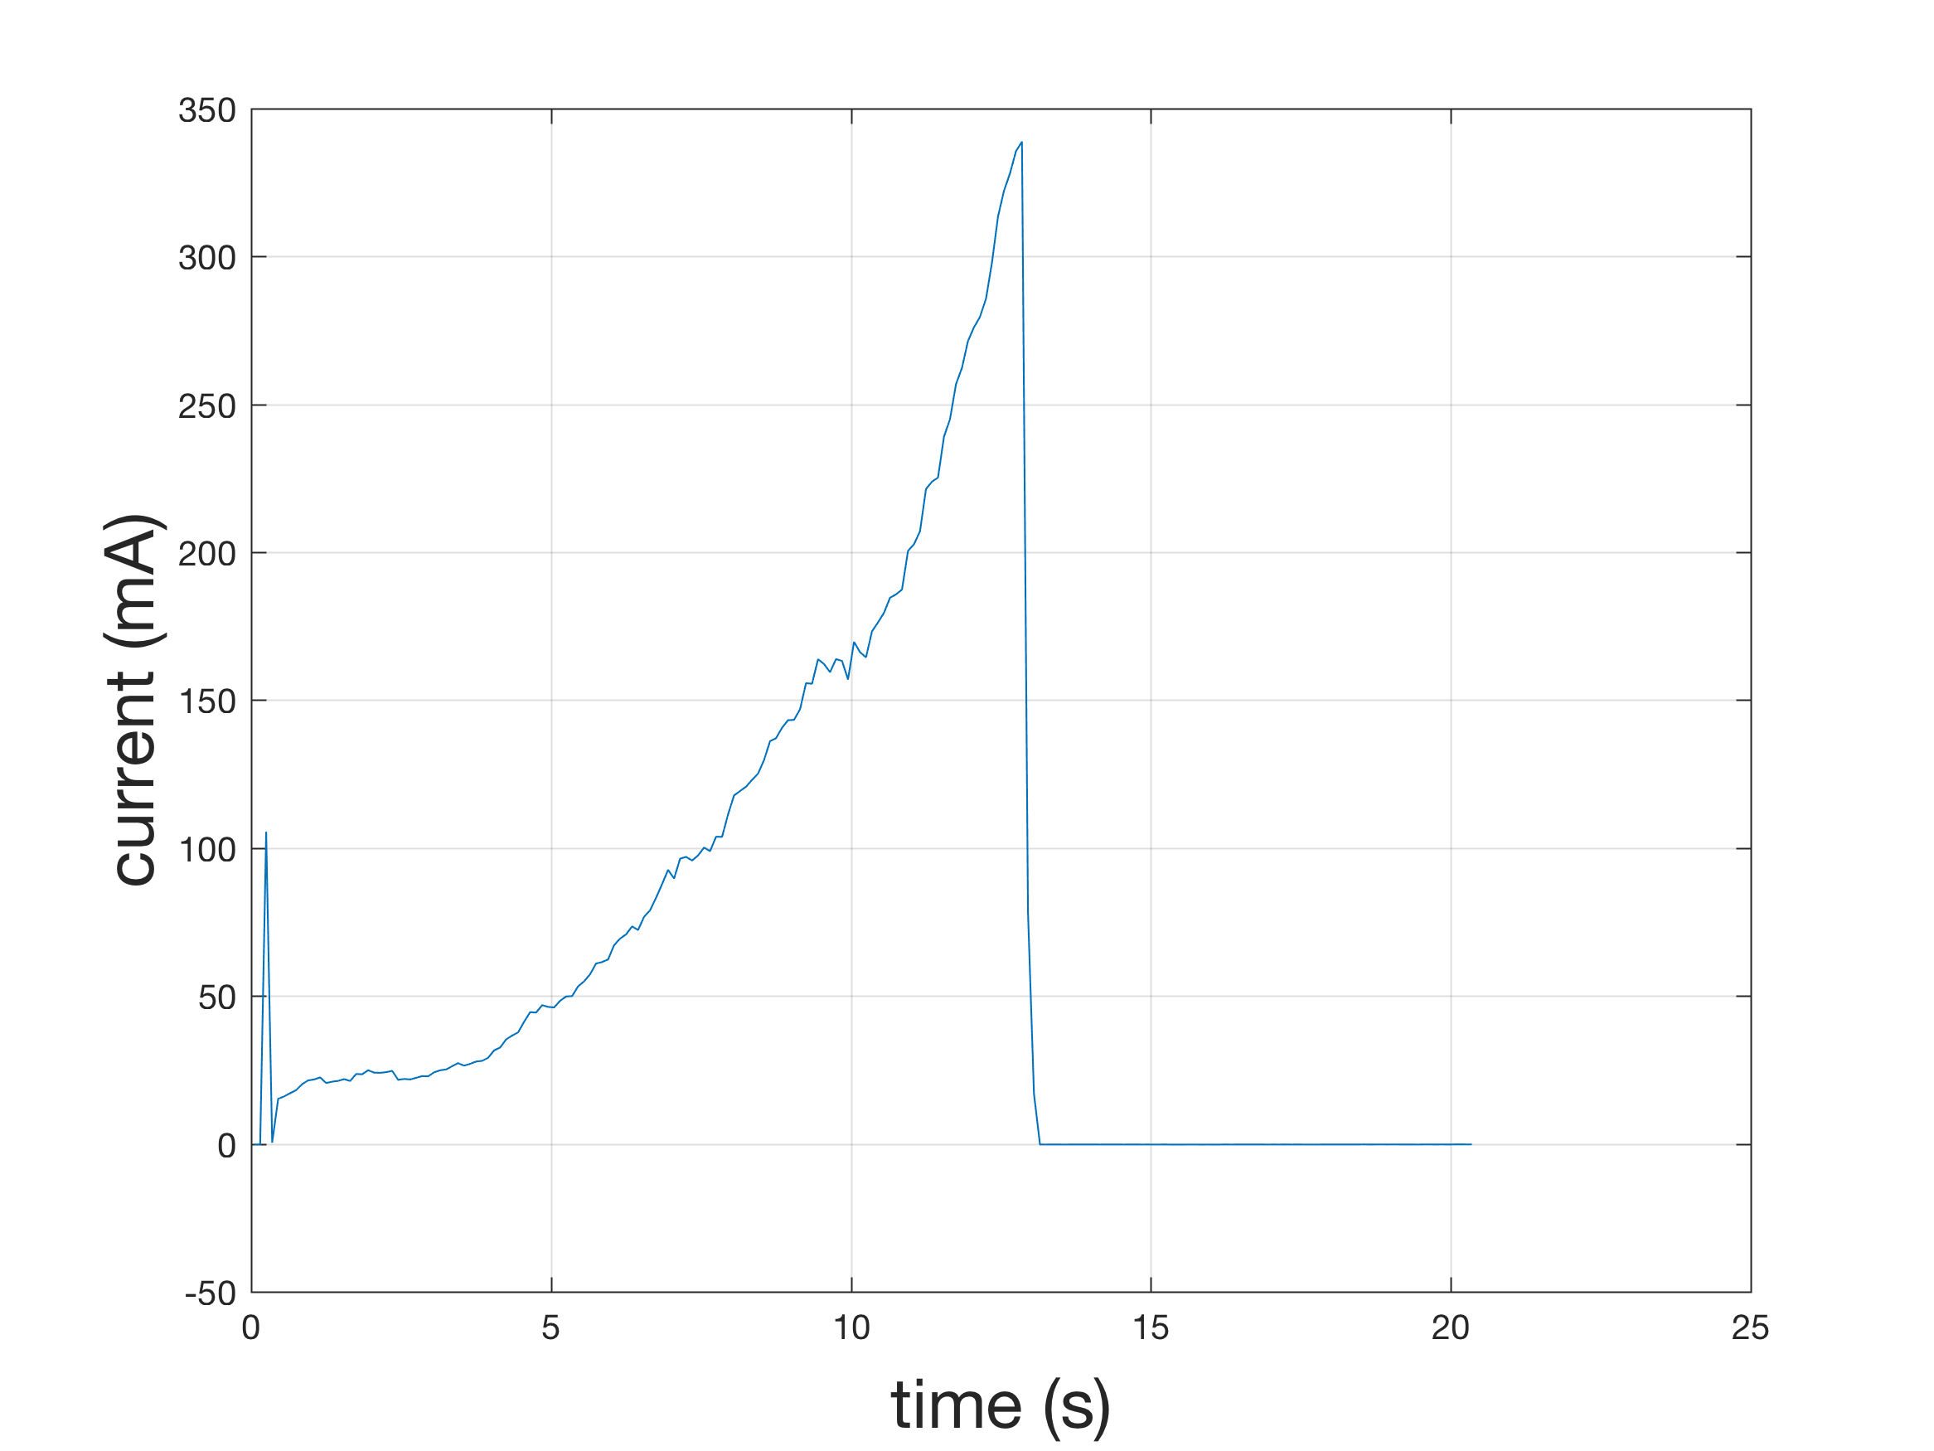
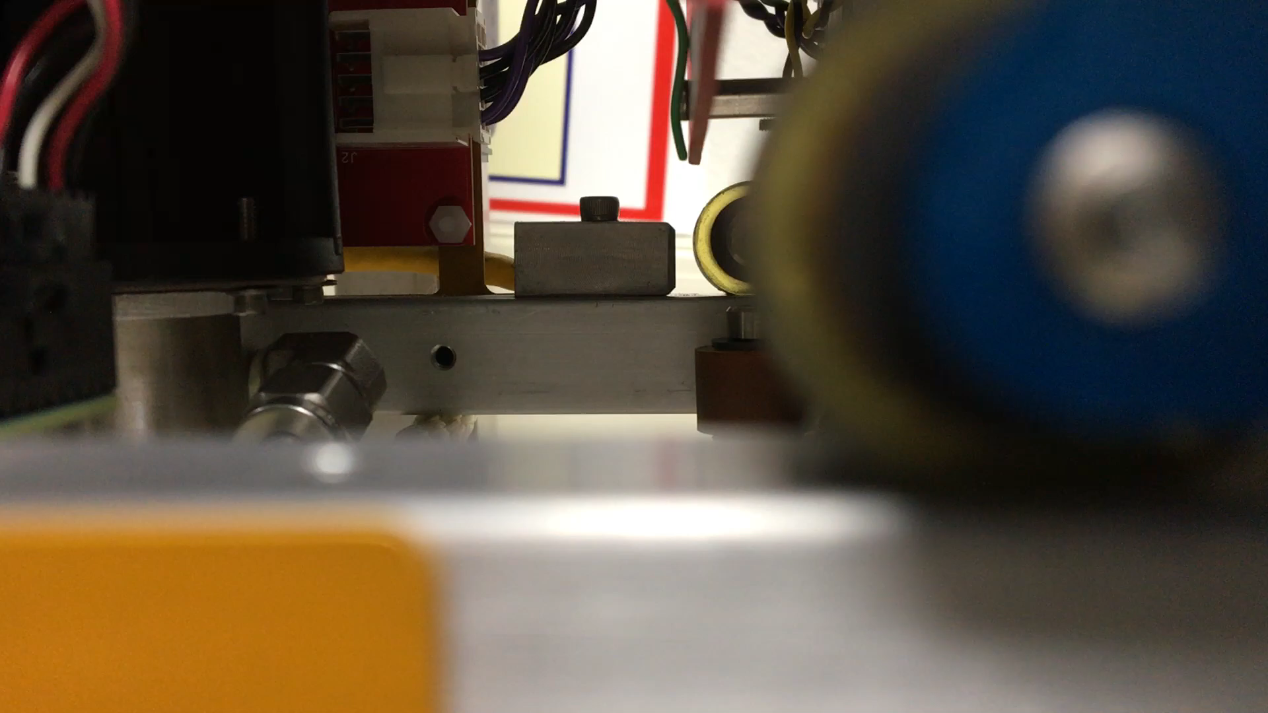
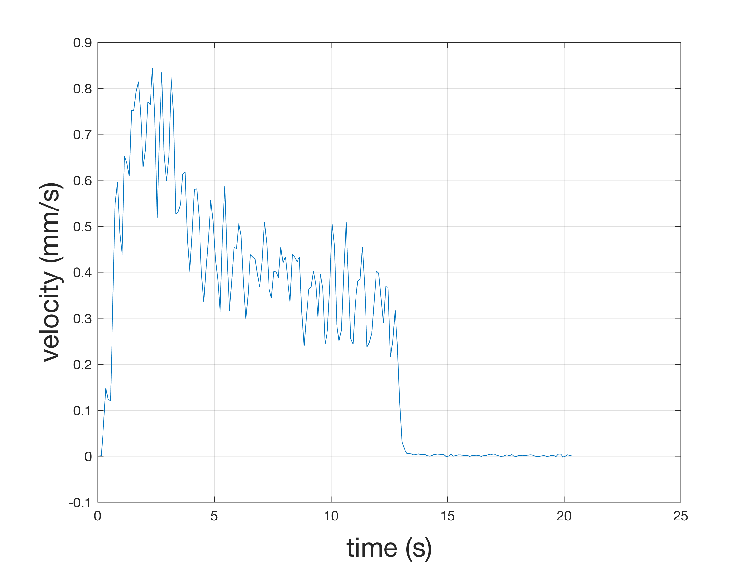
Time-to-Failure Prediction?
current vs time
overload
contact
shutdown
speed vs time
YES: WE HAVE A 10S HORIZON
Notes:
Current grows, velocity decreases
10s to catch the fault before it overloads.

Slide 11
2018 GOALS
Situational awareness
  achieve online FDI/P of a critical actuator
  achieve online FDI of a sensor
  test with fault-injection system
Fault-tolerance
  implement sensor redundancy
  implement analytical redundancy

Slide 12
CANDIDATE SYSTEMS FOR FDI/P
MASS-SHIFTER
starting point
THRUSTER
ATTITUDE CONTROLLERS
SEABED COLLISION
GUIDANCE
SHIP COLLISION
NAVIGATION
SURFACING
COMMUNICATION
RUDDER/ELEVATOR
SONAR INTEGRITY
BATTERY
PROCESSOR INTEGRITY
DVL INTEGRITY
ground fault

Slide 13
Requirements

Slide 14
Capabilities
Focus on one actuator only
  mass-shifter: well-characterized, well-separated faults, long prognostic horizon
Limit the faults
  limit-tab overload, loose screw, bad absolute position sensor
Designed for algorithm development (not the other way around)
  in Python
  on a powerful computer that runs an actual OS
Create stand-alone hardware with minimal dependencies on the vehicle
Implement the FDI/P framework
  Fault = non-nominal operation
  Detect a fault “something’s weird”
  Isolate the fault “it’s a mass-shifter limit tab fault”
  Predict the time-to-failure “it will overload in 8 seconds”
Include realistic fault-injection from the start
  i.e. need to be able to put the system in an actual fault state, in actual conditions, and on purpose
  reversibly, repeatably, controllably

Slide 15
Requirements
System
SYS01. The system will be composed of 1) a predictive fault-detection subsystem, 2) a fault-injection subsystem, and 3) a fault-injection mission scripting tool, and 4) a post-mission analysis tool.
SYS02. The fault-detection and fault-injection subsystems will run on dedicated hardware that fits inside the LRAUV main housing, and that runs off power provided by the LRAUV.
SYS03. The fault-detection and fault-injection subsystems will have access to the vehicle data described in the Data Sources appendix.
SYS04. The system will be testable on the bench, in the tank, and at sea.
SYS05. The fault-detection and fault-injection processor will be selected to support 1) computationally-intensive floating-point algorithms, 2) at least a 5X scaling-up of the computational load.
SYS06. The fault-detection and fault-injection applications will be written in Python.
SYS07. The system will be capable of native compilation.
SYS08. The system will support at least 1MBps file transfer, without having to open the vehicle.
SYS09. The system will be capable of logging time-stamped data from its data sources and from its algorithms.

Slide 16
Requirements – cont’d
Fault Detection
FD01. The fault-detection subsystem will detect the following mass-shifter faults:
  Limit-tab current overload
  Loose lead-screw
  Position sensor failure
FD02. The fault-detection subsystem will estimate the remaining time to failure.
FD03. Optionally, the fault-detection subsystem will also detect the following thruster faults:
  Current overload
  Magnetic coupler failure
  Propeller loss
and estimate the remaining time to failure.

Slide 17
Requirements – cont’d
Fault Injection
FI01. The fault-injection subsystem will be capable of injecting the mass-shifter faults enumerated in FD01:
FI02. The fault-injection subsystem will be capable of injecting faults during a mission.
FI03. The fault-injection subsystem will be capable of injecting faults reversibly, repeatably, and controllably.
  reversibly: can return to nominal.
  repeatably: can do it multiple times during a mission.
  controllably: has hooks to control the fault parameters: rate of fault application, fault magnitude, etc.
FI04. The fault-injection subsystem will be capable of coordinating fault injection and actuator motion.
  i.e. if we inject a mass-shifter failure, we ought to make sure the mass-shifter is commanded to move.
FI05. Optionally, the fault-injection subsystem will be capable of injecting the thruster faults enumerated in FD03
  Current overload
  Magnetic coupler failure
  Propeller loss
and do so in accordance with FI02, FI03, and FI04.

Slide 18
Data source requirements
SENSOR RANGE, REPEATIBILITY, AND SAMPLING RATE
CONTEXT DATA
data | range | repeatibility | sampling rate
motor current | typical = +/- 50mA full range = +/- 500mA | 1 mA | 10Hz
absolute tray position | +/- 50mm | 0.1mm | 10Hz
tray speed | +/- 1mm/s | 0.05 mm/s | 10Hz
tray pitch | +/- 30 degrees | 0.5 degrees | 10Hz
motor voltage | +/- 24V | 0.1V | 10Hz
data
goto X command
homing command
current position

Slide 19
Hardware Design

Slide 20
Mass Shifter Drive Voltage and Current

Slide 21
Mass Shifter Position from Linear Sensor

Slide 22
Mass Shifter Speed from Linear Sensor vs. Encoder Pulses
Similar to lab measurement RMS noise floor

Slide 23
Sampling of linear position sensors

Slide 24
Thruster Motor Drive Voltage and Current

Slide 25
Phase 1: Current and Planned Lab Test Bed Design

Slide 26
Phase2: Prototype Proposed Hardware Design in Lab

Slide 27
Phase 3: Proposed Final System Hardware Design

Slide 28
Hardware Design Notes
Measuring Mass Shifter speed to 0.05 mm/sec. @ 10 Hz requires very high resolution position measurement - use encoder pulses!
Analog inputs need at least 11 effective number of bits (ENOB)*.
Embedded processor must support software toolchain, application processing load and hardware I/O requirements.
Full capability lab test system allows software development to proceed in parallel with hardware development.
* Converted signal resolution when all noise sources and quantization errors are taken into account.

Slide 29
Software Design

Slide 30
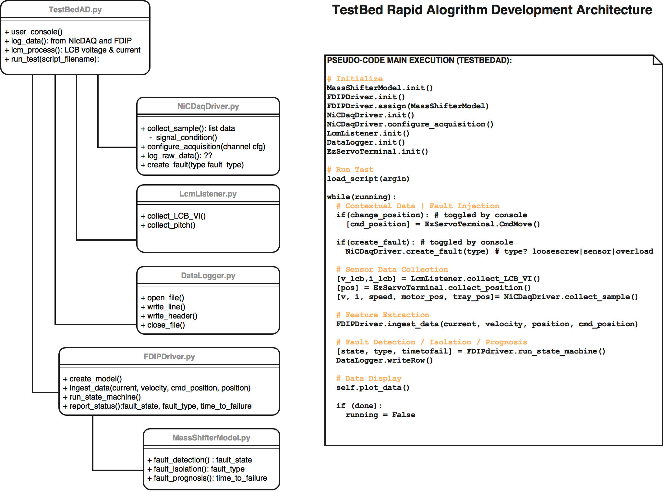
S/W architecture: Phase 1 & 2

Slide 31
Software Architecture: Phase 3
Adopt / Create a more formal framework.
Create a support layer of device drivers for move away from NI-cDAQ (C/C++).
Assess performance penalties of the Python implementation, create optimizations where necessary.
Implement bi-directional communication with the LRAUV application.

Slide 32
Data Acquisition
Sensor Data: Linux drivers
  C drivers with Python interface
Context Data: packet sniffing
  packet sniffing in and out of the servo controller
  LCB → servo: commanded position, homing command
  servo → LCB: motor position
Debug data: LCM
  e.g.: vehicle time, depth, heading, LCB voltage/current, encoder position
  LCM broadcast has been tested elsewhere – Tom/Brian K.
  Individual writers will have inherent time bases - 2.5Hz for many

Slide 33
Fault-injection
Goal: controlled injection from within the lrauv application through mission scripts.
  e.g. overload = manually editing the configuration file & commanding motion into the limit tab
  e.g. loose screw = DO control of the clutch (ez-servo).
  Measurements:
    false-alarm rate
    missed detection probability
    misclassification errors

Slide 34
Algorithm Design

Slide 35

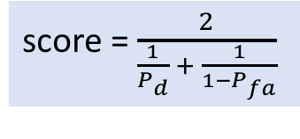
V1: baseline implementation of the FDI/P chain
Idea
  represent each of 4 states as 2D gaussians
    states = nominal, overload fault, screw fault, bad sensor
    get gaussian parameters from the 2017 data
  pick the nearest one
    technically, the one with the smallest Mahalanobis distance
  discard transients
Feature extraction
  current: mean over 100ms
  pitch detrending: linear in pitch
  position: mean over 100ms
  speed: finite differencing of mean position
  voltage: mean over 100ms
Transient rejection
  state machine = idle, accelerating, steady-state, decelerating
  only run detection during steady state
  idle → accelerating: on new command
  accelerating → steady-state: wait 1mm
  steady-state → decelerating: 1mm before target
  decelerating → idle:
Detection: nominal if distance < threshold
  pick the threshold that maximize a score giving equal weight to detection and false alarms
Isolation:
  compute the distance to each fault
  pick the nearest one
  overload: mean = best quadratic fit vs distance; sigma = cst
Time-to-Failure Prediction
  overload: extrapolate the current linearly to the overload value (350mA)
  screw and bad sensor faults: set TTF = 0 because they’re already failed.
score = $\frac{2}{\frac{1}{P_{d}} + \frac{1}{1−P_{fa}}}$
$${D=\left(X−\overline{X}\right)}^{+}Σ^{−1}\left(X−\overline{X}\right)$$

Slide 36
Algorithmic roadmap
V2: Physics-based overload degradation model - end of April
V3: Bayesian D-matrix fault isolation - tbd
  migrate to motor current/ relative speed model
  analytic redundancy
V4: model-based w/state residual - tbd
  false-alarms
  robustness to operating condition
V5: model-based w/parameter residual - tbd
  better/worse than state residual?
V6: deployed system - tbd

Slide 37
Fault-Injection

Slide 38
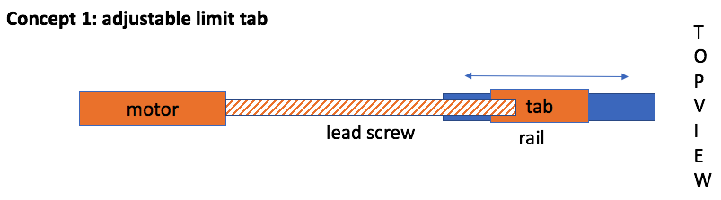
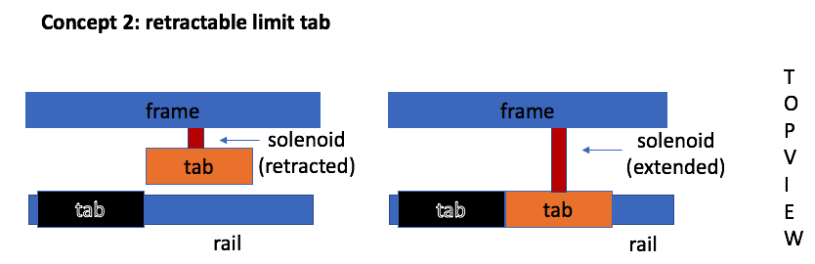
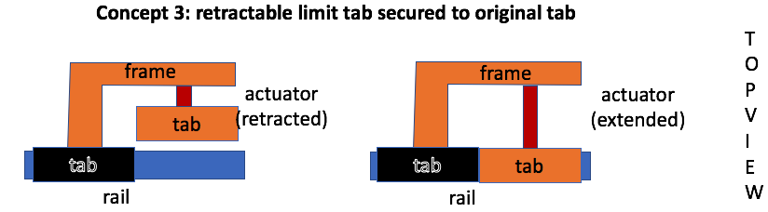
Limit-tab current overload
Fault description: wheel pushes into the mechanical stop until the electronics shuts-down due to a current overload.
Issue: software override.
Concept | Pros | Cons
1. Adjustable limit tab | control | most complex load passed onto motor
2. Retractable limit tab | simple load passed to tab | attachment location?
3. Retractable, secured to tab | simple load passed to tab
4. change the max position in the config file. | no hardware | sw override or not?
5. Move the tab manually | no hardware | no reversible while underway

Slide 39
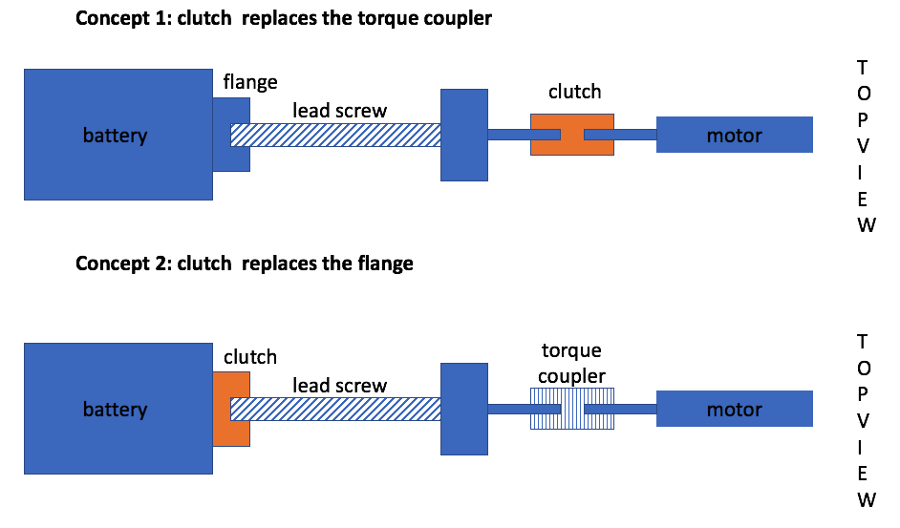
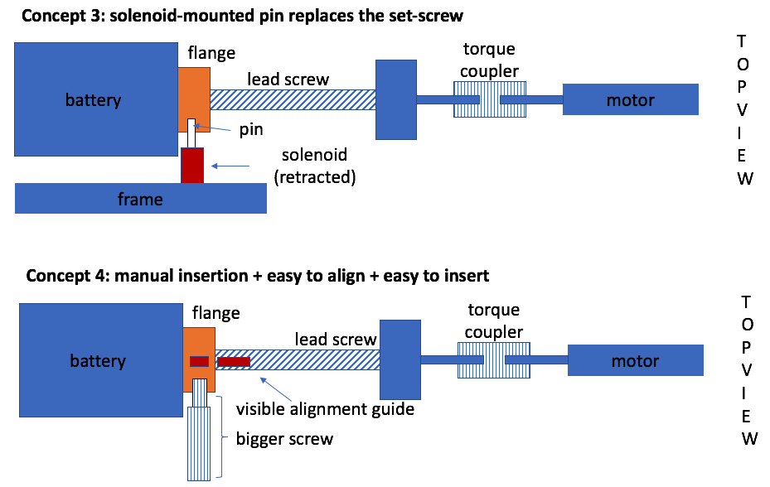
Loose lead-screw
Fault description: loss of coupling between the lead-screw and the mass.
Issues: reversibility, repeatability, controllability.
Concept | Pros | Cons
1. Clutch replaces torque coupler | easy to mount easy to re-attach battery is not loose | lose the torque coupler battery is not loose
2. Clutch replaces flange | easy to mount, correct location easy to re-attach battery is not loose | battery is not loose
3. Solenoid-mounted pin | actual failure, lab or at-sea | the battery will be loose hard to re-attach.
4. Manual & easier to align/insert | easy, actual failure | only in lab hard to re-attach

Slide 40
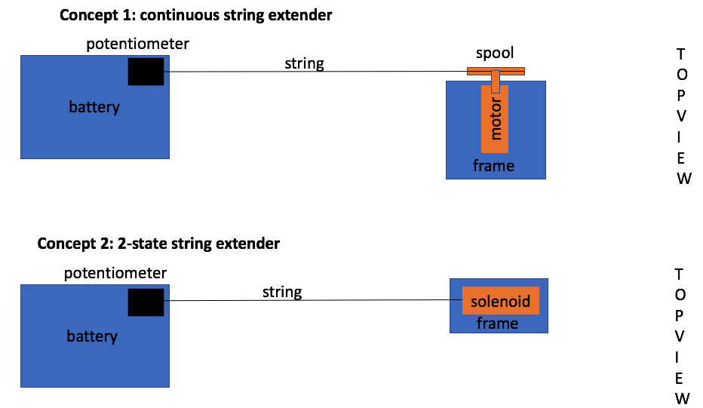
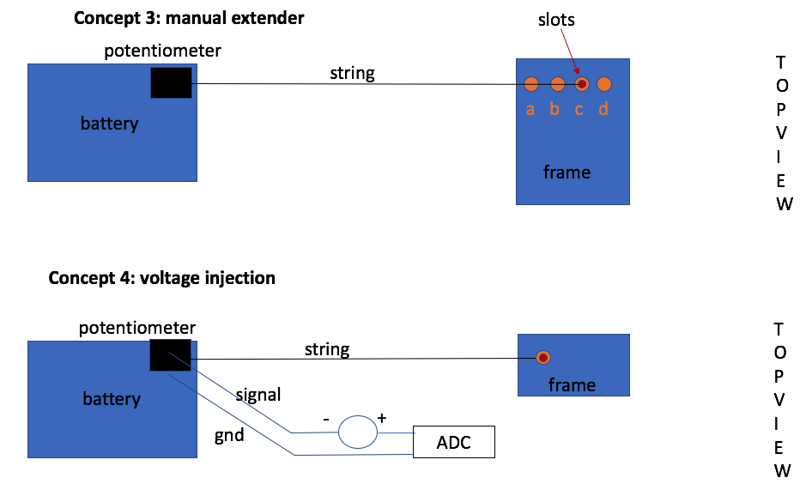
Position sensor bias
Fault description: string-pot attachment point moves.
Issues: reversibility, repeatability, controllability.
Concept | Pros | Cons
1. Continuous extender | control | complex
2. Binary extender | simple | limited bias values
3. Manual / slots | simplest | only in lab
4. Voltage injection | simple lab and at-sea

Slide 41
Risk Management

Slide 42
Risk Elements
risk element | point person | approach
collect the signals with the required accuracy and rate | Mark | analyze high-sampling rate data for required noise rejection derive reqs for speed sensing from position
reversible/repeatable/controllable fault-injection | MK | - hold a brainstorming session - rank candidate solutions
overload fault recovery | Eric | meet with LRAUV s/w people to assess the exact sequence of events after an overload identify options for shortening the recovery time
getting context data (pitch, commanded position, encoder position) | Eric | identify possible sources, e.g. LCM, separate sensor, data sniffing, and their properties , e.g. rate, packet format. identify pros/cons of each.
GSAP appropriatness: compatibility with Python, and implementation overhead. | MK | bring testbed back acquire NI DAQ data with python build proof-of-concept fault detection/isolation/prognostication in python

Slide 43
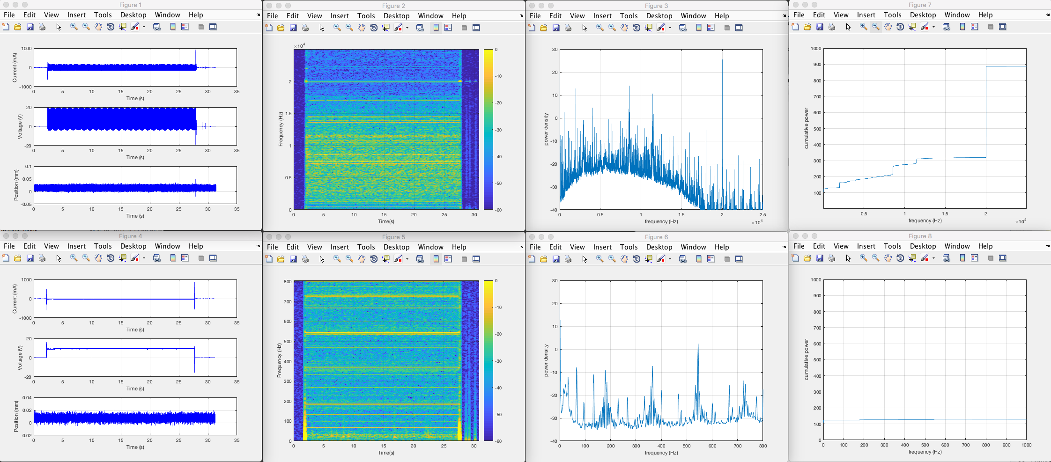
Denoising Requirement
spectrum vs frequency
energy below f
90% of the energy is noise
50,000 samples/s
at least 20dB of anti-aliasing filtering is needed to get the SNR above 10dB
1,600 samples/s

Slide 44
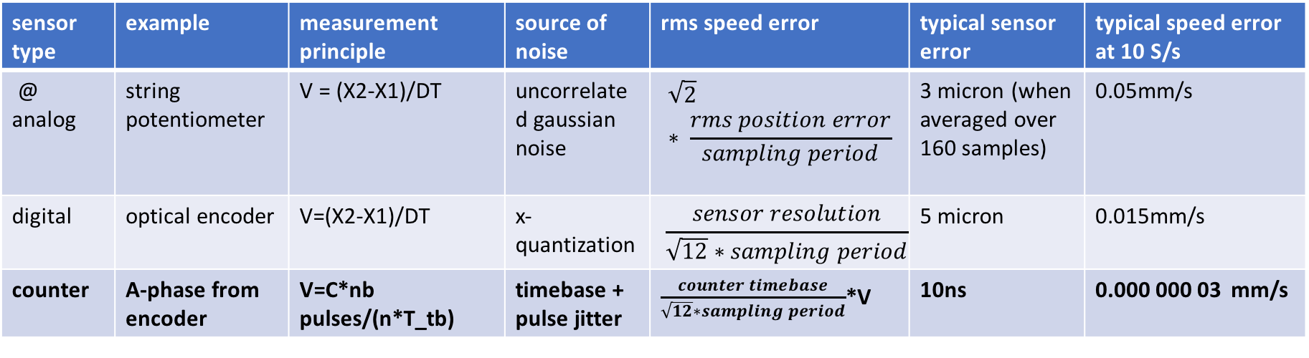
Speed Measurement
Requirement: 0.05mm/s at 10 S/s
sensor type | example | measurement principle | source of noise | rms speed error | typical sensor error | typical speed error at 10 S/s
@ analog | string potentiometer | V = (X2-X1)/DT | uncorrelated gaussian noise | $$\sqrt{2}∗ \frac{rms position error}{sampling period}$$ | 3 micron (when averaged over 160 samples) | 0.05mm/s
digital | optical encoder | V=(X2-X1)/DT | x-quantization | $$\frac{sensor resolution}{\sqrt{12}∗sampling period}$$ | 5 micron | 0.015mm/s
counter | A-phase from encoder | V=C*nb pulses/(n*T_tb) | timebase + pulse jitter | $\frac{counter timebase}{\sqrt{12}∗sampling period}$*V | 10ns | 0.000 000 03 mm/s
we will use a counter

Slide 45
GSAP/Python
Generic Software Architeture for Prognostication
GSAP is a no-go for now
  designed for prognostication → our focus is detection/ isolation
  has no Python bindings
  is model-based → we’re data-driven
  is too onerous for a prototype → keep option open for long-term

Slide 46
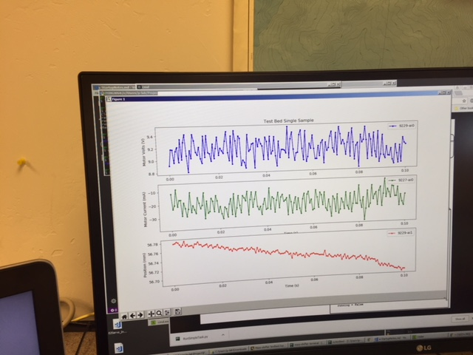
Risk-reduction s/w prototype
Goal: Prove that we can stream NI DAQ data to a Python script + run fault detection/isolation on the spot:
  using DAQmx → Python interface
  input: current, voltage, position, speed
  FDI algorithm # 1
Status
  I,V,X acquisition done and validated
  in process of adding FDI algorithm
  in process of adding speed (NI 9361 counter)

Slide 47
Overload Fault Recovery
When externally creating faults, the LRAUV Application must:
  Respond predictably to this fault
  Not disable the unit
  Recover without user intervention
  Report status appropriately
Current LRAUV fault handling:
  Overcurrent faults are resolved by unpowering the ez-servo from the LCB.
  The ez-servo goes through its startup, and is re-homed (5-20 seconds)
  This is allowed <X> times before the servo is considered in failure, which triggers the “default” mission.
  That <X> can be changed in configuration.
We can script missions that directly command the mass shifter to move. Both in water and the lab.†
Configurations will be modified to allow for many faults.
No core code changes will be required.
†unsure if that instruction allows for command past stops

Slide 48
Next steps

Slide 49
Next step: prototype design
2 parallel tracks
  track 1: algorithm development using NI-DAQ
  track 2: hardware development
  merger
Fault-Injection prototype
Review

