Slide 1
Phase 1: Current and Planned Lab Test Bed Design

Slide 2
Phase 2: Prototype Proposed Hardware Design in Lab

Slide 3
Phase 3: Proposed Final System Hardware Design

Slide 4
Mass Shifter Drive

Slide 5
Thruster Motor Drive

Slide 6
Mass Shifter Position & Speed from Position Pot

Slide 7
Mass Shifter Speed from Encoder Pulses

Slide 8
Sampling of linear position sensors

Slide 9
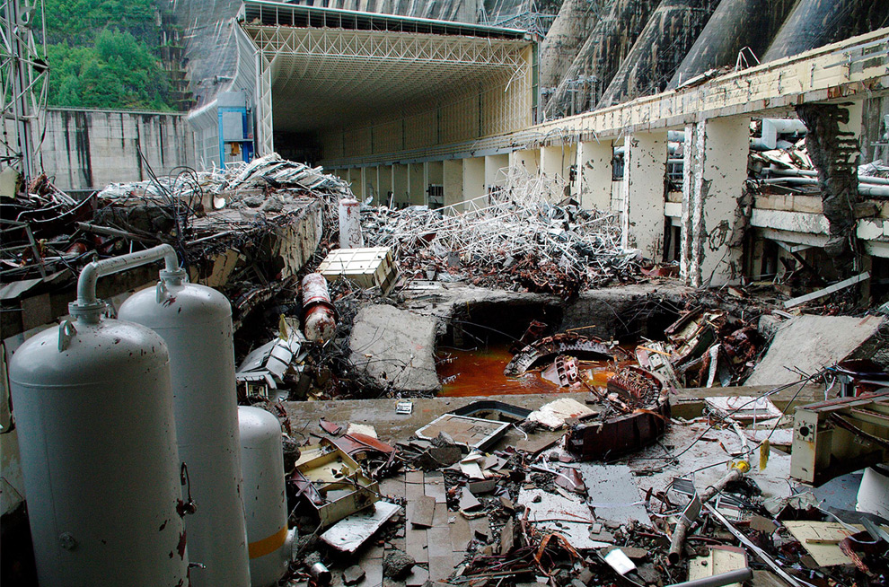
What Could Possibly Go Wrong?

Slide 10
Hardware Design Issues
Measuring speed to 0.05 mm/sec. @ 10 Hz requires very high resolution position measurement or use encoder pulses!
Low cost sensor unlikely to meet requirement.
High cost sensor might be OK for lab but will have alignment and interfacing issues.
What is driving the speed resolution requirement?
Will a low cost sensor (± 25µm) be OK?

Slide 11
4. Risks and Tasks Updates
risk element | point person | approach
getting required sensor resolution, noise level, and repeatability | Mark | analyze high-sampling rate data for required noise rejection analyze block-by-block the expected noise level derive reqs for speed sensing from position
reversible/repeatable/controllable fault-injection | MK | - hold a brainstorming session - rank candidate solutions
overload fault recovery | Eric | meet with LRAUV s/w people to assess the exact sequence of events after an overload identify options for shortening the recovery time
getting data from the vehicle (pitch, commanded position, encoder position) | Eric | identify possible sources, e.g. LCM, separate sensor, data sniffing, and their properties , e.g. rate, packet format. identify pros/cons of each.
GSAP appropriatness: compatibility with Python, and implementation overhead. | MK | bring testbed back acquire NI DAQ data with python build proof-of-concept fault detection/isolation/prognostication in python

