Slide 1
Fault detection weekly meeting
Feb 22

Slide 2
Digression: what’s the R&D question here?
How do we achieve reliability for an ocean-going system.
  small market
  size and power
Aerospace , automotive, US Navy subs achived it using redundancy + predictive maintenance. That’s the proposed approach here:
  sensor redundancy
  actuator redundancy
  analytical redundancy

Slide 3
First cut at top-level requirements
SYS. System requirements
SYS01. The system will be composed of 1) a predictive fault-detection subsystem, 2) a fault-injection subsystem, and 3) a fault-injection mission scripting tool, and 4) a post-mission analysis tool.
SYS02. The fault-detection and fault-injection subsystems will run on dedicated hardware that fits inside the LRAUV main housing, and that runs off power provided by the LRAUV.
SYS03. The fault-detection and fault-injection subsystems will have access to the vehicle data described in the Data Sources appendix.
SYS034. The system will be testable on the bench, in the tank, and at sea.
SYS04. The fault-detection and fault-injection processor will be selected to 1) support computationally-intensive floating-point algorithms, 2) support a 5x scaling-up of the computational load.
SYS05. The fault-detection and fault-injection applications will be written in Python.
SYS06. The system will be capable of native compilation.
SYS07. The system will support fast file transfer without having to recover the vehicle.

Slide 4
Requirements 1st cut – cont’d
FD. Fault Detection
FD01. The fault-detection subsystem will detect the following mass-shifter faults:
  Limit-tab current overload
  Loose lead-screw
  Position sensor failure
FD02. The fault-detection subsystem will estimate the remaining time to failure.
FD03. Optionally, the fault-detection subsystem will also detect the following thruster faults:
  Current overload
  Magnetic coupler failure
  Propeller loss
and estimate the remaining time to failure.

Slide 5
Requirements 1st cut – cont’d
FI. Fault Injection
FI01. The fault-injection subsystem will be capable of injecting the mass-shifter faults enumerated in FD01:
FI02. The fault-injection subsystem will be capable of injecting faults during a mission.
FI03. The fault-injection subsystem will be capable of injecting faults reversibly, repeatedly, and controllably.
  reversibly: can return to nominal.
  repeatedly: can do it multiple times during a mission.
  controllably: has hooks to control the fault parameters: rate of fault application, fault magnitude, etc.
FI04. The fault-injection subsystem will be capable of coordinating fault injection and actuator motion.
  i.e. if we inject a mass-shifter failure, we ought to make sure the mass-shifter is commanded to move.
FI05. Optionally, the fault-injection subsystem will be capable of injecting the thruster faults enumerated in FD03
  Current overload
  Magnetic coupler failure
  Propeller loss
and do so in accordance with FI02, FI03, and FI04.

Slide 6
MS. Mission scripting tools.
MS01. ...
PMA. Post-mission analysis tools.
  PMA01. ...

Slide 7
Appendix: Data Sources
MASS-SHIFTER
THRUSTER
Data | Source
commanded mass-shifter position | vehicle
pitch | vehicle
encoder speed and position | vehicle
commanded mass-shifter speed | vehicle config file
motor current | A/D
speed and position | A/D
motor voltage | A/D
Data | Source
commanded speed | vehicle
motor current | A/D
motor voltage | A/D

Slide 8
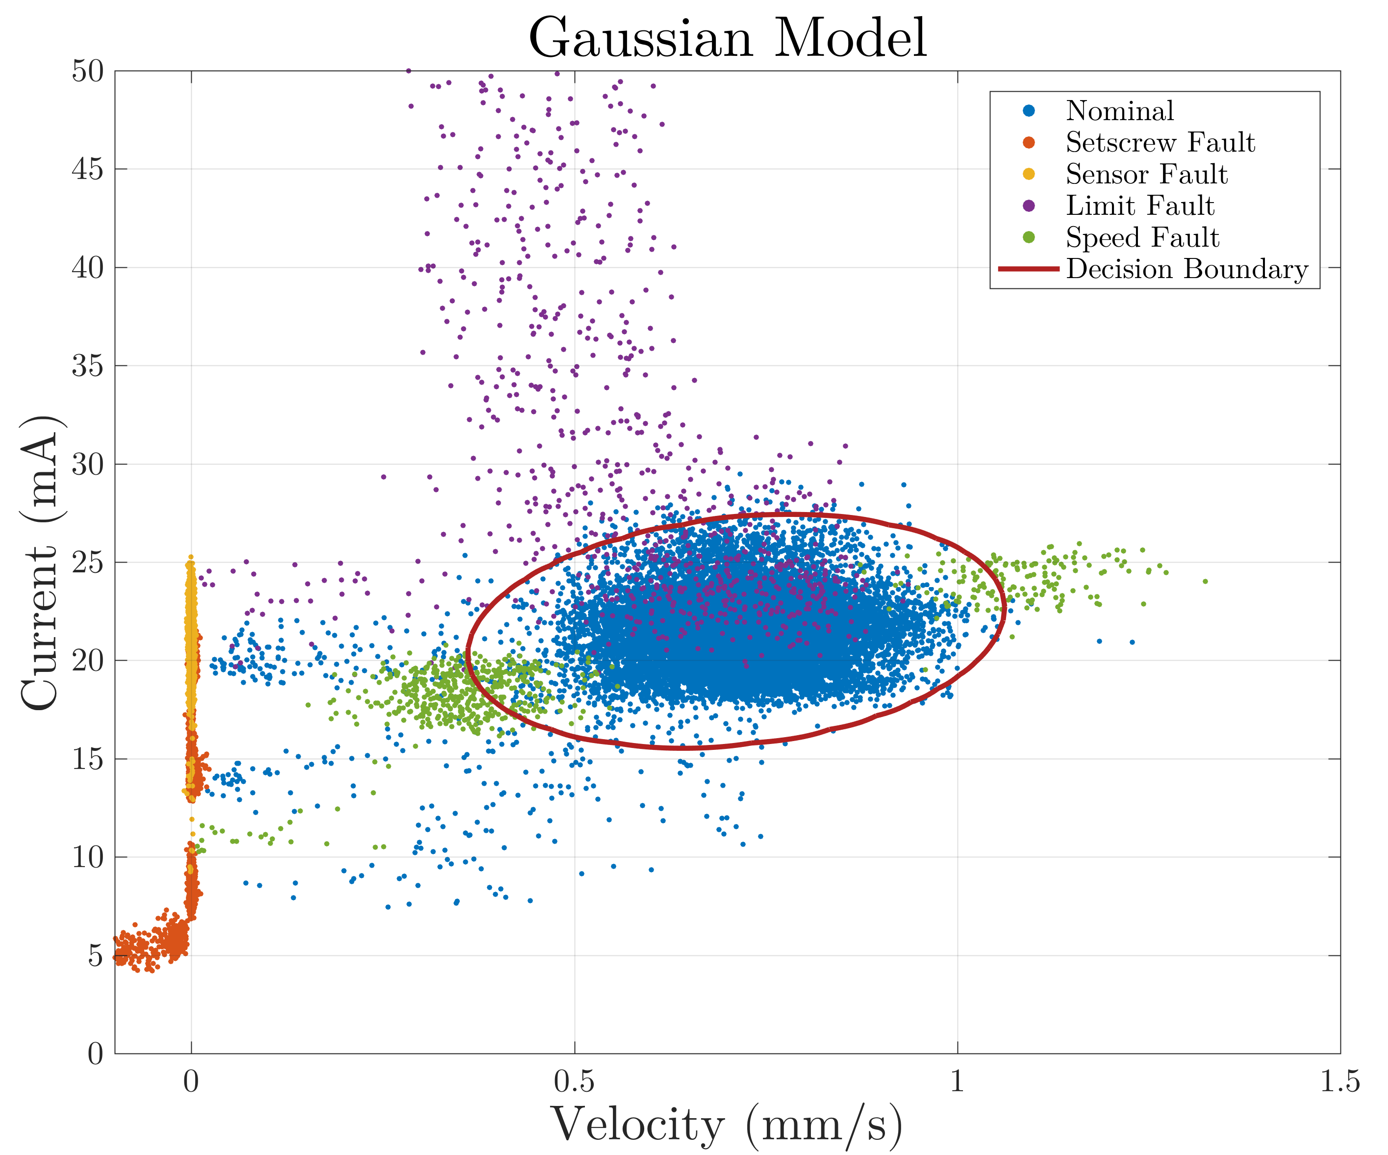
Mass-shifter faults - per the requirements
OVERLOAD
SENSOR
NOMINAL
LEAD SCREW
Notes:
All the data. Nice separation, except for the tails.

Slide 9
Fault detection/isolation
Fault | Description | Severity | Occurence | Detection method | Inputs needed | Analytical redundancy
None (nominal) | n/a | n/a | n/a | [current,speed] within a few sigmas NB: transient rejection | commanded position commanded velocity motor current pitch speed | motor voltage encoder speed
Overload | wheel pushes into limit tab until servo shuts down | high recoverable | frequent | high current / lower speed
Loose lead-screw | loose or missing set-screw | high unrecoverable | rare | no speed, low current encoder speed ≠ speed and lower current
Sensor failure | Position sensor malfunction | TBD | TBD | motor speed ≠ battery speed and normal current
NOT FINAL
Sensor | Range (no SF) | Desired precision | Desired Rate
current | typical = +/- 50mA full range = +/- 500mA | 1 mA | 10Hz
position | +/- 50mm | 0.1mm | 10Hz
speed | +/- 1mm/s | 0.05 mm/s | 10Hz
pitch | +/- 30 degrees | 0.5 degrees | 10Hz
motor voltage | +/- 16V | 0.1V | 10Hz

Slide 10
Risk Elements / Concept Design Review
Risk | Point Person
1. Can we collect the signals with the required accuracy and rate? | Mark
2. How do we inject faults reversibly, repeatedly, controllably? | MK
3. Can the vehicle s/w recover from an overload fault reversibly, repeatedly, controllably? | Eric
4. Can we run GSAP on a prototyping computer – Raspberry Pi, Beaglebone, etc? I/O? | Eric
5. Can we get the needed data from the vehicle? | Eric
6. Is GSAP the right framework? | MK
Milestone | Completion date | Entry criteria
Concept Design Review | March 29 | Risk elements retired System diagram done System requirements done
Design Review | May 31 | Design meets requirements Hardware verification done
Requirement verification review - bench | August 31 | Requirements tested on the bench.
Requirement verification review - tank | October 31 | Requirements tested in the tank.
First at-sea trial | November 30 | Requirements tested at-sea.

