Slide 1
Predictive Fault Detection Feb 28 meeting
Hardward status – Mark
GSAP status – Eric
Algorithm status - Matt

Slide 2
Updated Schedule
Milestone | Completion date | Entry criteria
Concept Design Review | March 29 | Risk elements retired System diagram done System requirements done
Design Review | May 31 | Design meets requirements Hardware verification done
Requirement verification review - bench | August 31 | Requirements tested on the bench.
Requirement verification review - tank | October 31 | Requirements tested in the tank.
First at-sea trial | November 30 | Test plan accepted by “review board”

Slide 3
Risk to retire by Concept Design Review
Risk | Point Person
1. Can we collect the signals with the required accuracy and rate? | Mark
2. How do we inject faults reversibly, repeatedly, controllably? | MK
3. Can the vehicle s/w recover from an overload fault reversibly, repeatedly, controllably? | Eric
4. Can we run GSAP on a prototyping computer – Raspberry Pi, Beaglebone, etc? I/O? | Eric
5. Can we get the data from the vehicle? | Eric
6. Is GSAP the right framework? | MK

Slide 4
Concept Development schedule

Slide 5
1. H/W status: Can we collect the signals with the required accuracy and rate?
Sensor | Range (no SF) | Desired precision | Desired Rate
current | typical = +/- 50mA full range = +/- 500mA | 1 mA | 10Hz
position | +/- 50mm | 0.1mm | 10Hz
speed | +/- 1mm/s | 0.05 mm/s | 10Hz
pitch | +/- 30 degrees | 0.5 degrees | 10Hz
motor voltage | +/- 24V | 0.1V | 10Hz

Slide 6
2. GSAP status: Is GSAP the right framework?

Slide 7
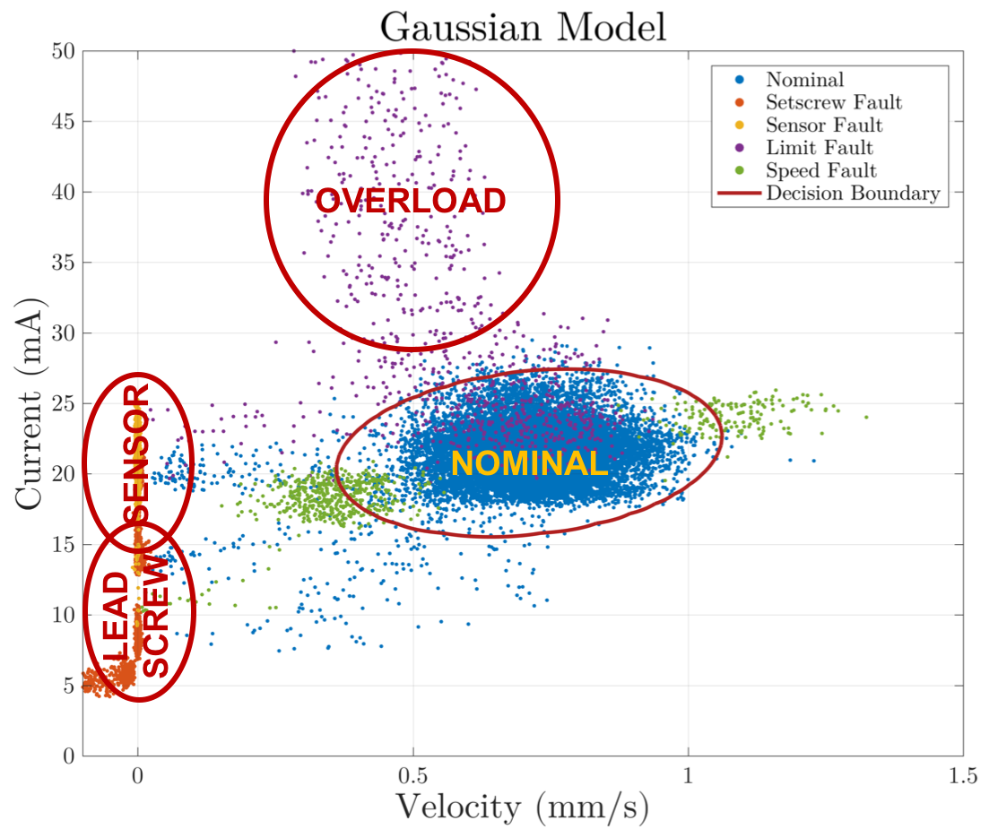
3. Algorithm status
DECOMPOSITION
Detection: we’re not nominal
Isolation: it’s this fault
Prognostication: it will fail in T seconds

Slide 8
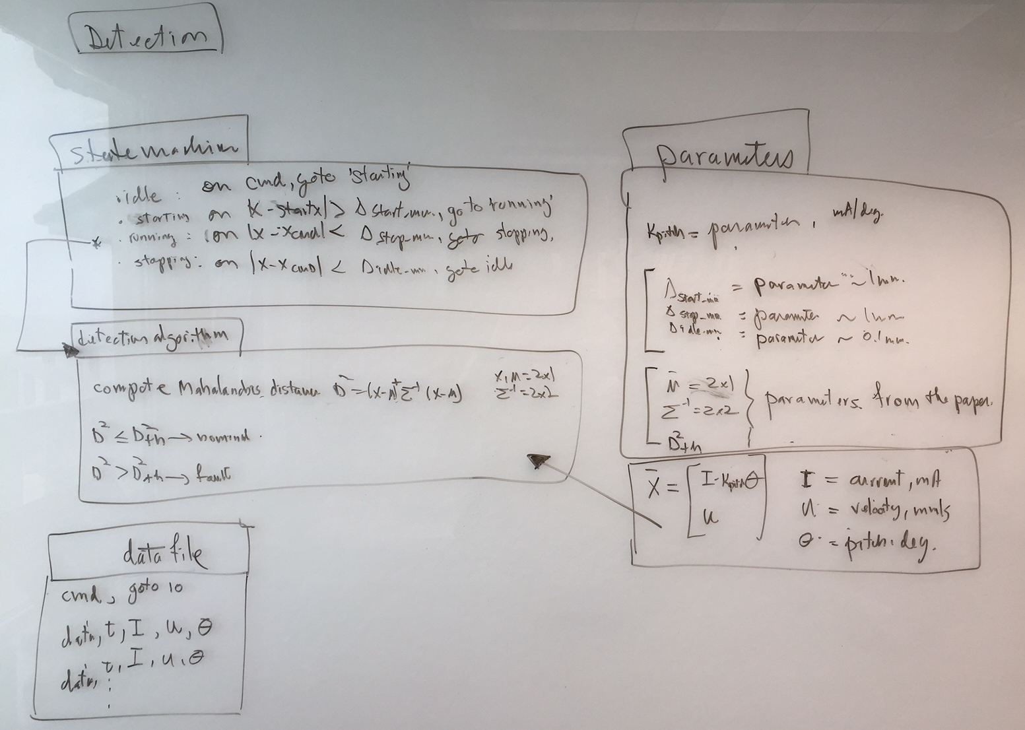
Detection block
Notes:
All the data. Nice separation, except for the tails.

Slide 9
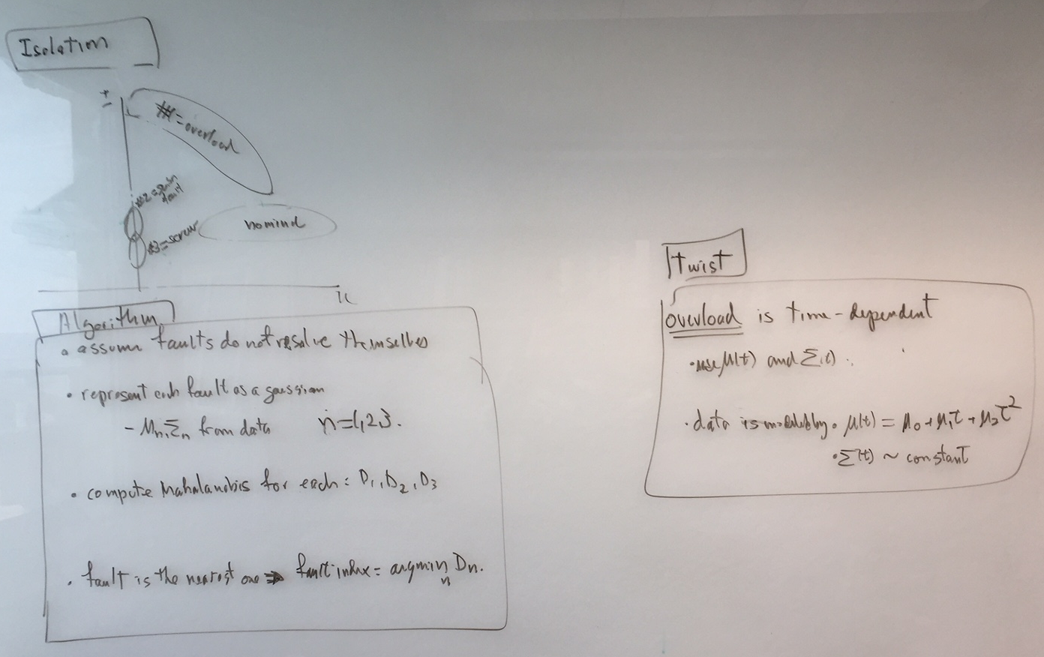
Isolation block

Slide 10
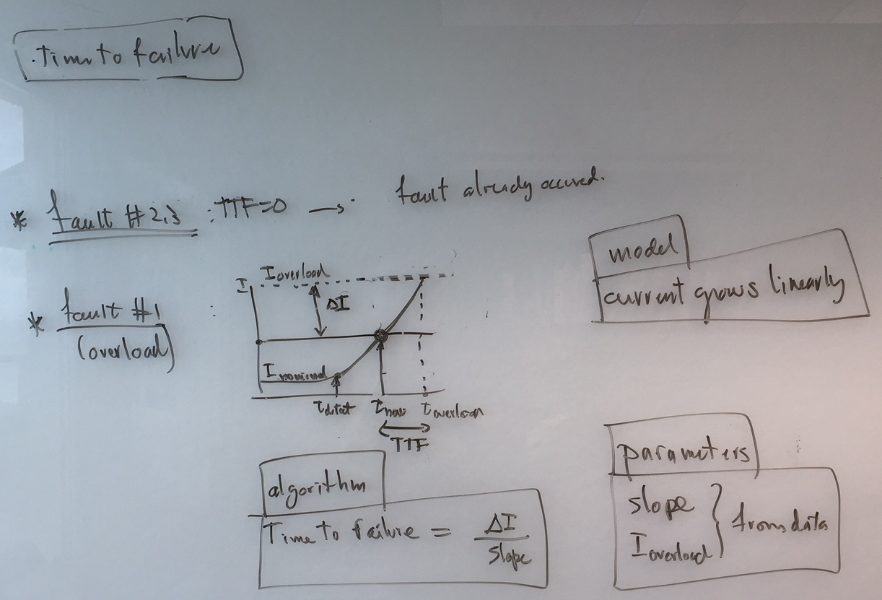
Time-to-Failure block

Slide 11
tomorrow
turn into Matlab code
create input files

