Slide 1
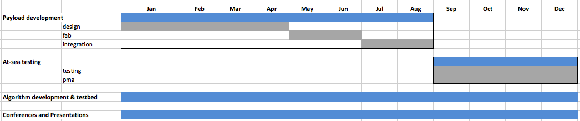
Updated Timelines
01/31 Requirements document (MK)
03/15 Concept Design Review (minus application s/w)
04/30 Application S/W Concept Design Review
05/15 Design Review (minus application s/w)
07/16 Application S/W Design Review
07/31 H/W fab done
09/28 H/W integration done
10/31 S/W integration done
11/01 Start of wet testing

Slide 2
System Definition

Slide 3
CONOPS
At mission time
  Read Mission Script
  For each fault in script:
  inject fault
  recover
  process fault data
  log
Between missions
  update models
Example: seabed avoidance
Fault parameter = dive angle
  grid = [5,10,...,30 degrees]
1. (inject fault) set dive angle
2. (recover) hold commanded depth
3. (measure risk) did altitude drop < 0?

Slide 4
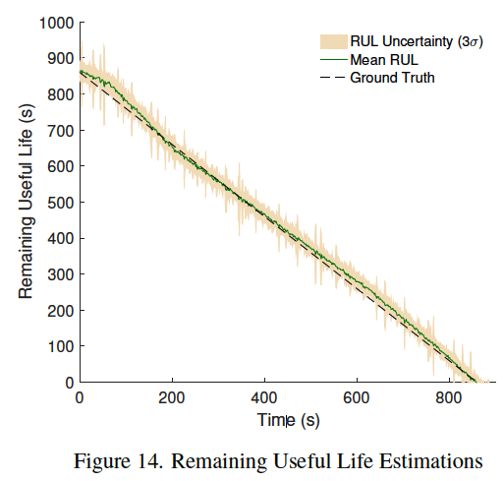
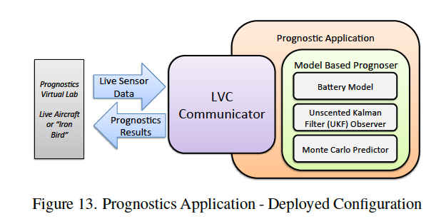
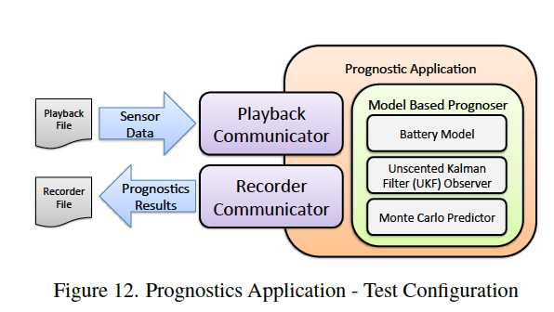

Slide 5
GSAP APPLICATION
SYSTEM DIAGRAM
Read/Implement script
Start/stop Processes
Fault Injection
Performance Assessment
Lifelong learning
Logging
GSAP Communicators
DATA SOURCES
Thruster
(speed, current, voltage)
GSAP PROGNOSER
Mass-shifter
(position, current, voltage)
Feature-extraction
Predictor
(particle filter)
Risk Estimation
OK
BAD
DRIVERS
LRAUV
(altitude, depth, depth rate, pitch, roll, heading, ...)
Dry Testing
Vehicle model
Wet Testing
Hydrophone
(SPL)
H/W
(Mark)
DRIVERS
(Eric)
APP S/W
(Tom)
ALGORITHMS
(MK)
Integration
(RE Tech)
Sea Trials
(RE Tech)

Slide 6
System Diagram
THRUSTER PROGNOSER
PROCESS MGMT
MASS SHIFTER PROGNOSER
LRAUV I/F
SEABED COLLISION PROGNOSER
SCRIPT PARSING/IMPLEMENTATION
GSAP APPLICATION
SHIP COLLISION PROGNOSER
FAULT INJECTION
SURFACING PROGNOSER
LOGGING
? STATE OF CHARGE PROGNOSER ?
LEARNING
PROGNOSER
SENSOR
DRIVER
FEATURE EXTRACTION
PREDICTOR
RISK ESTIMATION
OK / BAD
algorithm
dynamics
algorithm

Slide 7
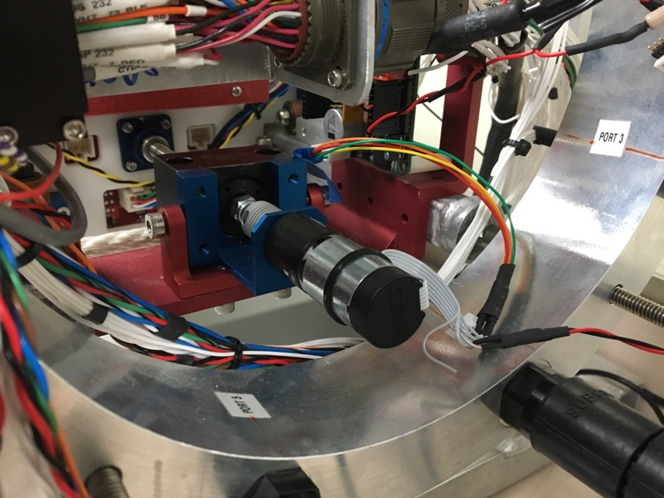
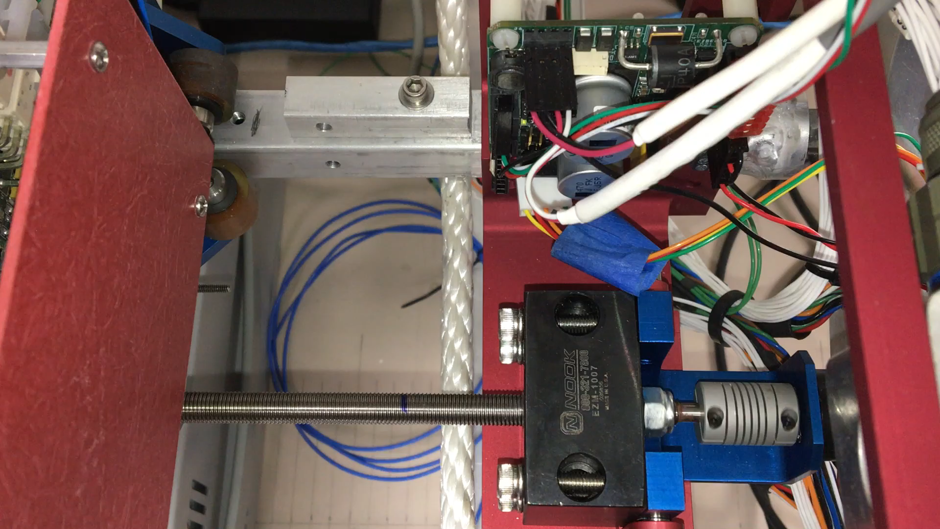
Mass Shifter

Slide 8
Data acquisition
Data sources:
  Current/voltage measured at the motor input at 1.6kHz (NI DAQ 9227,29)
  1-axis accelerometer mounted on vehicle frame at 5kHz (NI DAQ 9234)
  On-board data at 2.5Hz
Denoising
  20kHz PWM was filtered out with 100dB anti-aliasing filter
I/V features:
  I = inline with + terminal
  V = V₊ -V₋
  Feature = 100ms time average, no overlap
Mass-shifter string-pot:
  velocity = centered time-difference (dT=100ms), and 100ms time average.

Slide 9
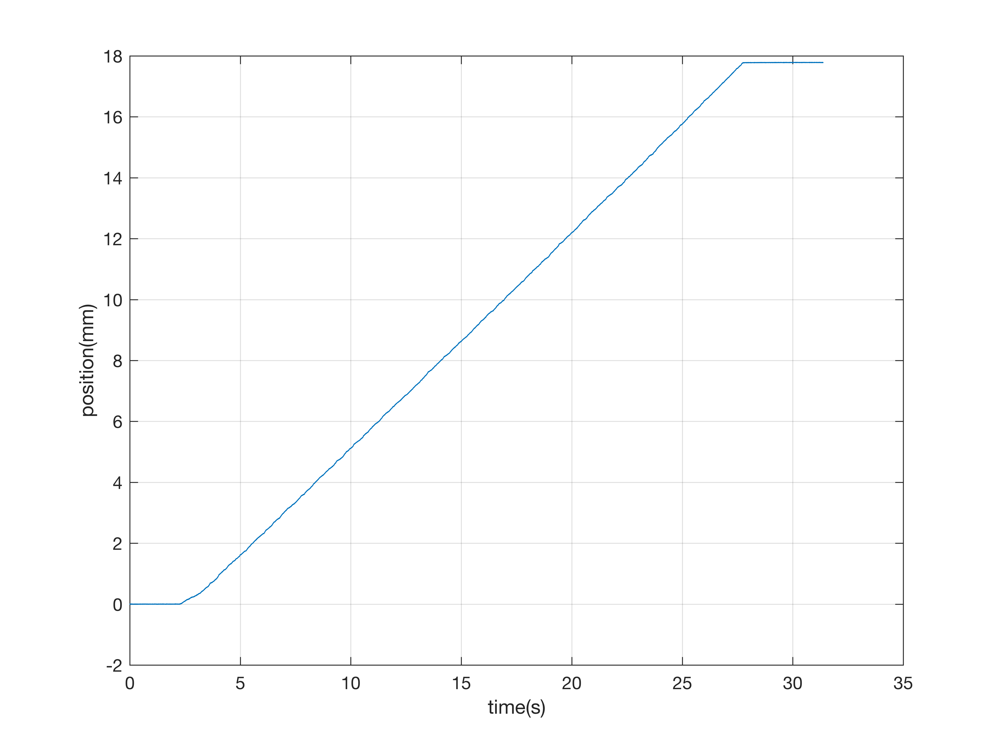
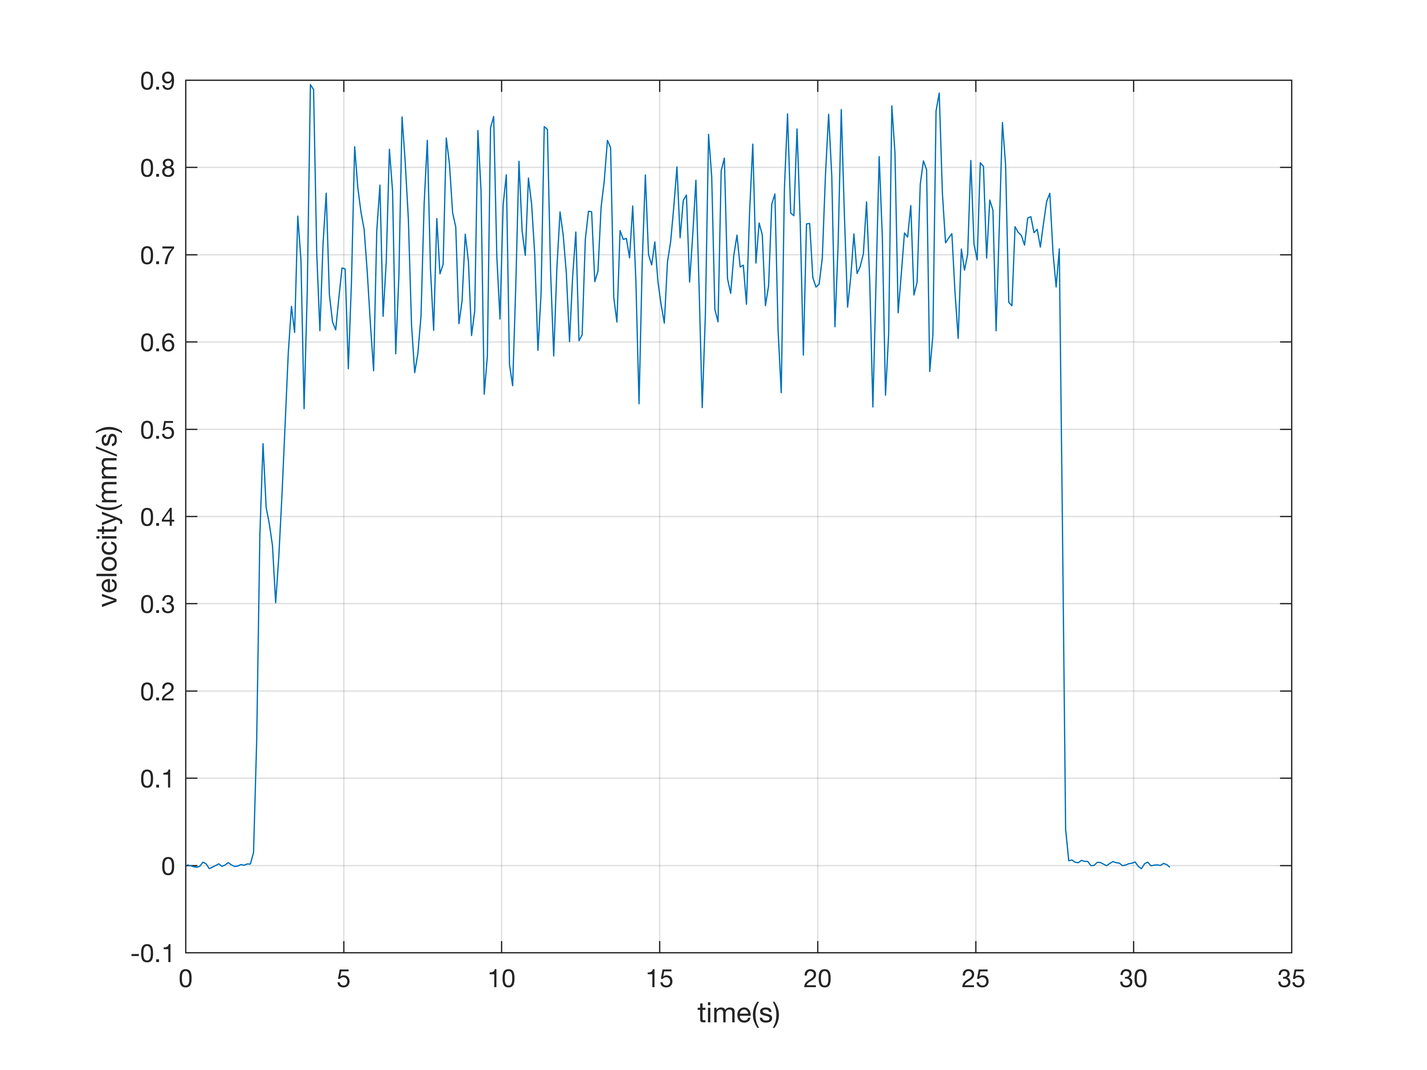
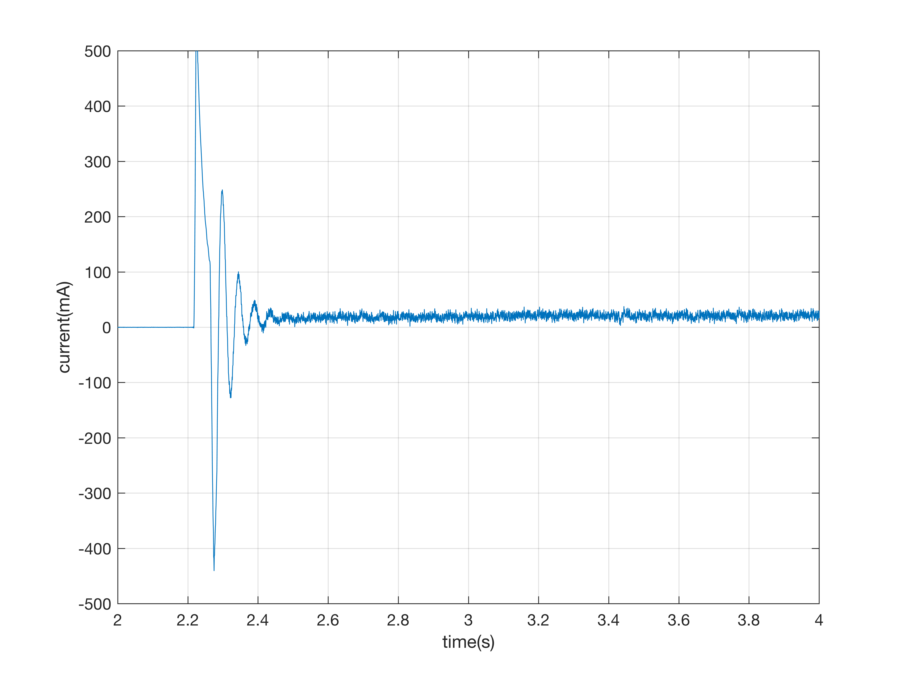
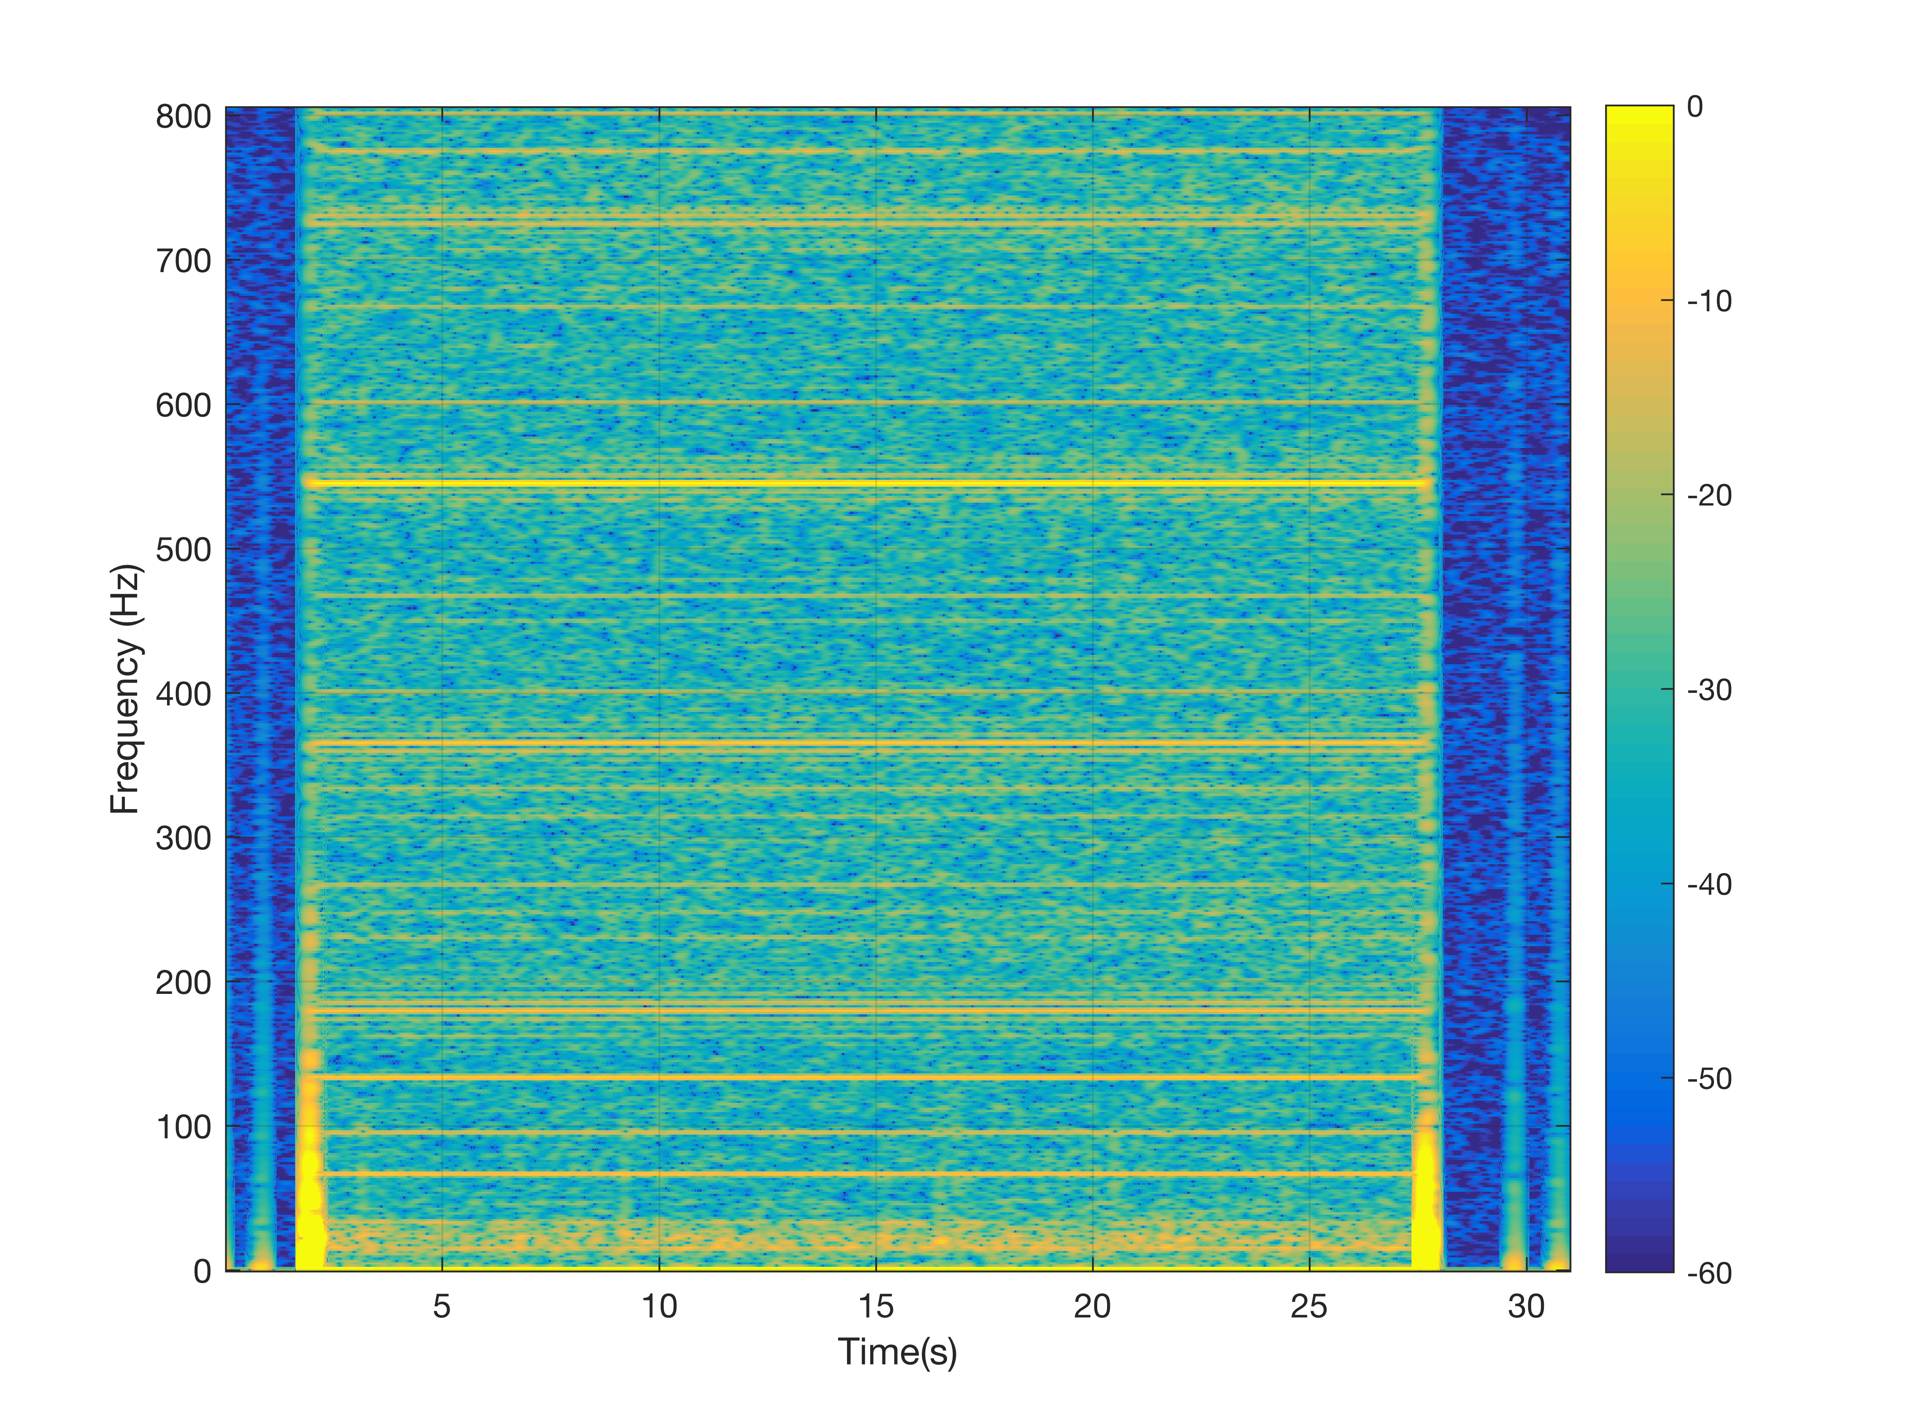

Mass-shifter response
position vs time
velocity vs time
current spectrogram
current vs time
Notes:
Position increases linearly.
Velocity fluctuates around a nominal value (0.7mm/s).
Current has a strong transient for 1/4 of a second, then it settles around a steady 25mA.
Sidebar: the current spectrum is super-rich, but we’re still trying to figure out what causes the different bands.

Slide 10
Data processing
Steady-state – reject 0.5s startup transient
Pitch detrending
  pitch-corrected current = measured current – K*pitch
Nominal
  60 seconds x 30 times x 5 pitch values
Known faults (8 times x 5 pitch)
  Limit fault: push into stop tab until overload.
  Setscrew fault: disconnect screw.
Novel faults (8 times x 5 pitch)
  Sensor fault: disconnect sstring pot sensor.
  Speed fault: change commanded velocity to 50% and 200%.

Slide 11
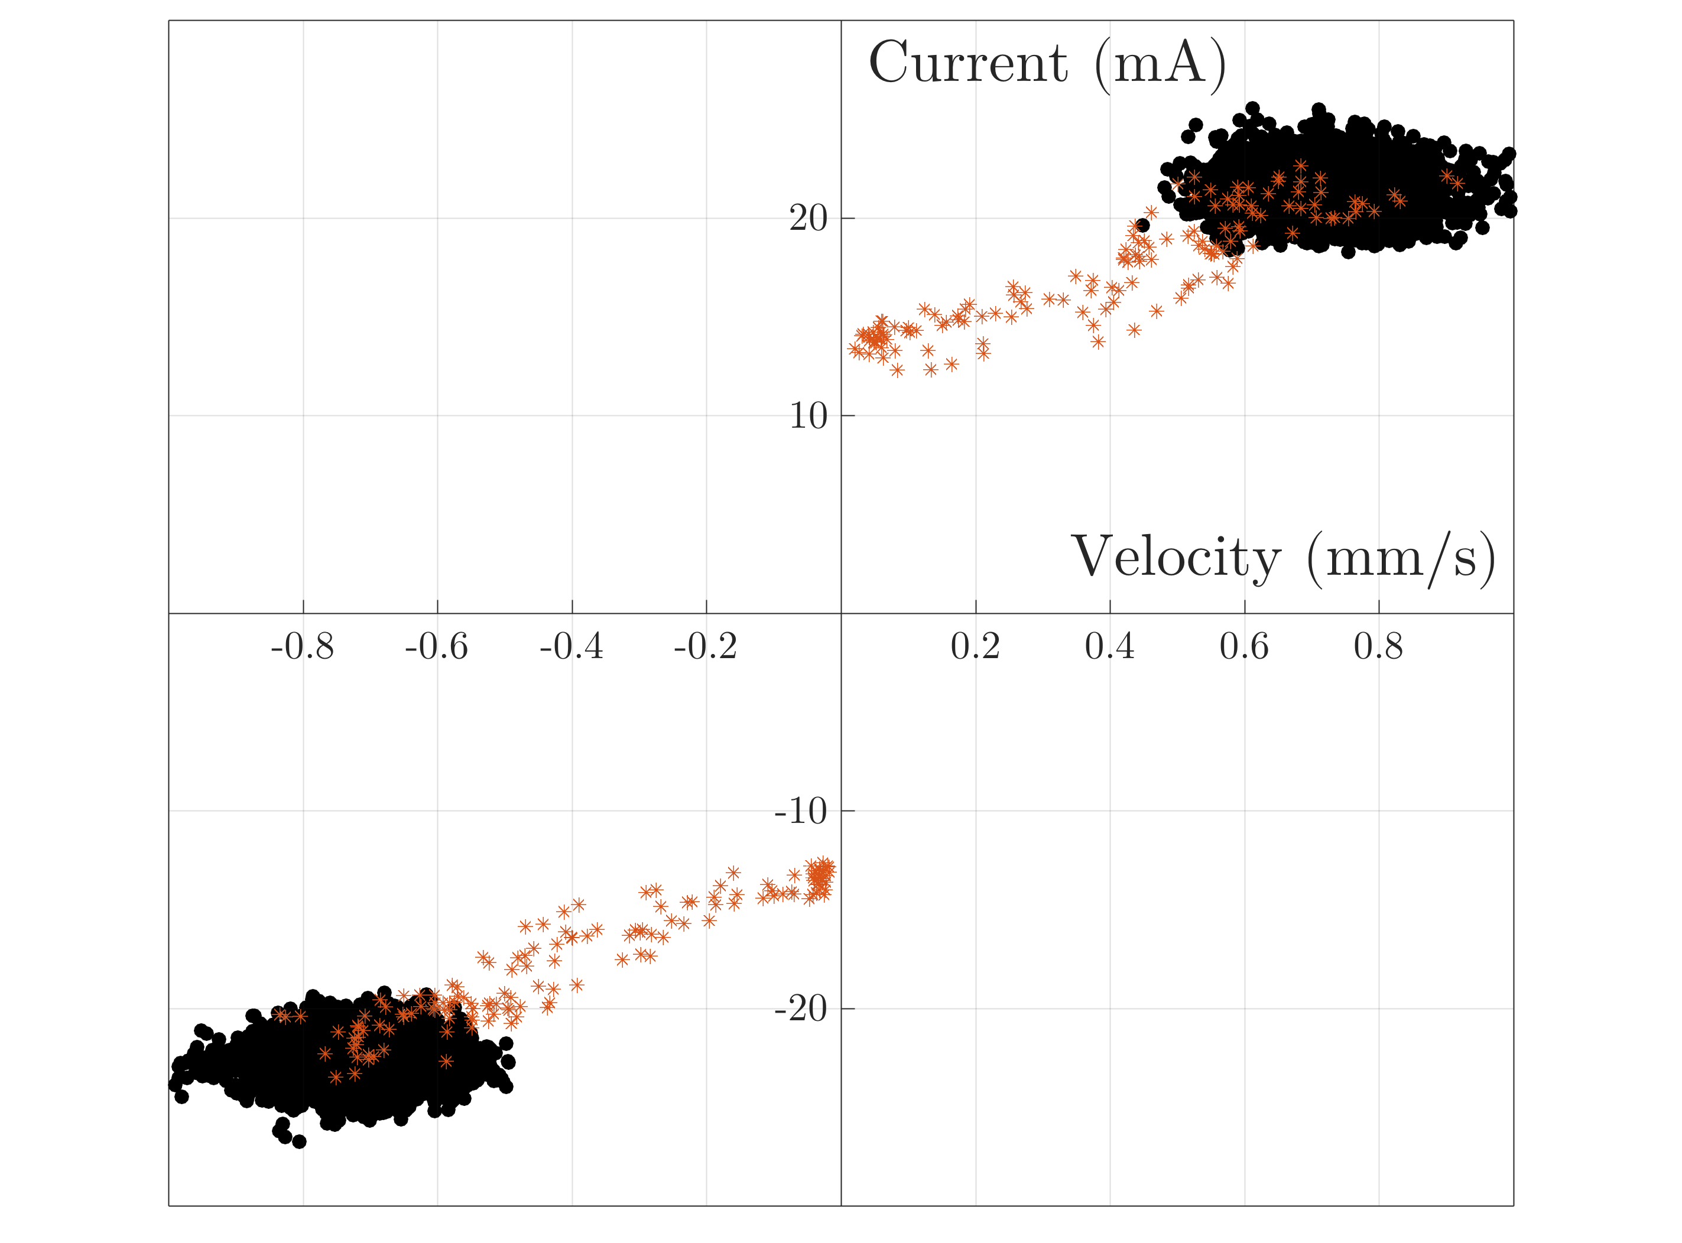
Nominal performance
Notes:
Nominal operation is nicely clustered.

Slide 12
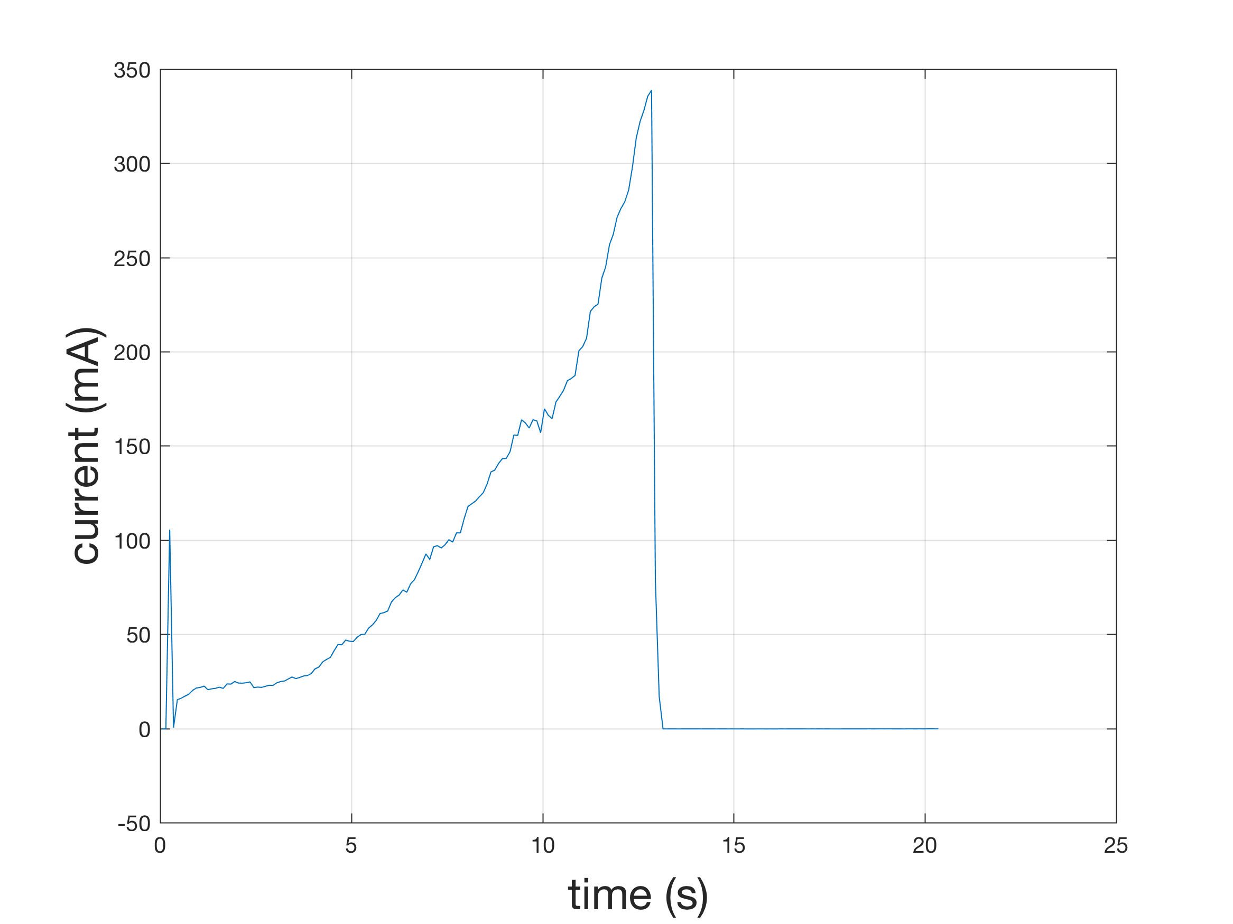
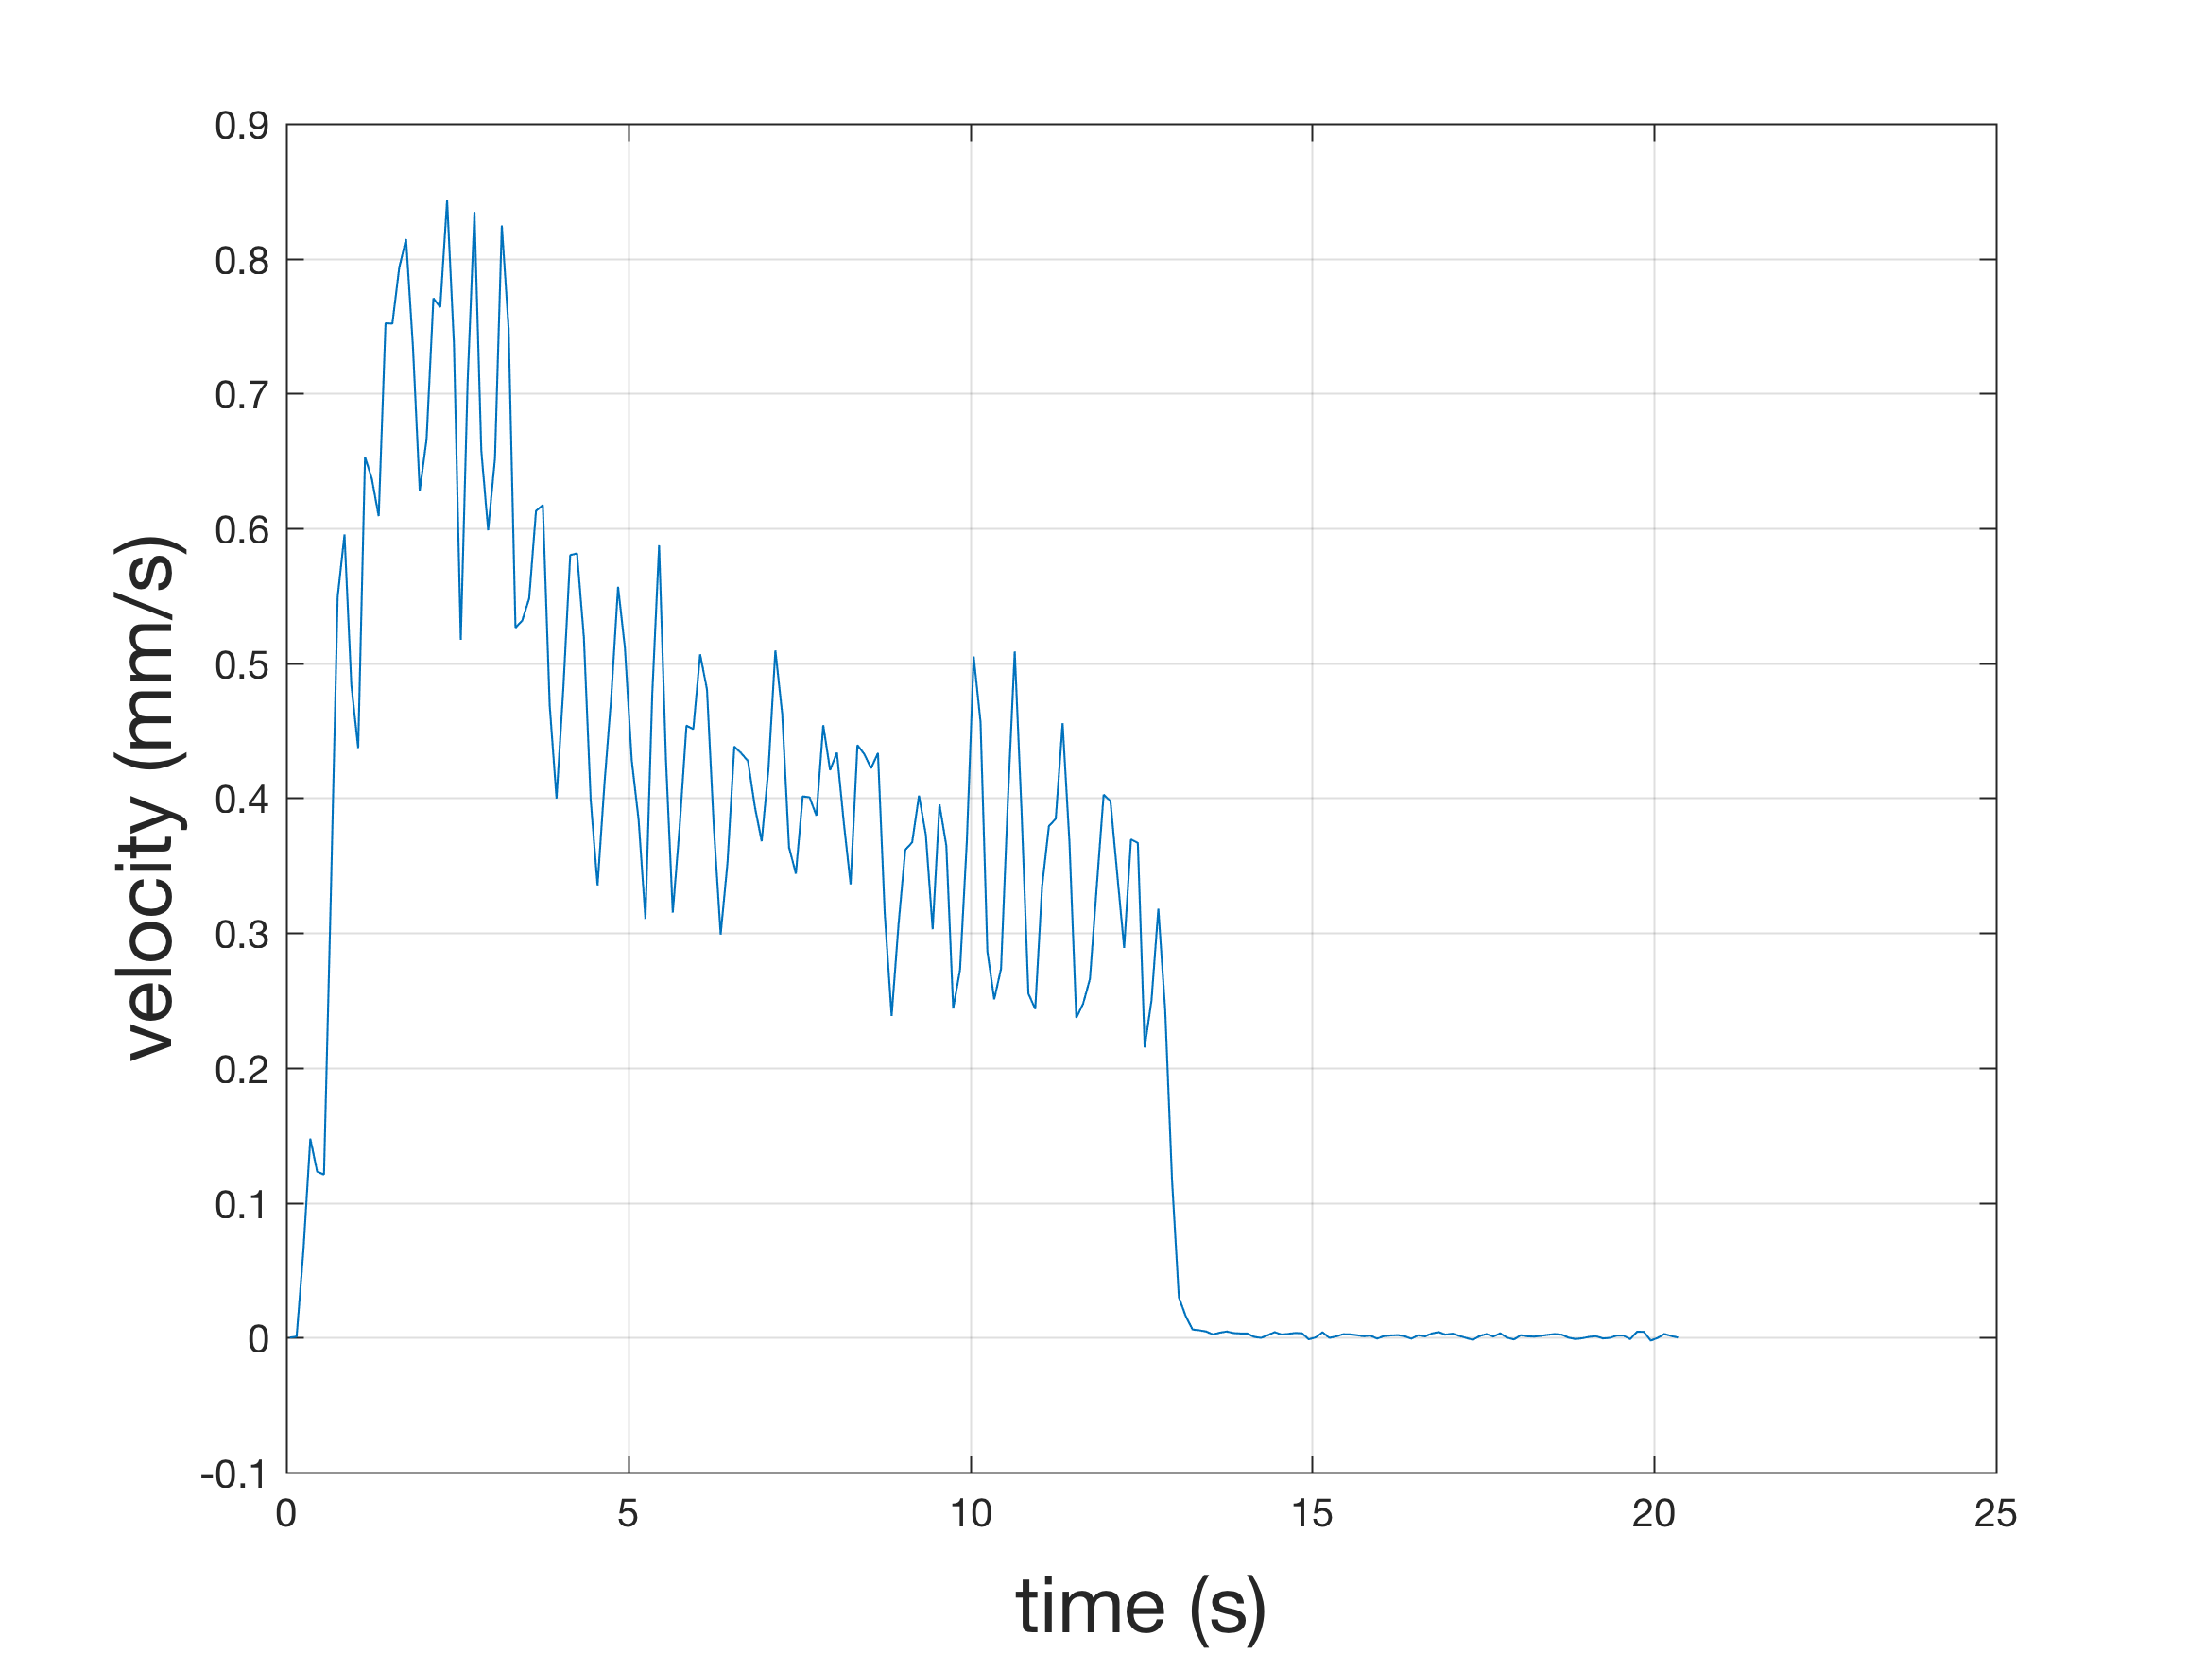
Overload Fault
Notes:
Current grows, velocity decreases
10s to catch the fault before it overloads.

Slide 13
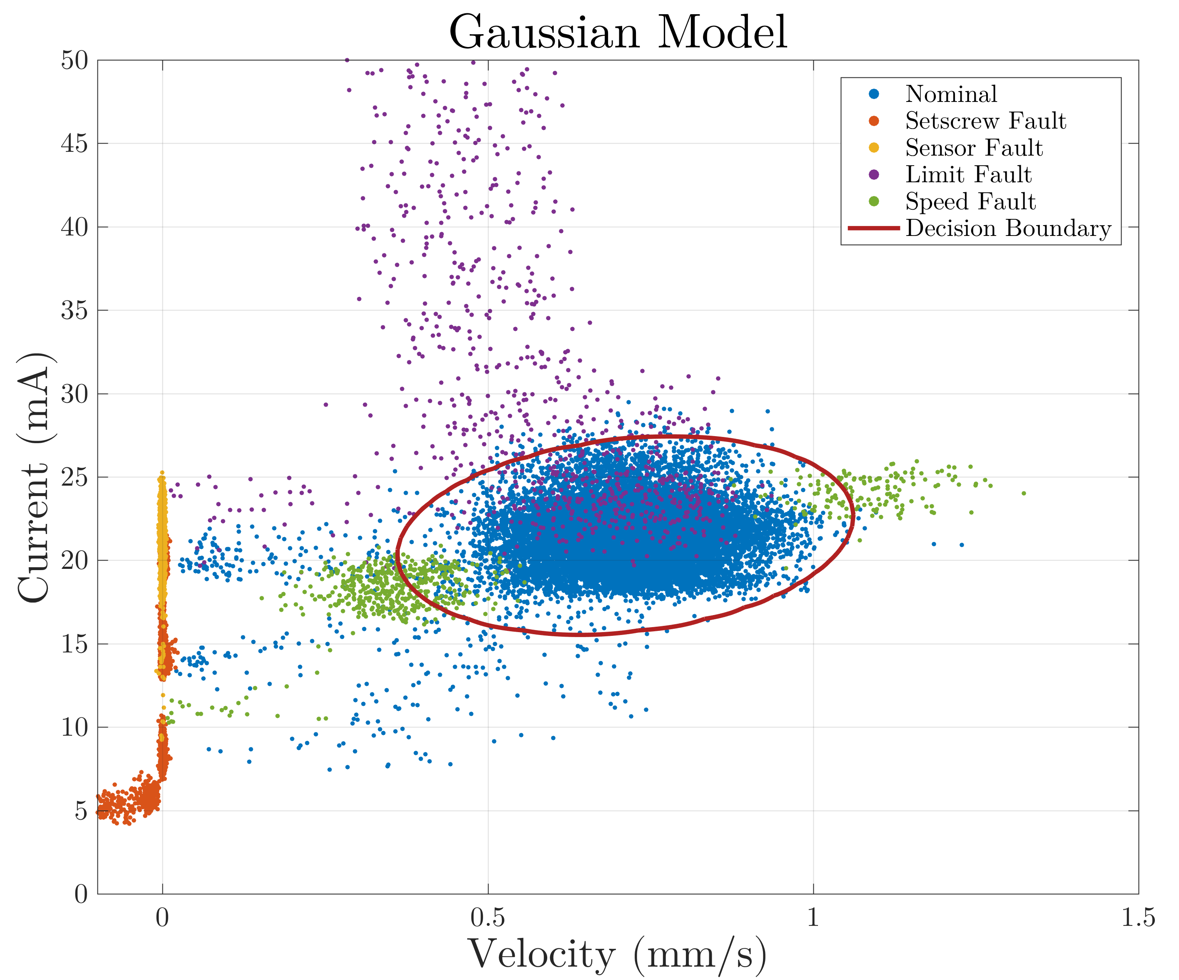
Nominal + Fault data
Notes:
All the data. Nice separation, except for the tails.

Slide 14
Sensing Requiements (in-progress)
Motor terminal current and Motor terminal voltage
  DC brushed motor
  rate: time-average of both, at ~ 10Hz
  strong filtering above ~ 10kHz is essential
Battery position/velocity
  rate: time-average of both at ~ 10Hz
  position: range ~ 50mm, and ~ 10 μm resolution
  velocity: range ~ [-2 to 2 mm/s] and 10 μm/s
  can derive velocity from position, but it pushes higher sampling rate/resolution requirements.

Slide 15
NASA Ames Visit
Guest: Kai Goebel, Head of Prognostics Center of Excellence
Start at 9:30, leave before noon.
Visitor paperwork is done.
Need to get a meeting location from him.
Possible hiccup: MK jury duty?
Goal of meeting:
  1. GSAP
    understanding GSAP licensing limitations
    get a sense for level of support
  2. R2U2
    get enough information for GO/NoGo by design review time
Car pooling
  Leaving Aptos at 7:30 from the Safeway parking lot, drive in Tom’s car; return to parking lot.
  South Bay folks?

