Slide 1
Fault Prognostication
Year 2 kickoff
12 January 2018

Slide 2
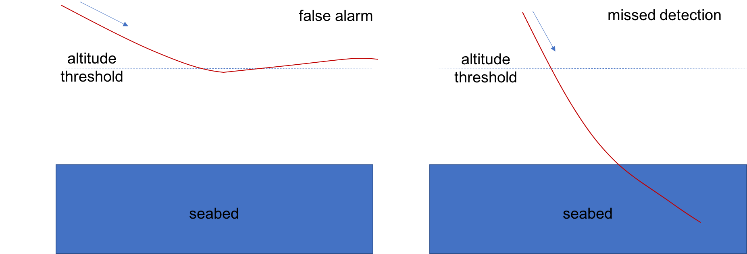
Type of problem we’re going after
ABORTED FOR NO GOOD REASON
SHOULD HAVE ABORTED WAY EARLIER

Slide 3
What’s missing?
Sensing alone is not enough. You also need to:
  understand how it will affect you (“OK” vs “BAD”)
  predict what’s about to happen.
I call this combination “Machine Awareness”, and I call the atomic modules “Awareness Engines”.
2018 goal: build a fault prognostication prototype, integrate it to LRAUV, deploy it.
  2019: extensive at-sea testing program + alpha design.
2018 prototype
  Limited scope
  COTS & simple design, lots of design margin.
  Focus on Mass-shifter and Thruster failures → based on 2017 work.
  Focus on Bottom and Surface hazards → using on-board sensors + hydrophone.

Slide 4
Awareness Engine Architecture
DATA SOURCES
Thruster
(speed, current, voltage)
AWARENESS ENGINE
Mass-shifter
(position, current, voltage)
Feature-extraction
Predictor
(particle filter)
Risk Estimation
OK
BAD
On-board data
(altitude, depth, depth rate, pitch, roll, heading, ...)
Vehicle model
Learning
Hydrophone
(SPL)
Fault Injection

Slide 5
Key Blocks
PREDICTOR
  particle filters (think hurricane forecast, but in near-real time).
RISK ESTIMATION
  altitude: BAD if Prob(altitude < 0) is bigger than some threshold.
  surface hazards:
    don’t know the cost function up-front, need to learn it.
    only way to learn it is to force the vehicle into a bunch of situations and see what happens.
LEARNING
  small NN where input layer = sensor data, output layer is result of experiment (0 = OK, 1 = BAD)
FAULT INJECTION
  used to accelerate learning.

Slide 6
Roles & Responsibilities
MK
  Project management
  System design
  Algorithms
  Performance evaluation
Mark
  Hardware design
Eric
  Embedded software design
TBD s/w architect
  Application software design
Research Tech
  Integration
  Sea-trials

Slide 7
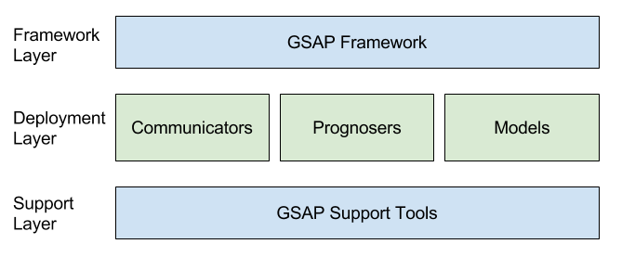
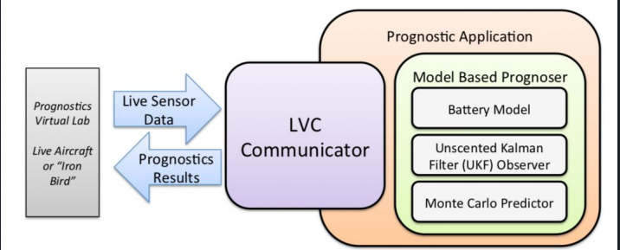
Note 1: GSAP
(GSAP = NASA Ames = Generic Software Architecture for Prognostics)

Slide 8
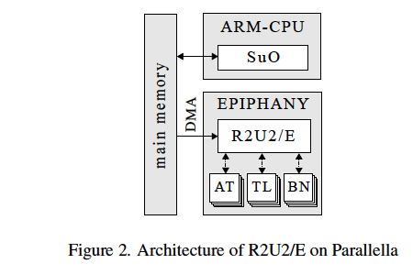
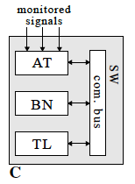
Note 2: NASA Ames has designed Prognostication hardware, and makes it available.
pre-processing
Bayesian networks
temporal logic
Need to assess if it is an appropriate choice at this point.

Slide 9
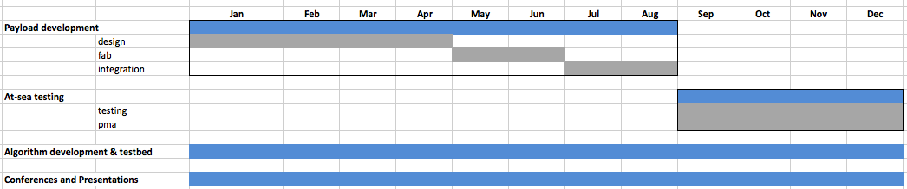
Timelines
01/31 requirements document (MK)
03/15 conceptual design review.
05/15 design review.
07/31 end of fab
09/30 end of integration to LRAUV
11/30 end of 2018 sea-trials

Slide 10
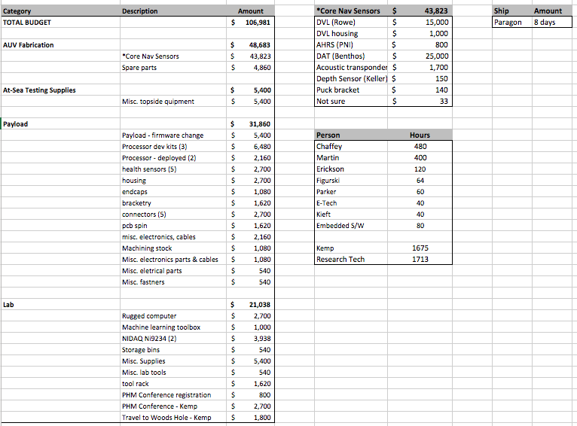
Budget

Slide 11
Next Steps
01/12 (today) incorporate constraints into schedule.
01/18 schedule NASA Ames visit.
01/31 requirements document initial release.

