Slide 1
LRAUV Build Project 901727.99
Responding to a request for more missions utilizing the MBARI Long Range Autonomous Vehicle (LRAUV), a project has been underway to fabricate four additional science research vehicles, with one vehicle dedicated to Mathieu Kemp’s engineering project on fault detection. In addition, a fifth vehicle has been constructed with external funding from the Department of Homeland Security’s (DHS) Arctic Domain Awareness Center.
The great endurance and complex mission capability of the MBARI developed LRAUV provides a unique tool for ocean data collection, particularly in detecting and tracking phenomenon of interest in Lagrangian space using coordinated multi-vehicle operation.
The success of the LRAUV program is largely driven by a very dedicated and capable engineering team that is working closely with science to advance the state-of-the-art in mission payloads and is constantly developing new sampling strategies.
The four new MBARI vehicles are being completed in 2018 and will be fully integrated into science and engineering programs in 2019.

Slide 2
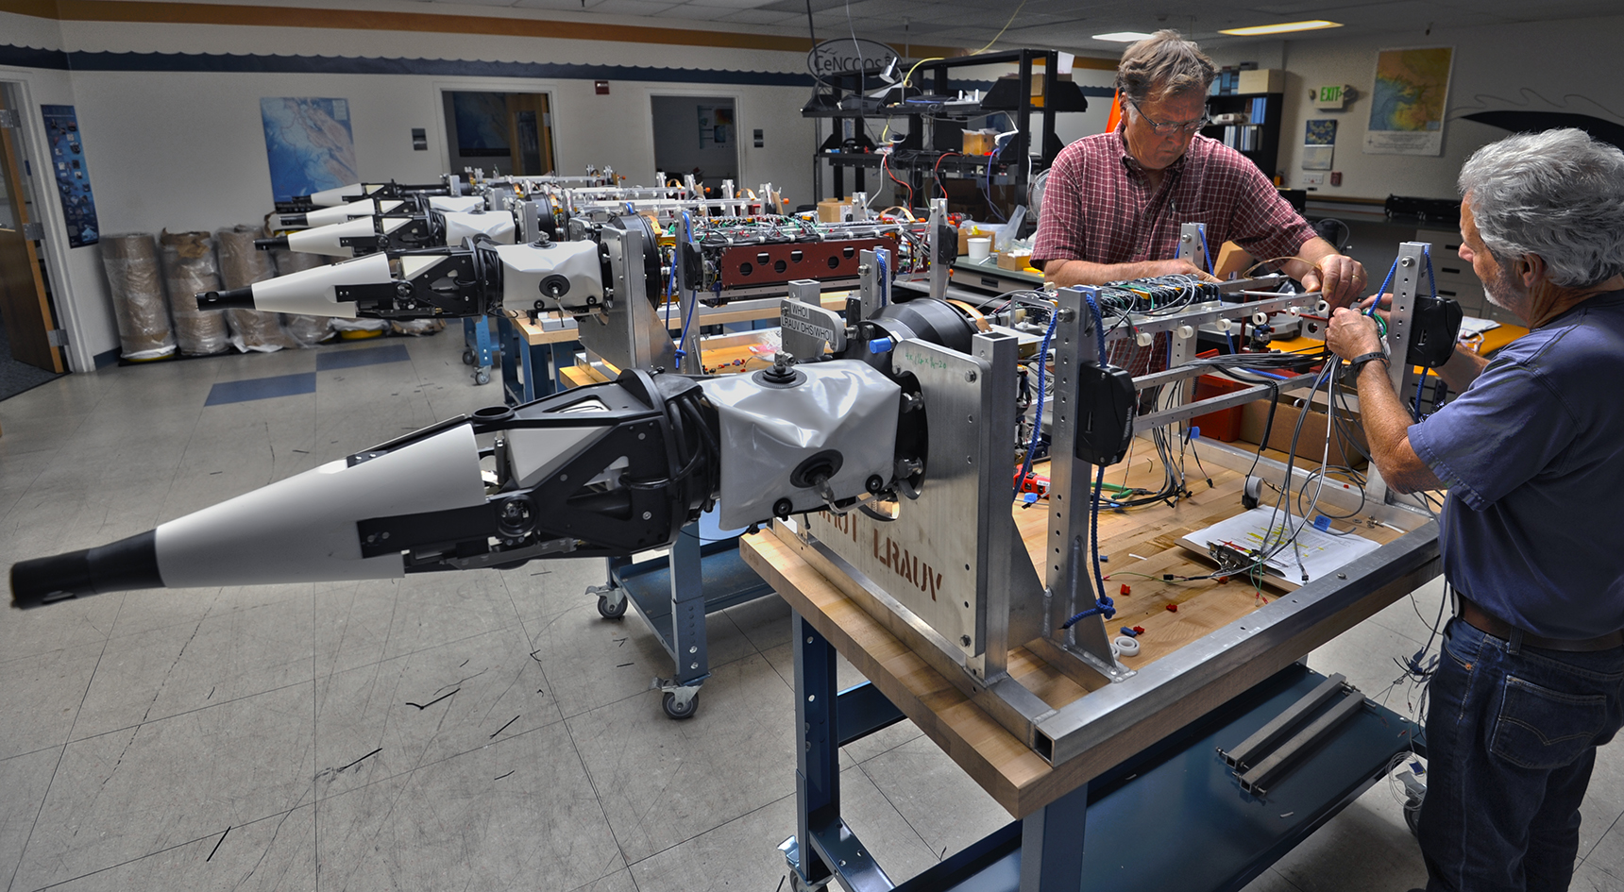
LRAUV Build Project 901727.99
Five new LRAUV’s under construction in summer 2018. The DHS vehicle in the foreground is complete and successfully passed sea trials. The second vehicle is completed and in lab testing and the final three are nearing completion.

