Slide 1
LRAUV Build Meeting

Slide 2
Agenda
My understanding is the we are building 4 units - three for the LRAUV lab and one for the Mathieu Kemp lab.
WHOI is building a fifth vehicle. How much assistance we giving them?
What is the internal and external charge structure for the MBARI and WHOI builds?
What are the total 2017 budgeted funds available for the MBARI builds?
Is there any mechanism for us to be able to split orders with WHOI or re-charge them without overhead in order for them to get a quantity discount on some parts?
What labor is to be charged to the WHOI account?
Are there any "trades" or other unofficial arrangements for swapping purchases with WHOI to date?
Where does the "Mesobot" project fit in? What is MBARI's role? What labor should be charged against this project?
What is the planned build and operational project schedule for the three LRAUV lab vehicles ? (Mathieu vehicle by July 2018). What about the WHOI vehicle?

Slide 3
Labor charges
Project manager:
Andrea Kukulya?
Marie Basile?
Project manager: Kakani
901706.99 MBARI
LRAUV Construction (3)
901727.99 MBARI
LRAUV Construction
70134 WHOI
LRAUV Construction
777004 MBARI/WHOI
Mesobot
$7500 budgeted for Electronics + Labor for testing. Does not look like any MBARI hardware design, procurement or fab. labor budgeted.
901706.99 MBARI
LRAUV Construction (3)
Four units total

Slide 4
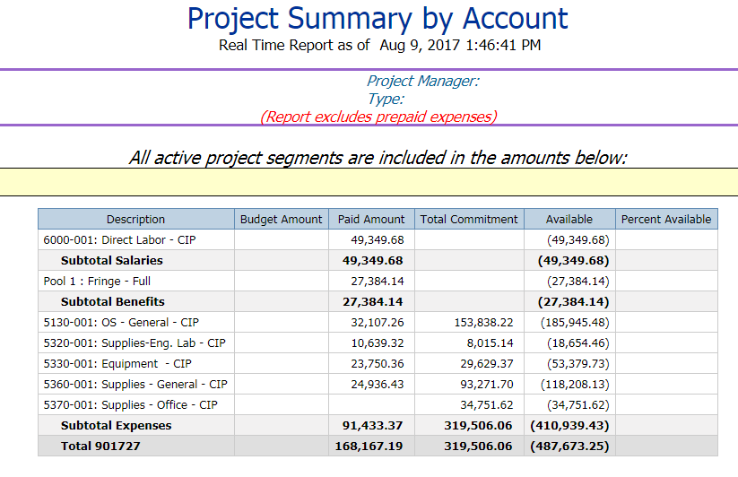
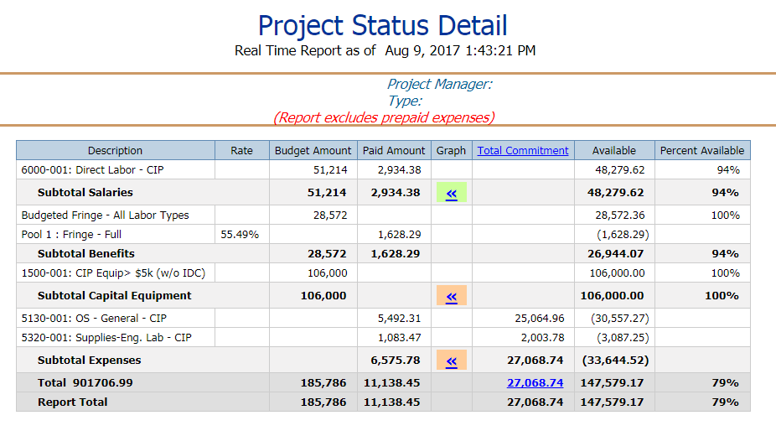
Budget
901727.99 LRAUV Construction (3)
901706.99 LRAUV Construction (Kemp)
2017 Build Budget = BOD committed funds $500k (“$450k” – Chris S.) + $106k from Kemp funds. What about $75k “cash” mentioned by Brett? Is this to be included?
Spent to date $346,575. Remaining budget $209,425 (using $450k +$106k and no $75k “cash”).
Order placement for mechanical parts is about 50% and electrical parts about 90%

