Slide 1
LRAUV Biology Camera Payload
2018 Proposal Abstract Presentation
Mark Chaffey

Slide 2
Why Do This Project
Provides a capability that will contribute to multiple research programs at MBARI are currently using the LRAUV or would use it if it had an imaging capability.
Increases the utility of a vehicle system that MBARI has made a substantial and long term commitment to.
Lowers the barrier of entry for visual surveys – LRAUV missions can be run from a lab using small vessels and minimal personnel.
We need to start now to have a fully functional system in 2-3 years.
Fits into our existing data flow and benefits from MBARI’s long term commitment to the video annotation system, VARS.

Slide 3
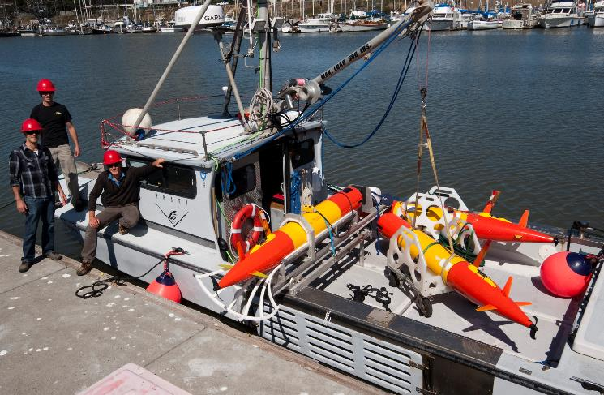
Why Use the LRAUV
Small size provides great operational flexibility with the endurance to maintain a persistent presence.
LRAUV can be cost effective compared to traditional sampling and observation methods.
Coordinated multi-vehicle operations allow sampling strategies that produce unique data sets.
Ability to re-task the mission during a deployment enables dynamic targeted sampling.
Small footprint – may help with avoidance issues.
Notes:
Front and patch tracking

Slide 4
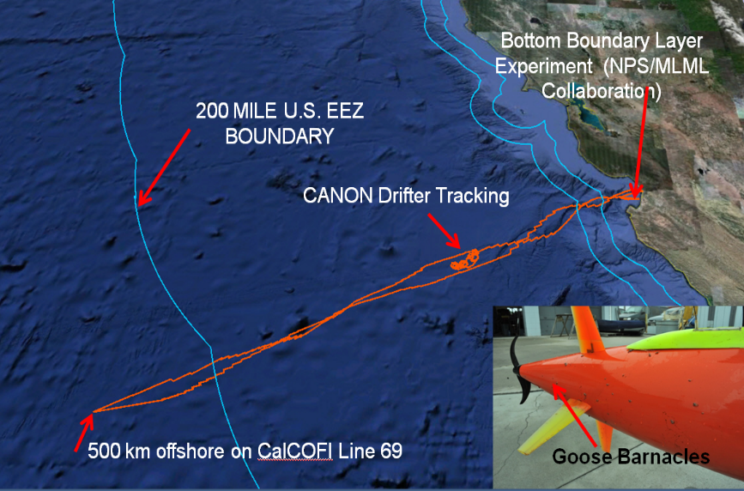
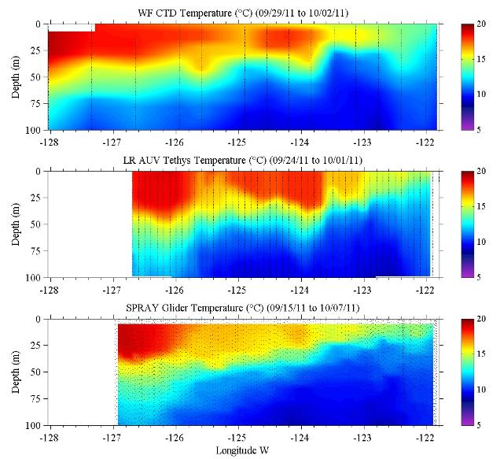
Long Endurance Autonomous Vehicles Make Economic Sense
The CalCOFI sampling line 69 time series is now routinely sampled by autonomous glider
MBARI Long Range AUV is capable of 1800 km missions, three times faster than a glider, with a greater science payload
The cost savings of reducing ship based sampling expeditions can easily pay the capital cost of a glider or Long Range AUV
Ship 3 days
LRAUV 7 days
Glider 21 days
Notes:
The California Cooperative Oceanic Fisheries Investigations (CalCOFI) are a unique partnership of the California Department of Fish & Wildlife, NOAA Fisheries Service and Scripps Institution of Oceanography.
67 year times-series of California coastal waters!
The organization was formed in 1949 to study the ecological aspects of the sardine population collapse off California. Today our focus has shifted to the study of the marine environment off the coast of California, the management of its living resources, and monitoring the indicators of El Nino and climate change.
CalCOFI conducts quarterly cruises off southern & central California, collecting a suite of hydrographic and biological data on station and underway.
Data collected at depths down to 500 m include: temperature, salinity, oxygen, phosphate, silicate, nitrate and nitrite, chlorophyll, transmissometer, PAR, C14 primary productivity, phytoplankton biodiversity, zooplankton biomass, and zooplankton biodiversity.

Slide 5
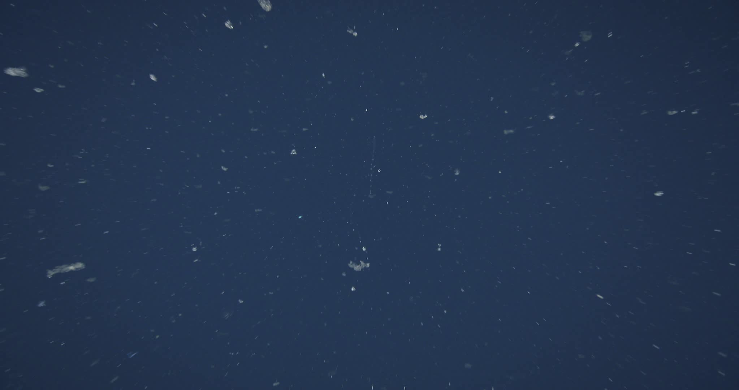
AUV 300 meter Transect Video (100 cm/sec.)
4 x slowed down playback for human annotation
Applications
Notes:
This is the same video record played back at ¼ speed. When the image is slowed down or stopped the frames can be analyzed.

Slide 6
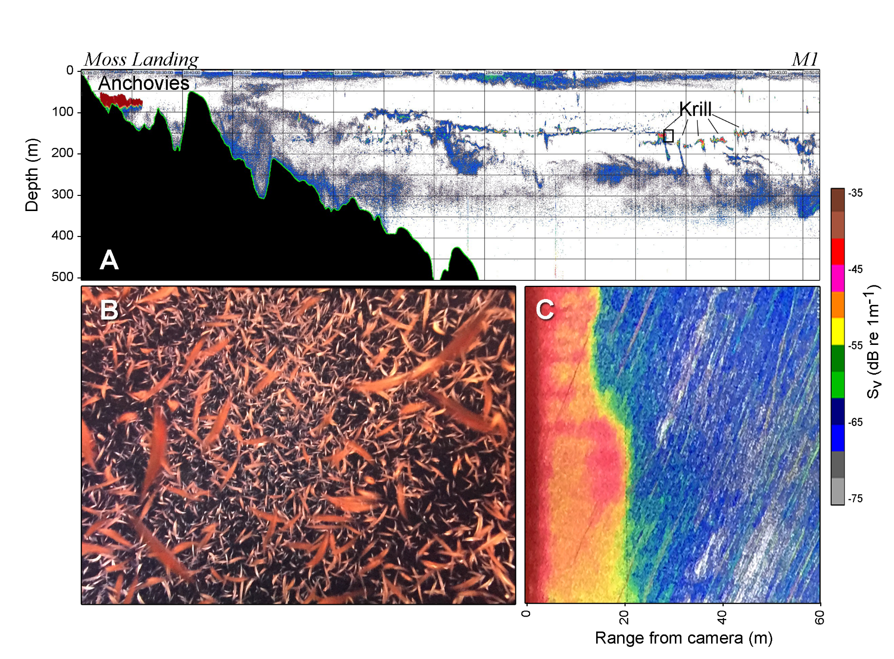
Applications
Kelly Benoit-Bird collected 5/11/17

Slide 7
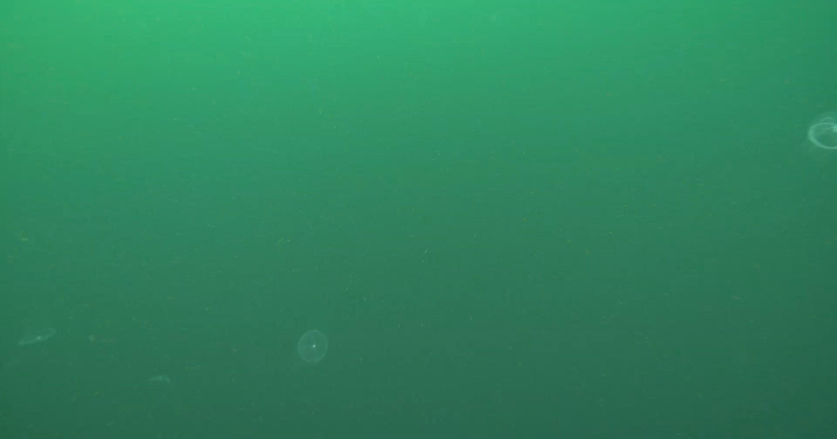
Notes:
AUV survey May 8, two days before.

Slide 8
Approach to Project
Phase 1: Multiple potential users requires a careful requirements definition.
Phase 2: Requirements (and expectations!) need to be refined to fit:
  Within the constraints of the LRAUV system.
  Within the constraints of commercially available camera modules and recording systems.
Phase 3: Finalize system design; full commercial system or camera module selection and MBARI integration.
  Minimize software development risk.
  Crisp interface to the LRAUV.
Phase 4: Design and construction.
  High quality optics.
  Integrated lighting system.

Slide 9
Technical Challenges
Meeting LRAUV size and weight constraints while maintaining image quality.
Reducing power requirements by 75%.
Providing enough illumination to allow fast shutter speeds and adequate depth of field.
The i2MAP system is a valuable reference for making detailed design trade-offs of transit speed vs shutter rate, illumination requirements, etc.
Notes:
What is not a challenge is that we currently have a complete “back-end” system for image storage and annotation using VARS.

Slide 10
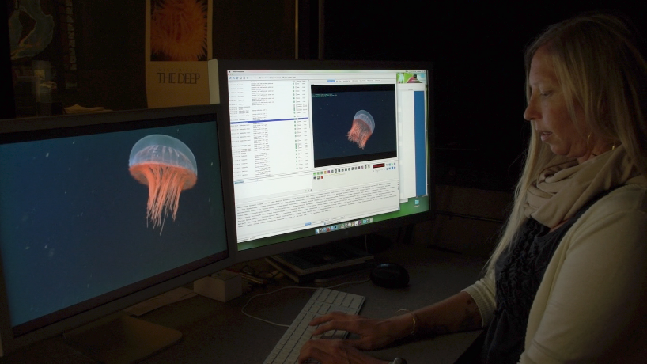
Synergies with Other MBARI Projects
LRAUV
VARS
Sea Star

Slide 11
Possibilities for Technology Export
Adaption of the camera system to LRAUV will result in a smaller and possibly less expensive package that can be installed on a larger selection of commercial AUV’s in the 35cm diameter size class.
i2MAP results have created a significant interest in making the technology available to the community.
  NOAA From Surface to Seafloor: Exploration of the Water Column workshop participants.
  Henk-Jan Hoving at GEOMAR (former MBARI post-doc)
WHOI/MBARI Mesobot project has a similar camera need.
  But probably should not drive the requirements.
Notes:
LRAUV will not be directed from camera images like Mesobot, it’s the other way around for LRAUV. Do not need realtime access to camera images.

Slide 12
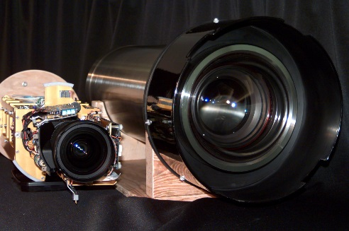
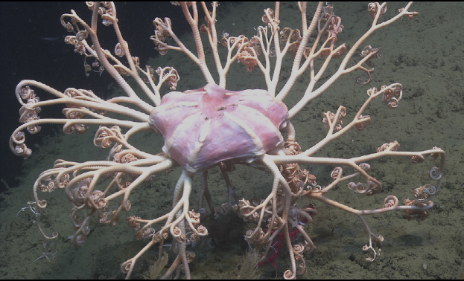
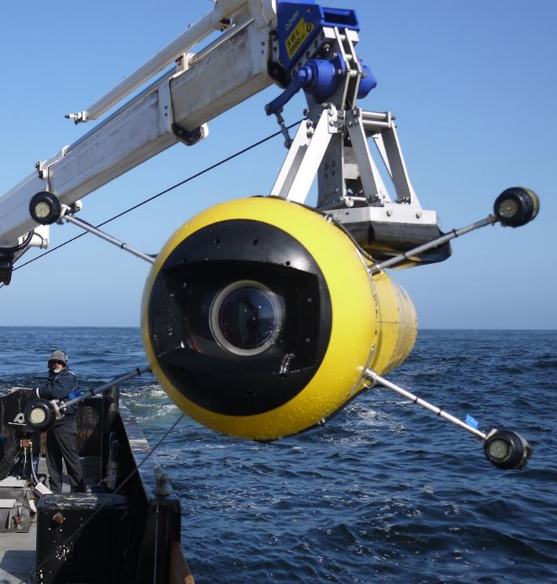
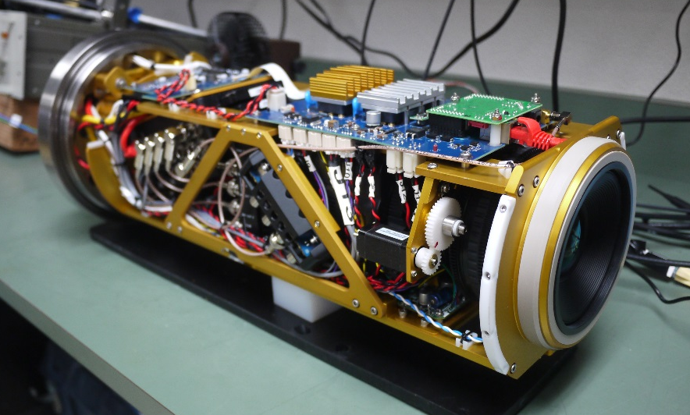
Previous Work
MBARI’s first ROV camera.
First full HDTV ROV camera system at MBARI.
First high quality large format AUV camera system.

