Slide 1
LRAUV Biology Camera Payload
2019 Proposal Abstract Presentation
Mark Chaffey

Slide 2
We propose to …
Develop a free space imaging system for the LRAUV to provide episodic video and still images of water column macro-zooplankton and micronekton as the LRAUV transits or drifts in a region of interest.
The anticipated target size is in the range of 1 mm to 10 cm .
Follow on proposal to the 2018 feasibility study in progress that is:
  Developing the science requirements.
  Will provide a concept design review.
  Will be completed before proposal submission.

Slide 3
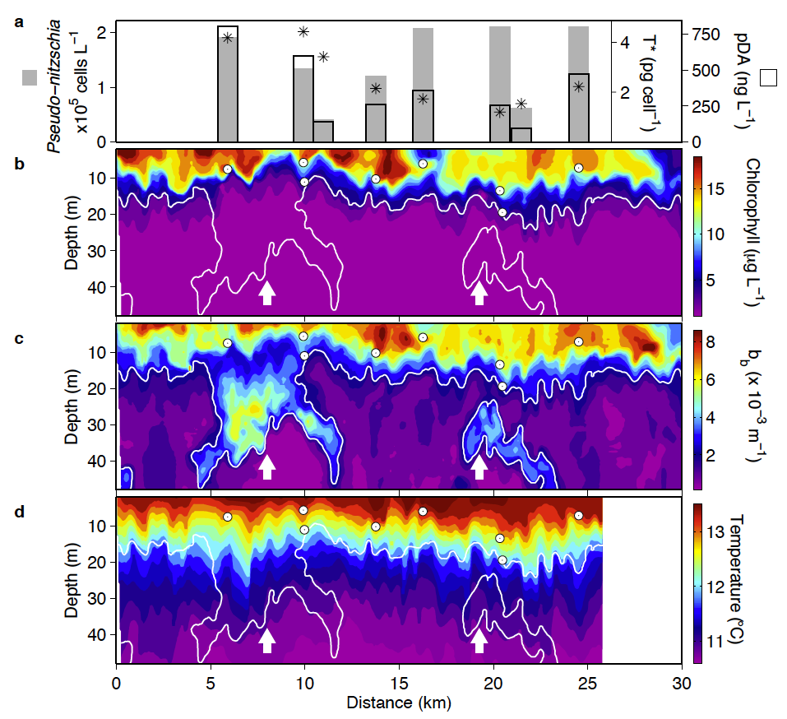
The Inspiration for This Proposal
The LRAUV physical sensors provide great data sets of the physical properties of the ocean environment …. BUT there are other biological properties that are missed altogether.
Ryan, J.P., et al., Boundary influences on HAB phytoplankton ecology in a stratification-enhanced upwelling shadow. Deep-Sea Res. II (2013), http://dx.doi.org/10.1016/j.dsr2.2013.01.017i

Slide 4
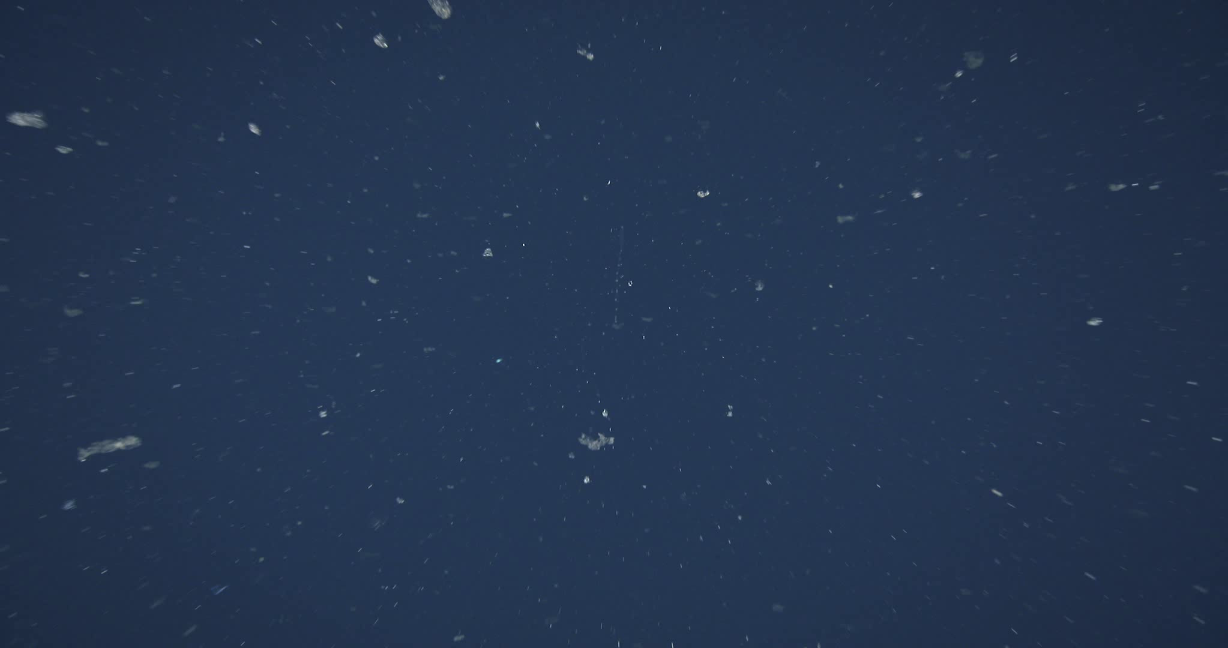
AUV 300 meter Transect Video (100 cm/sec.)
4 x slowed down playback for human annotation
A visual image provides information illuminating the richness of the biological realm that is not captured by other sensors
Notes:
This is the same video record played back at ¼ speed. When the image is slowed down or stopped the frames can be analyzed.

Slide 5
More Inspiration for This Proposal
Provides a capability that overlaps with multiple research programs at MBARI that would use LRAUV imaging data if it were available.
  “Big Ocean, Big Data” 901603 Video TAG
  Currently applying classification algorithms to i2MAP video data with great success. Would like to extend this to the LRAUV. High quality images result in better classification results.
  “Acoustical Ocean Ecology” 901700, Benoit-Bird
  Provide visual verification of organism aggregations observed by acoustic backscatter once the 2-frequency compact echosounder is installed on the LRAUV.
  “Vertical Migration Initiative” anticipated 2019 proposal Benoit-Bird/Katija

Slide 6
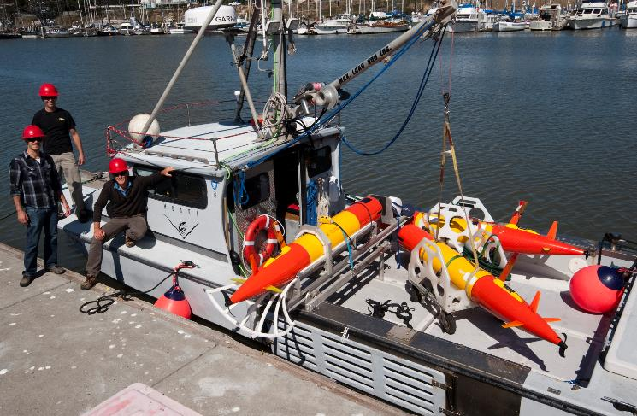
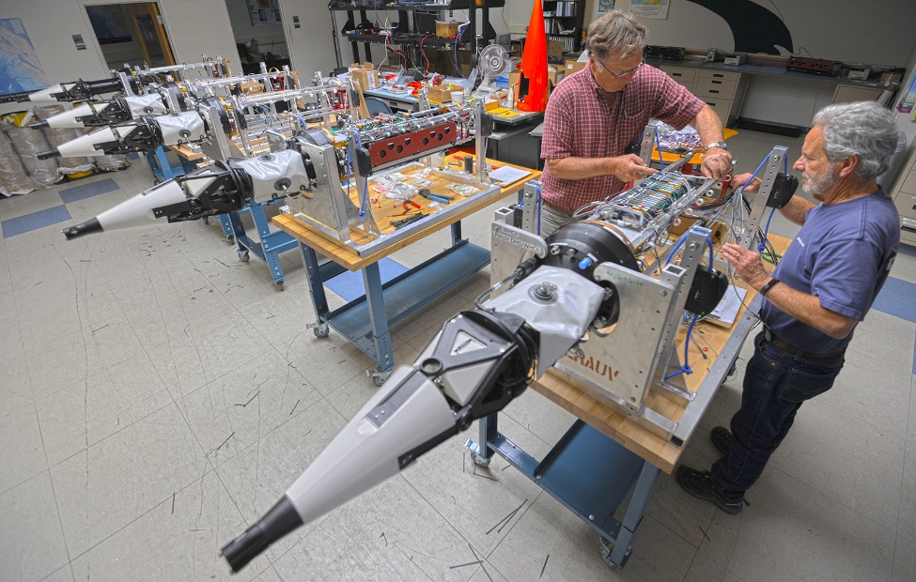
Motivation for Developing for the LRAUV
LRAUV provides great operational flexibility with long endurance.
Relatively slow transit speeds and drifting are possible.
Maximize the utility of an AUV system in which MBARI has made a substantial investment.
The LRAUV is a rich platform for the development of advanced sampling methods that would benefit from the inclusion of image data.
  “Targeted Sampling by Autonomous Vehicles” 901513, Yanwu Zhang
  Coordinated multi-vehicle operations allow sampling strategies that can produce unique data sets, i.e. patch tracking and sampling.
Notes:
Front and patch tracking

Slide 7
Technical Challenges
Meeting LRAUV size and weight constraints while maintaining image quality.
Reducing power requirements by 75%.
Providing enough illumination to allow fast shutter speeds and adequate depth of field.
Having the ability to efficiently download imagery without recovering the system or opening housings.
Providing a versatile control interface that can be tasked in the mission scripting process.
The i2MAP system is a valuable reference for making detailed design trade-offs of transit speed vs shutter rate, illumination requirements, etc.
Notes:
What is not a challenge is that we currently have a complete “back-end” system for image storage and annotation using VARS.

Slide 8
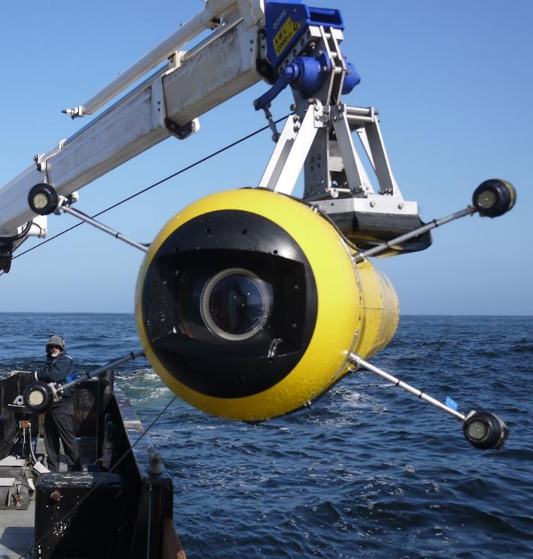
The Challenge

Slide 9
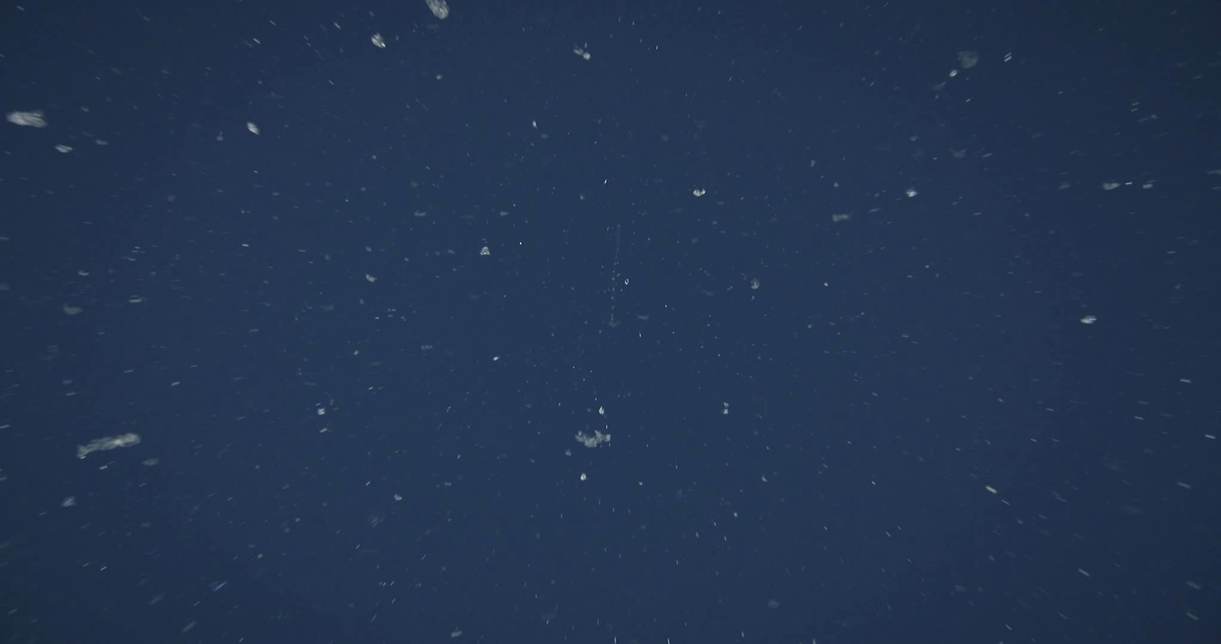
AUV 300 meter Transect Video (100 cm/sec.)
4 x slowed down playback for human annotation
Can the LRAUV Produce Quality Images?
One approach would be to narrow the field of view angle from nearly
90 degrees to about 40 degrees:
10 % of the imaging area
90 % less lighting required
Easier optical design
Notes:
This is the same video record played back at ¼ speed. When the image is slowed down or stopped the frames can be analyzed.

Slide 10
AUV 300 meter Transect Video (100 cm/sec.)
4 x slowed down playback for human annotation
Application Example
37 Degree Field of View:
Notes:
This is the same video record played back at ¼ speed. When the image is slowed down or stopped the frames can be analyzed.

Slide 11
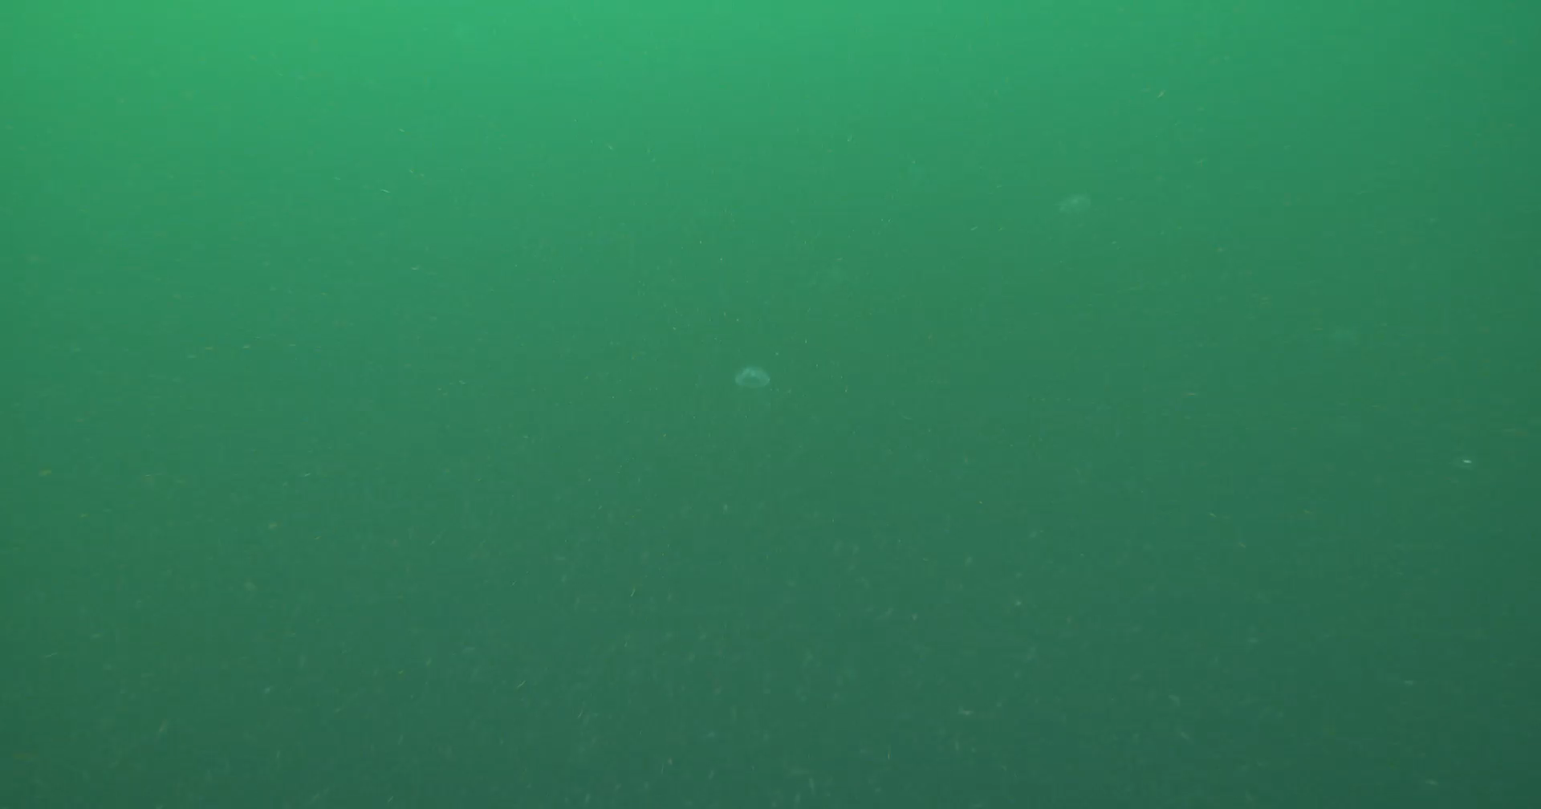
Another Application Example
37 Degree Field of View:
Notes:
AUV survey May 8, two days before.

Slide 12
Approach to the Project
2018 Feasibility Study underway.
  Requirements gathering from potential users and projects.
  Trade study of current state of the art and commercially available products.
  Science requirements and concept design review scheduled for mid June 2018.
2019 Project proposal to:
  Refine engineering design requirements.
  Finalize system design.
    Minimize software development risk.
    Crisp interface to the LRAUV with image capture incorporated into mission scripting.
  Complete detailed design and begin construction.

Slide 13
Possibilities for Technology Export
Adaption of the camera system to LRAUV will result in a smaller and possibly less expensive package that can be installed on a larger selection of commercial AUV’s in the 35cm diameter size class.
i2MAP results have created a significant interest in making the technology available to the community.
  NOAA From Surface to Seafloor: Exploration of the Water Column workshop participants.
  Henk-Jan Hoving at GEOMAR (former MBARI post-doc)
WHOI/MBARI Mesobot project has a similar camera need.
Notes:
LRAUV will not be directed from camera images like Mesobot, it’s the other way around for LRAUV. Do not need realtime access to camera images.

Slide 14
Questions?

