Slide 1
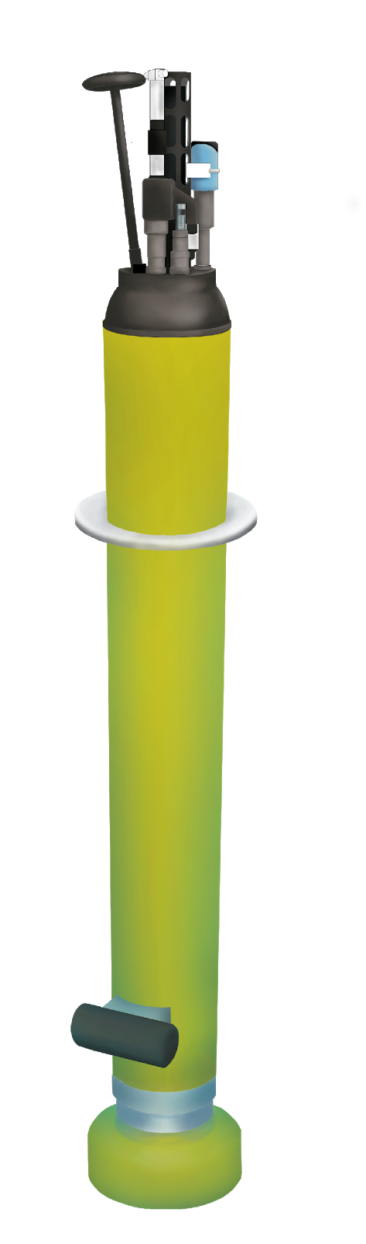
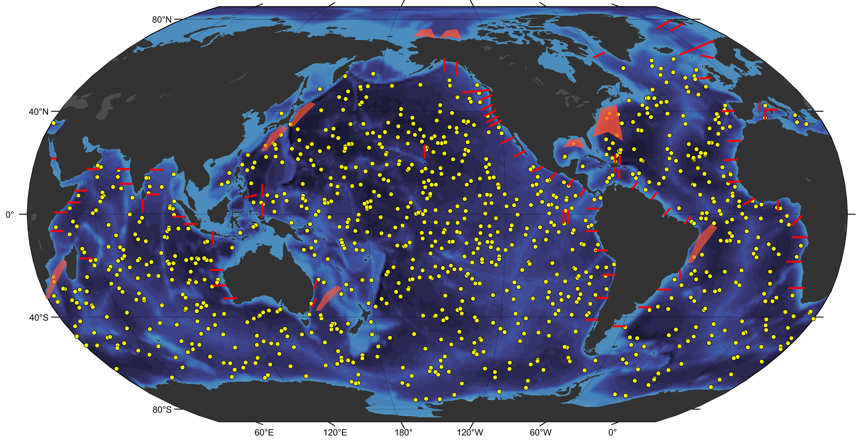
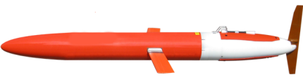
Ocean Biogeochemical Sensing Team
Help build a global biogeochemical observing system with profiling floats and gliders

Slide 2
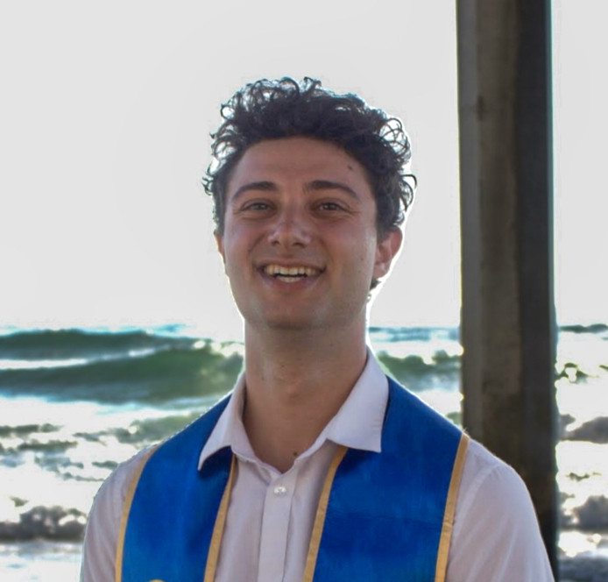
OBS team new member Ben Werb (Feb 12)

Slide 3
Main Objectives
Spray2 with pH
  Production led by Ben Werb
  SIO (April)
  WHOI (April)
  OSU (send controller for integration Feb)
  LOC-NESS (August 11-15)
Spray2 with nitrate
  Production/development led by Joe Warren
  Coordinate with SIO for integration
  Deliver 5 to WHOI by nov

Slide 4
Spray2 with pH
Spray2 with nitrate
NanoFET for LRAUV (2 units)
LOC-NESS
Oct Santa Barbara cruise
BEAMS support for KAUST and AOML
Organic Alkalinity from field samples
pH/TA sensor development
SURpH on gliders and floats
MBARI glider operations (CCS ROMS, diel cycle)
pH on WireWalkers
NanoFETv2 development
Float database development (Collab with Chem Sensor lab)

Slide 5

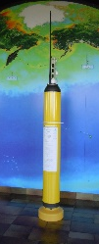
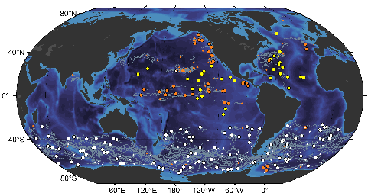
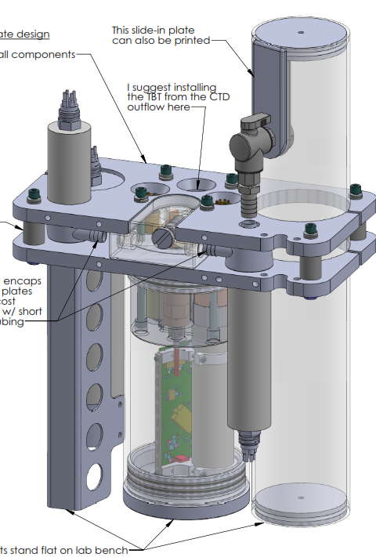
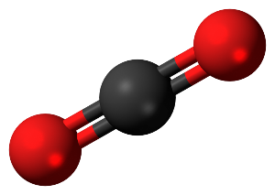
BGC Spray/Underwater Gliders
Work towards six parameter BGC gliders and linking BGC-Argo array to the coast
GO-BGC/BGC-Argo
Develop sensing & analytical techniques for BGC-Argo
CO₂ Thermodynamics
How do we get more accurate estimates of pCO₂ from pH sensors on profiling platforms?
Coastal Ecosystem Dynamics
Develop sensors and systems to accurately monitor changes in highly dynamic systems

Slide 6
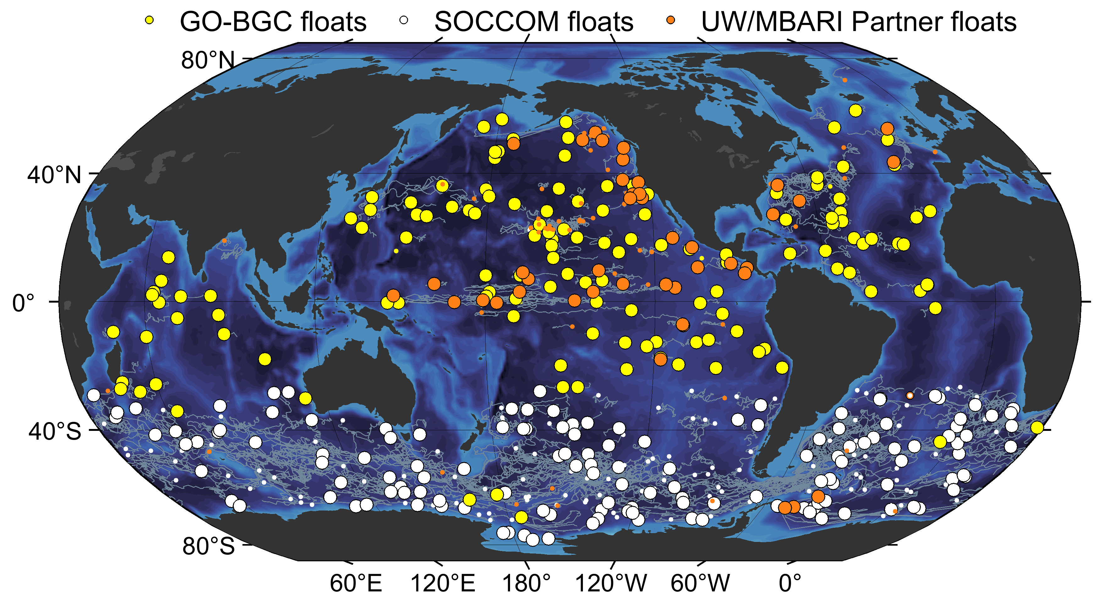
~90 deployed in 2023

Slide 7
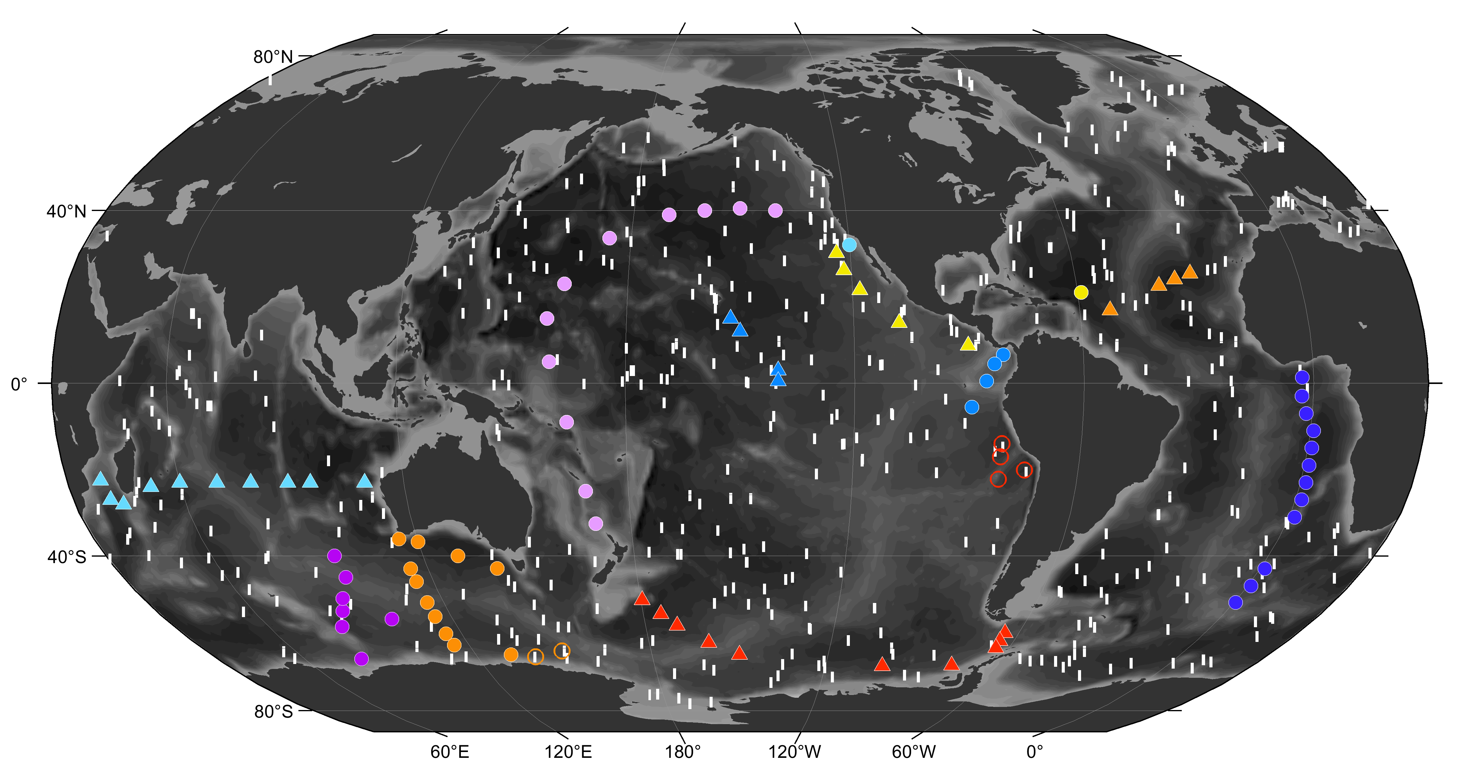
~70 planed in 2024 so far

Slide 8
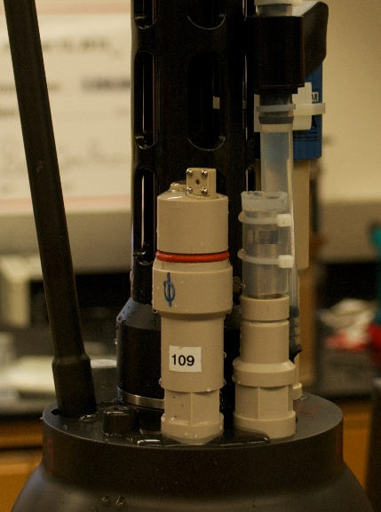
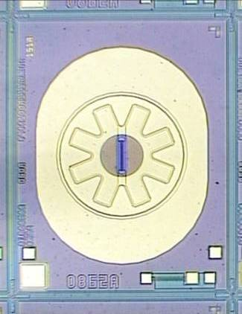

Honeywell ISFET production
Announced ISFET discontinuation June, 2022
Intervention from various government agencies got Honeywell to restart production!!
Seabird has received new set of ISFETs, and performance is good

Slide 9
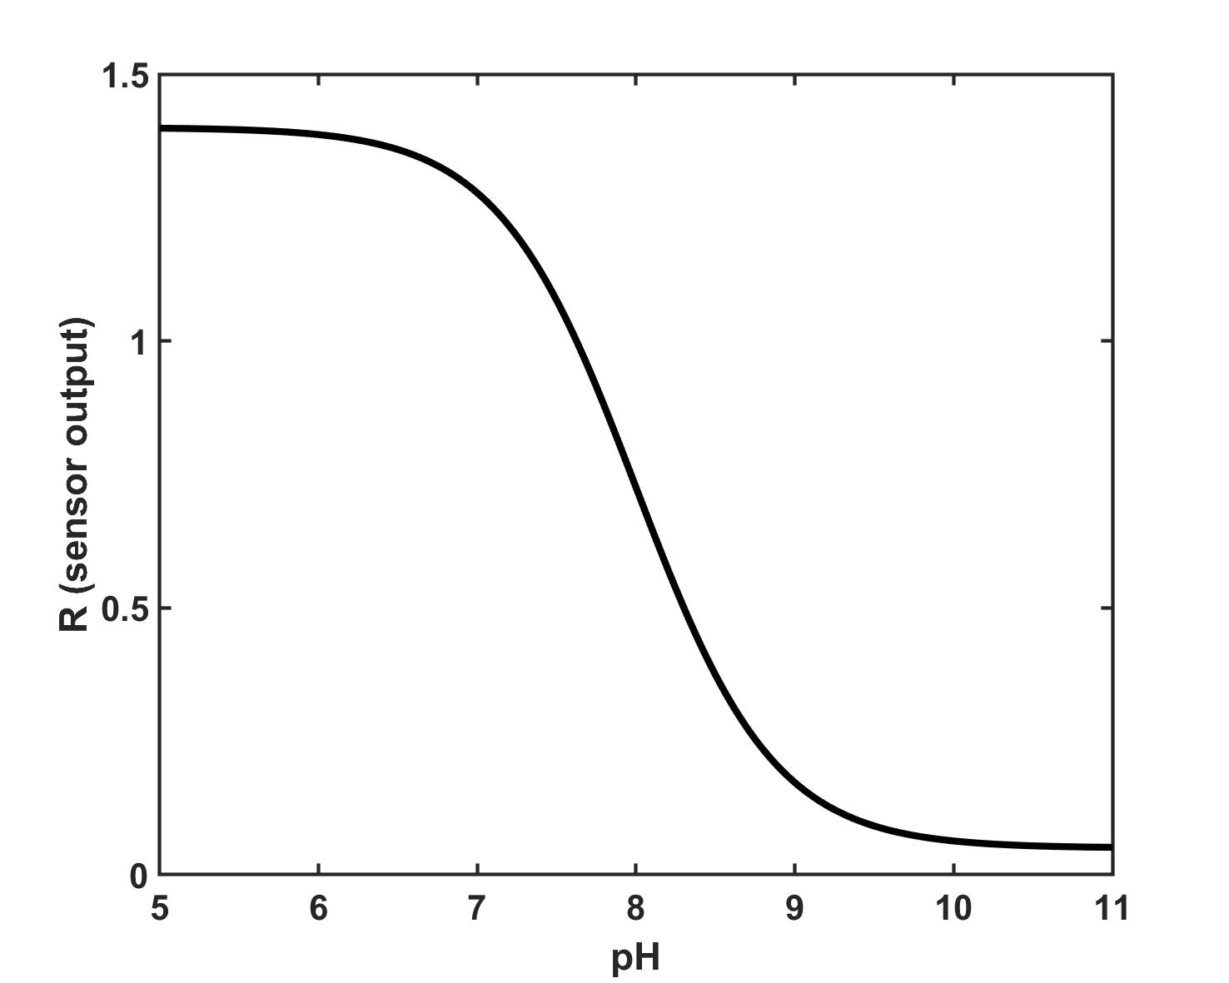
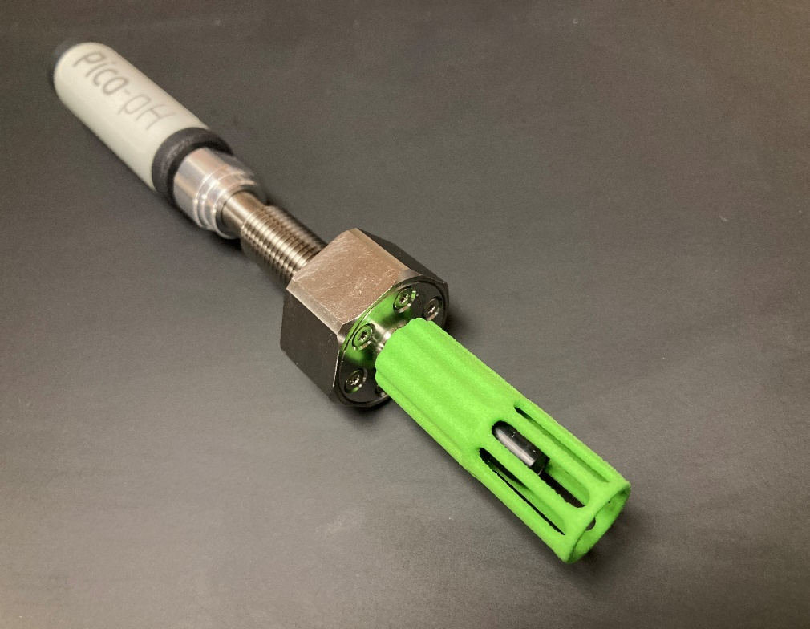

pH optode ‘Pico pH’
R1
pKa
slope
R2

Slide 10
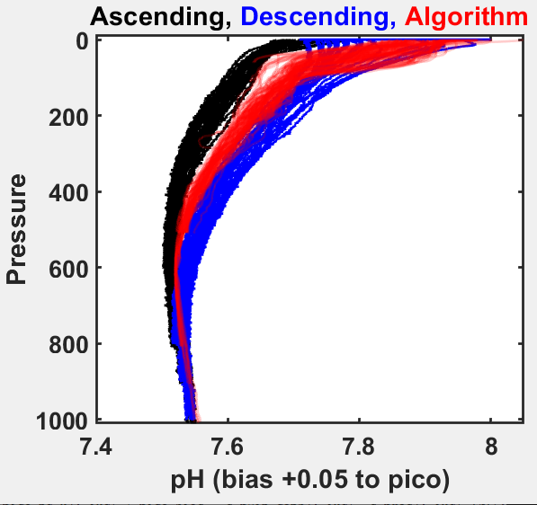
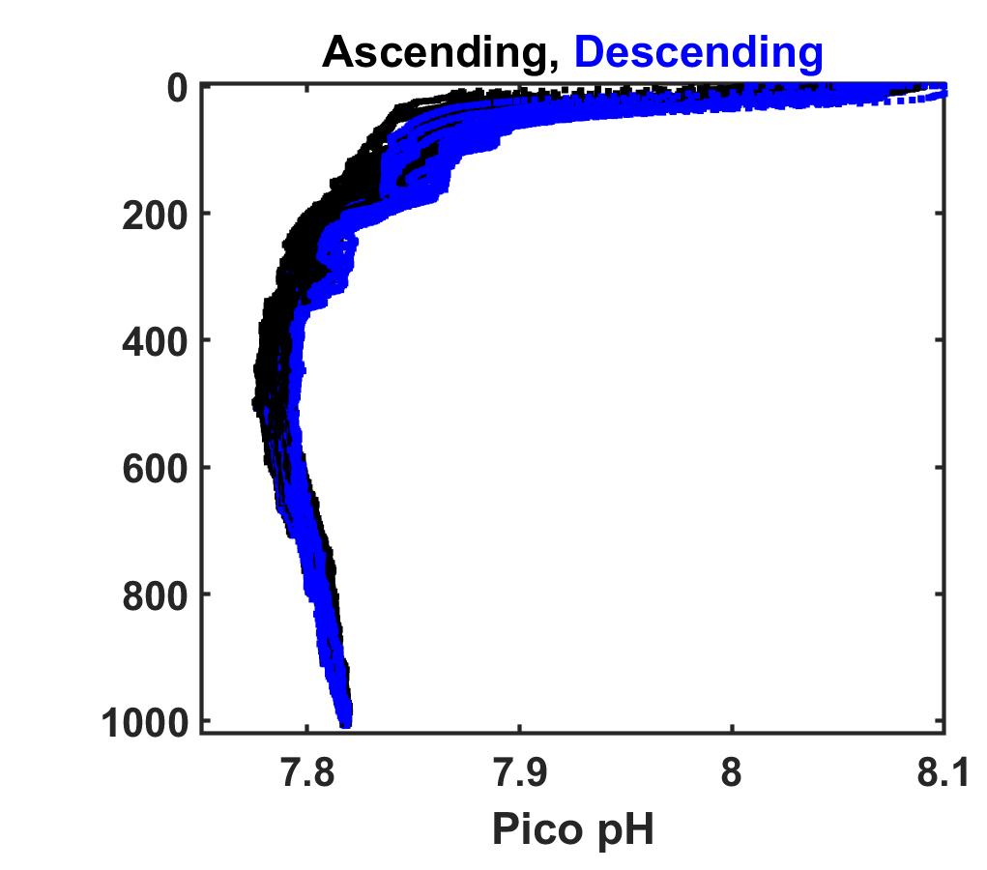
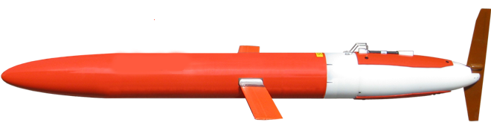
Field results from Spray glider
February 2023
July 2023
Original Foil,
Response time: 400-800 seconds
Fast response Foil,
Response time: 20-40 seconds

Slide 11

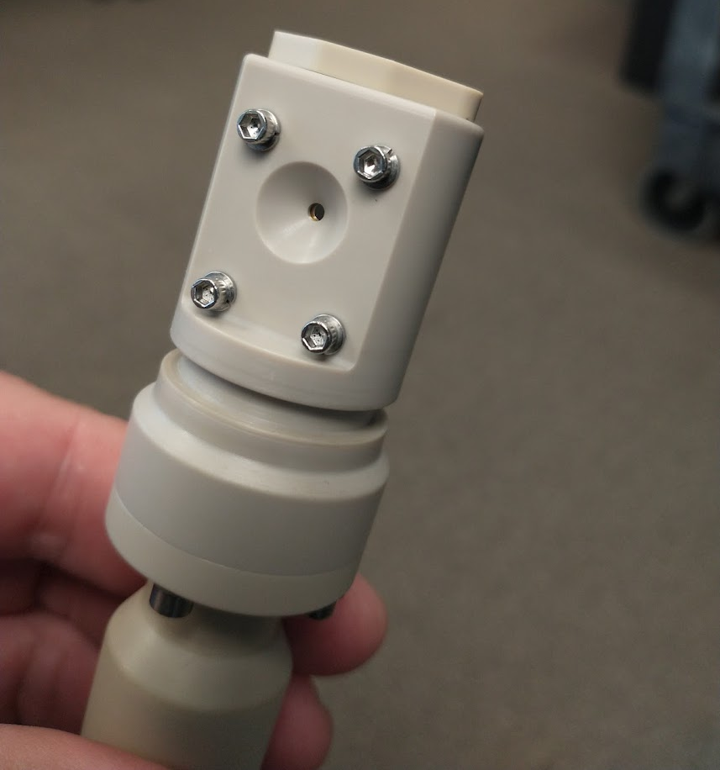
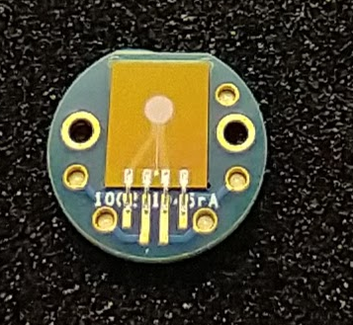
SURpH Sensor (ISFET)

Slide 12
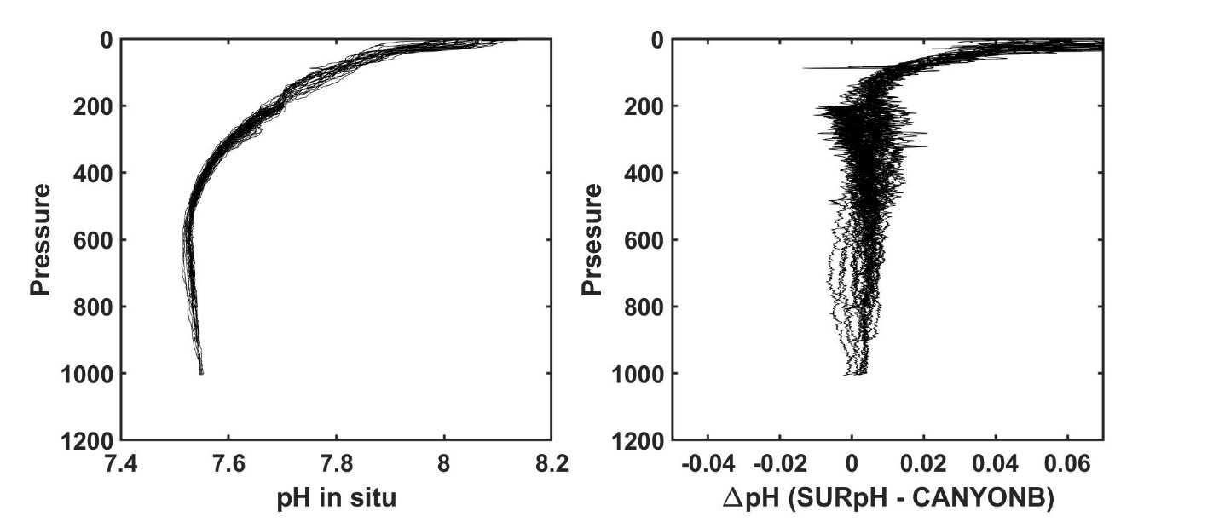
First test on Spray looks very promising
Profiles at M2

Slide 13
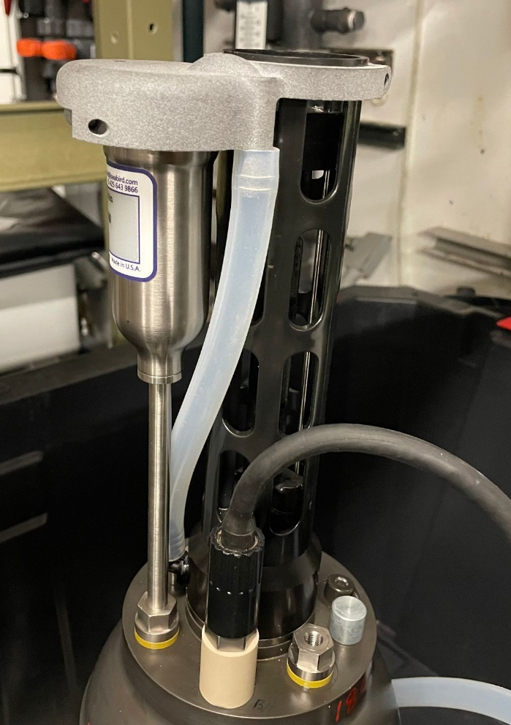
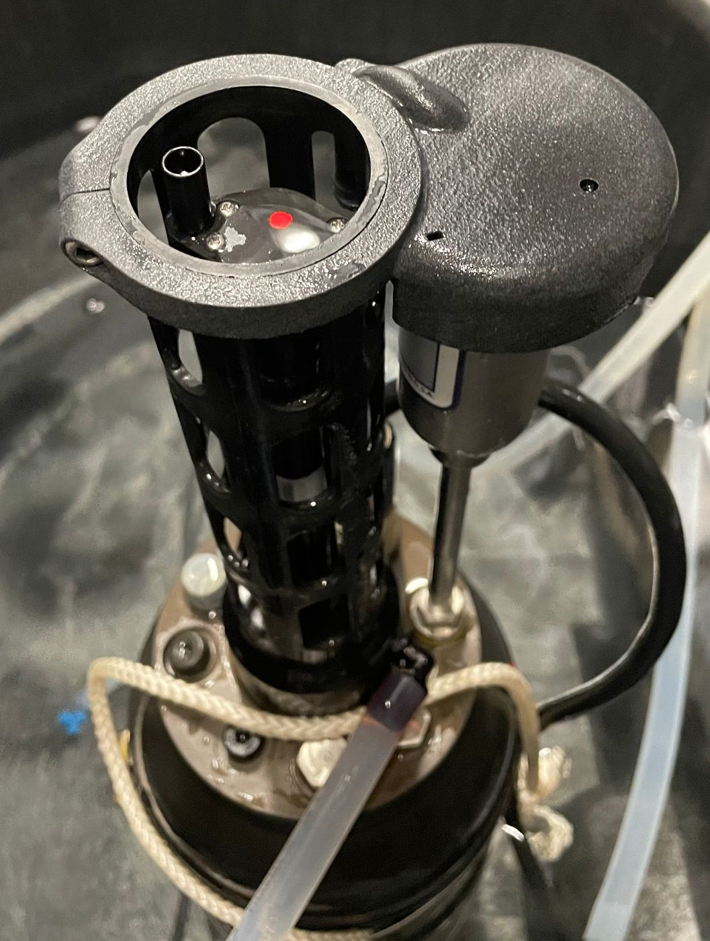
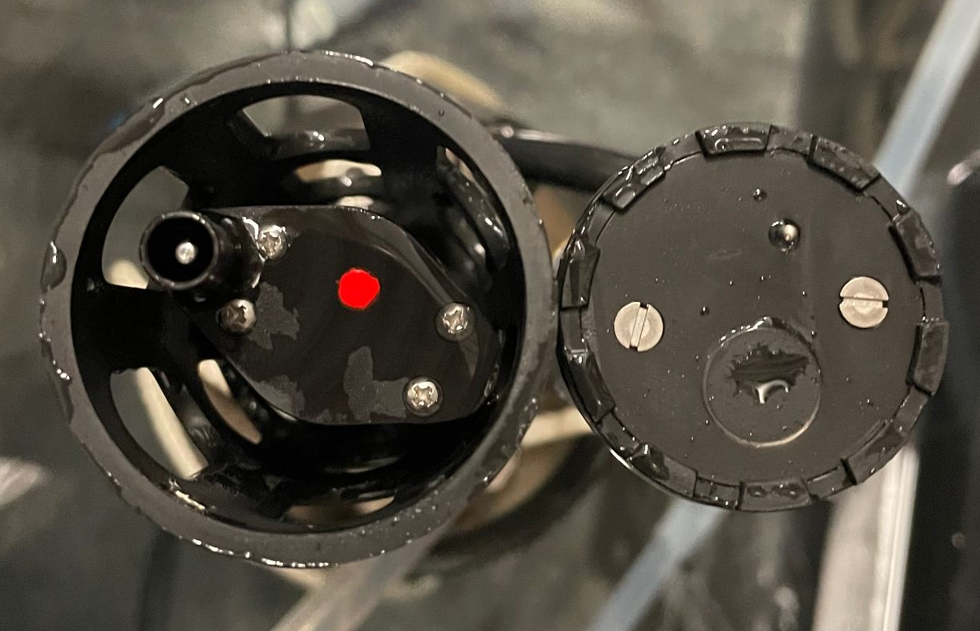
SBS83: a pumped and air-calibratable oxygen optode
Plenum
Sensing Foil
Flow Path
At surface, plenum drains exposing sensing foil to atmosphere for ai-calibrations
In pumped flow stream for faster response time

Slide 14
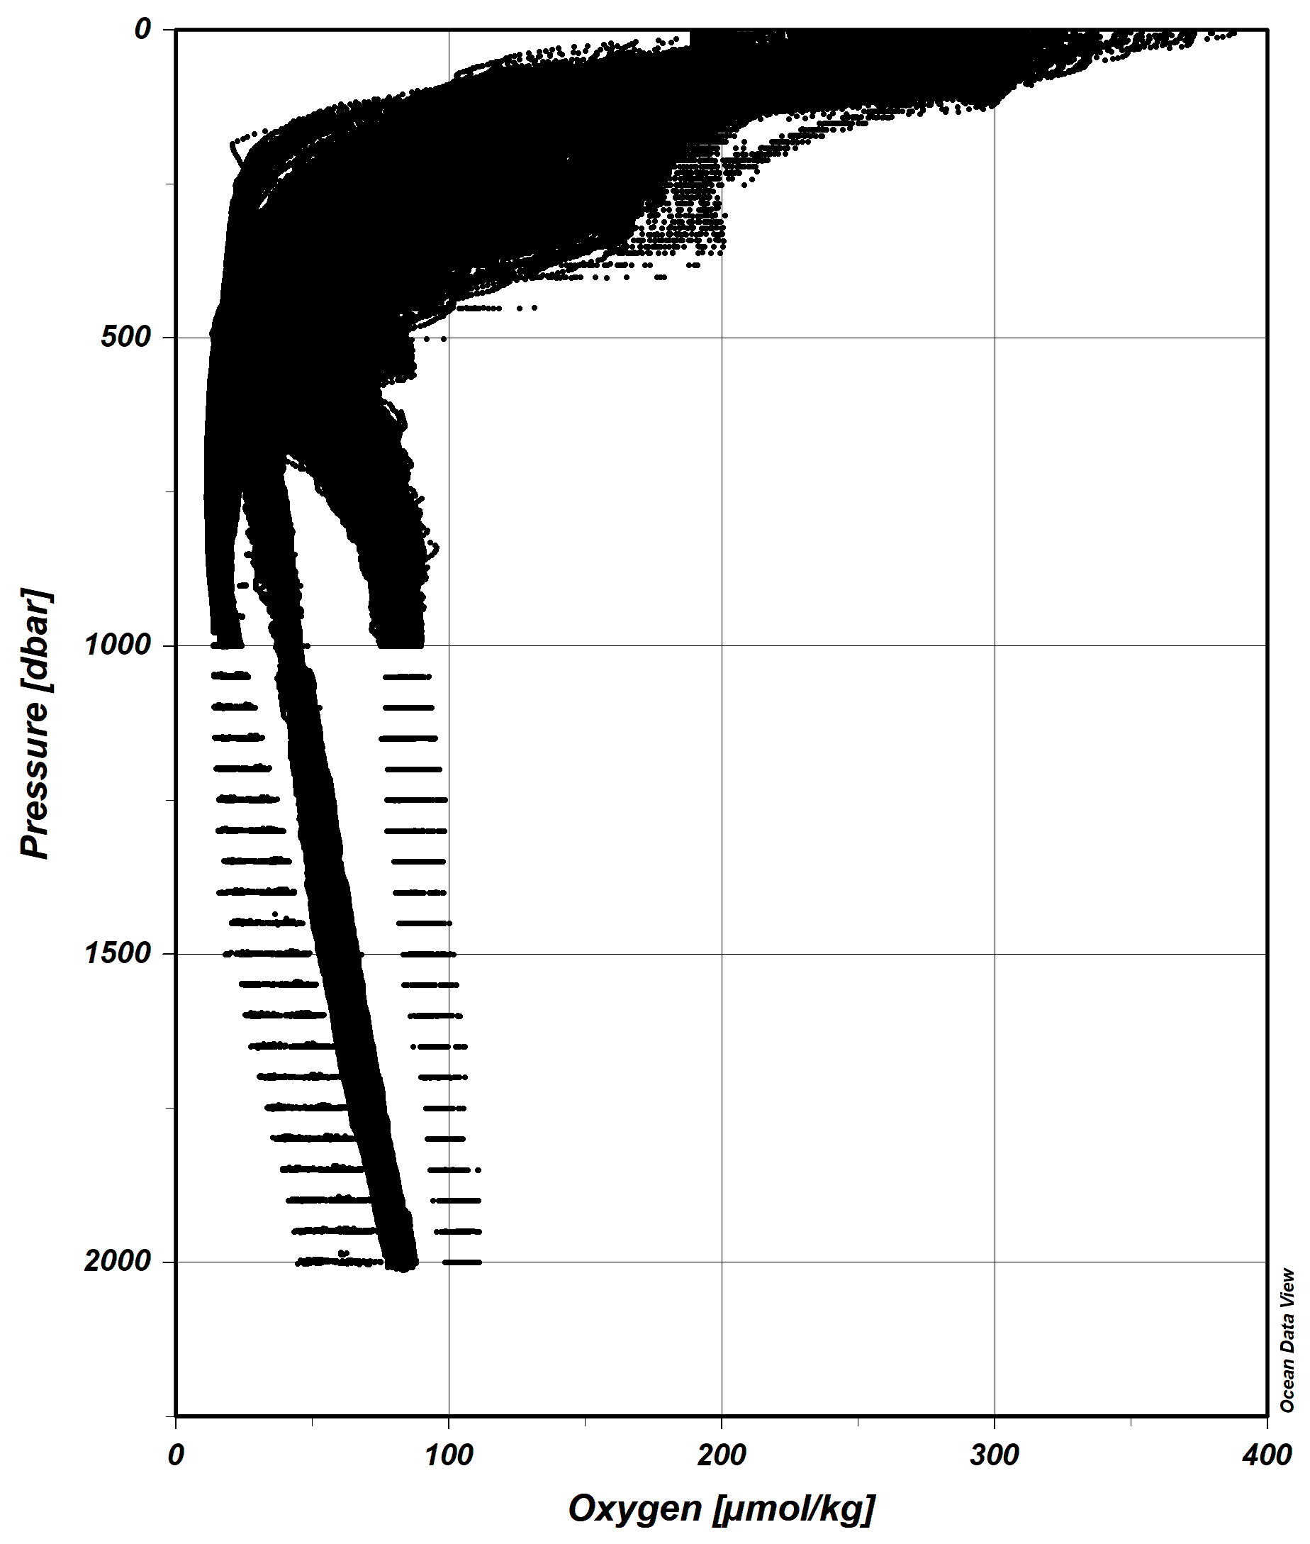
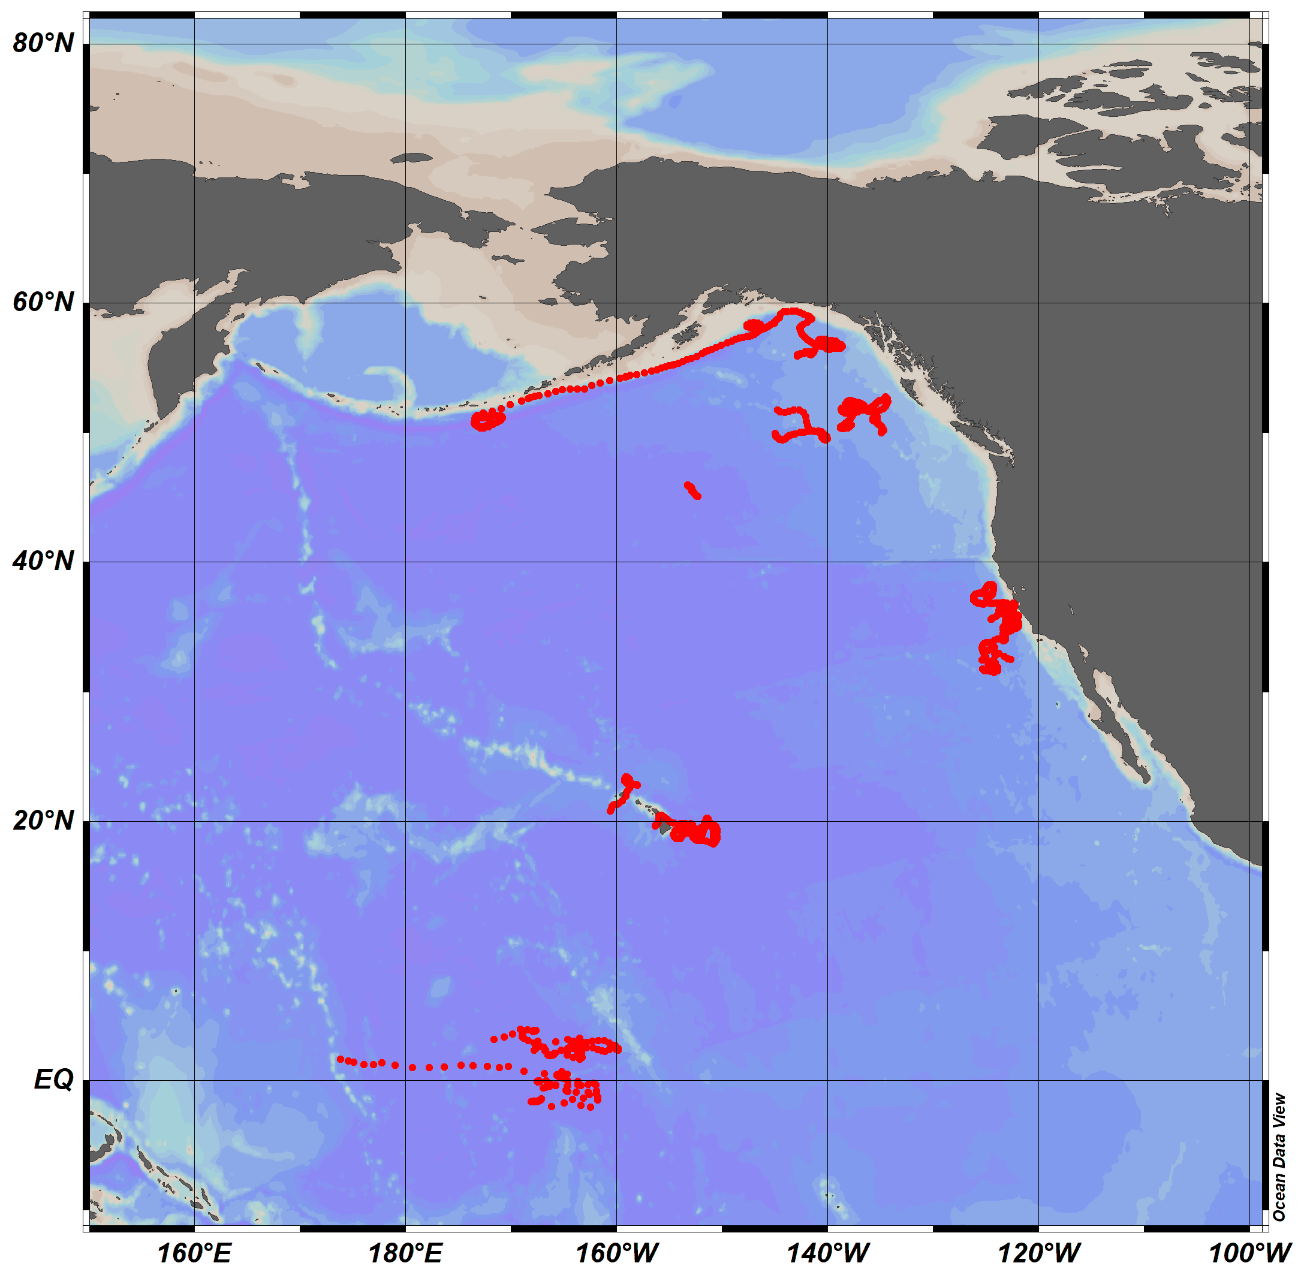
11 deployed worldwide
All sensors seem to be working well so far
8 in GDAC
3 TripleO2 floats

Slide 15
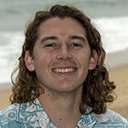
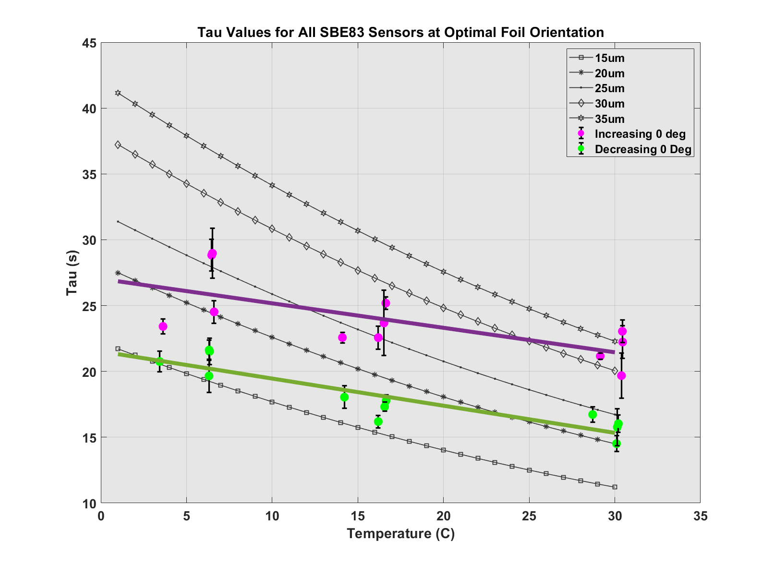
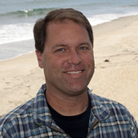
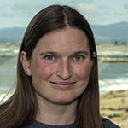
Quantifying Response Time in Lab

Slide 16
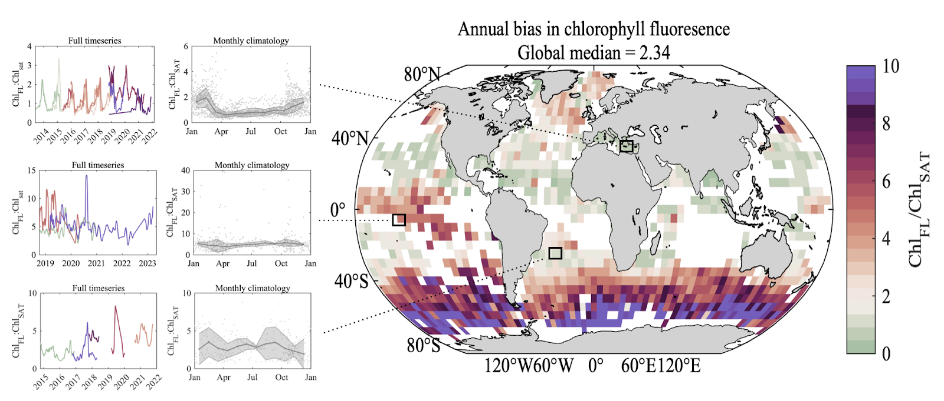
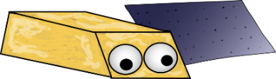
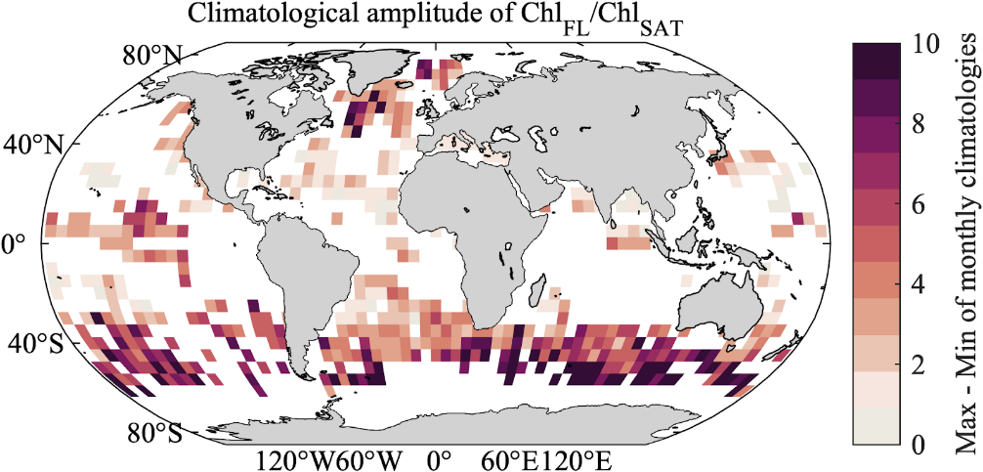
Gain ranged by an order of magnitude globally
Large, seasonal amplitude in gain correction

Slide 17
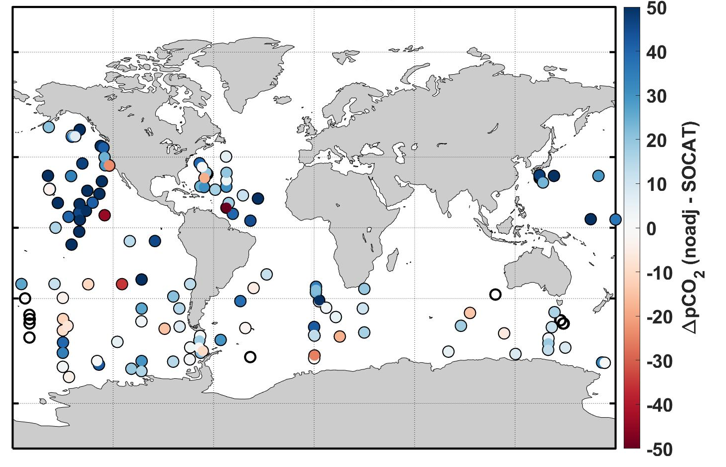
Accurate pCO from floats?
Float

Slide 18
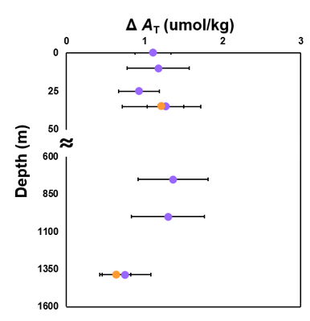
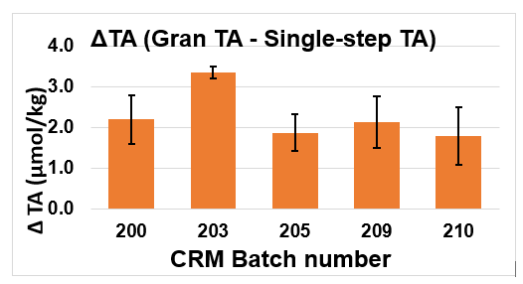
Organic Alkalinity (Lenka)
Profile at M2
Completed experiments demonstrating 2-4 umol/kg of organic alkalinity is consistently found in natural seawater, including M2
Results will be presented in Ocean Sciences, and UCSC seminar (March?)

Slide 19

Oxygen
Nitrate
Irradiance
Back-
scatter
pH
Chla Fluor.
Notes:
These are the 6 parameters that BGC-Argo

Slide 20

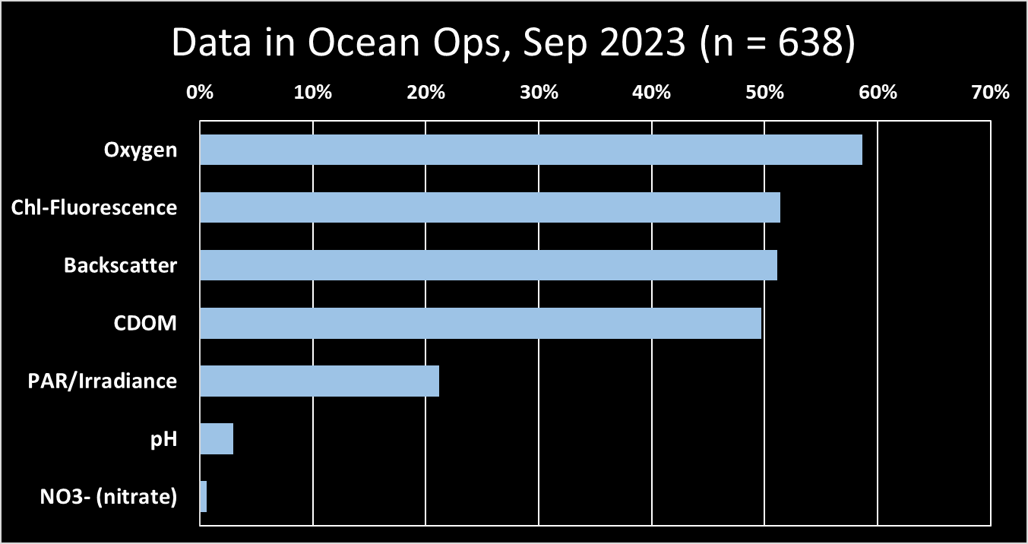
BGC sensors on gliders

Slide 21
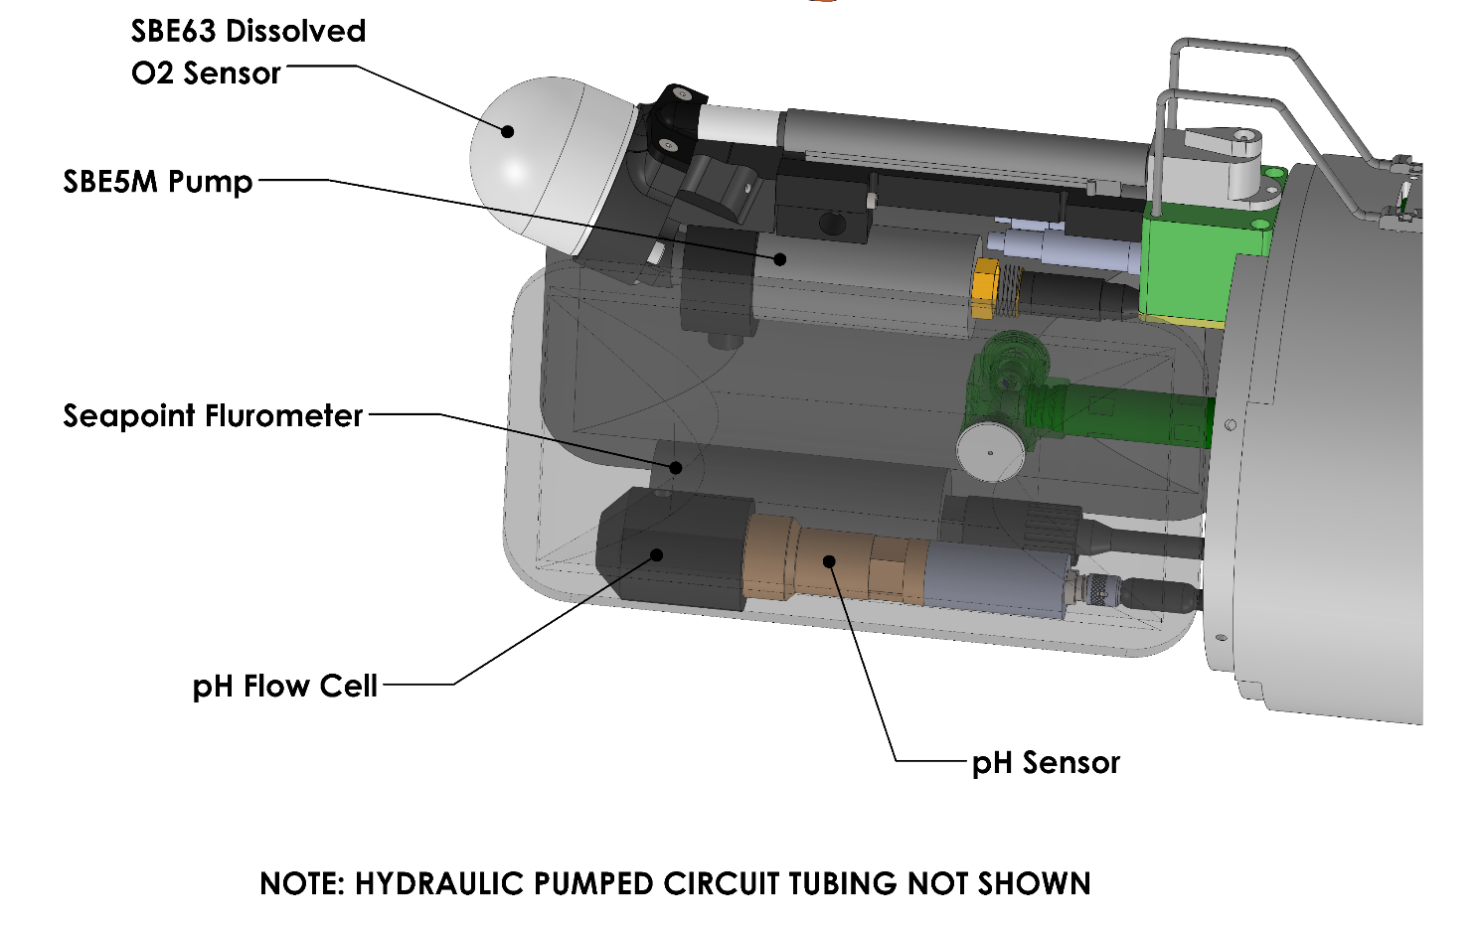
CTD
(Chl-a)
pH
Takeshita et al. 2021

Slide 22
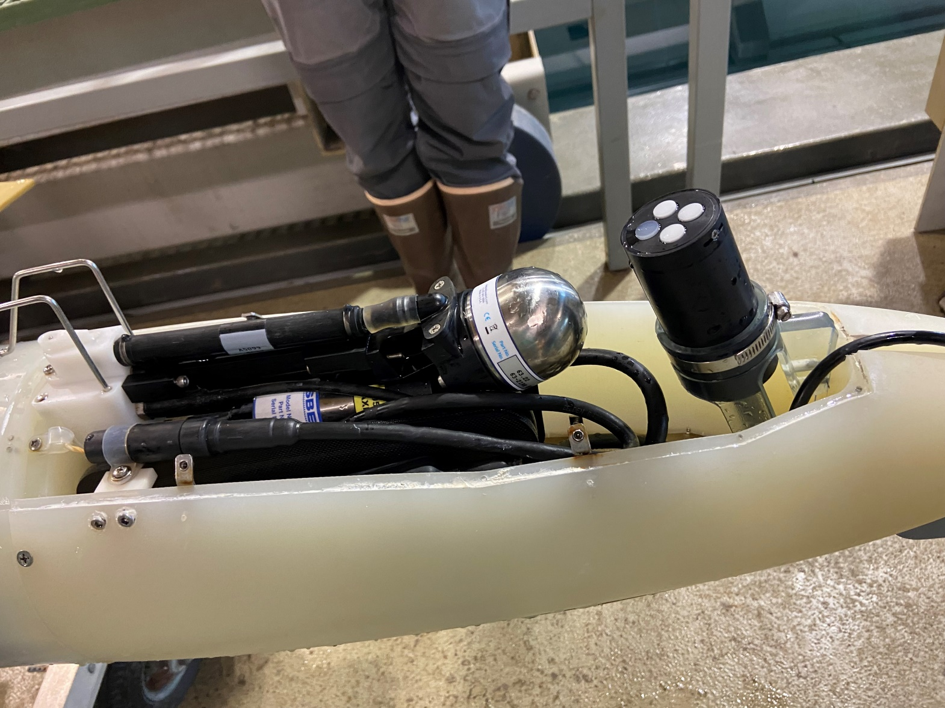
Radiometer
4-parameter Glider!
  O₂
  Chl-fl
  pH
  Downwelling Irradiance

Slide 23
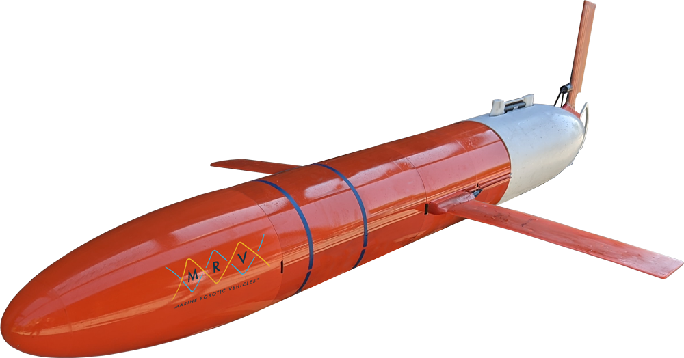


Spray2
Larger, more capacity
Designed for 6 BGC parameters
  SBS63 (O₂)
  Chl Fluorometer (Seapoint)
  Backscatter (FLBB/Seapoint)
  OCR-504
  ISFET pH
  Mini-ISUS

Slide 24
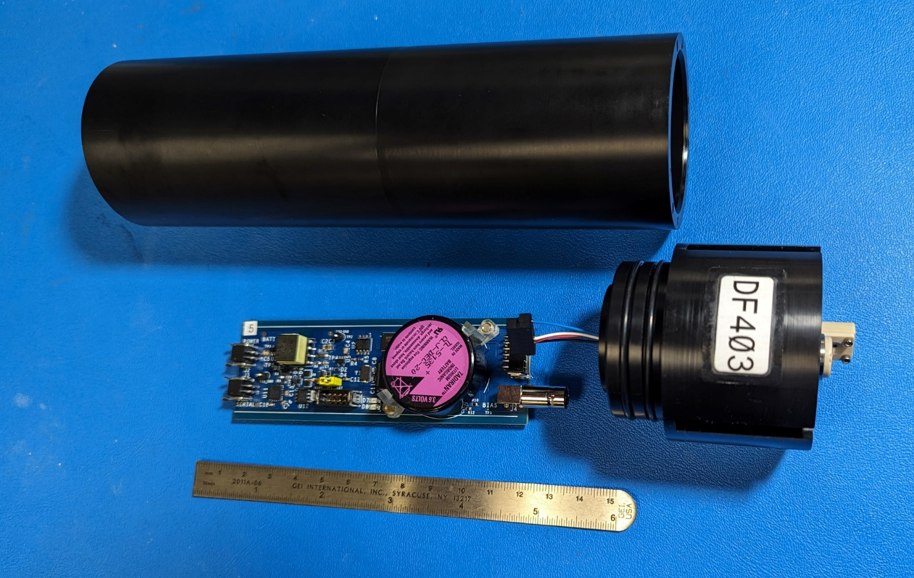
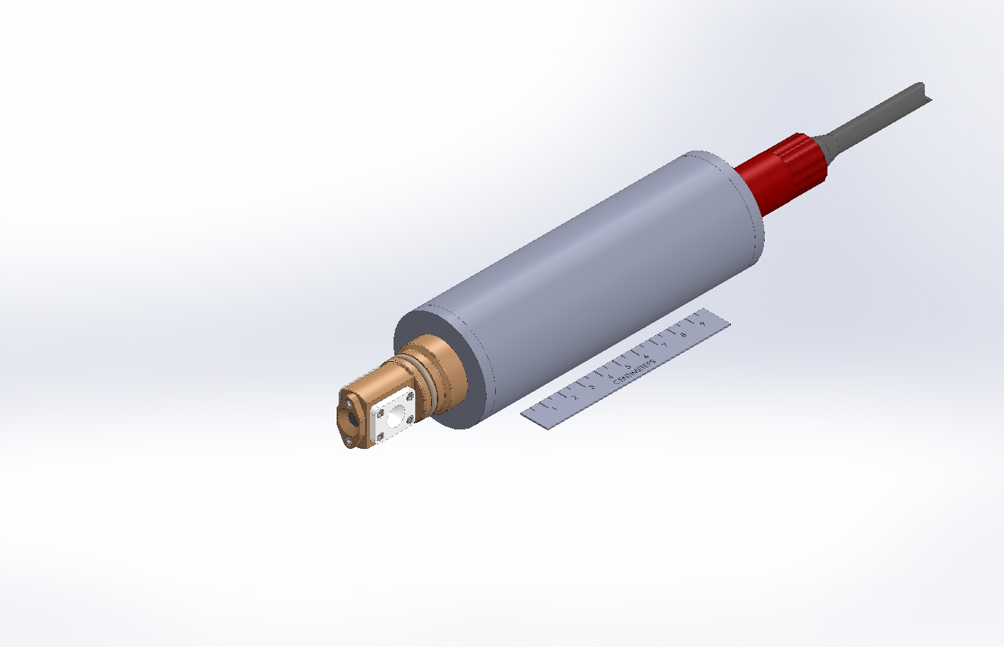
Modular pH sensor (NanoFET)
Same pH sensing element as Deep-Sea-DuraFET
Neutral/positively buoyant
Updated electronics
  1Hz sampling
  ~0.4 J/sample
  Bias battery lasts >1 year
Delivered first unit to SIO Q4 of 2023!
Can use SURpH sensors soon
Power, RS232
pH Electronics

Slide 25
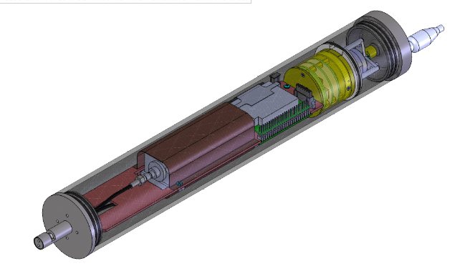
Mini-ISUS
Mostly same components as ISUS
  Smaller lamp
Neutrally buoyant
~14” long, 2.5” diameter
External power, RS232
>1 year delay from COVID
Aiming for field testing by mid 2024

Slide 26
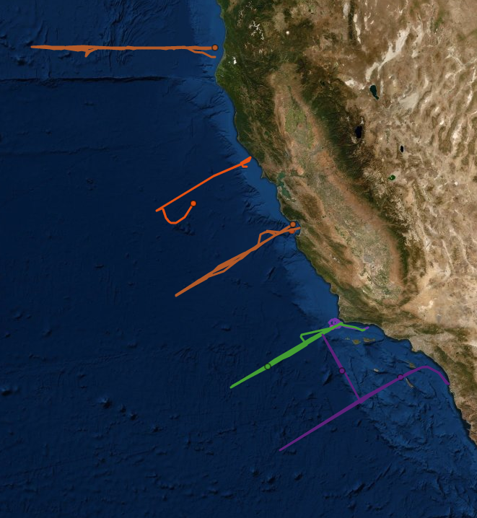
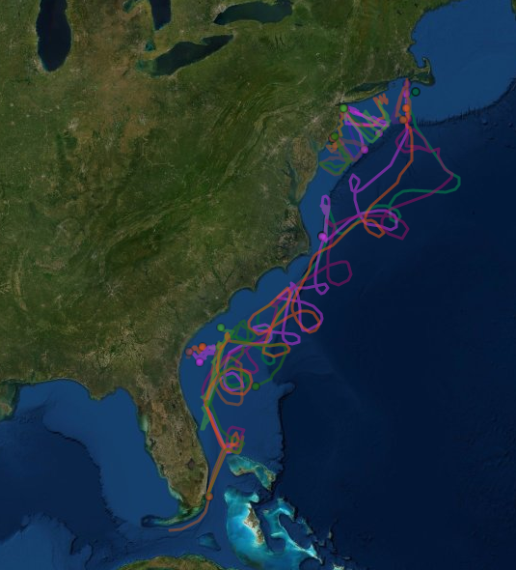

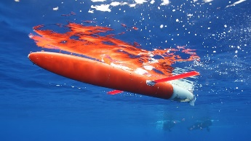

6 pH + Nitrate gliders over 3 years (2025-2027)
4 pH gliders over 2 years
(2024-2025)
Rudnick et al. 2016
Todd et al. 2016

Slide 27
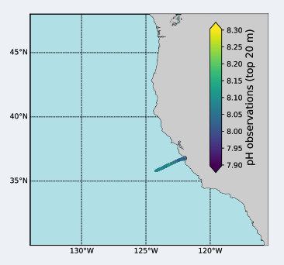
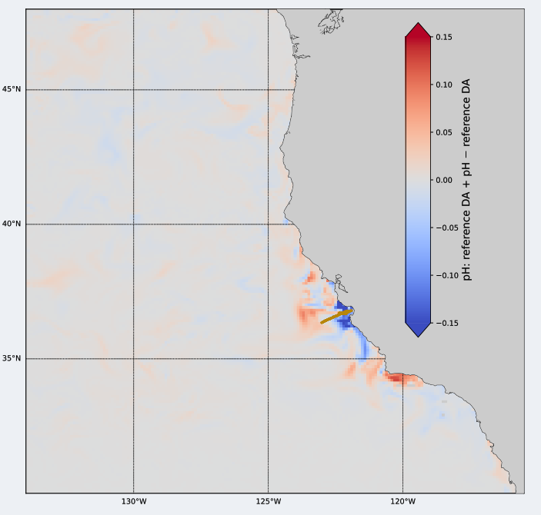
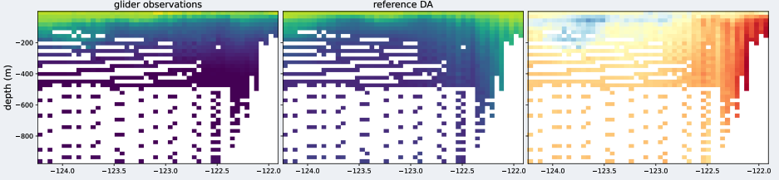
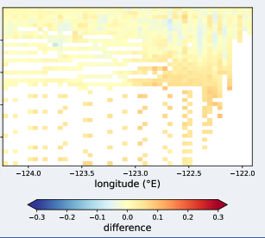

California Current: Improve Model Performance
Large Spatial impact!!
(Model – glider)
Mattern, Edwards, unpublished data

Slide 28
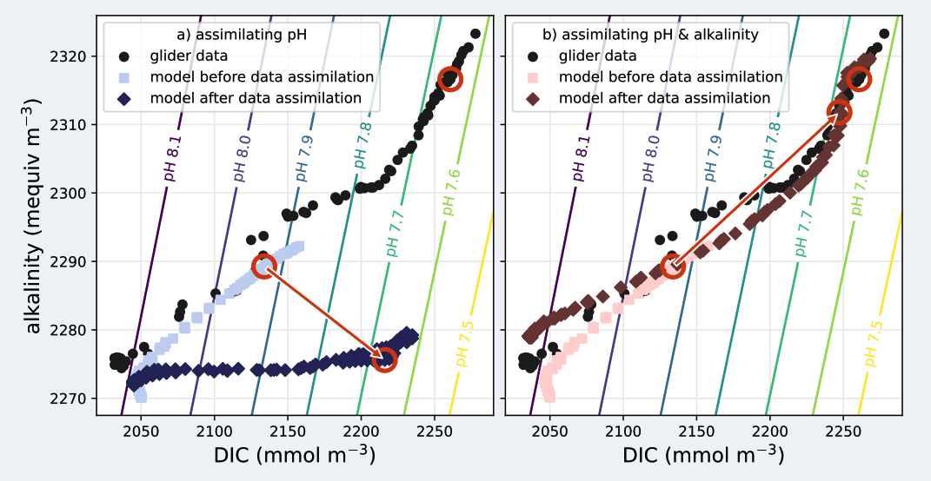
Mattern, Edwards, unpublished data

Slide 29
Schedule
First pH sensor delivered to SIO, Q4 2023. Firmware integration almost complete. First test deployment with pH projected March 2024.
Mini-ISUS delivery projected June/July 2024. Firmware integration has started with mock controller.
WHOI/MRV Spray2 test deployment: August 2024
Ocean Alkalinity Enhancement experiment (LOCNESS) August 2025 (5x Spray2s with pH)
2025: 2x BGC Spray2 (pH + nitrate) in SCOOS + CeNCOOS

Slide 30
pH sensor production 2024
3-4 units: WHOI/MRV (Depends on MRV’s Spray2 delivery)
3 units: MBARI (2 Sprays, 1 LRAUV)
1 unit: SIO (maybe)
Maybe 1 unit: OSU
If we have bandwidth: 2 for WireWalkers (Humboldt, MBARI)

Slide 31
Sensor production in 2025 and beyond (so far)
2025
2x pH to WHOI
2x pH + 2x NO3 to SIO (split SCOOS/CeNCOOS)
2026
2x pH + 2x NO3 to SIO (split SCOOS/CeNCOOS)
2027
2x pH + 2x NO3 to SIO (split SCOOS/CeNCOOS)

Slide 32
NanoFETv2
Shrink the current pH sensor -> led by Irene
  Target: Size of Seabird 5M or 5P pump
Test on MBARI Spray maybe by end of year
Phase them in to Spray2 network in 2025-?
Power, RS232
pH Electronics

Slide 33


Synchro
LRAUV + Planktivore
Combine imaging with passive acoustics
Target: April ~18 with Chavez Cruise (most likely)
Spray + passive acoustics

Slide 34

PIE (PCO2 Intercomparison Experiment)
Show animation in Google Earth

Slide 35



M2
67-75
150 m dives (~hourly)
10 days
67-90

Slide 36

Surface 5 m

Slide 37

Surface 5 m

Slide 38

Surface 5 m
Hourly Variability

Slide 39


Wire Walker pH

Slide 40

2024 timeline
Deliver first NanoFET MRV/WHOI
Spray2 pH SIO
Deliver mini-ISUS to SIO
Spray missions
THOON WW deployment?
Jan
Feb
Mar
Apr
May
Jun
Resolve ground fault issue
PIE (Spray + Tiny) SN34
SURpH in NanoFET ?
Synchro Glider
Spray29 science deployments (Line 67, diel cycles)
NanoFETv2 Electronics prototype
OAE test cruise with Spray2
Spray2 pH test deployment WHOI
Chem sensor Cruise?
Jul
Aug
Sep
Oct
Nov
Dec
PIE (Spray + Tiny) SN34
Spray29 science deployments (Line 67, diel cycles)
Test NanoFETv2 SN29

Slide 41



Slide 42


