Slide 1
901805 Coastal Biogeochemical Sensing Group Plan 2021
Jan 12, 2021

Slide 2
Four Main Categories of activities
BGC Spray Glider (pH, nitrate, bio-optics)
Benthic Flux systems (coral reefs)
Marine CO₂ thermodynamics
Sensor/System development

Slide 3
BGC Spray Glider
Operational
  Test pH sensors from SBE and MBARI (opportunistically, ~1 week each)
  Seasonal transect along line 67 (4x per year, ~2 weeks per transect)
  Support CANON (2x gliders, April 12-17). Fall CANON?
  2x deployment with 2 Sprays and WG-Tiny to compare pCO₂. 2 weeks each
  WF Cruise (May 8-14). To test empirical algorithms in S. California
Development
  ‘nanoFET’ development
  Deploy with ISUSv2 (June Target, CeNCOOS funded)

Slide 4
Spray Deployments
Test pH sensors from SBE and MBARI (opportunistically, ~1 week each; measure ascent and descent)
Seasonal transect along line 67 (4x per year, ~2 weeks per transect)
Support CANON (2x gliders, April 12-17). Fall CANON?
Updates before deployment:
  Use new mFET/mCAP boards, single input for bias battery, using D-Cell.
  Measure bias battery voltage (send back in real time too).

Slide 5
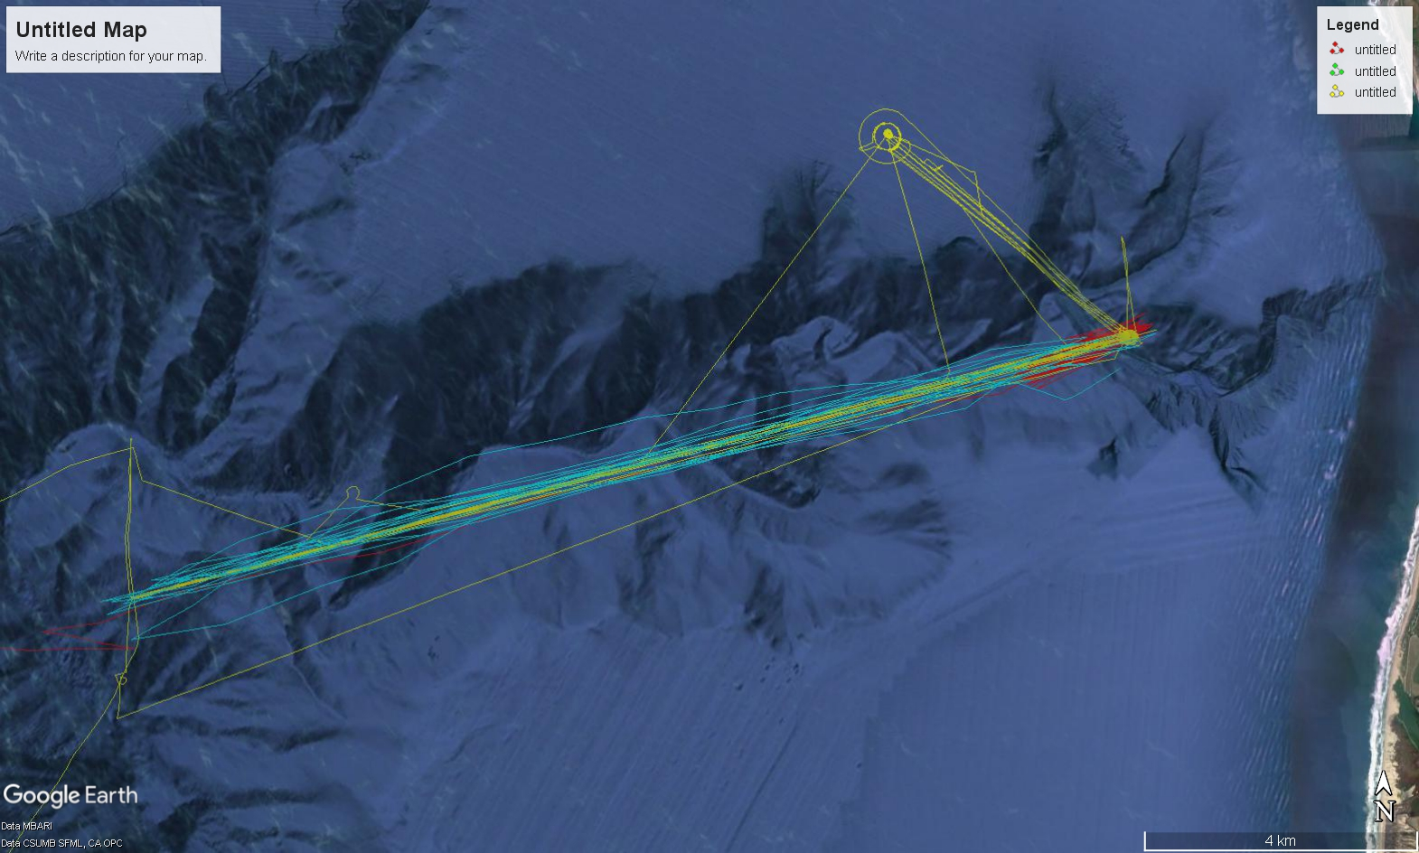


WG Tiny and Spray pCO₂ comparison
Stuck CPF
Spray034
Spray029
Track from Summer CANON 2020

Slide 6
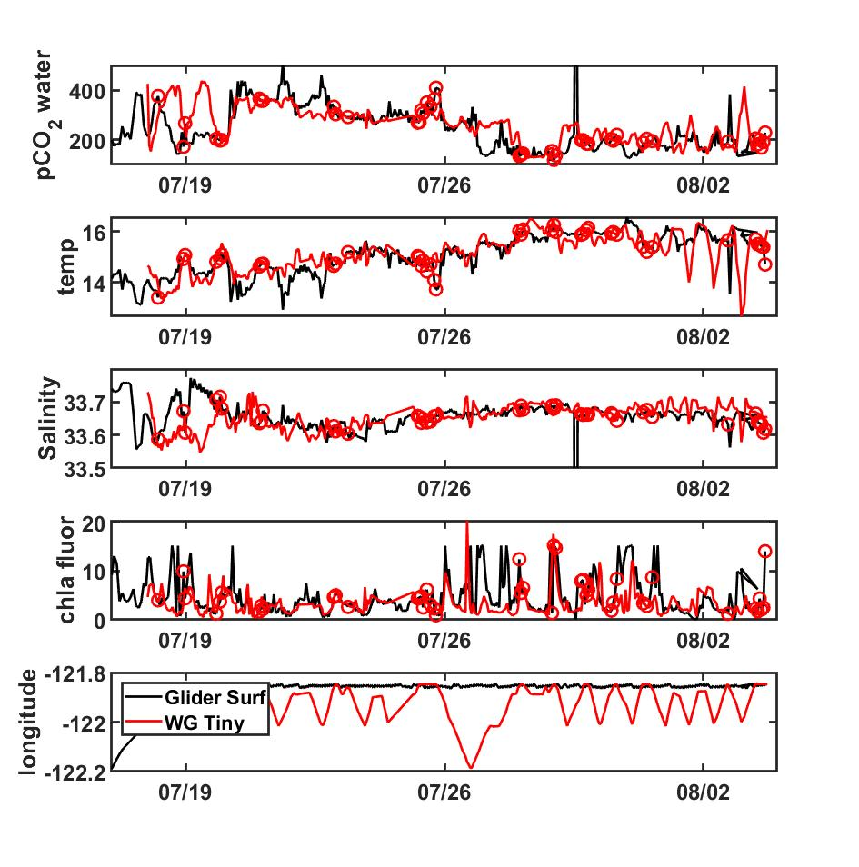
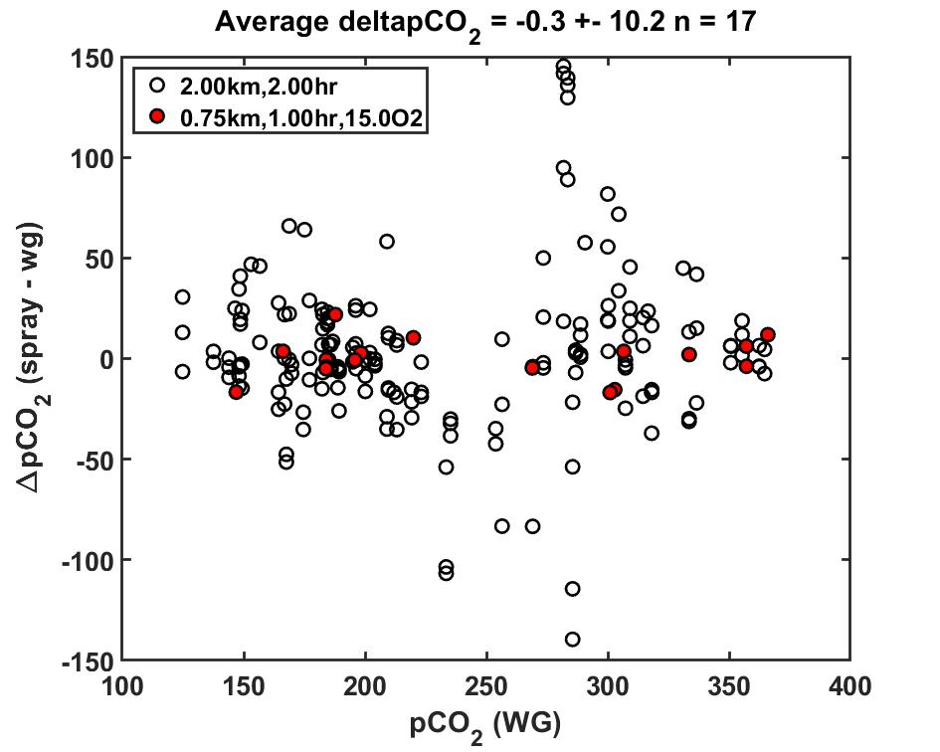
WG Tiny and Spray034 comparison
Within 1 km

Slide 7
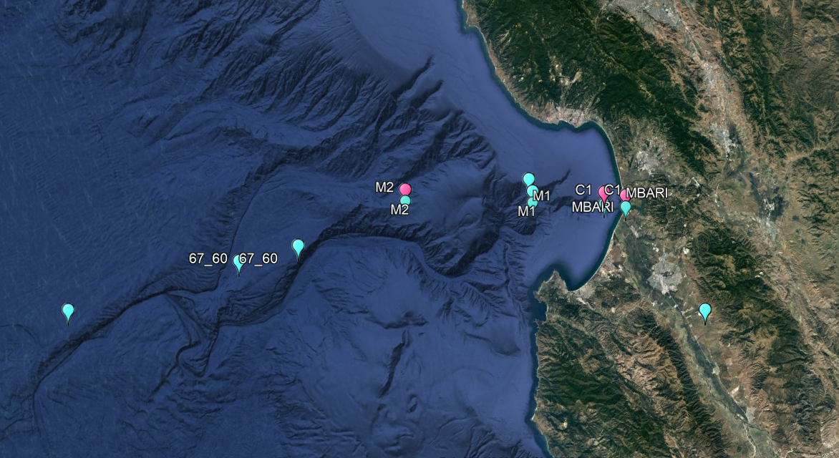
Proposed Mission locations 2021
April
November

Slide 8
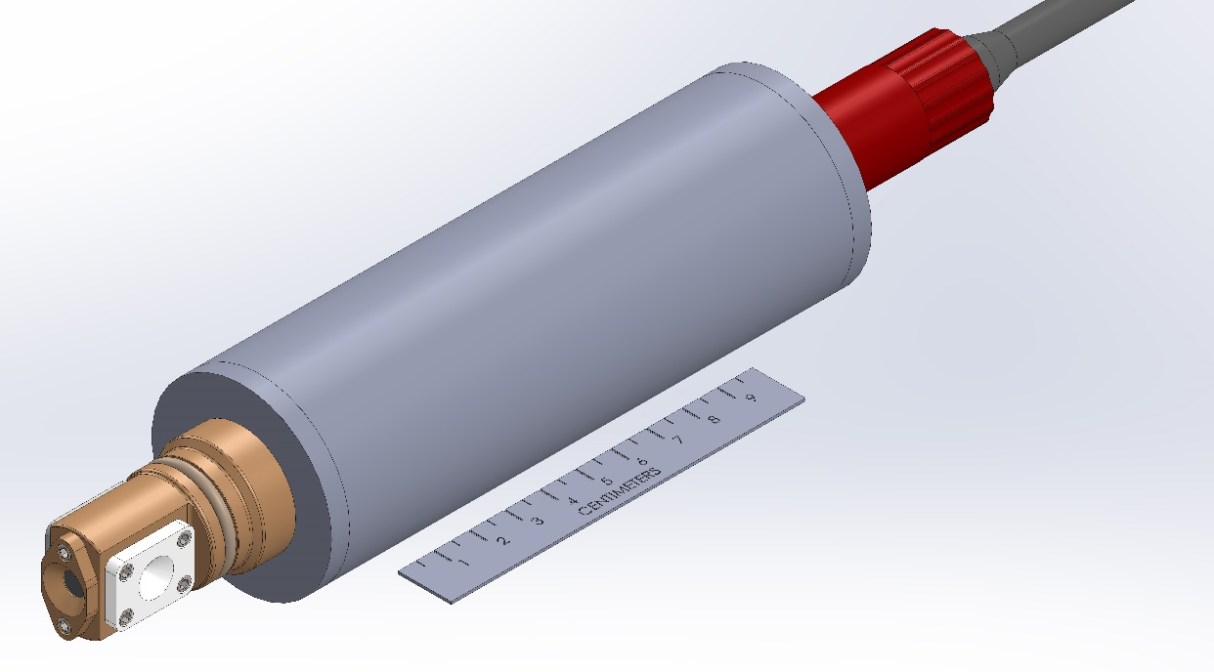
‘nanoFET’ development
Isolation scheme currently being tested
Target date for prototype fabrication to test in lab? Before phase I.
Target date for prototype fabrication for glider deployment?
Electronics, bias batt included inside

Slide 9
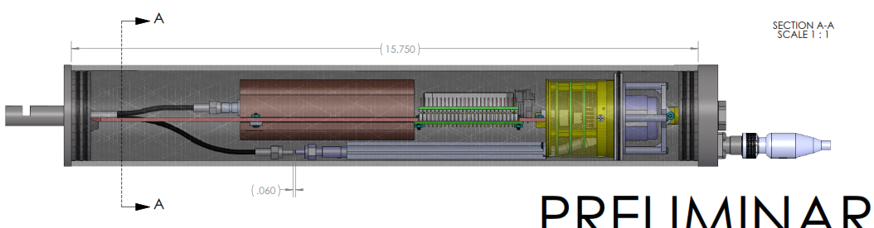
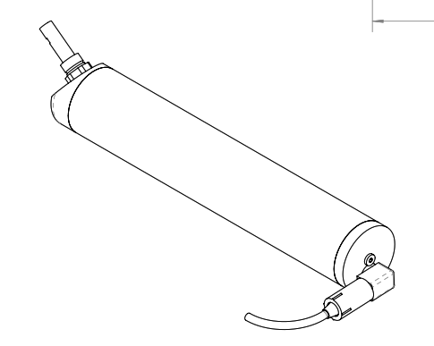
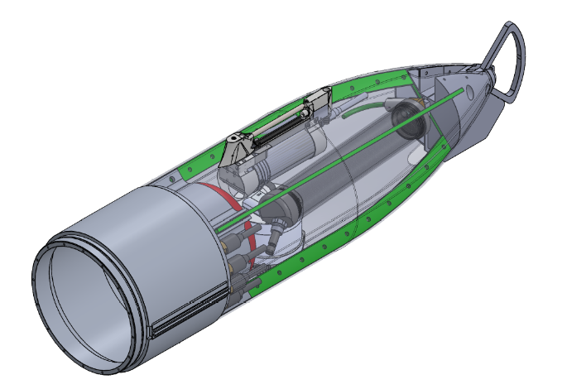
ISUSv2
Funded by CeNCOOS to deploy on Spray
  Powered by Spray. Logged internally by ISUS? Or polled?
  Prototype by end of year?
  No-cost extension possible
Long-term goal is Spray2 (SIO)
Spray 2 tail drawing

Slide 10
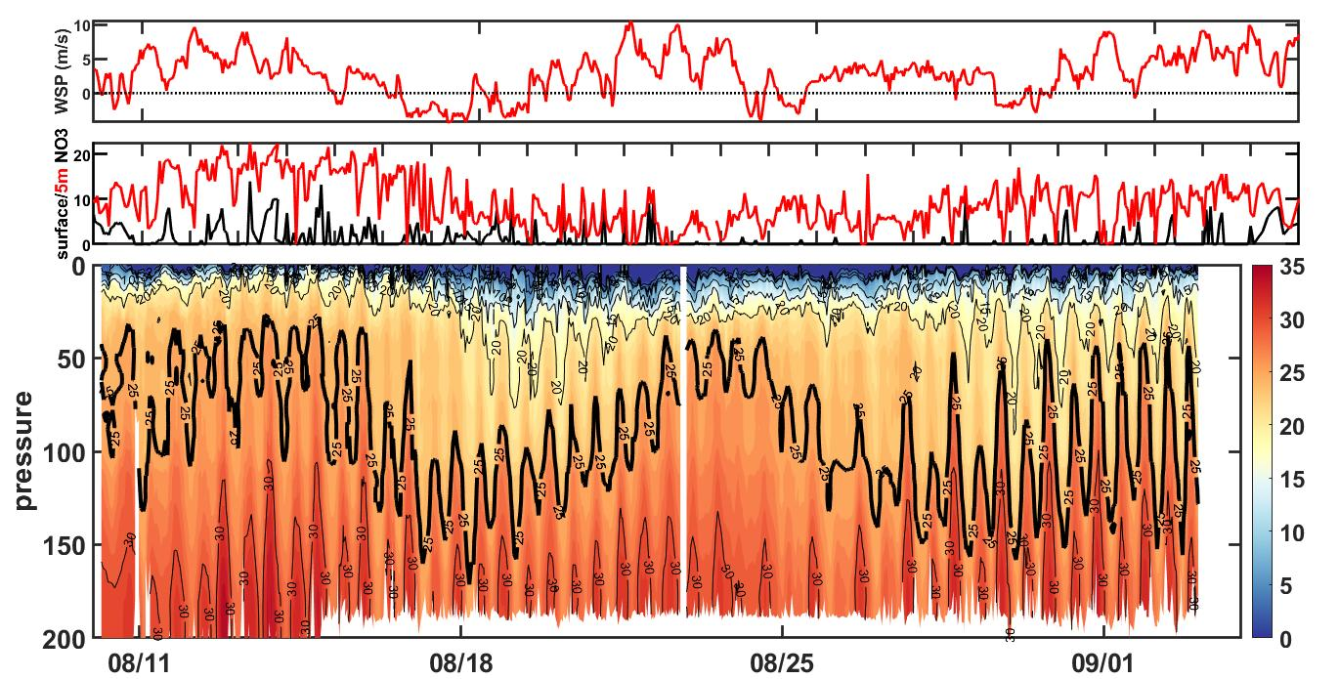
Potential Science ISUSv2: Tidal pumping at C1

Slide 11
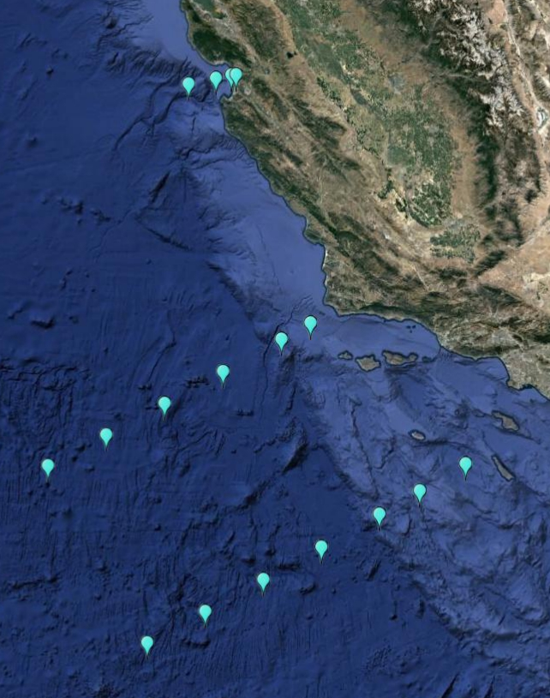
WF cruise (May 8- 15)
Primary objective: test empirical algorithsm to predict pH in Southern California (for glider operations)
Need to adjust cruise plan due to limited personnel
  Spend one day in SB Basin for nitrite
  Select stations in Southern transect
Nitrite (1day)
Initial station map
Priority Transect

Slide 12
Sensor/System Development
Self-Calibrating SP for Monterey Pier (CeNCOOS funded)
UV-LED to combat biofouling on backscatter sensor
Hyperspectral absorbance profiles for phytoplankton community composition.

Slide 13
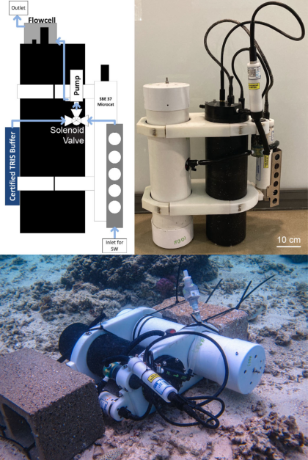
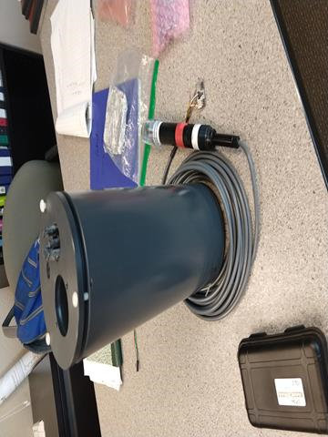
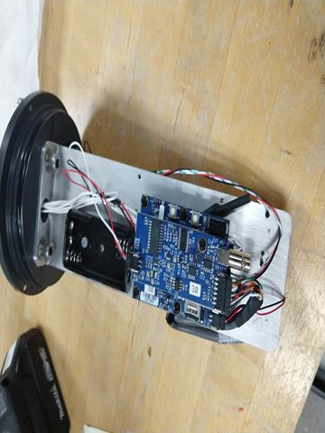
Self-Calibrating SeapHOx
Smaller housing
Use mpHOx board
Characterize response time to Tris (wet lab)
Target deployment: late summer 2021

Slide 14
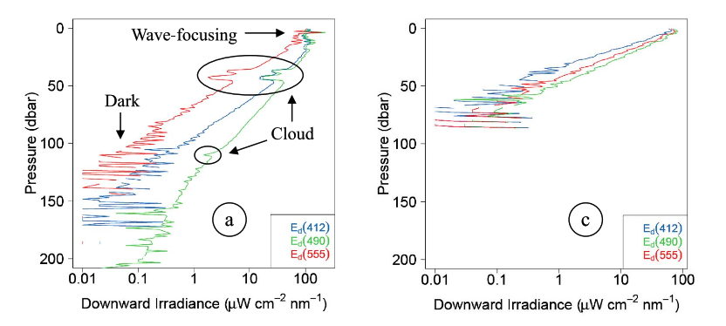
Hyperspectral absorbance for Phyto composition
If we can get full spectra across visible range, then we can potentially get various ratios of Chl pigments, which should be related to phytoplankton community
Sebastian will collect absorbance spectra for dominant phytoplankton communities in Monterey Bay
Can we get an upward facing spectrometer, and profile up/down with Paragon? Will MMS work? Or smaller spec?
Radiometers get absorbance at several wavelengths. Good at getting [Chl] profiles

Slide 15
Benthic Flux
Deploy BEAMS in Kahekili, Maui (late summer, COVID permitting)
  Need mpHOx board, with BEAMS firmware
Develop multi-analyte eddy covariance (pH, O₂, nitrate)
  Led by Irene?

Slide 16
Marine CO₂ thermodynamics
Simultaneous measurement of pCO₂, pH, TA, and DIC in lab
  Need mFET boards
Explore organic alkalinity (need mFET boards)
  Need mFET boards
NSF proposal in review; potential postdoc

Slide 17
2021 Proposed activities overview
BGC Spray Glider
  Test pH sensors from SBE and MBARI (opportunistically)
  Seasonal transect along line 67 (4x per year, ~2 weeks per transect)
  Support CANON (2x gliders, April 12-17)
  ‘nanoFET’ development
  Deploy Spray with ISUSv2 (June Target, CeNCOOS funded)
  2x deployment with 2 Sprays and WG-Tiny to compare pCO₂. 2 weeks each
  WF Cruise (May 8-14). To test empirical algorithms in S. California
Benthic Flux
  Deploy BEAMS in Kahekili, Maui (late summer, COVID permitting)
  Develop multi-analyte eddy covariance (pH, O₂, nitrate)
Marine CO₂ thermodynamics
  Simultaneous measurement of pCO₂, pH, TA, and DIC in lab (need mFET boards)
  Explore organic alkalinity (need mFET boards)
Sensor/System Development
  Self-Calibrating SP for Monterey Pier (CeNCOOS funded)
  UV-LED to combat biofouling on backscatter sensor
  Hyperspectral absorbance profiles for phytoplankton community composition

Slide 18
Spray-WG #1
CANON (2x Spray)
WF cruise (1x Spray)
Jan
Feb
Mar
Apr
May
Jun
Prelim PP absorbance
nanoFET lab
Spray-WG #2
Jul
Aug
Sep
Oct
Nov
Dec
ISUSv2 Glider
Self-calib SP
BEAMS (Maui)
nanoFET Glider

