Slide 1
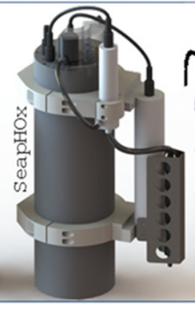
mpHOx
Sensor package, which measures pH, O₂, CTD
mpHOx is a miniaturized SeapHOx (right), which was developed at SIO, commercialized at Seabird
Goal is to make it smaller so it is easier to deploy/ship, enabled by controller developed by S. Jensen

Slide 2
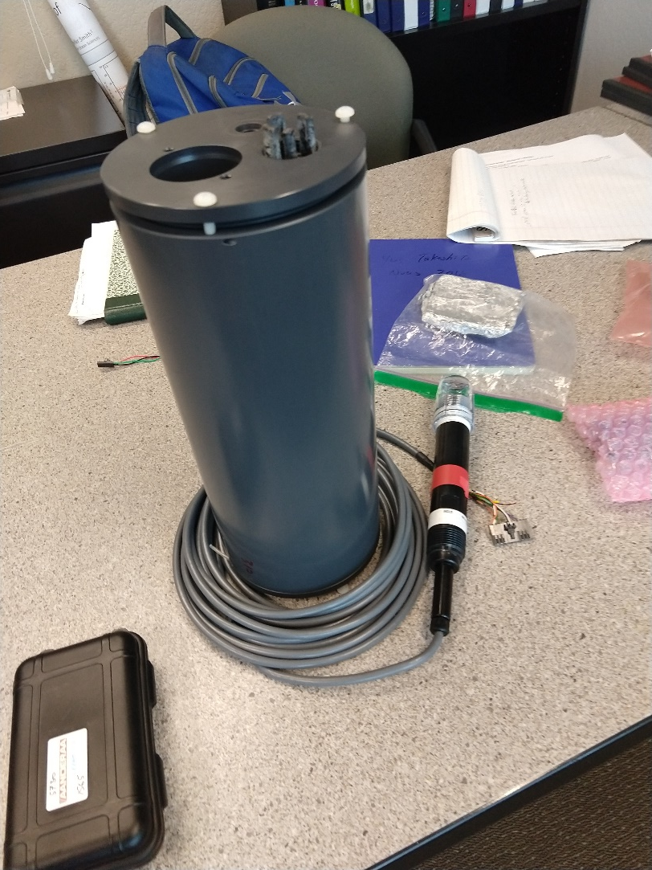
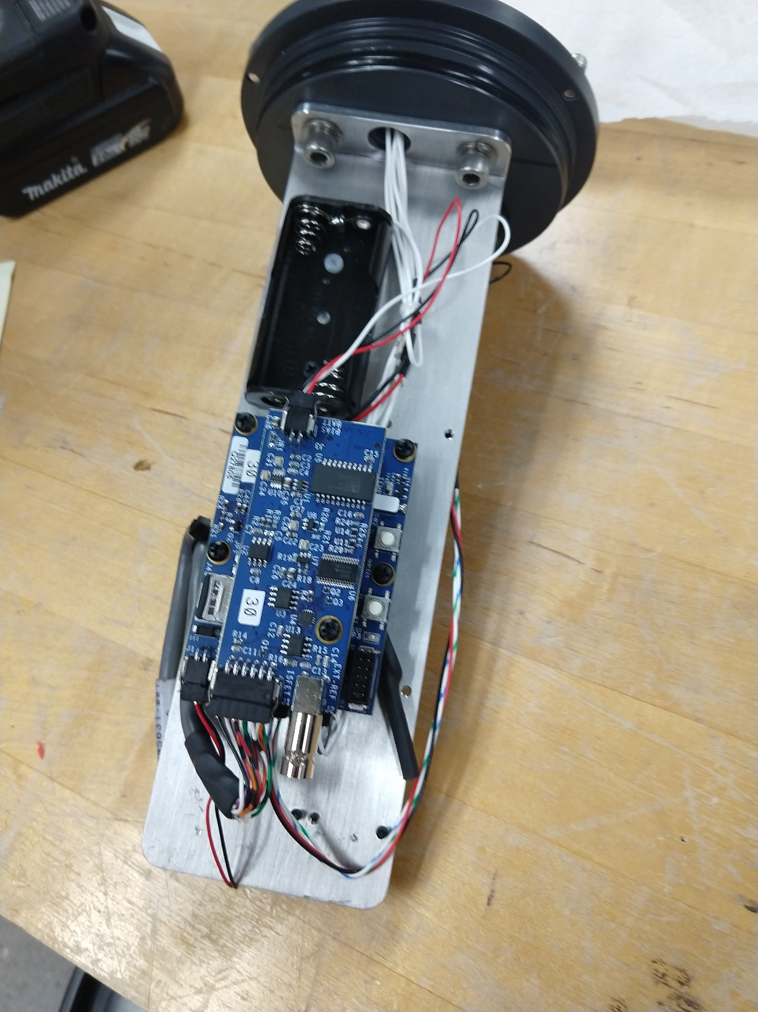
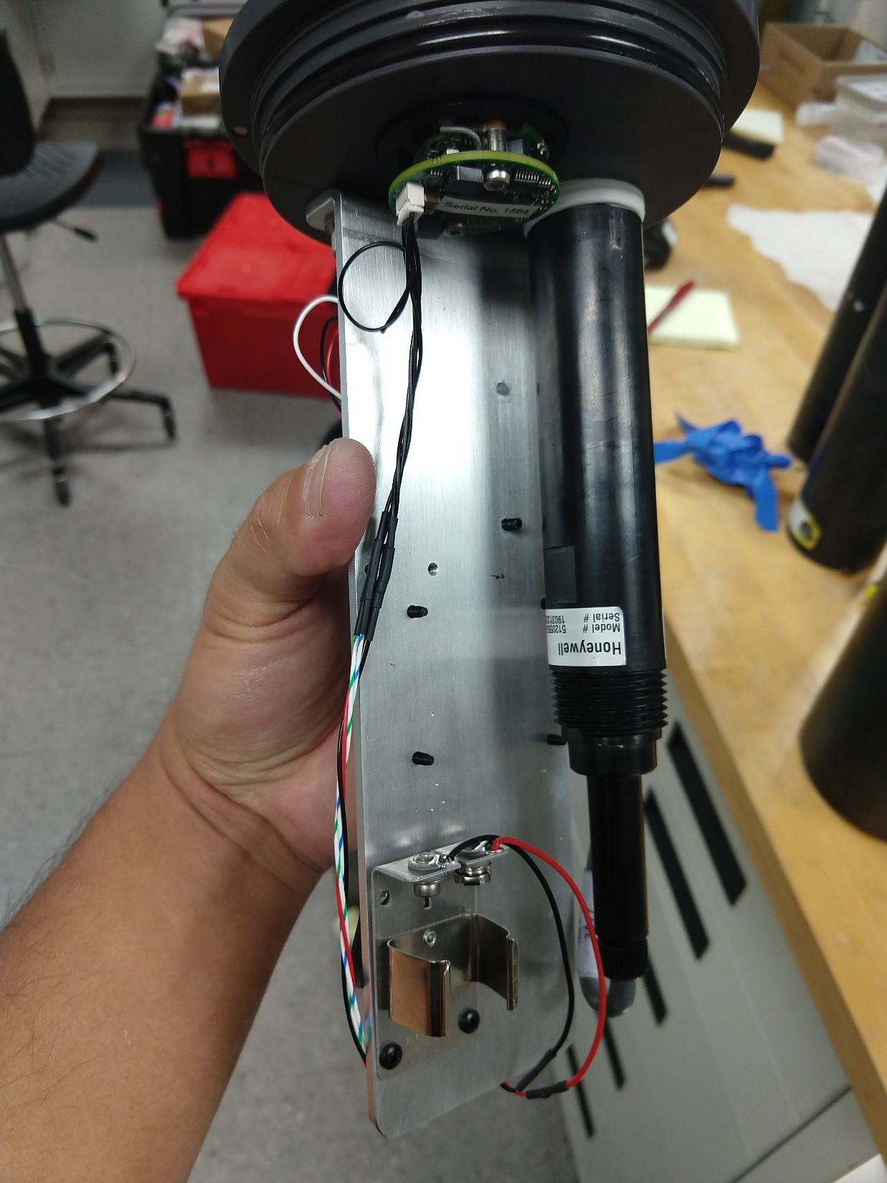
mpHOx sensor package
Controller

Slide 3
Use cases:
Moored system, data logger
‘Self Calibrating mpHOx’
  Moored system, data logger
  2 intakes, controlled by valve
Benthic Flux: BEAMS
  Moored system, data logger
  2 inlets/2 pumps.

