Slide 1
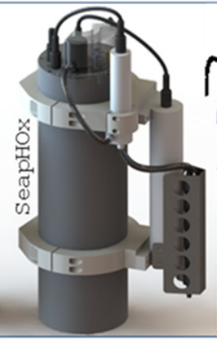
mpHOx design requirements (common)
Sensor package, which measures pH, O₂, CTD
mpHOx is a miniaturized SeapHOx (right), which was developed at SIO, commercialized at Seabird
Goal is to make it smaller so it is easier to deploy/ship, enabled by controller developed by S. Jensen
Depth rating: diving depth (30-50 m), 40C. Mostly mooring deployed; mixed orientation
Replace Honeywell Durafet with DSD/GDF. Keep options open for both for now. Use DSD for self-calibrating option.
Optode is Aanderaa 5730
Main battery: 3S D cells (lithium primary).
Bias battery: C cell (lithium primary)
SBE 5M (short)/5P (longer) Pump
SBE37 Microcat
More streamlined flow cell/tubing config
Flow should go through SBE37 first for poison, then pump, then pH/O2 (doesn’t matter which one first)
All bulkheads MCBH
Add PAR sensor

Slide 2
Use cases:
Moored system, data logger. Standard ‘mpHOx’
‘Self Calibrating mpHOx’. Additional bulkhead for Valve.
  Moored system, data logger. Periodically injects ‘tris’
  2 intakes, controlled by valve
  Minimize flow cell/path volume
  Additional bracket for Tris bag
  Flapper bags not OK here. Can’t have contamination to the calibration solution.
Benthic Flux: BEAMS
  Moored system, data logger. Benthic flux
  2 inlets/2 pumps. ½” ID tubing. Sometimes use valves.
  Flapper valve (or similar) can be used here.

Slide 3
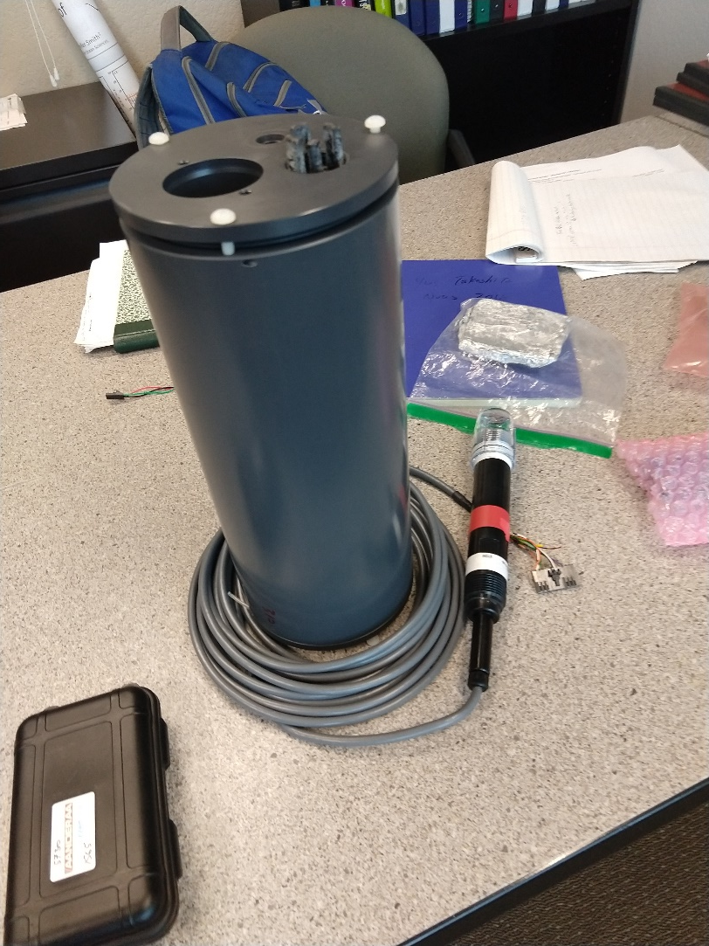
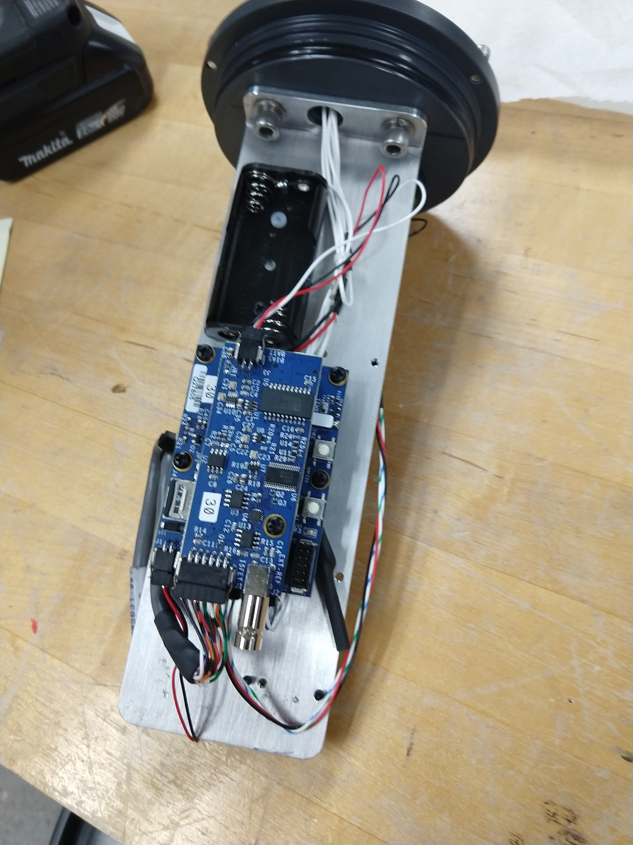
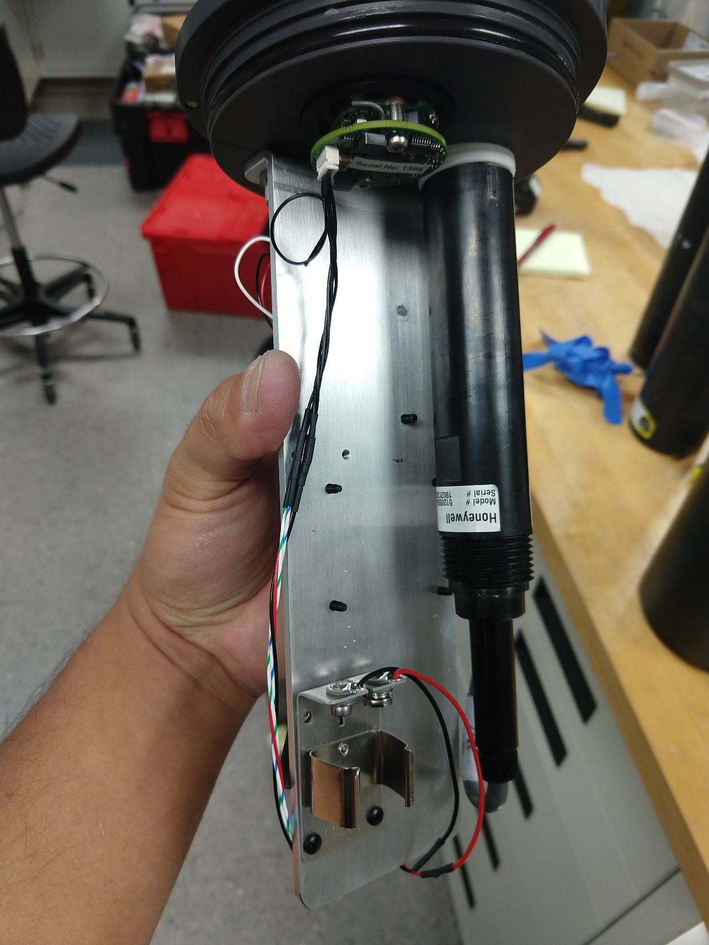
mpHOx sensor package
Controller

Slide 4
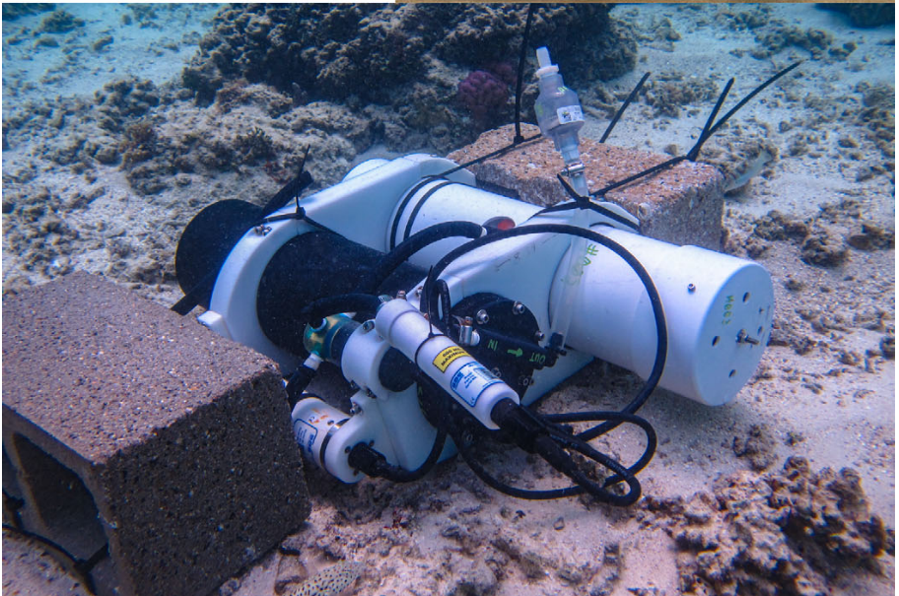
Self-calibrating SeapHOx

Slide 5
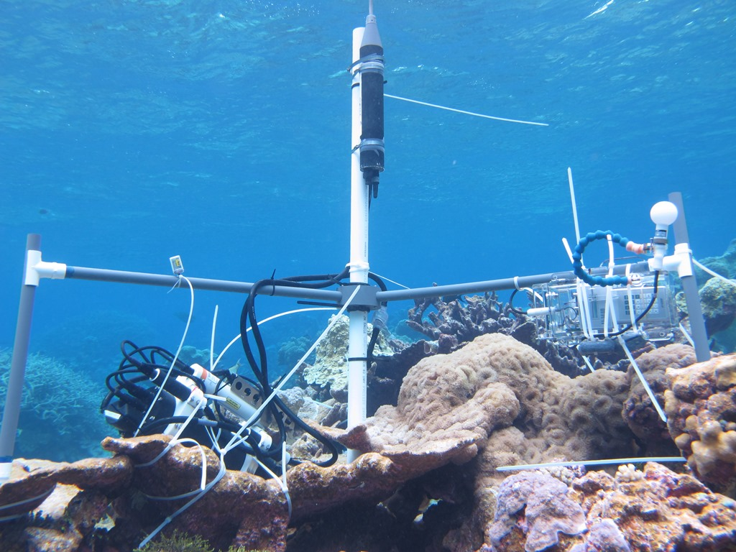
Benthic Flux: BEAMS

