Slide 1
Non-Isolated Testing Results (so far….)
Ben Werb, Joe Warren, Luke Beatman

Slide 2
Non-Isolated NanoFET Story
  Original weirdness with some Rework required
  SBE10343 and NanoFET A001002 in HCl
    Figure for stability over time Stir and Bath (Theoretically a lot of noise)
  Kloehn pump signal on Ik and Vk SBE10343 and NanoFET A001002 in HCl
    Generate Figure with some notes from Luke on timing
  DF403 and A001001 had issues
    Wet lab figure (Werb’s box data)
    Beaker figure (no bath, still bad)
    Check board w/ Jensenian = ok
    Check A001001 (Board from DF403) with SBE_10343 and OK (figures from BenchTest_07242025_A001001_SBE10343_A001002_DF403
    Clean DF403 and redeploy with A001002 = OK (have this plot and show warmup portion, figure for stability is trimmed of warmup)
    Swap A001001 and A001002 (need to plot this with longer time series BenchTest_07282025_A001001_DF403_A001002_SBE10343)

Slide 3
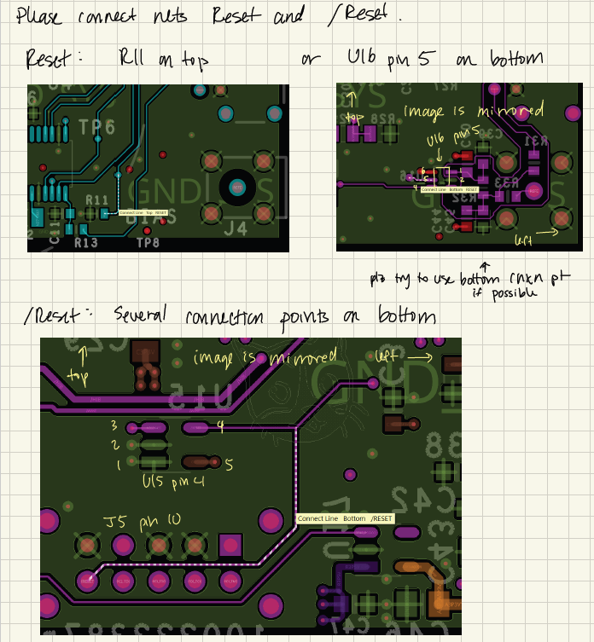
Rework Required!
Wake/Reset Circuit had issues.
Was affecting measurement values

Slide 4
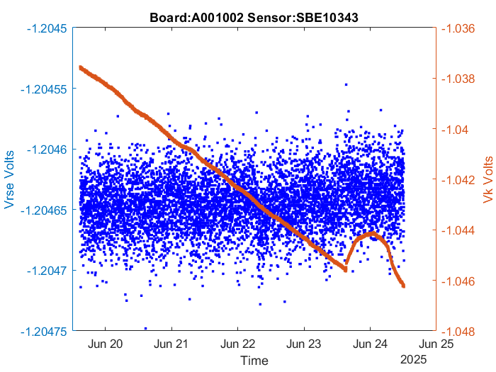
SBE10343 and NanoFET A001002 in HCl w/Stir and 20C Bath

Slide 5
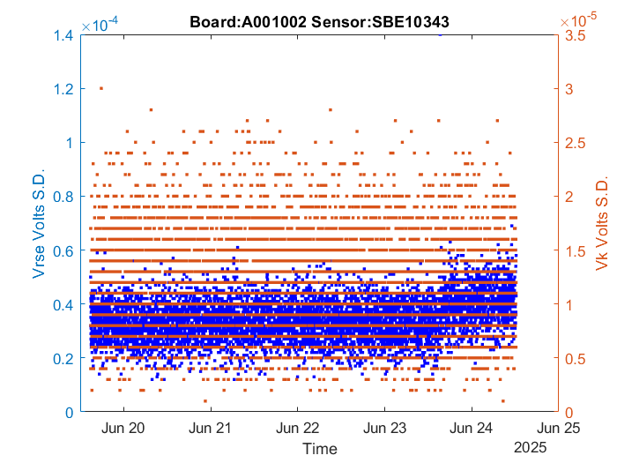
SBE10343 and NanoFET A001002 in HCl w/Stir and 20C Bath

Slide 6
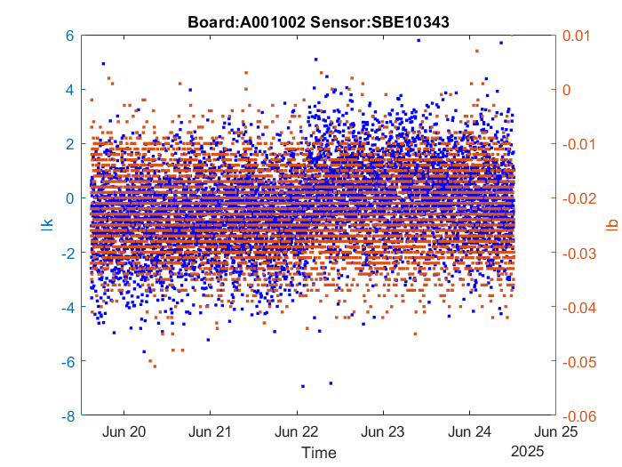
SBE10343 and NanoFET A001002 in HCl w/Stir and 20C Bath

Slide 7
NOW WITH KLOEHN

Slide 8
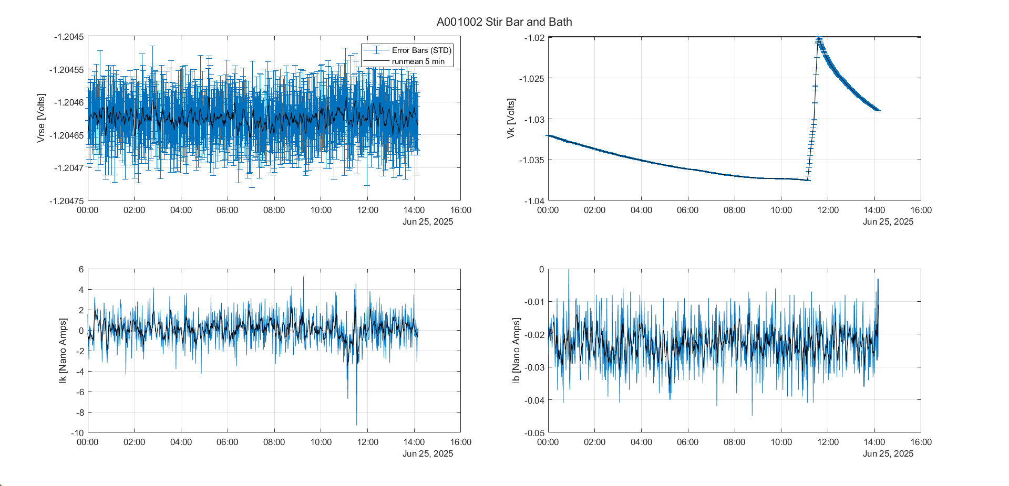
SBE10343 and NanoFET A001002 in HCl w/Stir and 20C Bath: Add Kloehn Pump

Slide 9
Rerun with Kloehn not powered
Rerun with Milligat
Run on BOG cruise Tuesday Underway
  Box vs SP batt vs stuff a 9v into the housing vs mFET controlled (JKW makes/finds cables and setup)
Show the sensor with not plumbed in and then plumbed in and then flow etc (be thorough)

Slide 10
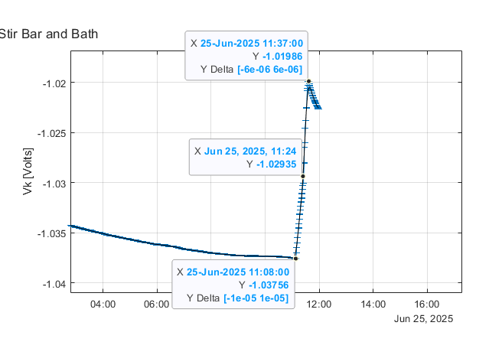
SBE10343 and NanoFET A001002 in HCl w/Stir and 20C Bath: Add Kloehn Pump

Slide 11
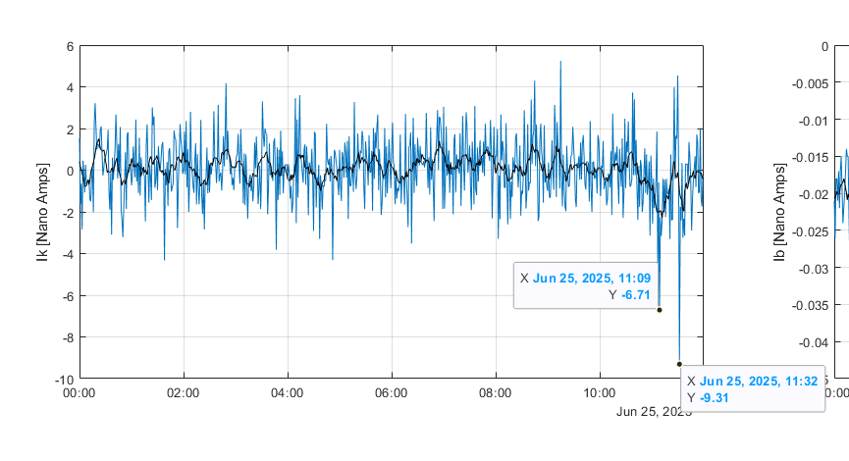
SBE10343 and NanoFET A001002 in HCl w/Stir and 20C Bath: Add Kloehn Pump

Slide 12
DF403 is not temperature controlled in following slides. Is in FSW in G119 Beaker

Slide 13
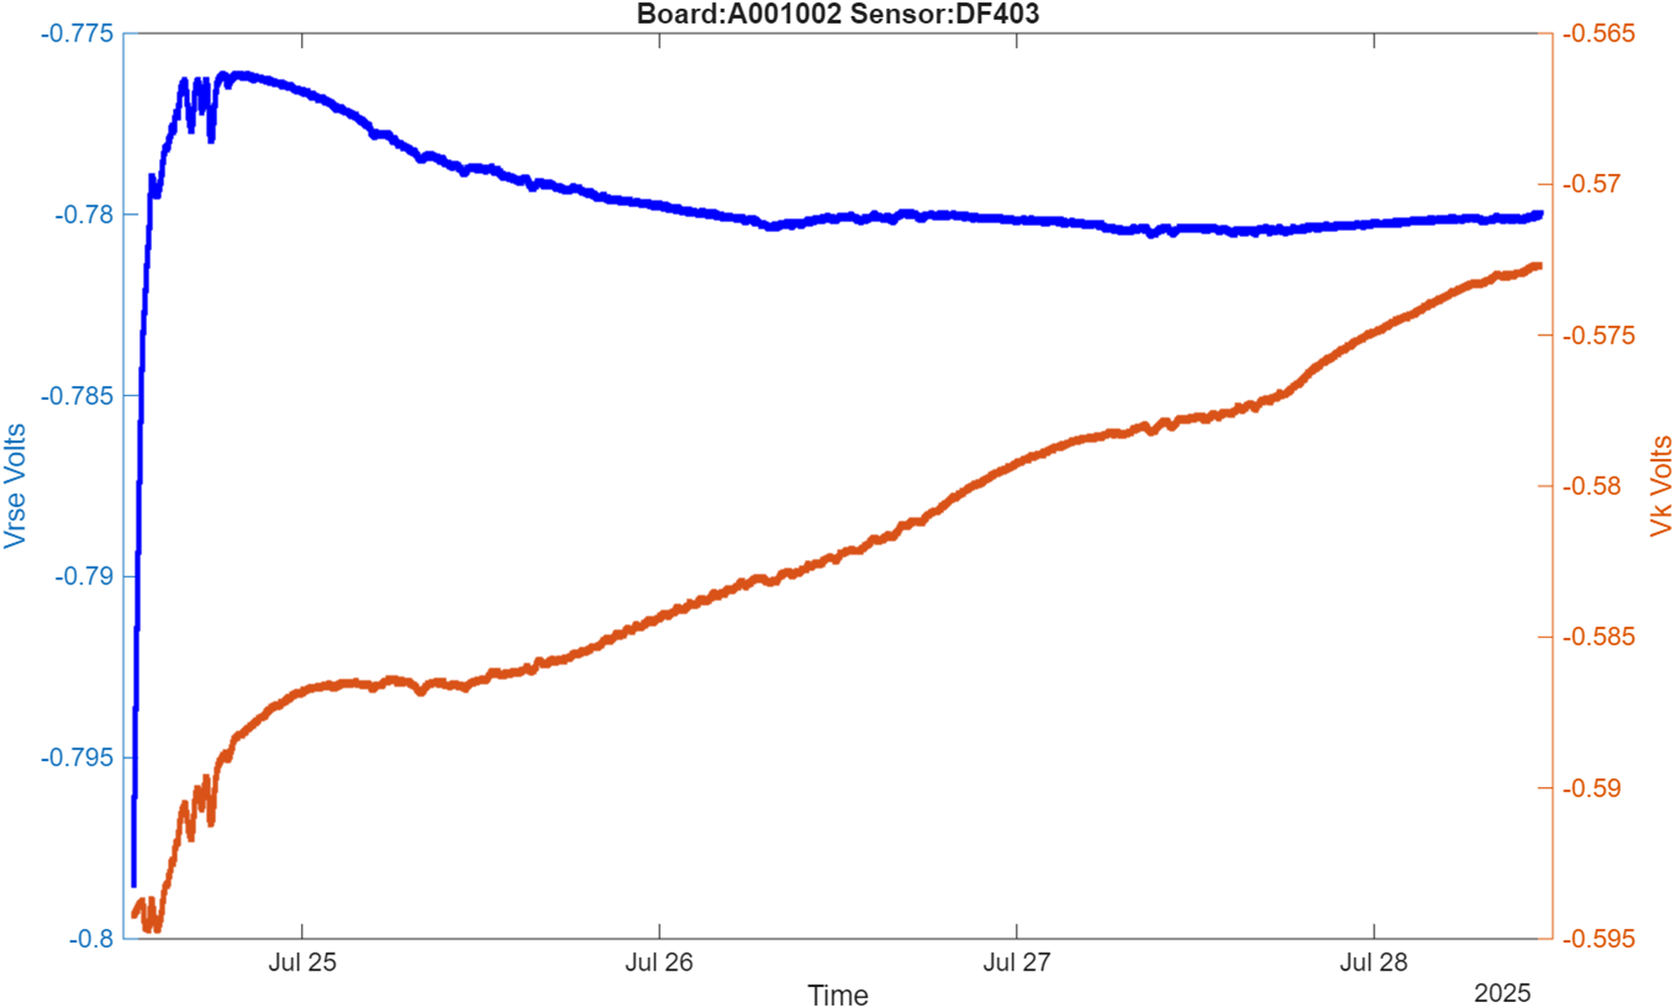
After Cleaning ISFET

Slide 14
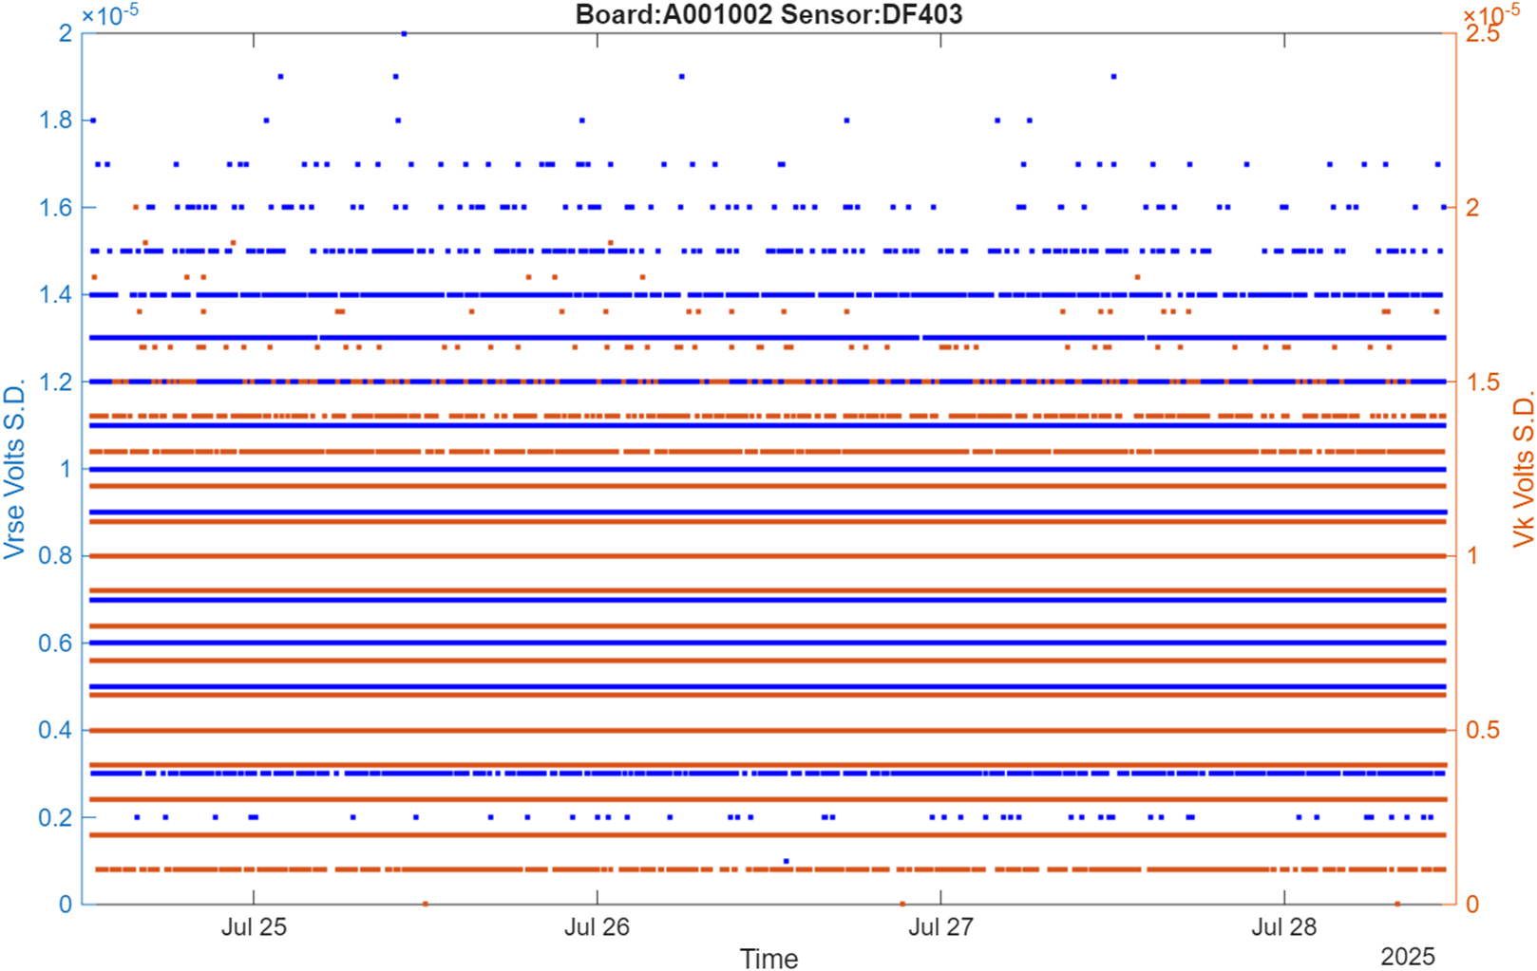
After Cleaning ISFET

Slide 15
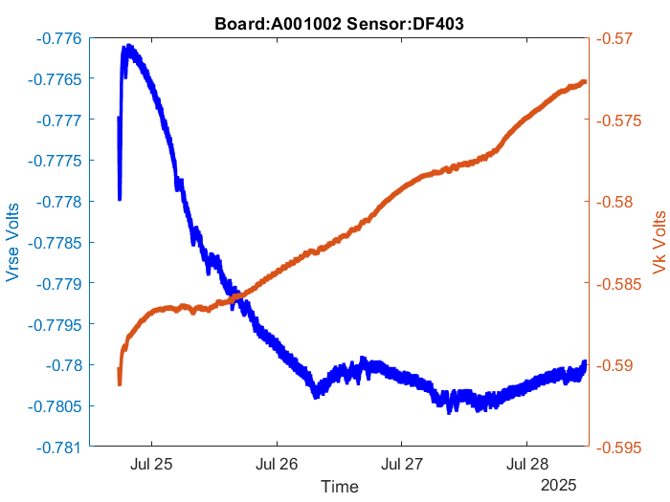

Slide 16
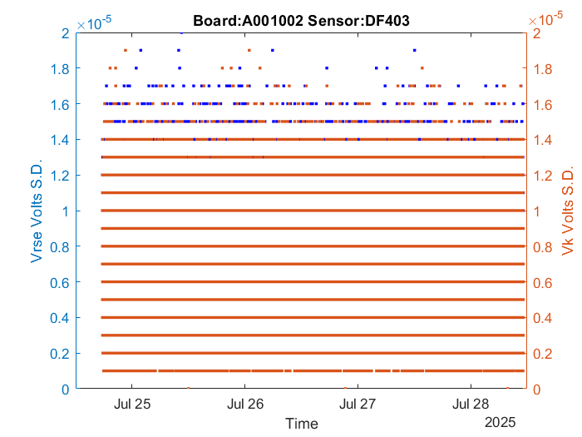

Slide 17
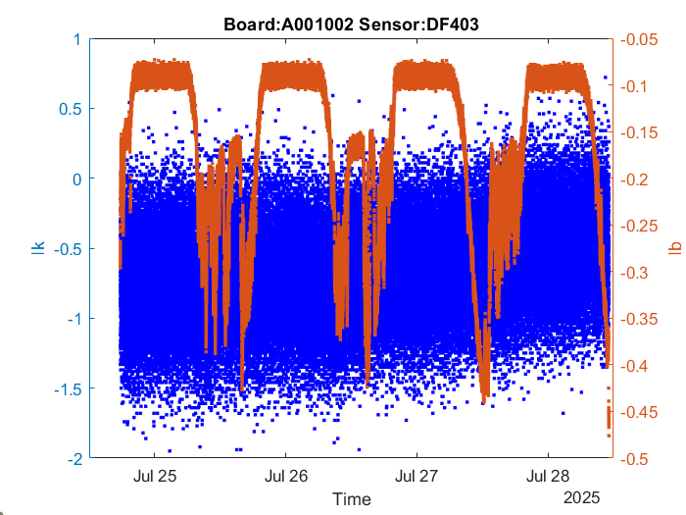

Slide 18
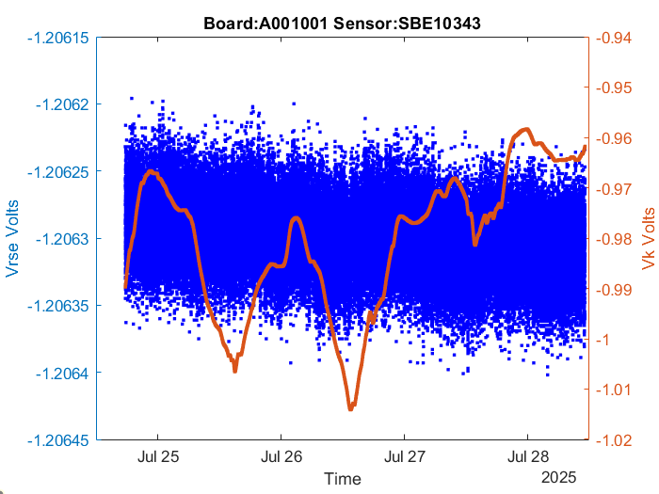

Slide 19
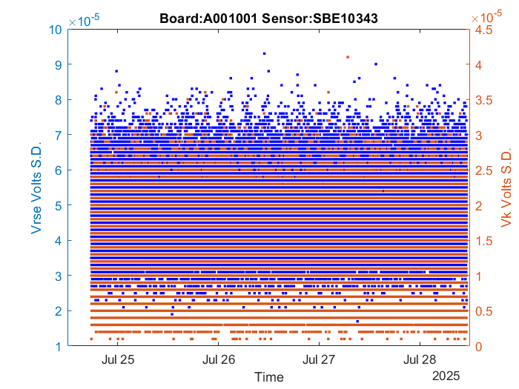

Slide 20
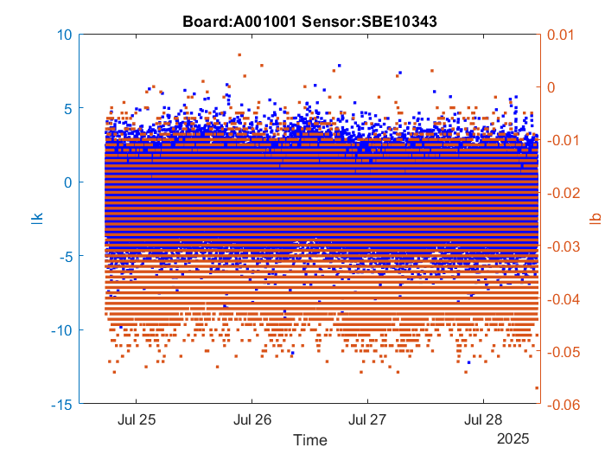

Slide 21
SWAP SENSORS/BOARDS

Slide 22
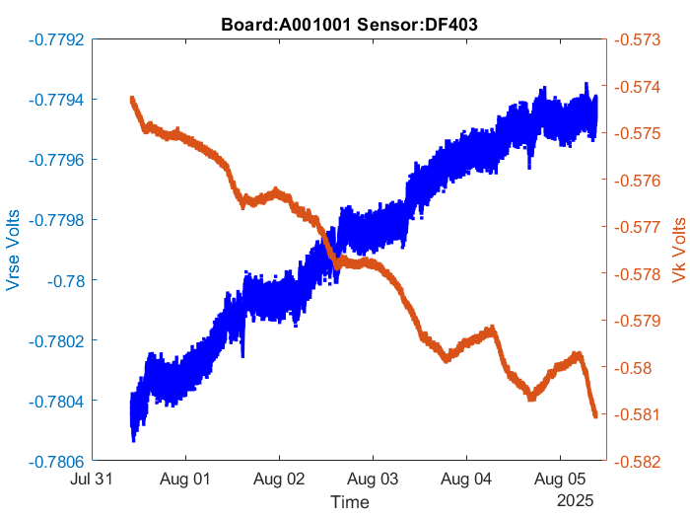

Slide 23
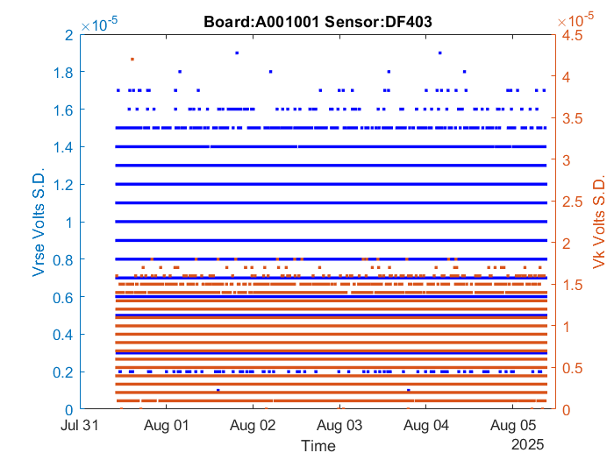

Slide 24
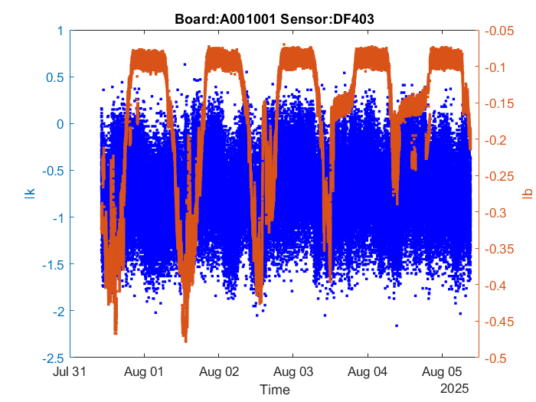

Slide 25
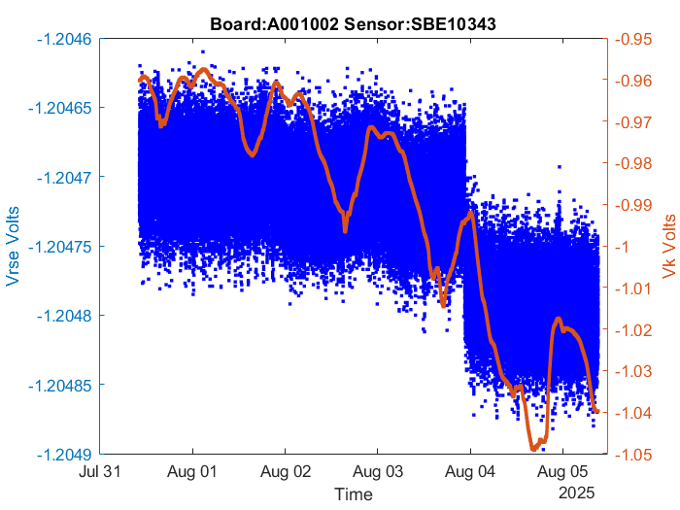

Slide 26
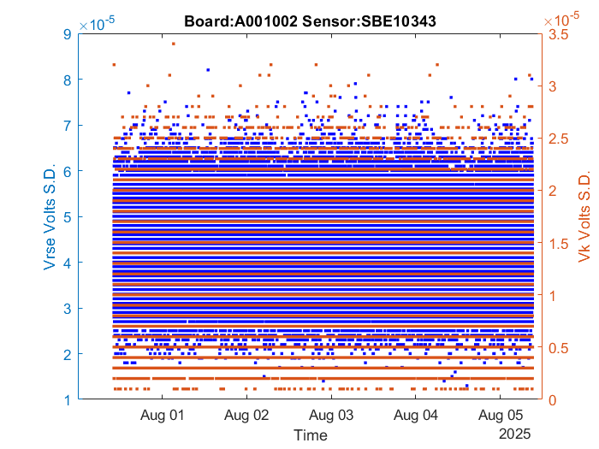

Slide 27
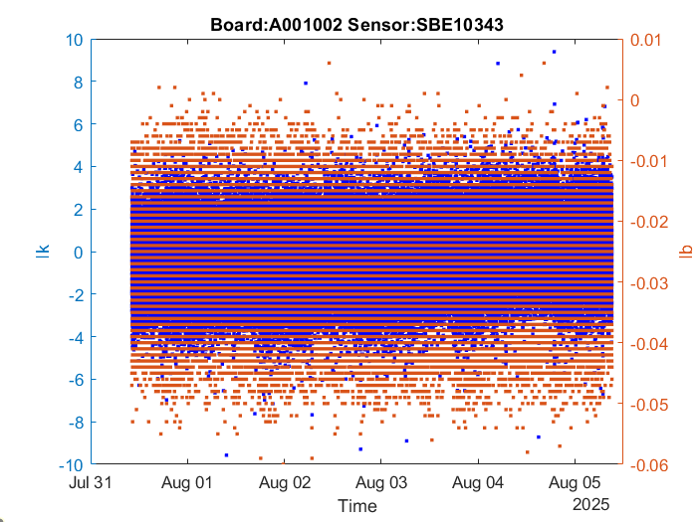

Slide 28
Now both overnight with Jensenian Adapters

Slide 29
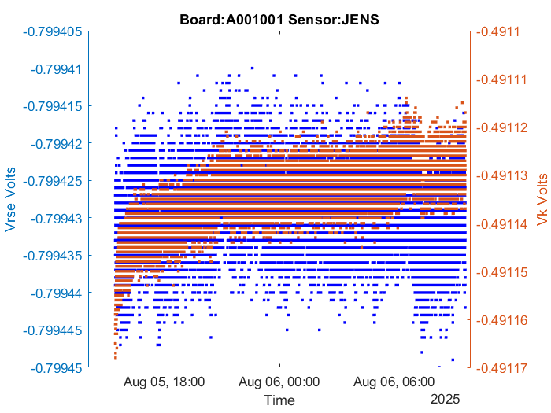

Slide 30
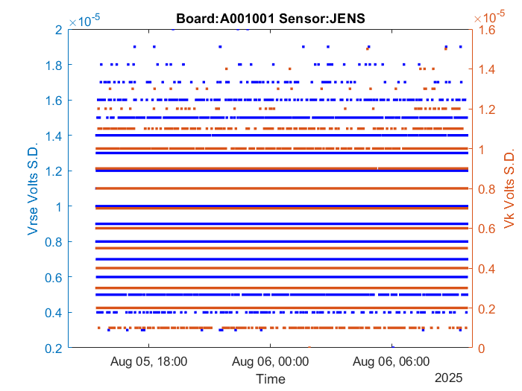

Slide 31
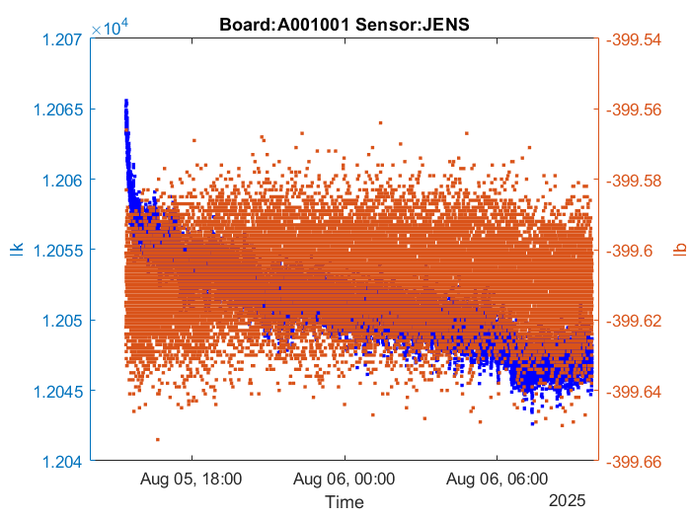

Slide 32
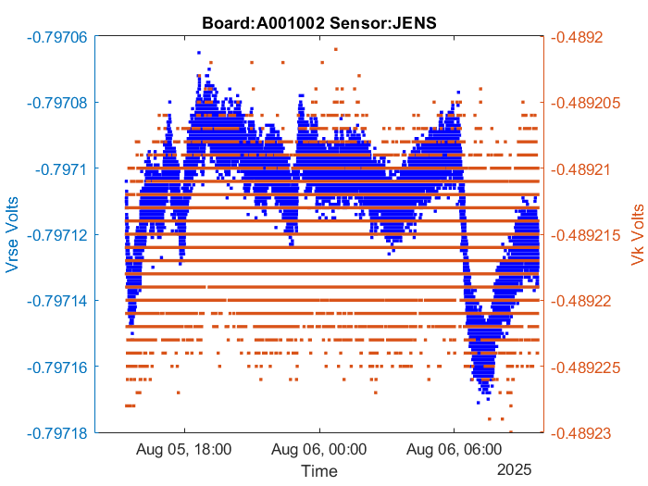

Slide 33
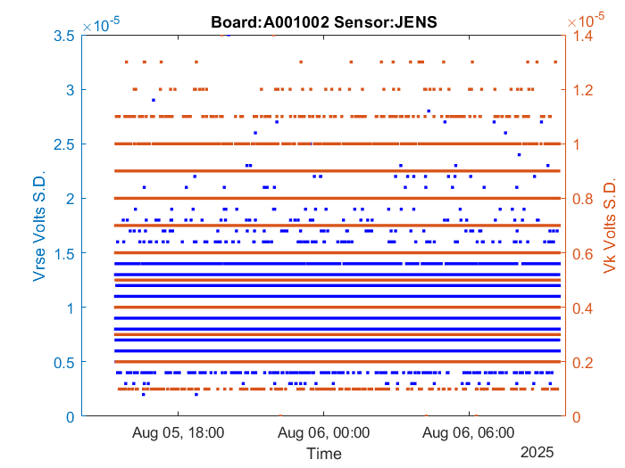

Slide 34
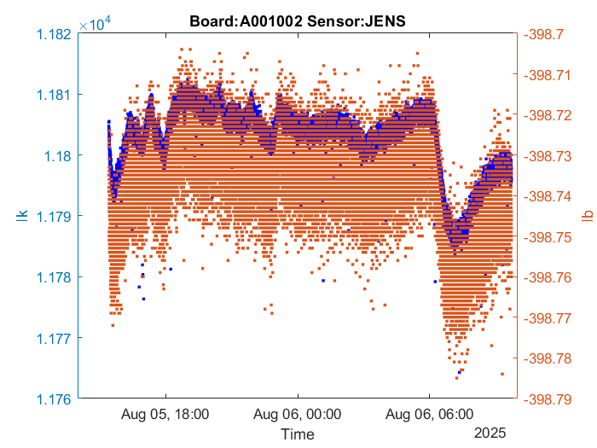

Slide 35
Jensenian swap
Get ready for wet lab for weekend, Boat for Tuesday

Slide 36
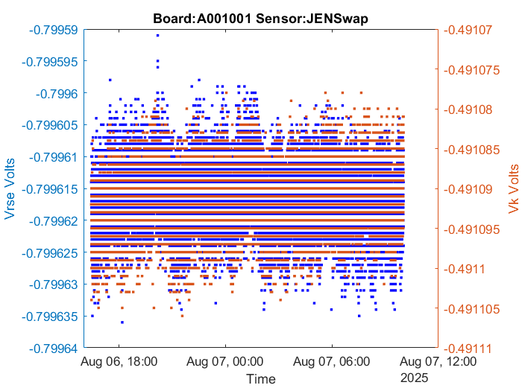

Slide 37
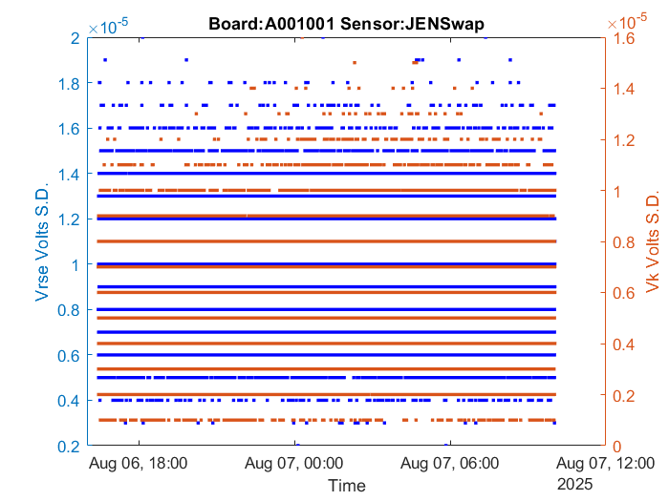

Slide 38
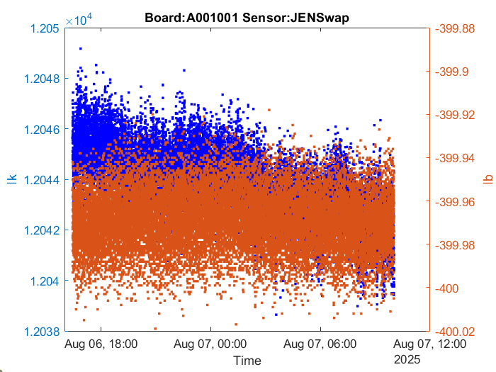

Slide 39
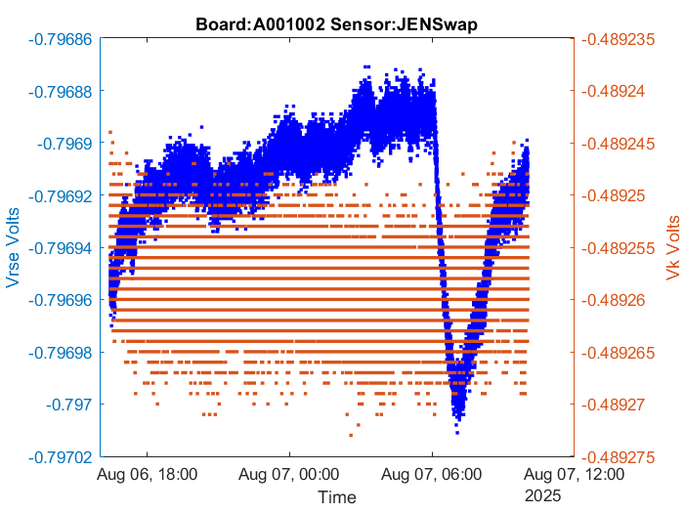

Slide 40
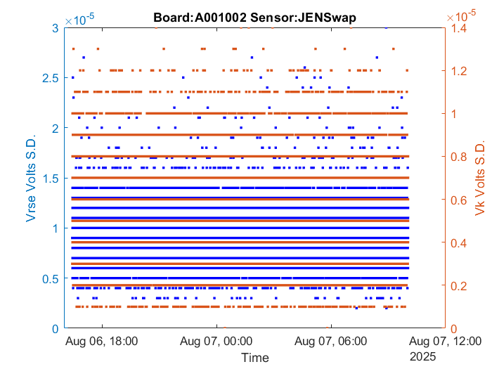

Slide 41
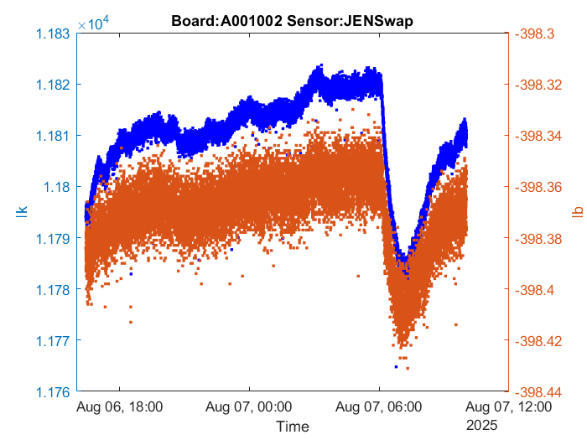

Slide 42
Jensenian swap summary slides: Looks like A001002 issue

Slide 43




Slide 44
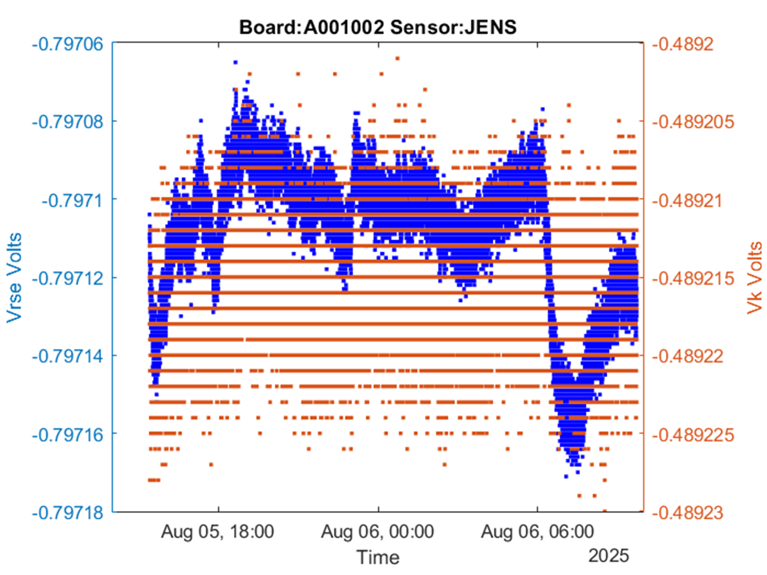



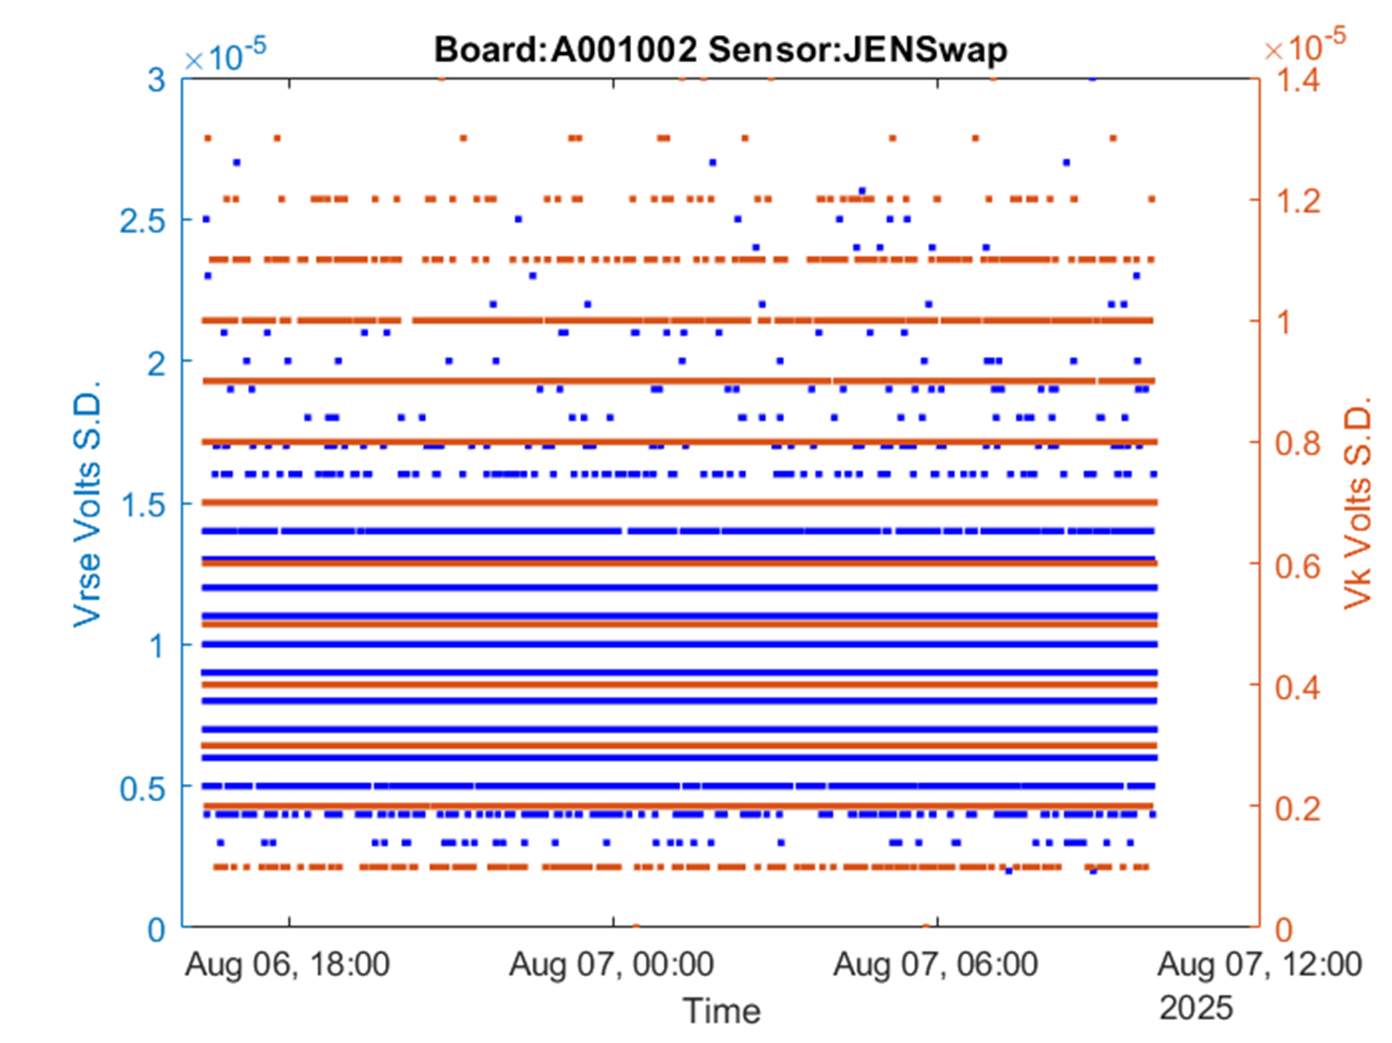


Slide 45
Future work
Redeploy DF403 A001001 in Wet Lab with other isolated ‘control’ sensors

