Slide 1
I2MAP +
Kelly Benoit-Bird (PI)
Eric Martin (PE)

Slide 2
<Statement of Problem>

Slide 3
Project Team
MBARI:
Kelly Benoit-Bird
Chad Waluk
Bruce Robison
Kim Reisenbechler
Eric Martin
Francois Cazenave
Hans Thomas
Collaborators:
<insert names and affiliations>

Slide 4
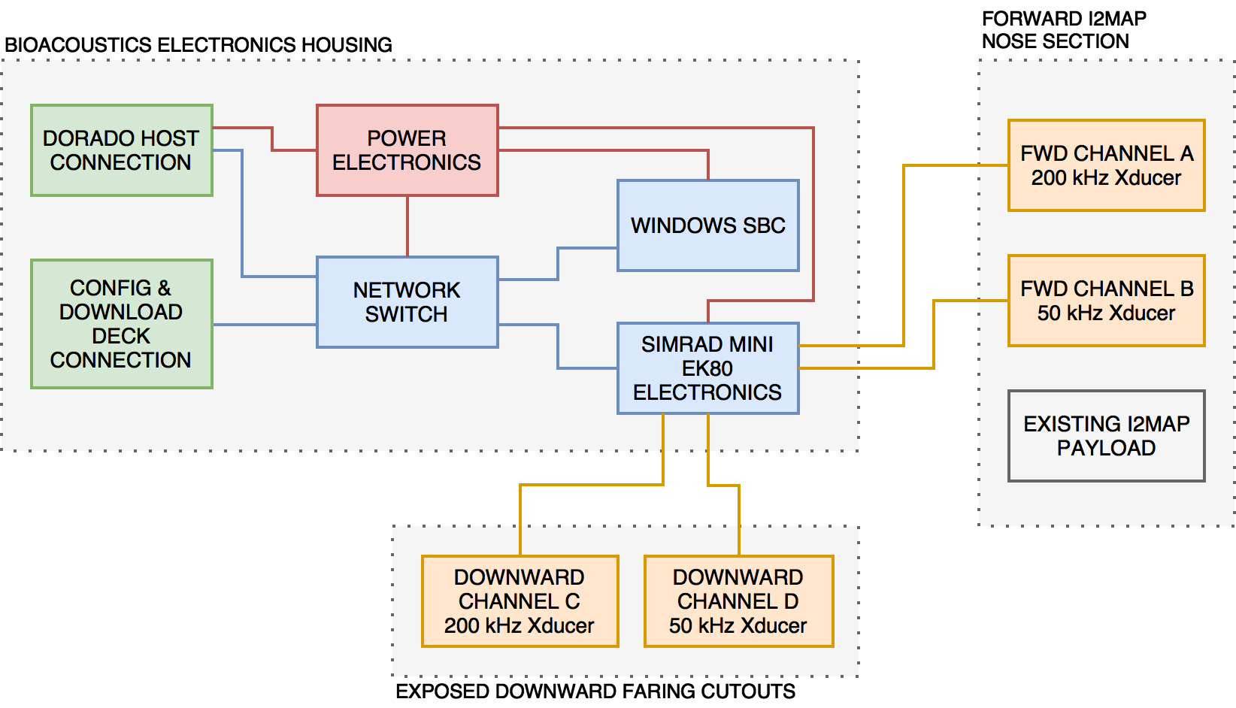
Basic Concept

Slide 5
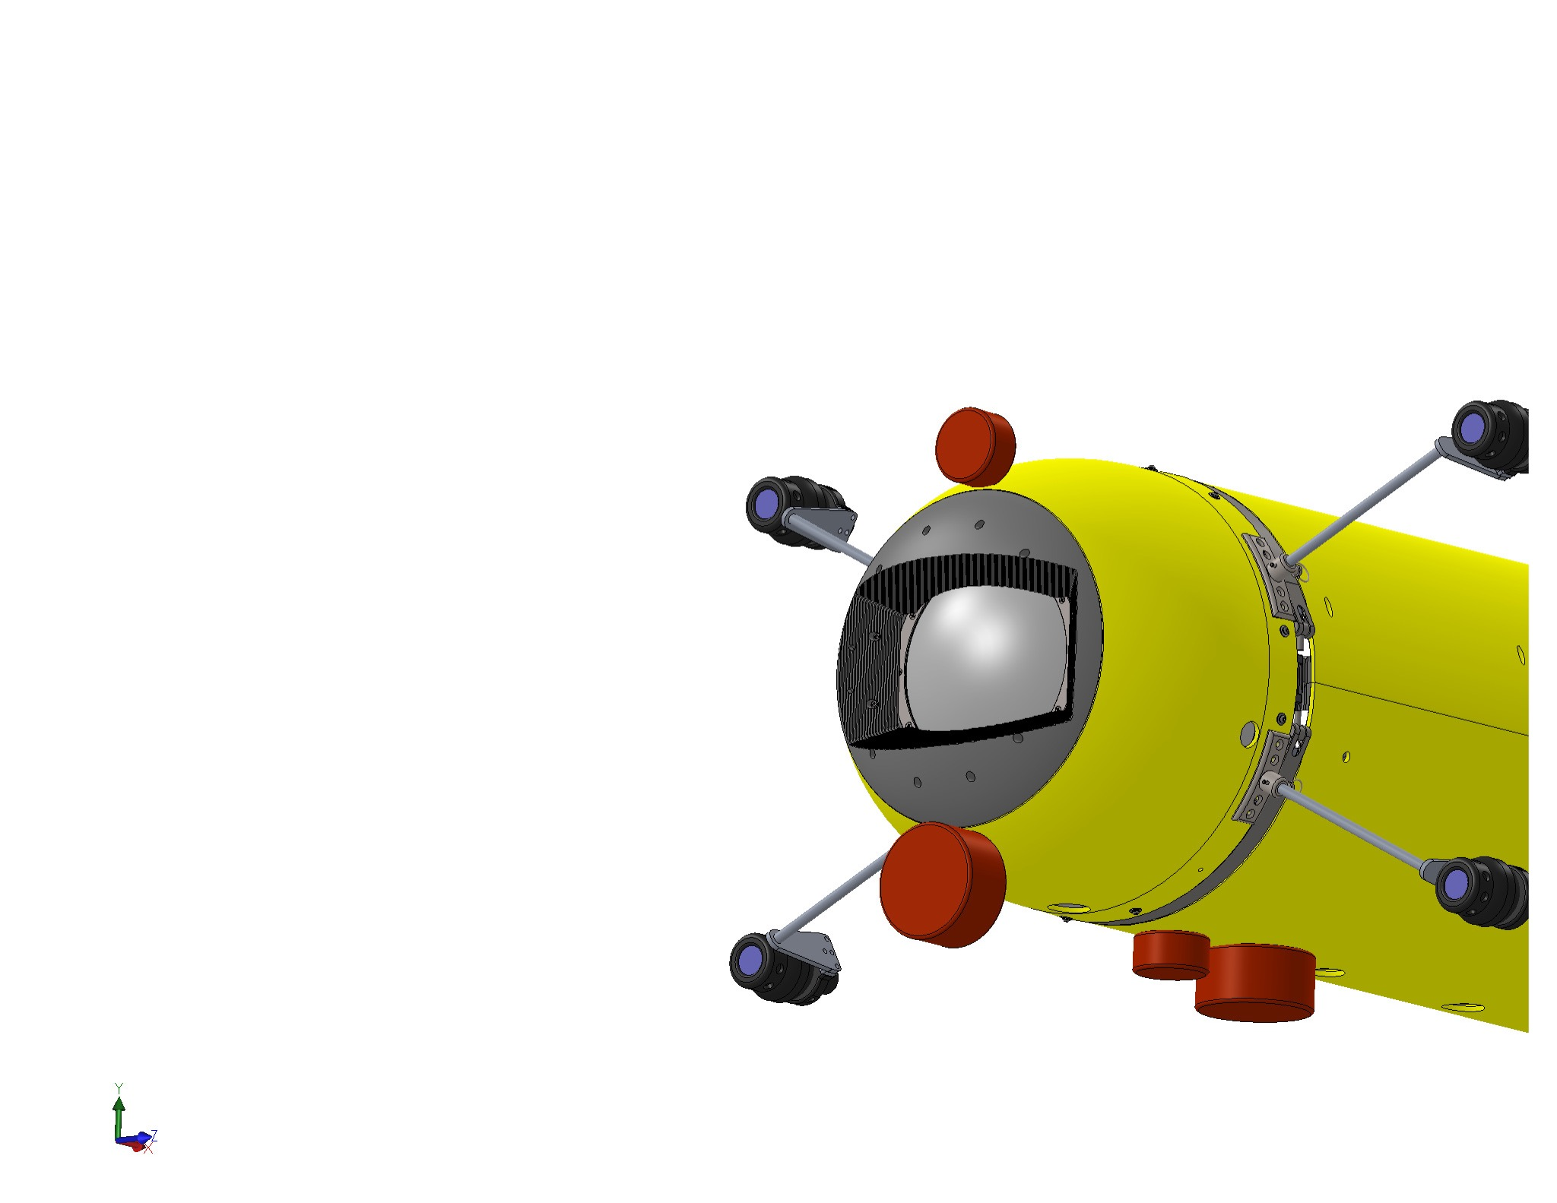
Simrad EK80
PUT SOME SAMPLE DATA HERE?

Slide 6
Science Goals - 2017
Quantify the behavioural responses of animals to the survey platform (avoidance/attraction) and compare those responses to responses to Ventana.
Obtain broadband backscatter measurements from individuals identified and sized with the camera system to improve acoustic classification.
Quantify the spatial distribution of organisms in midwater to address at what scales animals are aggregated, if those aggregations are organized by taxonomy size or other features, and what role variation in the habitat plays in structuring the biota.

Slide 7
Technical Goals - 2017
Design & manufacture a subsea housing containing the EK80 electronics, a supporting computer and supplementary components.
Integrate the transducers and this housing into the I2MAP configured Dorado AUV.
Conduct sea trials of the integrated system (2 days requested)
Evaluate vehicle stability with added drag components.

Slide 8
Future Applications

