Slide 1
Dorado Bioacoustics Concept
901807 Next Gen Bioacoustics on Dorado MBARI 2018

Slide 2
Statement of Problem (Kelly)

Slide 3
2018 Goals (Kelly)

Slide 4
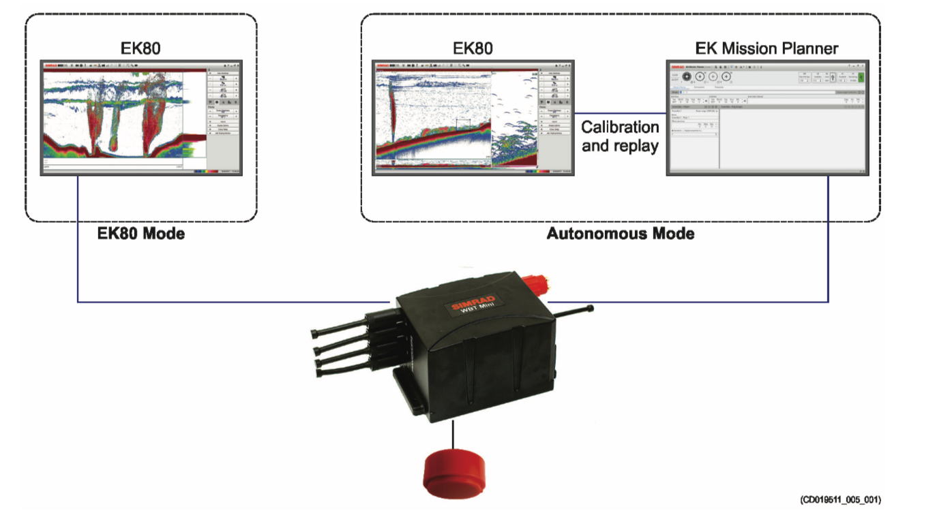
Simrad Mini-WBT
Compact version of the Wide Band Transceiver (WBT)
12-16 VDC input, Max 6W

Slide 5
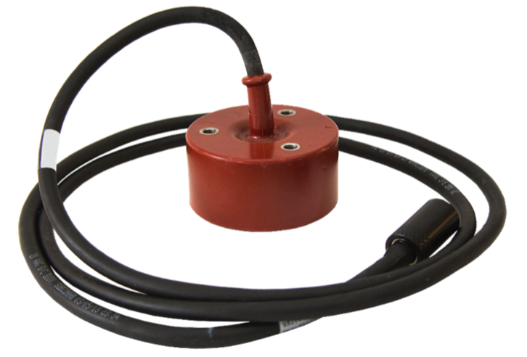
Transducers
ES200-7CDK Split
  Nominal Frequency: 200-kHz
  Frequency Range: 185 to 255 kHz
  Beamwidth: 7˚
  Split Beam
ES333-7CDK Split
  Nominal Frequency: 333-kHz
  Frequency Range: 270 to 445 kHz
  Beamwidth: 7˚
  Single Beam
Science reason?

Slide 6
Previous Integrations (Chad/Paul?)

Slide 7
Functional Requirements
All components must be contained within the I2Map Payload area.
The system must facilitate deck configuration and remote start/stop operation.
Time, depth, and position data from the vehicle must be incorporated in the recorded data.
The system must survive the depth rating of the overall payload.
Transducers cannot impact the video data.
The forward-oriented transducers’ field of view must overlap with the field of view of the camera from within the focal range of the camera.
I2Map must remain deployable without the acoustic payload and during development
Science Requirements: ping rate/ping power/detail
Cannot impact existing surveys in duration or depth capability.
Conduct continuous data collection.
Cannot impact other acoustic systems, and vice-versa.
Data must be available post-dive.
Data download must occur in time less than a recharge of the vehicle’s batteries.
System needs to deployed without the AUV for tank testing purposes
There must be a dedicated Windows-based processor to operate the software.

Slide 8
Derived Requirements
System:
Depth rated to 1500-m
No obstruction for transducers to 7 degrees
No video obstruction
Transducers mounting must easily be installed/removed.
Neutrally buoyant
Vehicle shall remain in stable flight at existing I2MAP normal through-water speeds (1 knot).
Interface:
Self-powered (12-17VDC) and auv-host connection (18-36VDC), existing electronics require a clean 12-17VDC input.
Isolated Trigger Input
GPS/Depth/MRU serial data to sonar software
Configuration interface (ethernet/remote desktop)
CPU must accommodate simrad and echoview software
Accommodate data storage at rate 25-GB/hr.
Disciplined time input (ntp or 1-PPS)
Download interface must facilitate a maximum 5-hour download time.
Minimum 6 hour run time.
Must respect normal AUV health monitoring standards.

Slide 9
System Concept

Slide 10
Forward Mounting Transducers
Transducers are embedded in the
Delrin piece below the camera:
Lower drag
Somewhat out of harm’s way
Closer to camera
No cables outside of fairing
Requires taking apart nose cone and machining plastic components.
No interference with light beams.

Slide 11
The cross section view above is offset from the center plane by 1.5”.
The transducers are mounted on a 3/16” metal plate.
The metal plate is screwed to the plastic ring from the front using two ¼-20 screws. The cables are easily routed to the back of the AUV.
View without the transducers.

Slide 12
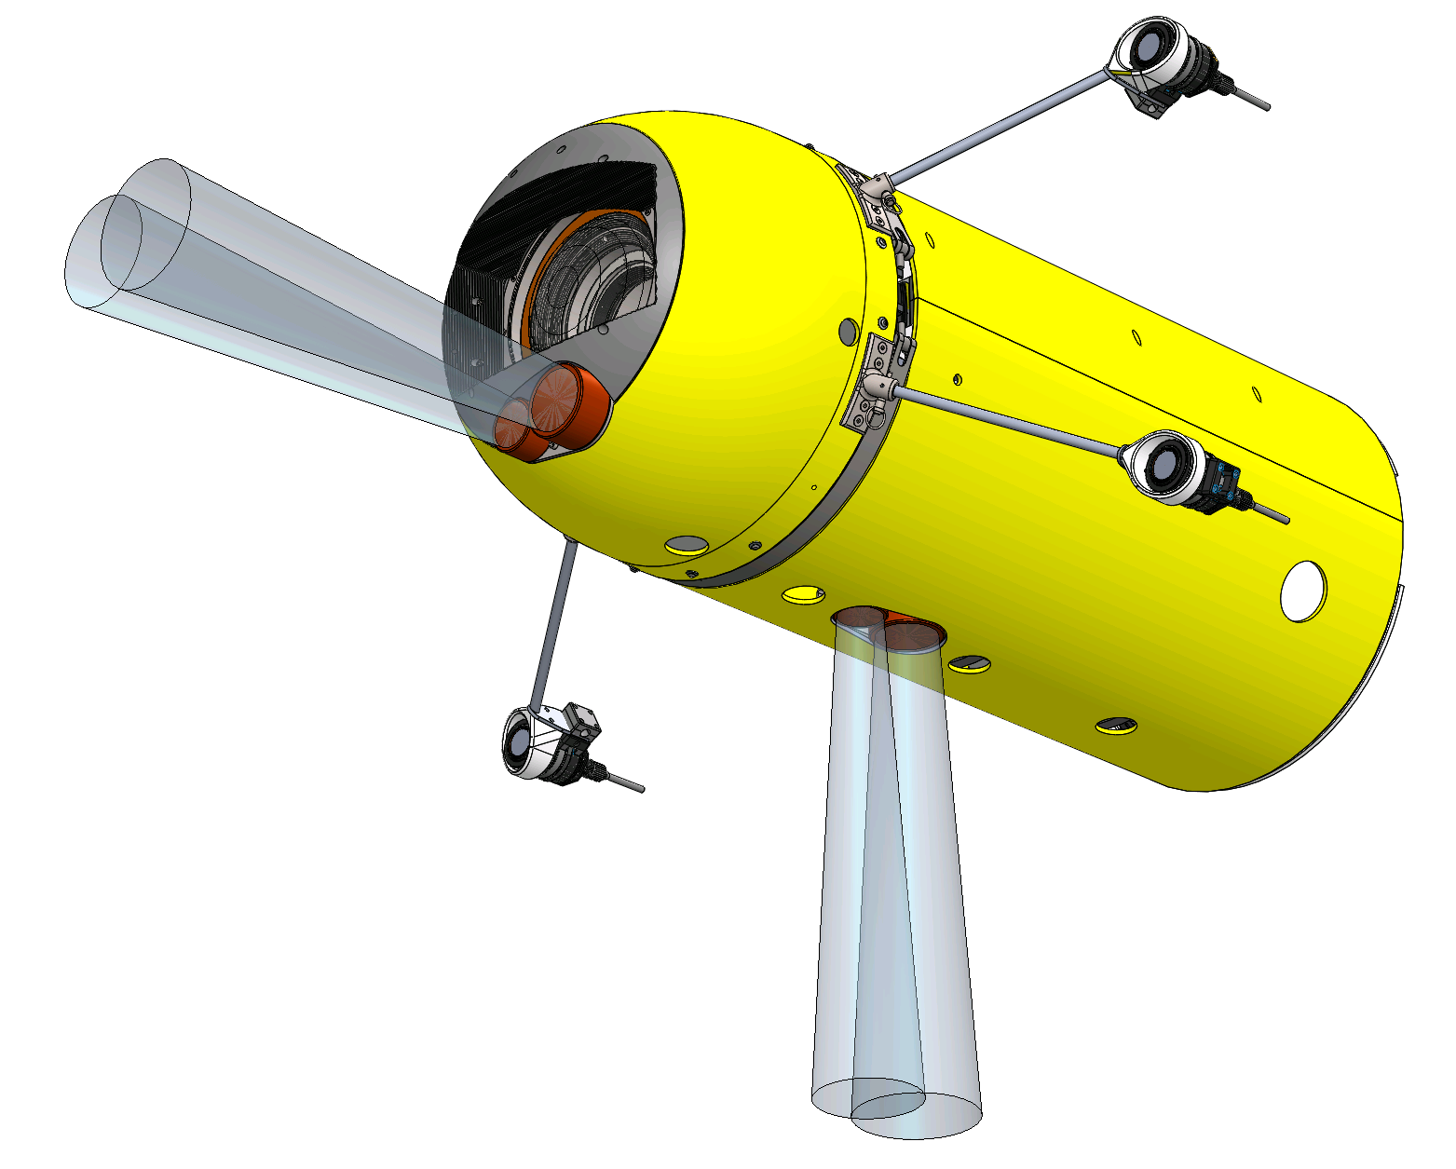
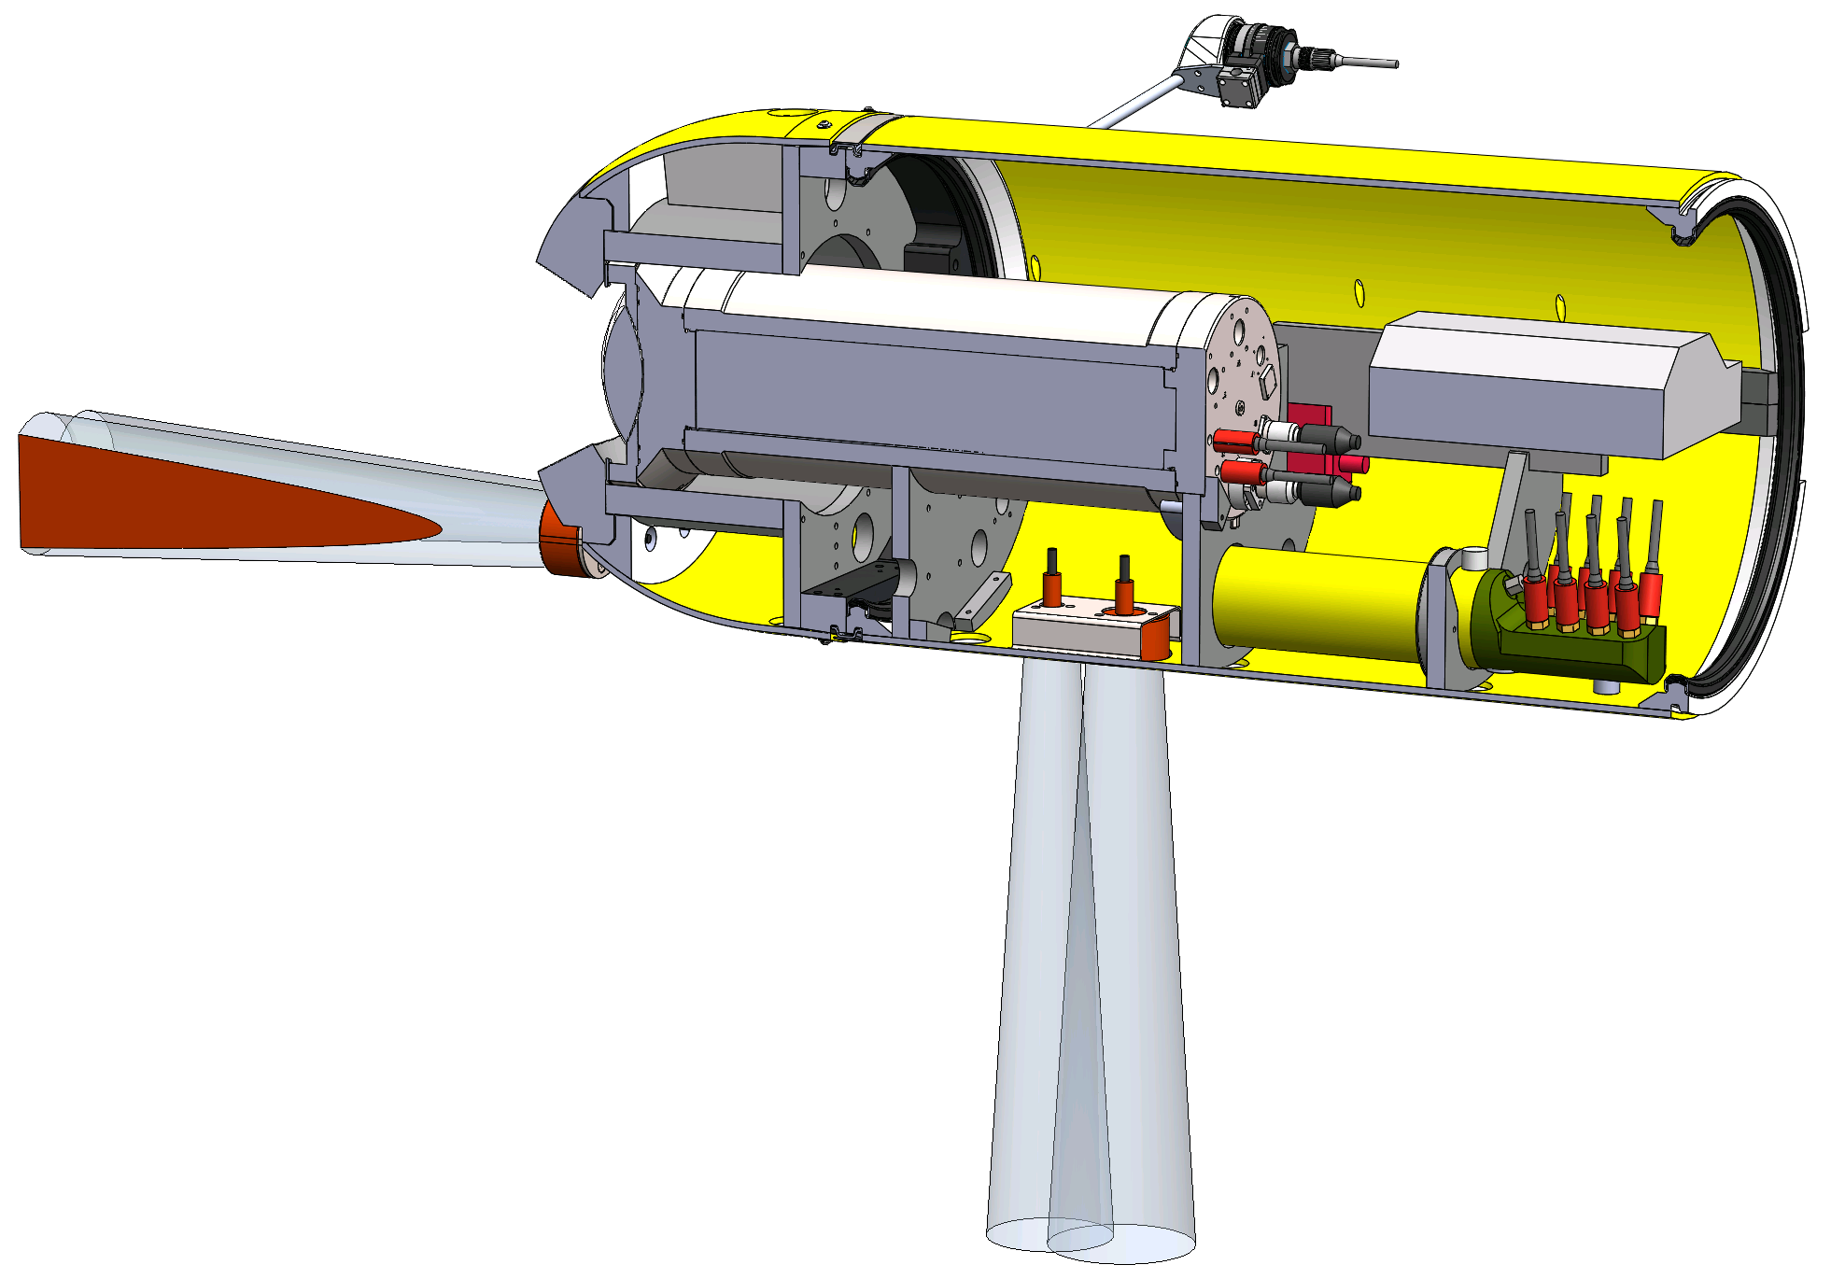
Placement of Downward Transducers in AUV

Slide 13
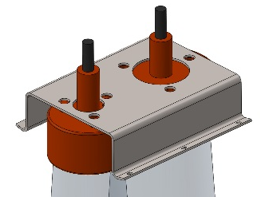
Downward facing transducer bracket
Gauge 14 stainless steel bracket
Gets screwed to bottom fairing
Transducers can we accessed without removing the camera housing (there is enough space on the sides for an operator to reach the fasteners)

Slide 14
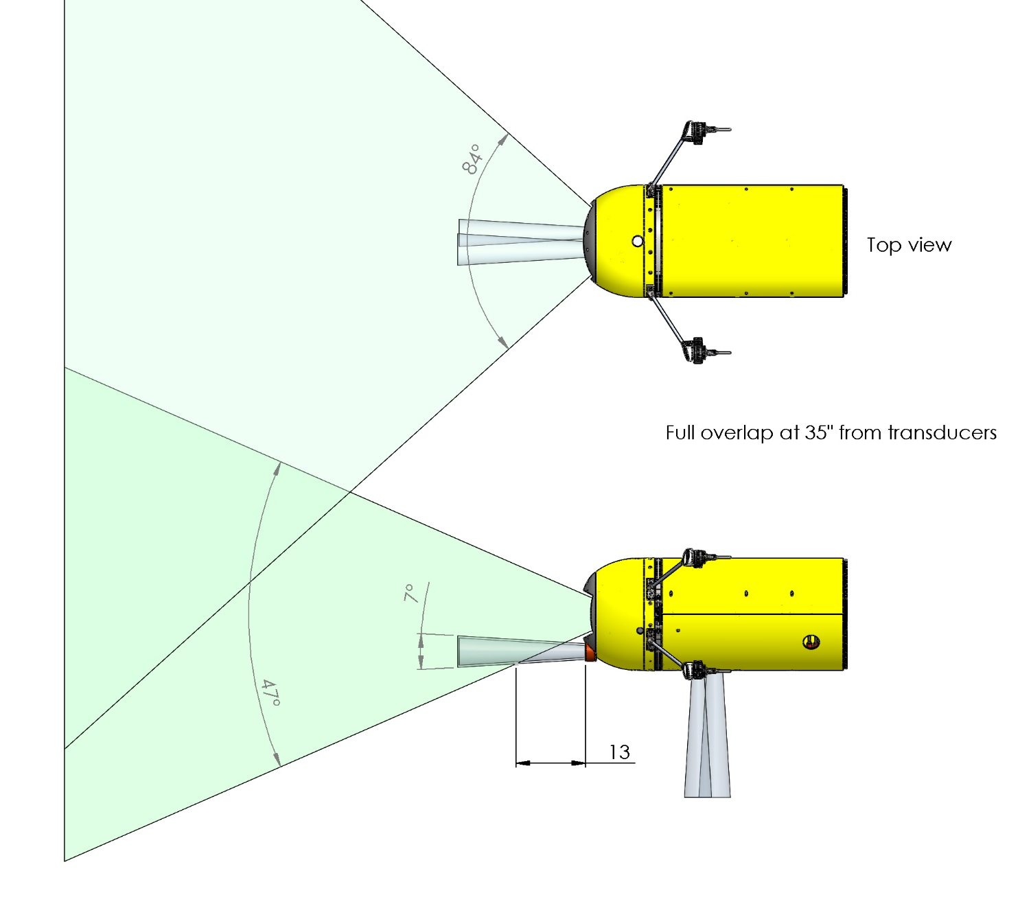
Comparison of camera field of view and transducer beams: Low bracket

Slide 15
Electronics Packaging:
The Sphere Solution
Concept
Since the system has been notoriously difficult in integrations, let’s choose a solution that provides initial flexibility and reduces design time and risk.
Replace a 5-kWhr sphere with a similar 17” sphere with Simrad and support electronics in its place.
Capable because of short i2Map mission duration limitation (recording 5 hours)
Enough room for key components, and space for a dedicated battery pack to run the acoustics and processor
Extra room allows for better EMI rejection
Removes need for new section
Current wet-connector count dictates a large housing regardless.
This solution will likely reduce need for much floatation.

Slide 16
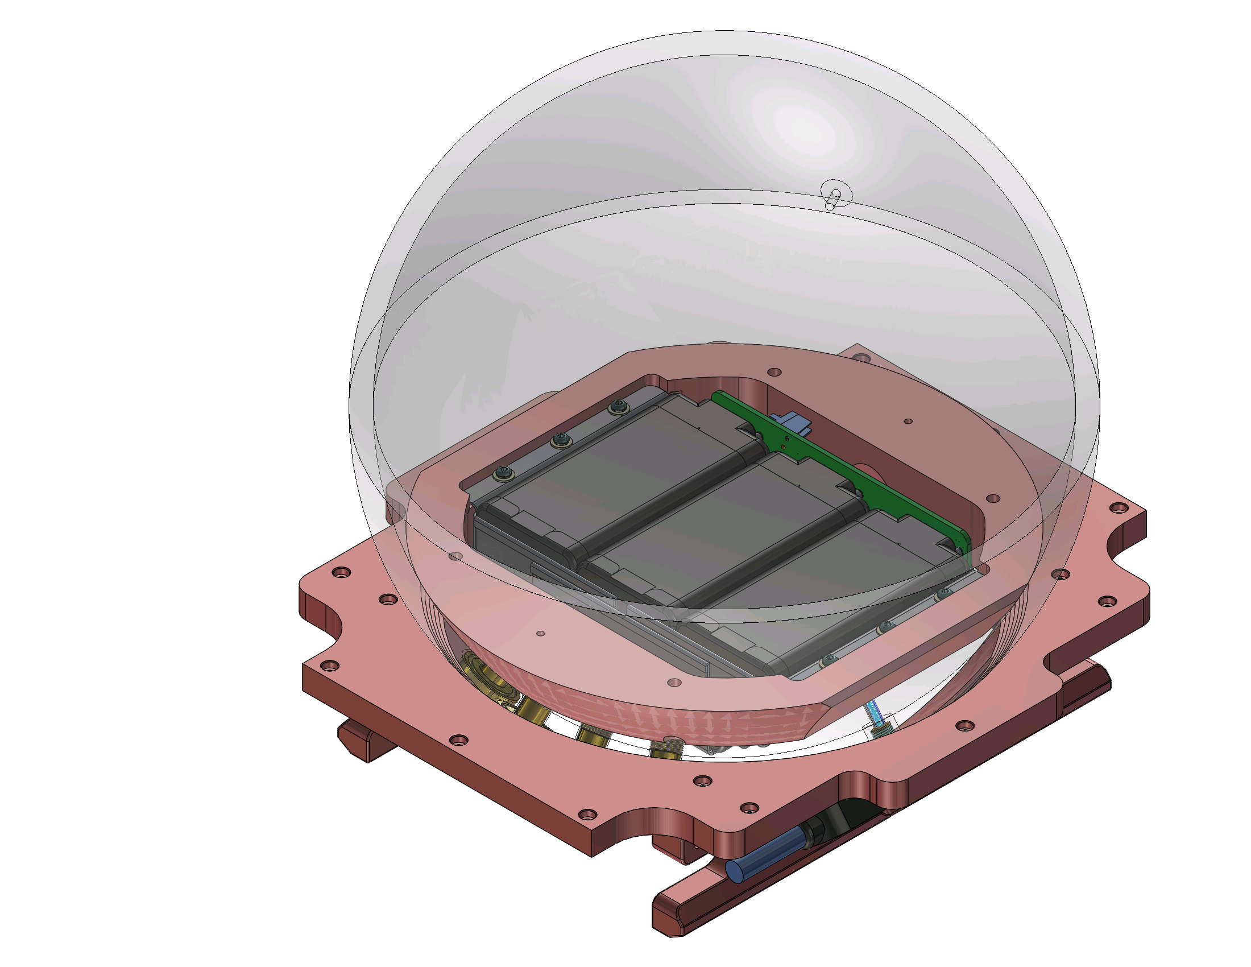
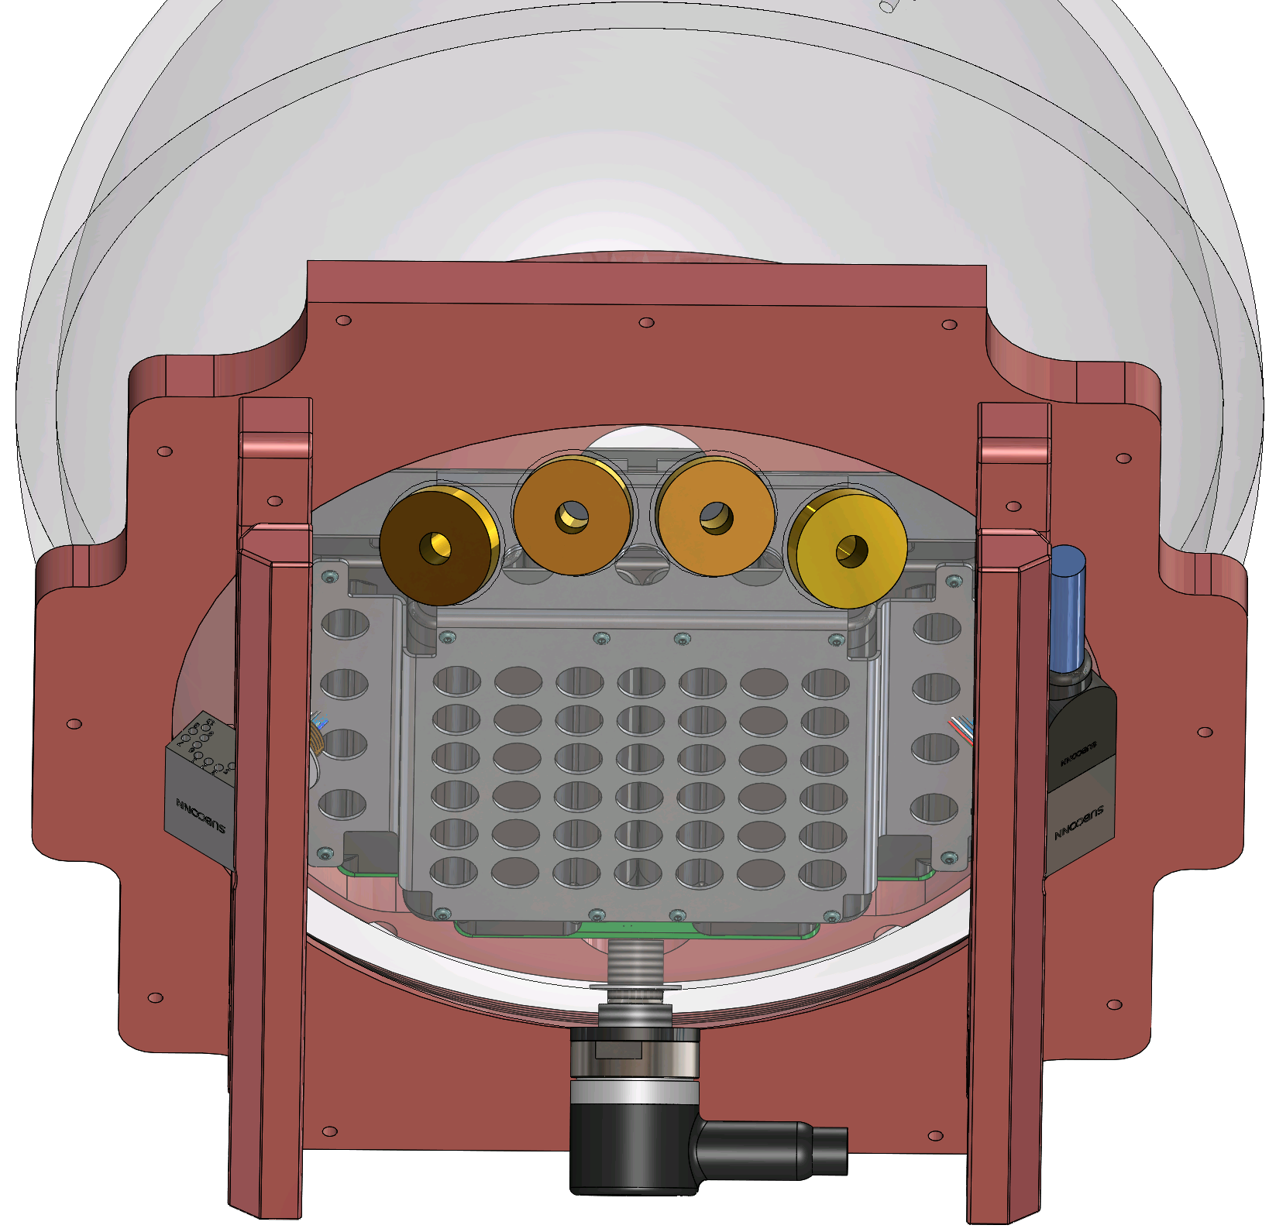
From Below, Connector View

Slide 17
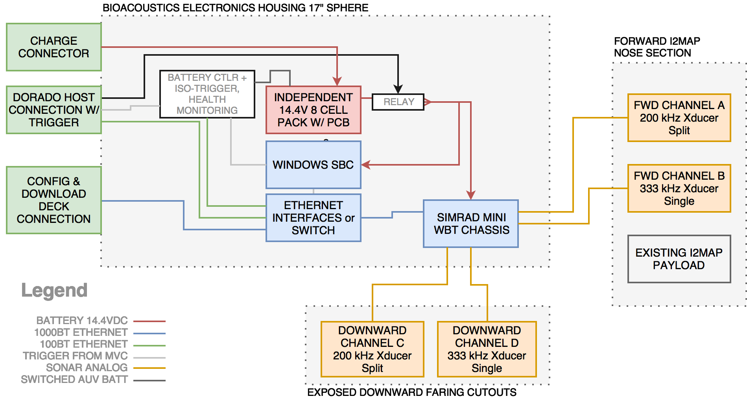
Notional Wiring Concept

Slide 18
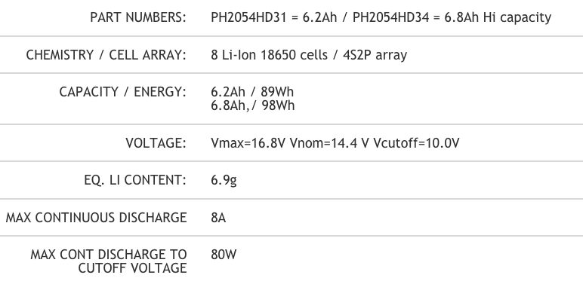
Custom Electronics:
Battery Controller
Features:
Incorporate the LPC1769 using micromint SOM and firmware from dorado
Leverage existing circuits from 41-Cell pb
Leverage existing filter circuit from the glider.=
Controls battery charge/discharge [CONTING ON INSPIRED ATM]
Trigger/Signal isolation
Fusing
Health Monitoring (humidity, pressure, leak)
Potential Voltage regulation for SBC, MiniWBT
Alternatively
We could skip some of this board, and since the charge will last for currently estimated 33 hours on 8 cells, you could avoid smart charging.
Current Battery: PH2054HD34

Slide 19
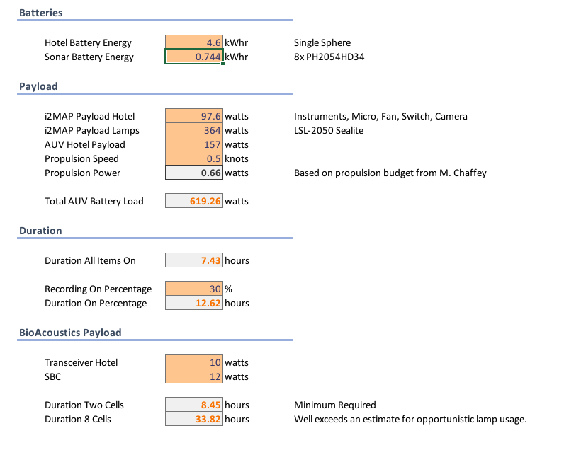
Preliminary Power Budget

Slide 20
Software Architecture (Windows SBC)
Time
NTP to MVC
Presence
MVC AHRS (VIRTUAL COM)
MVC GPS
(VIRTUAL COM)
Trigger
MVC ISO (TTL)
MVC DEPTH (VIRTUAL COM)
REAL-TIME PROCESSING W/ ECHOVIEW
Acquisition
EK80 SOFTWARE
WINDOWS REMOTE DESKTOP
FUTURE DEV
TARGETED VIDEO SAMPLING
TARGET TRACKING

Slide 21
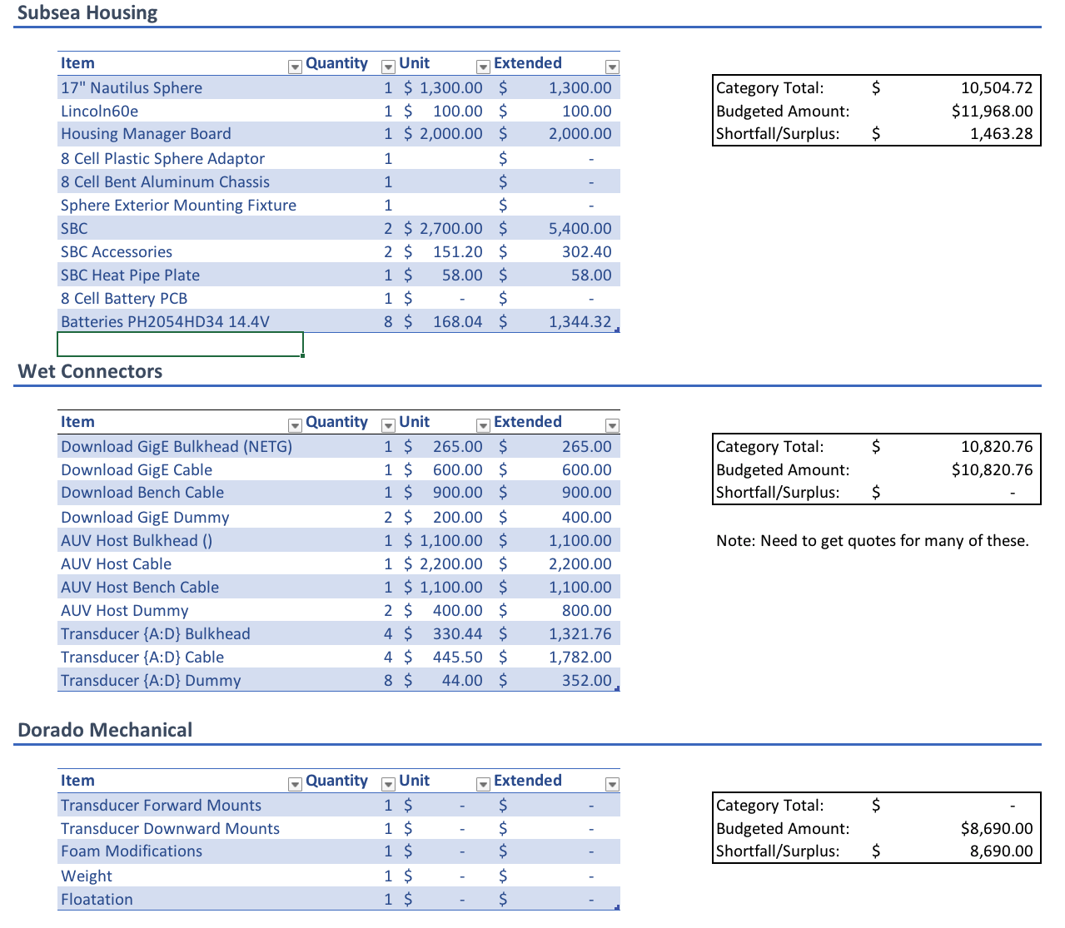
Preliminary Cost Estimates
Padding in budget from likely unnecessary foam and fairing line items.

Slide 22
Risk Elements
The Simrad MiniWBT has notorious noise susceptibility from a broad array of electrical and mechanical sources as seen in previous integrations (glider and Ventana)
  Approach:
    Leverage sphere space for EM enclosures other solutions
    Dedicated battery pack
    Leverage previously designed filters.
    Isolated connections
    Design room for mechanical isolation of transducers.
Acoustic interference from AUV subsystems, DVL & CTD Pump
  Approach: Characterize problem as early as possible.
The transducers are mechanically sensitive devices and must have unimpeded exposure to the environment.
  Approach: Transducers have been brought as close into vehicle as possible, there is room for more proctection if necessary.

Slide 23
Performance Stack-Up
Category | Requirement | Design Concept
Functionality | Preserve current functionality and capabilities. | No obstructions Small change in drag profile Transducers easily removed
Depth Rating | 1500 | 7000
Mission Duration | 6 | 7.5 (for AUV w/ 1 battery and package on its own)
Data Storage | 6*25GB/hr = 150-GB | TBD - Commonly Available
Data Offloading | 5 hour | 20 min at Gig-E
Mounting | 2FWD/2DWN Focal range | 2FWD/2DWN 1.3-m

Slide 24
Test Plan
April Tank testing:
  Identifying noise sources as soon as possible by running against i2Map section
  Waiting on transducers & software fixes
April/May:
  Purchase COTS components and test against the hardware in May
  Assess final processor requirement.
May/June: PCB Design CDR
July/August: Package assembly and testing
At Sea Testing: 10/26, 10/29, 12/6

Slide 25
Team
Kelly Benoit-Bird: PI, Simrad POC
Eric Martin: PM, Wiring, Board Design
Bruce Robison: Investigator, I2MAP POC
Kim Reisenbechler: I2MAP POC, collaborator
François Cazenave: Brackets, EMI Enclosures, Chassis Design
Hans Thomas: Sphere Housing, Wiring, Board Design
Paul McGill: Noise Isolation
Chad Waluk: Sonar software, SBC configuration

Slide 26
Questions

Slide 27
Additional Slides

Slide 28
SBC
Requirements
Celeron or better x86/x64
10-16.8V Input range desired
2x Gig-Ethernet & 2 100BT-Ethernet
Serial port or dig IO for trigger
Runs windows 7 or better
HDD SIZE BASED ON REQ

