Slide 1
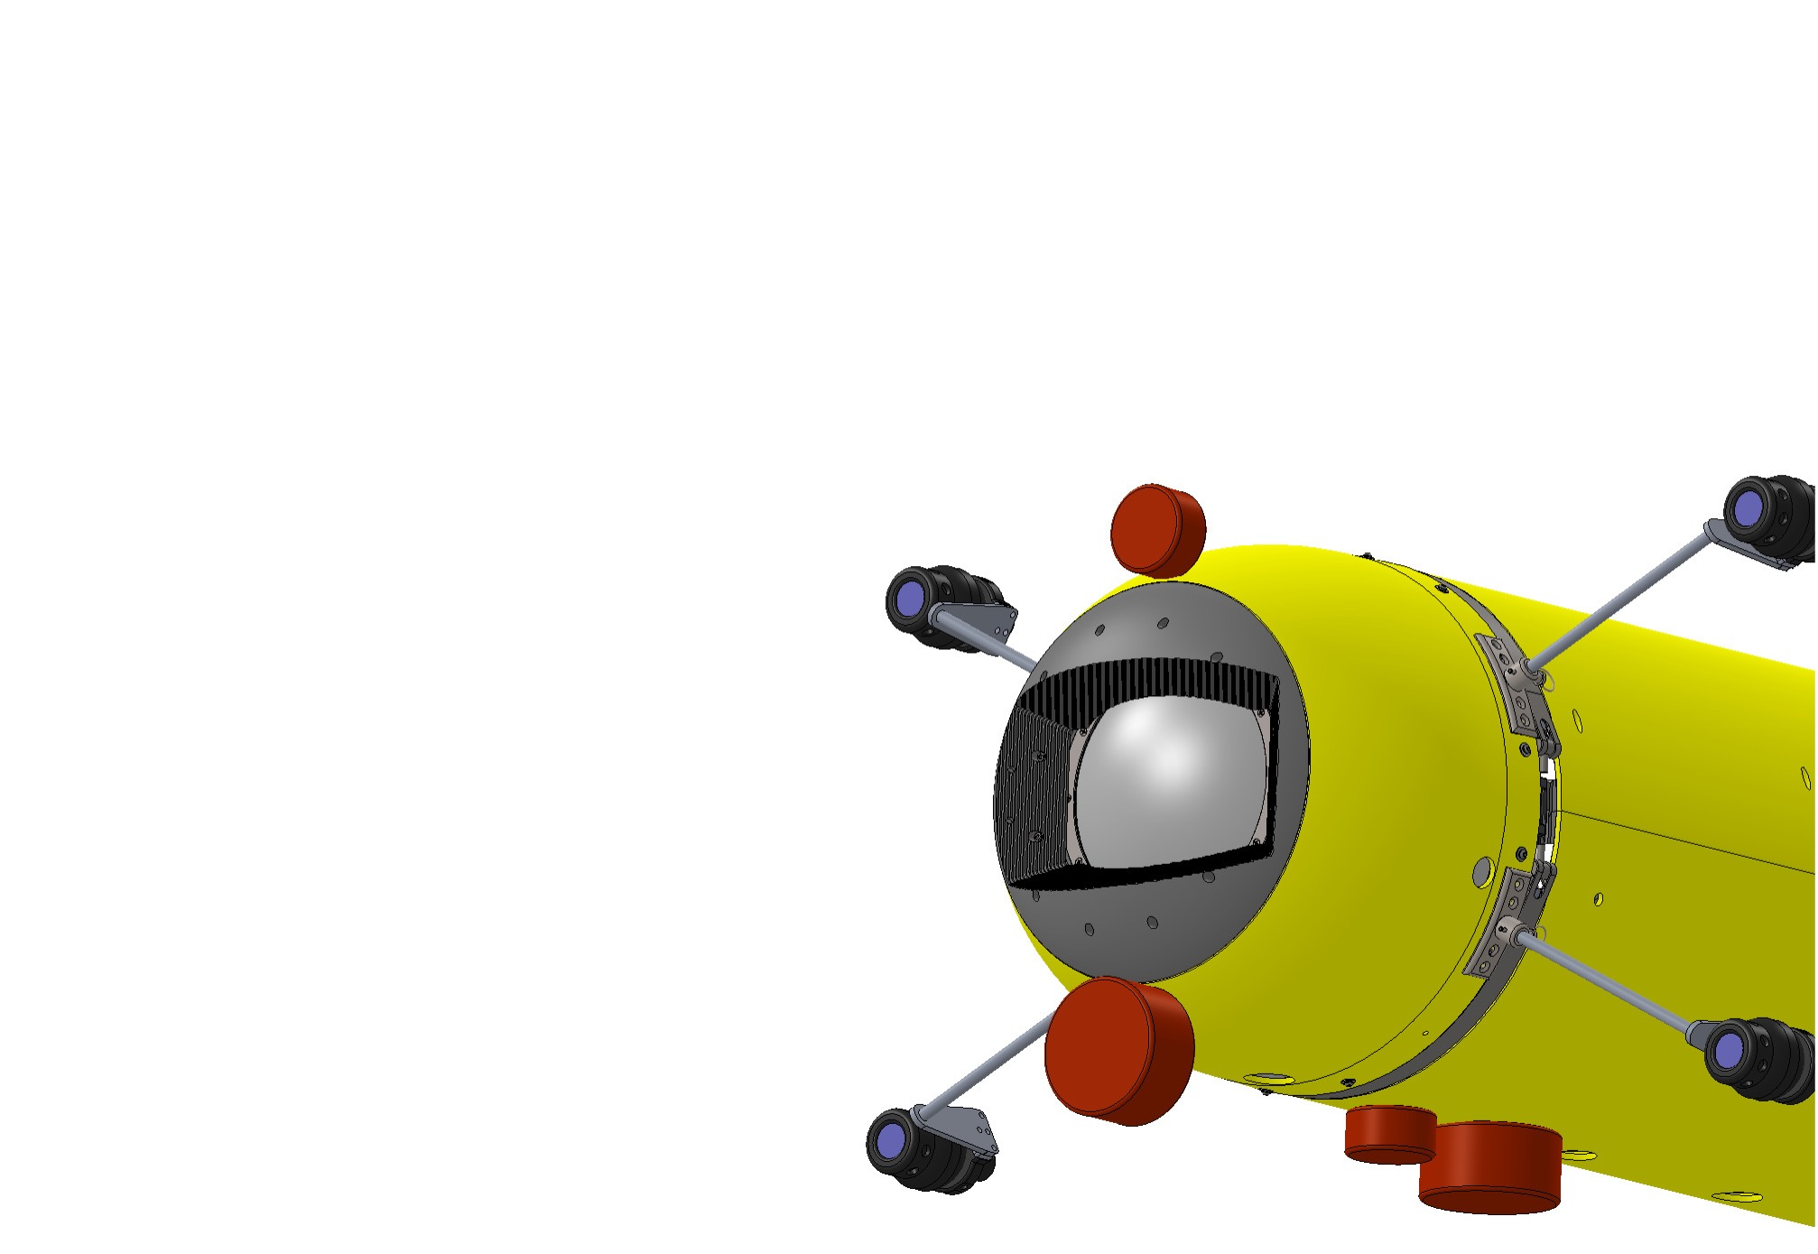
Goals:
Quantify behavioral responses to survey platforms
Develop broadband acoustic signatures to improve acoustic classification
Describe spatial
distribution of organisms in midwater both day and night
i2MAP+
Next generation bioacoustic sensing from Dorado
Integrating acoustics and imaging

Slide 2
For 2019:
Primary focus on data collection.
Data exploration and development of new paths of visualization.
i2MAP+
Next generation bioacoustic sensing from Dorado
Integrating acoustics and imaging

Slide 3
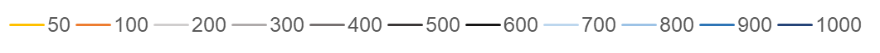
HYPOTHESIZED
ANIMAL RESPONSES OBSERVED TO THE ROV
No response
Visible
Avoidance
Acoustic biomass density
Acoustic biomass density
(70 kHz S_{v} in dB re 1m⁻¹)
Avoidance to a
consistent range
resulting in aggregation
Transect depth (m)
Range from ROV (m)
Attraction
Range from ROV
Notes:
At different depths, we saw all of these hypothesized responses and combinations of them

