Slide 1
Dorado Bioacoustics SBC Trade Study
901807 Next Gen Bioacoustics on Dorado
MBARI 2018

Slide 2
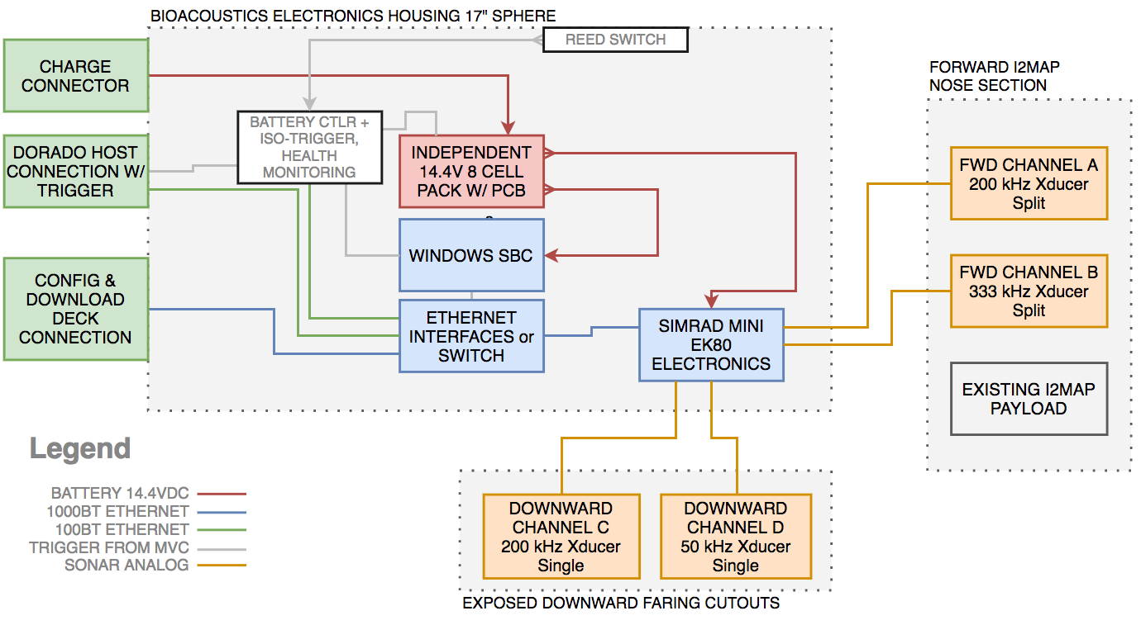
Notional Wiring Concept
SBCs exist that can offer the 4 connections as drawn through mini PCIe connections

Slide 3
SBC
Requirements
Celeron or better x86/x64
  Test on atom was not encouraging
  Previous SBC used a Celeron N2807, 2.16GHz 2-Core 2-Thread
10-16.8V Input range desired
2x Gig-Ethernet & 2x 100BT-Ethernet
Serial port or dig IO for trigger
Runs windows 7 or better
SATA 3 or mSATA storage interfaces
Storage Volume Requirement:
  25-GB/hr
  Initial max deployment is 7-hr, or 175GB of data
  Download at 1-Gbps is ~25 minutes
  Download at 100-Mbps is ~ 4 hours
I2C-SMBus also desired (unlikely support for windows)

Slide 4
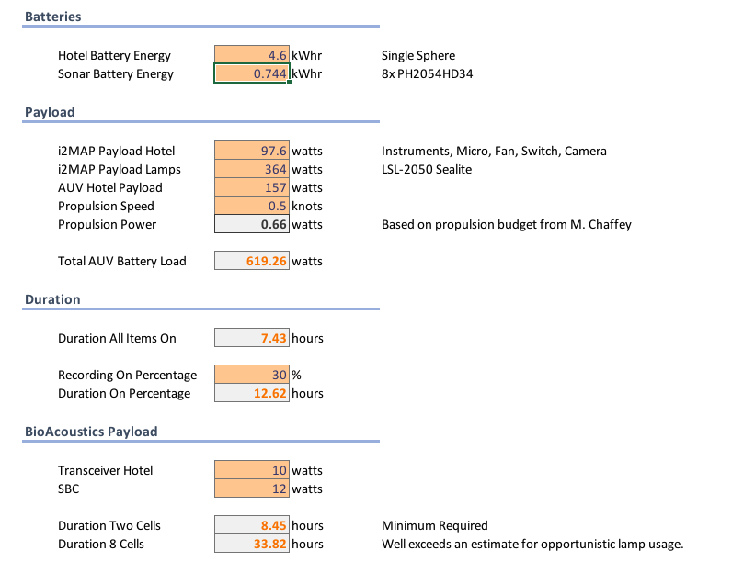
Preliminary Power Budget

Slide 5
Best Options
By finding a wide power input unit, we can eliminate another costly power supply development when none other is needed at the moment.
Having all 4 Ethernet connections at the PC eliminates the need for the switch, and all items are communicating centrally to the small board computer.
Mini-PCI Express slots allow for Ethernet expansion (including dual NIC) without USB converters
Also allow for compact enough mSATA (up to 1-TB)

Slide 6
Initial Findings
Found a few with the wide input power.
Many offer the industrial communications, such as Digital I/O and I2C, but only support those features for Linux installations.
  This means we won’t be able to initially talk to the batteries with the SBC, but some other options do exist via usb/etc.
  Could do it by writing a kernel mode windows driver, but is a high risk design choice.
I think we should consider a move from the Celeron® class to the Core U-Series®, which will allow for more onboard processing in future developments. Cost of the board is mostly driven by the chip selection.
I conducted a brief trade study to help elucidate the differences.
Following options all meet requirements for wide power inputs, passive cooling solutions, and all can be self-contained solutions (no USB adaptors or hard drives).

Slide 7
Potential Solutions
TraDE StuDY AT END

Slide 8
Versalogic Blackbird or Condor
7th Gen (current) Core (Condor) / 6th Gen (Blackbird)
Wide input power (8-30V)
Mil-spec Shock/Vibration (better connectors)
Most expensive
Blackbird has 3 Mini PCI-E slots, Condor has 2
Soldered on memory
Min price is condor at $2,100, and the accessories add another $200
Condor has good consumption in Core i3 Model (14W)
Has I2C/SPI, but no windows support at this time
DataSheets
  BlackBird
  Condor
Blackbird
Condor

Slide 9
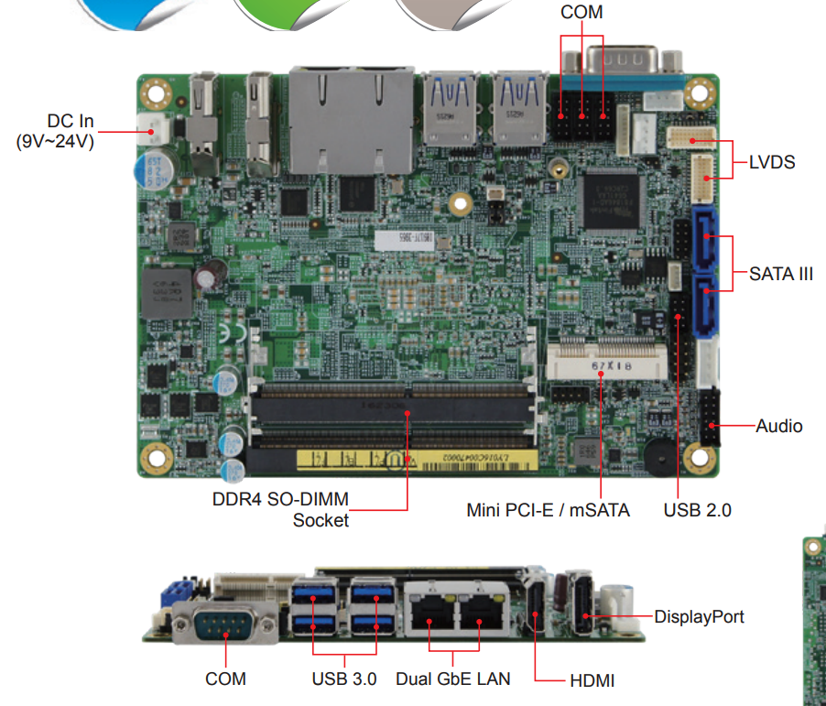
iBase IB917
7th Gen Core U-Series
Wide input power (9-24V)
20-30W Typical, so a little less efficient than the Versalogic options for similar processors.
Only 1 Mini PCI Express slot, would need SATA Hard drive
No I2C flexibility, no win drivers for its Dig IO
Biggest processor at the cheapest price
External Memory, Max 16GB
DataSheet: IB917

Slide 10
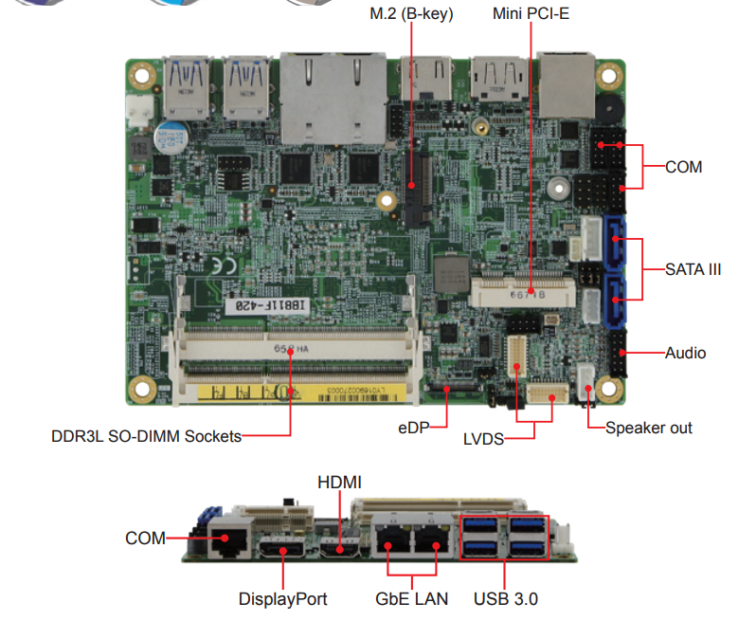
iBase IB811
Celeron/Pentium Product
Also wide input power (9-36)
Comparable to Gigabyte PC in size
Meets requirements as base model
One mSata for needed Gig-Ethernet expansion
One M.2 Slot for up to 2TB storage
External Memory, max 8GB
8W Typical
Lowest Cost: $350
Standard connectors/
DataSheet: IB811

Slide 11
CongaTech MA5
Same as the IB811 in consumption and memory limitation at 8GB
Eval boards are large 294x244
Wide input voltage modules
Would make the most sense if we planned on creating a custom carrier for fit into smaller space.

Slide 12
Trade Study Findings
iBase has a comparable model to the condor, also wide input, but will never replace the battery controller.
Versalogic could replace the battery controller, but likely significant effort will be required and is too much risk at present time.
The Blackbird, Condor and IB811 have the same ranking. The added cost but high quality of the versalogic is a good trade against the savings of the IB811 and its lower power consumption.

Slide 13
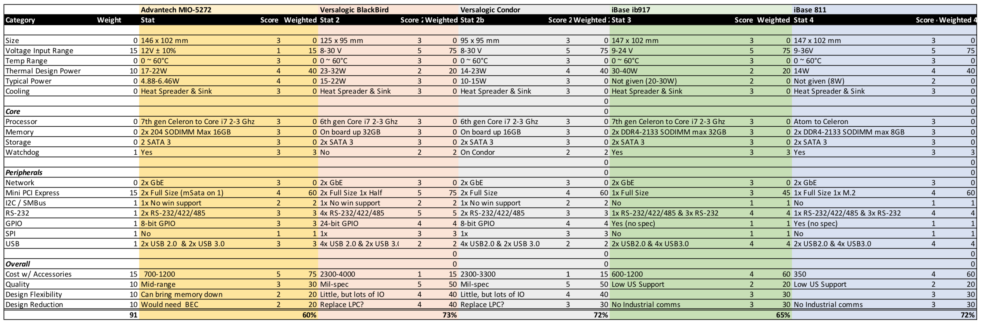
Product Comparison Sheet

Slide 14
Moving Forward
I would recommend the Versalogic Condor or the iBase IB811
The Condor future proofs, but sparing it would be expensive, and it will take more power.
The IB811 is the lowest performance I would like to test, and likely will work well.
At its low cost, perhaps we should test the IB811, and if it fails, we can upgrade later.

