Slide 1
Mounting of Transducers on bioacoustics AUV
February 6th 2018
Engineer: François Cazenave

Slide 2
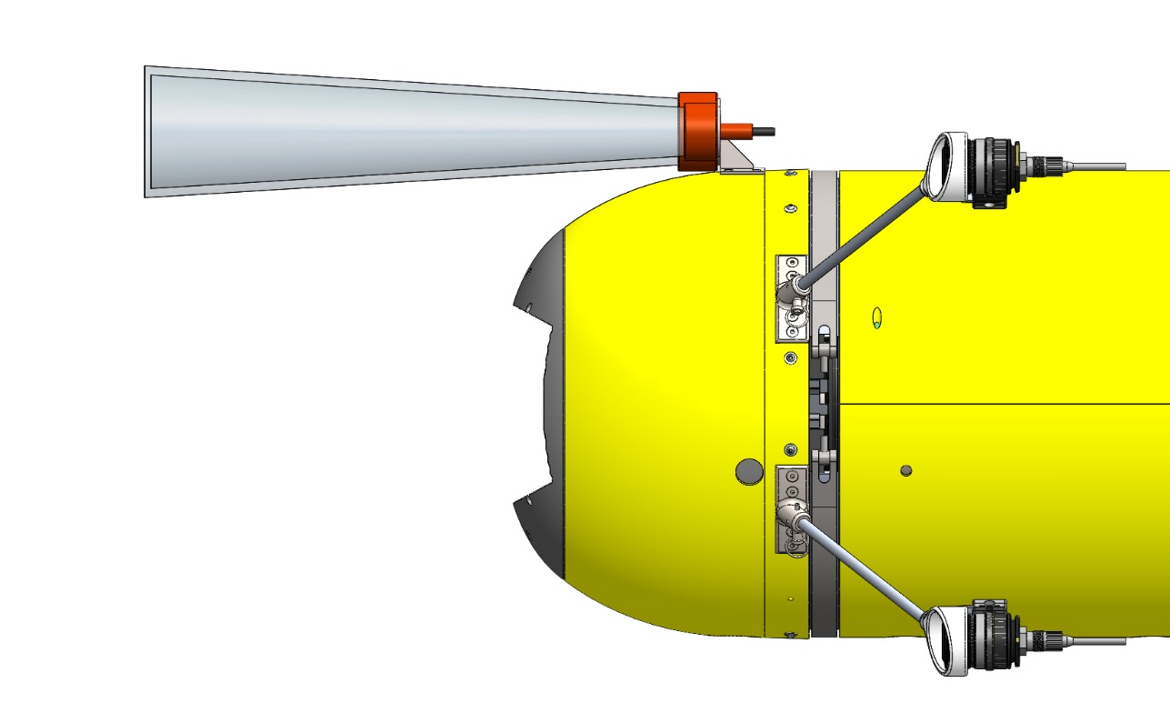
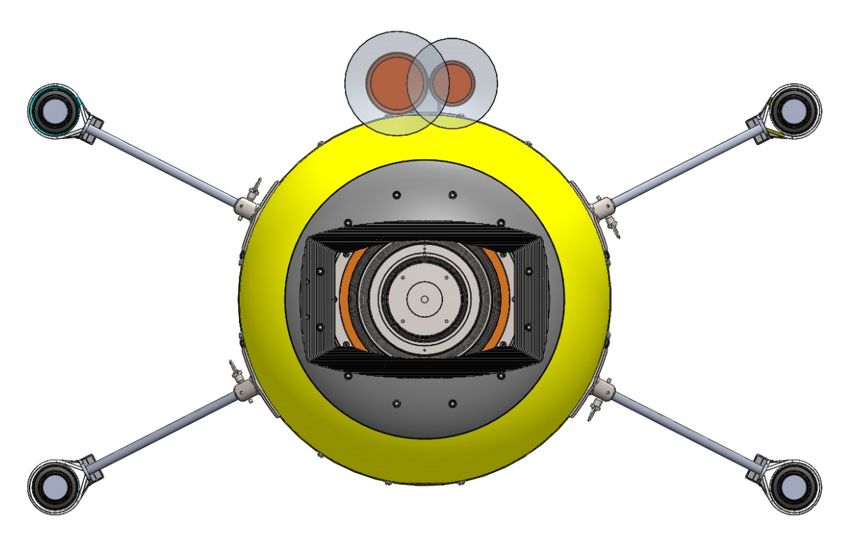
Suggested mounting location for forward looking transducers
- Transducers are very close to each other
- Somewhat out of harm’s way.
- Beams are a good distance from the fairing (no obstruction)
- Risk of catching kelp at the surface (could be alleviated with guard)

Slide 3
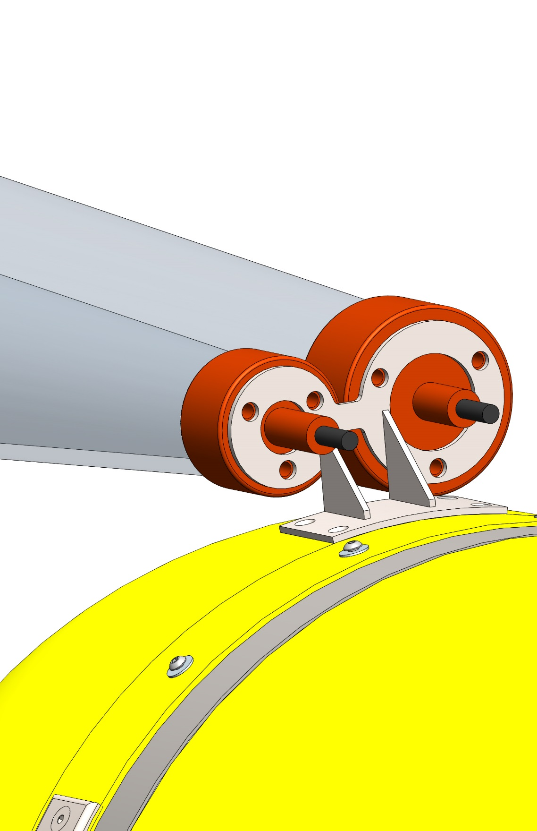
Bracket
Sturdy and lightweight (0.34lb)
Easy and inexpensive to fabricate
Material: grade 2 titanium (cost < $100)
Low drag bracket
Screwed to nose shell.
Shims may be needed to get good alignment
with camera
No interference with parallel section top shell (does not impede AUV maintenance)

Slide 4
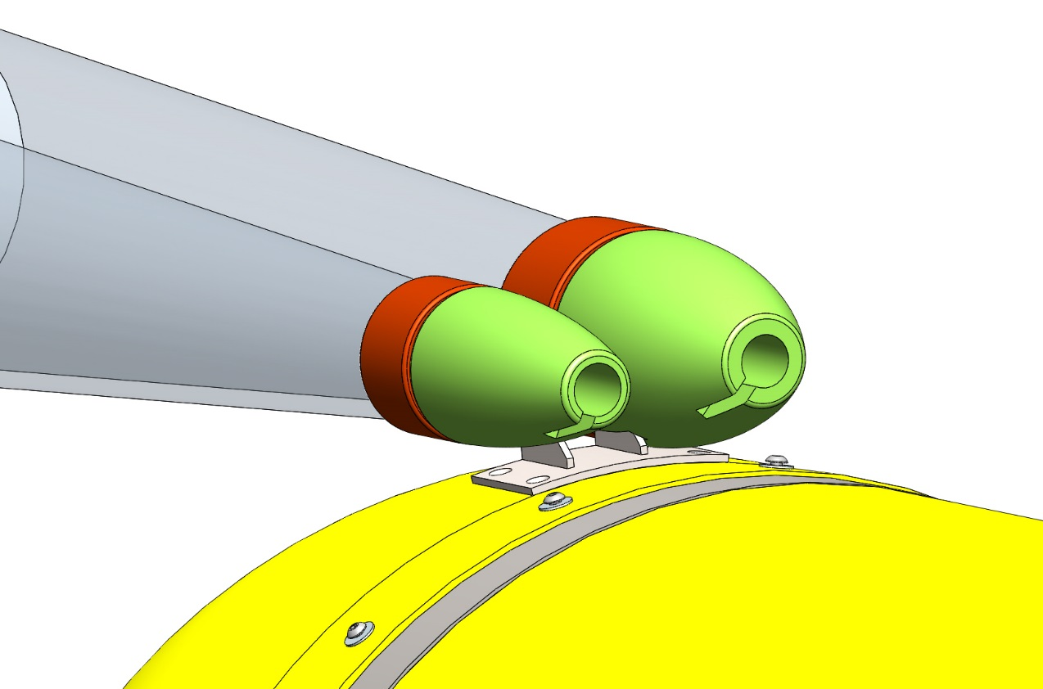
Foam fairing
Syntactics foam fairings can be added to offset
the weight of the transducers and reduce drag.

Slide 5
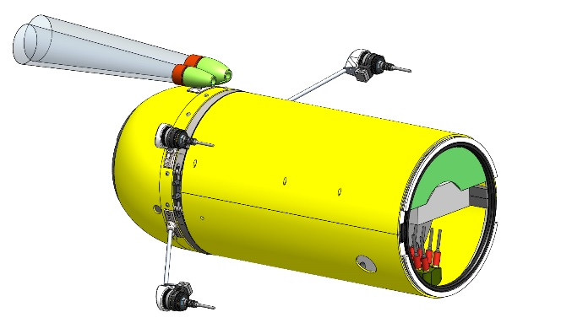
Cable routing option 1
Cables can be routed to the side hole where the light cables go. Routing through the AUV is fairly easy and would take about 10 minutes including taking the fairly off.
The 2m cable might be long enough to go all the way to the glass sphere but it would be easier to have a connector in the parallel section.

Slide 6
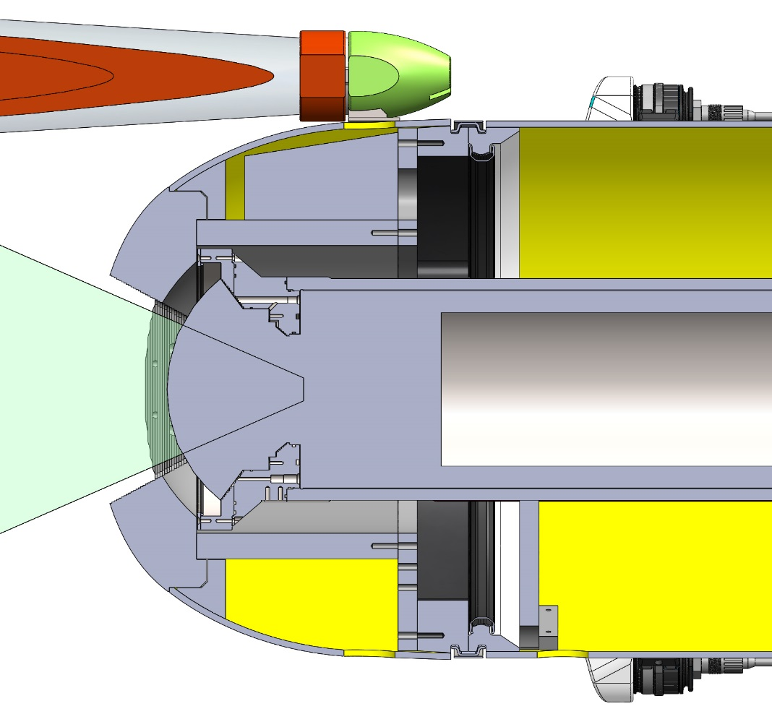
Cable routing option 2
Same as option 1 except the cables go in the hole at the top of the nose shell.
That would make routing the cable inside the AUV much easier and it would require less cable length than option 1.
However it would require cutting the existing syntactic foam block (arrow).
I recommend this option.

Slide 7
Cable routing option 3
Cables can be routed on top of the fairing and attached with zipties every 6” or so. The cable would have to be removed every time the fairing is opened (every dive). A connector mid-span would be required or a lot of slack in the cable that can be shoved in the hole.

Slide 8
Other solution for Mounting transducers
The “chin turret”
Transducers are imbedded in the
Delrin piece below the camera:
Lower drag
Somewhat out of harm’s way
Closer to camera
No cables outside of fairing
Requires taking apart nose cone and machining plastic components.
No interference with light beams.

Slide 9
The cross section view above is offset from the center plane by 1.5”.
The transducers are mounted on a 3/16” metal plate.
The metal plate is screwed to the plastic ring from the front using two ¼-20 screws. The cables are easily routed to the back of the AUV.
View without the transducers.

Slide 10
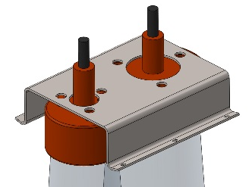
Downward facing transducer bracket
Gauge 14 stainless steel bracket
Gets screwed to bottom fairing
Transducers can we accessed without removing the camera housing (there is enough space on the sides for an operator to reach the fasteners)

Slide 11
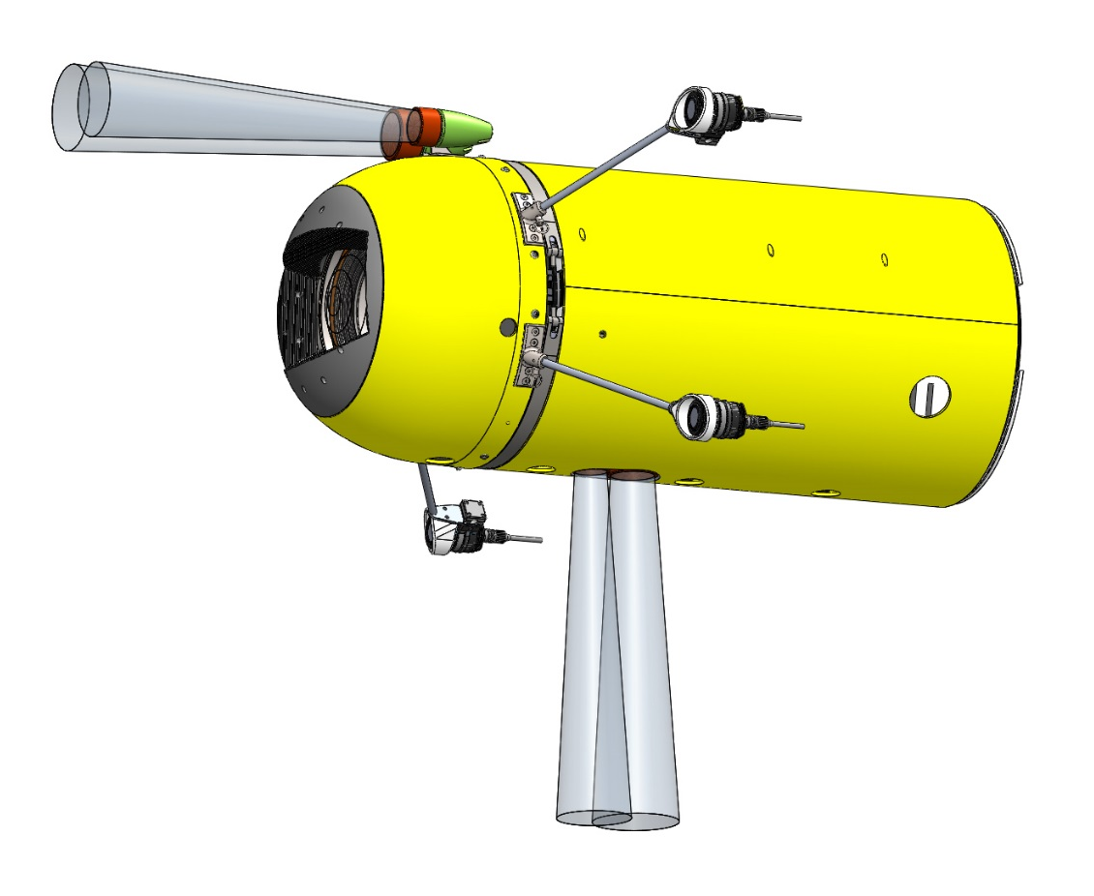
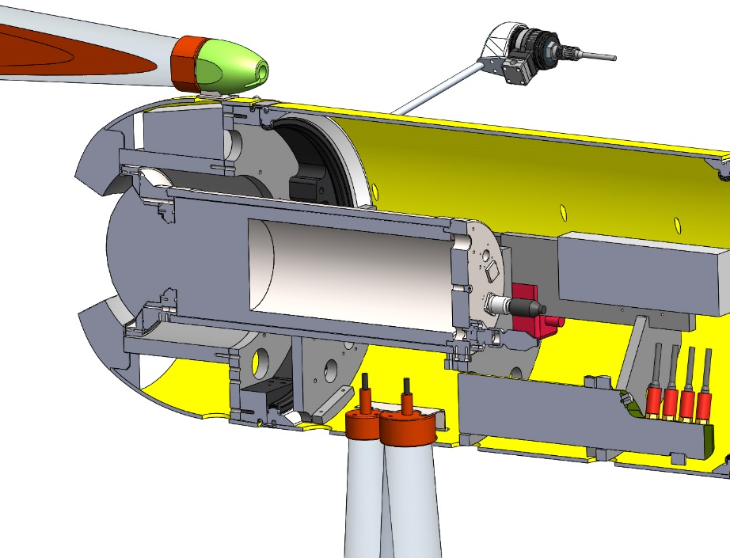
Placement of downward transducers in AUV
There appears to be enough room for the transducers in the I2map section.

Slide 12
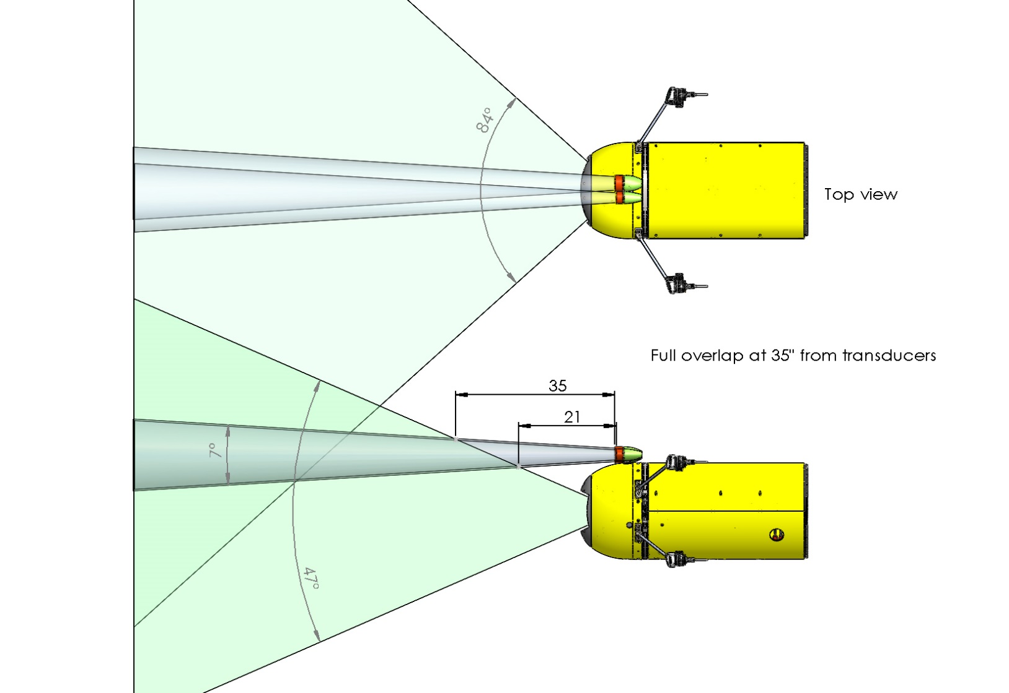
Comparison of camera field of view and transducer beams: Top bracket

Slide 13
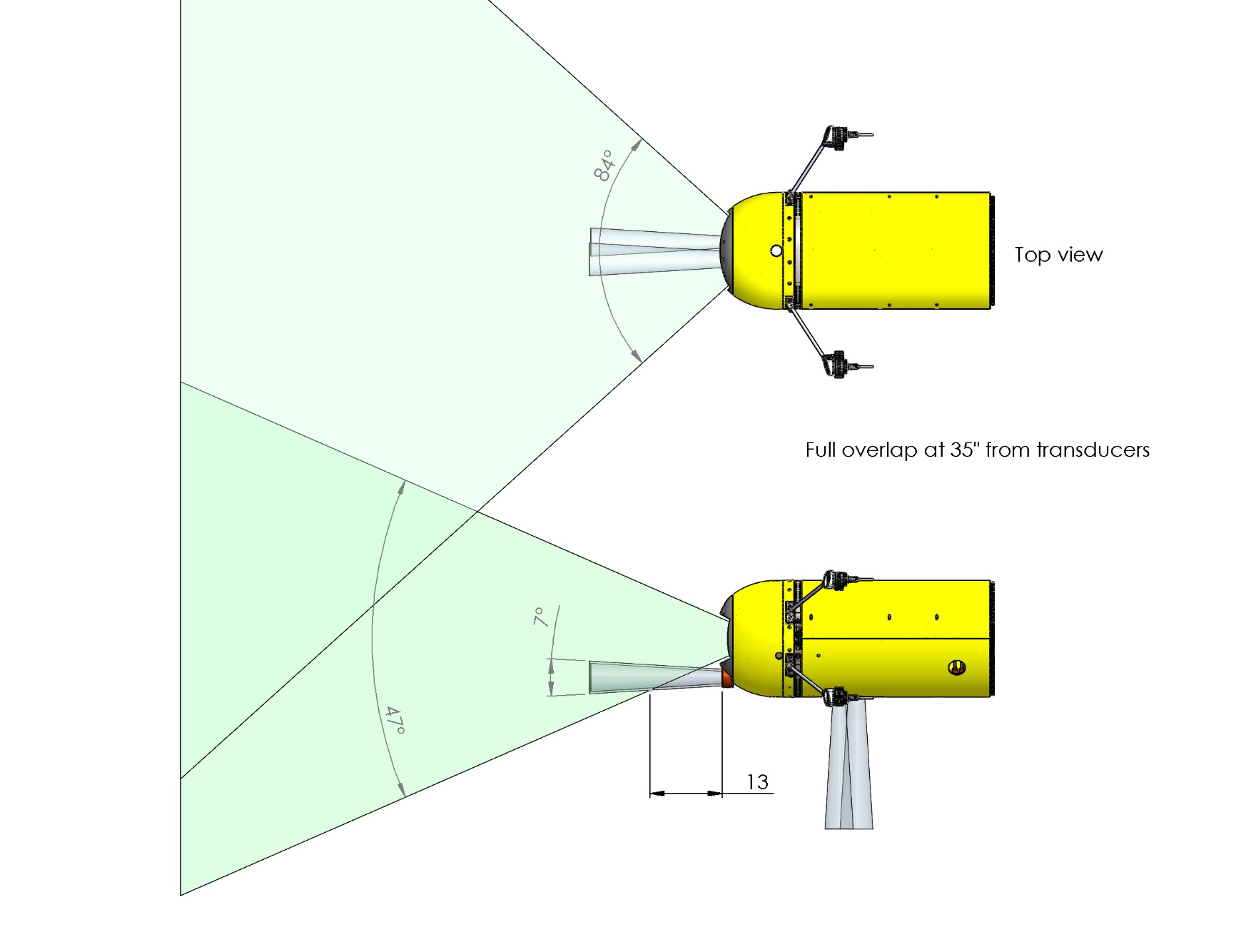
Comparison of camera field of view and transducer beams: Low bracket

