Slide 1
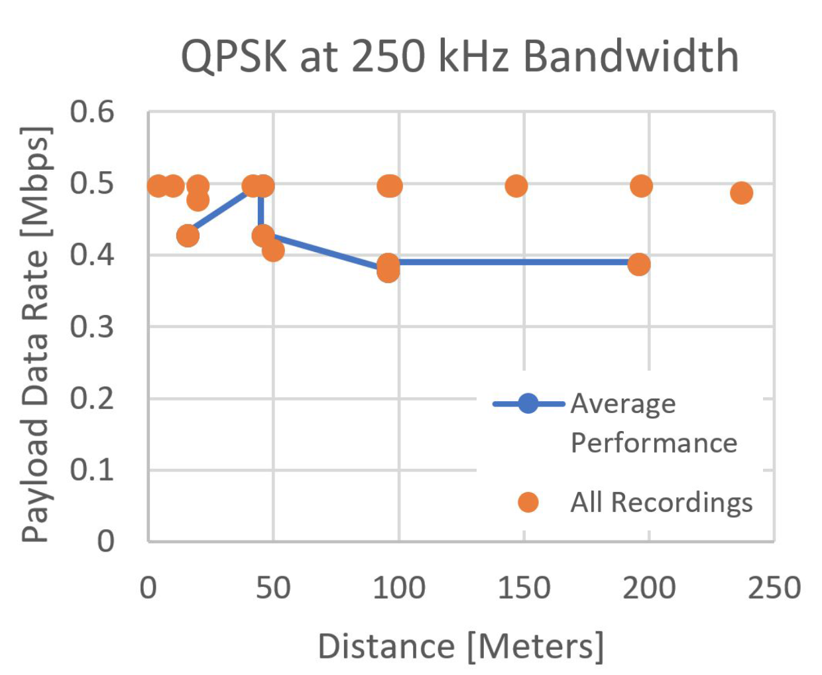
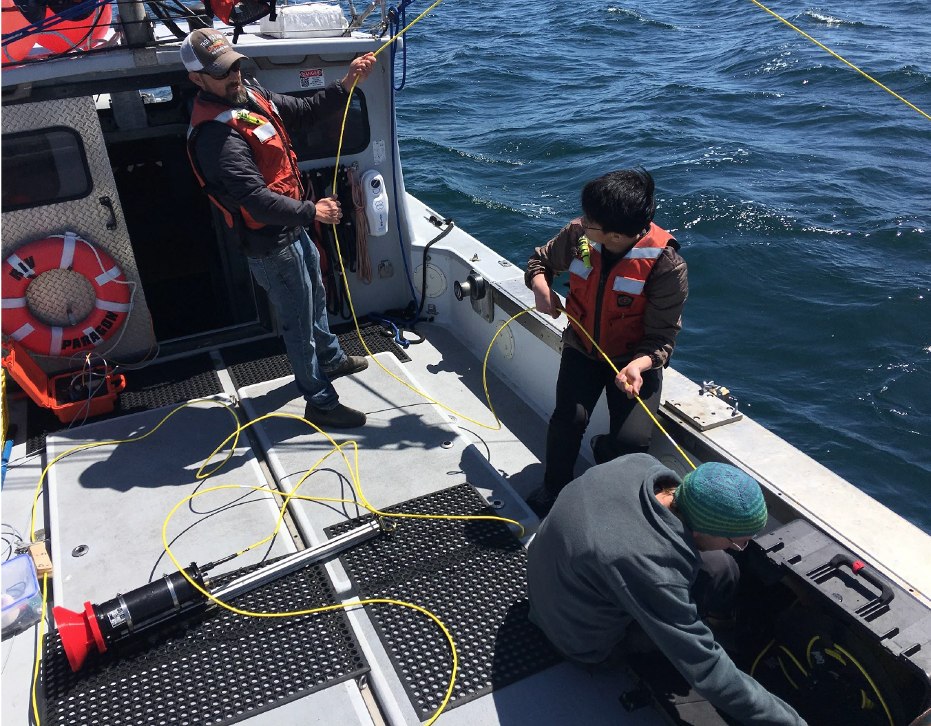
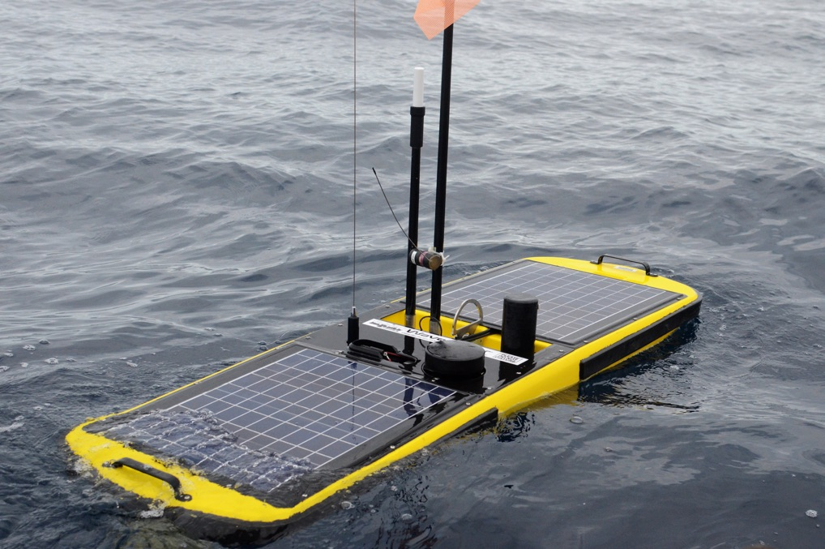
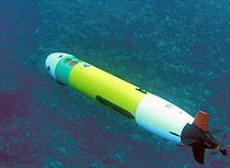
901913: WET WIFI (Kemp/Roman)
PROBLEM: SLOW COMMUNICATION WHILE SUBMERGED
2018: TECH EVALUATION
WiFi does not work underwater.
Acoustic communication is slow – 100 to 1,000 bits per second.
OceanComm Inc is developing a new modem that could change that.
Purpose: assess the performance of Ocean Comm’s fast modem in Monterey Bay.
Outcome: demonstrated 400 kbps at any depth up to 200m in all testing conditions.
2019-2021: DEMONSTRATION OF A HIGH-BANDWIDTH LINK BETWEEN AN AUV AND A WAVE-GLIDER
2019
2020
Develop 2-way comms software stack
Develop rendez-vous conops + requirements
Integrate modems to AUV and Wave-Glider
400kbps @ 200m
2021
At-sea testing

